Slide 1
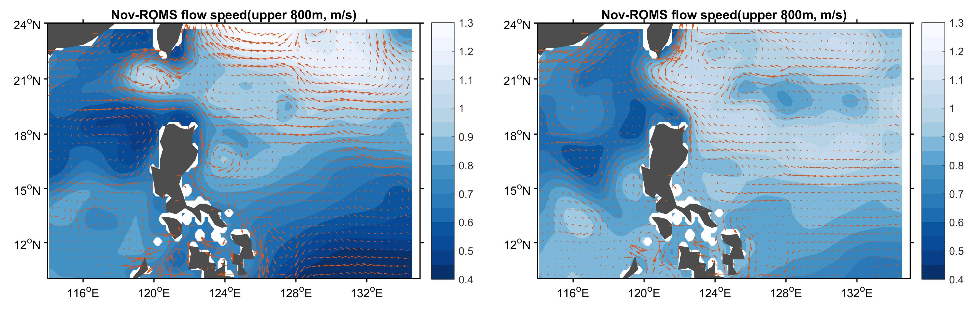
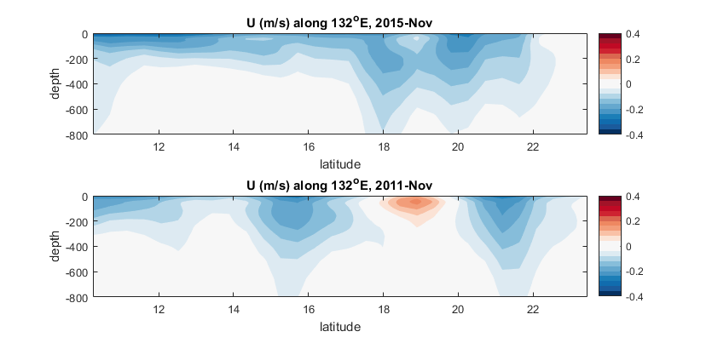
2015-16(El-Nino)
2011-12(La-Nina)
2015-16(El-Nino)
2011-12(La-Nina)

Slide 2
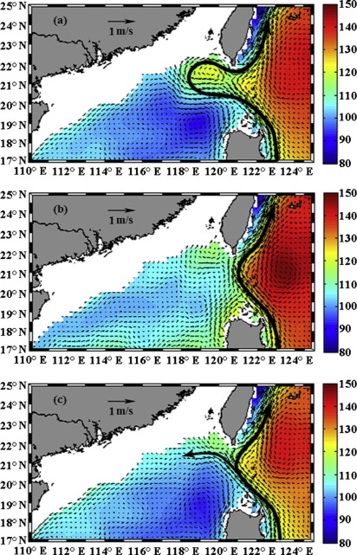
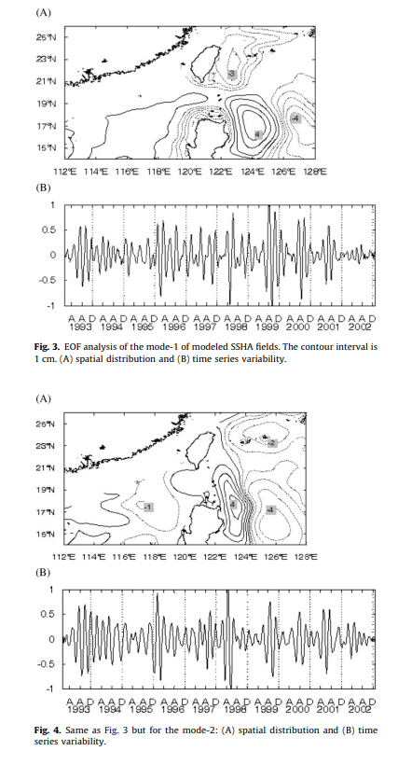
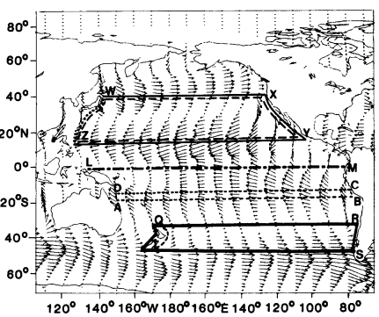
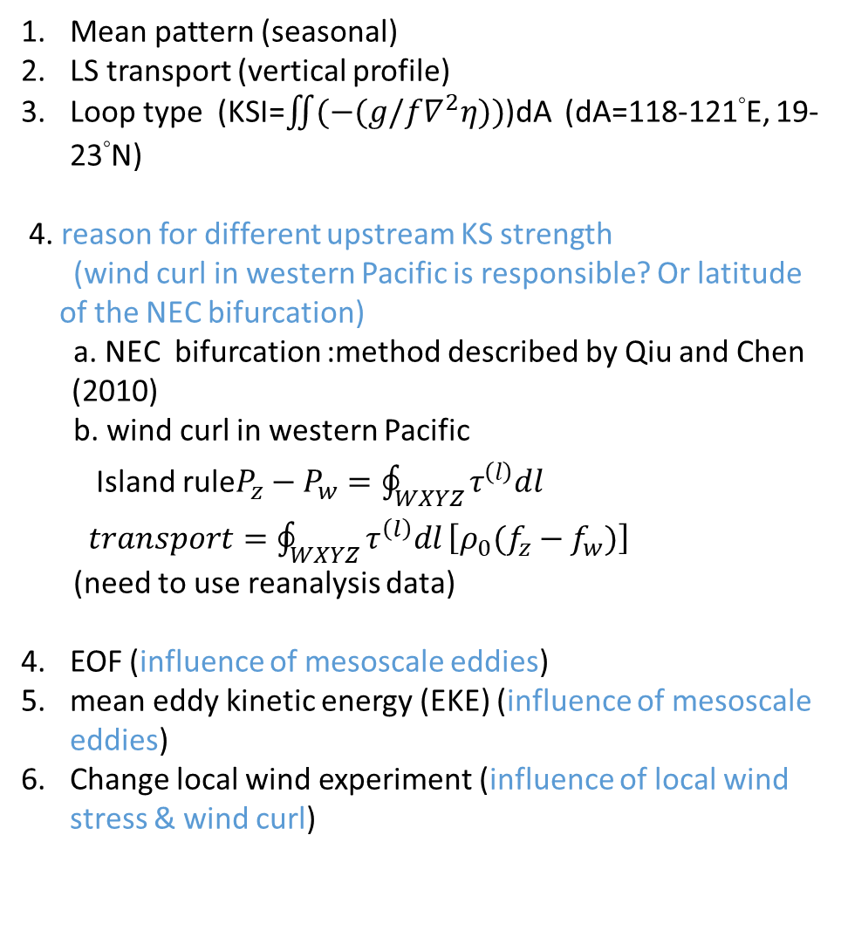
Mean pattern (seasonal)
LS transport (vertical profile)
Loop type (KSI=$\iint{(−(g/f∇^{2}η))}$)dA (dA=118-121°E, 19-23°N)
4. reason for different upstream KS strength
(wind curl in western Pacific is responsible? Or latitude of the NEC bifurcation)
a. NEC bifurcation :method described by Qiu and Chen (2010)
b. wind curl in western Pacific
Island rule$P_{z}−P_{w}=\oint_{WXYZ}{τ^{\left(l\right)}dl}$
$transport=\oint_{WXYZ}{τ^{\left(l\right)}dl}\left[ρ_{0}(f_{z}−f_{w})\right]$
(need to use reanalysis data)
EOF (influence of mesoscale eddies)
mean eddy kinetic energy (EKE) (influence of mesoscale eddies)
Change local wind experiment (influence of local wind stress & wind curl)
[Nan et al. 2015. Progress in Oceanography]
[Sheu et al. 2010 Deep Sea Research ]
[Nan et al. 2011 ocean dynamics]
[Godfrey 1988 Geophysical & Astrophysical Fluid Dynamics]

Slide 3
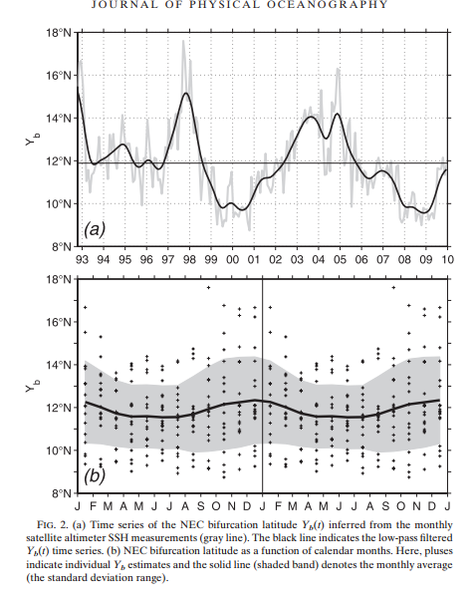
Qiu and Chen (2010)
Seasonal variation?
Mean dynamic topography(mdt_cls2013_global)+monthl_SLA

Slide 4
Standard cases
EXP1 (switch WRF IC&BC+ one-way coupled)
Northeasterly of northerly → favoring KS looping (intrusion)
Easterly → favoring KS leaping state
Notes:
The upper-layer water transport through Luzon strait (0-700) was controlled by the ocean IC/BC, i.e. NEC and upstream KS.
Taiwan Strait transport controlled by the local wind.
Mindoro strait and LS transport have opposite signs, and they have out of phase variation.

Slide 5
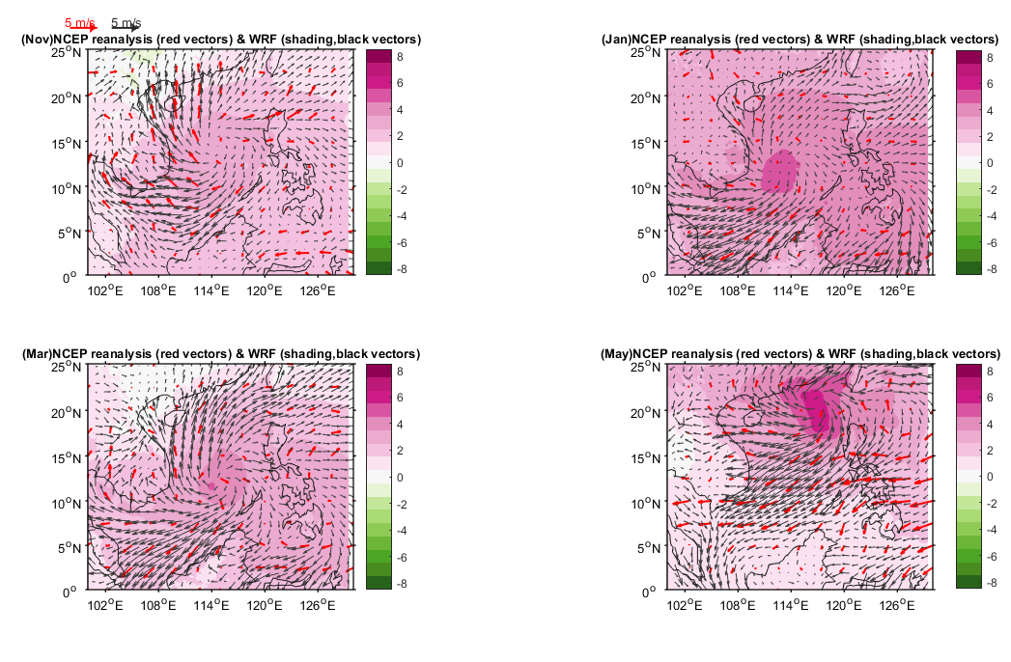
New SCS2 2015/16 minus 2011/2 –comparison with NCEP reanalysis data
WRF_d02
Ekman transport brought cooling advection
Ekman transport brought warming advection

Slide 6
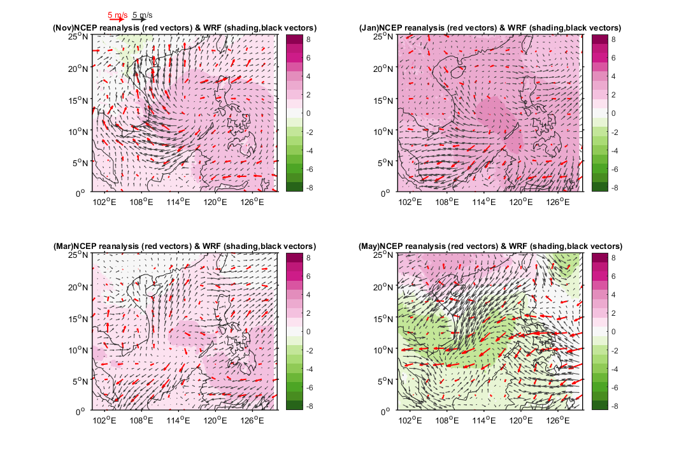
1way coupled

