Slide 1
Data
Data | G40.000 (model) | SODA 2.2.4 (reanalysis) | SODA 3.6.1 (reanalysis)
Name | CESM1 1° Ocean-Ice Interannually Forced Control | Simple Ocean Data Assimilation ocean/sea ice reanalysis Version 2 | Simple Ocean Data Assimilation ocean/sea ice reanalysis Version 3
Resolution | T62_gx1v6 | 0.5x0.5 | 0.5x0.5
Time (used in analysis) | 1-300 / 1948-2007 (1960-2007) Monthly | 1890-2010 (1960-2008) Monthly | 1980-2009 (1980-2008) Monthly
Wind Forcing | COREv2 interannual forcing (Version 2 Forcing for Coordinated Ocean-ice Reference Experiments) | C20Rv2 (mean corrected) | COREv2
Model | CESM1 GIAF Compset | LANL POP2.1 (Parallel Ocean Program) | GFDL MOM5/SIS (Modular Ocean Model)

Slide 2
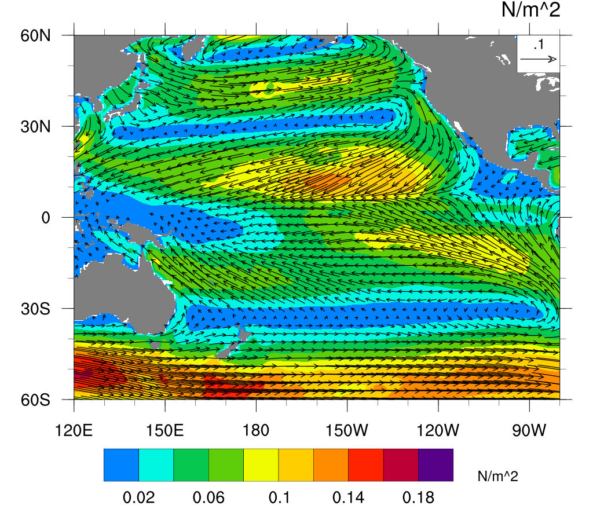
Wind Stress (G40)

Slide 3
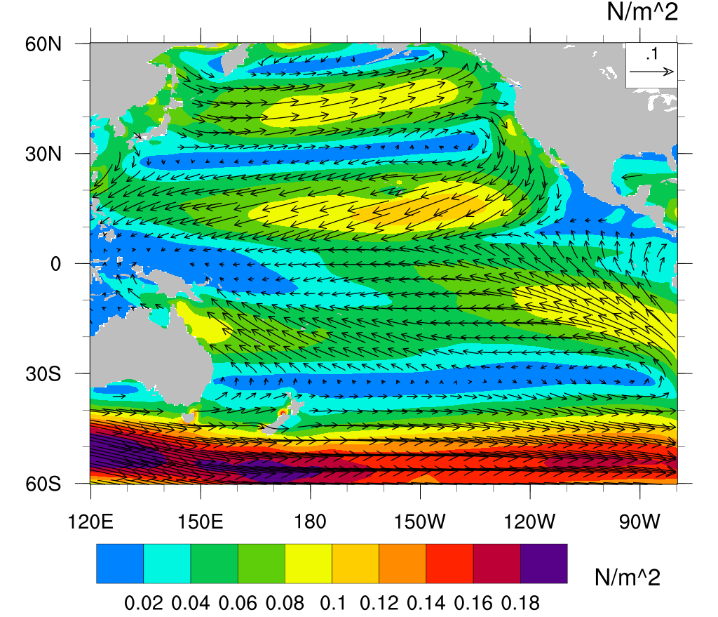
Wind Stress (SODA 2.2.4)

Slide 4
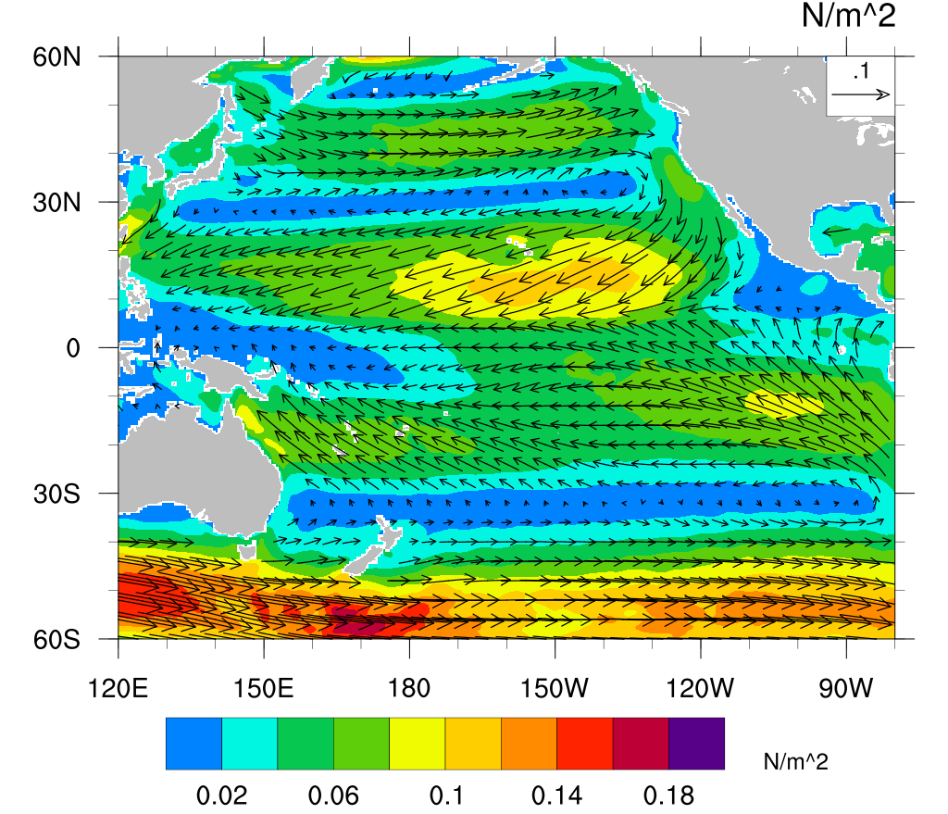
Wind Stress (SODA 3.6.1)

Slide 5
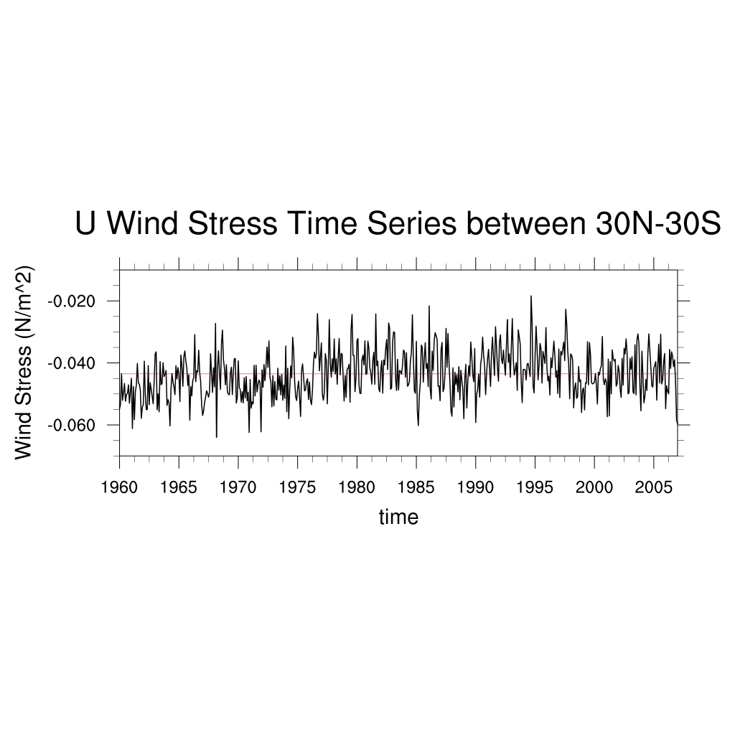
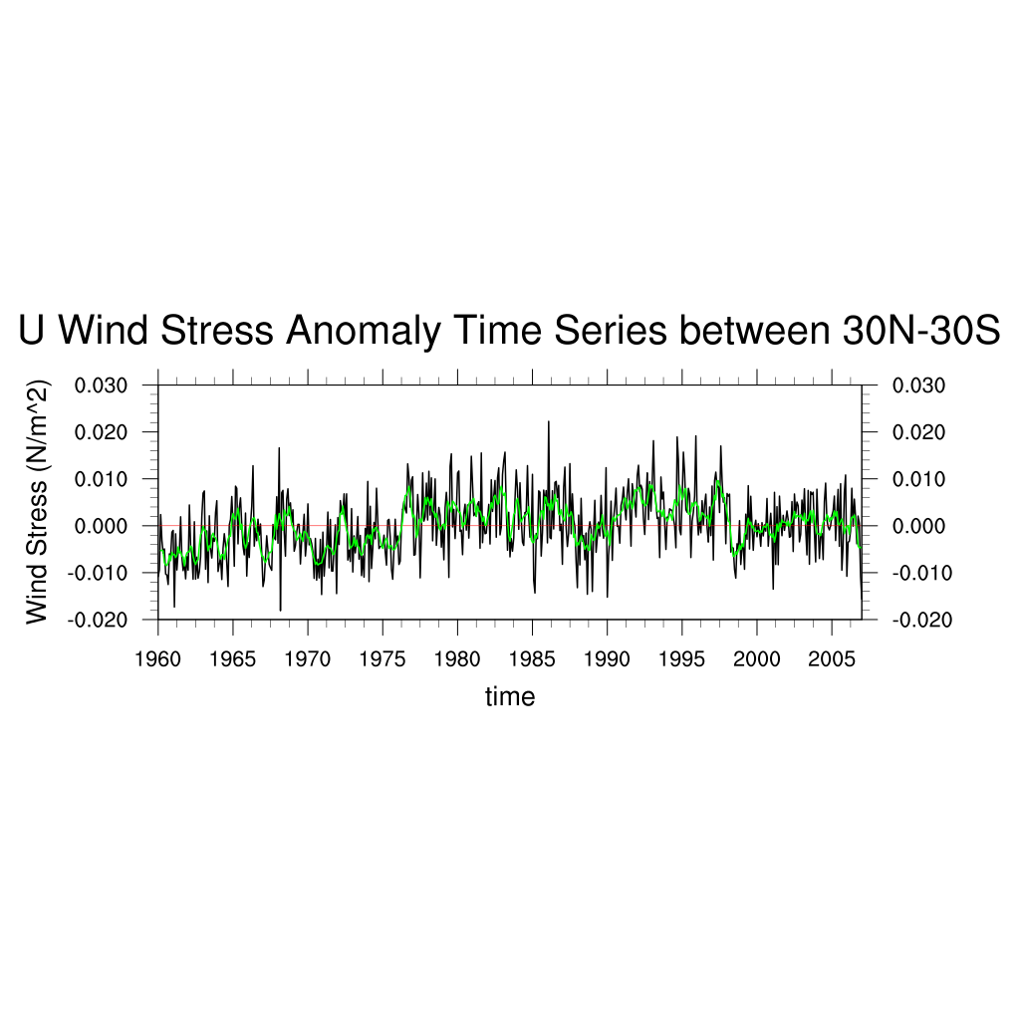
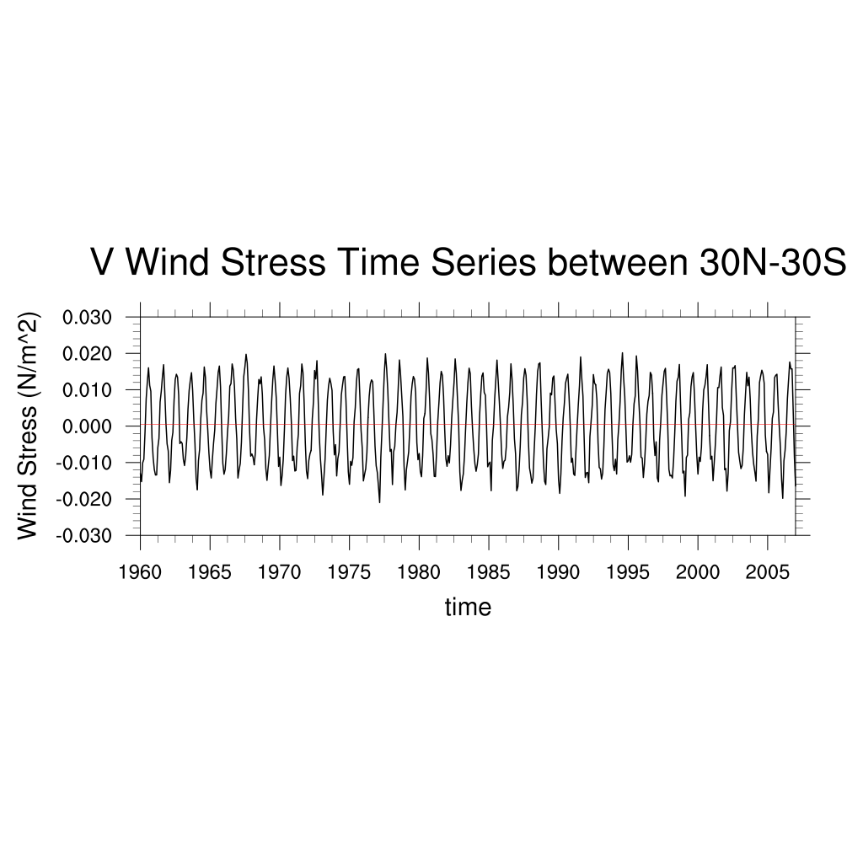
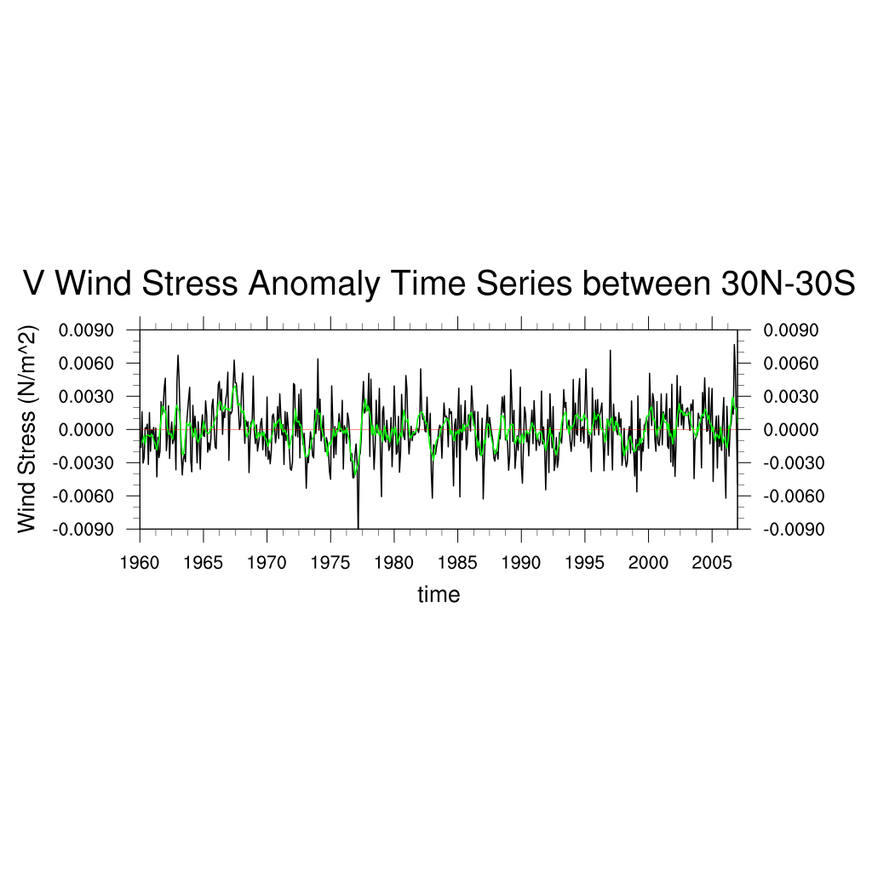
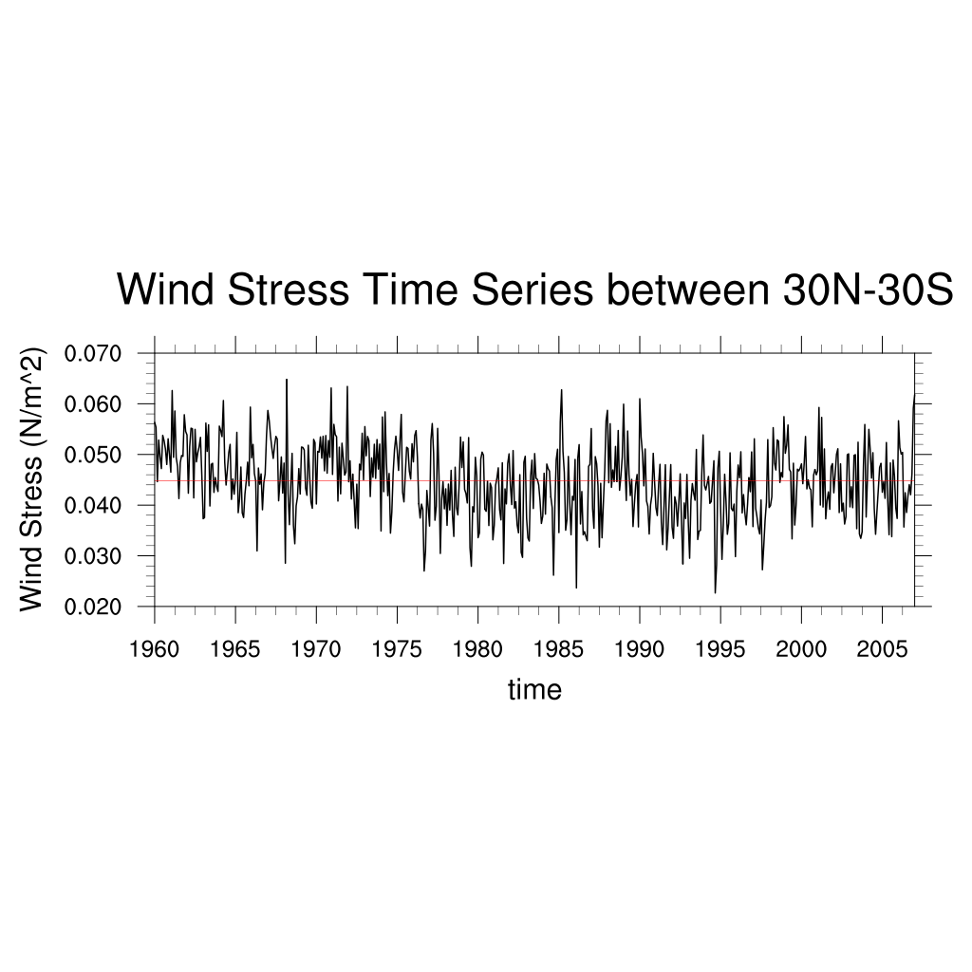
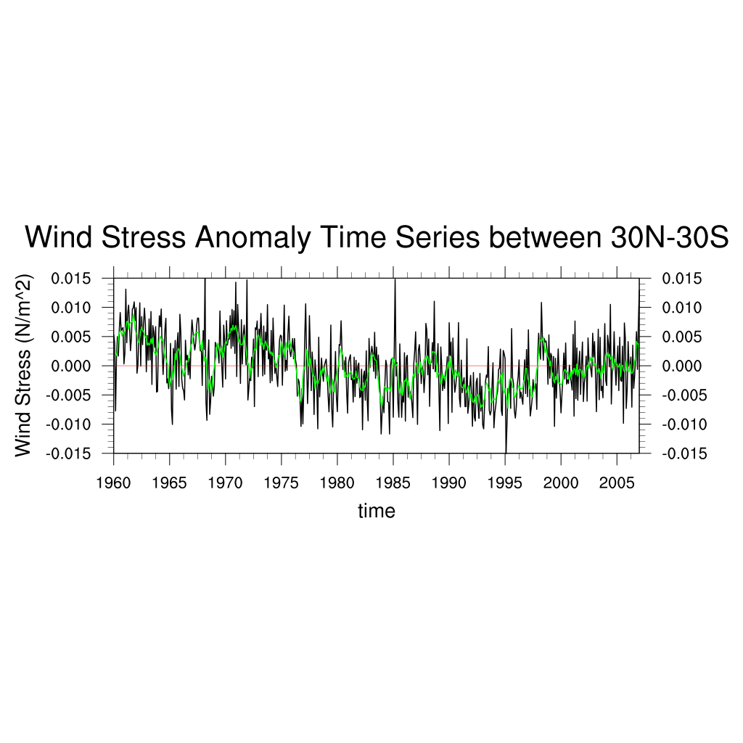
Wind Stress Time Series (G40)
Anomaly, 6 mths running

Slide 6
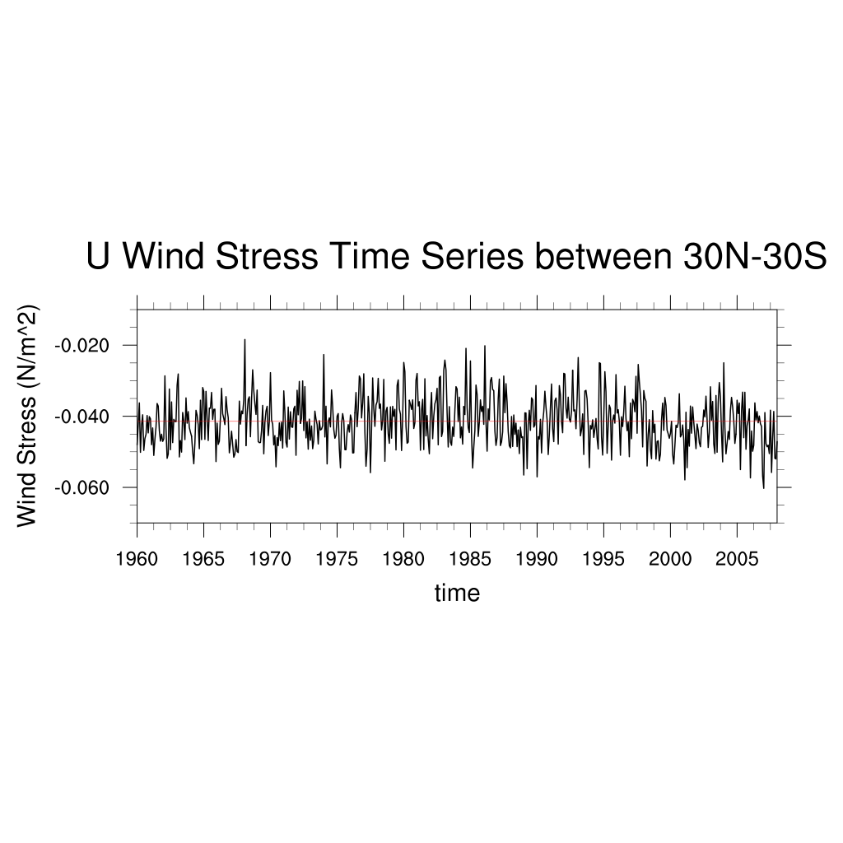
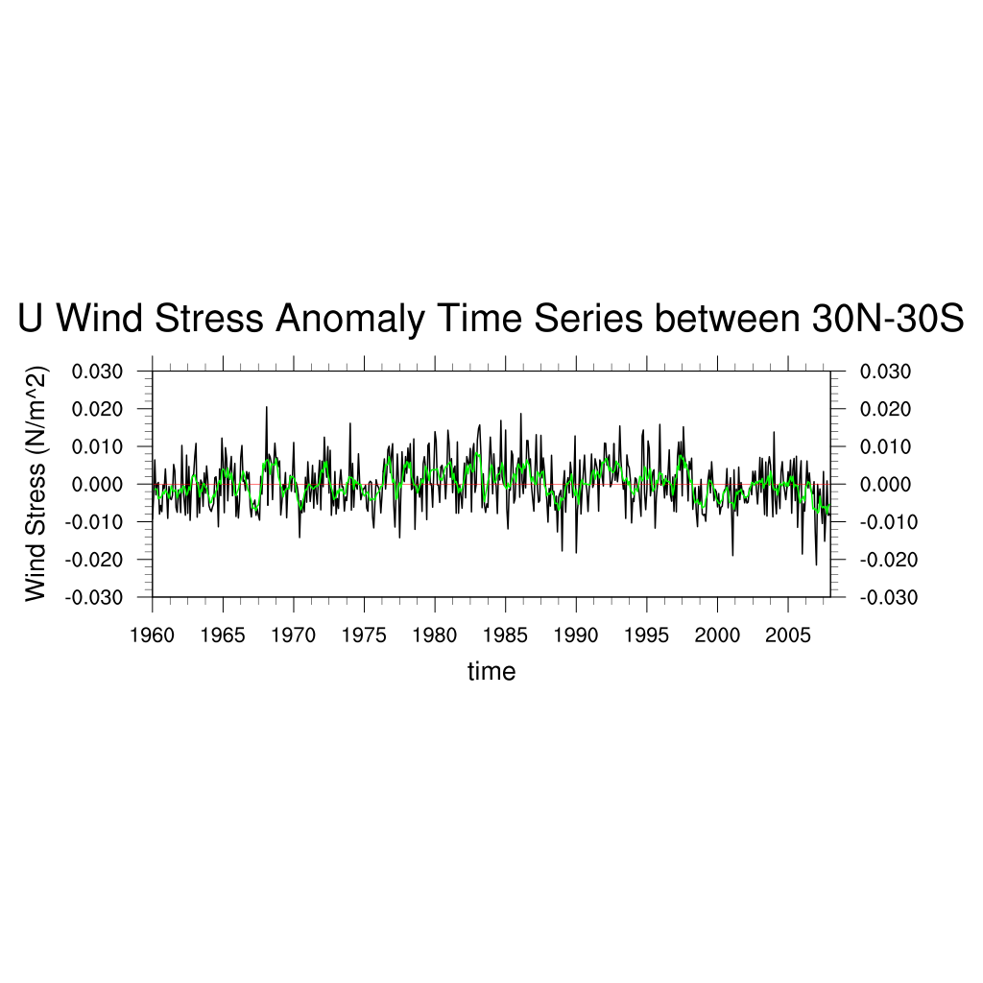
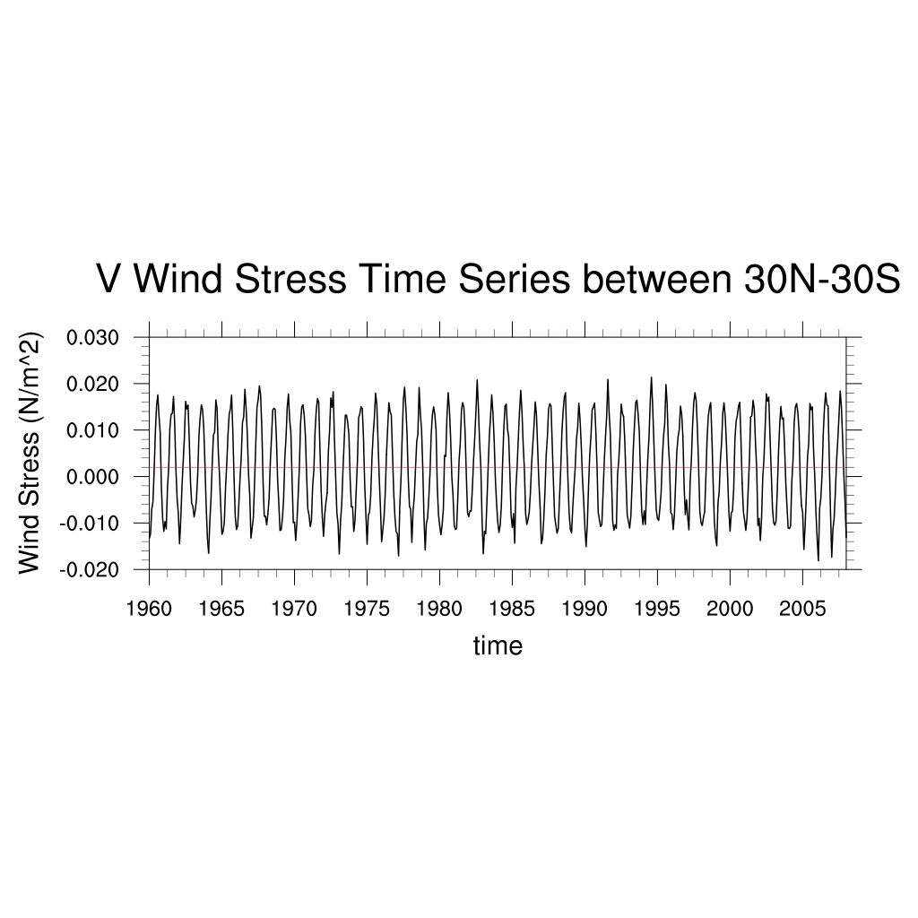
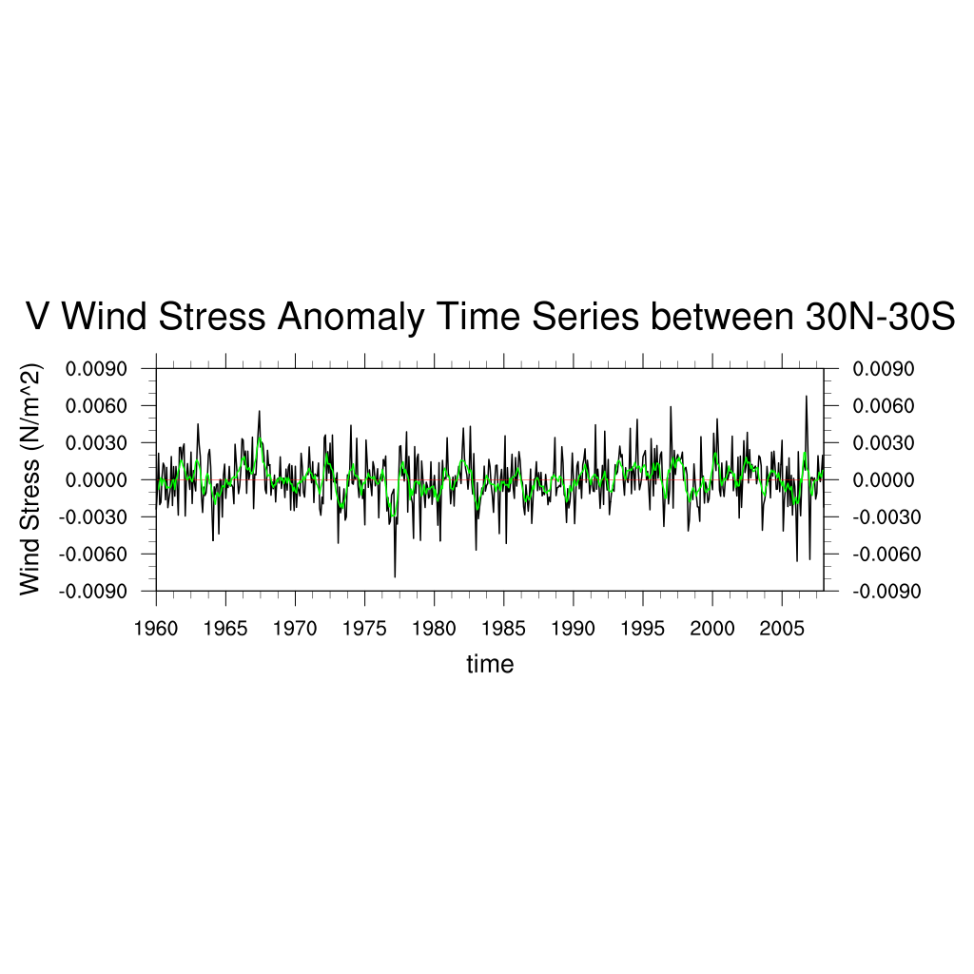
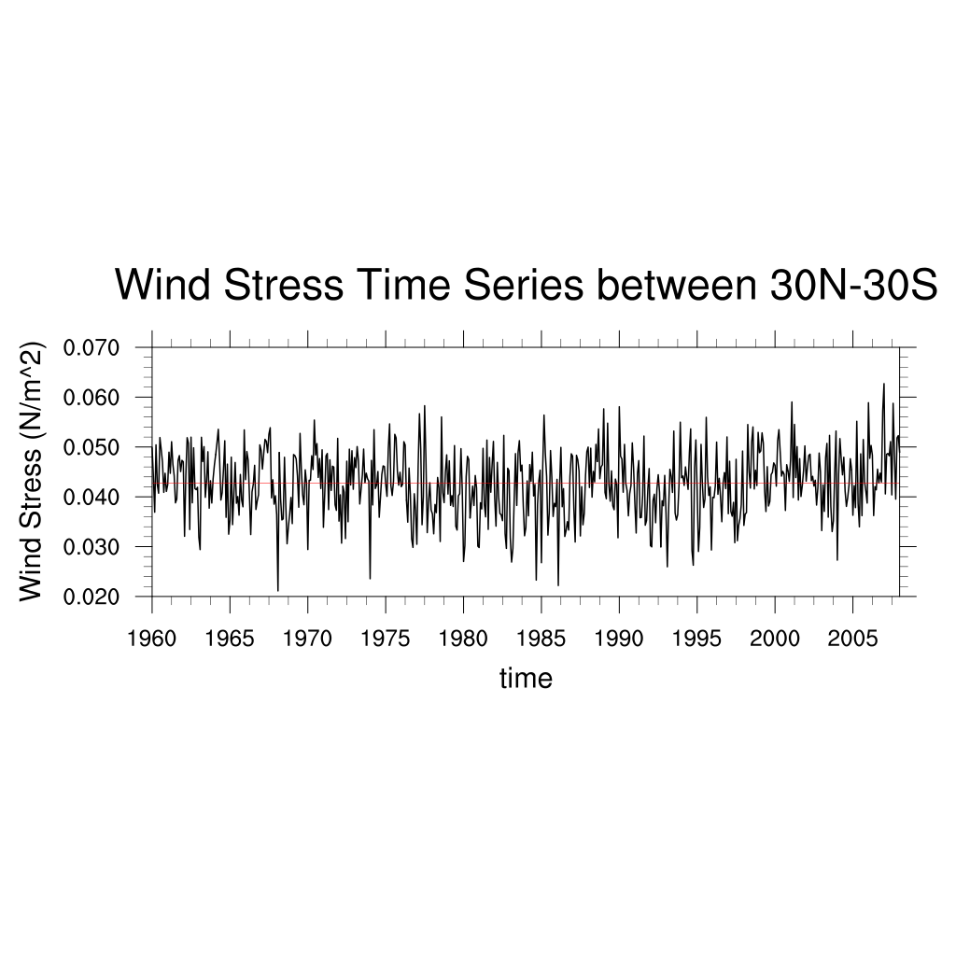
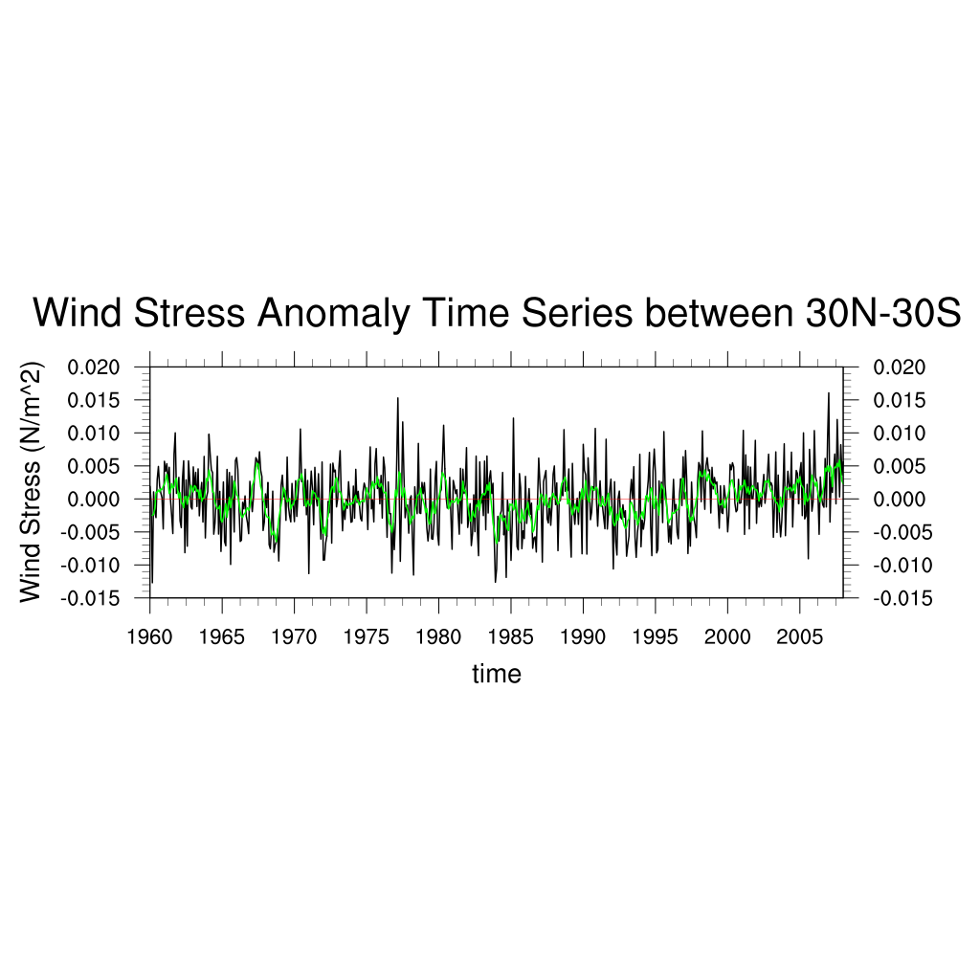
Wind Stress Time Series (SODA 2.2.4)
Anomaly, 6 mths running

Slide 7
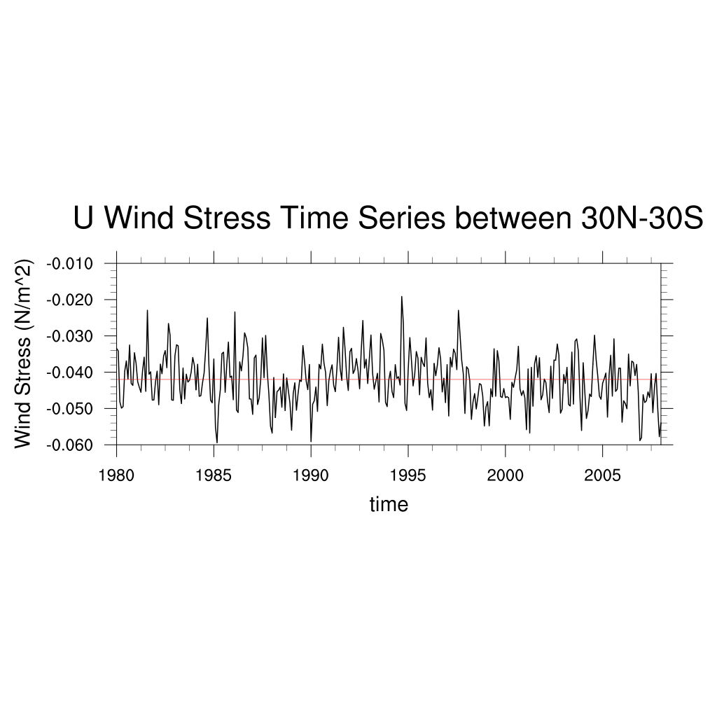
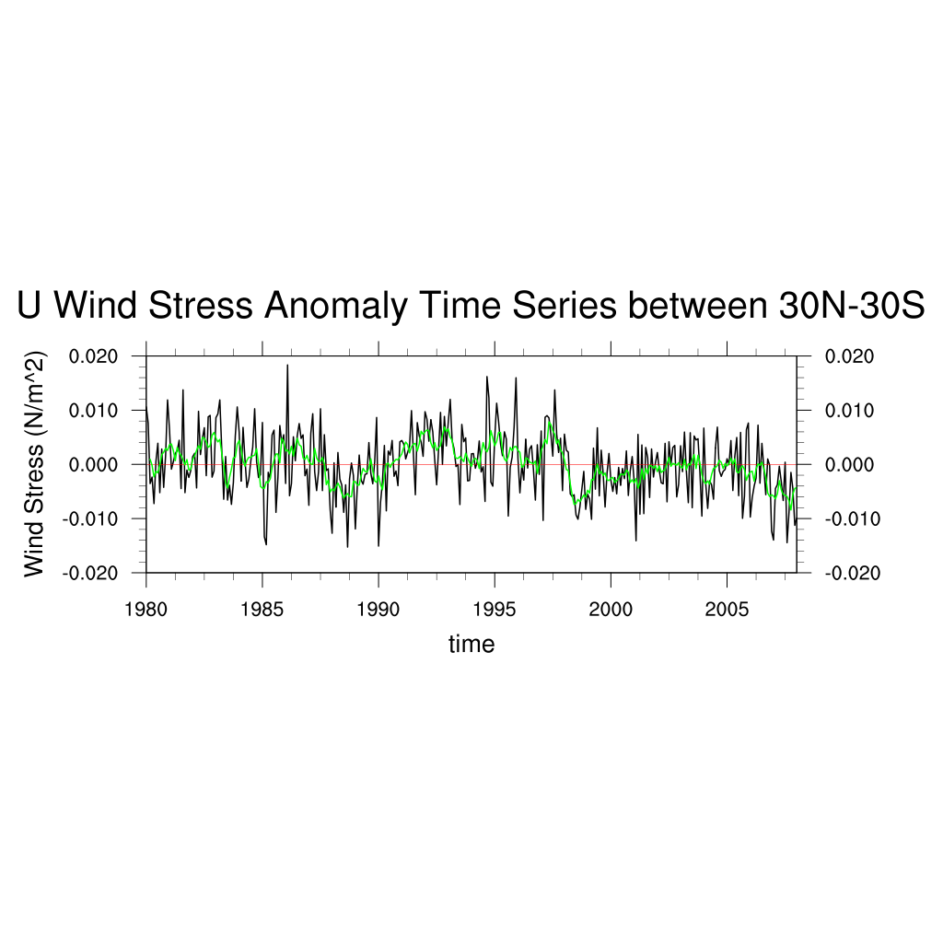
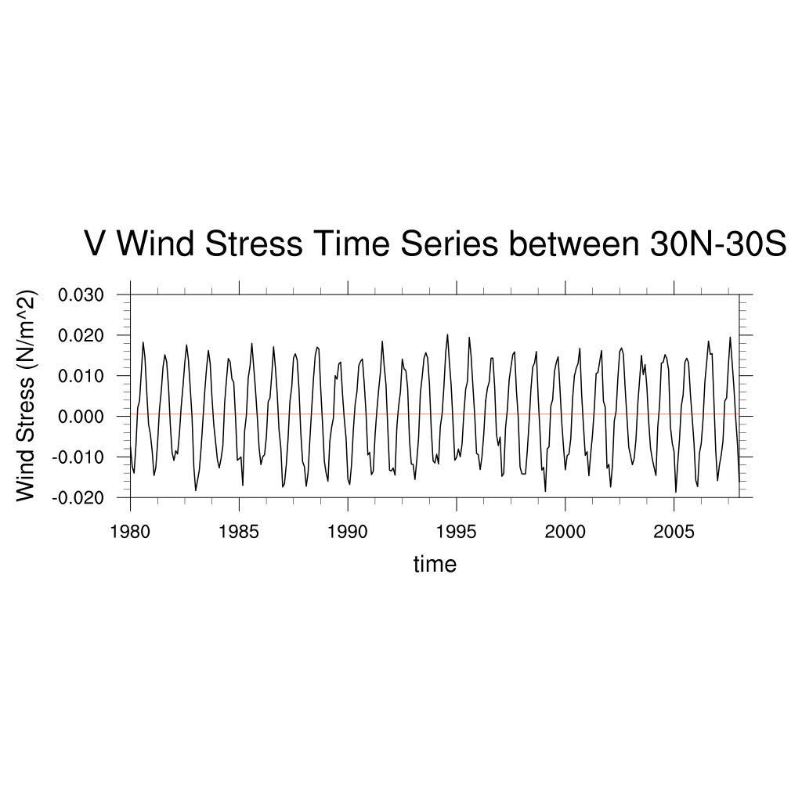
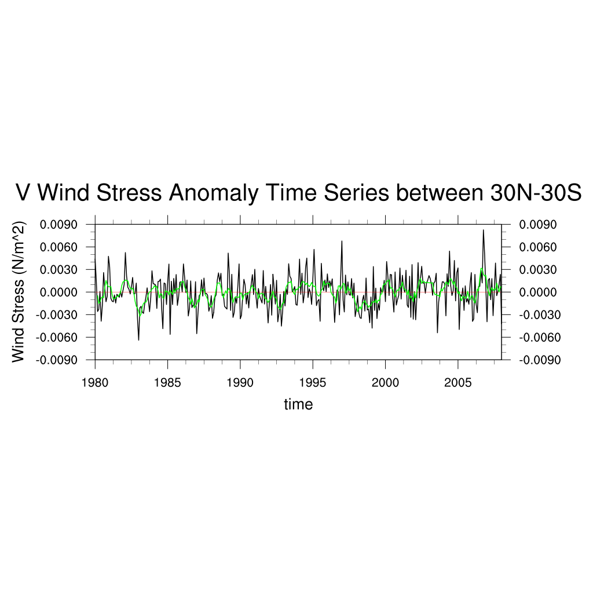
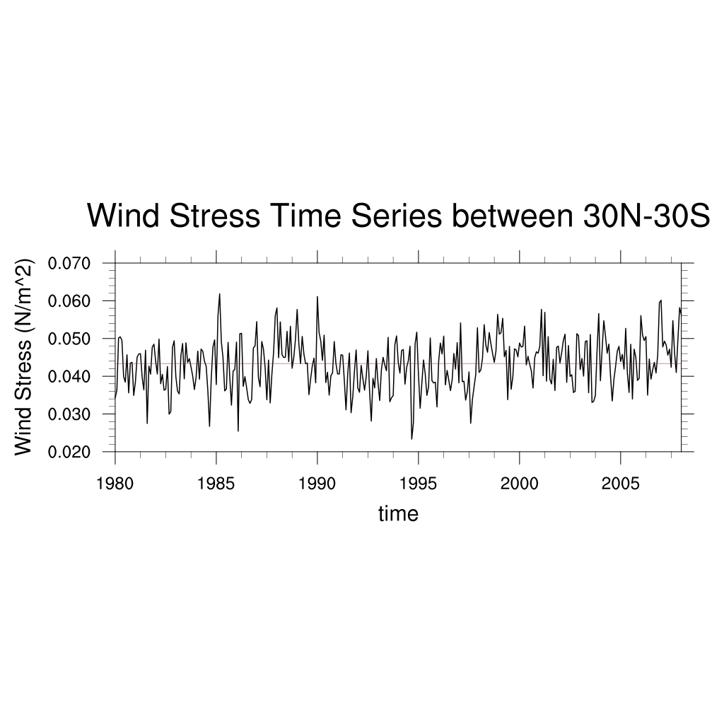
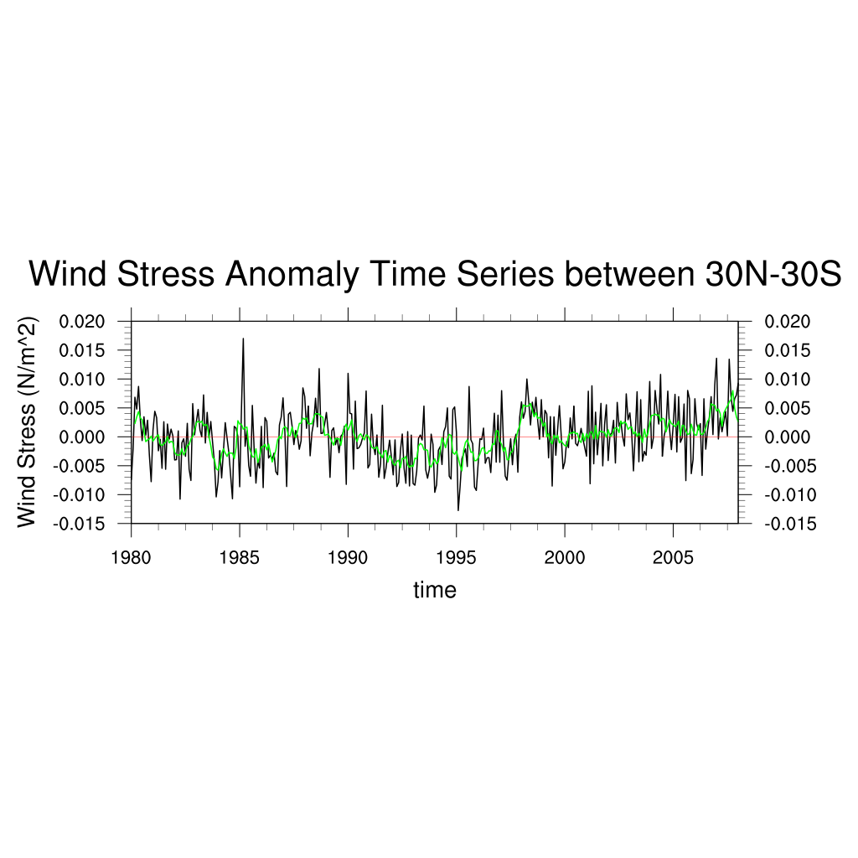
Wind Stress Time Series (SODA 3.6.1)
Anomaly, 6 mths running

Slide 8
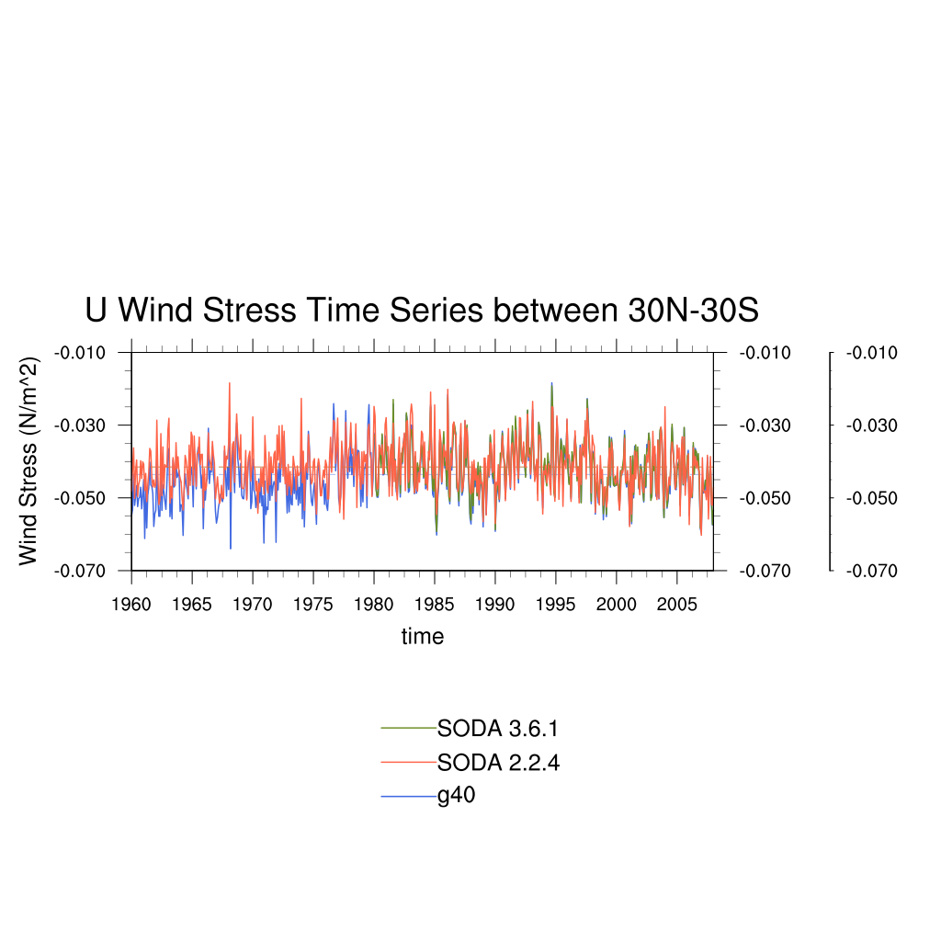
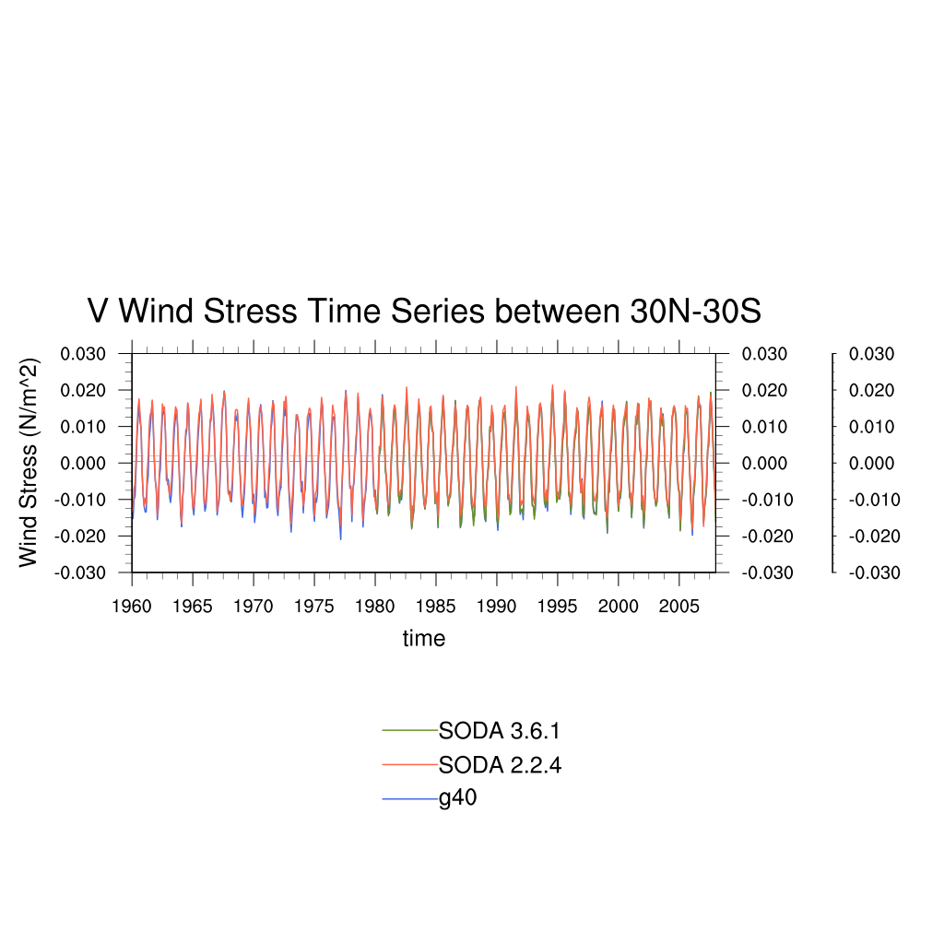
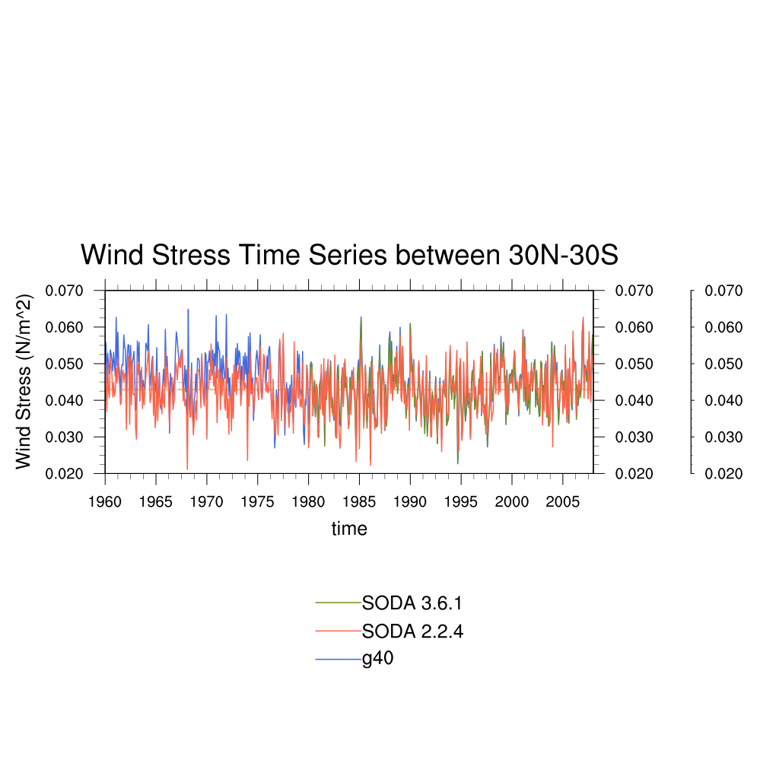
Wind Stress Time Series (compare)

Slide 9
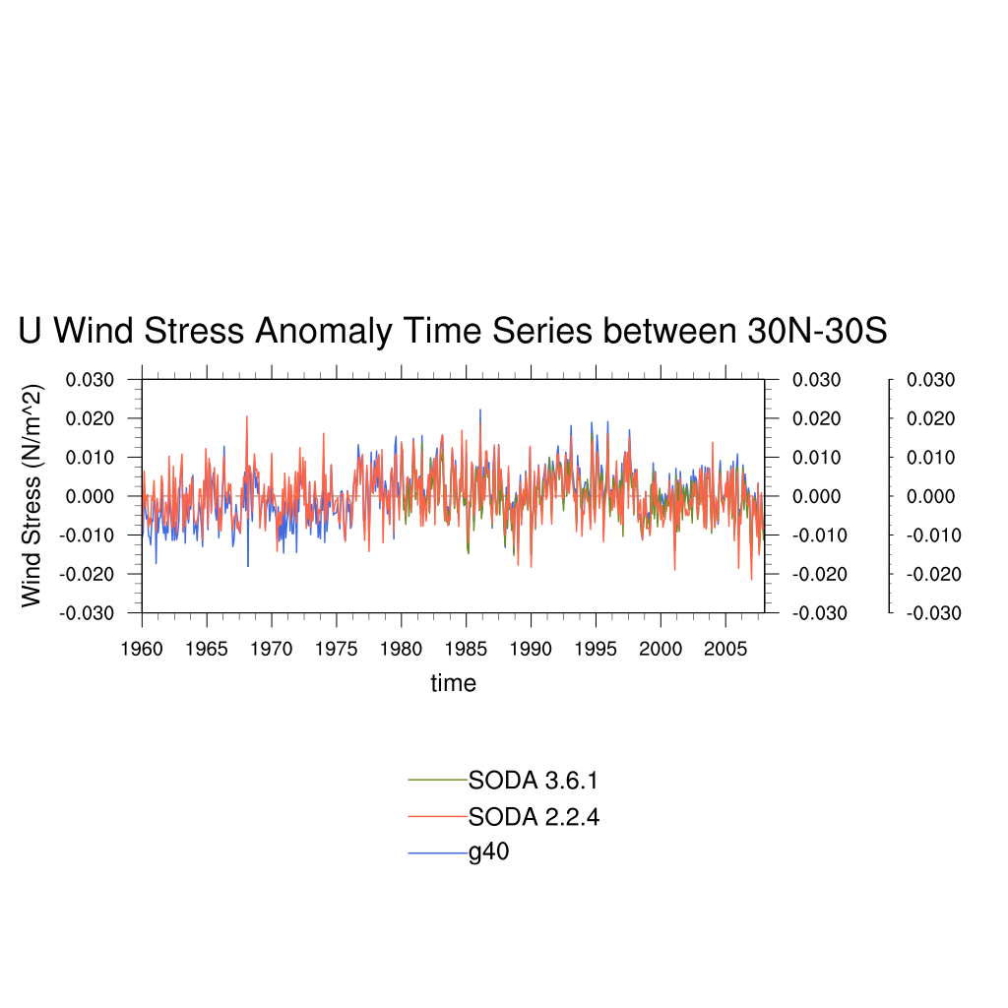
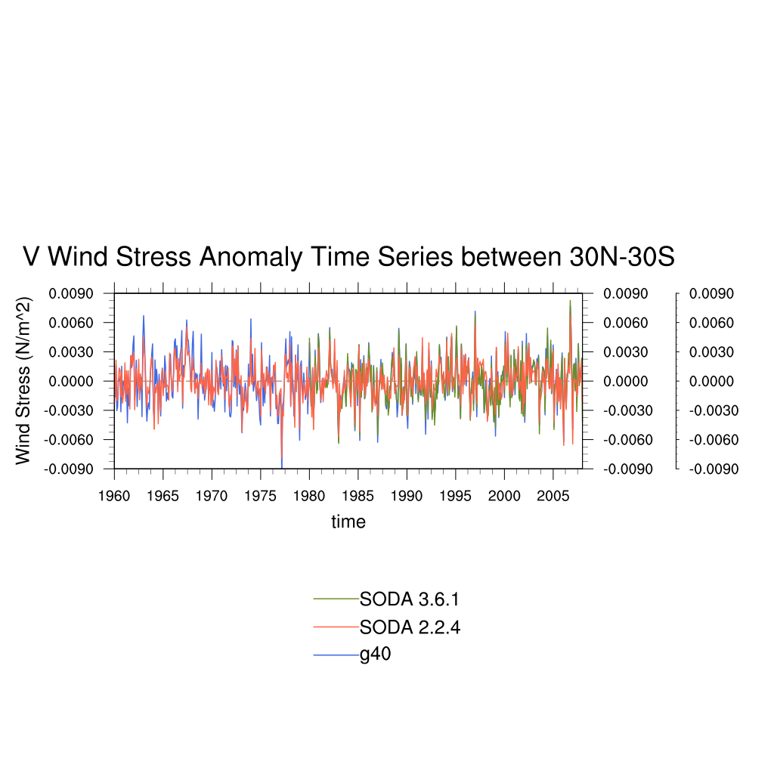
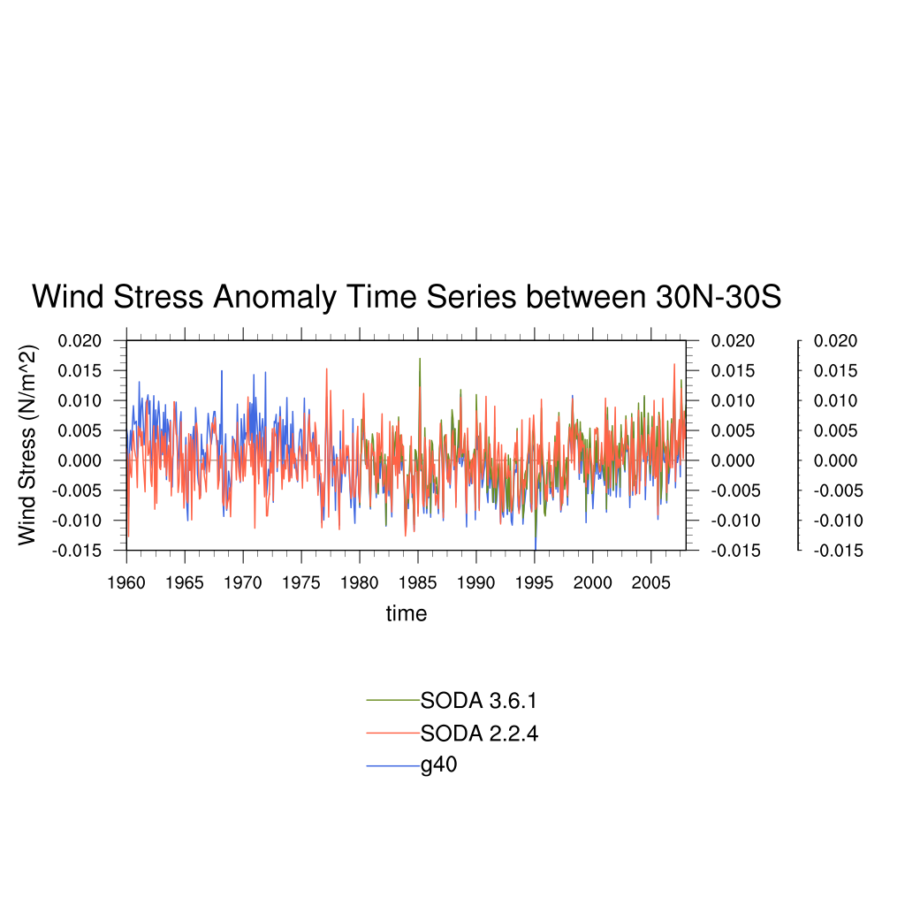
Wind Stress Time Series (compare)
Anomaly

Slide 10
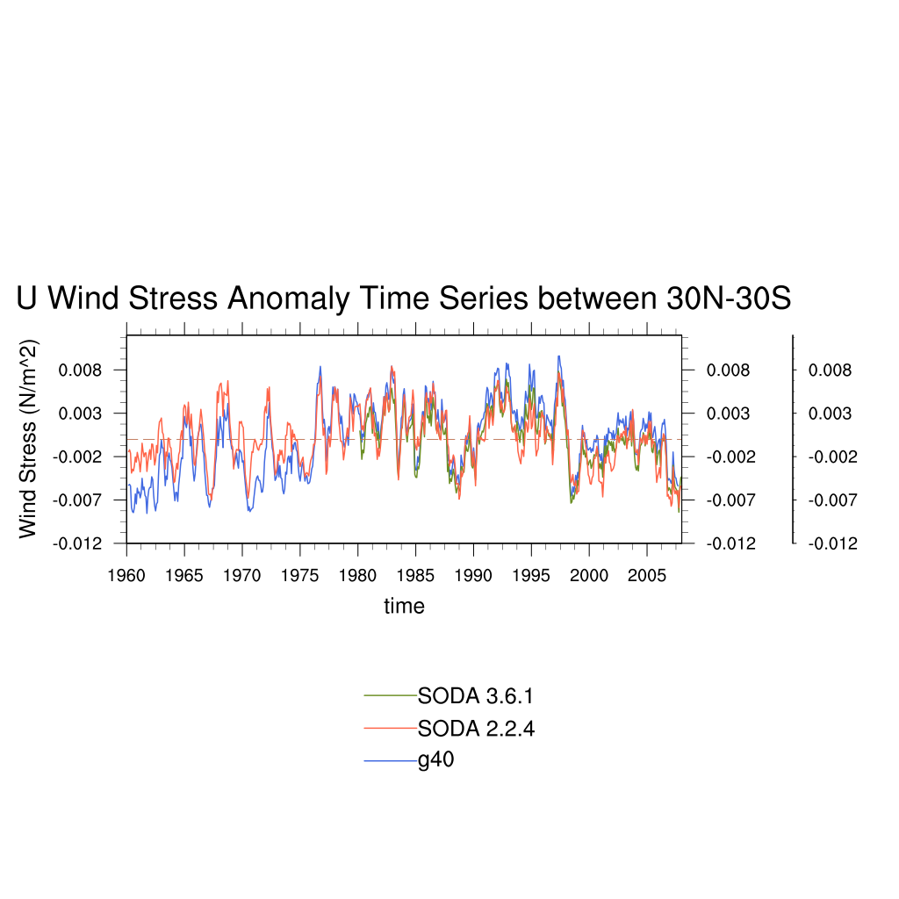
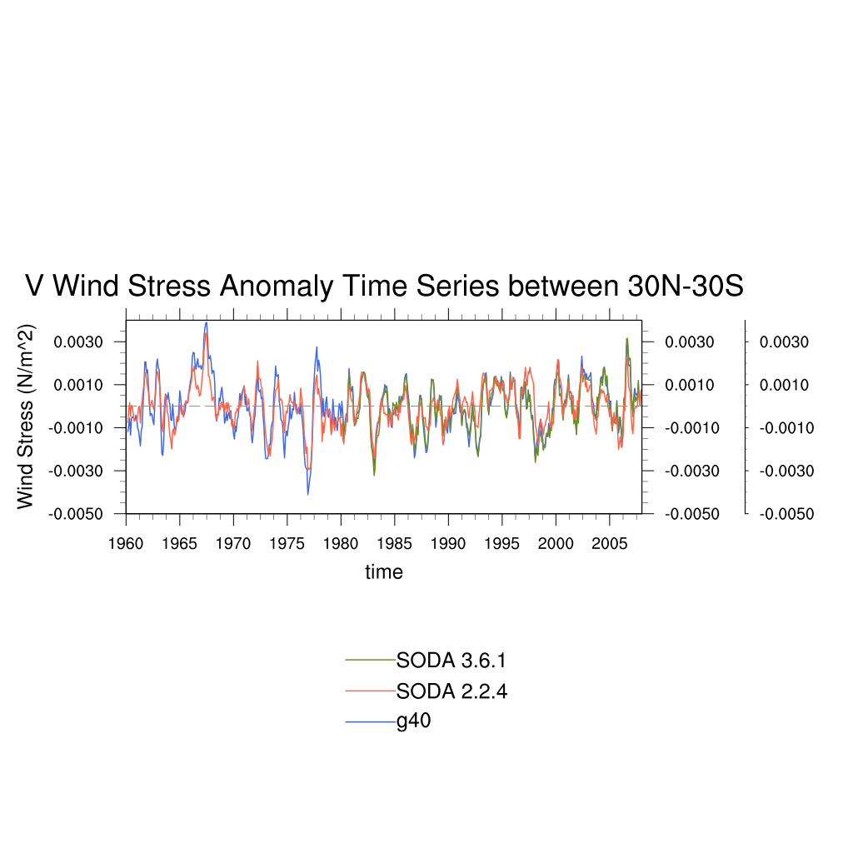
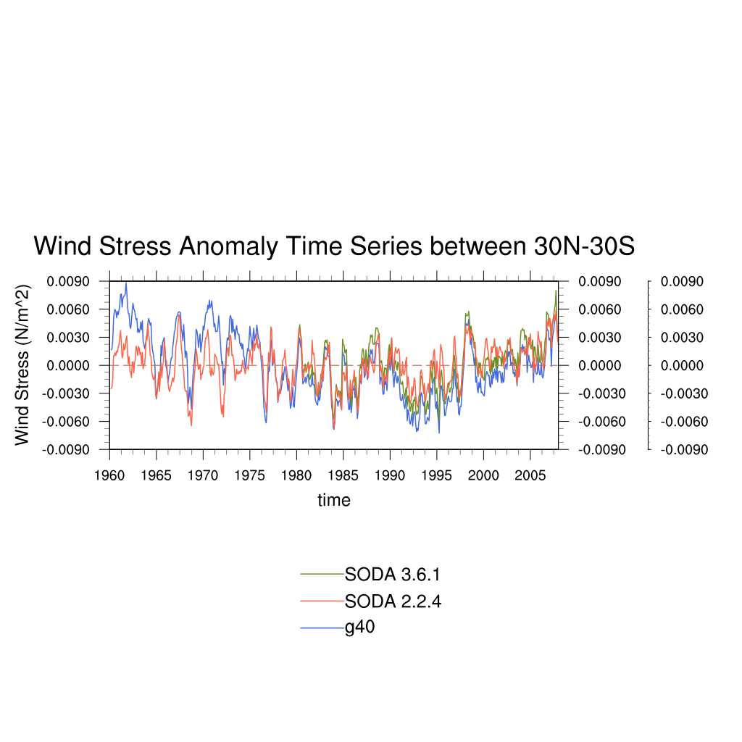
Wind Stress Time Series (compare)
Anomaly,
6 months running average

Slide 11
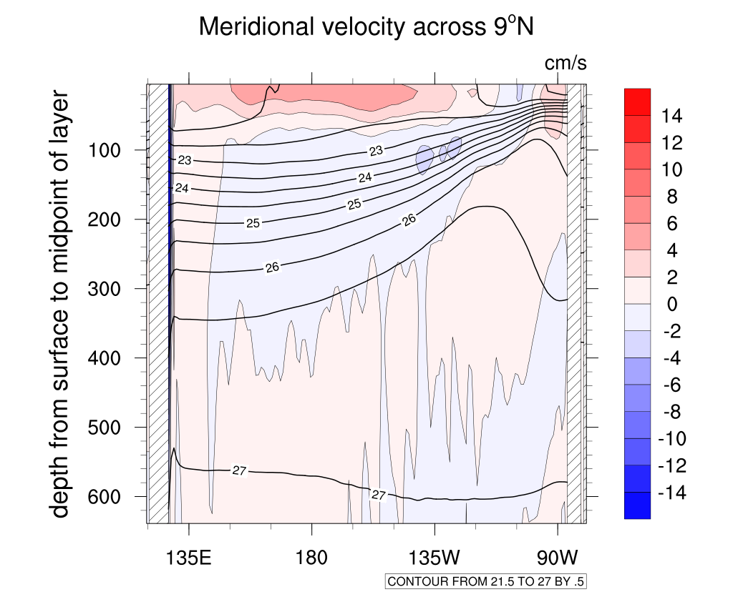
Profile (G40)

Slide 12
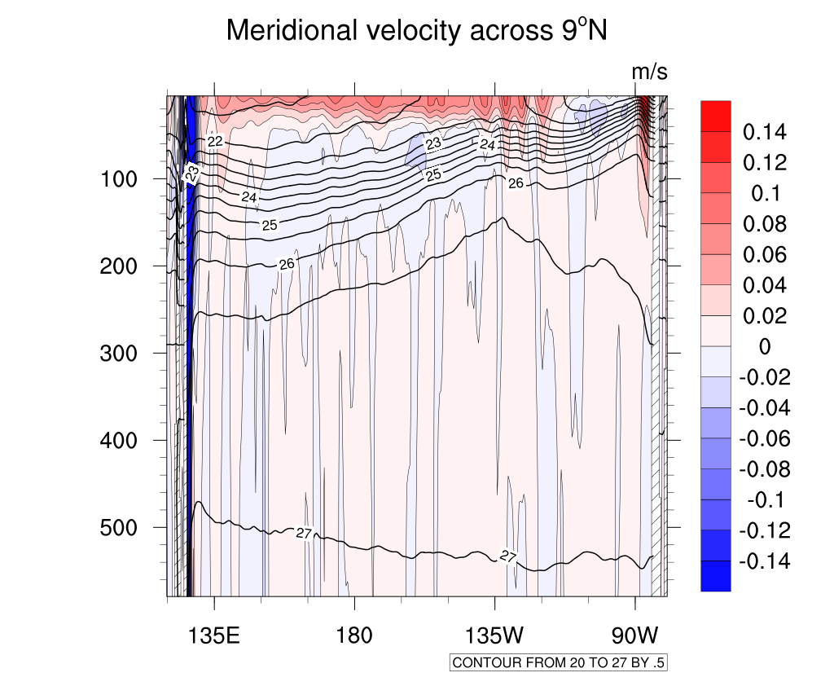
Profile (SODA 2.2.4)

Slide 13
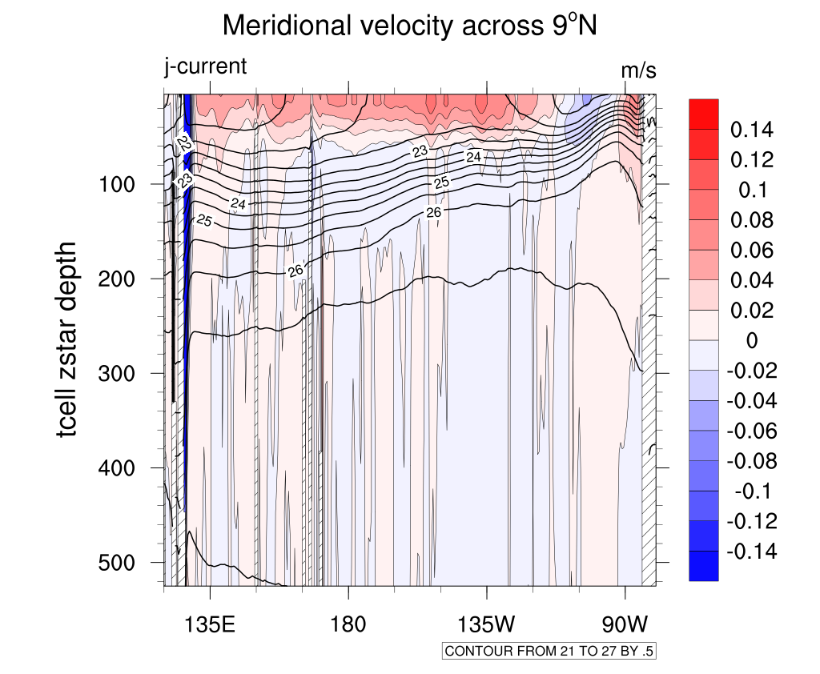
Profile (SODA 3.6.1)

Slide 14
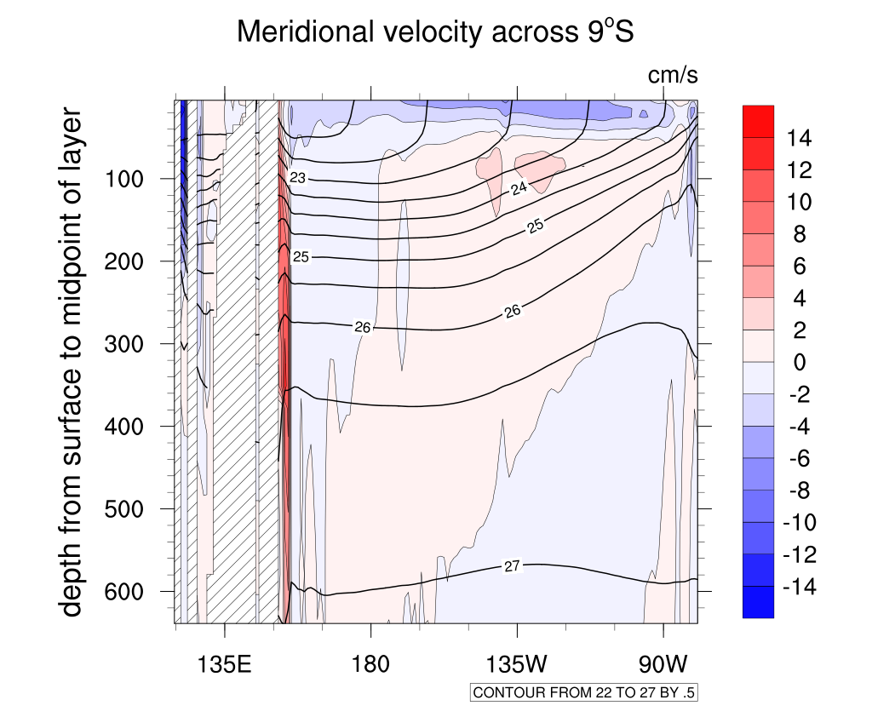
Profile (G40)

Slide 15
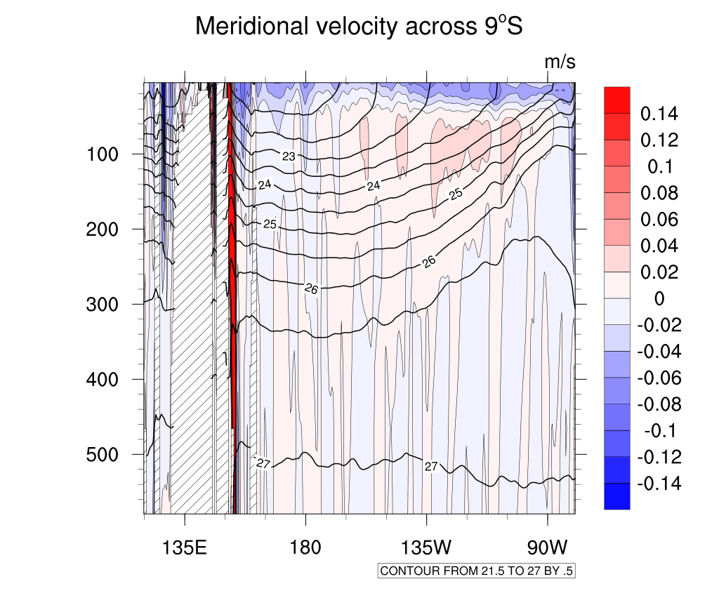
Profile (SODA 2.2.4)

Slide 16
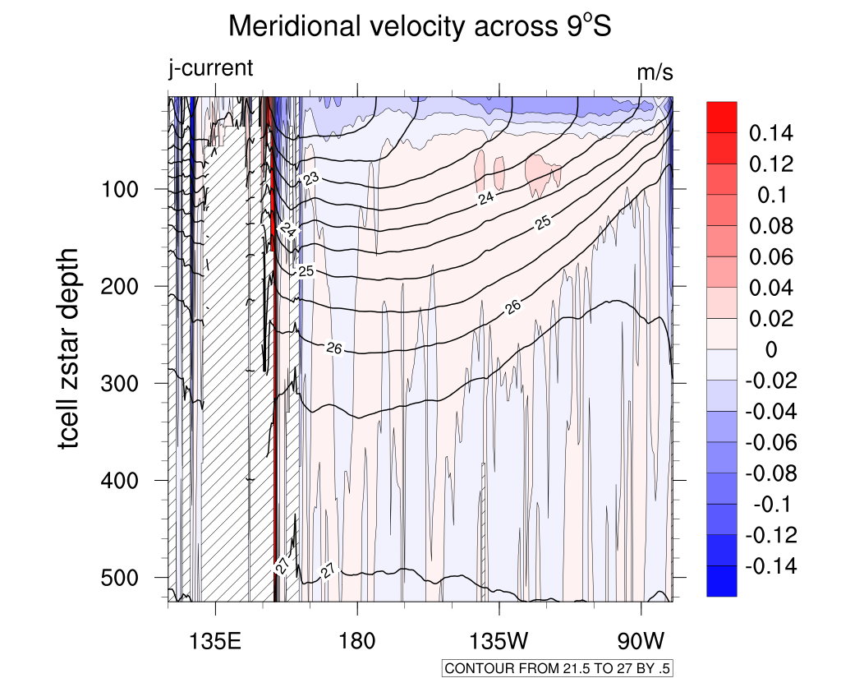
Profile (SODA 3.6.1)

Slide 17
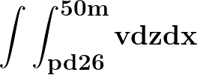
Pacific Interior Subtropical Cells (STCs)
Meridional overturning circulations in the upper ocean and connect the subtropical and tropical Pacific Oceans
Meridional Velocity (v) Flux Transport near Subtropical Pacific Region
North: 140°E-80°W @ 9°N
South: 160°E-80°W @ 9°S
Convergence:
pd26: integrate to the depth of potential density 1026 kg/m3
d20: integrate to the depth of temperature 20°

Slide 18
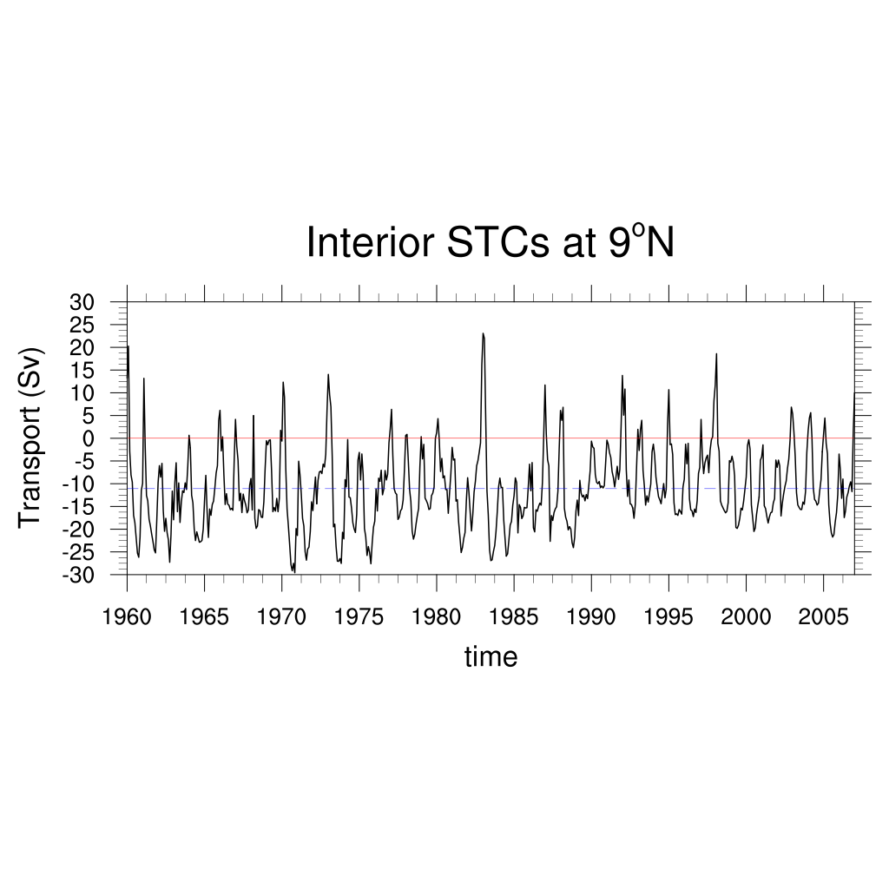
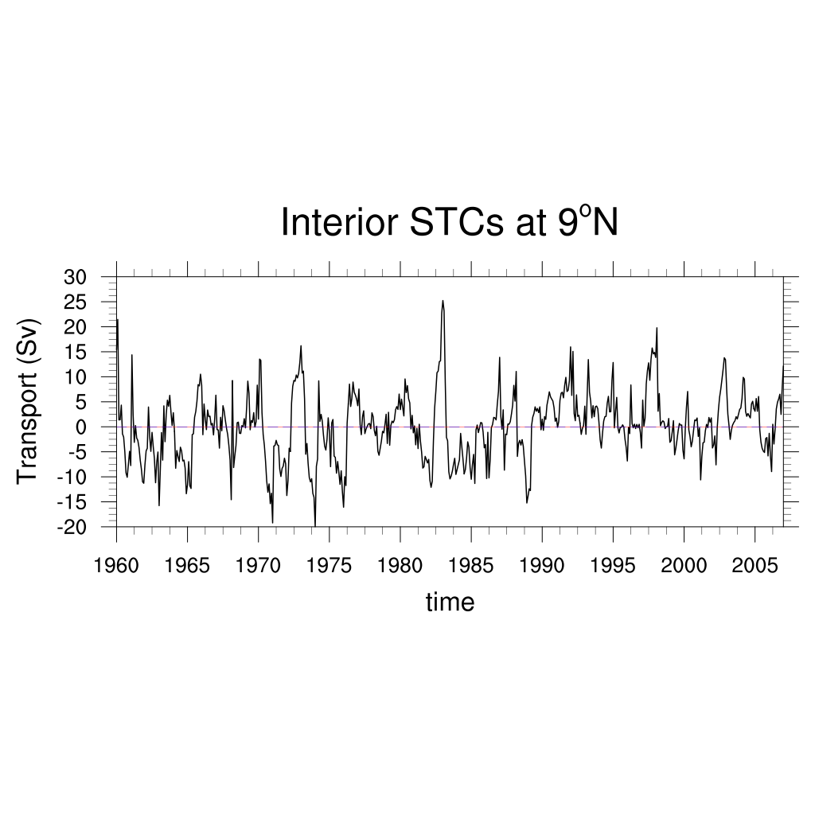
STC Time Series (G40) pd26
Anomaly

Slide 19
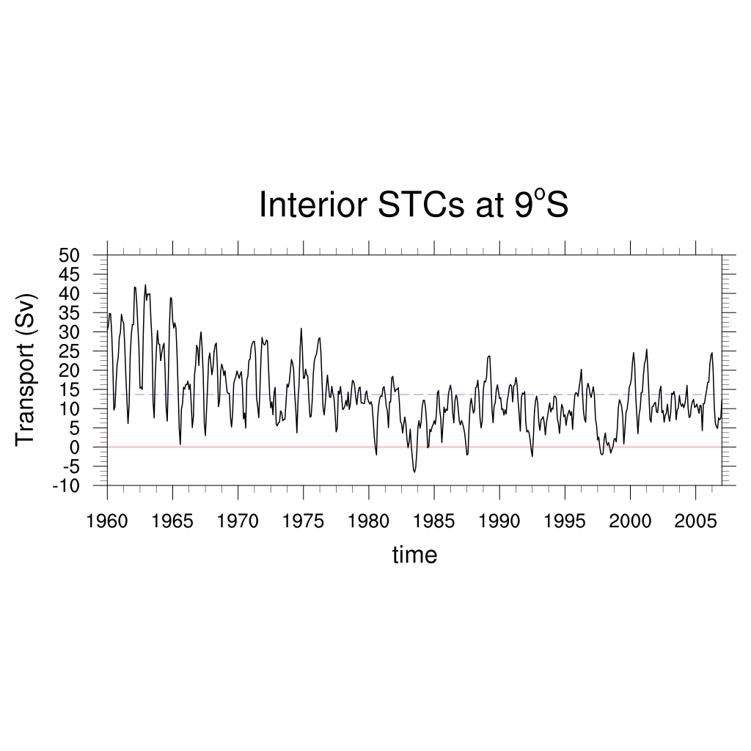
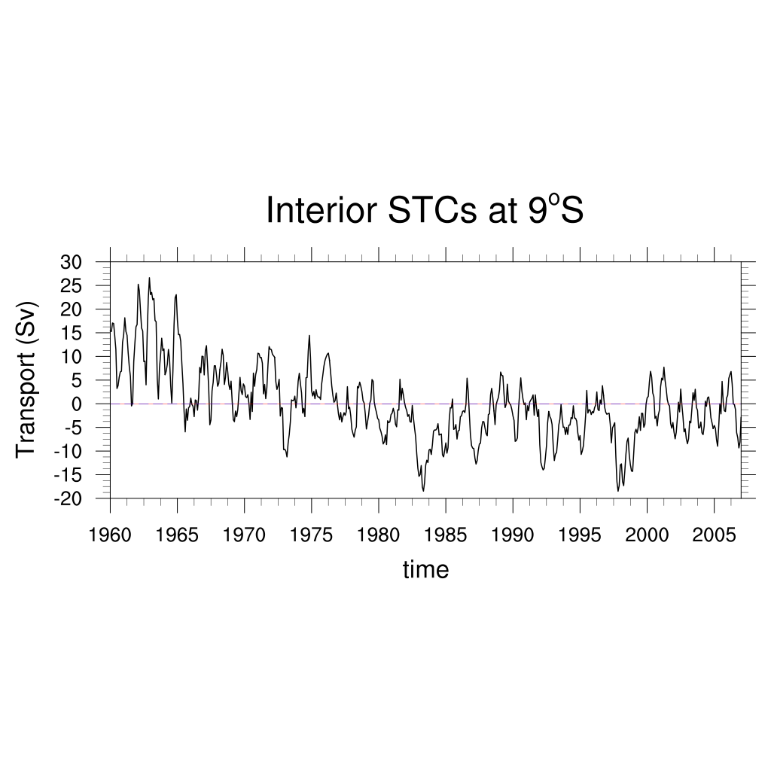
STC Time Series (G40) pd26
Anomaly

Slide 20
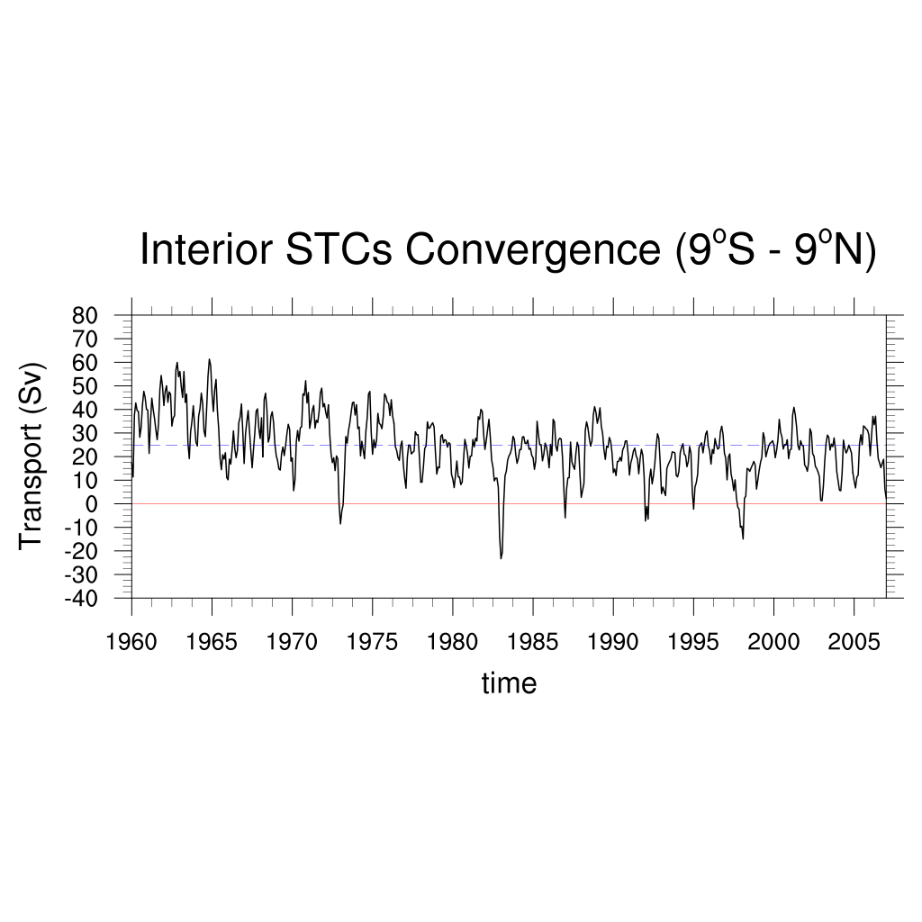
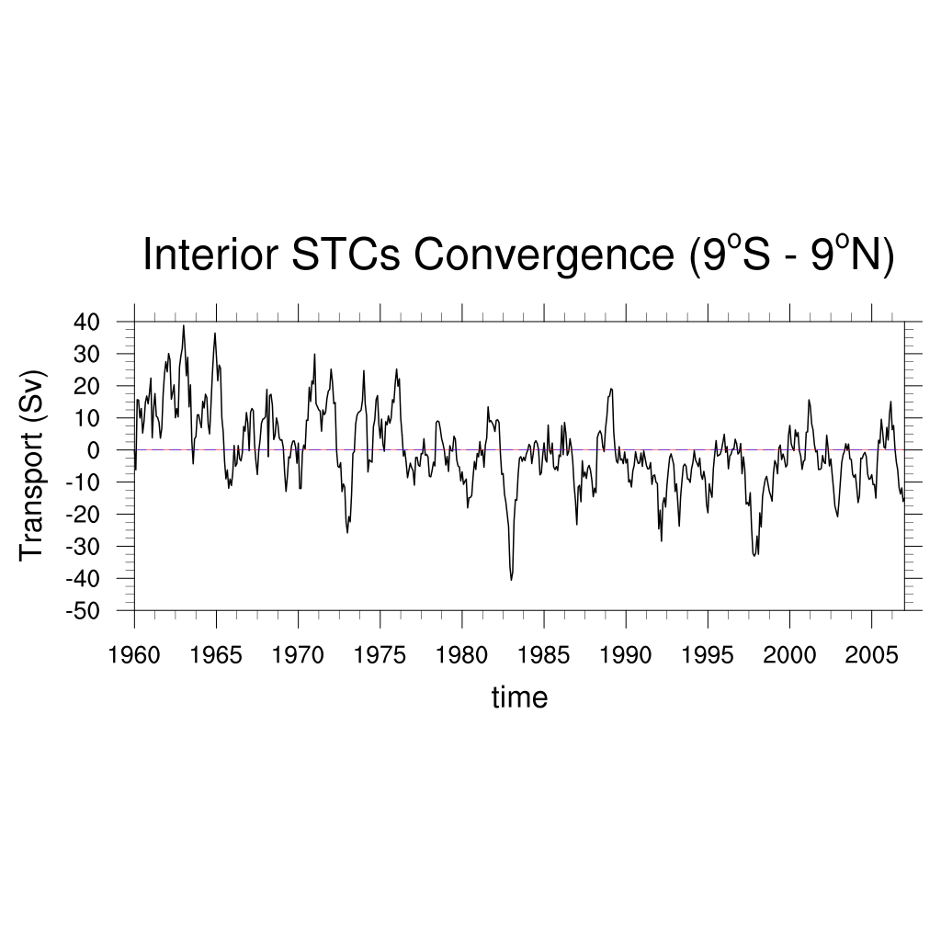
STC Time Series (G40) pd26
Anomaly

Slide 21
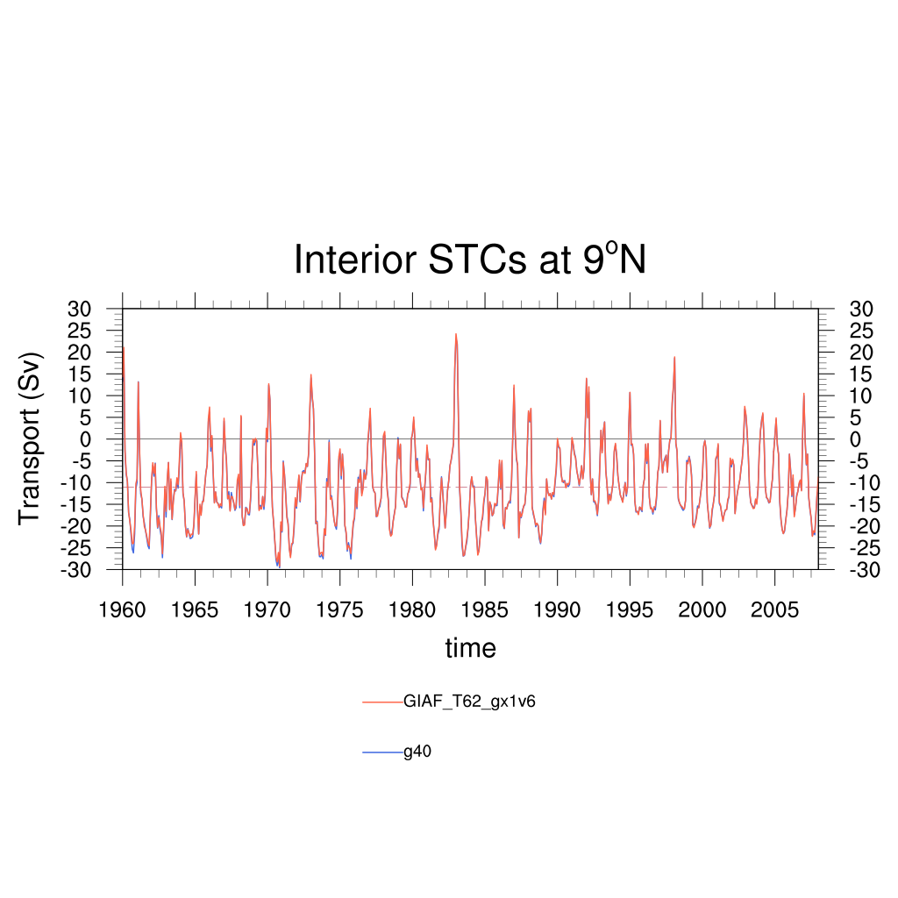
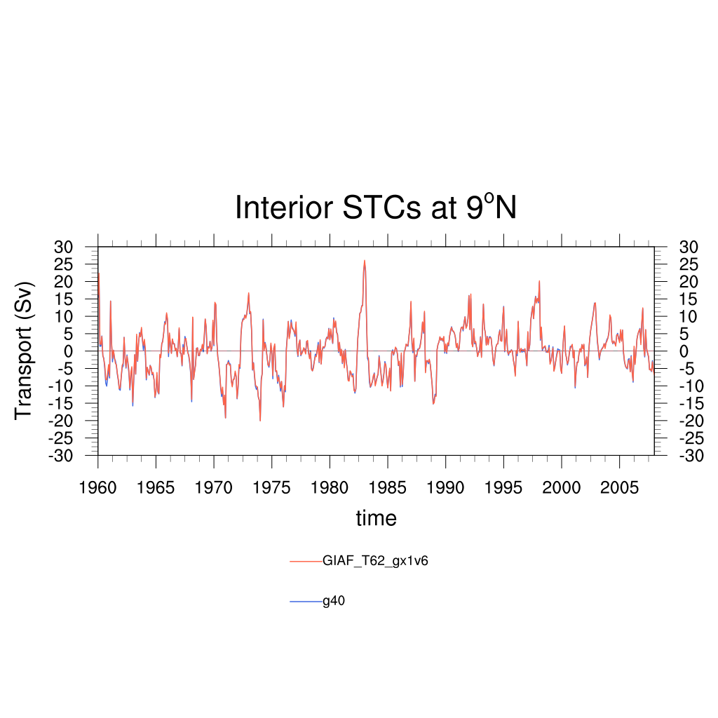
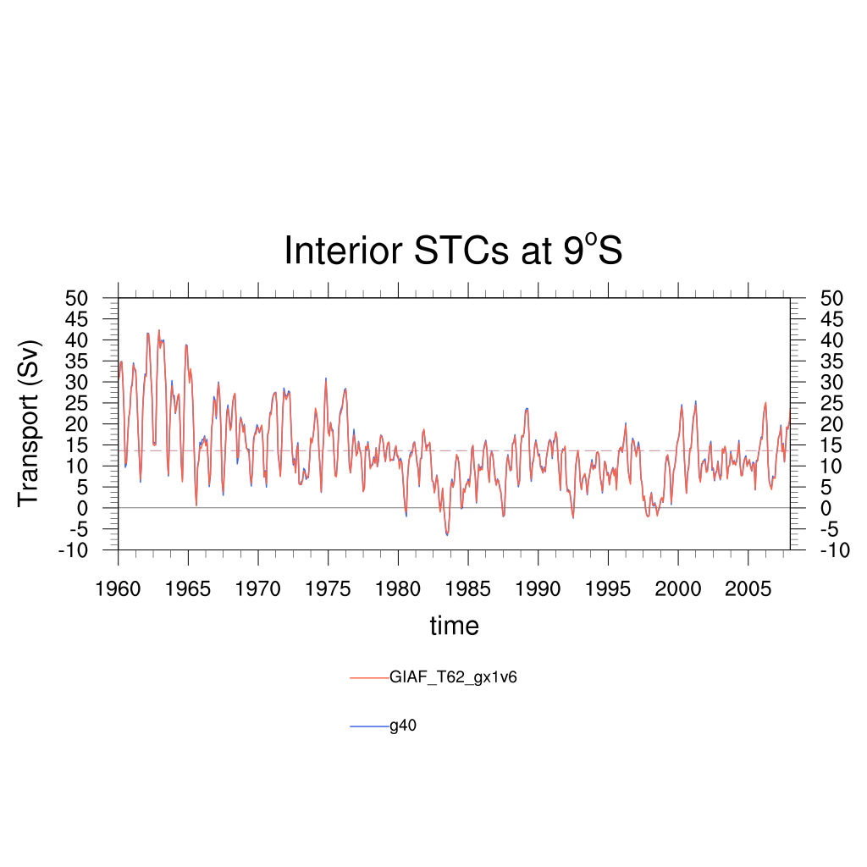
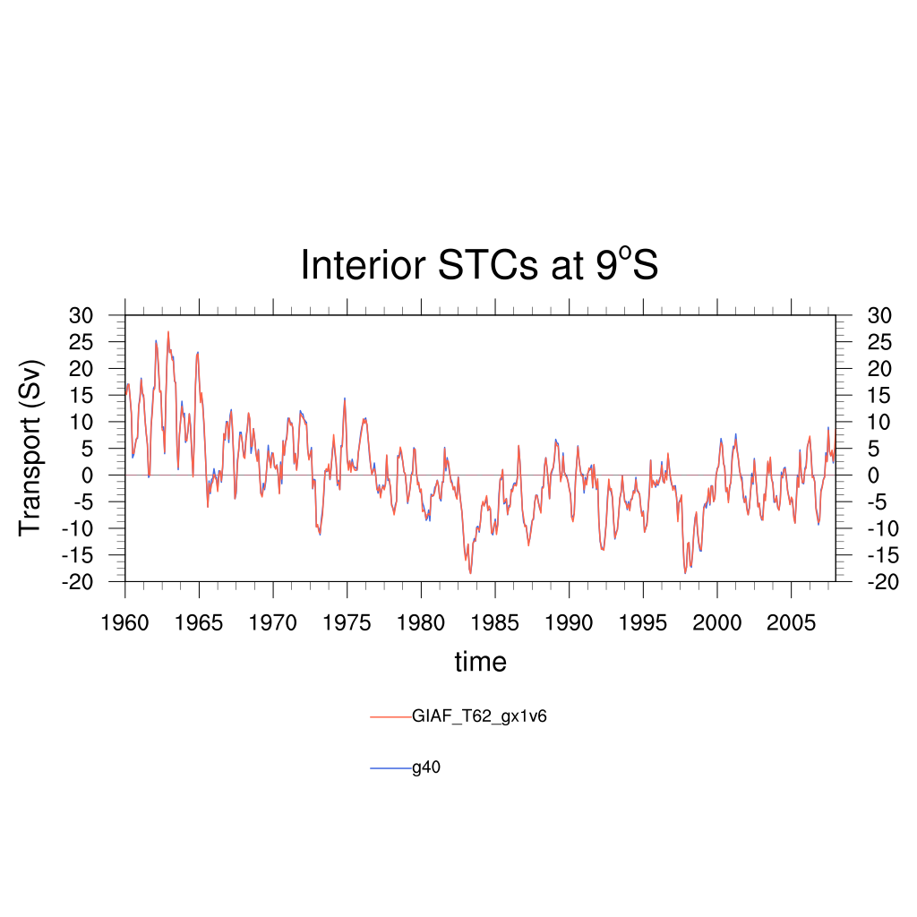
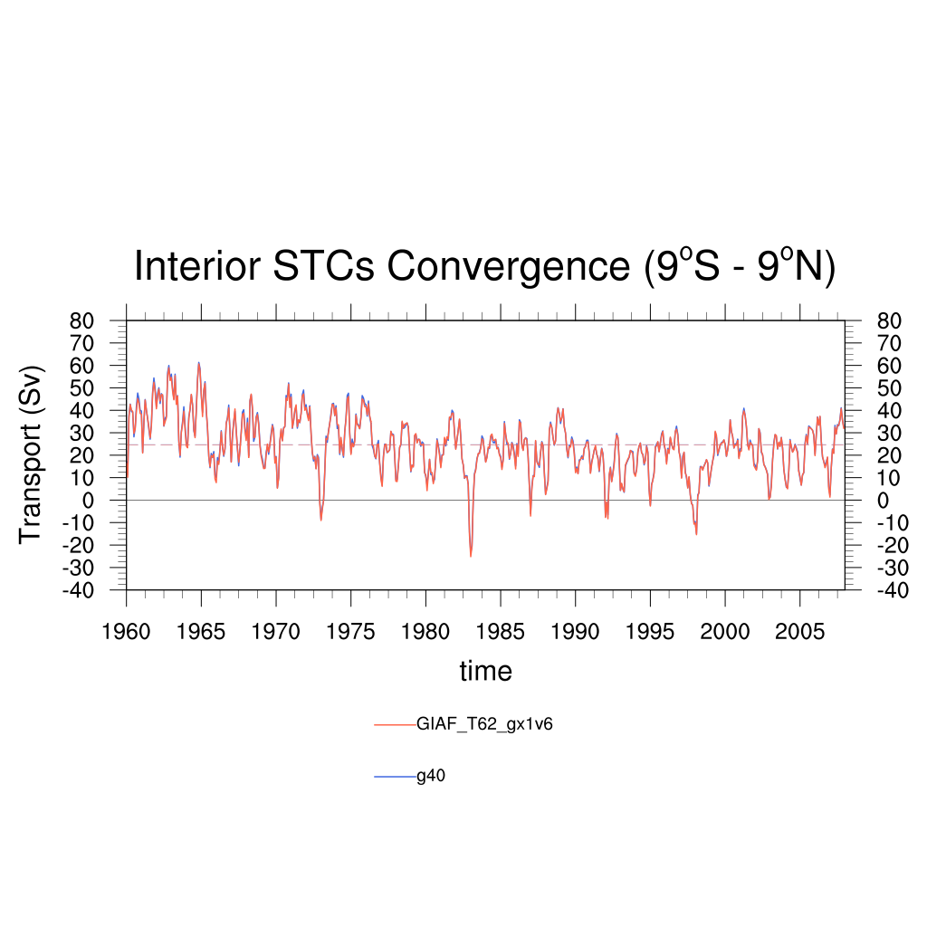
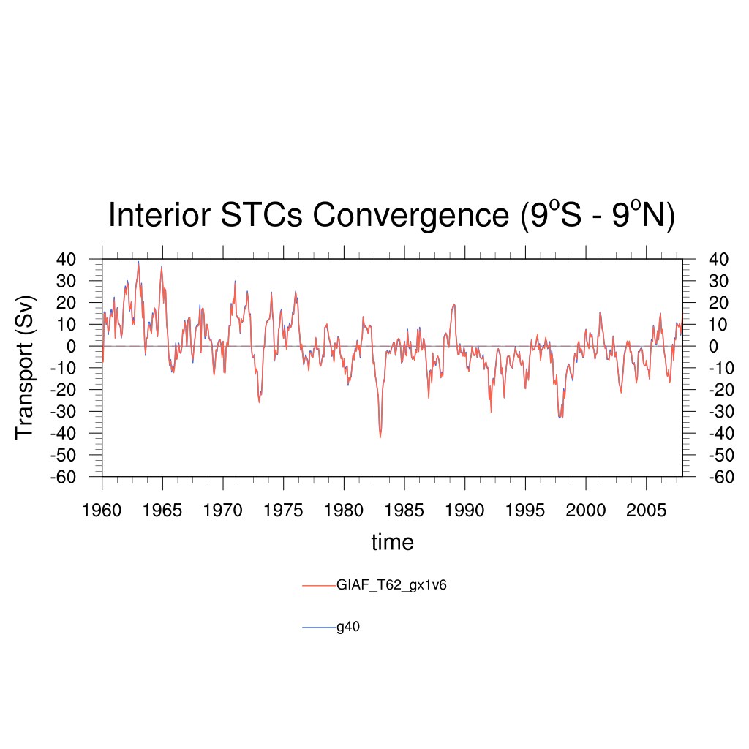
STC Time Series (model compare) pd26
Anomaly

Slide 22
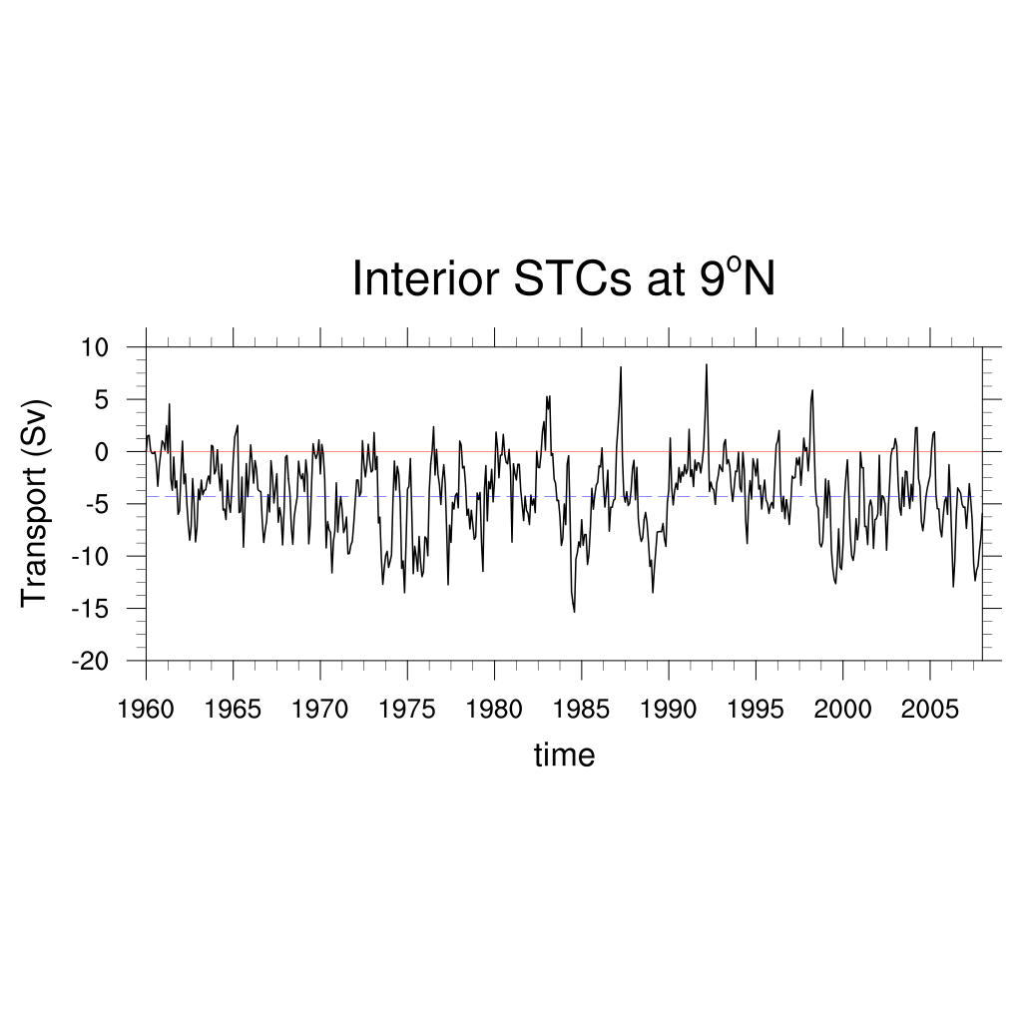
STC Time Series (SODA 2.2.4) pd26
Anomaly

Slide 23
STC Time Series (SODA 2.2.4) pd26
Anomaly

Slide 24
STC Time Series (SODA 2.2.4) pd26
Anomaly

Slide 25
STC Time Series (SODA 3.6.1) pd26
Anomaly

Slide 26
STC Time Series (SODA 3.6.1) pd26
Anomaly

Slide 27
STC Time Series (SODA 3.6.1) pd26
Anomaly

Slide 28
STC Time Series (compare) pd26

Slide 29
STC Time Series (compare) pd26
Anomaly

Slide 30
STC Time Series (compare) pd26

Slide 31
STC Time Series (compare) pd26
Anomaly

Slide 32
STC Time Series (compare) pd26

Slide 33
STC Time Series (compare) pd26
Anomaly

Slide 34
STC Time Series (G40) d20
Anomaly

Slide 35
STC Time Series (G40) d20
Anomaly

Slide 36
STC Time Series (G40) d20
Anomaly

Slide 37
STC Time Series (model compare) d20
Anomaly

Slide 38
STC Time Series (SODA 2.2.4) d20
Anomaly

Slide 39
STC Time Series (SODA 2.2.4) d20
Anomaly

Slide 40
STC Time Series (SODA 2.2.4) d20
Anomaly

Slide 41
STC Time Series (SODA 3.6.1) d20
Anomaly

Slide 42
STC Time Series (SODA 3.6.1) d20
Anomaly

Slide 43
STC Time Series (SODA 3.6.1) d20
Anomaly

Slide 44
STC Time Series (compare) d20

Slide 45
STC Time Series (compare) d20
Anomaly

Slide 46
STC Time Series (compare) d20

Slide 47
STC Time Series (compare) d20
Anomaly

Slide 48
STC Time Series (compare) d20

Slide 49
STC Time Series (compare) d20
Anomaly

Slide 50
STC Time Series (pd26 & d20 compare)

Slide 51
STC Time Series (pd26 & d20 compare)
Anomaly

Slide 52
STC Time Series (pd26 & d20 compare)

Slide 53
STC Time Series (pd26 & d20 compare)
Anomaly

Slide 54
Oceanic Nino Index

Slide 55
STC & ONI Cross Correlation (G40)
Anomaly,
3 months running average

Slide 56
STC & ONI Cross Correlation (SODA 2.2.4)
Anomaly,
3 months running average

Slide 57
STC & ONI Cross Correlation (SODA 3.6.1)
Anomaly,
3 months running average

Slide 58
Heat Budget

Slide 59
Heat Budget (G40)
VT | -233.3998
V’T- | -8.635806
V-T’ | -0.39612
V’T’ | -7.947994
V-T- | -216.4199
-233.3998

Slide 60
Heat Budget (G40)
(VT)a | 6.163194e-07
VT | -233.3998
(VT)- * -1 | 233.3998
V’T- | -8.635806
V-T’ | -0.39612
V’T’ | -7.947994
(V’T’)- *-1 | 7.947994
0
-9.031926

Slide 61
Heat Budget (G40)

Slide 62
Heat Budget (G40)
VT | 316.7138
V’T- | 6.840544
V-T’ | -0.1125912
V’T’ | 7.5591
V-T- | 302.4268
316.7138

Slide 63
Heat Budget (G40)
(VT)a | -1.319444e-07
VT | 316.7138
(VT)- * -1 | -316.7138
V’T- | 6.840544
V-T’ | -0.1125912
V’T’ | 7.5591
(V’T’)- *-1 | -7.5591
0
6.727954

Slide 64
Heat Budget (G40)

Slide 65
Heat Budget (G40)
VT | 550.1136
V’T- | 15.47635
V-T’ | 0.2835288
V’T’ | 15.50709
V-T- | 518.8466
550.1136

Slide 66
Heat Budget (G40)
(VT)a | -7.482639e-07
VT | 550.1136
(VT)- * -1 | -550.1136
V’T- | 15.47635
V-T’ | 0.2835288
V’T’ | 15.50709
(V’T’)- *-1 | -15.50709
0
15.75988

Slide 67
Heat Budget (G40)

Slide 68
Heat Budget (SODA 2.2.4)
VT | -98.49834
V’T- | -9.450144
V-T’ | 0.6009599
V’T’ | -4.472873
V-T- | -85.17628
-98.49834

Slide 69
Heat Budget (SODA 2.2.4)
(VT)a | 1.10034e-06
VT | -98.49834
(VT)- * -1 | 98.49834
V’T- | -9.450144
V-T’ | 0.6009599
V’T’ | -4.472873
(V’T’)- *-1 | 4.472873
0
-8.849184

Slide 70
Heat Budget (SODA 2.2.4)

Slide 71
Heat Budget (SODA 2.2.4)
VT | 341.8821
V’T- | 13.2319
V-T’ | 0.195765
V’T’ | 6.244033
V-T- | 322.2104
341.8821

Slide 72
Heat Budget (SODA 2.2.4)
(VT)a | -2.122449e-06
VT | 341.8821
(VT)- * -1 | -341.8821
V’T- | 13.2319
V-T’ | 0.195765
V’T’ | 6.244033
(V’T’)- *-1 | -6.244033
0
13.42766

Slide 73
Heat Budget (SODA 2.2.4)

Slide 74
Heat Budget (SODA 2.2.4)
VT | 440.3804
V’T- | 22.68204
V-T’ | -0.4051949
V’T’ | 10.71691
V-T- | 407.3867
440.3804

Slide 75
Heat Budget (SODA 2.2.4)
(VT)a | -3.222789e-06
VT | 440.3804
(VT)- * -1 | -440.3804
V’T- | 22.68204
V-T’ | -0.4051949
V’T’ | 10.71691
(V’T’)- *-1 | -10.71691
0
22.27685

Slide 76
Heat Budget (SODA 2.2.4)

Slide 77
Heat Budget (SODA 3.6.1)
VT | -71.80632
V’T- | -5.255835
V-T’ | -0.397252
V’T’ | -2.871037
V-T- | -63.282195
-71.80632

Slide 78
Heat Budget (SODA 3.6.1)
(VT)a | 6.2516365e-15
VT | -71.80632
(VT)- * -1 | 71.80632
V’T- | -5.255835
V-T’ | -0.397252
V’T’ | -2.871037
(V’T’)- *-1 | 2.871037
0
-5.653087

Slide 79
Heat Budget (SODA 3.6.1)

Slide 80
Heat Budget (SODA 3.6.1)
VT | 256.5108
V’T- | 5.676464
V-T’ | -0.281303
V’T’ | 3.2315
V-T- | 247.884191
256.5108

Slide 81
Heat Budget (SODA 3.6.1)
(VT)a | -1.8840548e-14
VT | 256.5108
(VT)- * -1 | -256.5108
V’T- | 5.676464
V-T’ | -0.281303
V’T’ | 3.2315
(V’T’)- *-1 | -3.2315
0
5.39516

Slide 82
Heat Budget (SODA 3.6.1)

Slide 83
Heat Budget (SODA 3.6.1)
VT | 328.3171
V’T- | 10.932299
V-T’ | 0.115948
V’T’ | 6.102538
V-T- | 311.166386
328.3171

Slide 84
Heat Budget (SODA 3.6.1)
(VT)a | -2.5092185e-14
VT | 328.3171
(VT)- * -1 | -328.3171
V’T- | 10.932299
V-T’ | 0.115948
V’T’ | 6.102538
(V’T’)- *-1 | -6.102538
0
10.81635

Slide 85
Heat Budget (SODA 3.6.1)

