Slide 1
Properties, formation, and dissipation of the North Pacific Eastern Subtropical Mode Water and its impact on interannual spiciness anomalies

Slide 2
Purpose of the study
- Investigate the properties, formation,
and dissipation of the North Pacific ESTMW
- Impact of the North Pacific ESTMW on interannual spiciness anomalies in the upper permanent pycnocline

Slide 3
Temperature and Salinity: Argo (2005-2015)
$$Q=gf\frac{∂σ_{θ}}{∂p};N=\sqrt{g^{2}\frac{∂σ_{θ}}{∂p}}$$
Mode water: ${Q<3.0×10}^{−10}m^{−1}s^{−1}$ below a mixed layer base
Core properties of mode water: where Q is minimum
Mode water thickness (MWT): difference between the top and bottom pressures of the mode water
Mixed layer temperature, salinity, potential density and depth of each Argo profiles is from Holte et al. 2017

Slide 4
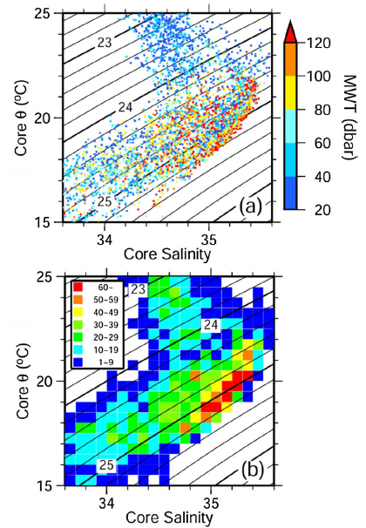
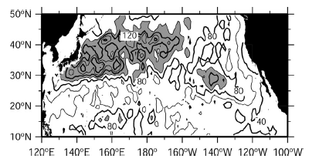
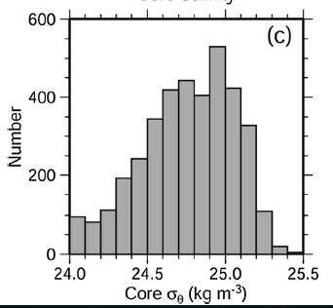
MLD in February,
gray shading: MLD>100dbar
MWT >20dbar in Apr-June of
2005-2015 in 15-35N, 155-125W
ESTMW: ${24.5≤σ}_{θ}$ $≤25.2 kgm^{−3}$
Notes:
ESTMW is identified as a thermostad with a temperature range of 16–22 °C in the eastern subtropical North Pacific. It is formed in the winter mixed layer depth (MLD) maximum centered at 30°N, 140°W.
The core properties of mode water in the eastern subtropics from during April–June (Fig. 2a and b) are distributed broadly on a θ-S diagram along contours of σ_{θ}, indicating that its temperature and salinity mutually provide a compensating contribution to determine density, and showed that a denser mode water also tended to be thicker.

Slide 5
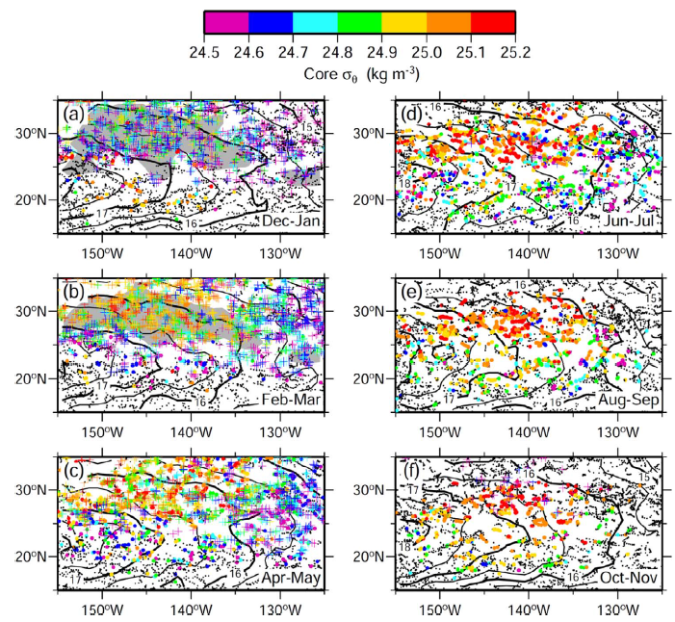
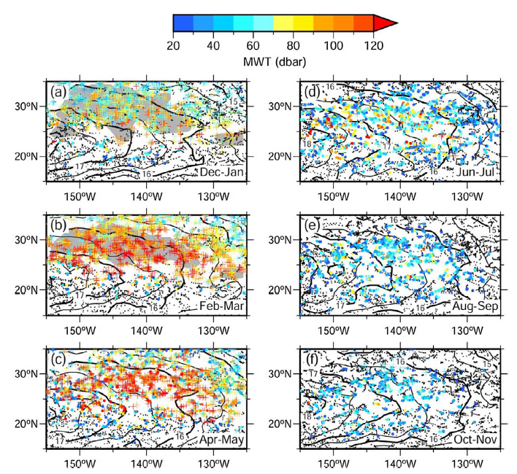
Distribution of $σ_{θ}$ (MWT>20 dbar)
Distribution of $MWT$
D-J
J-J
D-J
J-J
$σ_{θ}$ of non-outcropped (colored dots), outcropped (colored crosses). Contours: geopotential anomaly at 10-dbar depth. Gray shading in (a) and (b): MLD > 80 dbar. Small black dots: the position of Argo profiles without ESTMWs > 20 dbar.
Notes:
The spatial distribution and persistence of the ESTMW differed among its core σ_{θ}. During February–March, denser ESTMWs were formed as deep winter mixed layers (outcropped) in 27−35°N, 150−135°W, while lighter ESTMWs were formed east (135−125°W) and south (23−27°N) of the MLD maximum (Fig. 3b). They were capped by a seasonal pycnocline and remained below the mixed layer from spring to summer (Fig. 3c-d). ESTMWs rapidly thinned from
summer to autumn as reported by previous studies (Fig. 4d-f). Most lighter ESTMWs did not persist until the following winter (Fig. 3a and f) but rather disappeared in August–September (Fig. 3e), indicating their evanescence. In contrast, denser ESTMWs persisted until October–November (Figs. 3f and 4f). However, most were overlain by newly forming ESTMWs (deepening mixed layer) in December–January and only few parts subducted in 17−23°N west of 140°W (Figs. 3a and 4a).

Slide 6
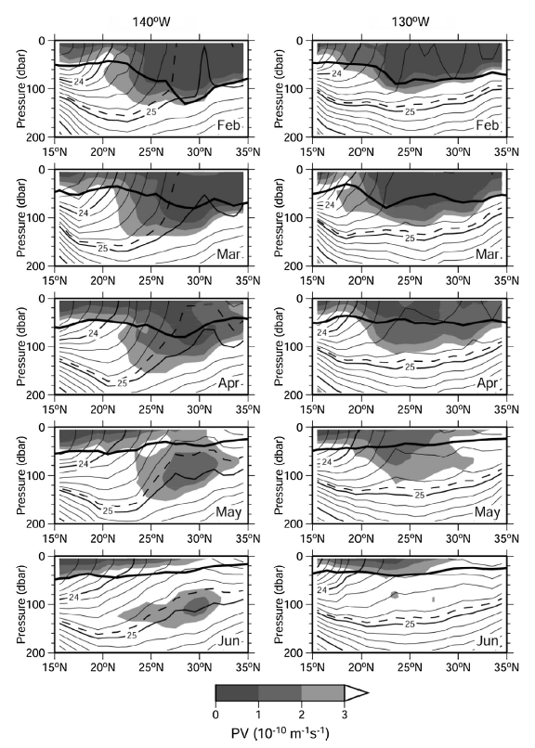
Meridional section of $σ_{θ}$ and Q in Feb-June
Contours: $σ_{θ}$
Gray shading: Q
Thick curves: MLD
Dashed curves:
$σ_{θ}$ =24.9kgm-3
Lighter ESTMWs dissipate sooner as compared to denser ESTMWs
Formation of subsurface low PV water in spring is due to the shoaling of the deep winter mixed layer
Notes:
The spatial distribution and persistence of ESTMWs were also confirmed by meridional sections in monthly climatological fields (Fig. 5). Along the 140°W section, which crosses the MLD maximum, a denser ESTMW was formed as a deep winter mixed layer in 27−35°N, which was deepest (∼140 dbar) at 28°N in February, and left below a mixed layer as a low PV layer in the subsurface from March to June (Fig. 5, left). A lighter ESTMW was formed in the MLD front in
23−27°N in February. It remained in the subsurface as a pycnostad in 100–140 dbar in June. Along the 130°W section (Fig. 5, right), which crosses east of the MLD maximum, a lighter ESTMW was formed north of 23°N as an 80-dbar mixed layer in February–March. Although it exuded from the mixed layer base in April–May, it disappeared in June, indicating that lighter ESTMWs dissipate sooner as compared to denser ESTMWs.
Along 140°W, MLD exceeded 120 dbar in 27−32°N in February where denser ESTMWs were formed (Fig. 5, left). As it shoaled to 40 dbar in June, the low PV layer corresponding to a denser ESTMW was formed below the mixed layer base, indicating the formation of a denser ESTMW through the shoaling of the mixed layer. In 23−27°N, low PV water corresponding to a lighter ESTMW was exuded across the MLD front in February–March. Considering that equatorward velocity estimated from the geopotential anomaly distribution (Fig. 3) was approximately 2.0 cm s−1, the formation of lighter ESTMWs is also driven by the shoaling of the mixed layer as denser ESTMW. Along 130°W, the mixed layer reached ∼80 dbar north of 23°N in February and shoaled to 40 dbar in May (Fig. 5, right). In association with this shoaling, low PV water were left below the mixed layer. These results indicate that the formation of subsurface low PV water in spring is due to the shoaling of the deep winter mixed layer

Slide 7
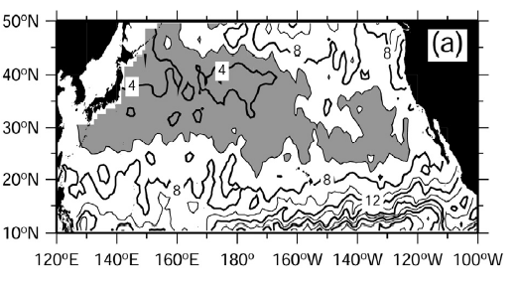
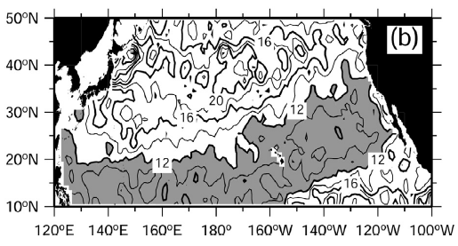
Distribution of N at MLD in Feb
Southeastward extension
Gray shading indicates values smaller than 6 $×{10}^{−3}s^{−1}$
Northeastward extension
Distribution of N at MLD in Aug
Deep winter MLD in the ESTMW formation region is the result from preconditioning by weak stratification
Gray shading indicates values smaller than 12 $×{10}^{−3}s^{−1}$
Notes:
A deep winter mixed layer in the ESTMW formation region has been assumed to result from preconditioning by weak stratification. Distribution of N at MLD in the North Pacific showed weak stratification in the ESTMW formation region (Fig. 6). Winter stratification was weakest in the Kuroshio Extension region, and this weak stratification extended southeastward to the ESTMW formation region as a stability gap south of the subarctic front (Fig. 6a). In summer, stratification intensified as the seasonal pycnocline developed, and the stability gap (N < 12×10−3 s−1) was extended northeastward from the western tropics to the eastern subtropics (Fig. 6b). Although the stability gap shifted equatorward to 10−20°N west of 160°W from winter to summer, it did not show meridional displacement east of 160°W, causing weak stratification to be maintained in the ESTMW formation region during summer.

Slide 8
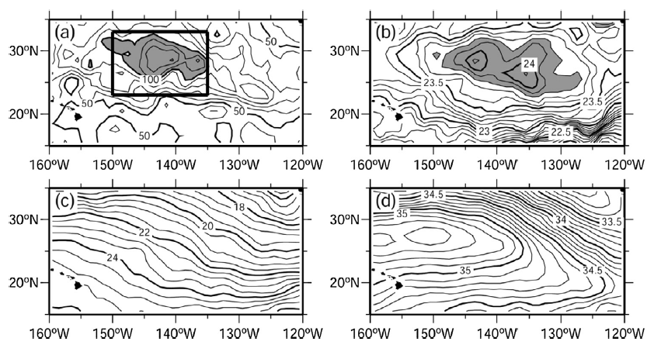
MLD in Feb
$σ_{θ}$ at 10dbar depth in Aug
SSD
SST
SSS
Mean $θ$at 10dbar depth from monthly climatology
Mean salinity at 10dbar depth from monthly climatology
Gray shading in (a): MLD > 100dbar; ${\text{Gray} \text{shading} \text{in}\text{ (}\text{b}\text{):} σ}_{θ}$ > 23.8kgm⁻³
Maximum of summer SSD → Small vertical density gradient → Weak stratification in the ESTMW formation region
Notes:
How is the weak stratification in the ESTMW formation region maintained during summer? Distribution of summer sea surface density (SSD) showed a horizontal SSD maximum exceeding 23.8 kgm−3 in the eastern subtropics at 24−32°N, 150−130°W, which corresponded to the winter MLD maximum centered at 30°N, 140°W (Fig. 7a and b). Horizontal σ_{θ} maximum in summer was not found below MLD (not shown), leading to a small vertical density gradient, and hence, weak stratification. This SSD maximum was not associated with an SST minimum or an SSS maximum, and was located south of an SSS front lying northeast of the SSS maximum (Fig. 7c and d).

Slide 9
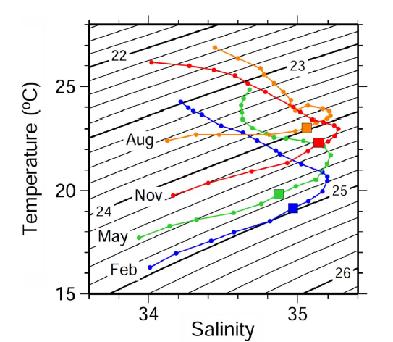
Temperature-Salinity relationship at 10-dbar depth along 140°W from 15°N to
35°N. Squares indicate the values at 30°N. Contours denote $σ_{θ}$
The SSS front → formation of the SSD maximum → the maintenance of weak stratification in the ESTMW formation region
Notes:
The SST–SSS relationship along 140°W showed that SSD increased northward as SST decreased south of the SSS front (Fig. 8). North of 30°N, SSD decreased
northward due to a decrease in SSS across the SSS front, which dominated the meridional gradient of SSD throughout the year. As a result, the SSD maximum formed south of the SSS front. Thus, the SSS front contributes to the maintenance of weak stratification in the ESTMW formation region in summer through the formation of the SSD maximum. This preconditions development of a deep winter mixed layer, and hence, formation of ESTMW

Slide 10
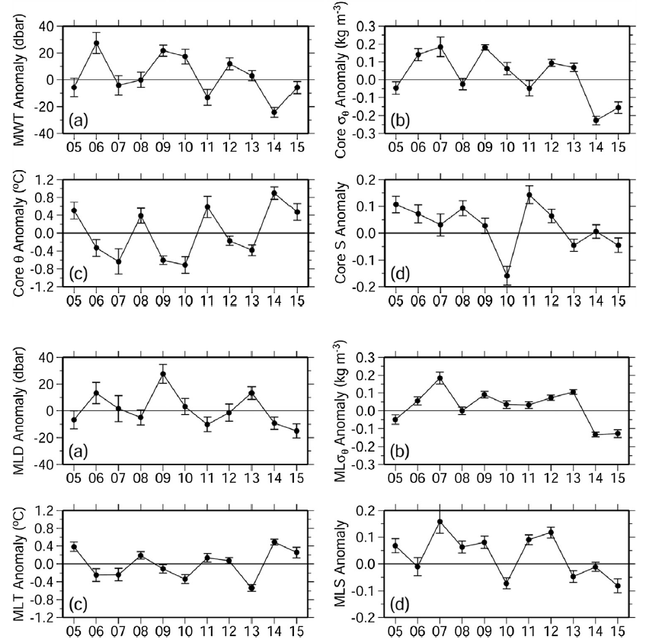
Interannual variation of ESTMW
Anomalies at the core of ESMWT, 2005-2015, April-June,
25-33N,
150-135N
Anomalies of mixed layer, 2005-2015,
Jan-March,
25-33N,
150-135N
Notes:
Properties of ESTMW showed interannual variation. The interannual variation of MWT corresponds to that of core σθ (Fig. 9b). Core σθ anomaly showing a high correlation with MWT (correlation coefficient R=0.77). This indicates that a thick (thin) ESTMW tended to be denser (lighter) on an interannual time scale. Interannual variation of core σθ reflected that of core θ (Fig. 9c). Core θ anomaly showing a negative correlation with core σ_{θ} (R=−0.90). Core S did not show a large interannual variation except for a strong freshening in 2010 (Fig. 9d). This freshening canceled out the low core θ anomaly, and core σθ did not show a large anomaly in 2010.
The interannual variations of ESTMW reflect those of the winter mixed layer in the formation region (Fig. 10). Winter MLD anomaly correlated strongly with MWT (R=0.75; Figs. 9a and 10a). Mixed layer σθ and temperature were also highly correlated with core σθ (R=0.92; Figs. 9b and 10b) and θ (R=0.88; Figs. 9c and 10c). Although mixed layer salinity showed a larger interannual variation as compared to core S, their correlation relationship was still significant, with a large decrease in 2010 (R=0.69; Figs. 9d and 10d).

Slide 11
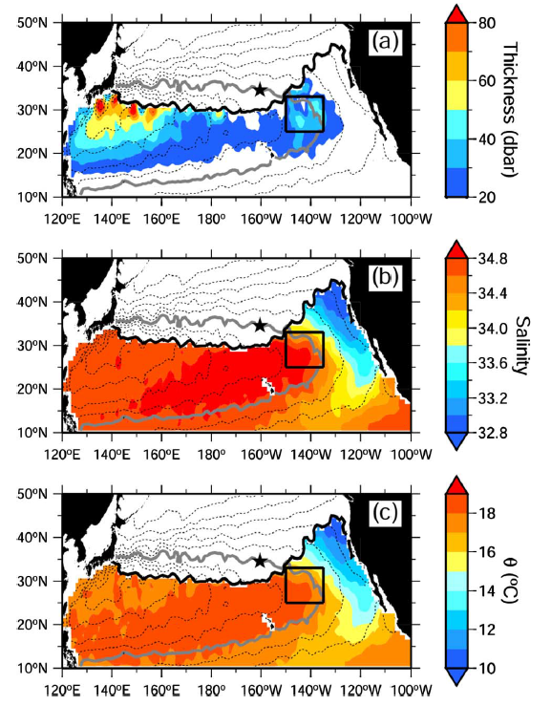
Relationship of ESTMW and spiciness anomalies
$σ_{θ}$ =25-25.2kgm⁻³ in Feb
Black thick curve: $σ_{θ}$ = 25.0kgm⁻³ at 10-dbar depth.
Dashed lines: contours of acceleration potential in August and contour interval is 1m² s⁻².
Gray thick line: acceleration potential of 16.0m²s⁻².
Notes:
To explore the relationship between interannual variations of ESTMW and spiciness anomalies in the permanent pycnocline, we focused on the isopycnal layer of σθ=25.0–25.2 kgm−3, which corresponds to the denser variety of ESTMW and to the upper permanent pycnocline. This isopycnal layer was thicker in the eastern subtropics and southeast of Japan, corresponding to the ESTMW and the North Pacific Subtropical Mode Water, respectively (Fig. 11a). This isopycnal layer outcropped in 30−35°N west of 160°W. This outcrop line shifted northward and cool/fresh water was subducted from subarctic region
east of 160°W (Fig. 11b-c).

Slide 12
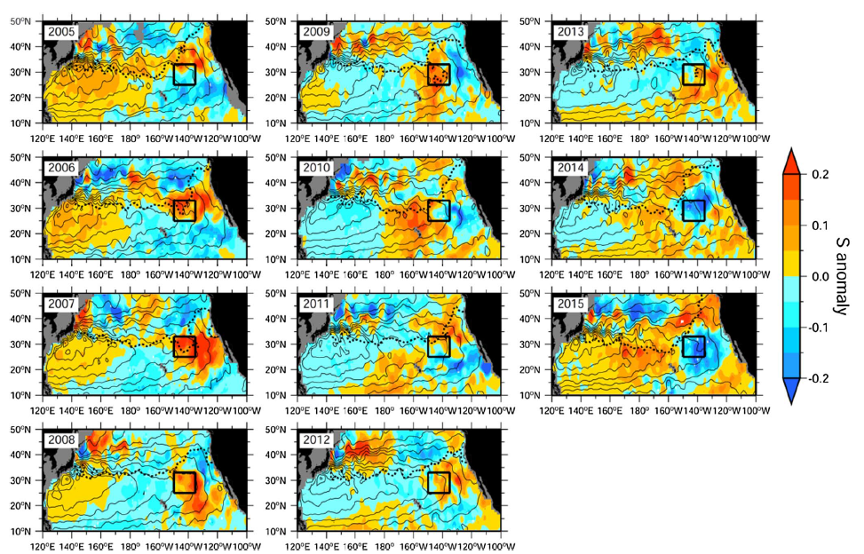
Isopycnal salinity anomalies, $σ_{θ}$ =25-25.2 kgm⁻³
Thin black lines: AP
Thick dotted lines: $σ_{θ}$ =25.0kgm⁻³
at 10dbar depth ( yearly fields of Jan-Mar)
Notes:
In this isopycnal layer, interannual spiciness anomalies propagated clockwise along stream lines from the outcrop line (Fig. 12). In 2005, a cool/fresh anomaly was detected south of the ESTMW formation region, in 15−30°N, 170−110°W. It propagated southwestward along stream lines and reached 160°E in 2009. A warm/salty anomaly was also detected in 2005 north of the ESTMW formation region, which reached 160°E in 2012. In 2006, a cool/fresh anomaly formed at 40°N, 140°W and propagated southward until it disappeared in 2013. The formation and propagation of these spiciness anomalies are consistent with previous studies (Sasaki et al., 2010; Kolodziejczyk and Gaillard, 2012). Following this, a warm/salty anomaly was detected north of the ESTMW formation region in 2009. It propagated southward and weakened in 2014. A cool/fresh anomaly then formed in 2013 north of the ESTMW formation region along the outcrop line and propagated southward until 2015.

Slide 13
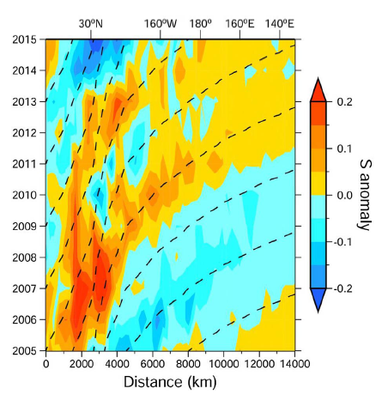
$σ_{θ}$ =25-25.2kgm⁻³ along acceleration potential of 16.0m² s⁻² in August
Dashed line: advection by geostrophic current calculated from the AP distribution
Distance is from the reference point (black star)
Propagation of spiciness anomalies was driven by the geostrophic advection
Notes:
To further verify whether propagation of these spiciness anomalies was due to advection by the geostrophic current, a Hovmöller diagram of the salinity anomaly along a stream line traversing the ESTMW formation region, was plotted (Fig. 13). The propagation speed was corresponded well to the geostrophic velocity and was ∼2.0 cm s−1 in the eastern subtropical Pacific and ∼10 cm s−1 in the tropics, which were comparable to estimates from previous studies
(Sasaki et al., 2010; Kolodziejczyk and Gaillard, 2012), indicating that propagation of spiciness anomalies was driven by the geostrophic advection.

Slide 14
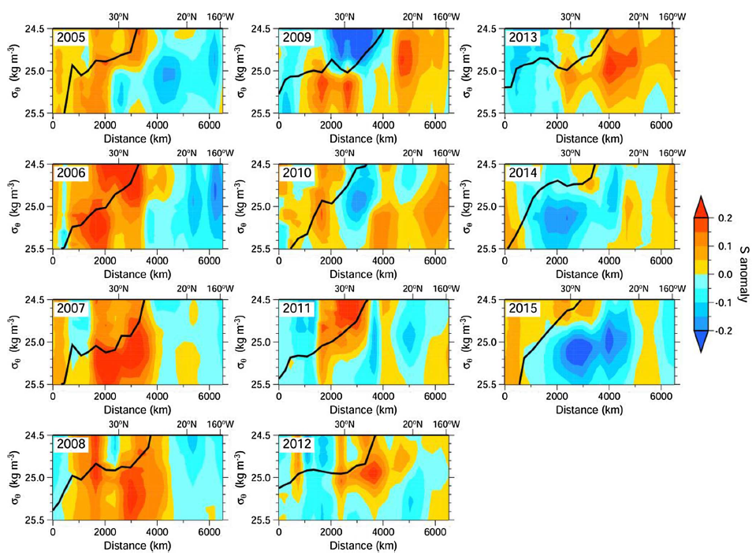
$σ_{θ}$ =25-25.2kgm⁻³ along AP of 16.0m² s⁻² in August
Black line: $σ_{θ}$ at 10-dbar depth in yearly fields of January–March in each year.
Notes:
During propagation, some of these spiciness anomalies were intensified in the vicinity of the ESTMW formation region; the warm/salty anomaly north of the ESTMW formation region in 2005 intensified in 2006–2007 and the cool/fresh anomaly formed in 2013 intensified in 2014–2015 (Figs. 12 and 13). To establish whether these intensifications outcropped, a vertical section of the spiciness anomaly along a stream line was investigated (Fig. 14). In 2005, the warm/salty
anomaly was seen in σθ > 25.0 kgm−3 north of 30°N. During its advection, the anomaly intensified in σθ > 25.2 kgm−3 near 30°N (2000–3000 km from the reference point) below the winter outcrop in 2006–2007. In 2014–2015, the cool/fresh anomaly formed in 2013 intensified in σθ > 25.0 kgm−3. The intensifications of these spiciness anomalies were not outcropped, indicating the occurrence of spice injection. In 2010, a cool/fresh anomaly appeared in σθ > 25.0 kgm−3 in 30°N, which was observed in the ESTMW formation region (Fig. 12). Similar to the previously discussed spiciness anomalies, this anomaly
did not outcrop, indicating its genesis in the subsurface of the ESTMW formation region.

Slide 15
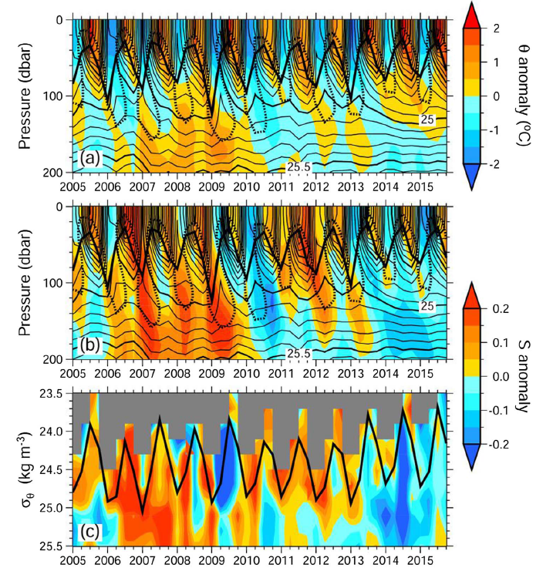
Relationship between the intensification
of spiciness anomalies and ESTMW
(a) θ and (b) salinity anomaly on isobaric level averaged over 3 months (January–March, April–June, July–September, and October–December) in 25−33°N, 150−135°W (color).
Thick solid line: MLD.
Dotted line: Q = 3x10⁻¹⁰m⁻¹ s⁻¹
(c) salinity anomaly on isopycnal surface averaged over 3 months (January–March,
April–June, July–September, and October–December)
in 25−33°N, 150−135°W (color). Thick black line: $σ_{θ}$ of mixed layer.
Notes:
To investigate the relationship between the intensification of spiciness anomalies and ESTMW, time series of vertical profiles of isobaric salinity and temperature anomalies, and isopycnal salinity anomaly from the mean vertical profile in the ESTMW formation region were investigated (Fig. 15). Isobaric warm/salty anomalies were generated at ESTMW bases (∼150 dbar) in April–June, which corresponds with the dissipation of ESTMW, and propagated downward except in 2010 (Fig. 15a-b). Temperature and salinity anomalies on isobaric levels below 150 dbar correspond well to spiciness anomalies on isopycnal levels of σθ > 25.0 kgm−3 (Fig. 15c). In 2006–2009, the downward propagation of a warm/salty anomaly formed at the ESTMW base intensified the background warm/salty spiciness anomaly, which was detected north of the ESTMW formation region in 2005 (Fig. 12). In 2010, when the winter mixed layer and ESTMW experienced significant cooling and freshening (Figs. 9c-d and 10c-d), a cool/fresh anomaly propagated downward, corresponding to the cool/fresh anomaly in the ESTMW formation region in 2010 (Fig. 12). In 2014–2015, the winter mixed layer was anomalously shallow (Fig. 10a) and propagation of a warm/salty anomaly did not reach deeper layers, leading to intensification of the cool/fresh anomaly formed in 2013. Thus, formation
and dissipation of ESTMW contributes to the occurrence of spice injection and intensification of spiciness anomalies on interannual time scale

Slide 16
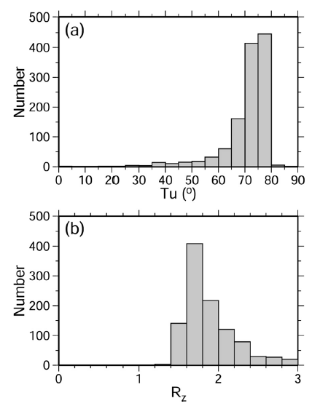
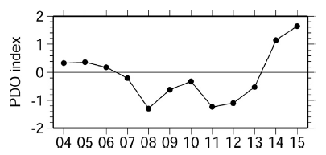
T_{u} > 71.6⁰ (R_{z} < 2.0): double diffusive convection becomes active
Vertical structure at the base of ESTMW is favorable for salt finger convection
The PDO-related wind stress anomaly affects the spiciness anomaly in the upper permanent pycnocline controlling the ESTMW formation and spice injection
25-35N, 150-135W in April-June of 2005-2015
Notes:
Spice injection occurred at the base of the ESTMW associated with its dissipation, and spiciness anomalies were intensified in the upper permanent pycnocline. Spice injection is caused by convective mixing. To ascertain whether the vertical structure at the base of the ESTMW is favorable for convective
mixing, the Turner Angle and vertical density ration (Rz), which are measures of degree of vertical density compensation of temperature and salinity, were calculated. Most Argo floats observed 70° < Tu < 80° and 1.6 < Rz < 2.0 at the base of the ESTMWs in April–June (Fig. 16), indicating that the vertical structure at the base of ESTMW is favorable for salt finger convection. This fact supports that finding that the rapid dissipation of ESTMW are due to salt finger convection, as suggested by previous studies. Furthermore, the fact also reinforces the finding that the dissipation of ESTMW contributed the generation of spice injection and intensification of spiciness anomalies, which was revealed in this study
Interannual variations of MWT and MLD in the ESTMW formation region may be related to the Pacific Decadal Oscillation. Yearly means of the PDO index (Fig. 17) showed a negative correlation with MWT (Fig. 9a; R=−0.55) and winter MLD (Fig. 10a; R=−0.26) with a one-year lead of the PDO index. This is
consistent with Dawe and Thompson (2007), who demonstrated that MLD in the ESTMW formation region decreases during a positive phase of the PDO with modelling study. They also reported that decreasing of MLD is coincident with wind stress weakening, suggesting that the PDO-related wind stress anomaly affects the spiciness anomaly in the upper permanent pycnocline controlling the ESTMW formation and spice injection.

Slide 17
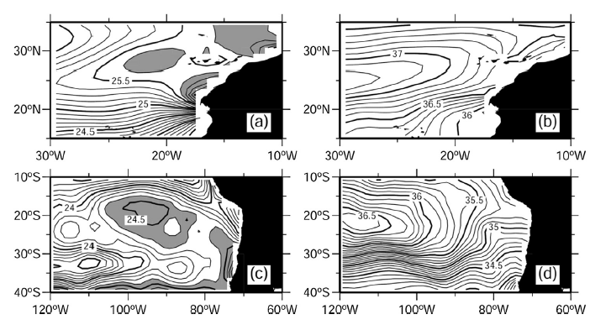
Relationship between the ESTMW formation region and SSD maximum in world ocean basins
SSD
SSS
July
Feb
Data: the climatology of the World Ocean Atlas 2001
Gray shading in (a) and (c): $σ_{θ}$ > 25.6 kgm−3 and 24.4 kgm−3, respectively
Notes:
As previously mentioned, stratification in the ESTMW formation region in summer is weak due to the existence of an SSD maximum associated with the strong SSS front to the north of it. ESTMW also forms and distributes in the North Atlantic and in the South Pacific. To examine the relationship between the ESTMW formation region and SSD maximum in these ocean basins, summer SSD distribution was investigated using the climatology of the World Ocean Atlas 2001 (Conkright et al., 2002; Fig. 18). In the North Atlantic, a summer SSD maximum exceeding 25.6 kgm−3 was centered at 30°N, 20°W (Fig. 18a) lying south of a zonal SSS front in 29−35°N (Fig. 18b). In the South Pacific, summer SSD exceeding 24.4 kgm−3 was centered at 20°S, 90°W and adjacent to a zonal SSS front lying poleward in 28−35°S (Fig. 18c-d). These SSD maxima corresponded to the formation region of each ESTMW. Considering that summer stratus cloud cover in the ESTMW formation region is not as strong in the North Atlantic as compared to the North and South Pacific (Philander et al., 1996) and that these ESTMW formation regions are not associated with a summer SST minimum, this suggests that the SSS front is essential for preconditioning of the winter mixed layer deepening and hence formation of ESTMW through summer SSD maximum.

