Slide 1
El Niño–Southern Oscillation complexity
Timmermann, Axel, et al. “El Niño–Southern Oscillation complexity.” Nature 559.7715 (2018): 535.

Slide 2
ENSO recharge oscillator model

Slide 3
Thermocline feedback
Recharge process
Determine timescale
- Mean advection - Thermal damping
+ Zonal advection + Ekman pumping
+ thermocline feedback

Slide 4
Recharge-discharge theory
(Jin 1997; Meinen & McPhaden 2000, 2001)
Geostrophic
Ekman
τ_{a}
SSTa(+)
τ_{a} ~ 0
SSTa ~0
Depth anomaly
Depth anomaly
Geostrophic
Ekman
τ_{a}
τ_{a} ~ 0
SSTa ~0
SSTa(-)
Depth anomaly
Depth anomaly

Slide 5
Recharge-discharge theory
(Jin 1997; Meinen & McPhaden 2000, 2001)
Nonlinear dynamical and thermodynamical processes
Positive skewness
Asymmetry between warm and cold events

Slide 6
Space–time complexity of ENSO
Empirical orthogonal function (EOF) analysis
EOF patterns of SSTA (25°S-25°N, 140°E-80°W) during 1958-2016
1st EOF mode: eastern Pacific warming, quasi-quadrennial (3-7 yrs.) timescales
2nd EOF mode: zonal SST dipole, quasi-biennial and decadal timescales
PC2
PC1

Slide 7
EP and CP ENSO
Westerly wind events (WWEs)
28.5°C isotherm
Shading: SSTA
EP El Niño events (ex: 1997/1998)
  basin-scale equatorial wind anomalies
  a strong relaxation of the zonal tilt of the equatorial thermocline
  large eastward shifts of tropical Pacific convection
  strong discharge of heat content away from the equatorial region, which boosts the likelihood of transitioning into a La Niña event.
T300 anomaly (5°S-5°S, 120°E-90°W)
Shading: SSTA, contours: Precipitation anomaly in NDJ

Slide 8
EP and CP ENSO
Westerly wind events (WWEs)
28.5°C isotherm
Shading: SSTA
CP El Niño events (ex: 2004/2005)
  more local wind feedbacks
  a stronger role for the zonal advective feedback
  stronger role for thermal damping during the decay phase
  more susceptibility to disruption by wind noise.
T300 anomaly (5°S-5°S, 120°E-90°W)
Shading: SSTA, contours: Precipitation anomaly in NDJ

Slide 9
EP and CP ENSO
La Niña
  Less diversity in spatial patterns than El Niño events

Slide 10
Origin of El Niño diversity
Random processes
  Stochastic westerly wind events (WWEs)
Low-frequency deterministic dynamics
  Initial subsurface ocean conditions
Outside the tropical Pacific
  North Pacific Oscillation
  South Pacific Oscillation
  Atlantic variability etc.
  Preceding El Niño by 2-3 seasons

Slide 11
A unifying framework
Modified Zebiak-Cane model
Quasi-quadrennial (QQ) mode
  Deep mean thermocline, weak trade winds
  Strong thermocline feedback (TF)
Quasi-biennial (QB) mode
  Shallow mean thermocline, strong trade winds
  Strong zonal advective feedback (ZAF)

Slide 12
Temporal complexity
QQ mode & QB mode
External excitation processes
ENSO asymmetry
  Increased WWE during El Niño
  Enhanced tropical instablility waves during La Niña
Annual cycle
Decadal subsurface processes

Slide 13
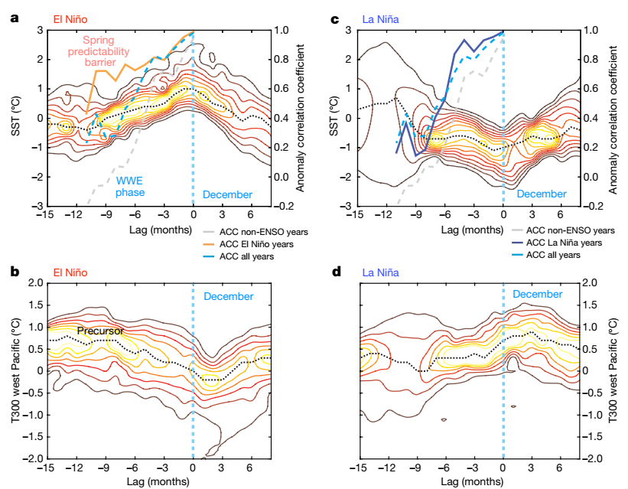
1958-2016
Monthly SSTA & T300 Probability Density Composite
1980-2015
Prediction Skill
El Niño only
La Niña only
All years
All years
NINO3.4
SSTA
Neutral Only
Neutral Only
5°S-5°N
120°E-155°W
20-yr high pass
West Pacific
T300
probability density, cint = 0.005
black dashed: maximum

Slide 14
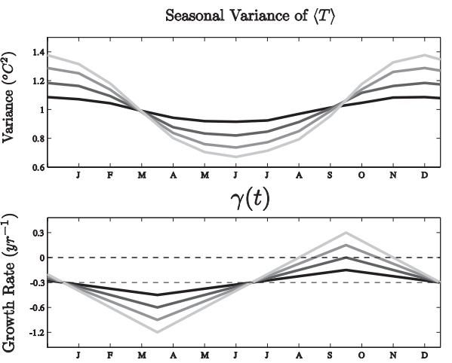
WWE leads to initiation in boreal spring
Maximum growth rates in boreal summer
a. ITCZ at equator (正確的背景輻合在C-Z Model對ENSO季節性最重要)
b. seasonal low SST over EP (正確的背景海溫在C-Z Model對ENSO季節性次重要)
c. seasonal shallow thermocline depth over EP (Kelvin Waves能有效影響SST)
d. reduction of negative cloud feedbacks (夏季東太均海表溫低->深對流少)
Decay in boreal winter due to southward anomalous westerlies shift
a. seasonal warm pool migration
b. SPCZ development
c. increased surface heat flux damping (冬季東太均海表溫高->深對流)
Interaction between AC & ENSO
→ C-mode:
Near annual (9 & 15-18 month) signals are enhanced.
I_{BJ}
Stein et al., 2010

Slide 15
ENSO predictability
Potential precursor (9-15 months lead time)
Triggers (6-9 months lead time)
Transition processes (recharge process/seasonal ENSO dynamics)
Ocean pre-condition: Charged western tropical Pacific heat content (Prior to boreal spring)
Atmospheric precursor:
North and South Pacific
Indian Ocean
Atlantic

Slide 16
ENSO predictability
Potential precursor (9-15 months lead time)
Triggers (6-9 months lead time)
Transition processes (recharge process/seasonal ENSO dynamics)
Only oceanic or atmospheric precursors are not sufficient for event growth (e.g. 2012, 2014, 2017)
Triggers: Stochastic WWE (boreal spring and early summer)
But
Individual WWEs are not predictable beyond the weather prediction horizon, which implies that, on average, forecasts initialized in boreal spring have relatively low long-term skill, in particular in the absence of precursor signals
-> Spring predictability barrier
Precursor signals in western tropical Pacific heat content could be indicative of potentially developing El Niño conditions, which in effect enhance the predictability relative to the averaged case

Slide 17
ENSO predictability
Potential precursor (9-15 months lead time)
Triggers (6-9 months lead time)
Transition processes (recharge process/seasonal ENSO dynamics)
During Bjerknes feedback phase (summer)
High degree of climate predictability
Decaying phase
Discharge of zonal heat content, subsurface processes and southward shift of zonal wind
-> low-noise atmospheric environment

Slide 18
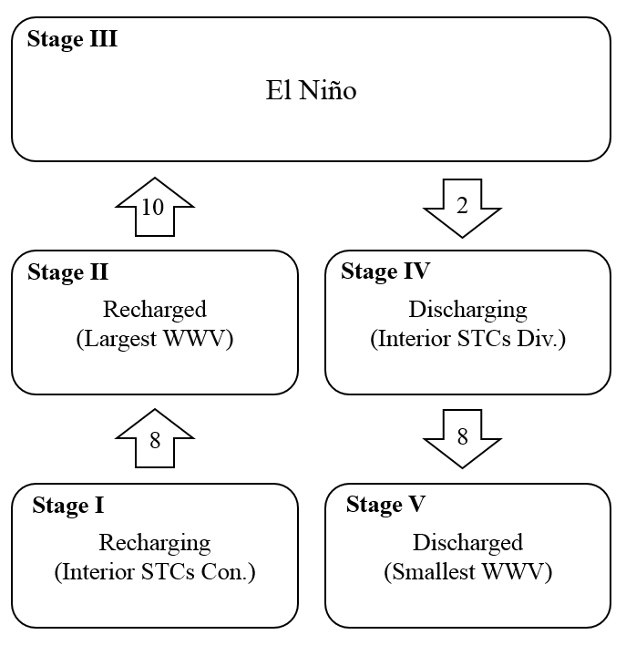
ENSO predictability
Potential precursor (9-15 months lead time)
Triggers (6-9 months lead time)
Transition processes (recharge process/seasonal ENSO dynamics)
For La Nina
El Nino -> La Nina (6-9 months after discharged)
Other initial condition

