Slide 1
Observational evidence for propagation of decadal spiciness anomalies in the North Pacific
GEOPHYSICAL RESEARCH LETTERS, 2010

Slide 2
Introduction
Data
Mean State
Propagation of Spiciness Anomalies
Summary and Discussion

Slide 3
Introduction
The subduction and propagation of density‐compensated temperature and salinity water‐mass perturbations, referred to as spiciness anomalies, from the mid‐latitude to the equatorial Pacific have been hypothesized to play an important role in decadal variability in the Pacific.
Gu, D. F., and S. G. H. Philander (1997), Interdecadal climate fluctuations that depend on exchanges between the Tropics and extratropics.

Slide 4
Introduction
While modeling studies have demonstrated the propagation of spiciness perturbations from the subtropics to the equator.
Nonaka, M., and S.‐P. Xie (2000), Propagation of North Pacific interdecadal subsurface temperature anomalies in an ocean GCM.
Pierce, D. W., T. B. Barnett, and M. Latif (2000), Connections between the Pacific Ocean Tropics and midlatitudes on decadal timescales.
Fukumori, I., T. Lee, B. Cheng, and D. Menemenlis (2004), The origin, pathway, and destination of Niño‐3 water estimated by a simulated passive tracer and its adjoint.
Yeager, S. G., and W. G. Large (2004), Late‐winter generation of spiciness on subducted isopycnals.
observational evidence has been more limited.

Slide 5
Introduction
The basin‐wide network of XBT observations has tracked subducted temperature anomalies from the subtropics to tropics on decadal timescales, but only along repeat hydrographic lines and at the Hawaii Ocean Time‐series station could decadal spiciness anomalies on isopycnals be separated from undulations of the depth of isopycnals.
Schneider, N., A. J. Miller, M. A. Alexander, and C. Deser (1999), Subduction of decadal North Pacific temperature anomalies: Observations and dynamics
Luo, J.‐J., and T. Yamagata (2001), Long‐term El Niño‐Southern Oscillation (ENSO) ‐like variation with special emphasis on the South Pacific
The recent advent of the Argo network of drifting buoys allows, for the first time, the basin‐wide description of spiciness signals.
Notes:
expendable bathythermograph 有許多缺點: 因為它是用射的進入海(有初速度，影響觀測)，且只有溫度資料

Slide 6
Data
Argo profiles for the period 2001–2008 are obtained from the US Global Argo Data Assembly Center and linearly interpolated onto standard levels and isopycnal surfaces.
We use two gridded products of temperature and salinity on isopycnal surfaces derived from Argo data.
Method I averages data for each month and within 3° latitude × 3° longitude bins, typically at least 50 profiles (Figure 1a) and then forms annual averages using weights dependent on the number of observations for each month.
Method II employs a variational interpolation technique (K. Lebedev, in preparation, 2010) that minimizes the misfit between the irregularly distributed original data and the interpolated, monthly and annual averaged fields.
The interpolated data are smoothed by twice applying a spatial filter with half‐power cutoffs of 10° latitude and longitude.
Notes:
These interpolated profiles of potential temperature, salinity, potential density, isopycnal depth, and stratification are horizontally gridded using two different methods.
White contours in Figure 1a–1c and black contours in Figure 1d denote 1.6 and 3.4 m2 s−2 isopleths of the mean Montgomery potential averaged over 25 < s < 25.5 kgm−3 isopycnals
在這裡應該是看研究區域和資料數量，所以白線先不用細說

Slide 7
Data
Montgomery potential and geostrophic velocities on isopycnal surfaces are calculated from the bin‐averaged hydrography using as reference level the mean 2001–2008 surface dynamic topography that is based on the mean surface dynamic topography and AVISO sea level anomalies.
Results are robust if the 1000‐m depth velocity field from Argo floats is used as a reference instead.
White contours denote 1.6 and 3.4 m² s⁻² isopleths of the mean Montgomery potential averaged over 25 < $σ_{θ}$< 25.5 kgm⁻³ isopycnals

Slide 8
Mean State
The depths(m) of 25 < $σ_{θ}$ < 25.5 kg m⁻³ isopycnals that connect the subtropical and tropical Pacific [Johnson and McPhaden, 1999] are characterized by a bowl shape in the subtropical gyre.
The winter(February) outcrop line of $σ_{θ}$= 25.25 kg m⁻³ is located between 30°N and 35°N from 140°E to 160°W and sharply turns northeastward east of 160°W (black dashed line).
The water subducted east of 160°W flows southward between 120°W and 150°W and then westward in the North Equatorial Current (NEC) between 9°N and 15°N to the western boundary.
This subduction pathway is the focus of the present study.
Notes:
2001-2008平均來看
Johnson, G. C., and M. J. McPhaden (1999), Interior pycnocline flow from the subtropical to the equatorial Pacific Ocean(用CTD資料的樣子)

Slide 9
Mean State
(c) potential vorticity (× 107 kg m⁻⁴ s⁻¹) averaged over 25 < $σ_{θ}$< 25.5 kg m⁻³ isopycnals
Potential vorticity is roughly conserved along this pathway except near the outcrop region.
(d) mixed layer depth (m) in February for the period 2001–2008
White contours denote $σ_{θ}$= 24, 25, and 26 kg m⁻³ at the mixed layer base.
the base of the deep mixed layer associated with Eastern North Pacific Subtropical Mode Water formation [Hautala and Roemmich, 1998] is close to $σ_{θ}$ = 25 kg m⁻³
These conditions favor the generation of spiciness anomalies in the upstream portion of the subduction path by anomalous advection across salinity/temperature gradients [Schneider, 2000]
Notes:
Potential vorticity in Figure 1c is defined as f ∂s/∂z, where f is the Coriolis parameter
Mixed layer depths are estimated using a temperature criterion [Kara et al., 2000] with a temperature difference of 0.2°C [de Boyer Montégut et al., 2004].

Slide 10
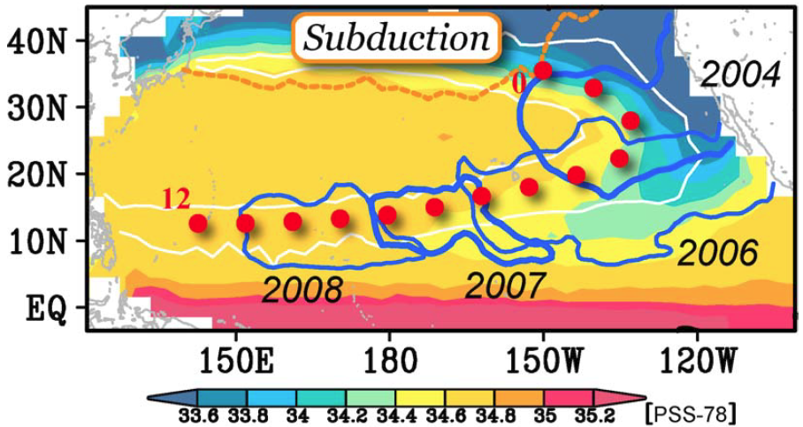
Mean State
Color indicates the long‐term mean of salinity average on the same isopycnals
Blue contours denote −0.03 PSS‐78 isopleths of annual mean salinity anomaly in 2004, 2006, 2007 and 2008
white contours: mean Montgomery potential
$σ_{θ}$= 25.25 kg m⁻³ outcrops in February along the orange line
Red dots are placed from the outcrop line along the subduction path at an interval of 103 km, so the westernmost dot is the terminus of a 12 × 103‐km long trajectory.
In the eastern subtropics, spiciness gradients along isopleths of the mean Montgomery potential are large

Slide 11
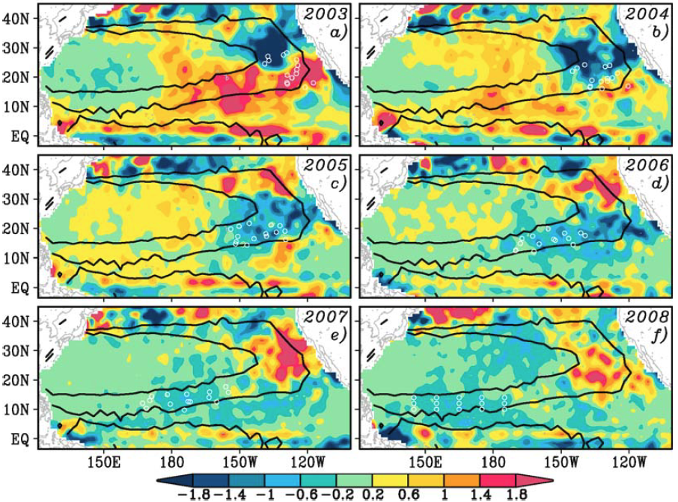
Propagation of Spiciness Anomalies
Annual mean salinity anomalies (× 10 PSS‐78) averaged over 25 <${ σ}_{θ}$ < 25.5 kgm⁻³ isopycnals
two warm/salty anomalies and a cool/fresh anomaly persist for several years, following the mean advective path
A cool/fresh anomaly propagates clockwise around the subtropical gyre from 2003 to 2008
When passing Hawaii around 2005–2006 it is consistent with observations at the Hawaii Ocean Time‐series station
Notes:
the anomalies are deviations from the mean field computed for the period 2001– 2008.
Contours denote 1.6 and 3.4 m2 s−2 mean Montgomery potential isopleths

Slide 12
Propagation of Spiciness Anomalies
Warm/salty spiciness anomalies are observed before and after the cool/fresh spiciness anomaly.
the paths of these warm/salty anomalies are consistent with the path of the cool/fresh anomaly.
In 2005, a warm/salty spiciness anomaly is first detected at 30°N–40°N near the outcrop region

Slide 13
Propagation of Spiciness Anomalies
Circles indicate tracer positions
We seed a passive tracer at the position of the 2008 cool/fresh spiciness anomaly (circles) and estimate its upstream positions from the time averaged, geostrophic velocity on the isopycnals.
The propagation speed of the spiciness anomalies matches mean advection speeds.
This backtracking also suggests that the waters that make up the cool/fresh spiciness anomaly were subducted around 1999–2000, when Argo float density there was too low to investigate associated surface processes.

Slide 14
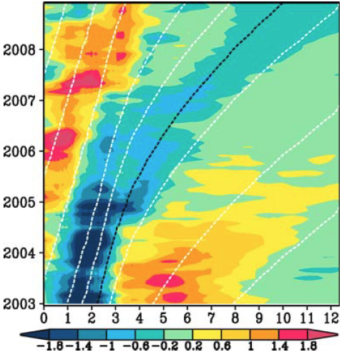
Propagation of Spiciness Anomalies
Time‐distance diagram of monthly salinity anomaly (× 10 PSS‐78) averaged vertically over 25 < $σ_{θ}$< 25.5 kg m⁻³ isopycnals and horizontally over the 1.6 and 3.4 m² s⁻² mean Montgomery potential isopleths
Horizontal axis is the distance (× 103 km) from the outcrop line along the path (see red dots in Figure 2)
White lines indicate advection by the mean geostrophic current
black line describes movement of the center of mass of tracer particles shown in Figure 3.

Slide 15
Propagation of Spiciness Anomalies
spiciness anomalies are primarily advected by the mean circulation
although the speed of the mean circulation is slower than the propagation of the spiciness signals in the upstream potion of the path.
The spiciness anomalies are modified along their path, with amplitude gradually decreasing with time
Intraannual variability is superposed
a rapid shift from cool/fresh to warm/salty anomalies in winter 2007, likely a manifestation of spiciness anomaly generation on the subducted isopycnals.
Notes:
Intraannual variability is superposed, especially in the first three to four thousand kilometers from the outcrop line
This region is favorable for generation of spiciness anomalies on subducted isopycnals

Slide 16
Summary and Discussion
The unprecedented temporal and spatial coverage of temperature and salinity observations by the Argo array allows observational analysis of the basin‐wide, coherent propagation of spiciness anomalies
a cool/fresh spiciness anomaly can be tracked for 6 years from the eastern subtropical North Pacific in 2003 to the western tropical North Pacific in 2008
The propagation path and speed of the spiciness anomaly are explained by the advection by the mean geostrophic current.

Slide 17
Summary and Discussion
These observations raise further questions regarding the attenuation of spiciness anomalies and their downstream impact.
An important process for the attenuation is temporal variability of velocity fields, which act to diffuse spiciness anomalies from the mean path.
Indeed, a part of the cool/fresh anomaly overshoots the path to the shadow zone in the eastern Pacific around 5°N–10°N (Figures 2 and 3).
This overshoot is consistent with the modeling result that intraannual variability of the velocity field enhances tracer transports from the subtropics to equator through an interior path [Fukumori et al., 2004].

Slide 18
Summary and Discussion
These observations raise further questions regarding the attenuation of spiciness anomalies and their downstream impact.
At the western boundary, the NEC bifurcates into the northward Kuroshio and the equatorward Mindanao current.
Spiciness anomalies are expected to split into northward and equatorward components while being further attenuated by western boundary current mixing
The equatorial portion either enters the Indian Ocean via the Indonesian Throughflow [Stammer et al., 2008] or affects the temperature and salinity characteristics of the source waters of equatorial upwelling [Fukumori et al., 2004] and impacts tropical climate [Schneider, 2004].

