Slide 1
Paper Review： Atmosphere-ocean coupled processes in the Madden-Julian oscillation (PART I)
speaker：Shao Yun-Chuan

Slide 2
Citation
DeMott, C. A.¹, N. P. Klingaman², and S. J. Woolnough² (2015), Atmosphere-ocean coupled processes in the Madden-Julian oscillation, Rev. Geophys. 53, 1099-1154
¹ Department of Atmospheric Science, Colorado State University, Fort Collins, Colorado, USA,
² National Centre for Atmospheric Science-Climate and Department of Meteorology, University of Reading, Reading, UK

Slide 3
outline
Introduction
MJO Forcing to the Ocean
Ocean Response to MJO Forcing
Ocean Feedbacks to the MJO
Modeling

Slide 4
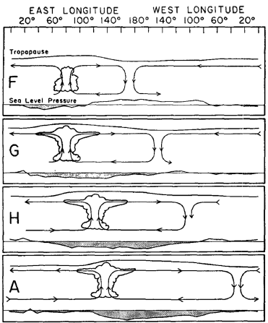
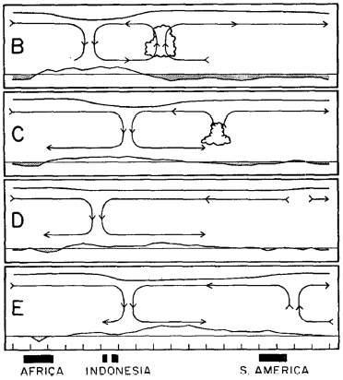
Introduction
Discovered by:
Roland Madden and Poul Julian in 1970s
Scale:
O(10,000km)
Period:
30-70 days, intraseasonal oscillation(ISO)
Velocity:
5 m/sec, eastward
To figure out:
How does the ocean SST modulate surface fluxes throughout the MJO life cycle?
How do SST-modulated fluxes impact MJO convection?

Slide 5
MJO Forcing to the Ocean
The surface energy balance
Factors controlling intraseasonal surface flux variations
Relative phasing of SST, surface fluxes and rainfall

Slide 6
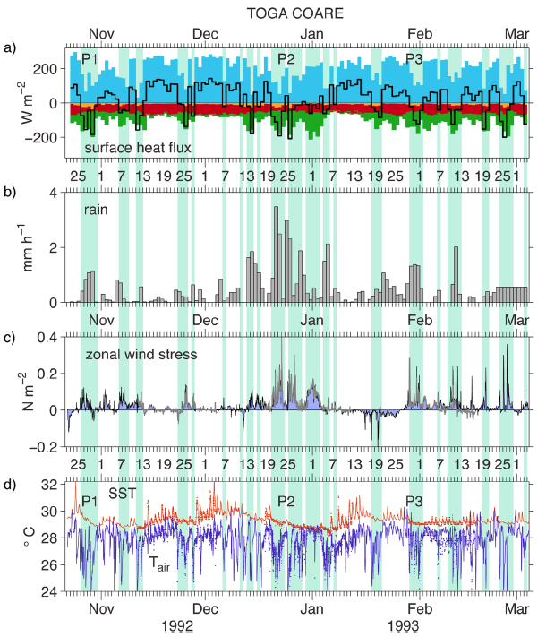
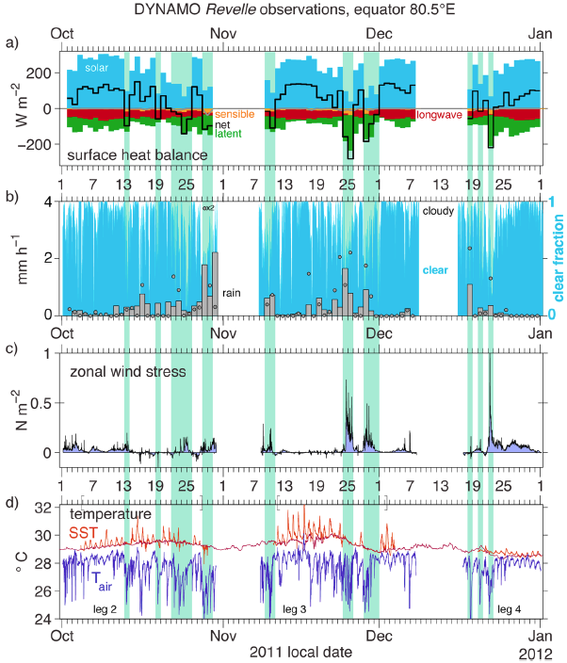
MJO Forcing to the Ocean
The Surface Energy Balance

Slide 7
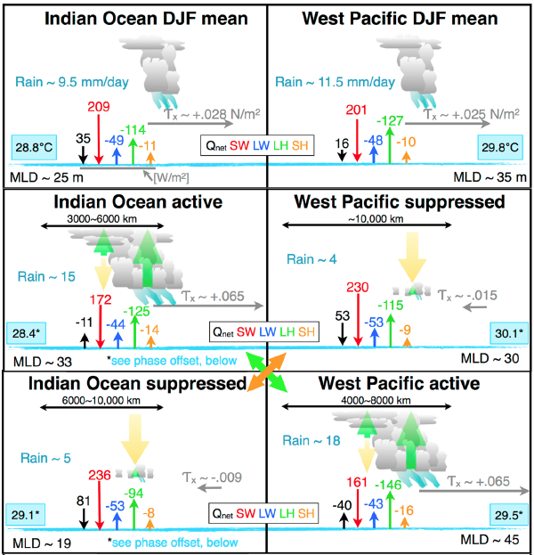
MJO Forcing to the Ocean
The Surface Energy Balance
The mean latent heat are weaker in Indian Ocean, means the shortwave radiation has a stronger influence .
Intraseasonal air-sea interactions are primarily driven bythe atmosphere.
Central role for clouds and convection in modulating the surface exchanges of radiant and turbulent energy.
Ocean warming by solar radiation is strongly modulated by cloud properties.
Intraseasonal variations in wind-dominated surface turbulent fluxes are driven by downdrafts and large-scale wind anomalies.

Slide 8
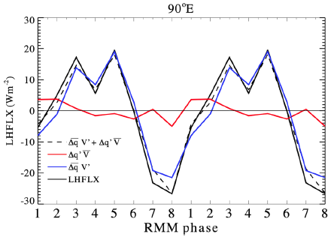
MJO Forcing to the Ocean
Factors controlling intraseasonal surface flux variations
Δq is the near-surface vertical moisture gradient (q_{SST} - q_{air},q_{SST} is the saturation specific humidity)
ΔT is the temperature gradient(T_{SST} – T_{air})
|V| is wind velocity
Overbars represent the background means, primed quantities are time-varying departures from the background means.
Zonal wind anomalies of either side may produce suppressed or enhanced fluxes, depending on the sign of the mean wind
Δq and ΔT are more sensitive to q_{air} and T_{air} than SST, particularly near convective downdrafts.
A given |V| and T_{air}(q_{air}) will produce a stronger sensible(latent) heat flux over a warmer patch of ocean than it will over a colder patch.

Slide 9
MJO Forcing to the Ocean
Relative phasing of SST, surface fluxes and rainfall
MJO suppressed phase :
Decreasing cloudiness, wind and surface fluxes
Increasing surface radiation
MJO active phase initiation:
Increasing cloudiness, and reduced surface shortwave radiation followed by an increase in wind speed and surface fluxes out of the ocean and decreasing SSTs.

Slide 10
Ocean Response to MJO Forcing
Processes affecting the upper ocean
Intraseasonal mixed layer heat and salinity budgets
The mixed layer diurnal cycle

Slide 11
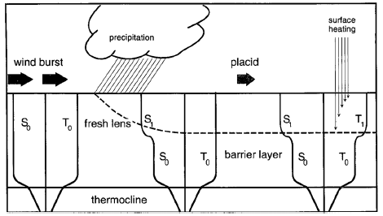
Ocean Response to MJO Forcing
Processes affecting the upper ocean

Slide 12
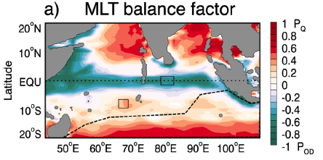
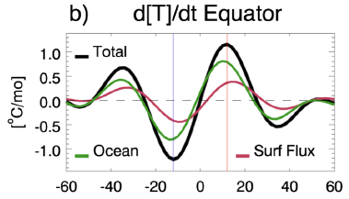
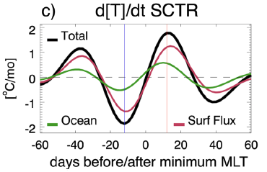
Ocean Response to MJO Forcing
Intraseasonal mixed layer heat and salinity budgets
Positive : contribution of surface fluxes to mixed layer temperature budget.
Negitive : contribution of ocean dynamics to mixed layer temperature budget
In Equator:
Advection dominates the ocean process
In 10E:
Vertical mixing dominates ocean process

Slide 13
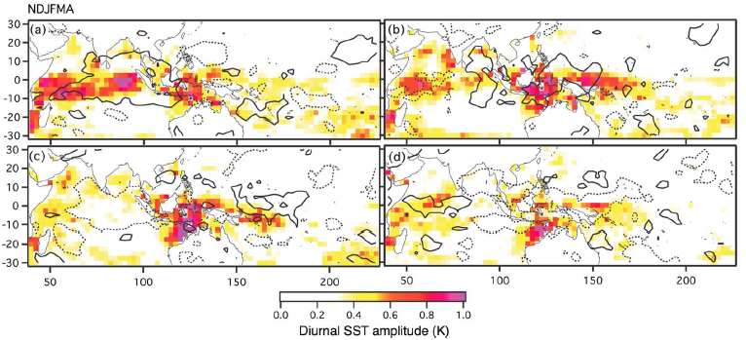
Ocean Response to MJO Forcing
The mixed layer diurnal cycle
The presence of diurnal warm layers and shallow mixed layers provides a near-surface “energy reservoir”.

Slide 14
Ocean Feedback to the MJO
Sensitivity to interannual SST variability
Sensitivity to intraseasonal SST variability
Sensitivity to diurnal SST variability

Slide 15
Modeling
The past numerical experiment showed an enhanced MJO in the GCMs by
Introducing momentum mixing by convection to reduce vertical wind shear.
Revising the triggering of convection to account for low-level horizontal moisture convergence.
Altering the convective parameterization to enhance shallow-convective heating and moistening east of the MJO active phase, or to produce more upper level heating from stratiform precipitation.
Artificially increasing the westward tilt of the GCM diabatic heating profile with height.
Increasing the sensitivity of an ascending convective parcel to environmental humidity.
The transition from shallow to deep convection appears to be particularly critical.

Slide 16
Modeling
Upper Ocean Response to Atmospheric Forcing
Slab Ocean Model
The Coupled Model Mean State
High-Frequency SST Forcing
Air-Sea interaction and MJO Prediction

Slide 17
Thanks for your attention

