Slide 1
Scrip (mapping file )
Edit Project/project_name.h
compile: ./coawst.bash → coawstM
3. prepare WRF & ROMS IC BC and scrip file (mapping file for different grids between WRF and ROMS)
3.1) WPS/namelist.wps (download the input files)
3.2) WRF/run/namelist.input
3.3) /COAWST/Projects/Sandy/create_sandy_application.m
3.4) roms_master_climatology_coawst_mw.m
3.5) ./scrip_coawst scrip_coawst_xxx.in
3.6) edit ocean_xxx.in, coupling_xxx.in
4, ./run_coawst

Slide 2
Project/SCS

Slide 3
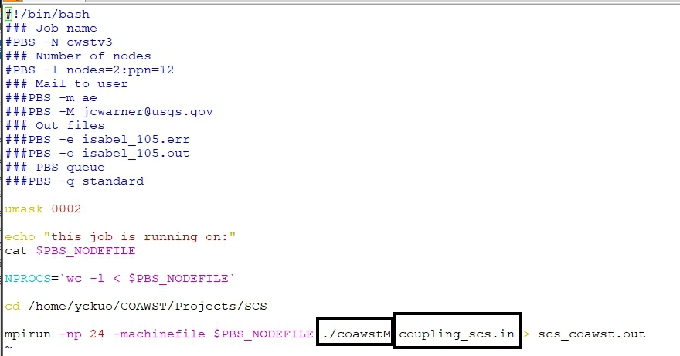
run_coawst

Slide 4
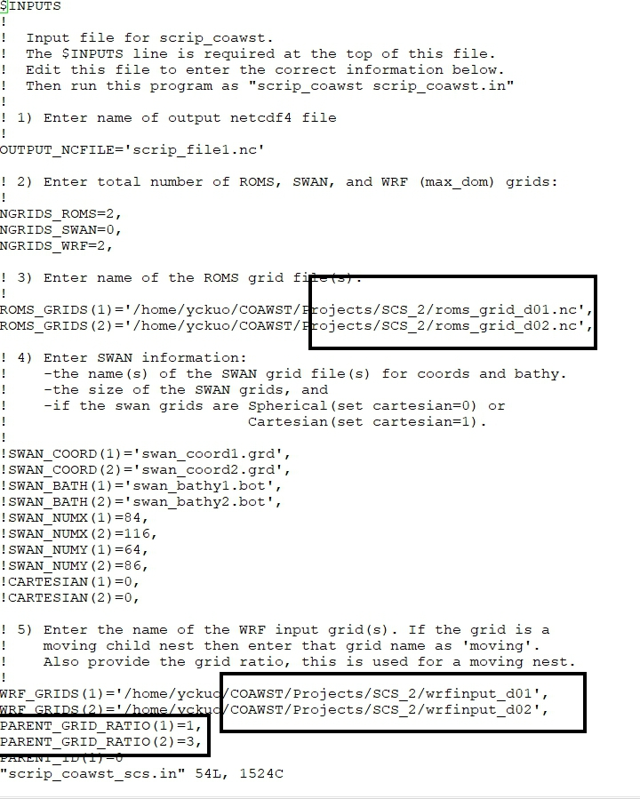
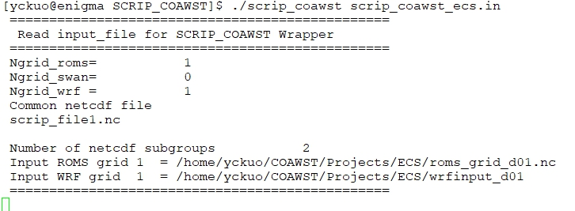
scrip_coawst.in
Create mapping file (scrip_file.nc)

Slide 5
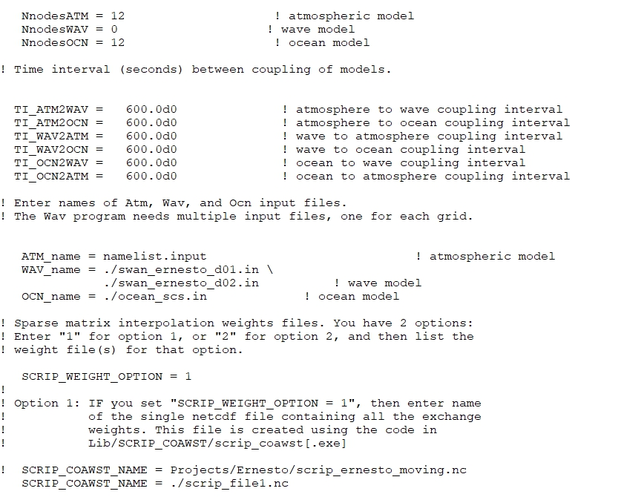
Couple.in
Consistent with those in namelist.input & ocean.in

Slide 6
Add COAWST/Tools/mfiles/rutgers
Add COAWST/Tools/mfiles/mtools/ to your path
Add path COAWST/Tools/mfiles/roms_clm/
1. Create roms grid file
Same grid as in wrfinput
/COAWST/Tools/mfiles/mtools/wrf2roms_mw.m
different grid to wrfinput
/COAWST/Projects/Sandy/create_sandy_application.m
2. Create roms IC &BC file
Using HYCOM GLBa0.08 data (2008~now)
roms_master_climatology_coawst_mw.m

Slide 7
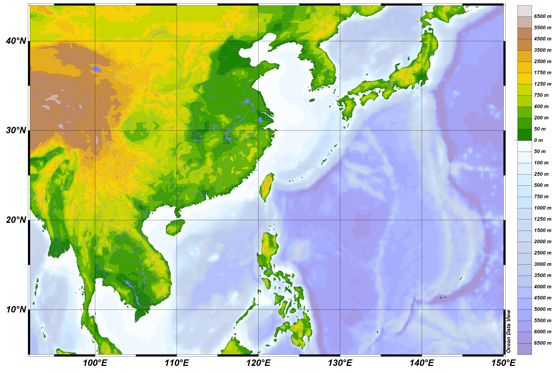
e_we = 181, 190, 331,
e_sn = 151, 190, 331,
d01: 92°- 150°E 5°-44°N
d02: 111°-129.5°E 15.5°-31.5°N
d03 :115.5° 126°E 19°-28°N
Ex. ROMS
100-140E resolution: 30km
% pick 4 corners for roms parent grid
Istr=800/27~=29
Iend=4800/27~178;
%step 3: pick number of points in the grid
numx=133;
d01 (18x18km)
d02 (6x6km)
d03(3x3km)
d02(9x9km)
d01 (27x27km)

