Slide 1
Effects of wave dependent ocean roughness during Hurricane Ida – Nor’Ida
Maitane Olabarrieta
John C. Warner
Olabarrieta, M., Warner, J.C., and Armstrong, B. (2012). “Ocean-atmosphere dynamics during Hurricane Ida and Nor'Ida: an atmosphere-ocean-wave coupled modeling system application.” Ocean Modelling, 43-44, pp 112-137.
Notes:
Good afternoon. My name is Maitane Olabarrieta and the work I am going to show now was done in collaboration with John and Brandy Armstrong.
Our main interest, when we started with this project, was to analyze the sensitivity of COAWST to the wind wave roughness effects, and who the feedbacks between the wind, heat fluxes and waves would affect the estimation of wind intensity, waves, surface ocean currents and the storm surge. To make this analysis we selected a extreme storm (NorIda that happened in November 2009).

Slide 2
QUESTIONS WE WANTED TO ANSWER WITH THIS STUDY:
HOW MUCH DOES THE OCEAN SURFACE ROUGHNESS PARAMETERIZATION AFFECT WIND, WAVE AND SURGE PREDICTIONS DURING EXTREME STORMS?
DOES THE MODEL SKILL IMPROVE WHEN INCLUDING THE WAVE DEPENDENCY?
IS THERE ANY PARAMETERIZARION THAT PROVIDES THE BEST WIND, WAVE AND STORM SURGE ESTIMATIONS?
Notes:
Location 1: Oblique aerial photography from Wallops Island, VA on May 21, 2009 (top) and December 4, 2009 (bottom), roughly two weeks after the storm. The yellow arrows point to the same location in each photograph. The protective beach fronting this section of the NASA facility on Wallops Island was severely eroded, exposing what appears to be more than one generation of shore protection structures. Some overwash deposition is evident in the post-storm photograph, particularly in the right (north) half of the image.

Slide 3
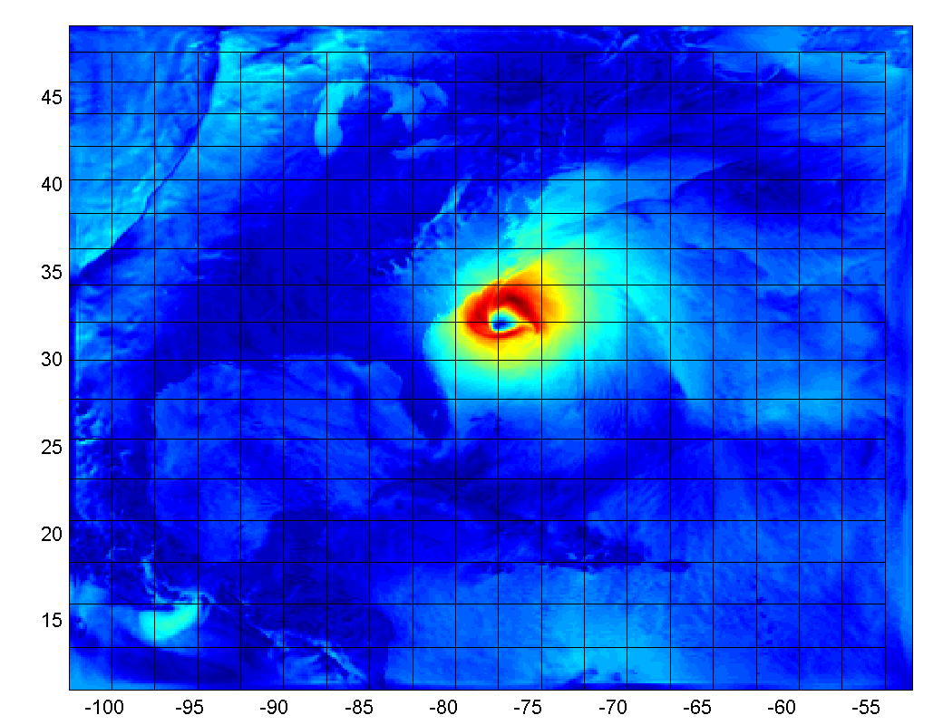
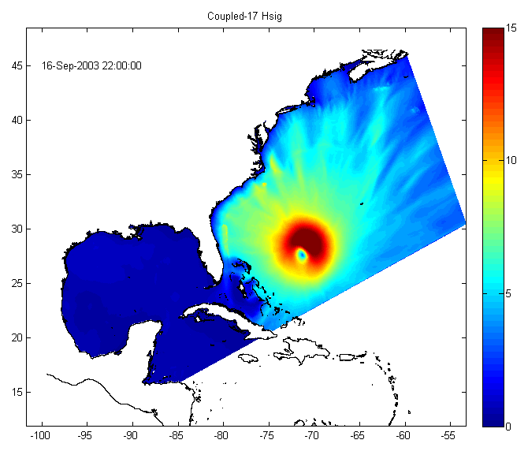
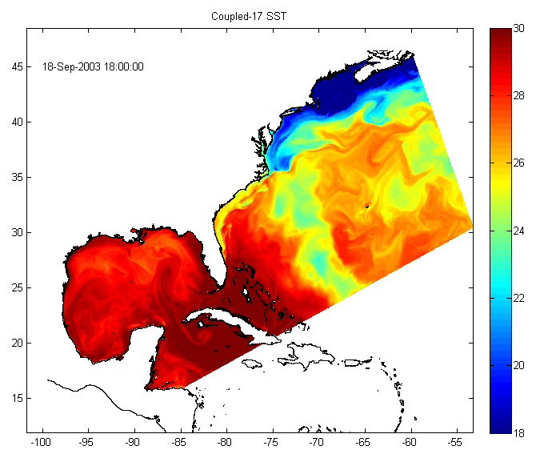
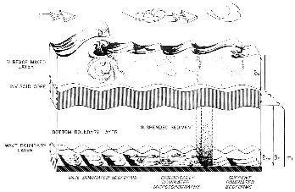
COAWST (Coupled Ocean – Atmosphere – Wave – Sediment Transport) Modeling System
ATMOSPHERE
H_{sig,} L_{wave}, , T_{wave},
Uwind, Vwind, Patm, RH, Tair,
cloud, rain, SWrad, LWrad, LHeat, SHeat
Latitude
SST
MCT
MCT
WRF wind speed
Longitude
Uwind, Vwind
WAVE
SWAN Hsig
ROMS SST
OCEAN
H_{sig}, L_{wave}, D_{wave},
T_{surf}, T_{bott},Q_{b}, W_{dissip}, U_{b}
MCT
u_{s}, v_{s}, η, bath
Notes:
Basically we wanted to determine was the effect of considering a wave dependent ocean roughness and how this dependency affects wind, wave and storm surge predictions.

Slide 4
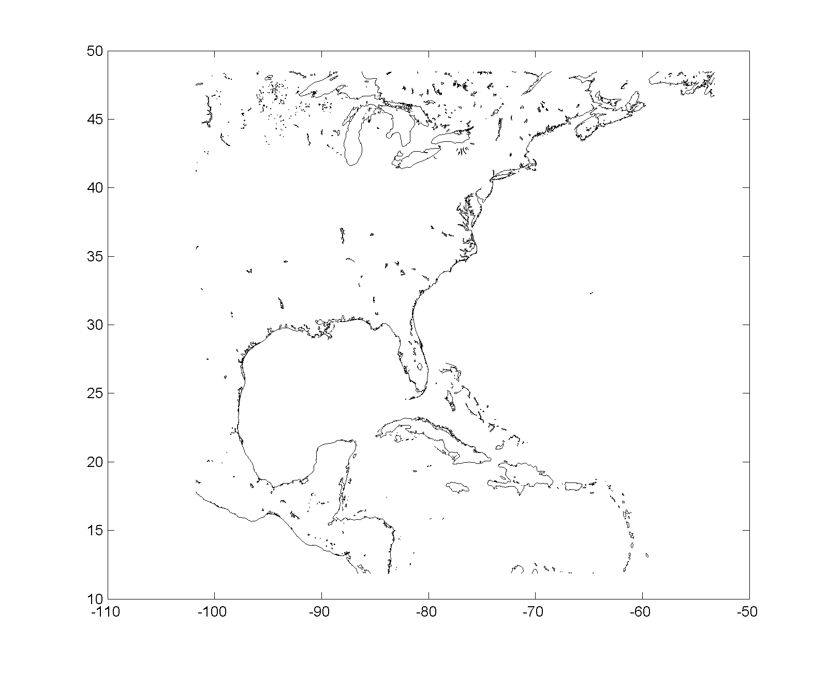
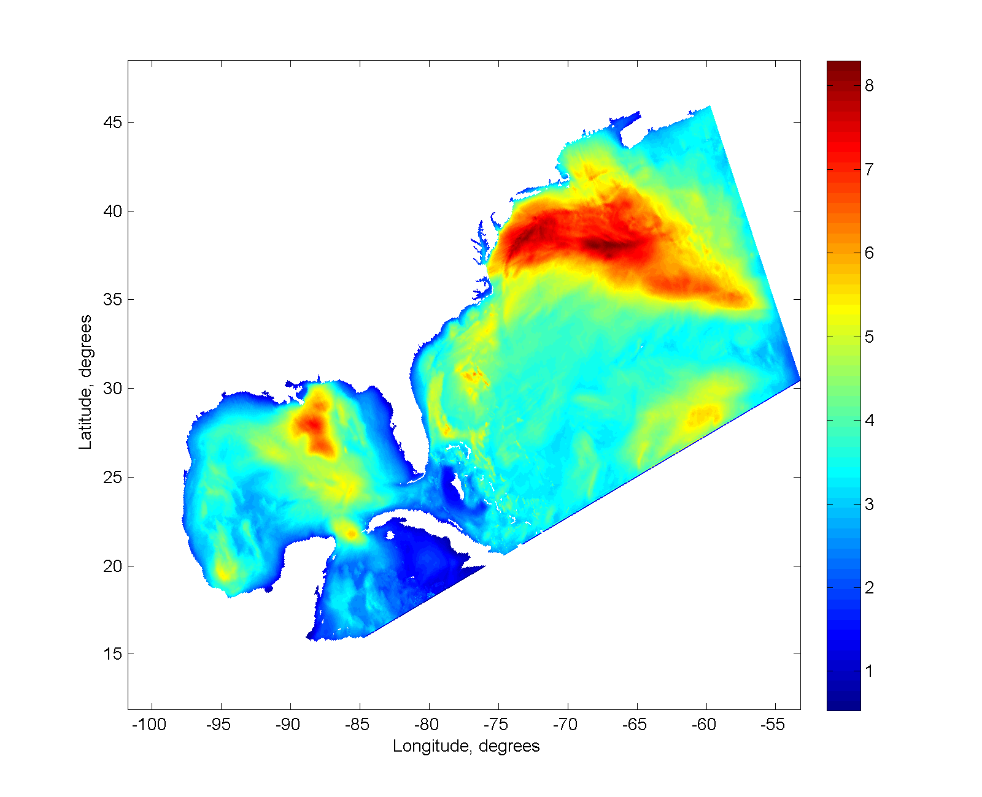
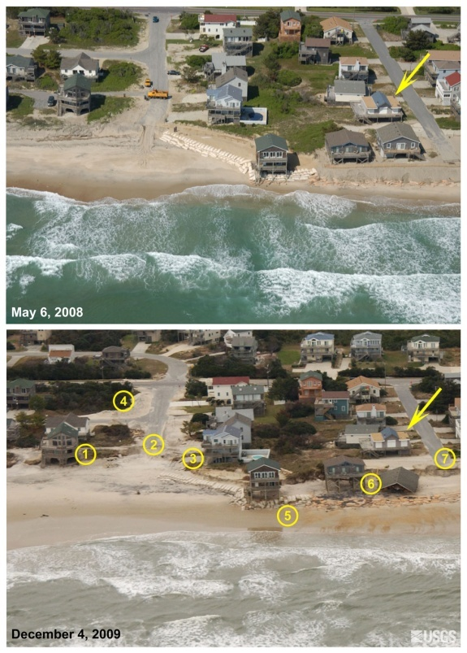
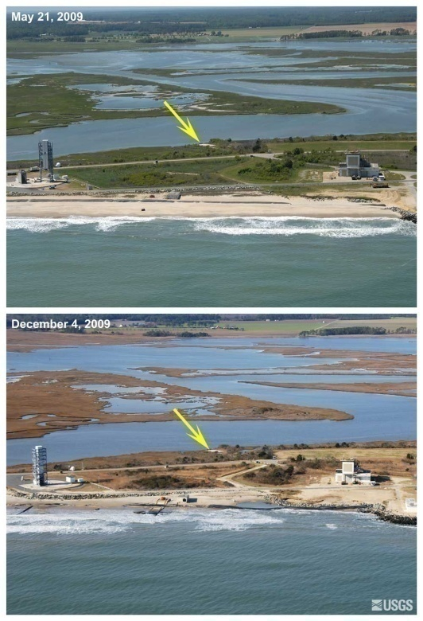
Nor’Ida Nov 2009
wind speed
23 m/s (50 mph)
H
Wave heights (m)
Bodie Island, NC
13thNov
L
11thNov
L
10thNov
Wallops Island, VA
Before
9th Nov
8th Nov
Before
wind speed
40 m/s (90 mph)
After
After
http://coastal.er.usgs.gov/hurricanes/norida/
Notes:
Location 4: Oblique aerial photography from Bodie Island (South Nags Head), NC on May 6, 2008 (top) and December 4, 2009 (bottom), roughly two weeks after the storm. The yellow arrows point to the same location in each photograph. Working from left to right (south to north) in the post-storm photograph, note (1) the dune erosion around the base of the southernmost house; (2) the road perpendicular to the beach has been undermined and has retreated to the approximate location of the orange truck in the 2008 photo; (3) the driveway that has been undermined and has lost pavement ; (4) a large pile of overwashed sand one block back from the beach that was likely cleared from the road; (5) the deterioration of the sand bag structure protecting oceanfront houses; (6) the change in exposed length of pilings on the house on the left (south) and the collapsed house on the right indicating undermining by erosion; (7) the significant erosional scarp located behind two oceanfront houses
Location 1: Oblique aerial photography from Wallops Island, VA on May 21, 2009 (top) and December 4, 2009 (bottom), roughly two weeks after the storm. The yellow arrows point to the same location in each photograph. The protective beach fronting this section of the NASA facility on Wallops Island was severely eroded, exposing what appears to be more than one generation of shore protection structures. Some overwash deposition is evident in the post-storm photograph, particularly in the right (north) half of the image.

Slide 5
COAWST (Coupled Ocean – Atmosphere – Wave – Sediment Transport) Modeling System
ATMOSPHERE
H_{sig,} L_{wave}, , T_{wave},
Uwind, Vwind, Patm, RH, Tair,
cloud, rain, SWrad, LWrad, LHeat, SHeat
Latitude
SST
MCT
MCT
WRF wind speed
Longitude
Uwind, Vwind
WAVE
SWAN Hsig
ROMS SST
OCEAN
H_{sig}, L_{wave}, D_{wave},
T_{surf}, T_{bott},Q_{b}, W_{dissip}, U_{b}
MCT
u_{s}, v_{s}, η, bath
Notes:
Basically we wanted to determine was the effect of considering a wave dependent ocean roughness and how this dependency affects wind, wave and storm surge predictions.

Slide 6
WAV interactions
ATM
U_{wind}, V_{wind}
WAV
1) Generation – wind speed forcing
is modified by ocean currents:
S(w) = f( U_{wind} – u_{s} ; V_{wind} – v_{s} )
u_{s}, v_{s}, η, bath, Z₀
OCN
2) Propagation
– wave celerity in geographic space is modified by ocean currents
c_{x} = c_{gx} + u_{s ;} c_{y} = c_{gy} + v_{s}
– change of wave direction (refraction) due to η, bathy, and currents:

Slide 7
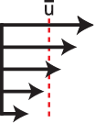
OCN interactions
ATM
Uwind, Vwind, Patm, RH, Tair,
cloud, rain, evap, SWrad, Lwrad
LH, HFX, Ustress, Vstress
Use wrf vars in COARE algorithm
H_{wave}, L_{mwave}, L_{pwave}, D_{wave},
T_{psurf}, T_{mbott}, Q_{b},
Diss_{bot}, Diss_{surf}, Diss_{wcap},
U_{bot}
Use consistent stress roms+wrf
or
OCN
Salt flux
Atm press
WAVE
Patm
Ustress, Vstress,
Swrad, Lwrad
LH, HFX
Uwind, Vwind
Swrad, Lwrad,
RH, Tair,
cloud
rain, evap
Water column
τ
Surface
Bottom
Stokes + VF
s= f ( Z_{os} )
Zoa
τ
b = f ( Z_{ob} )
H_{wave}, L_{mwave}, D_{wave},
T_{psurf}, Q_{b},
Diss_{bot}, Diss_{surf},
Diss_{wcap},
H_{wave}, L_{pwave}, D_{wave}, T_{psurf},
H_{wave}, L_{mwave}, D_{wave},
T_{mbott}, U_{bot}
Integration and Application Network (ian.umces.edu/symbols),
University of Maryland Center for Environmental Science.

Slide 8
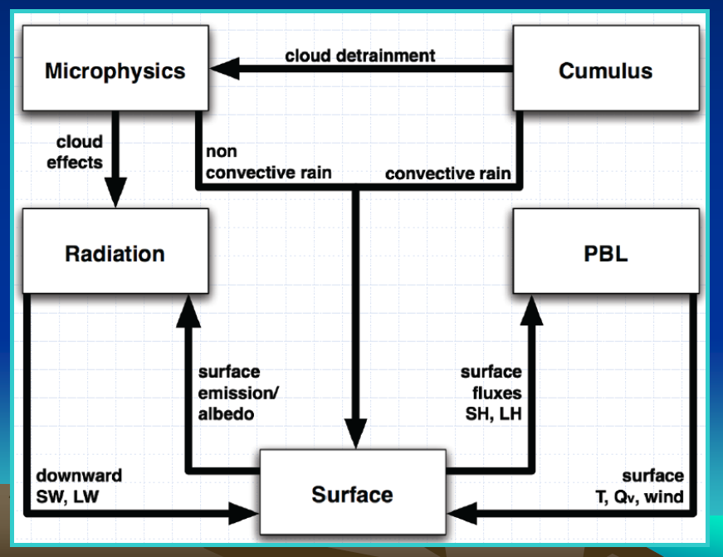
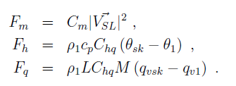
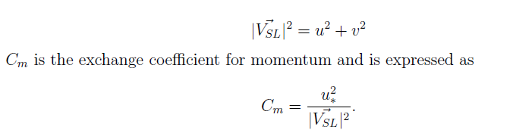
ATM interactions
ATM
H_{wave}, L_{pwave}, T_{psurf},
SST
OCN
WAV
SST
OCN
Momentum
Surface fluxes
Heat
Moisture
= f ( H_{wave}, L_{pwave}, T_{psurf} )
WAV

Slide 9
OCEAN SURFACE ROUGHNESS CLOSURE MODELS
CHARNOCK 1955
TAYLOR & YELLAND 2001: TY2001
- Wave steepness based parameterization.
- Based on three datasets representing sea-state conditions ranging from strongly forced to shoaling.
DRENNAN 2003: DGQH
Wave age based formula to characterize the ocean roughness.
They combined data from many field experiments representing a variety of condition and grouped the data as a function of the wind friction velocity.
OOST 2002: OOST
- Wave age dependent formula but it also considers the effect of the wave steepness.

Slide 10
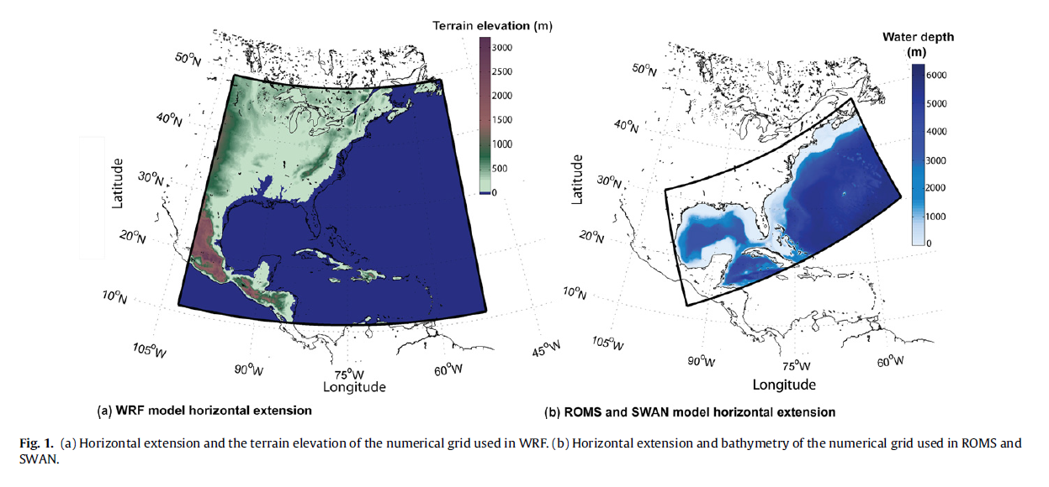
Model setup
WRF configuration:
6 km grid
28 vertical levels
2 km vortex following nest
Kain-Fritsch cumulus param.
MYNN PBL scheme
ROMS configuration:
5 km grid
16 vertical levels
Wave enhanced : bed roughness
and surface tke flux
Wave –current interaction
SWAN configuration:
5 km grid
25 freq bins
60 directional bins

Slide 11
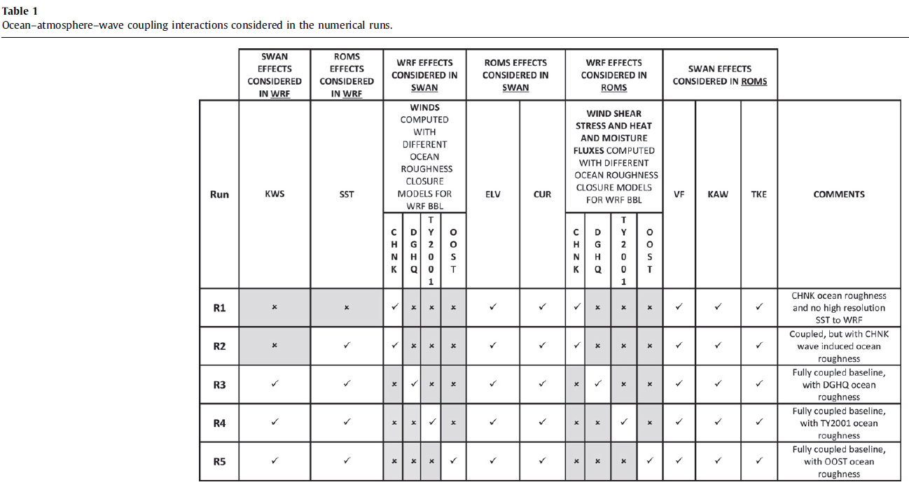
Model simulations
WRF
WRF + ROMS
WRF + ROMS + SWAN
WRF + ROMS + SWAN
WRF + ROMS + SWAN
Test sensitivity of model performance to inclusion of model physics through coupling.

Slide 12
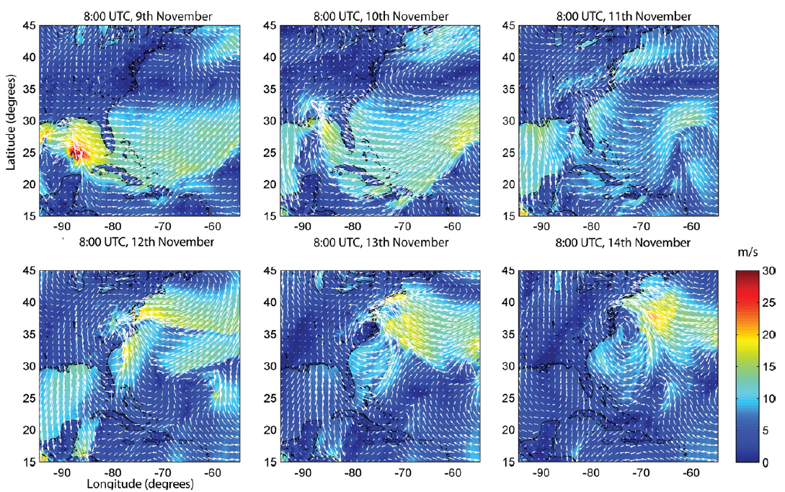
WRF only (Run 1) - winds

Slide 13
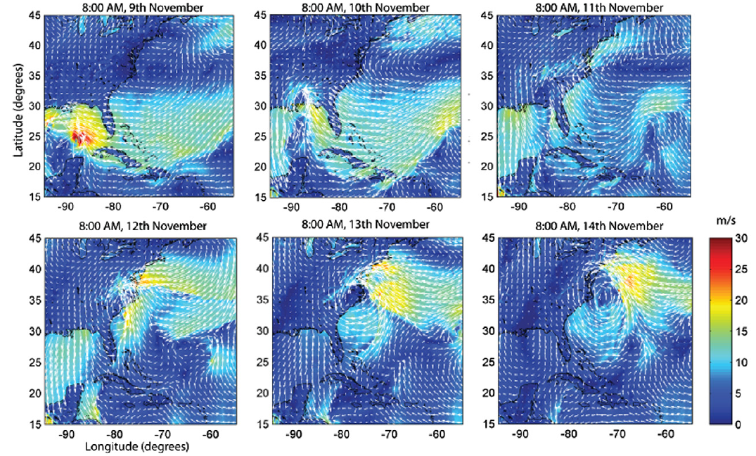
WRF+ROMS (Run 2) - winds
In GoM – sst not much effect.
Along US east coast, sst increased wind speeds

Slide 14
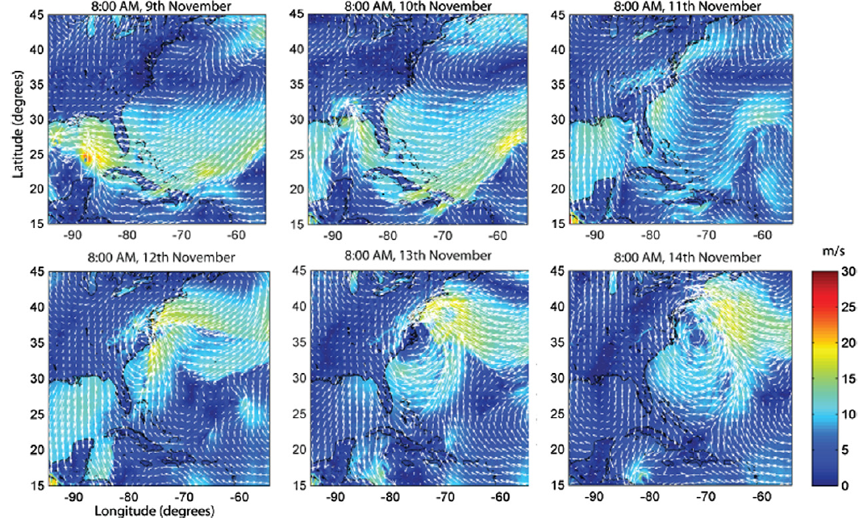
WRF+ROMS+SWAN (Run 3) - winds
In GoM – waves reduced wind speed
Along US east coast, waves reduced wind speeds

Slide 15
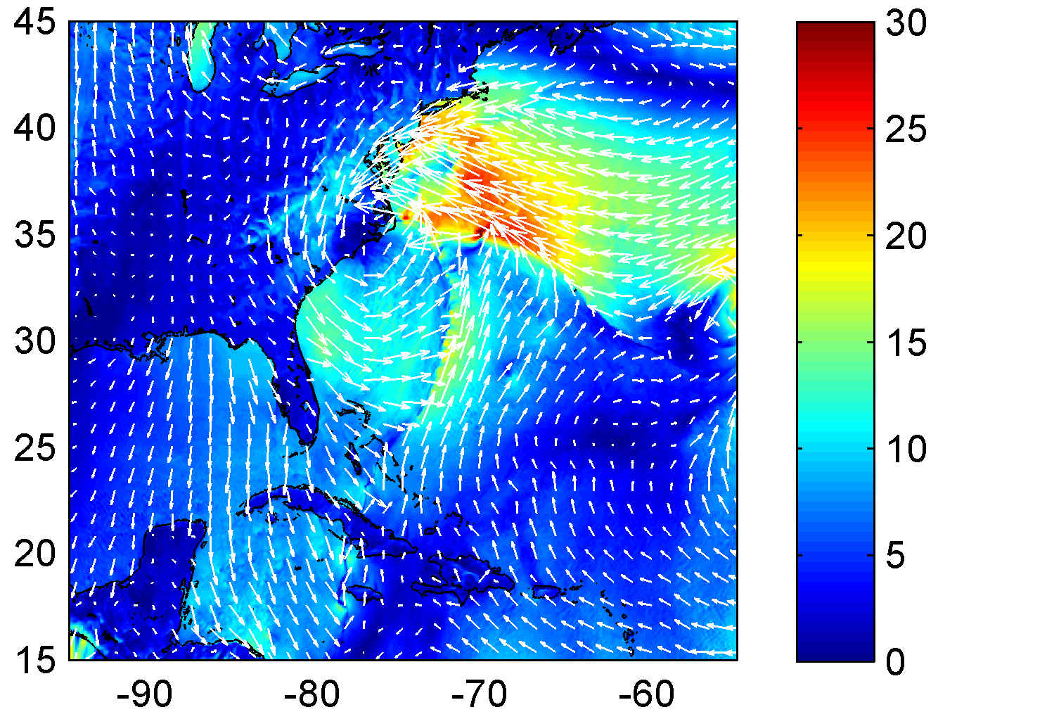
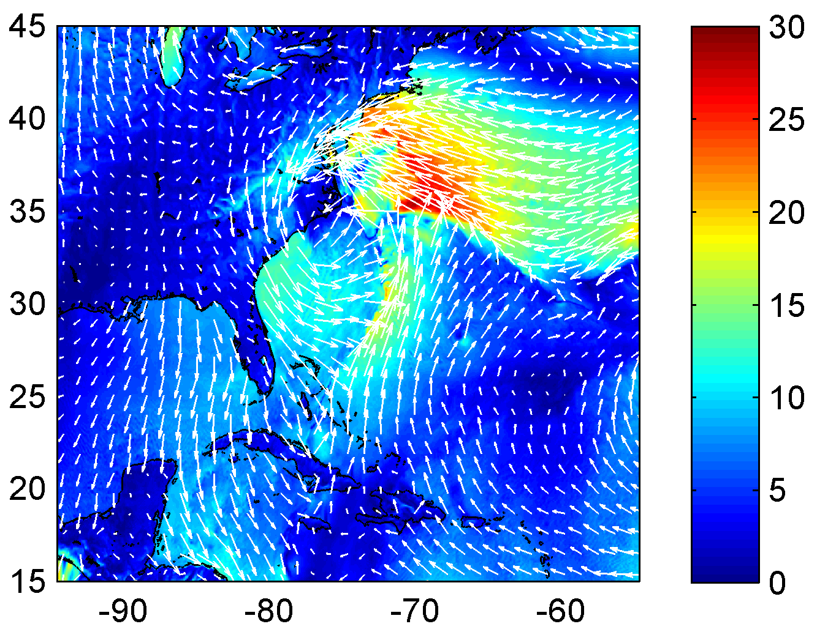
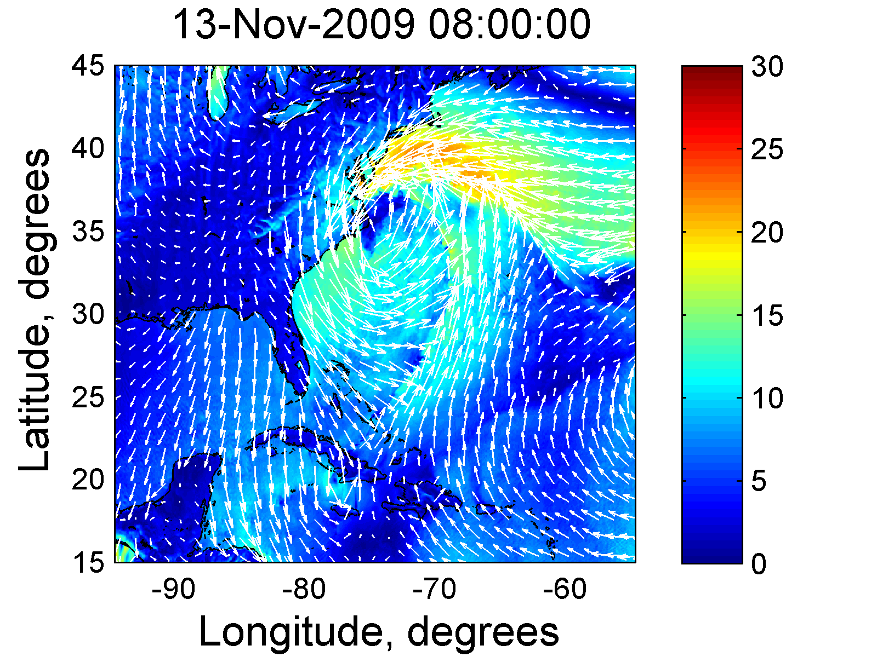
WINDS
WRF
WRF + ROMS
WRF + ROMS + SWAN
m/s
Reduced wind speed with waves coupling.
DATA
WRF
WRF+ROMS
WRF+ROMS+SWAN
S
0.85
0.78
0.89
Notes:
Biggest effect was with the waves. Swan used OOST.

Slide 16
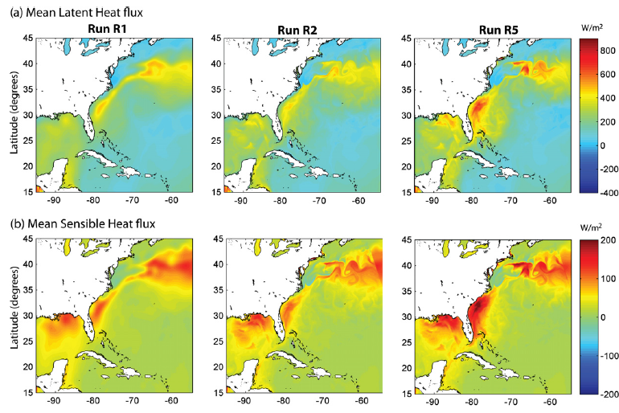
Heat fluxes
WRF
WRF + ROMS
WRF + ROMS + SWAN

Slide 17
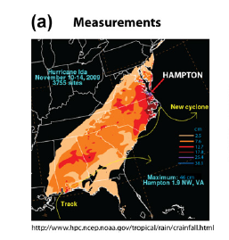
Precipitation
Run 1
Run 2
Run 3
WRF
WRF + ROMS
WRF + ROMS + SWAN
Waves coupling increased maximum precipitation eastward.

Slide 18
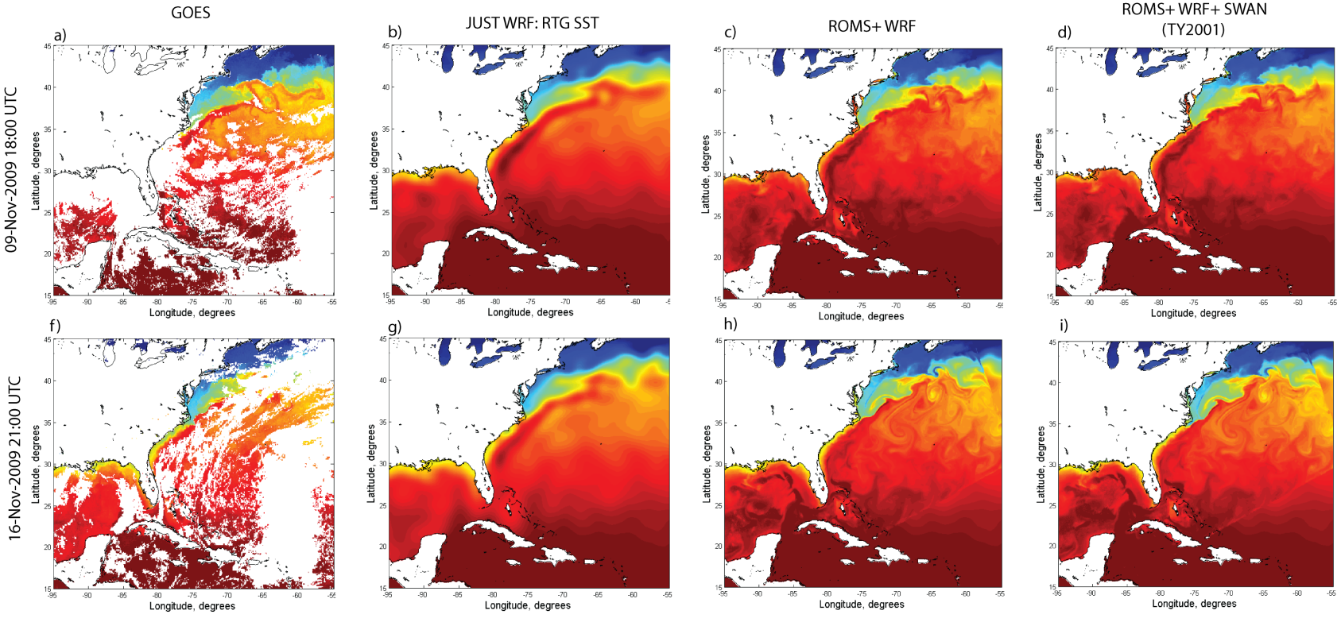
SST
Run 1
Run 2
Run 3
GOES
WRF
WRF + ROMS
WRF + ROMS + SWAN
Before
After

Slide 19
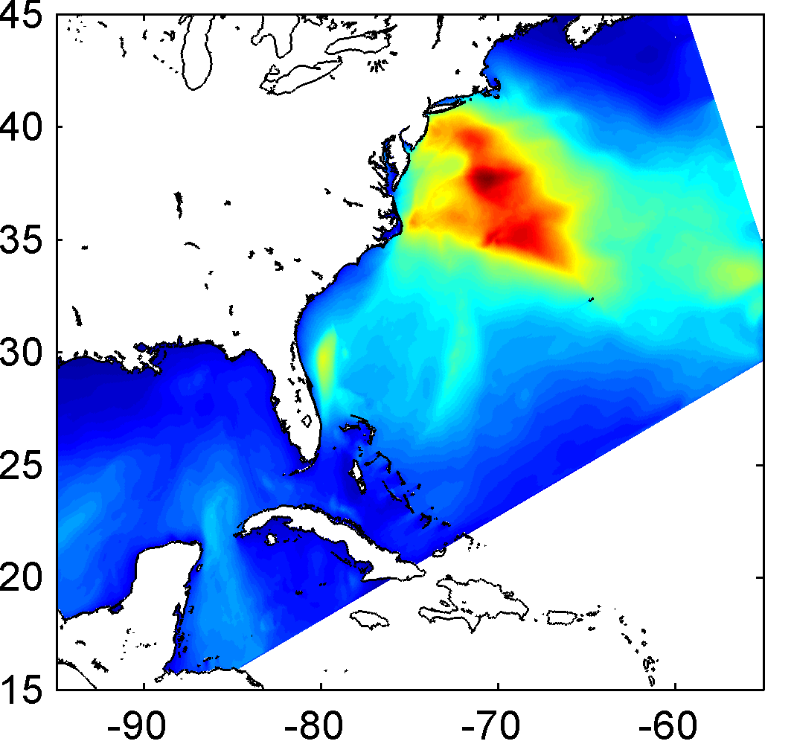
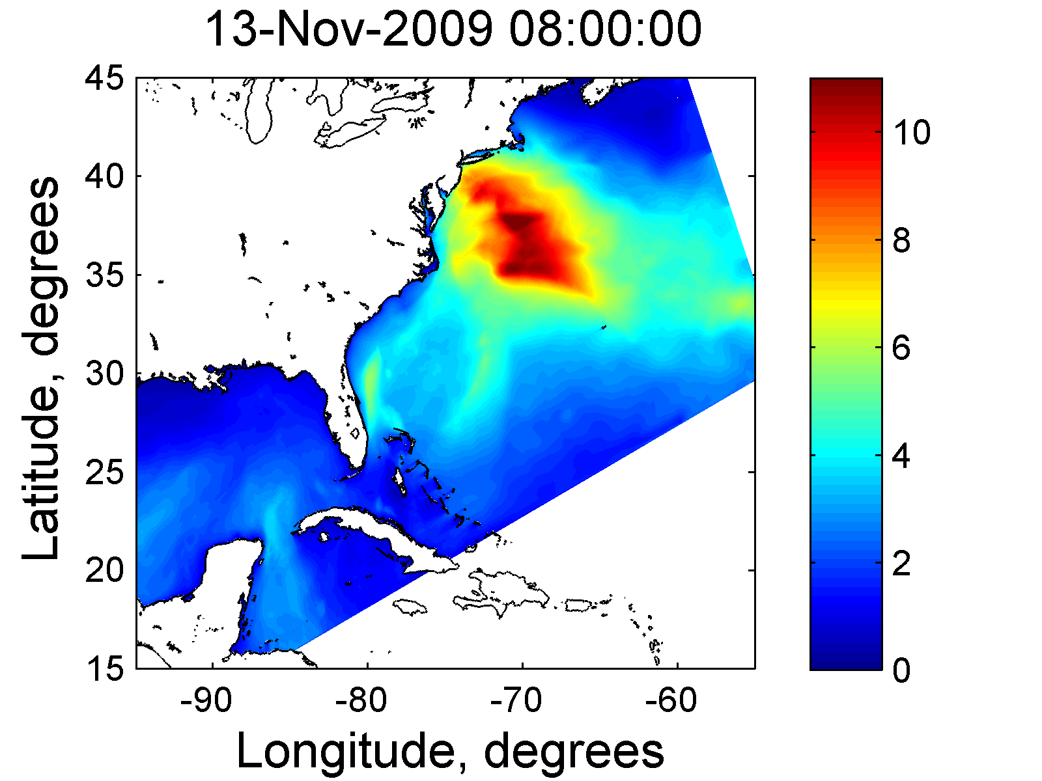
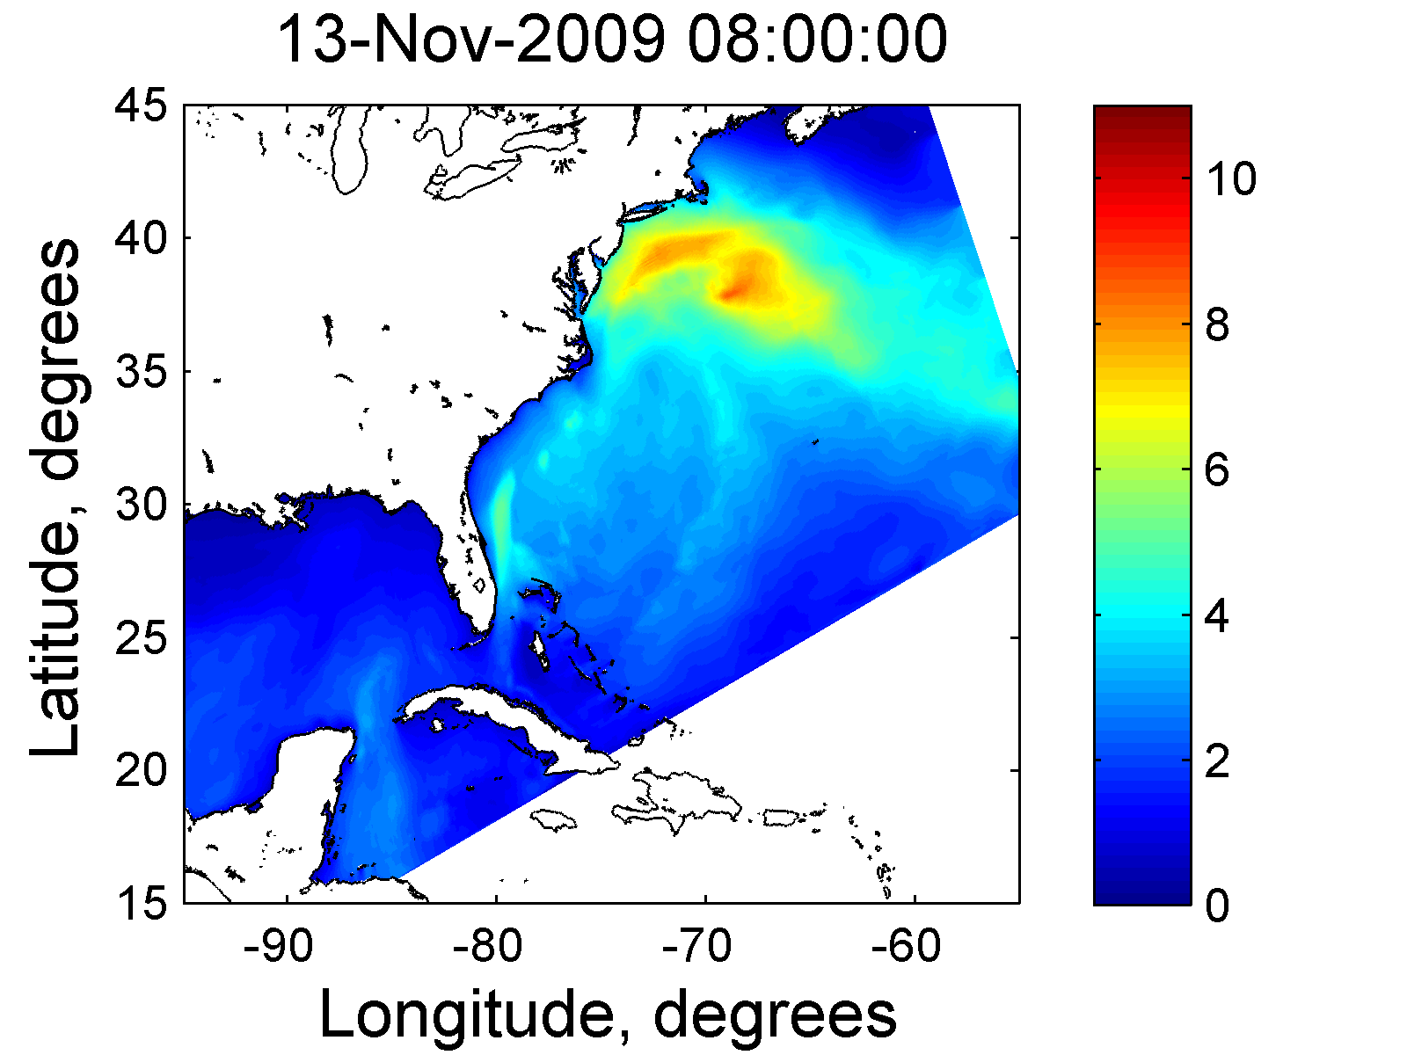
WAVES
WRF
WRF + ROMS
WRF + ROMS + SWAN
WRF
WRF + SST
WRF + SST +OOST
m
Reduced waves with waves coupling.
DATA
WRF
WRF+ROMS
WRF+ROMS+SWAN
S
0.80
0.74
0.88

Slide 20
COAWST (Coupled Ocean – Atmosphere – Wave – Sediment Transport) Modeling System
ATMOSPHERE
Different Wave
parameterizations
H_{sig,} L_{wave}, , T_{wave},
Uwind, Vwind, Patm, RH, Tair,
cloud, rain, SWrad, LWrad, LHeat, SHeat
Latitude
SST
MCT
MCT
WRF wind speed
Longitude
Uwind, Vwind
WAVE
SWAN Hsig
ROMS SST
OCEAN
H_{sig}, L_{wave}, D_{wave},
T_{surf}, T_{bott},Q_{b}, W_{dissip}, U_{b}
MCT
u_{s}, v_{s}, η, bath
Notes:
This is to say that we analyzed the effect of the interaction indicated with the red and green arrows together.

Slide 21
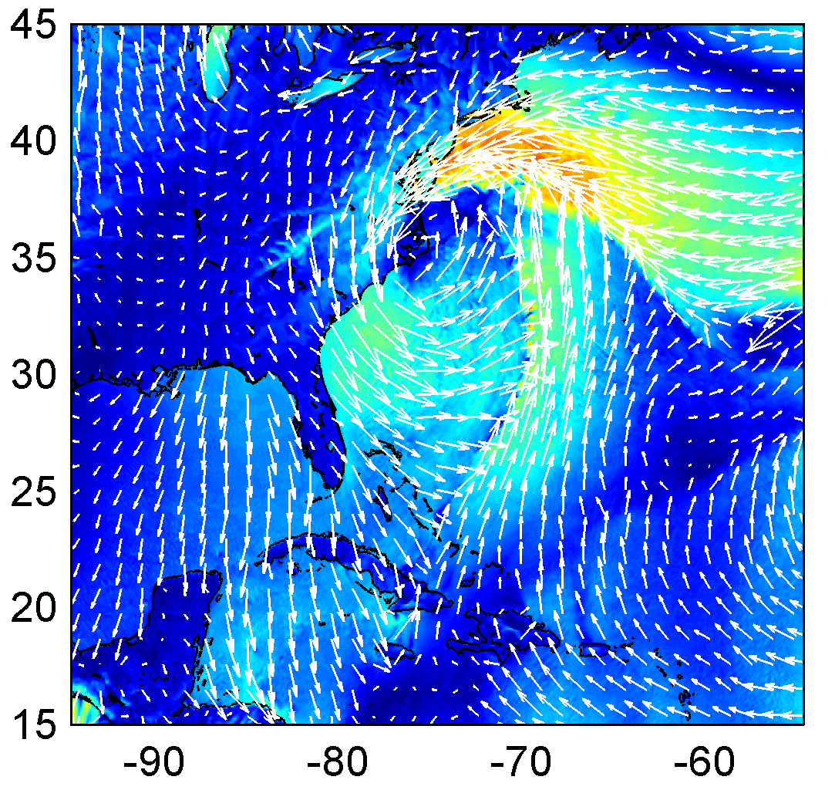
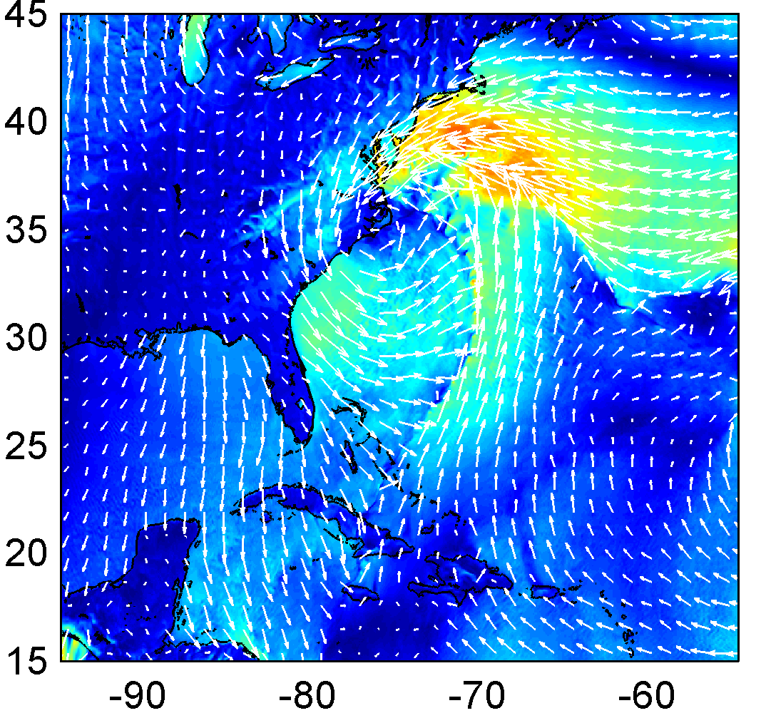
WINDS
WRF + ROMS + SWAN( )
(OOST)
WRF + SST + TY2001
(DGQH)
WRF +SST + OOST
m/s
(TY)
WRF + SST + DGQH
SST + WRF
WRF + ROMS
DATA
WRF
WRF+ROMS
W+R+S (DGQH)
W+R+S (TY2001)
W+R+S (OOST)
NAM
Reduced wind speed with waves coupling.
OOST best.

Slide 22
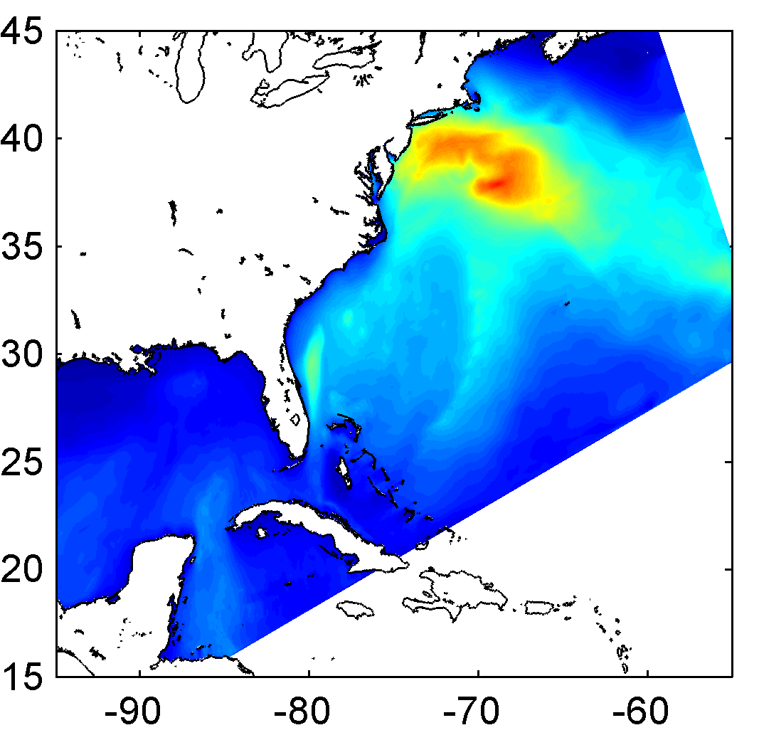
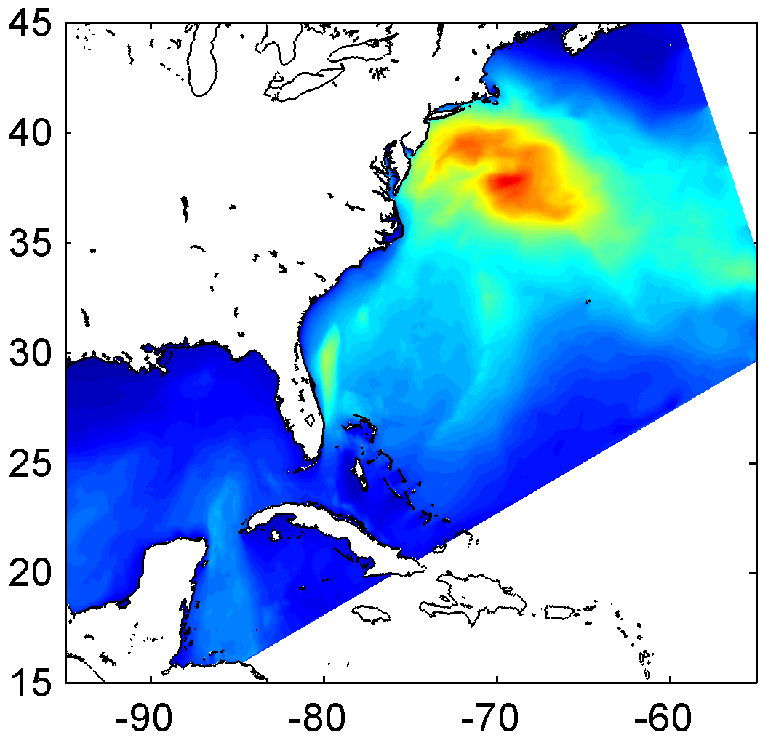
WAVES
WRF + ROMS + SWAN( )
(OOST)
WRF + SST + TY2001
WRF + SST + DGQH
WRF + SST +OOST
m
(TY)
(DGQH)
WRF + ROMS
DATA
WRF
WRF+ROMS
W+R+S (DGQH)
W+R+S (TY2001)
W+R+S (OOST)
NAM
Reduced wave heights with waves coupling.
OOST best.

Slide 23
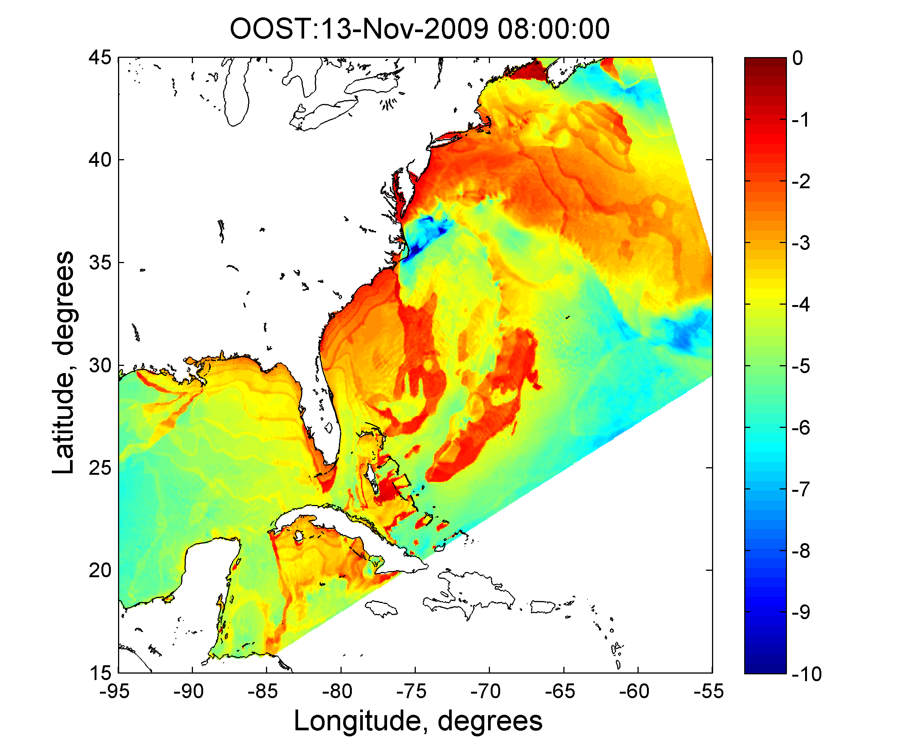
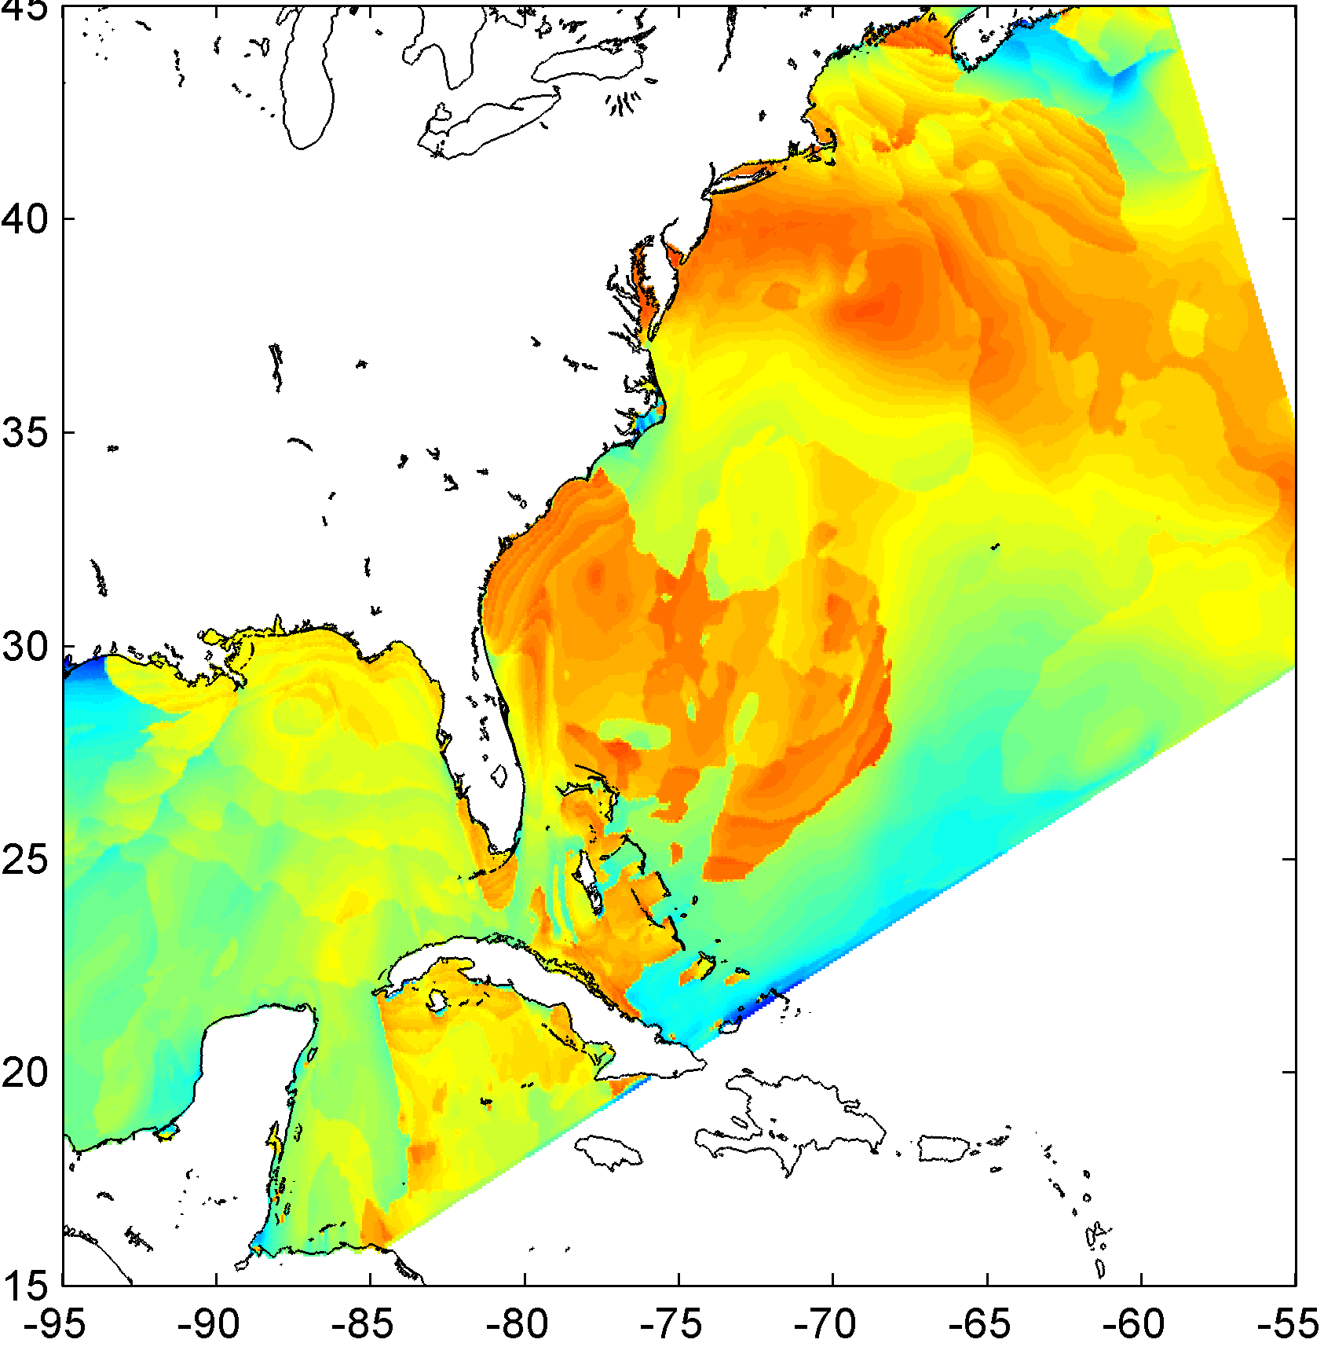
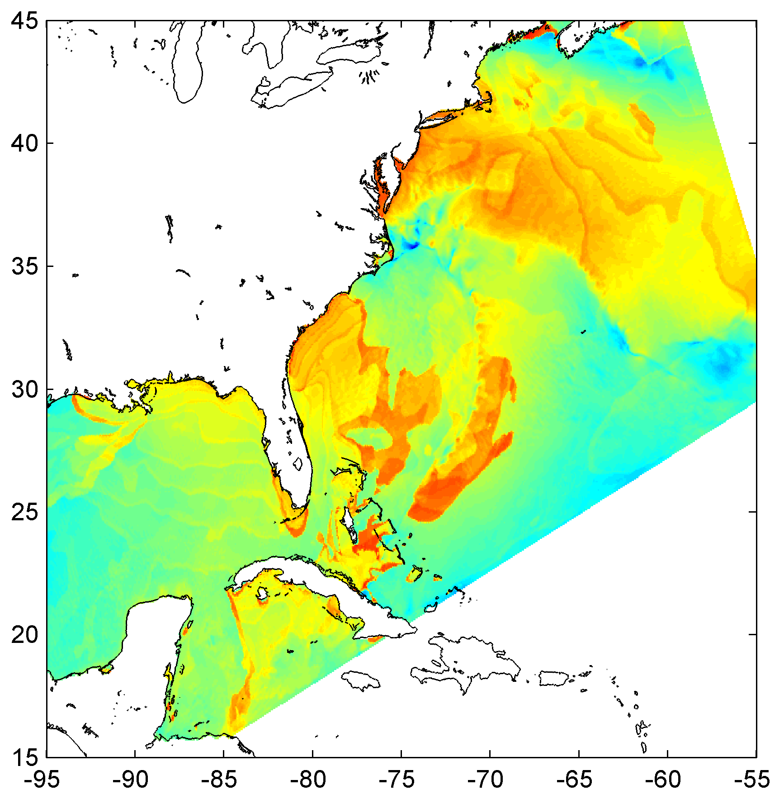
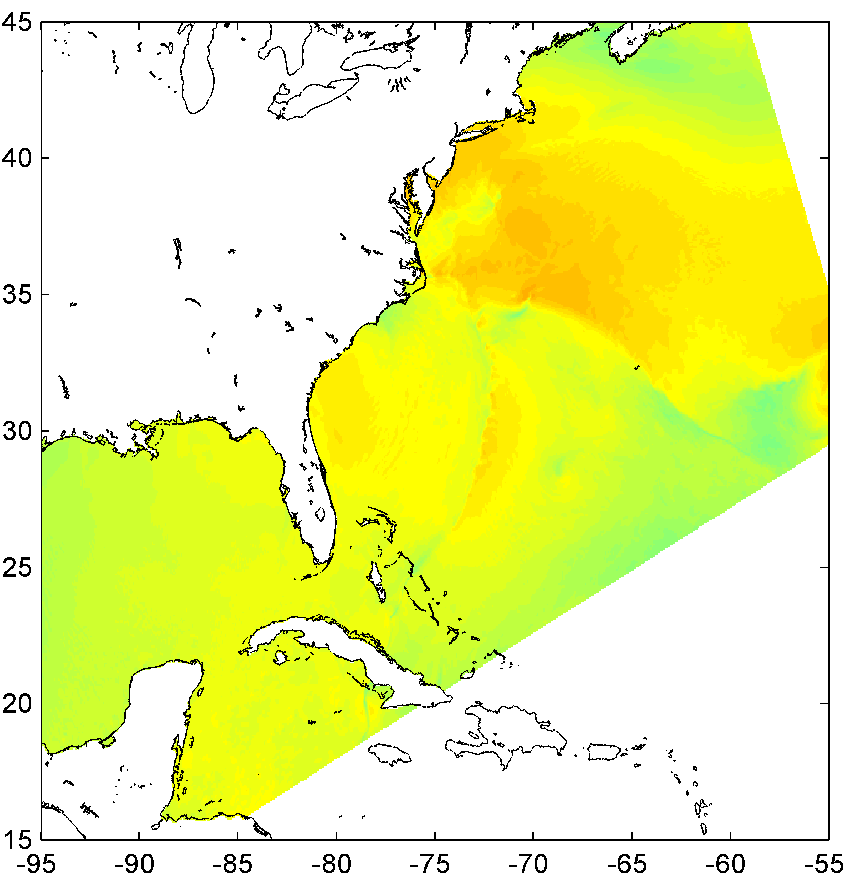
SEA SURFACE ROUGHNESS
WRF + ROMS + SWAN( )
(OOST)
(TY)
(DGQH)
WRF + ROMS (charnock)
Increased stress was higher because roughness was larger.
OOST highest.
log₁₀(z_{0m})

Slide 24
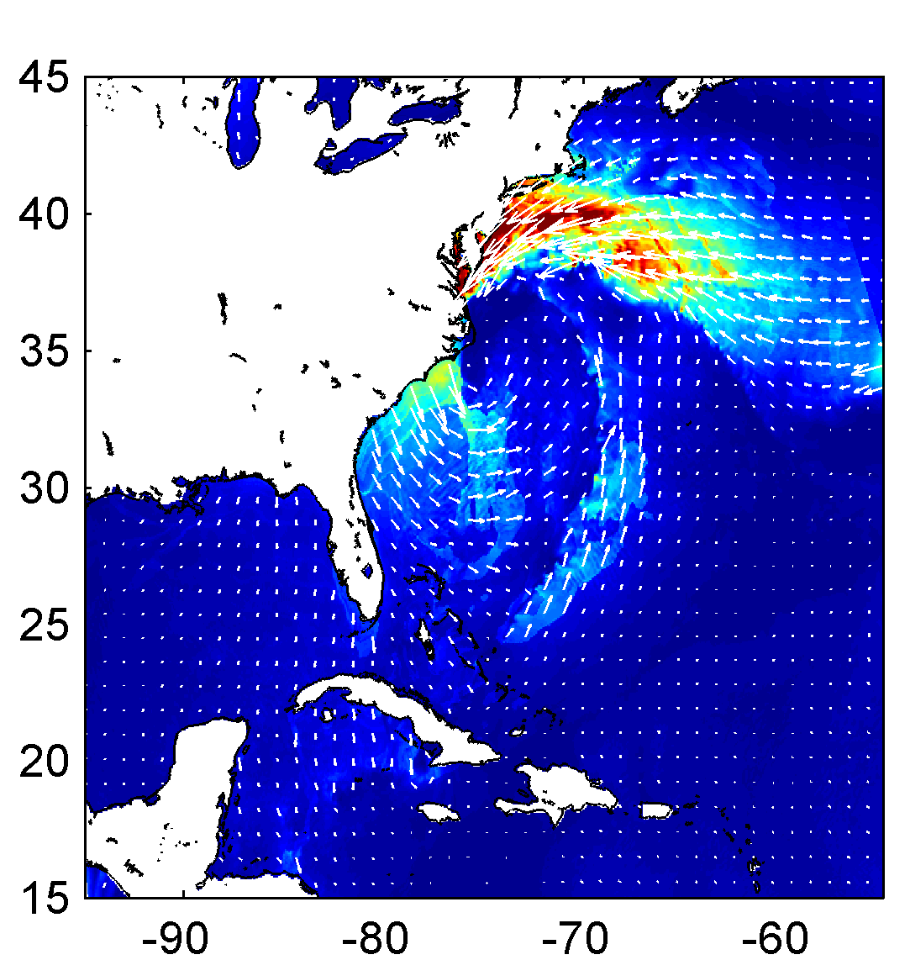
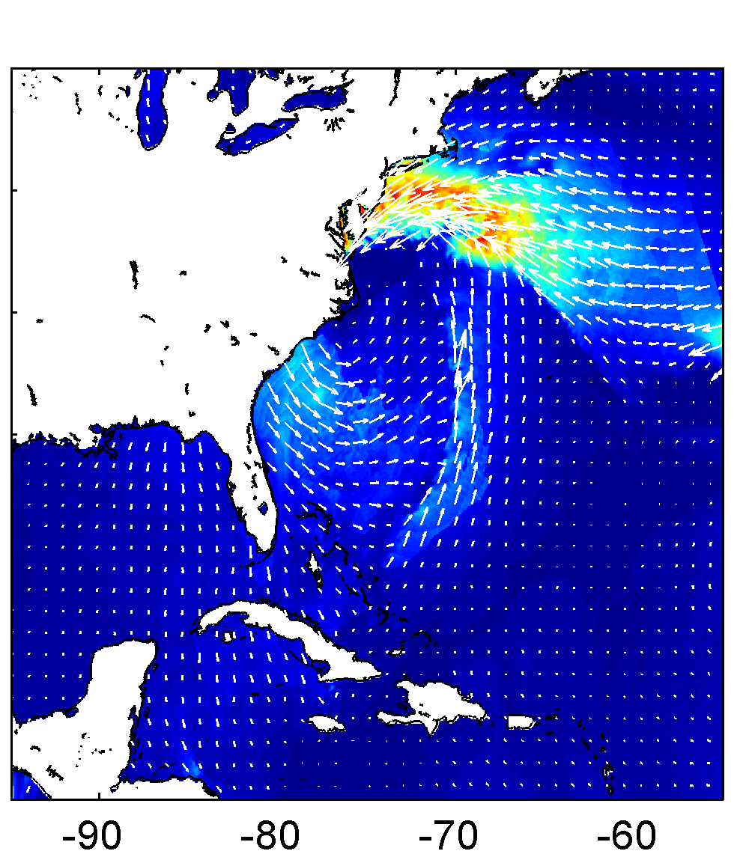
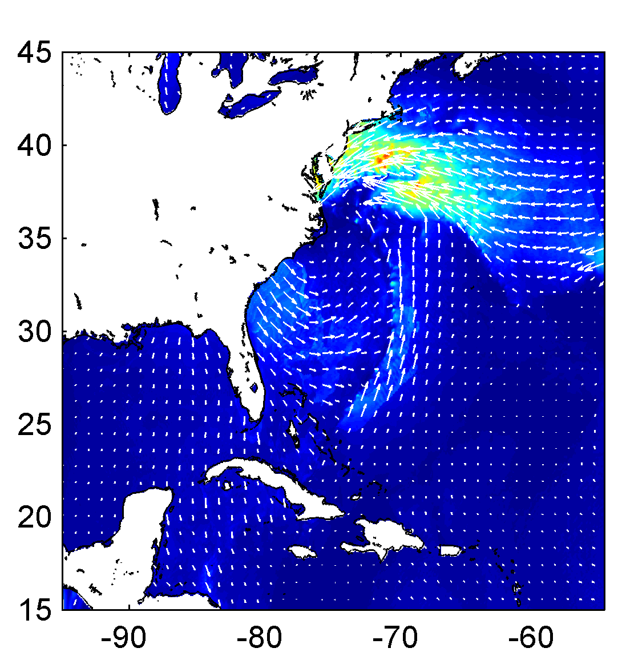
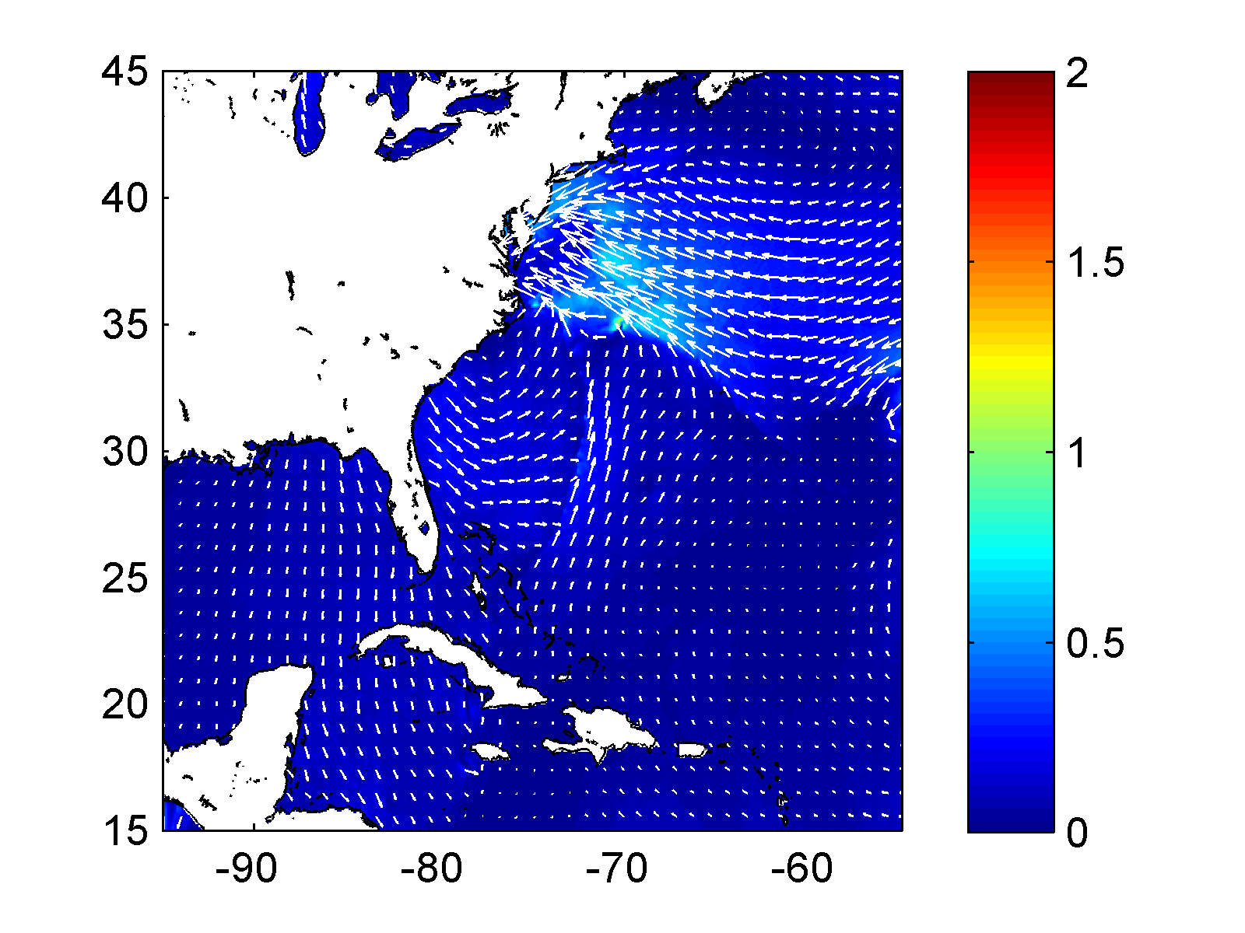
WIND STRESS
WRF + ROMS + SWAN( )
(OOST)
(TY)
(DGQH)
WRF + ROMS (charnock)
Increased stress with waves coupling.
OOST highest.
N/m²

Slide 25
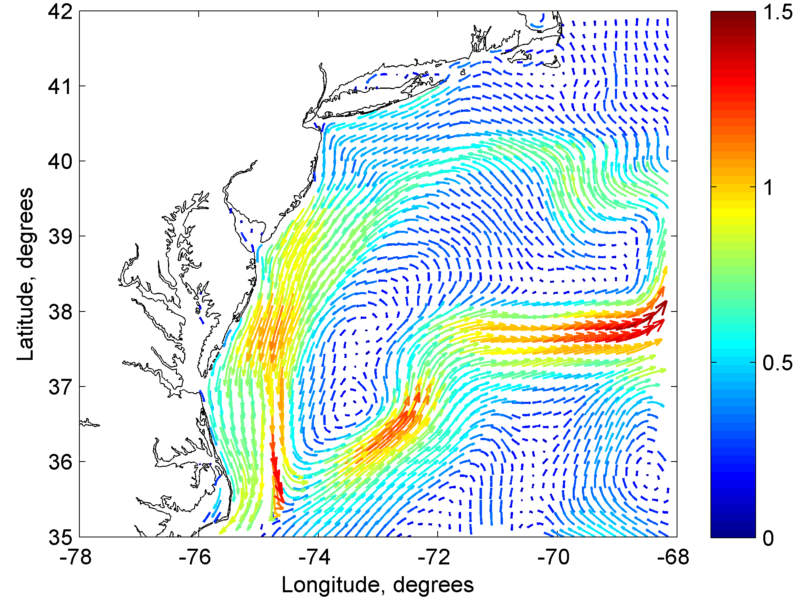
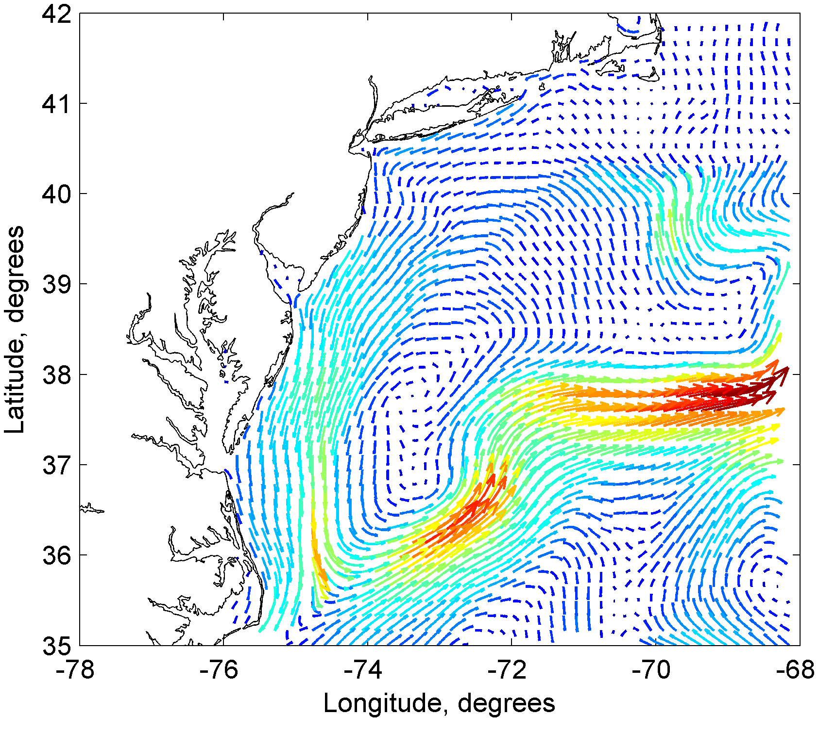
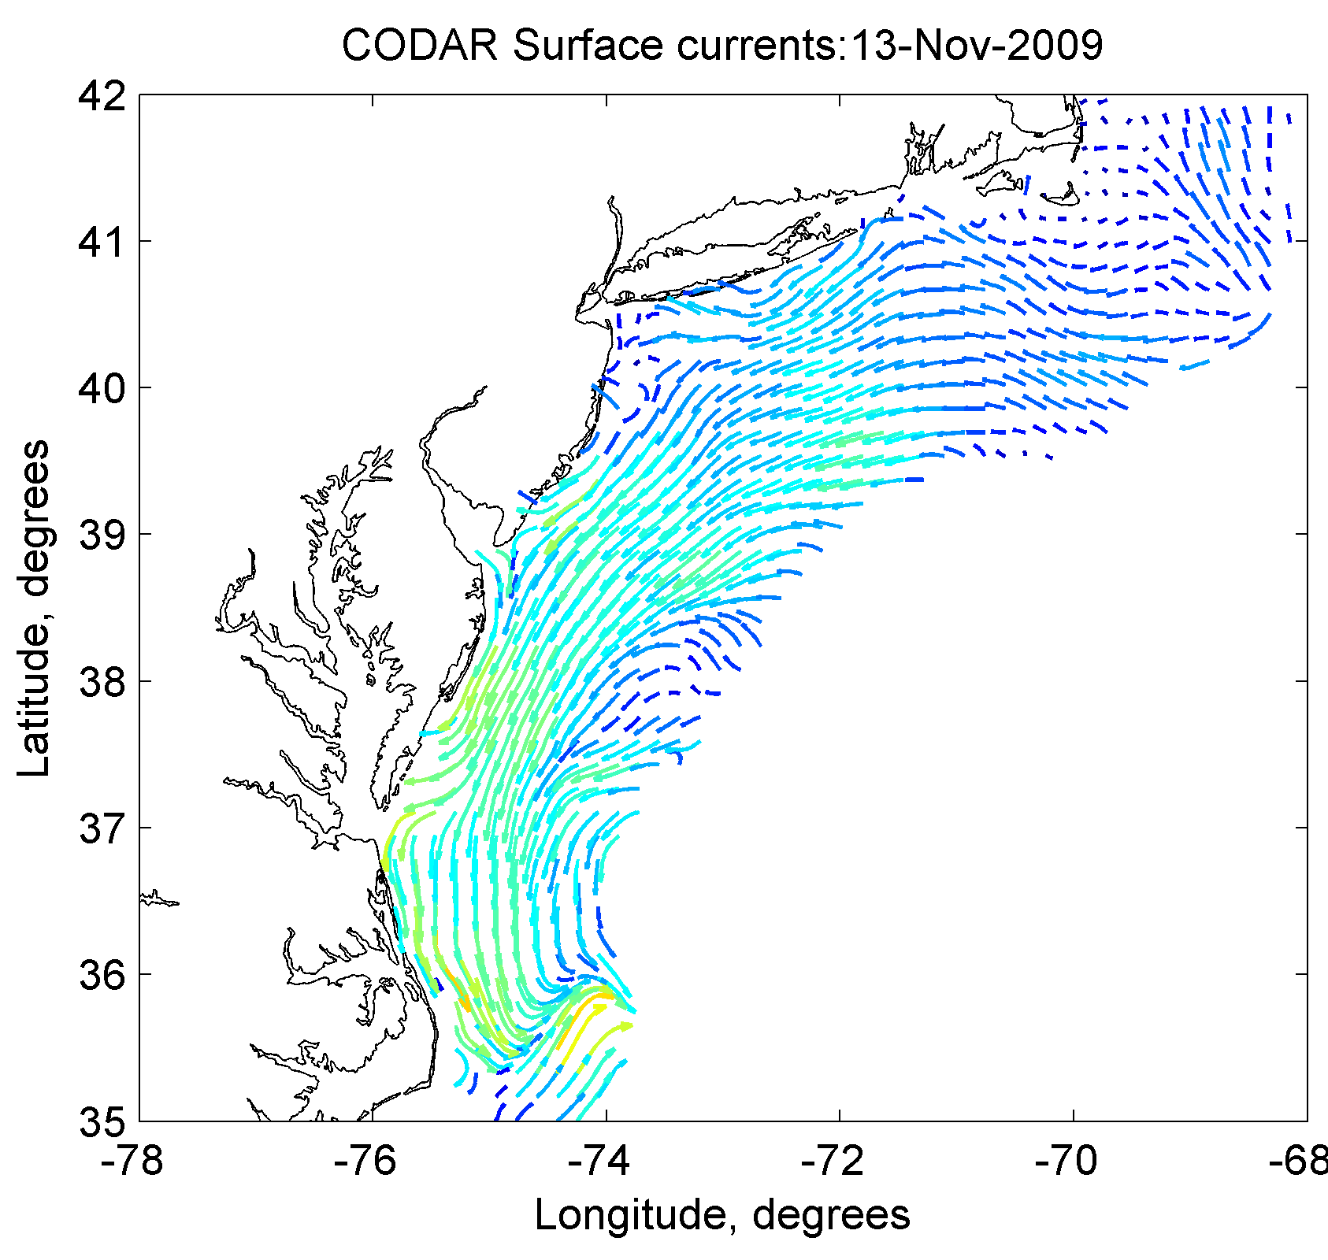
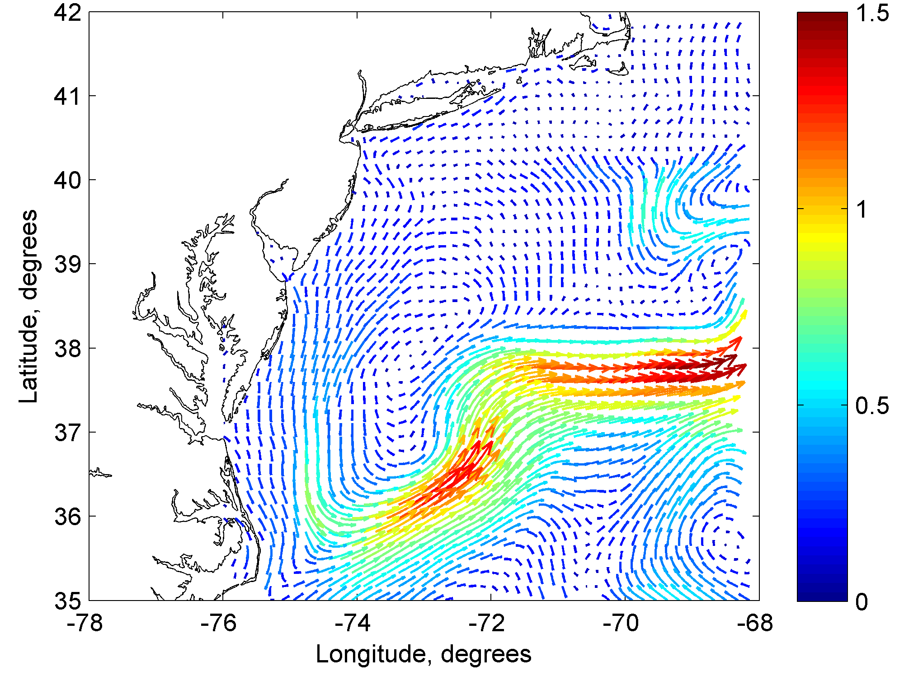
Effect of waves on SURFACE CURRENTS
WRF + ROMS + SWAN( )
(OOST)
(TY)
(DGQH)
WRF + SST + OOST
WRF + SST + TY2001
WRF + SST + DGQH
Increased current speed with waves coupling.
TY / DGQH best.
CODAR
WRF + ROMS (charnock)
m/s
^{m/s}

Slide 26
SURFACE CURRENTS
WRF + ROMS + SWAN( )
(OOST)
(TY)
(DGQH)
WRF + SST + DGQH
Model currents (m/s)
RMSE (m/s) 0.26
RMSE (m/s) 0.13
RMSE (m/s) 0.14
CODAR currents (m/s)
CODAR currents (m/s)
CODAR currents (m/s)
Increased current speed with waves coupling.
TY / DGQH best.
CODAR
WRF + ROMS (charnock)
m/s
RMSE (m/s) 0.24

Slide 27
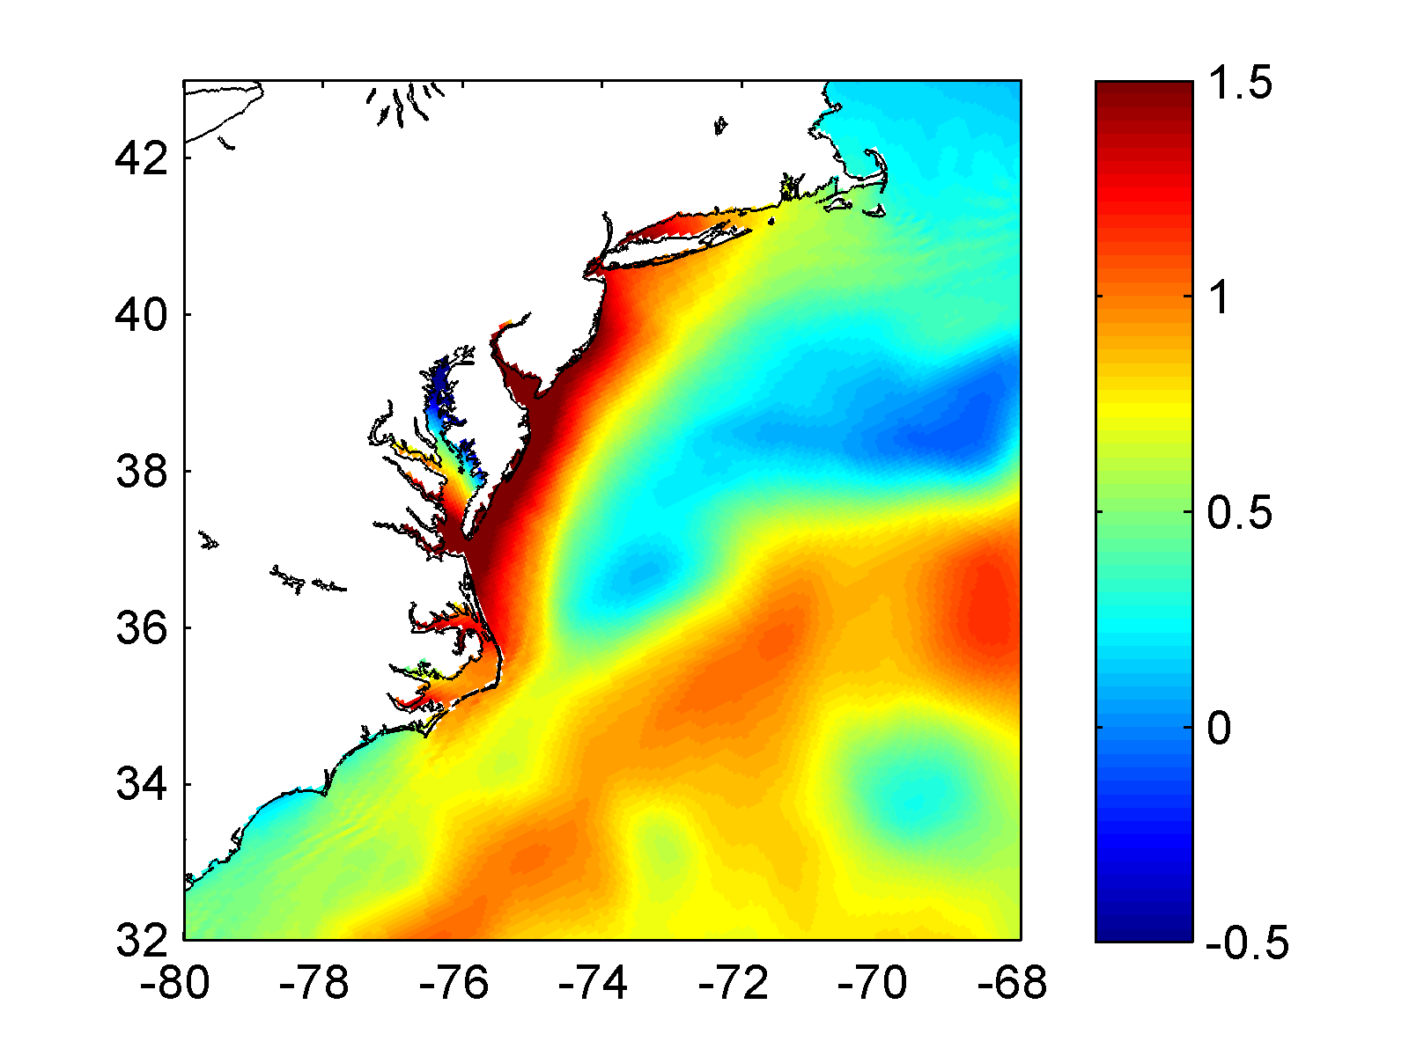
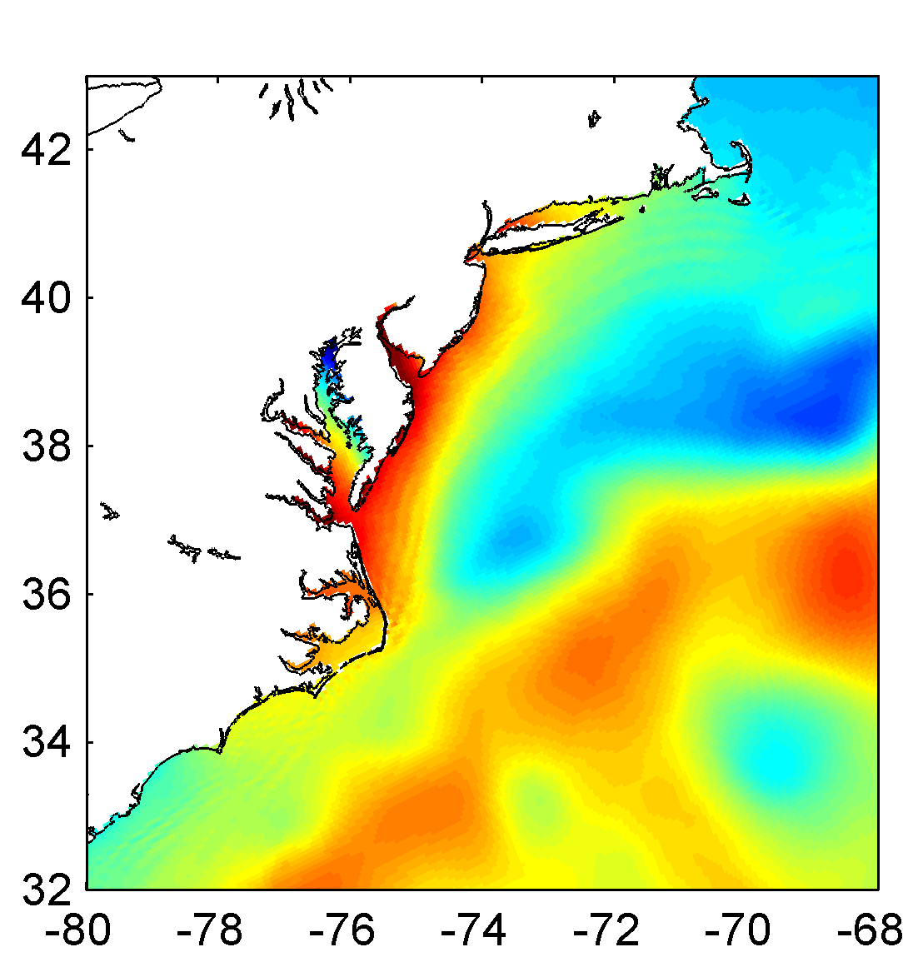
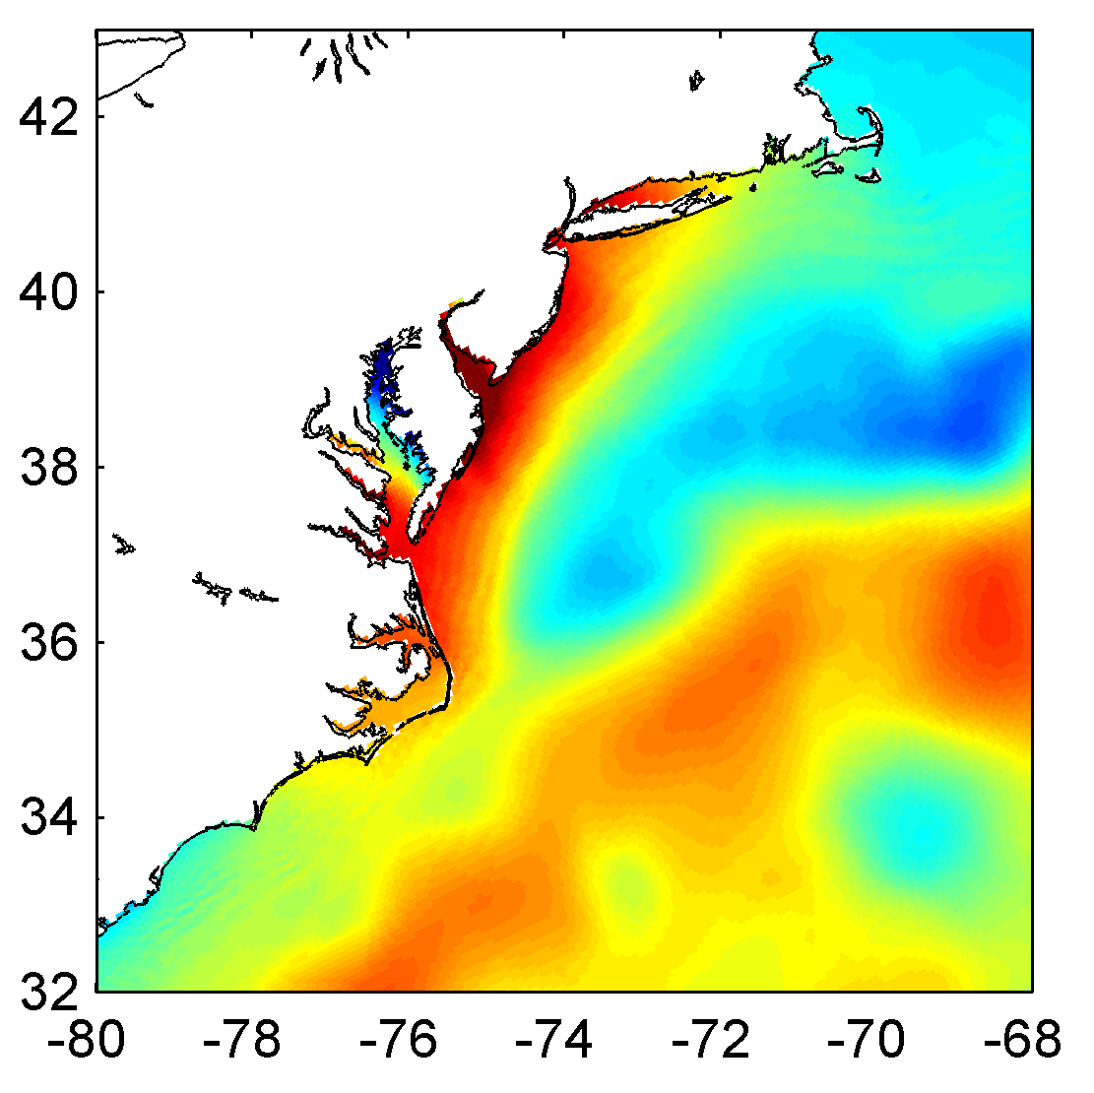
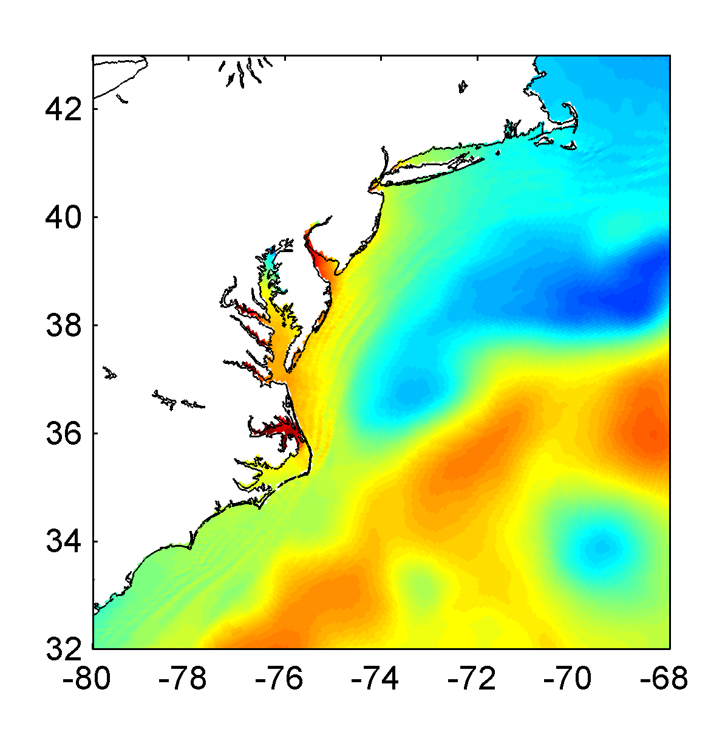
STORM SURGE
WRF+ SST + OOST
WRF + ROMS + SWAN( )
(OOST)
m
(TY)
(DGQH)
WRF
WRF + ROMS
Increased surge with waves coupling.
TY / DGQH best?
DATA
WRF
WRF+ROMS
W+R+S (DGQH)
W+R+S (TY2001)
W+R+S (OOST)

Slide 28
QUESTIONS WE WANTED TO ANSWER WITH THIS STUDY:
HOW MUCH DOES THE OCEAN SURFACE ROUGHNESS PARAMETERIZATION AFFECT WIND, WAVE AND SURGE PREDICTIONS DURING EXTREME STORMS?
DOES THE MODEL SKILL IMPROVE WHEN INCLUDING THE WAVE DEPENDENCY?
IS THERE ANY PARAMETERIZATION THAT PROVIDES THE BEST WIND, WAVE AND STORM SURGE ESTIMATIONS?
Notes:
Location 1: Oblique aerial photography from Wallops Island, VA on May 21, 2009 (top) and December 4, 2009 (bottom), roughly two weeks after the storm. The yellow arrows point to the same location in each photograph. The protective beach fronting this section of the NASA facility on Wallops Island was severely eroded, exposing what appears to be more than one generation of shore protection structures. Some overwash deposition is evident in the post-storm photograph, particularly in the right (north) half of the image.
HOW MUCH DOES THE OCEAN SURFACE ROUGHNESS PARAMETERIZATION AFFECT WIND, WAVE AND SURGE PREDICTIONS DURING EXTREME STORMS?
DOES THE MODEL SKILL IMPROVE WHEN INCLUDING THE WAVE DEPENDENCY?
IS THERE ANY PARAMETERIZATION THAT PROVIDES THE BEST WIND, WAVE AND STORM SURGE ESTIMATIONS?

Slide 29
OCEAN SURFACE ROUGHNESS CLOSURE MODELS
#if defined DRAGLIM_DAVIS
Z0=MIN(Z0,2.85E-3) !Davis limiting
#endif
TAYLOR & YELLAND 2001: TY2001
- Wave steepness based parameterization.
- Based on three datasets representing sea-state conditions ranging from strongly forced to shoaling.
DRENNAN 2003: DGQH
Wave age based formula to characterize the ocean roughness.
They combined data from many field experiments representing a variety of condition and grouped the data as a function of the wind friction velocity.
OOST 2002: OOST
- Wave age dependent formula but it also considers the effect of the wave steepness.

