Slide 1
The COAWST Toolbox
COAWST Workshop 2019
NCSU
Notes:
ONR

Slide 2
The COAWST Toolbox: What are the components needed for an arbitrary model setup?
Notes:
ONR

Slide 3
1) grid
Notes:
ONR

Slide 4
2) initial condition: T, S, η, u, v, sediment, vegetation, waves
Notes:
ONR

Slide 5
3) atmospheric forcing
LW, SW
radiation
precipitation
air temperature
humidity
stresses
winds
Notes:
ONR

Slide 6
4) boundary forcing
LW, SW
radiation
precipitation
air temperature
humidity
stresses
winds
waves
tides
incoming or
outgoing
currents, T,
S, sediment
Notes:
ONR

Slide 7
5) climatology
LW, SW
radiation
precipitation
air temperature
humidity
winds
waves
tides
incoming or
outgoing
currents, T,
S, sediment
Notes:
ONR

Slide 8
The COAWST Toolbox: What is it?
suite of MATLAB tools, scripts, and functions distributed with COAWST via svn
provides standard functionality to create grids, initial condition, boundary, and climatology files, atmospheric forcing files, tidal forcing files
ROMS expects specific variable names, dimensions, units, netcdf conventions
check varinfo.dat
SWAN expects specific file formats
check SWAN User Manual
Notes:
ONR

Slide 9
The COAWST Toolbox: What is it?
other very useful toolboxes are also distributed within
utility, analysis, plotting routines
tidal analysis
map generation
Notes:
ONR

Slide 10
The COAWST Toolbox: What is it?
recommended approach:
add the toolbox to your MATLAB path
copy overarching (master) functions to your own folder for editing for your application
Notes:
ONR

Slide 11
The COAWST Toolbox: Where is it?
[~/COAWST]$ ls
coawst.bash Lib run_coawst WRF
COAWST_User_Manual.doc makefile SOILPARM.TBL WW3
Compilers Master SWAN
Data Projects Tools
ESM REFDIF URBPARM.TBL
GENPARM.TBL ROMS User
InWave RRTM_DATA VEGPARM.TBL
LANDUSE.TBL RRTM_DATA_DBL WPS
Notes:
ONR

Slide 12
The COAWST Toolbox: What is in it?
[~/COAWST/Tools/mfiles/]$ ls
inwave_tools
m_map
mtools
roms_clm
rutgers
swan_forc
tides
Notes:
ONR

Slide 13
The COAWST Toolbox: What is in it?
[~/COAWST/Tools/mfiles/]$ ls
inwave_tools
m_map
mtools
roms_clm
rutgers
swan_forc
tides
Notes:
ONR

Slide 14
The COAWST Toolbox: inwave_tools
[~/COAWST/Tools/mfiles/inwave_tools/]$ ls
Bound_wave.m InWave_inlet_test_param.m plot_bound_wave.m
create_InWave_bry.m InWave_lip_param.m read_swan_spc.m
create_InWave_grd.m InWave_shoreface_param.m specchar.m
create_InWave_ini.m jonswap_lip.m waven.m
freq_test.m master_InWave_create_files.m
groupchar.m offbreach_2012103100.spc2d
InWave is an infragravity wave model that uses SWAN S(ƒ,θ) to generate and propagate infragravity wave energy
scripts to build test cases (master_*.m, InWave_*_param.m, create_InWave_*.m)
scripts to calculate wave characteristics (waven.m, specchar.m, freq_test.m, …)
Notes:
ONR

Slide 15
The COAWST Toolbox: What is in it?
[~/COAWST/Tools/mfiles/]$ ls
inwave_tools
m_map
mtools
roms_clm
rutgers
swan_forc
tides
Notes:
ONR

Slide 16
The COAWST Toolbox: m_map
[~/COAWST/Tools/mfiles/m_map/]$ ls
Contents.m m_etopo2.m m_idist.m m_range_ring.m m_usercoast.m
m_annotation.m m_etopo2.m.OLD m_jet.m m_rectangle.m m_utmgrid.m
map.html m_fdist.m m_legend.m m_ruler.m m_vec.m
mapug.html m_geo2mag.m m_line.m m_scale.m m_windbarb.m
m_coast.m m_geodesic.m m_ll2xy.m m_scatter.m m_xy2ll.m
m_colmap.m m_grid.m m_lldist.m m_shadedrelief.m m_xydist.m
m_contfbar.m m_gshhs_c.m m_mag2geo.m m_shaperead.m mygrid_sand2.m
m_contourf.m m_gshhs_f.m m_patch.m m_streamline.m private
m_contour.m m_gshhs_h.m m_pcolor.m m_tba2b.m wysiwyg.m
m_coord.m m_gshhs_i.m m_plotbndry.m m_tbase.m
m_demo.m m_gshhs_l.m m_plot.m m_text.m
m_elev.m m_gshhs.m m_proj.m m_track.m
m_ellipse.m m_hatch.m m_quiver.m m_ungrid.m
https://www.eoas.ubc.ca/~rich/map.html
mapping functionality for MATLAB
Notes:
ONR

Slide 17
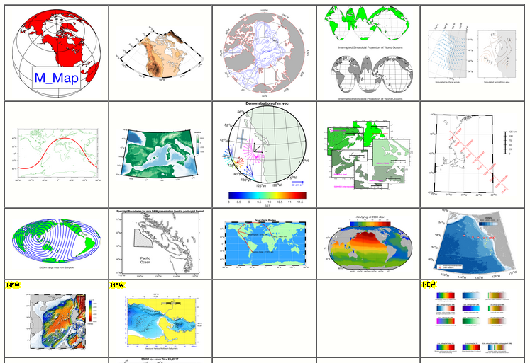
The COAWST Toolbox: m_map
Notes:
ONR

Slide 18
The COAWST Toolbox: What is in it?
[~/COAWST/Tools/mfiles/]$ ls
inwave_tools
m_map
mtools
roms_clm
rutgers
swan_forc
tides
Notes:
ONR

Slide 19
The COAWST Toolbox: mtools
[~/COAWST/Tools/mfiles/mtools/]$ ls
create_extra_rho_grid.m ncei_2roms.m
create_roms_child_clm.m ncei_2swan.m
create_roms_child_init.m netcdf_load.m
create_roms_forcings.m parentchild_bathy.m
create_roms_init.m parentchild_mask.m
create_roms_netcdf_grid_file.m pcolorjw.m
create_roms_rivers.m plot_scrip_weights.m
create_roms_xygrid.m roms2swan.m
create_ww3_grid_files.m roms_getnplot_grid_rutgers.m
create_ww3_wind_forcing.m s2hms.m
earthdist.m set_depth.m
gregorian.m stretching.m
ij2ind.m swanmat2roms.m
ind2ij.m sw_dist.m
julian.m sw_f.m
maplev.m wrf2roms_mw.m
mat2roms_mw.m wrf_rename.plx
narrnc2roms.m
Notes:
ONR

Slide 20
The COAWST Toolbox: mtools
[~/COAWST/Tools/mfiles/mtools/]$ ls
create_extra_rho_grid.m ncei_2roms.m
create_roms_child_clm.m ncei_2swan.m
create_roms_child_init.m netcdf_load.m
create_roms_forcings.m parentchild_bathy.m
create_roms_init.m parentchild_mask.m
create_roms_netcdf_grid_file.m pcolorjw.m
create_roms_rivers.m plot_scrip_weights.m
create_roms_xygrid.m roms2swan.m
create_ww3_grid_files.m roms_getnplot_grid_rutgers.m
create_ww3_wind_forcing.m s2hms.m
earthdist.m set_depth.m
gregorian.m stretching.m
ij2ind.m swanmat2roms.m
ind2ij.m sw_dist.m
julian.m sw_f.m
maplev.m wrf2roms_mw.m
mat2roms_mw.m wrf_rename.plx
narrnc2roms.m
Notes:
ONR

Slide 21
The COAWST Toolbox: mtools
[~/COAWST/Tools/mfiles/mtools/]$ ls
create_extra_rho_grid.m ncei_2roms.m
create_roms_child_clm.m ncei_2swan.m
create_roms_child_init.m netcdf_load.m
create_roms_forcings.m parentchild_bathy.m
create_roms_init.m parentchild_mask.m
create_roms_netcdf_grid_file.m pcolorjw.m
create_roms_rivers.m plot_scrip_weights.m
create_roms_xygrid.m roms2swan.m
create_ww3_grid_files.m roms_getnplot_grid_rutgers.m
create_ww3_wind_forcing.m s2hms.m
earthdist.m set_depth.m
gregorian.m stretching.m
ij2ind.m swanmat2roms.m
ind2ij.m sw_dist.m
julian.m sw_f.m
maplev.m wrf2roms_mw.m
mat2roms_mw.m wrf_rename.plx
narrnc2roms.m
calculates the distance in m between two lat/lon points
Notes:
ONR

Slide 22
The COAWST Toolbox: mtools
[~/COAWST/Tools/mfiles/mtools/]$ ls
create_extra_rho_grid.m ncei_2roms.m
create_roms_child_clm.m ncei_2swan.m
create_roms_child_init.m netcdf_load.m
create_roms_forcings.m parentchild_bathy.m
create_roms_init.m parentchild_mask.m
create_roms_netcdf_grid_file.m pcolorjw.m
create_roms_rivers.m plot_scrip_weights.m
create_roms_xygrid.m roms2swan.m
create_ww3_grid_files.m roms_getnplot_grid_rutgers.m
create_ww3_wind_forcing.m s2hms.m
earthdist.m set_depth.m
gregorian.m stretching.m
ij2ind.m swanmat2roms.m
ind2ij.m sw_dist.m
julian.m sw_f.m
maplev.m wrf2roms_mw.m
mat2roms_mw.m wrf_rename.plx
narrnc2roms.m
time functionality
Notes:
ONR

Slide 23
The COAWST Toolbox: mtools
[~/COAWST/Tools/mfiles/mtools/]$ ls
create_extra_rho_grid.m ncei_2roms.m
create_roms_child_clm.m ncei_2swan.m
create_roms_child_init.m netcdf_load.m
create_roms_forcings.m parentchild_bathy.m
create_roms_init.m parentchild_mask.m
create_roms_netcdf_grid_file.m pcolorjw.m
create_roms_rivers.m plot_scrip_weights.m
create_roms_xygrid.m roms2swan.m
create_ww3_grid_files.m roms_getnplot_grid_rutgers.m
create_ww3_wind_forcing.m s2hms.m
earthdist.m set_depth.m
gregorian.m stretching.m
ij2ind.m swanmat2roms.m
ind2ij.m sw_dist.m
julian.m sw_f.m
maplev.m wrf2roms_mw.m
mat2roms_mw.m wrf_rename.plx
narrnc2roms.m
vertical coordinates
functionality
Notes:
ONR

Slide 24
The COAWST Toolbox: mtools
[~/COAWST/Tools/mfiles/mtools/]$ ls
create_extra_rho_grid.m ncei_2roms.m
create_roms_child_clm.m ncei_2swan.m
create_roms_child_init.m netcdf_load.m
create_roms_forcings.m parentchild_bathy.m
create_roms_init.m parentchild_mask.m
create_roms_netcdf_grid_file.m pcolorjw.m
create_roms_rivers.m plot_scrip_weights.m
create_roms_xygrid.m roms2swan.m
create_ww3_grid_files.m roms_getnplot_grid_rutgers.m
create_ww3_wind_forcing.m s2hms.m
earthdist.m set_depth.m
gregorian.m stretching.m
ij2ind.m swanmat2roms.m
ind2ij.m sw_dist.m
julian.m sw_f.m
maplev.m wrf2roms_mw.m
mat2roms_mw.m wrf_rename.plx
narrnc2roms.m
loads an entire netcdf file
Notes:
ONR

Slide 25
The COAWST Toolbox: mtools
[~/COAWST/Tools/mfiles/mtools/]$ ls
create_extra_rho_grid.m ncei_2roms.m
create_roms_child_clm.m ncei_2swan.m
create_roms_child_init.m netcdf_load.m
create_roms_forcings.m parentchild_bathy.m
create_roms_init.m parentchild_mask.m
create_roms_netcdf_grid_file.m pcolorjw.m
create_roms_rivers.m plot_scrip_weights.m
create_roms_xygrid.m roms2swan.m
create_ww3_grid_files.m roms_getnplot_grid_rutgers.m
create_ww3_wind_forcing.m s2hms.m
earthdist.m set_depth.m
gregorian.m stretching.m
ij2ind.m swanmat2roms.m
ind2ij.m sw_dist.m
julian.m sw_f.m
maplev.m wrf2roms_mw.m
mat2roms_mw.m wrf_rename.plx
narrnc2roms.m
pcolor that doesn’t clip data in interpolation
Notes:
ONR

Slide 26
The COAWST Toolbox: mtools
[~/COAWST/Tools/mfiles/mtools/]$ ls
create_extra_rho_grid.m ncei_2roms.m
create_roms_child_clm.m ncei_2swan.m
create_roms_child_init.m netcdf_load.m
create_roms_forcings.m parentchild_bathy.m
create_roms_init.m parentchild_mask.m
create_roms_netcdf_grid_file.m pcolorjw.m
create_roms_rivers.m plot_scrip_weights.m
create_roms_xygrid.m roms2swan.m
create_ww3_grid_files.m roms_getnplot_grid_rutgers.m
create_ww3_wind_forcing.m s2hms.m
earthdist.m set_depth.m
gregorian.m stretching.m
ij2ind.m swanmat2roms.m
ind2ij.m sw_dist.m
julian.m sw_f.m
maplev.m wrf2roms_mw.m
mat2roms_mw.m wrf_rename.plx
narrnc2roms.m
fills missing data via a filter
Notes:
ONR

Slide 27
The COAWST Toolbox: mtools
[~/COAWST/Tools/mfiles/mtools/]$ ls
create_extra_rho_grid.m ncei_2roms.m
create_roms_child_clm.m ncei_2swan.m
create_roms_child_init.m netcdf_load.m
create_roms_forcings.m parentchild_bathy.m
create_roms_init.m parentchild_mask.m
create_roms_netcdf_grid_file.m pcolorjw.m
create_roms_rivers.m plot_scrip_weights.m
create_roms_xygrid.m roms2swan.m
create_ww3_grid_files.m roms_getnplot_grid_rutgers.m
create_ww3_wind_forcing.m s2hms.m
earthdist.m set_depth.m
gregorian.m stretching.m
ij2ind.m swanmat2roms.m
ind2ij.m sw_dist.m
julian.m sw_f.m
maplev.m wrf2roms_mw.m
mat2roms_mw.m wrf_rename.plx
narrnc2roms.m
Notes:
ONR

Slide 28
The COAWST Toolbox: mtools
[~/COAWST/Tools/mfiles/mtools/]$ ls
create_extra_rho_grid.m ncei_2roms.m
create_roms_child_clm.m ncei_2swan.m
create_roms_child_init.m netcdf_load.m
create_roms_forcings.m parentchild_bathy.m
create_roms_init.m parentchild_mask.m
create_roms_netcdf_grid_file.m pcolorjw.m
create_roms_rivers.m plot_scrip_weights.m
create_roms_xygrid.m roms2swan.m
create_ww3_grid_files.m roms_getnplot_grid_rutgers.m
create_ww3_wind_forcing.m s2hms.m
earthdist.m set_depth.m
gregorian.m stretching.m
ij2ind.m swanmat2roms.m
ind2ij.m sw_dist.m
julian.m sw_f.m
maplev.m wrf2roms_mw.m
mat2roms_mw.m wrf_rename.plx
narrnc2roms.m
creates SWAN .bot and .grd from roms grid
Notes:
ONR

Slide 29
The COAWST Toolbox: mtools
[~/COAWST/Tools/mfiles/mtools/]$ ls
create_extra_rho_grid.m ncei_2roms.m
create_roms_child_clm.m ncei_2swan.m
create_roms_child_init.m netcdf_load.m
create_roms_forcings.m parentchild_bathy.m
create_roms_init.m parentchild_mask.m
create_roms_netcdf_grid_file.m pcolorjw.m
create_roms_rivers.m plot_scrip_weights.m
create_roms_xygrid.m roms2swan.m
create_ww3_grid_files.m roms_getnplot_grid_rutgers.m
create_ww3_wind_forcing.m s2hms.m
earthdist.m set_depth.m
gregorian.m stretching.m
ij2ind.m swanmat2roms.m
ind2ij.m sw_dist.m
julian.m sw_f.m
maplev.m wrf2roms_mw.m
mat2roms_mw.m wrf_rename.plx
narrnc2roms.m
Notes:
ONR

Slide 30
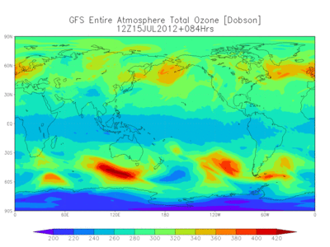
The COAWST Toolbox: mtools
https://www.ncdc.noaa.gov/data-access/model-data/model-datasets
extracts atmospheric variables from the chosen product
GFS
Global
analysis and forecast
products
2007-present
NARR
North American
reanalysis product
1979-2014
NAM
North American
analysis and forecast
products
2004-present
Notes:
ONR

Slide 31
The COAWST Toolbox: What is in it?
[~/COAWST/Tools/mfiles/]$ ls
inwave_tools
m_map
mtools
roms_clm
rutgers
swan_forc
tides
Notes:
ONR

Slide 32
The COAWST Toolbox: roms_clm
[~/COAWST/Tools/mfiles/mtools/roms_clm/]$ ls
create_roms_netcdf_bndry_mwUL.m roms_from_stdlev_mw.m
create_roms_netcdf_clm_mwUL.m roms_master_climatology_coawst_mw.m
create_roms_netcdf_init_mw.m roms_zint_mw.m
dirsort.m u2rho_2d_mw.m
get_ijrg.m u2rho_3d_mw.m
rho2u_2d_mw.m updatbdry_coawst_mw.m
rho2u_3d_mw.m updatclim_coawst_mw.m
rho2v_2d_mw.m updatinit_coawst_mw.m
rho2v_3d_mw.m v2rho_2d_mw.m
roms_cgridpos.m v2rho_3d_mw.m
roms_combine_clm_bdy.m
Notes:
ONR

Slide 33
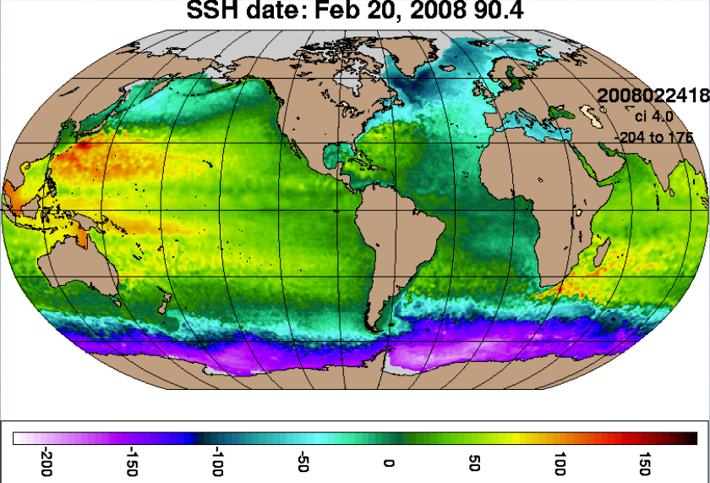
The COAWST Toolbox: roms_clm
HYCOM (Hybrid Coordinate Ocean Model)
data assimilative
1/12° resolution
hybrid vertical coordinates
excellent source for initial, boundary, and climatology conditions
Notes:
ONR

Slide 34
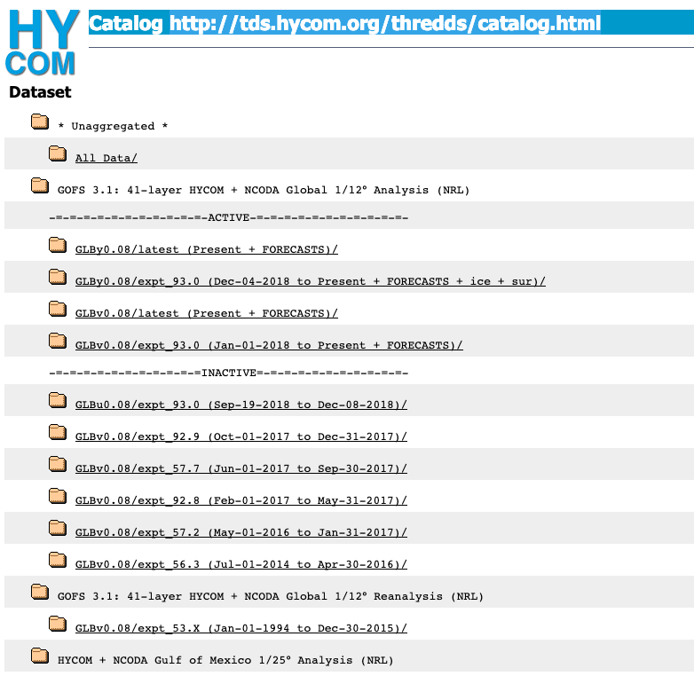
The COAWST Toolbox: roms_clm
HYCOM (Hybrid Coordinate Ocean Model)
data assimilative
1/12° resolution
hybrid vertical coordinates
excellent source for initial, boundary, and climatology conditions
Notes:
ONR

Slide 35
The COAWST Toolbox: roms_clm
find the lat/lon range of your grid within the HYCOM domain
initialize the climatology, boundary, and initial conditions netcdf files
extract HYCOM u, v, η, T, S within the lat/lon range found
transform vertical coordinates
calculate ubar, vbar
rotate to your ROMS grid
write out initial fields
append climatology fields for time period and frequency requested
write boundary fields
Notes:
ONR

Slide 36
The COAWST Toolbox: roms_clm
[~/COAWST/Tools/mfiles/mtools/roms_clm/]$ ls
create_roms_netcdf_bndry_mwUL.m roms_from_stdlev_mw.m
create_roms_netcdf_clm_mwUL.m roms_master_climatology_coawst_mw.m
create_roms_netcdf_init_mw.m roms_zint_mw.m
dirsort.m u2rho_2d_mw.m
get_ijrg.m u2rho_3d_mw.m
rho2u_2d_mw.m updatbdry_coawst_mw.m
rho2u_3d_mw.m updatclim_coawst_mw.m
rho2v_2d_mw.m updatinit_coawst_mw.m
rho2v_3d_mw.m v2rho_2d_mw.m
roms_cgridpos.m v2rho_3d_mw.m
roms_combine_clm_bdy.m
Notes:
ONR

Slide 37
The COAWST Toolbox: What is in it?
[~/COAWST/Tools/mfiles/]$ ls
inwave_tools
m_map
mtools
roms_clm
rutgers
swan_forc
tides
Notes:
ONR

Slide 38
The COAWST Toolbox: rutgers
[~/COAWST/Tools/mfiles/rutgers/]$ ls
4dvar bin coastlines forcing initial netcdf
bathymetry boundary colormaps grid landmask seawater
utility
ROMS-distributed toolbox
Notes:
ONR

Slide 39
The COAWST Toolbox: What is in it?
[~/COAWST/Tools/mfiles/]$ ls
inwave_tools
m_map
mtools
roms_clm
rutgers
swan_forc
tides
Notes:
ONR

Slide 40
The COAWST Toolbox: swan_forc
[~/COAWST/Tools/mfiles/swan_forc/]$ ls
bdry_com.m ww3gb_2TPAR.m
createswan2Dspec.m ww3partition_2TPAR.m
extract_and_save_WW3_partitioned_data.m ww3_specpoints.m
extract_partition_data_awk_westcoast.sh ww3_swan_input.m
Read_SWAN_Dspec.m WWIIIpartitioned2full2D.m
Notes:
ONR

Slide 41
The COAWST Toolbox: swan_forc
NCEP WaveWatch3
Identify points along the boundary where bulk wave parameters or 2D spectra will be defined
Extract either bulk wave parameters or partitioned data which will be reconstructed into spectra
Write to appropriate file format for SWAN to read
Provide user commands for swan.in file
Notes:
ONR

Slide 42
The COAWST Toolbox: swan_forc
[~/COAWST/Tools/mfiles/swan_forc/]$ ls
bdry_com.m ww3gb_2TPAR.m
createswan2Dspec.m ww3partition_2TPAR.m
extract_and_save_WW3_partitioned_data.m ww3_specpoints.m
extract_partition_data_awk_westcoast.sh ww3_swan_input.m
Read_SWAN_Dspec.m WWIIIpartitioned2full2D.m
Notes:
ONR

Slide 43
The COAWST Toolbox: What is in it?
[~/COAWST/Tools/mfiles/]$ ls
inwave_tools
m_map
mtools
roms_clm
rutgers
swan_forc
tides
Notes:
ONR

Slide 44
The COAWST Toolbox: tides
[~/COAWST/Tools/mfiles/tides/]$ ls
create_roms_tides.m roms_tide_forc_file.m tidal_ellipse t_tide
Notes:
ONR

Slide 45
The COAWST Toolbox: tides
[~/COAWST/Tools/mfiles/tides/]$ ls
create_roms_tides.m roms_tide_forc_file.m tidal_ellipse t_tide
generate ADCIRC or TPXO tidal forcing
Notes:
ONR

Slide 46
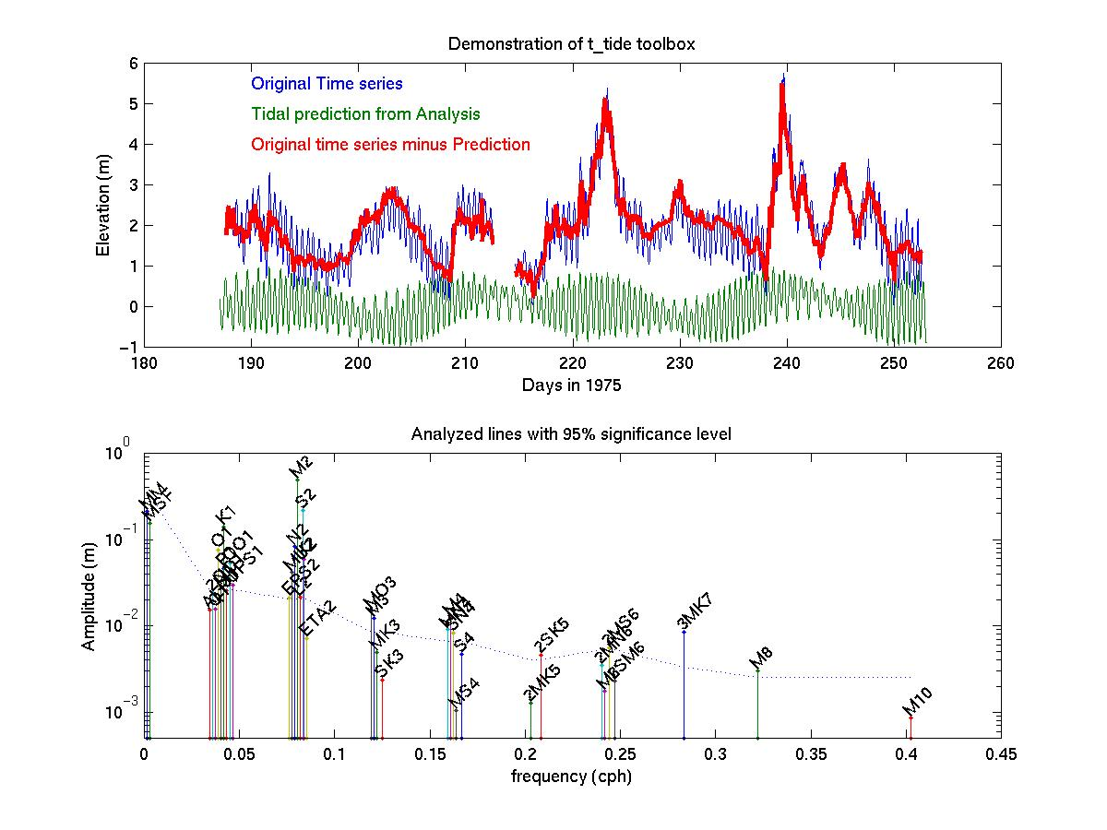
The COAWST Toolbox: tides
[~/COAWST/Tools/mfiles/tides/]$ ls
create_roms_tides.m roms_tide_forc_file.m tidal_ellipse t_tide
Notes:
ONR

Slide 47
The COAWST Toolbox: general format for master scripts
% script ww3_swan_input.m
%
% This script is the main driver to
% download, convert and interpolate WW3 data to TPAR input for SWAN.
%
% Written 4/23/09 by Brandy Armstrong
% some mods, jcwarner Arpil 27, 2009
% added partition file call, jcw, 04Feb2019
%
% First, acquire the necessary grib, ascii (gz), or nc files from
% ftp://polar.ncep.noaa.gov/pub/history/waves/

Slide 48
The COAWST Toolbox: general format for master scripts
% ************* BEGIN USER INPUT ****************************
% 1) Enter WORKING DIRECTORY.
% This is the location of ww3 files downloaded and the
% location of output for the forcing files to be created.
%
working_dir='F:\data\models\COAWST_tests\coawstv3.4_update\coawst_v3.4_tests\sandy\Projects\Sandy\ww3'
% 2) Enter start dates of data requested.
yearww3='2012'; %input year of data yyyy
mmww3='10'; %input month of data mm
ddww3='00'; %keep this as '00’

Slide 49
The COAWST Toolbox: general format for master scripts
% flag for simulations that span several months.
% 0 = one month, 1 = more than one month
% This long run flag is only coded for TPAR files for now.
long_run=0;
if long_run
total_number_months=2; % total number of months
% (not the length of the run, but rather the number
% of ww3 files)
end
% 3) Enter path\name of SWAN grid. This is set up to use the roms grid as the same for swan.
modelgrid='F:\data\models\COAWST_tests\coawstv3.4_update\coawst_v3.4_tests\sandy\Projects\Sandy\Sandy_roms_grid.nc';

Slide 50
The COAWST Toolbox: general format for master scripts
% 5)
% Here you decide to use gridded field output (to make TPAR) or spectral partition data (to make 2Dspec). Read this:
% ftp://polar.ncep.noaa.gov/pub/history/waves/multi_1/00README
% Pick one of these:
use_field_output=0; % will create TPAR files.
use_partition_data=1; % will create 2D spec files.
if (use_field_output)
% Enter the ww3 grid area
ww3_area='multi_1.at_10m'; %western north atlantic
end
if (use_partition_data)
% Enter name of wave watch 3 partition file
partfile='multi_1.partition.glo_30m.201210';
end
% *************END OF USER INPUT****************************

Slide 51
The COAWST Toolbox
Common issues:
atmospheric forcing, climatology, boundary, initial condition files
file formats, variable names, etc. change over the years
check THREDDS catalogs
For help:
ROMS forum
COAWST forum
email
Future developments:
github version control and community contribution
Notes:
ONR

