Slide 1
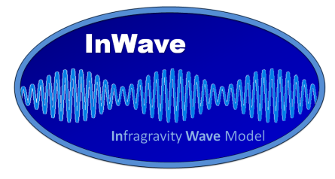



INWAVE:
THE INFRAGRAVITY WAVE DRIVER OF COAWST
Maitane Olabarrieta
John C. Warner
Christie Hegermiller
COAWST WORKSHOP
Raleigh, 25th -28th February, 2019

Slide 2

OUTLINE
  INTRODUCTION AND MOTIVATION
  IG WAVE GENERATION AND DISSIPATION MECHANISMS
  IG WAVE MODELING TECHNIQUES
  INWAVE
    a. EQUATIONS AND NUMERICAL SCHEME
    b. HOW IS IT LINKED TO THE VORTEX FORCE?
    c. APPLICATIONS
    d. FUTURE PLANS

Slide 3

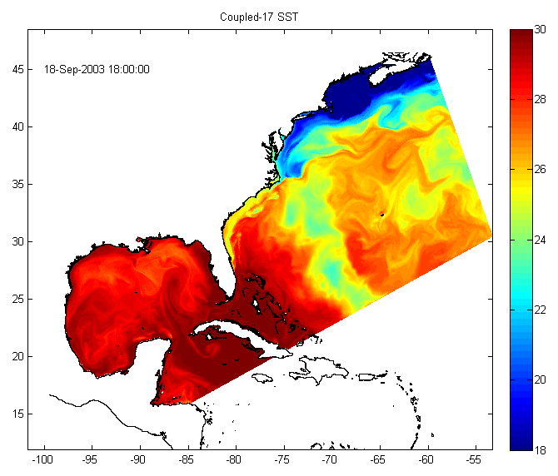
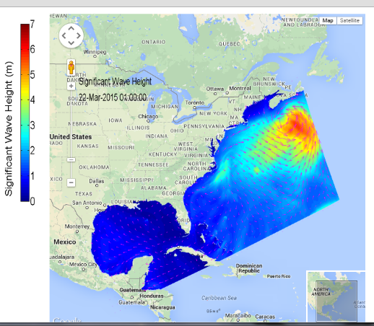

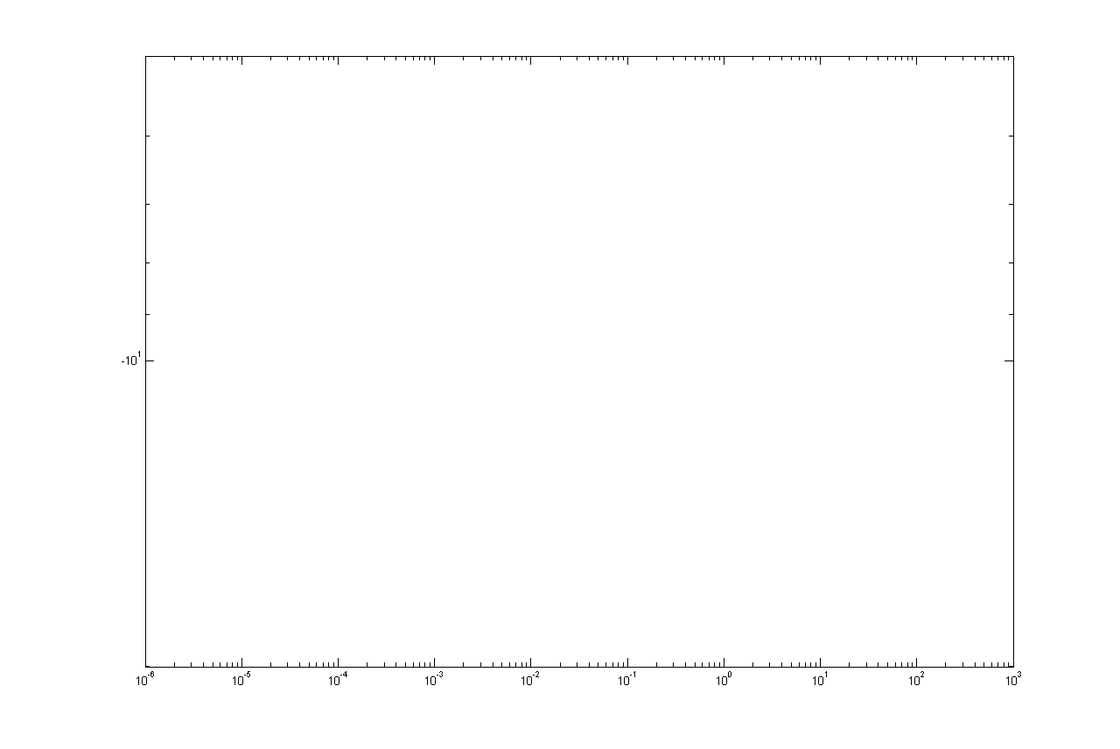

INTRODUCTION AND MOTIVATION
Shallow water waves
Intermediate and deep water waves
24 h
12 h
5 min
30 s
1 s
0.1 s
Period
Tides
Infra-gravity Waves
Gravity Waves
Ultra-gravity Waves
Long Waves
Capillarity Waves
Kind of Wave
Storms, tsunamis
Sun, Moon
Wind
Forcing
Coriolis
Gravity Waves
Surface Tension
Gravity
SWAN Hsig
Restoring Force
ROMS SST
Energy
OCEAN
Frequency (Cycles per second)

Slide 4
INTRODUCTION AND MOTIVATION
InfraGravity (IG) waves are defined as waves with periods between 30 and 300 seconds generated by the non-linear interactions of gravity waves.
In deep water the energy transfer to IG waves is non-resonant and the height of the IG waves is few millimeters. In shallow water the energy transfer becomes near-resonant and IG wave height can increase to over 1 m.
IG waves are highly correlated with the modulation of wind or swell waves.

Slide 5
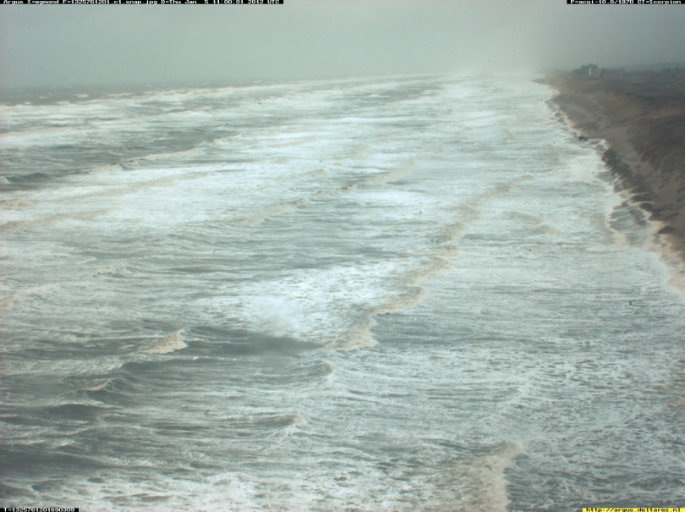
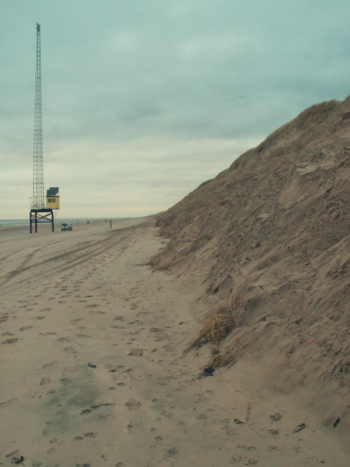
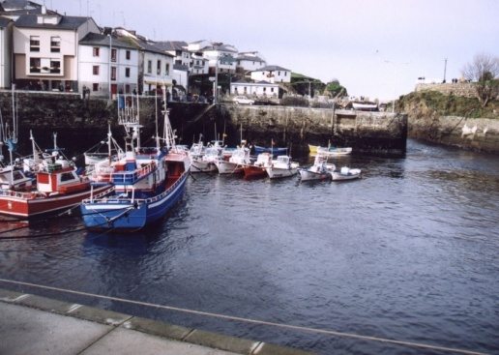
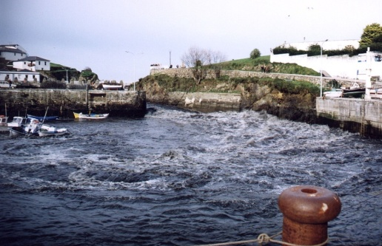
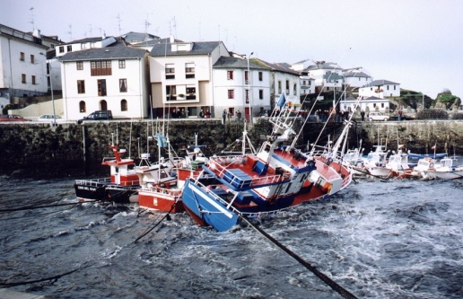
INTRODUCTION AND MOTIVATION
RUNUP AND BEACH-DUNE EROSION
HYDRODYNAMICS IN CORAL REEFS
HARBOR RESONANCE

Slide 6
INTRODUCTION AND MOTIVATION
tides
≈ 15%
offshore
surfzone
sea-swell
infragravity
Ruessink, B.G. (2010). Observations of turbulence within a natural surf zone. Journal of physical oceanography, 40 (12).

Slide 7
INTRODUCTION AND MOTIVATION
TOTAL WATER LEVEL=
ASTRONOMIC TIDE (AT) + STORM SURGE (SS) + WAVE RUNUP
atmospheric pressure +
wind stress +
shelf oscillations or seiche
wave setup +
incident wave runup +
IG wave runup

Slide 8
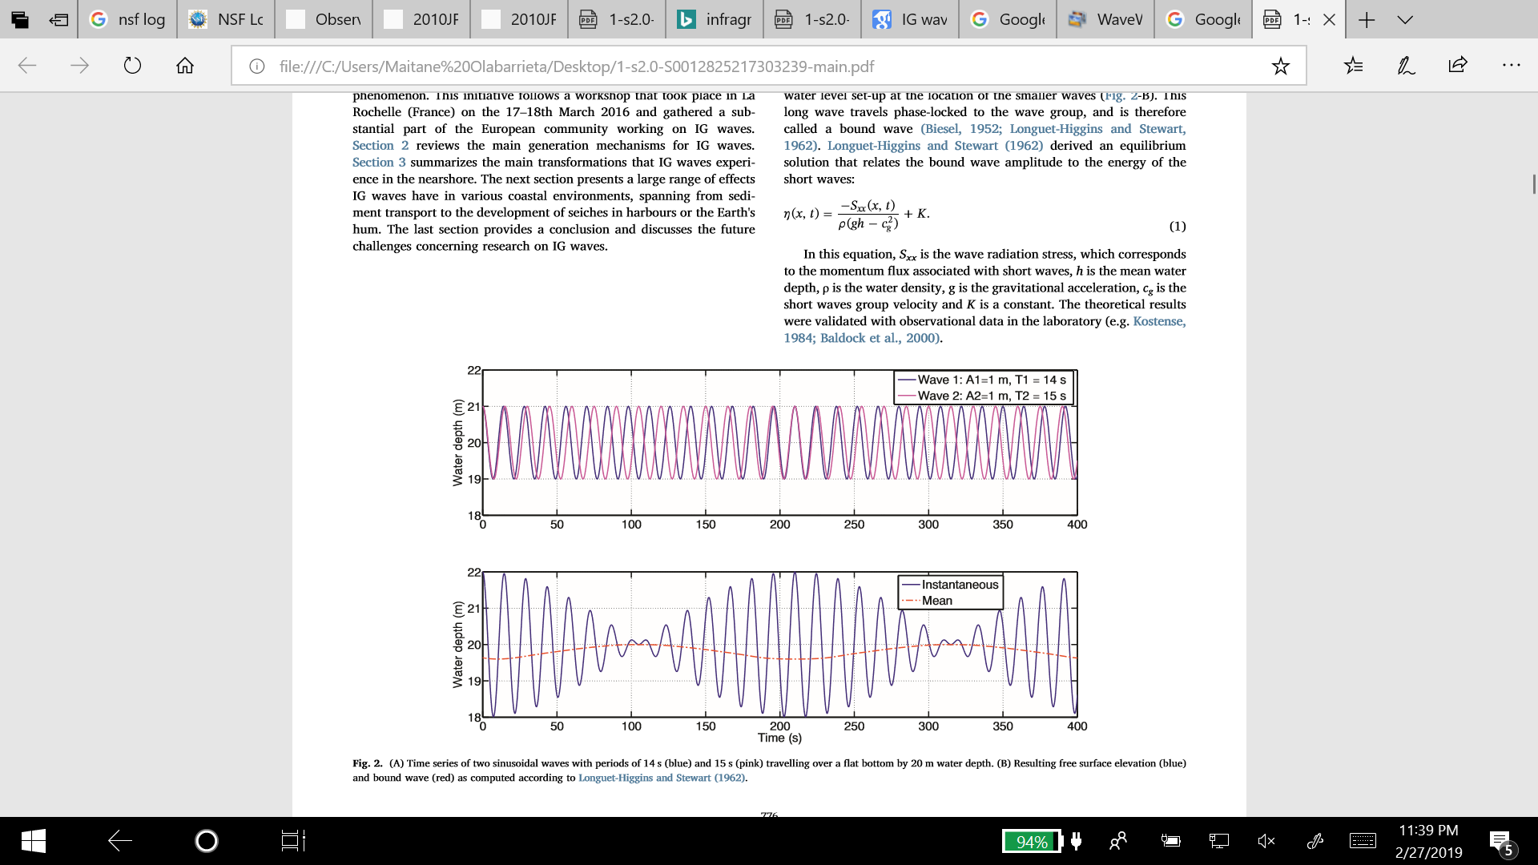
IG WAVE GENERATION AND DISSIPATION MECHANISMS
GENERATION MECHANISMS
GROUP-BOUND WAVE GENERATION AND SHOALING: Quadratic difference interaction among pairs of primary waves, resulting in group-bound second-order waves (Biesel, 1952; Longuet-Higgins and Stewart, 1962).
Figure taken from Bertin et al. (2018) Infragravity waves: from driving mechanisms to
Impacts. Earth science reviews.

Slide 9
IG WAVE GENERATION AND DISSIPATION MECHANISMS
Breaking point
Incident wave group
Incident wave groups
Incoming and outgoing free long wave
Incoming bound long wave
Outgoing free long wave
z
Reflection
x (cross-shore direction)
Dominant over mild slopes

Slide 10
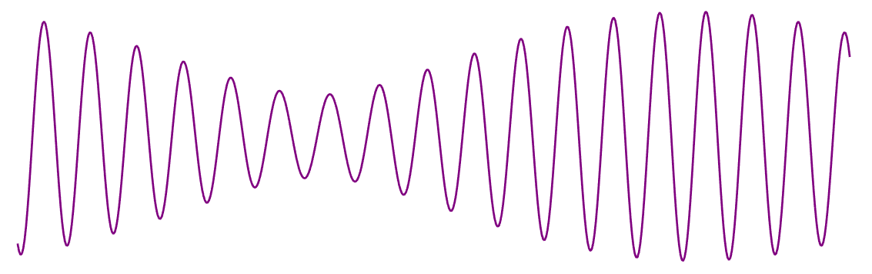
IG WAVE GENERATION AND DISSIPATION MECHANISMS
BREAK-POINT MOVEMENT: Symonds et al., 1982; Symonds and Bowen, 1984, Schaffer and Jonsson, 1990 and Schaffer, 1990.
Incident wave groups
Breaking point variation
Shoreward breakpoint forced long wave
Outgoing breakpoint forced long wave
z
Breakpoint
x (cross-shore direction)
Setup
Wave height
Dominant over steep slopes

Slide 11
IG WAVE GENERATION AND DISSIPATION MECHANISMS
The highest waves in the wave group produce a higher
setup than the smallest waves: wave group modulation
of the wave setup
Incident wave groups
Breaking point variation
z
Breakpoint
x (cross-shore direction)
Setup
Wave height

Slide 12
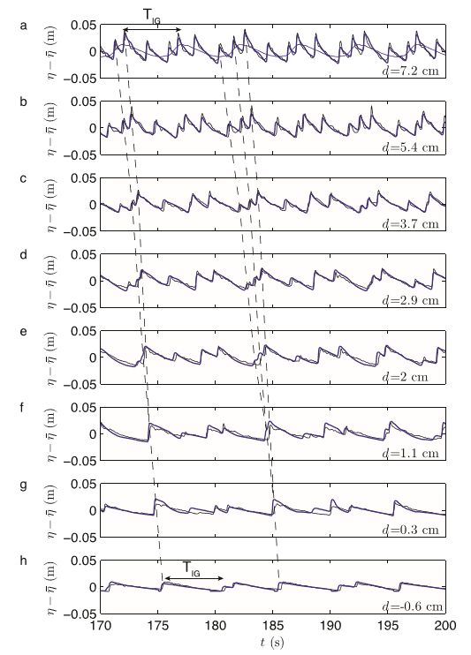
IG WAVE GENERATION AND DISSIPATION MECHANISMS
3. BORE MERGING or BORE-BORE CAPTURE (BBC) MECHANISM: Huntley and Bowen, 1975; Huntley and Bowen, 1974; Bradshaw, 1980; Mase, 1989; Sénéchal et al. 2001; Marche et al., 2007; Tissier et al. 2017 ….
for the bichromatic wave case A-1 from van Noorloos (2003) lab experiment
Tissier et al. 2017

Slide 13
IG WAVE GENERATION AND DISSIPATION MECHANISMS
GENERATION MECHANISMS
Battjes, J. A., H. J. Bakkenes, T. T. Janssen, and A. R. van Dongeren (2004),
Shoaling of subharmonic gravity waves, J. Geophys. Res., 109, C02009.
Breakpoint mechanism is dominant over steep slopes
Bound-wave shoaling is dominant over mild-slopes
BBC or Bore merging seems to be a less dominant mechanism for IG wave generation (according to the results of Tissier et al., 2017)

Slide 14
IG WAVE GENERATION AND DISSIPATION MECHANISMS
DISSIPATION MECHANISMS
Bottom friction (Henderson and Bowen, 2002; de Bakker et al., 2014).
Non-linear energy transfer back to sea-swell frequencies through triad interaction (Henderson et al., 2006; Thomson et al., 2006; Guedes et al., 2013).
IG wave breaking (Battjes et al., 2004; Van Dongeren et al., 2007; Lin and Hwung, 2012; Nazaka and Hino, 1991).
Energy transfer thru non-linear interactions to lower periods.
It is not clear which is the main dissipation mechanism and it might depend on the beach slope and on the frequency of the IG components.

Slide 15
IG WAVE MODELLING TECHNIQUES
MODELLING APPROACHES OR TECHNIQUES
WAVE RESOLVING TECHNIQUES:
BOUSSINESQ , PARTICLE METHODS, NON-HYDROSTATIC MODELS OR RANS MODELS
WAVE AVERAGED OR PHASE AVERAGED TECHNIQUES:
WAVE ACTION BALANCE EQUATION + NLSW

Slide 16

IG WAVE GENERATION AND DISSIPATION MECHANISMS

Slide 17
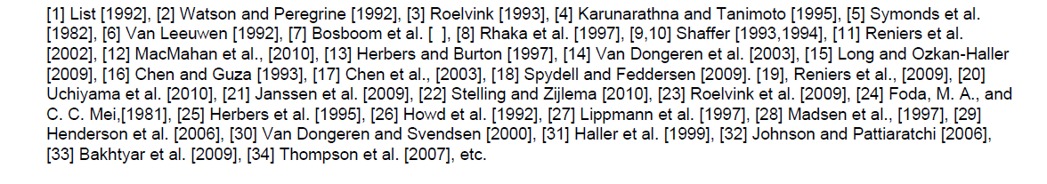
IG WAVE MODELLING TECHNIQUES
Modeling approaches:
from Reniers, 2012 (Long Wave and Runup Workshop)
Dimension | Short wave resolving | Short wave averaged | LSWE | NSWE | RANS | NH | BSNQ | WKB
1D | 2,7,8 | 1,30,3,5,9 | 1,5,9 | 2,30,3 |  |  | 7,8
1D+ |  | 10,11,25,26 | 10,11,26 |  |  |  |  | 25
2DH | 18,17, 32 | 15,14,23 |  | 15,14,23 |  |  | 18,17,32
2DV | 33 |  |  |  | 33
Q3D |  | 30 |  | 30
3D | 22 | 19 |  | 19 |  | 22

Slide 18
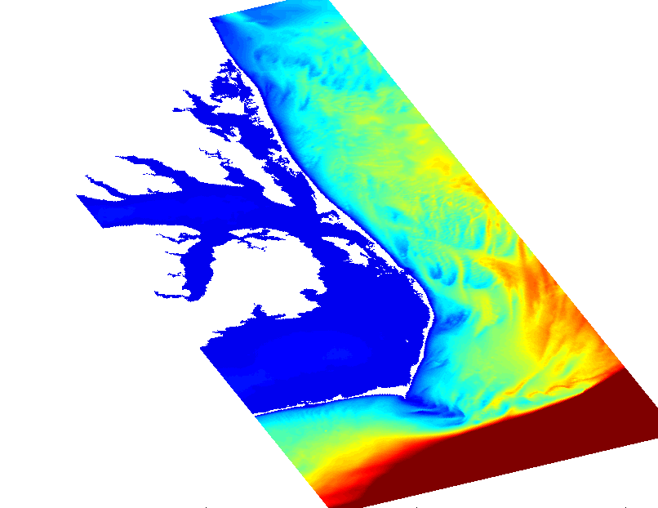

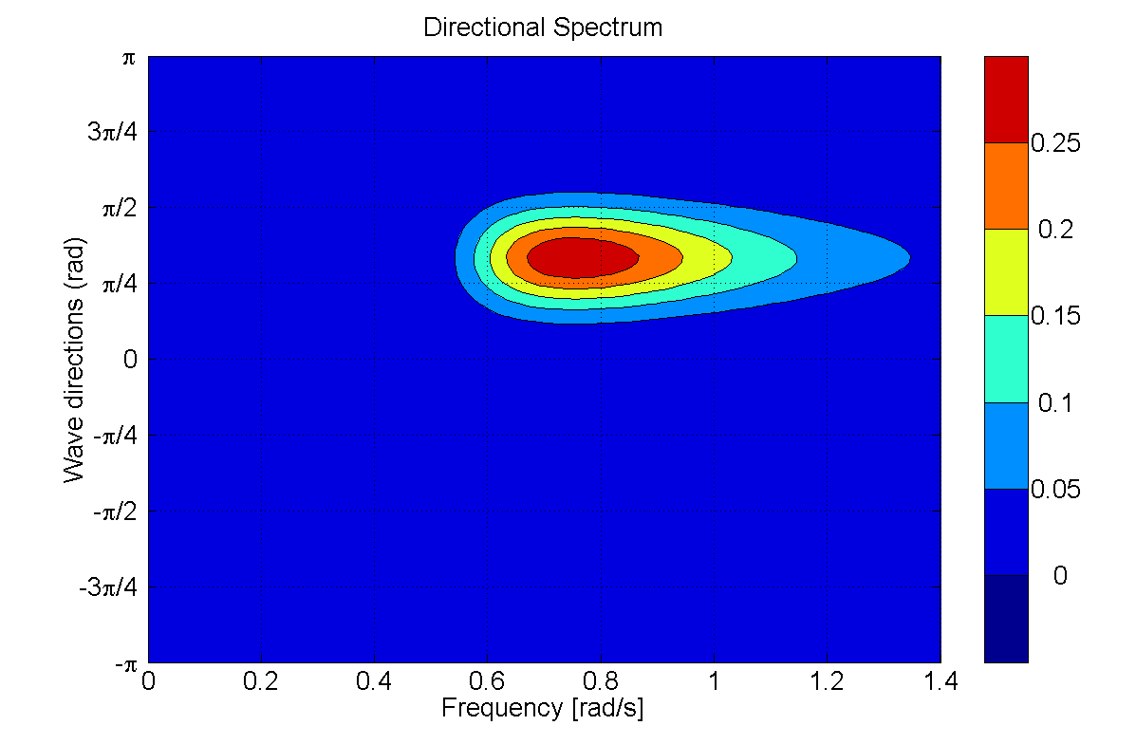
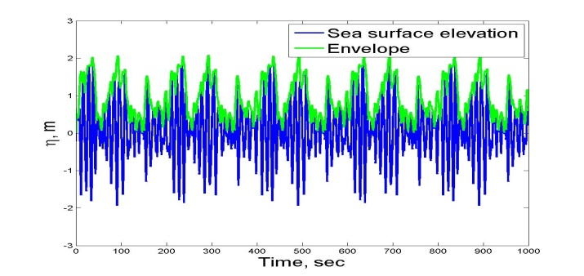
INWAVE
INWAVE IS BASED ON THE WAVE-AVERAGED OR PHASE-AVERAGED TECHNIQUE
INWAVE IS SIMILAR TO XBEACH MODEL (Roelvink et al., 2009) BUT WITH THE DIFFERENCE
THAT INWAVE+ROMS IS ABLE TO SIMULATE 3D CIRCULATION
SWAN or WW III
DOMAIN
SWAN/WWIII domain: Wave spectral time scale
DIRECTIONAL WAVE SPECTRUM
INWAVE DOMAIN
Boundary region
Wave group time scale

Slide 19

INWAVE
FREE SURFACE ELEVATION AND WAVE ENERGY ENVELOPE TIME VARIATION
Boundary condition for the wave action conservation equation
$$\frac{∂A}{∂t}+\frac{∂c_{g,x}A}{∂x}+\frac{∂c_{g,y}A}{∂y}+\frac{∂c_{g,θ}A}{∂θ}=−\frac{D}{σ} \text{where} A\left(x,y,θ,t\right)=\frac{E\left(x,y,θ,t\right) wave energy}{σ\left(x,y,t\right) intrinsic frequency}$$
Vortex Force terms varying in wave group scale
Wave group scale varying
Wave forcing
Infragravity wave generation +
3D hydrodynamics

Slide 20
INWAVE
MAIN MODULES OF INWAVE
READ SWAN DIRECTIONAL
SPECTRAL OUTPUTS AT
THE CHILD GRID BOUNDARIES
RECONSTRUCT THE GROUP SCALE
VARYING WAVE ACTION TIME SERIES
AT THE CHILD GRID BOUNDARY
RECONSTRUCT THE INCOMING
BOUND INFRAGRAVITY WAVES
(e.g. Herbers et al. 1994)
PROPAGATE IN TIME AND SPACE
THE GROUP VARYING WAVE
ENERGY AT THE CHILD GRID
USE THE GROUP VARYING WAVE ENERGY FORCING AS INPUTS
FOR THE VORTEX-FORCE (VF) IN ROMS
Infragravity wave generation thru VF and propagation of the bound IG wave
ROMS
Leaky, bound and trapped infragravity waves

Slide 21
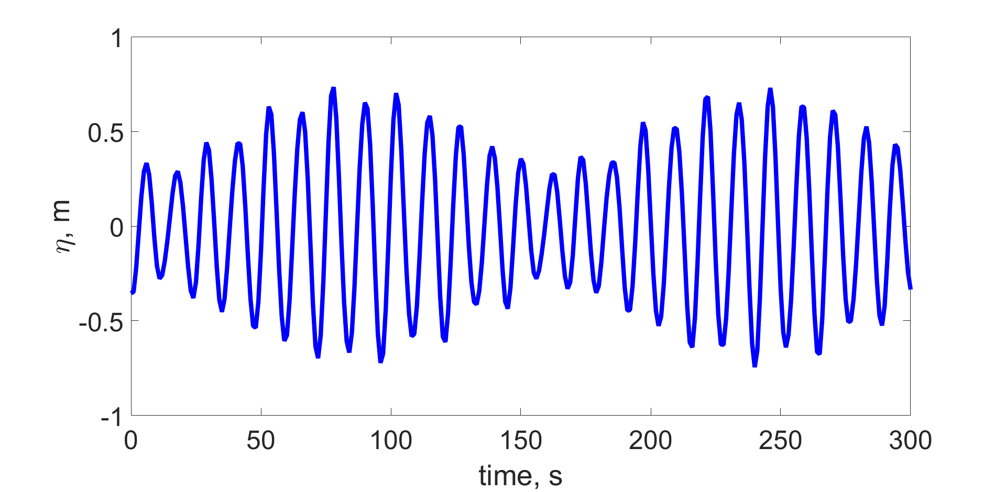
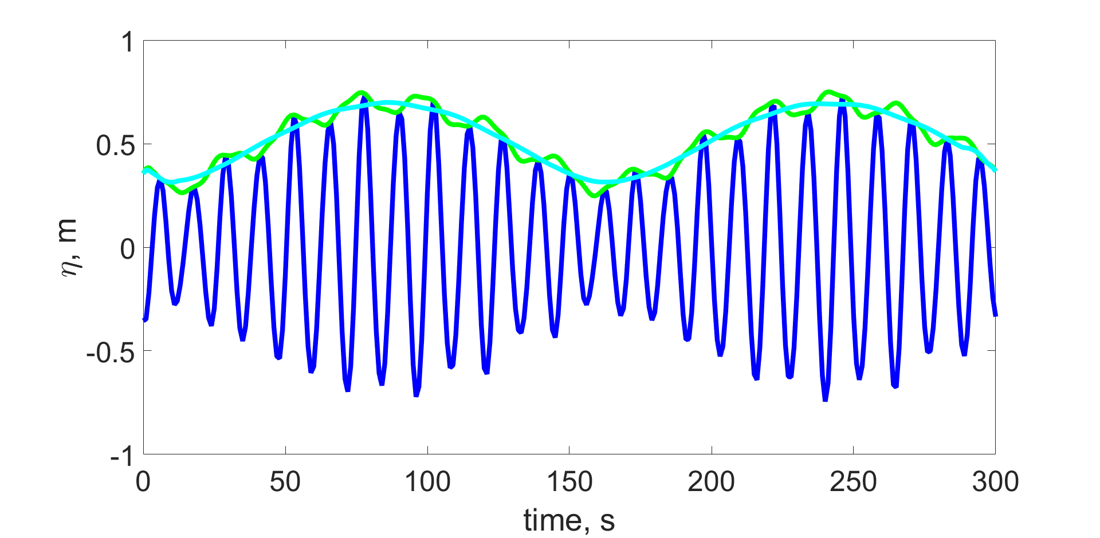
INWAVE
RANDOM PHASES +
INVERSE FFT
HILBERT TRANSFORM +
LOW-PASS FILTER
For each realization A(x,y,θ,t) is going to be different
Notes:
x = hilbert(xr) returns a complex helical sequence, sometimes called the analytic signal, from a real data sequence. The analytic signal x = xr + i*xi has a real part, xr, which is the original data, and an imaginary part, xi, which contains the Hilbert transform. The imaginary part is a version of the original real sequence with a 90° phase shift. Sines are therefore transformed to cosines and vice versa. The Hilbert transformed series has the same amplitude and frequency content as the original real data and includes phase information that depends on the phase of the original data.

Slide 22

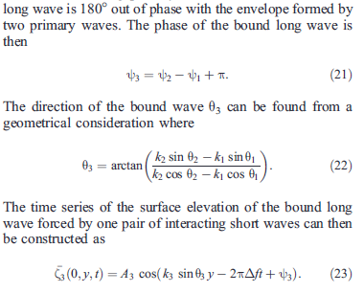
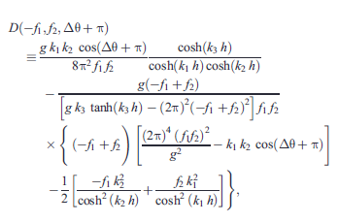



INWAVE
RECONSTRUCT THE INCOMING BOUND INFRAGRAVITY WAVES
Van Dongeren et al. (2003) -> Hasselman (1963) & Herbers et al. (1994)
1. The energy of the secondary forced elevation E₃ (Δf) for one particular pair of interacting primary waves can be computed following Herbers et al. (1994)
2. Bound wave out of phase with the envelope formed by each interacting pair
3. The direction of the bound wave is give by
4. The time series of the surface elevation of the bound wave is
5. This process is repeated for every pair of short-wave components. The summation of all components gives the total bound wave.
Amplitude of the bound wave for each interacting pair

Slide 23



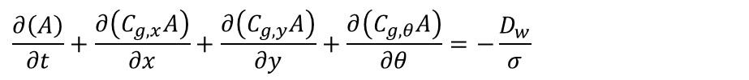



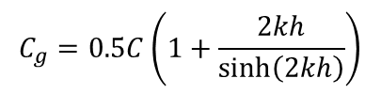


INWAVE
Wave action balance equation in Cartesian coordinate system
$$\frac{∂\left(A\right)}{∂t}+\frac{∂\left(C_{g,x}A\right)}{∂x}+\frac{∂\left(C_{g,y}A\right)}{∂y}+\frac{∂\left(C_{g,θ}A\right)}{∂θ}=−\frac{D_{w}}{σ}$$
$$C_{g,x}=C_{g}cosθ+U$$
$$C_{g,y}=C_{g}sinθ+V$$
$$C_{g,θ}=\frac{σ}{sinh\left(2kh\right)}\left(\frac{∂h}{∂x}sinθ−\frac{∂h}{∂y}cosθ\right)+cosθ\left(\frac{∂U}{∂x}sinθ−\frac{∂U}{∂y}cosθ\right)+sinθ\left(\frac{∂V}{∂x}sinθ−\frac{∂V}{∂y}cosθ\right)$$
Wave dispersion relation + Doppler relation
$$σ=\sqrt{gktanh\left(kh\right)}$$
$$C_{g}=0.5C\left(1+\frac{2kh}{sinh\left(2kh\right)}\right)$$
$$C=\frac{gktanh\left(kh\right)}{sinh\left(2kh\right)}$$
$$w=σ+\vec{k}⋅\vec{u}$$
Eikonal equation
$$\frac{∂k_{x}}{∂t}=−\frac{∂\left(w\right)}{∂x}$$
$$\frac{∂k_{y}}{∂t}=−\frac{∂\left(w\right)}{∂y}$$
$$|\vec{k}|=k_{x}^{2}+k_{y}^{2}$$

Slide 24



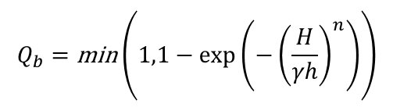







INWAVE
Wave breaking
$D_{w}=\text{Total} \text{energy} \text{dissipation} \text{[}\text{J} \text{m}\text{−2} \text{s}\text{−1}$]
$$D_{w}=D_{b}⋅Q_{b}$$
$D_{b}=\text{Energy} \text{dissipation} \text{in} \text{a} \text{breaking} \text{wave}$ $\text{[}\text{J} \text{m}\text{−2} \text{s}\text{−1}$]
$$Q_{b}=\text{Fraction} \text{of} \text{breaking} \text{waves}$$
H= γh
Roelvink (1993)
$$Q_{b}=\text{min}\left(1,1−exp\left(−{\left(\frac{H}{γh}\right)}^{n}\right)\right)$$
$$D_{b}=2αf_{rep}E_{w}$$
$$γ=\text{Breaking} \text{parameter}$$
$$α=\text{Coefficient} \text{O}\text{(1)}$$
$$h=\text{water} \text{depth}\text{ [}\text{m}\text{]}$$
$$f_{rep}=\text{Representative} \text{frequency}$$
$$H=\text{wave} \text{height}\text{ [}\text{m}\text{]}$$
$$E_{w}=\text{Wave} \text{energy} \text{integrated} \text{over} \text{directions}$$
$$n=\text{Coefficient}$$
Roelvink, J.A., 1993. Dissipation in random wave groups incident on a beach. Coastal Eng., 19:127- 150.

Slide 25
INWAVE
Horizontal space

Slide 26
INWAVE
Directional space
1
ND
2
ND
1
3
ND-1
2
3
4
5
6

Slide 27





INWAVE
Driver_inwave.F
mod_inwave_bound.F
mod_inwave_swan.F
COAWST
mod_inwave_params.F
mod_inwave_vars.F
get_inwave_bnd_grid.F
get_inwave_ini.F
set_inwave_data.F
get_inwave_data.F
interp2d.F
set_inwave_swan_data.F
get_inwave_grid.F
math_tools.F
swan_reader.F
inwave_globaldefs.h
celer_inw.F
dispersion_inw.F
prestep_inw.F
corstep_inw.F
dissip_inw.F
curr_inw.F
frc_inw.F
AC3dbc_im.F
cx3dbc_im.F
ct3dbc_dir_im.F
cy3dbc_im.F
ct3dbc_im.F
Tr3dbc_im.F
TOOLS
mfiles
Inwave_tools
Matlab files for test cases inputs

Slide 28


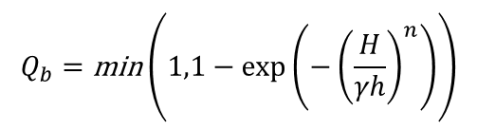
INWAVE
/* Master list of all InWave cpp options
*# define INWAVE_MODEL turn ON or OFF InWave model
*# define INWAVE_SWAN_COUPLING turn ON or OFF InWave SWAN coupling
*# define DOPPLER turn ON or OFF the effect of currents on the dispersion relation
*# define ACX_ADVECTION turn ON or OFF advection of Ac in the xi direction
*# define ACY_ADVECTION turn ON or OFF advection of Ac in the etai direction
*# define ACT_ADVECTION turn ON or OFF advection of Ac in the directional direction
*# define WDISS_GAMMA turn ON or OFF energy dissipation
*# define WDISS_ROELVINK turn ON or OFF Roelvink energy dissipation
WDISS_GAMMA
WDISS_ROELVINK
H= γh
$$D_{w}=D_{b}⋅Q_{b}$$
$$Q_{b}=\text{min}\left(1,1−exp\left(−{\left(\frac{H}{γh}\right)}^{n}\right)\right)$$
$$D_{b}=2αf_{rep}E_{w}$$

Slide 29
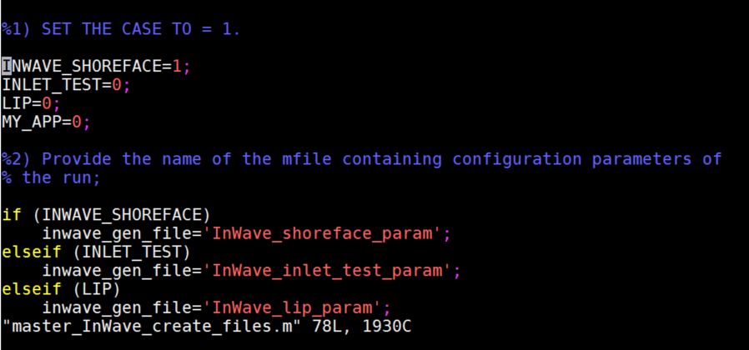
INWAVE
INWAVE_SHOREFACE TEST CASE
STEP 1
Inwave_tools
Matlab files for test cases inputs: master_Inwave_create_files.m
STEP 2
Edit and run InWave_shoreface_param.m
make_Inwave_grd=1;
make_Inwave_ini=1;
make_Inwave_bry=1;

Slide 30
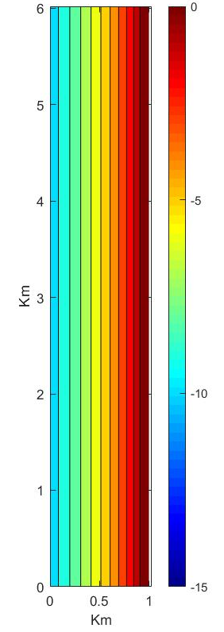
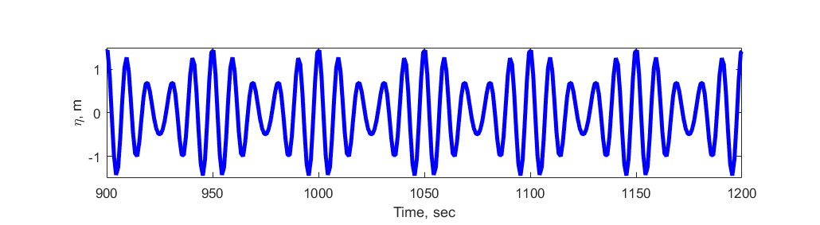
INWAVE
INWAVE_SHOREFACE TEST CASE
create_Inwave_grd.m
dx, dy, x, y, depth, angle,
Masking, f, spherical
create_Inwave_ini.m
Nbinds
Ta
Ac_ini
C_ini
create_Inwave_bnd.m
Ta1=10 s, a1= 1 m
Ta2= 8.3 s, a2=0.5 m
Θ= 261 degrees
(m)
H_{rms_max}= 3 m

Slide 31
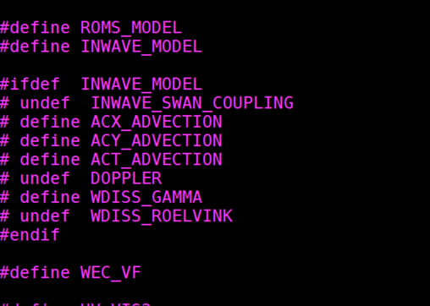
INWAVE
INWAVE_SHOREFACE TEST CASE
STEP 3
Edit the file Projects/inwave_shoreface.h and compile COAWST
CCP OPTIONS
STEP 4
Edit the file Projects/InWave_shoreface/ocean_inwave_shoreface.in

Slide 32
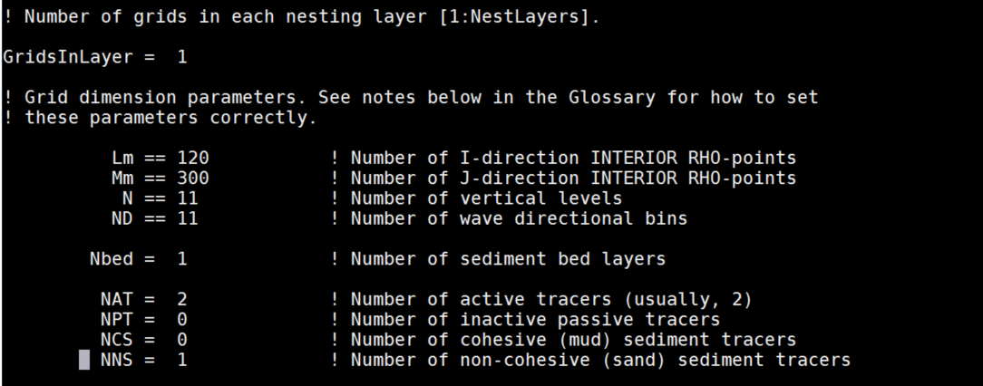
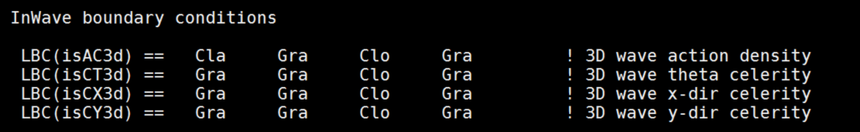
INWAVE
ocean_inwave_shoreface.in

Slide 33
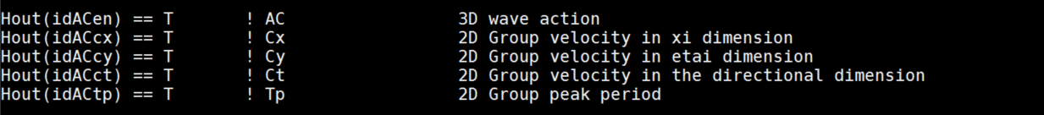
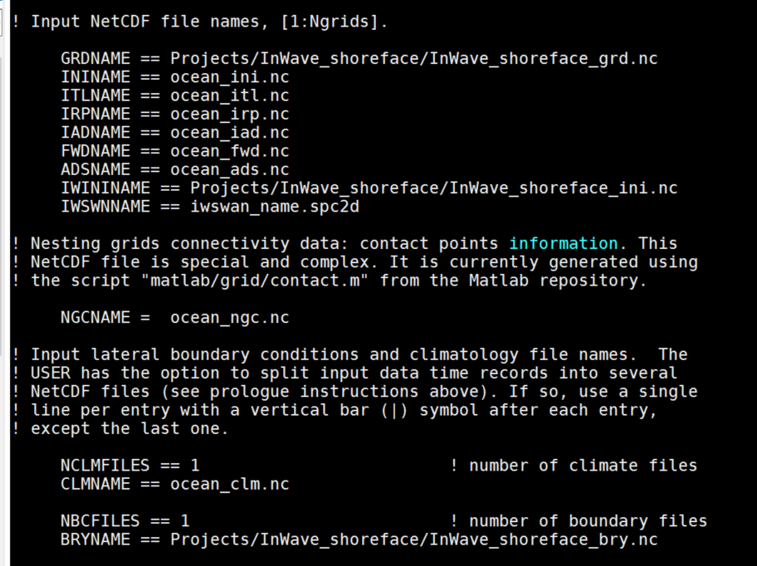
INWAVE
GRDNAME
IWININAME
BRYNAME
STEP 5
RUN!

Slide 34
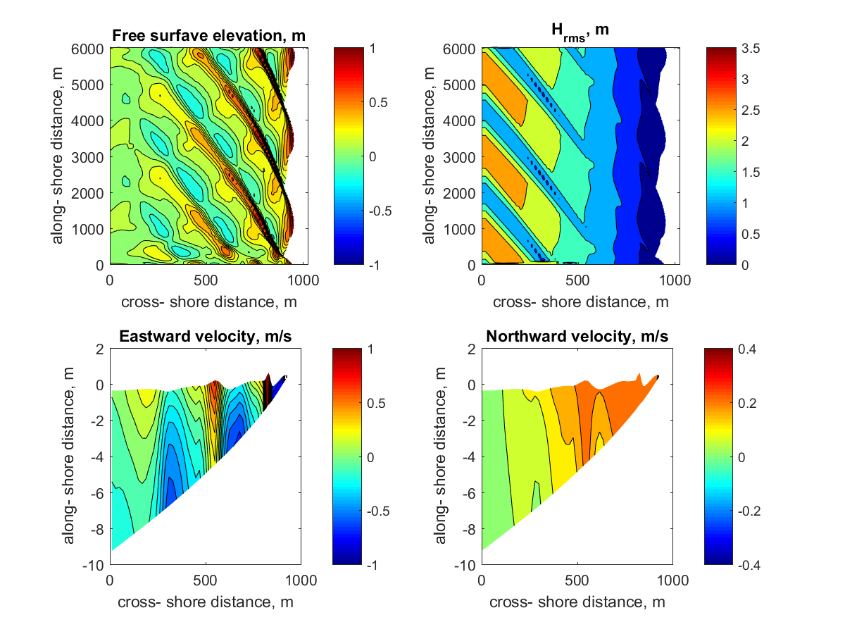
INWAVE
β=1.18
Steep-slope regime: breakpoint generation dominance

Slide 35
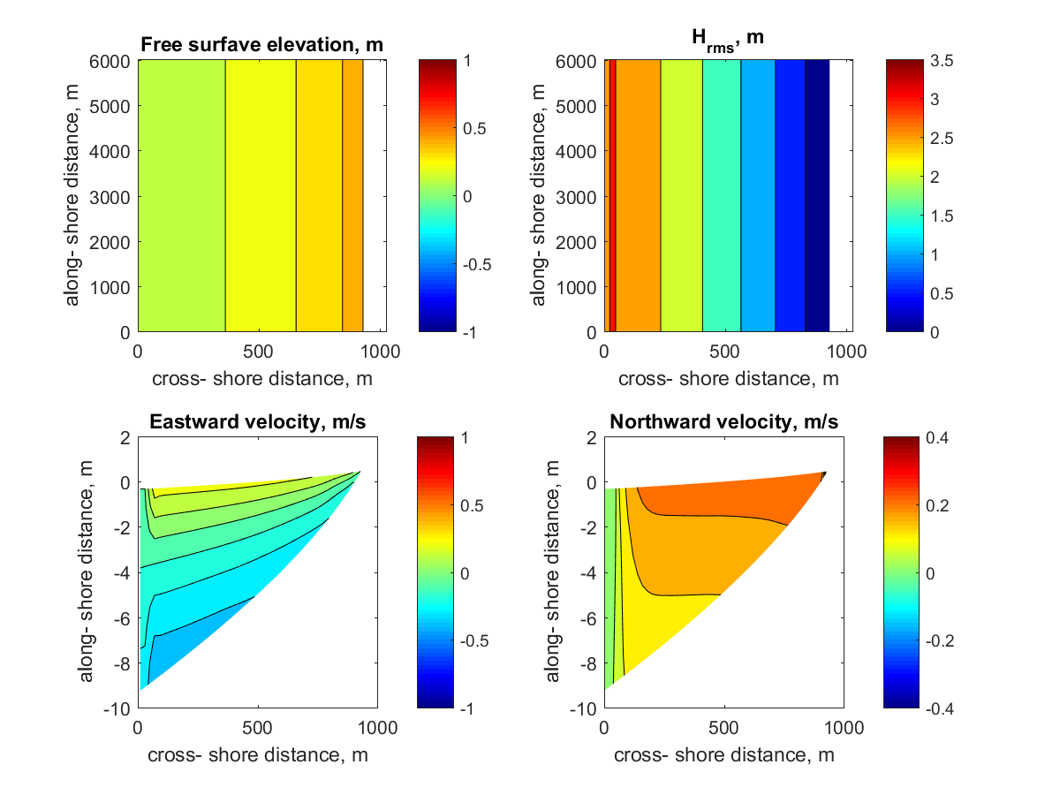
INWAVE
What do we get for the equivalent wave field but without wave-groups?

Slide 36
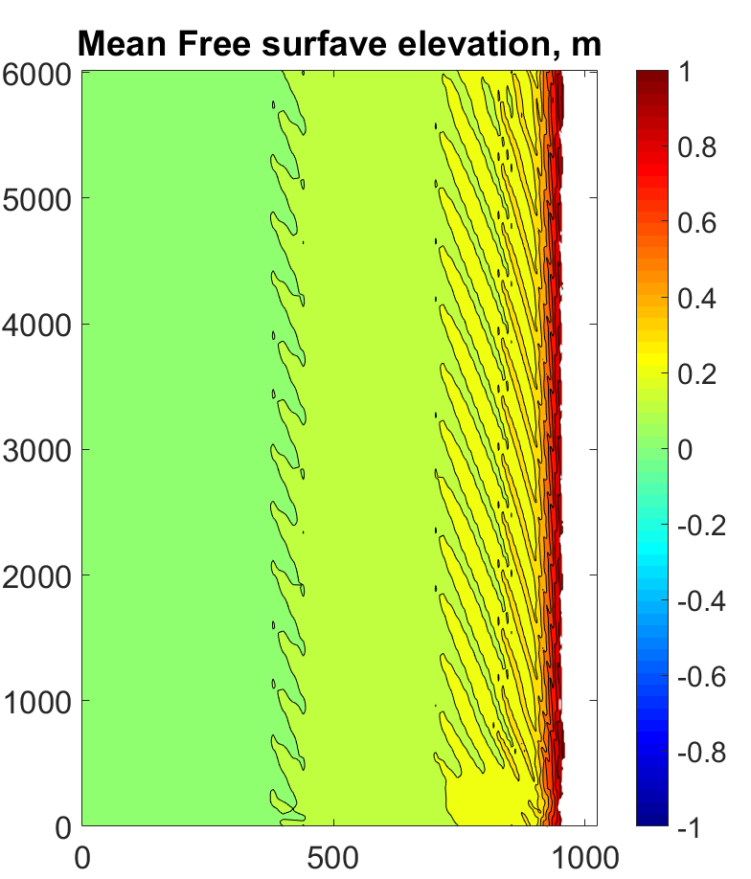
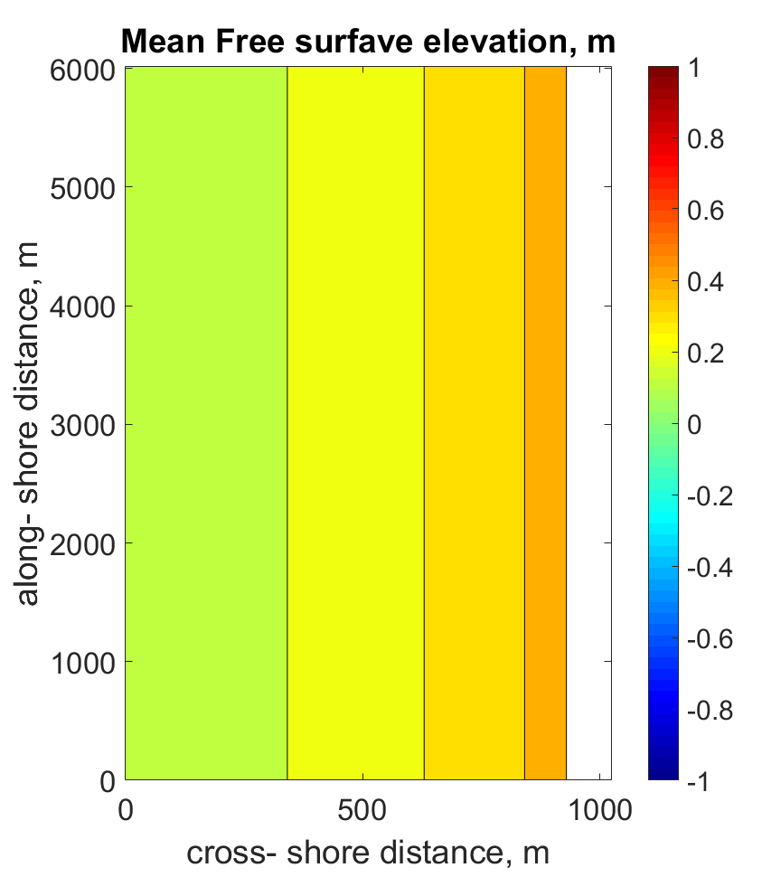
INWAVE
With wave-groups

Slide 37
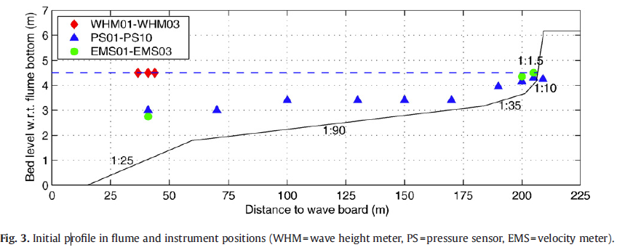
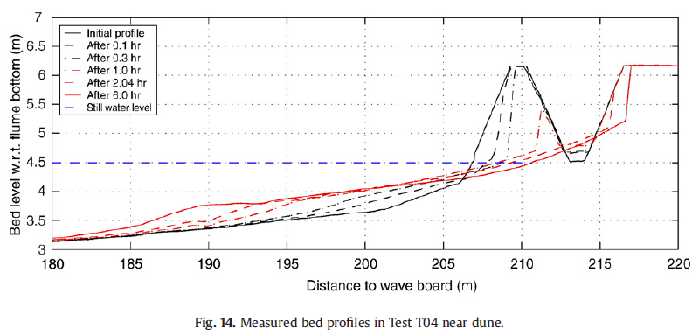
INWAVE
2DV CASE: DELTA FLUME EXPERIMENT T04 FROM DELTARES
Pierson-Moskowitz
H_{m0}=1.5 m
T_{p}= 7.35 s
T_{m}= 6.68 s
Figures from Van Gent el at., 2008

Slide 38
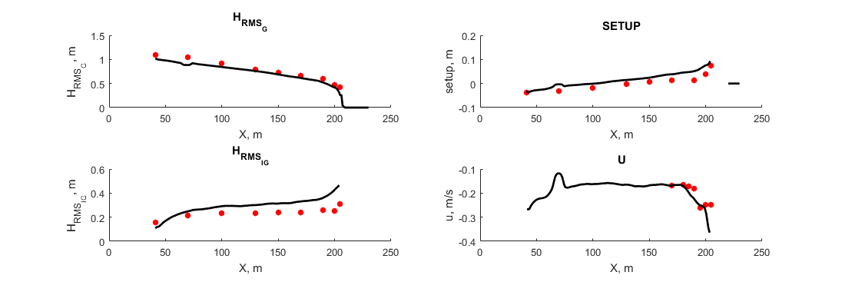
INWAVE
COAWST- MEASUREMENTS COMPARISON
RMSE=0.02 m
RMSE=0.15 m
RMSE=0.1 m
RMSE=0.07 m/s

Slide 39
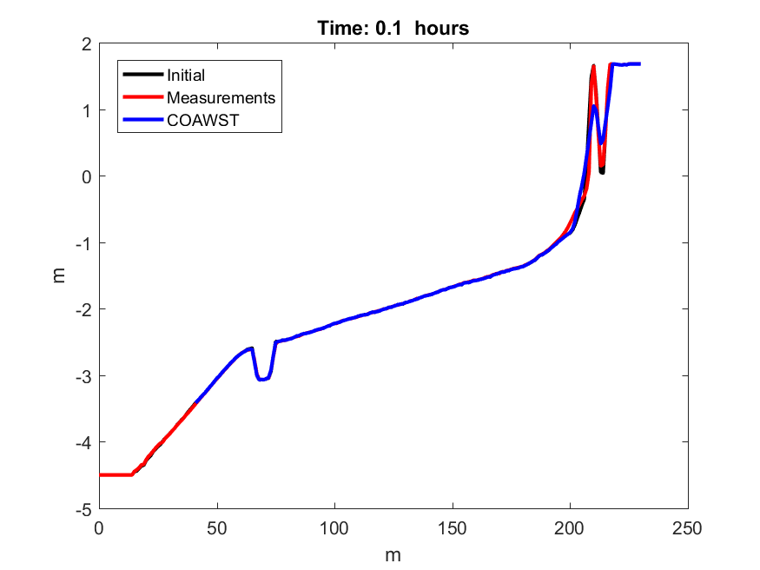
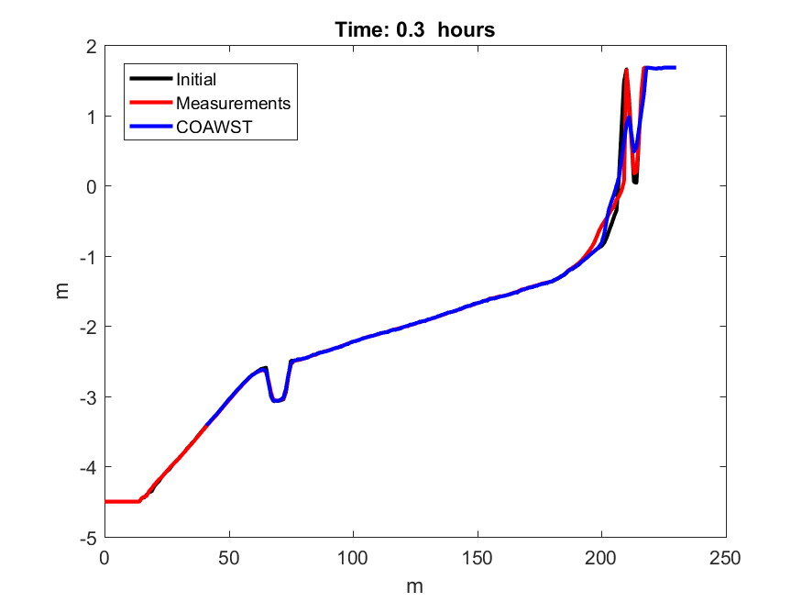
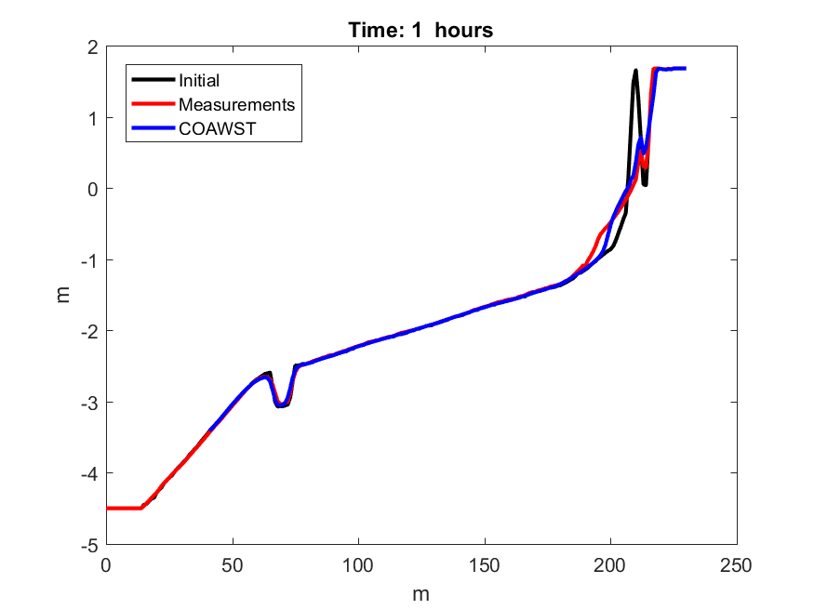
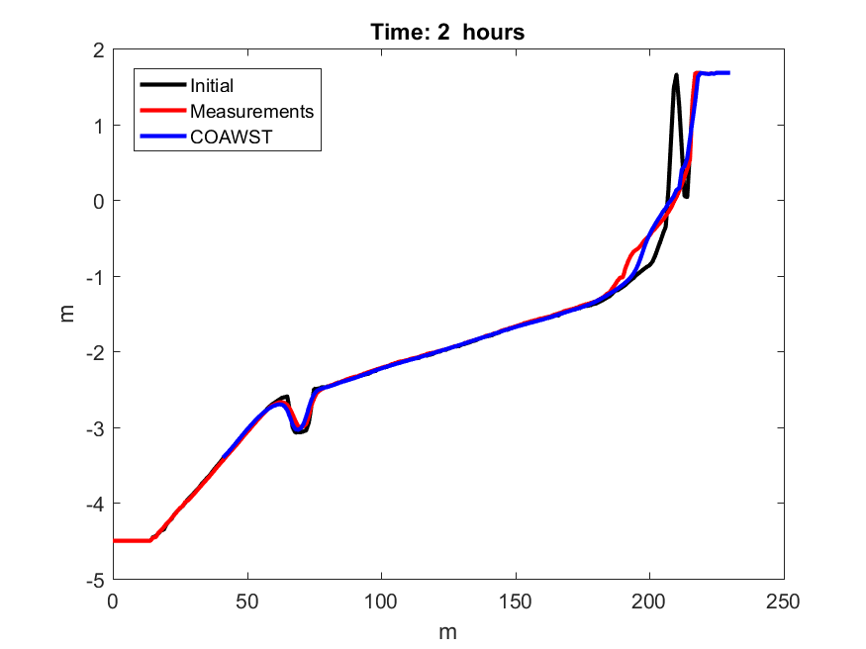
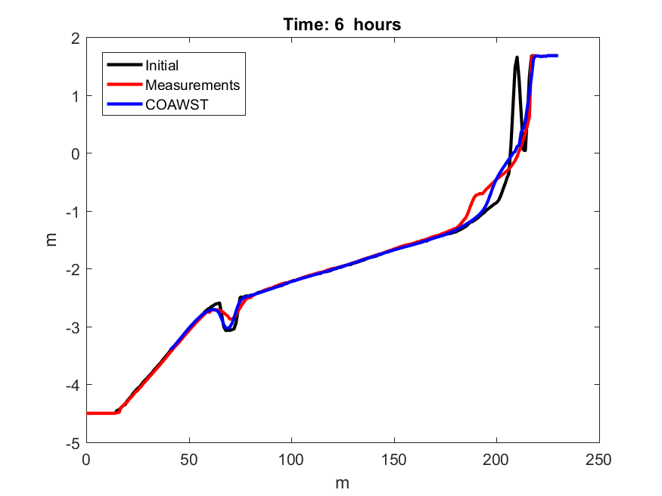
INWAVE
MORPHODYNAMIC EVOLUTION
Time at 0.1, 0.3, 1, 2, and 6 hours

Slide 40
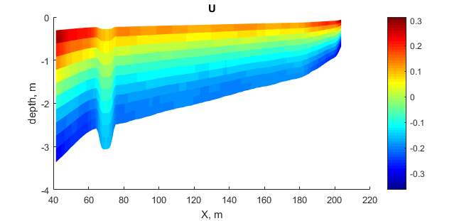
INWAVE
MEAN WAVE-AVERAGED CURRENTS
m/s

Slide 41
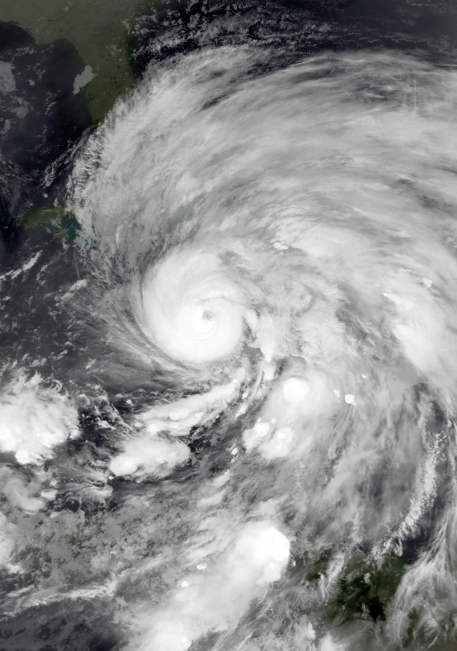
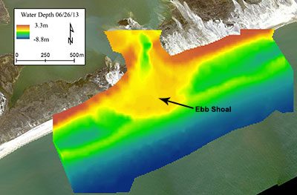
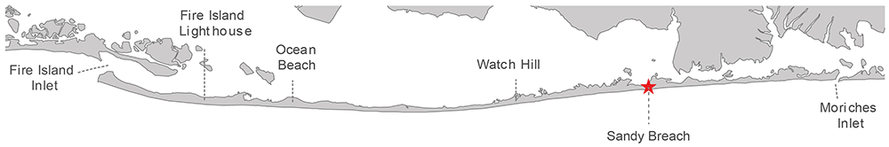
INWAVE
3D CASE REAL APPLICATION: HURRICANE SANDY (2012)
http://storms.ngs.noaa.gov/storms/sandy/

Slide 42
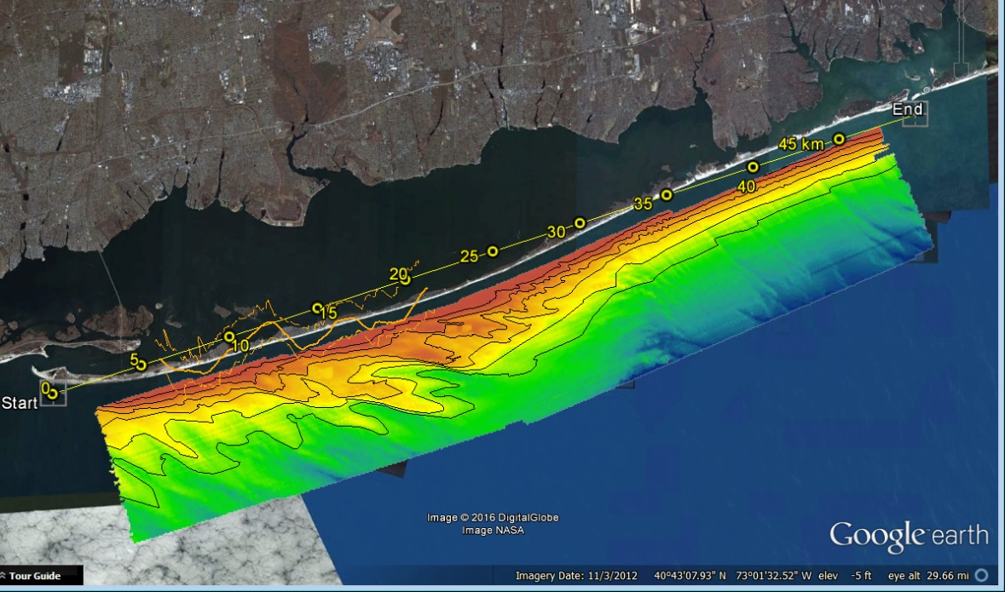
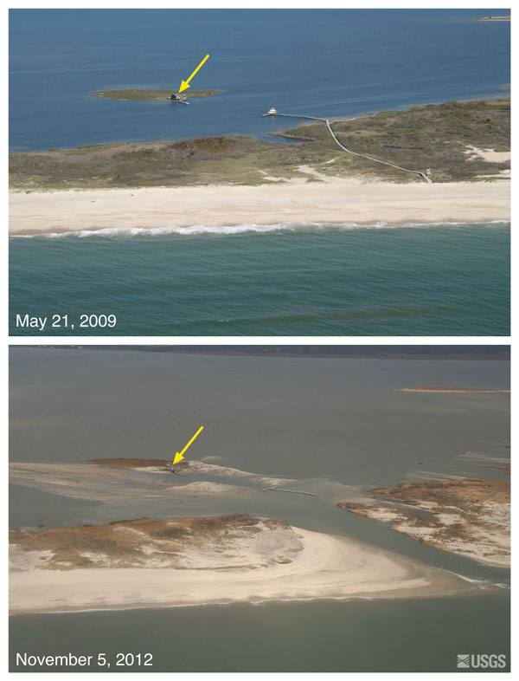

INWAVE
Breach occurred at "Old Inlet“ Was open between 1763 and 1827.
Re-opened during H Sandy. Still open today.
Breach occurred at
"Old Inlet"
Was open between 1763 and 1827.
Re-opened during H Sandy.
Still open today.
http://coastal.er.usgs.gov/hurricanes/sandy/photo-comparisons/

Slide 43


COAWST model application
INWAVE
Modeling system grids used for coupled concurrent numerical simulations of oceanographic, wave, and sediment transport processes. The grids have regions of increased refinement to allow greater resolution in selected locations.
USEast grid
(5-km res.)
New York Bight
grid (700-m res.)
Shelf grid
(100-m res.)
Breach grid
(5-10 m res.)
Notes:
A) 5 km resolution USEast grid: Dashed magenta lines indicate where we set the wave boundary conditions based on the global wave model WaveWatchIII. Black rectangle shows the extent of the 700 m resolution New York Bight grid.
B) 700 m resolution New York Bight grid: Black rectangle shows the extent of the 100 m resolution Fire Island Shelf grid.
C) 100 m resolution Fire Island Shelf grid: Black lines show the extent of the 5-40 m resolution Fire Island Strip grid.
D) 5-40 m resolution Fire Island Strip grid: Only a 15-km (alongshore) section near the 2014 Experiment platforms are shown.
'x' in A&B indicates the location of the NDBC Buoy#44066
'square' in B indicates the location of the NDBC Buoy#44065
'circle' in B indicates the location of the NDBC Buoy#44025
'triangle' in B indicates the location of the NDBC Buoy#44017
'dots' in B&C&D indicate the locations of the platforms in the 2014 Experiment.

Slide 44

INWAVE

Slide 45



INWAVE
Back bay
Offshore
simulate peak storm intensity
Use 2D spectra from Offshore point to drive InWave
Infragravity wave (0.8m)
Surge (1.5m)
Tide (1.0m)
MSL (0.0m)
Elevation (m)
Cross Shore distance (m)
Notes:
RM lower right ?

Slide 46

InWave Fire Island breach simulations
INWAVE
Physics:
Roller model (Reniers et al., 2004)
Dissipation (Roelvink et al., 1993)
Vortex Force
UV_KIRBY
SSW BBL (wave enhanced)
Suspended load
Bedload van Der A
Sed Avalanching
Land
Depth (m)
Ocean
Grid Setup
Boundary Conditions:
West/East: Water level
North: Water level
South: Water level, BoundWave, AC
480 cells x-dir
439 cells y-dir
dx ~ 5m
dy ~ 20m offshore to 3m dunes
Use 25 directional bins, 10 deg ea., 50:290

Slide 47


INWAVE
Start with a 2D spectra
(Hs=7.8m)
- integrate over directions
- compute amplitude of each frequency.
- phase is 2*pi*f + random component.
- add up all freq and compute a water level time series.
impose wave action density
(wave group envelope)
Energy (E) = 1/8 ρ g (2η)²;
WaveAction (A) = E/(2π/T);
distribute the time series weighted back into directional bins

Slide 48

Wave heights and water levels
INWAVE
~ 1 km
Waves are long crested – need to phase along open boundary.
Offshore currents driven westward from winds
Nearshore currents driven eastward from breaking waves

Slide 49
INWAVE
FUTURE PLANS
INWAVE is not capable of including wave spectral variations along its boundaries and future efforts will be directed to include these capabilities.
We are still testing and verifying Inwave performance with model cases.

Slide 50
INWAVE:
THE INFRAGRAVITY WAVE DRIVER OF COAWST
Maitane Olabarrieta
John C. Warner
Christie Hegermiller
COAWST WORKSHOP
Raleigh, 25th -28th February, 2019

