Slide 1
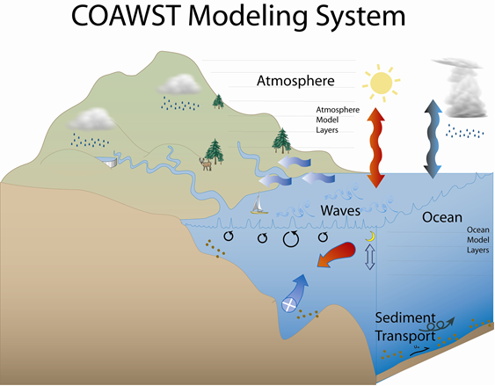
Sediment Transport in COAWST
Alfredo Aretxabaleta
USGS Woods Hole, February 2019

Slide 2
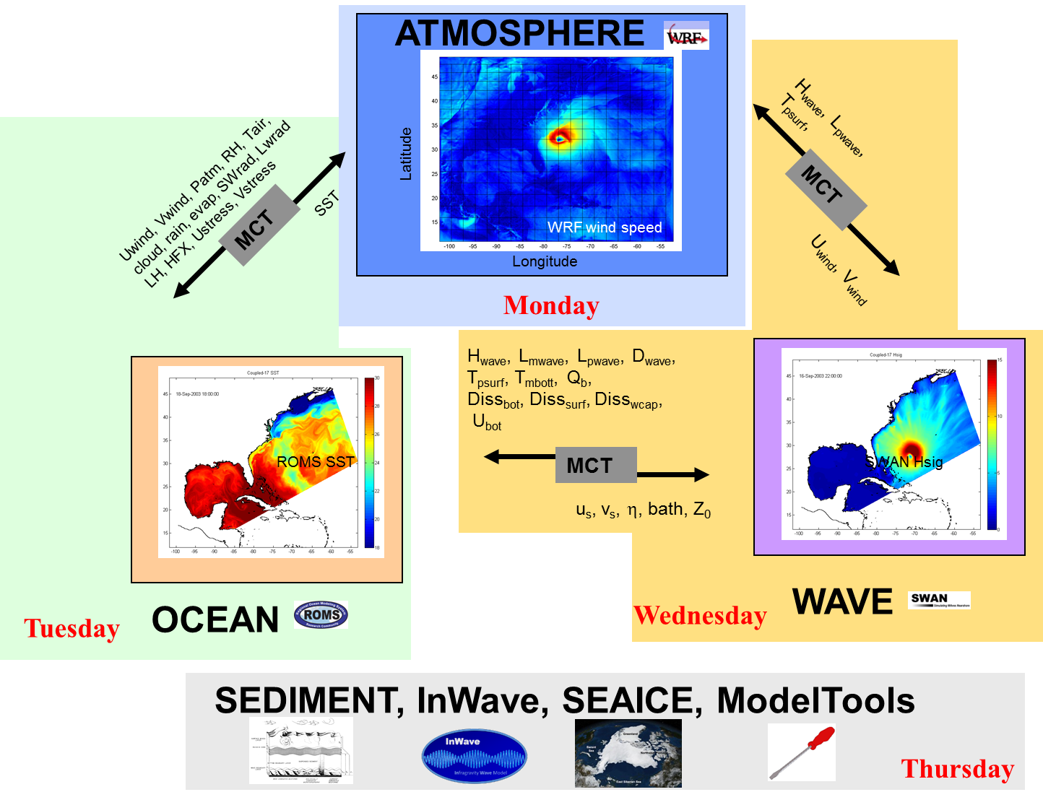

COAWST: Coupled-Ocean-Atmosphere-Wave- Sediment Transport Modeling System.

Slide 3
Sediment Transport Components
Erosion / deposition / bed model (sand, mud, or mixed)
Settling
Bedload transport and flux divergence
Morphological evolution
Flocculation/aggregation
Sediment influence on density
Positive-definite advection scheme (MPDATA)
Wave input (specified, or SWAN, 1- or 2-way coupled)
Wave-current combined bottom stresses
Wetting and drying

Slide 4
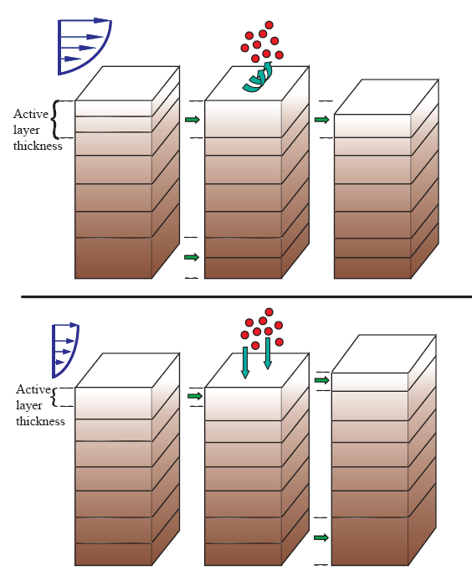
Resuspension and Deposition
Active layer thickness
Erosion
Sedimentation
Net deposition
Notes:
Oversimplification…erosion is actually

Slide 5
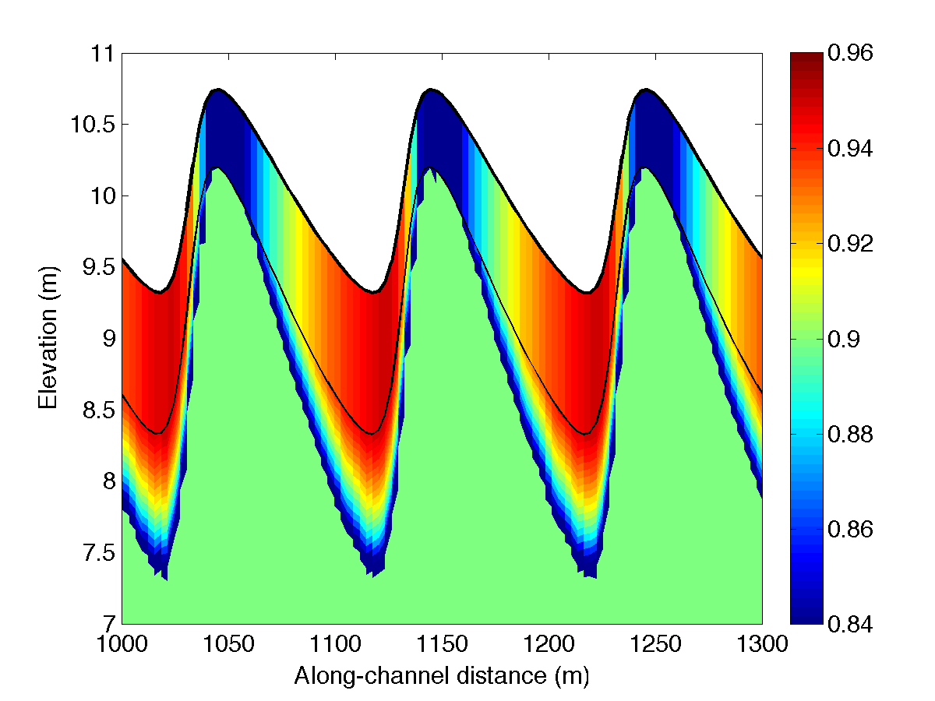
Bedload
Meyer-Peter Müeller (1948)
Or Soulsby and Damgaard (2005)
Accounts for net transport over a wave cycle of components parallel and perpendicular to mean currents
Bed slope effect
where
Upwind flux differencing

Slide 6
Bottom Boundary Layer
Roughness (z₀): grains, saltation, ripples, biogenic features
Law of the wall
where |u| is current speed, u_{*cw} is shear velocity, z is elevation, κ is von Kármán’s constant
Apparent roughness (z_{0a}) is a function of z₀ and wave-current interaction

Slide 7
Wave-Current Bottom Boundary Layer
Orbital motions of waves near bottom creates more turbulence than currents alone
More turbulence, better coupling of flow to bottom, more drag on mean flow (u_{*cw}, z_{0a})
Also, higher instantaneous bed stresses to mobilize sediment
Madsen (1994) or Styles and Glenn (2000) or Soulsby (1997)

Slide 8
Ripple Roughness
Ripples increase roughness of seabed, adding drag and increasing stresses
Ripple geometry (height, wavelength, maybe orientation) are computed from instantaneous equilibrium (Malarky and Davies, 2003 method of Wiberg and Harris, 1994)
z_{0BF} ~ height²/wavelength
Some of this is form drag; that portion does not contribute to the skin friction stresses that move sediment: corrected according to Smith and McLean (1997) and Wiberg and Nelson (1992)

Slide 9
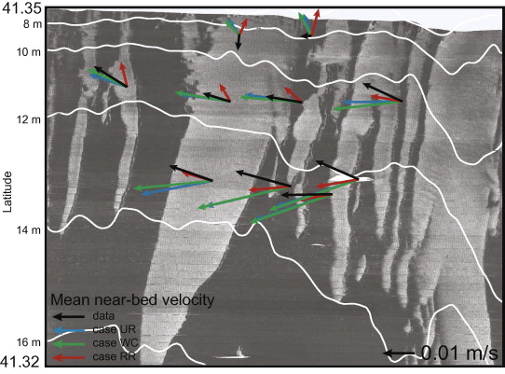
Example: Bottom Roughness
Explore bottom friction effects on near-bottom flow (MVCO):
Ganju & Sherwood, Ocean. Mod., 2010

Slide 10
COAWST/CSTMS Sediment
if SEDIMENT
sediment.F - Initiate sediment routines
if BEDLOAD
sed_bedload.F - Bedload transport
endif
if SUSPLOAD
if SED_FLOCS
sed_flocs.F - Floc dynamics
endif
sed_settling.F - Suspended sediment settling
sed_fluxes.F - Erosion / Deposition
endif
if COHESIVE_BED or MIXED_BED
sed_bed_cohesive.F *- Cohesive / mixed stratigraphy
if SED_FLOCS and SED_DEFLOC
sed_bed_cohesive.F *- Adjust floc distribution in bed
endif
elseif NONCOHESIVE_BED2
sed_bed2.F *- Non-cohesive stratigraphy (revised)
else
sed_bed.F - Non-cohesive stratigraphy (original)
endif
if SED_BIODIFF
sed_biodiff.F* - Biodiffusive mixing of bed
endif
sed_surface.F - Update surface properties
endif
Flocs
Cohesive/mixed bed
Biodiffusion
Stratigraphy
Biogeochemistry Julia Moriarty, Courtney Harris and collaborators
*
*
**
*

Slide 11
Stratigraphy
Warner et al., 2008
Constant number of bed layers
During erosion:
Active layer thickens
Material is removed from top layer
During deposition:
Material is added to top layer
New layers are created when threshold is reached

Slide 12
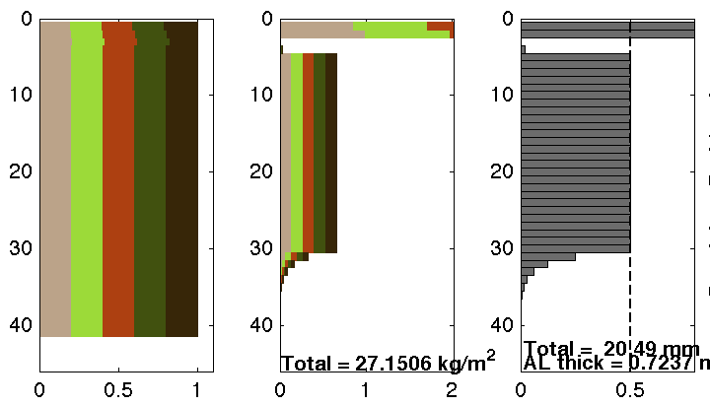
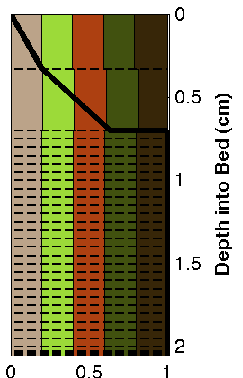
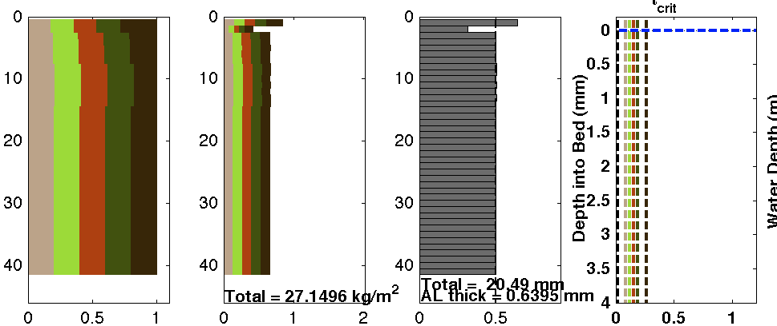
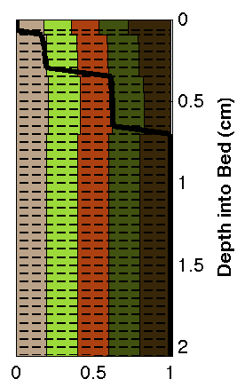
Stratigraphy
Non-cohesive bed 1
1st layer thickness = active layer thickness
2nd layer thickness changes with erosion/deposition
bottom layers are combined as needed
Improved preservation of fractioning, age, porosity, and diffusivity information in the bed
Layer Number
Fraction Mass Thickness Fraction
Non-cohesive bed 2

Slide 13
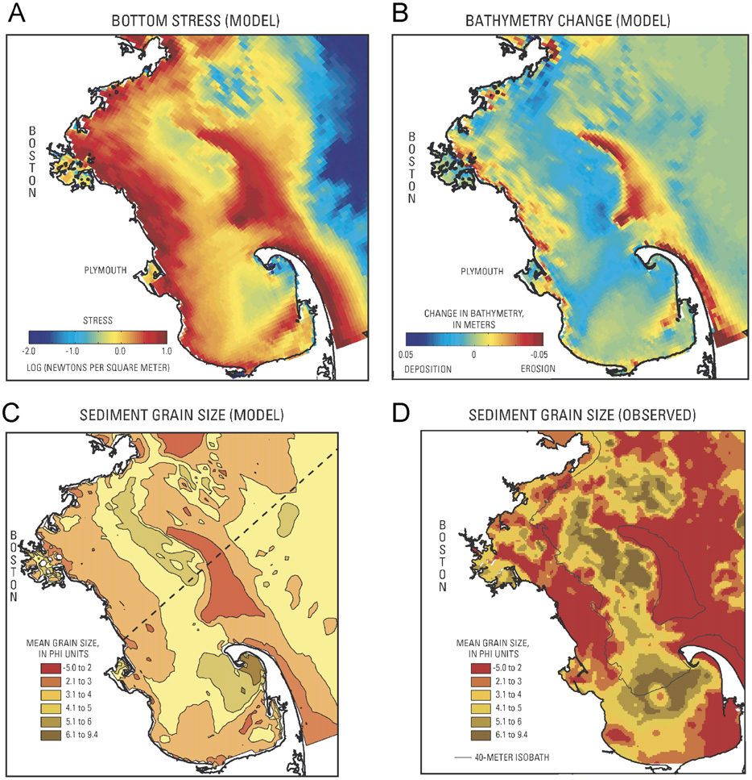
Example: non-cohesive bed
Study the sediment size distribution (Mass Bay):
Warner et al., CSR, 2008
Notes:
Warner et al (2008) studied the hydrodynamic response of Mass Bay under certain storm conditions. The spatially uniform bed of mixed sediments was exposed to a series of Northeasters and evolved to a pattern similar to the observed sediment distribution.

Slide 14
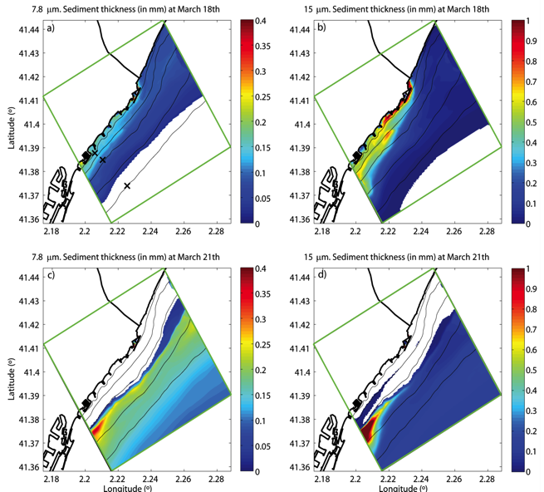
Example: non-cohesive bed
Explore the path of shelf mud deposits originated from a river (Barcelona):
Grifoll et al., JGR, 2014
Notes:
Grifoll et al (2014) explored the fate of sediment from a episodic discharge river in the Mediterranean. First, the fine sediment was deposited in ephemeral layers that subsequently got reworked by wave action and transported along-shelf.

Slide 15
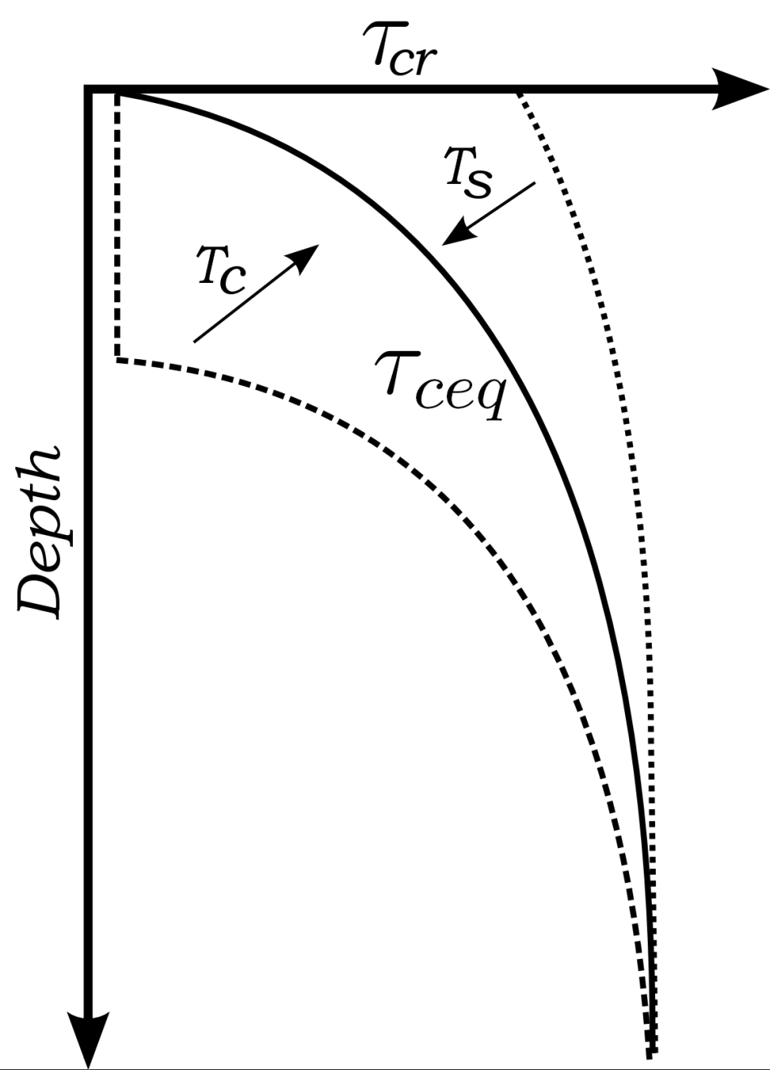
Cohesive behavior
(Pa)
eroded profile &
swelling
Mass depth z_{r} (kg/m²)
deposited profile
& consolidation
T_{c} = Time scale of consolidation
T_{s}= Swelling time scale (order 100 times slower)
Development:
Harris, Rinehimer + VIMS
Sherwood, Ferré, Aretxabaleta + USGS
Rinehimer, 2008
Sherwood et al., 2018

Slide 16
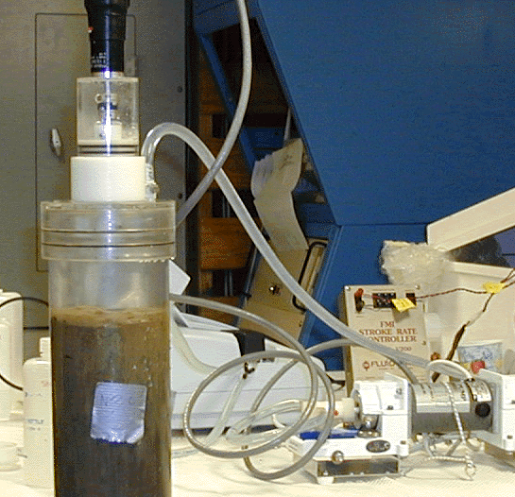
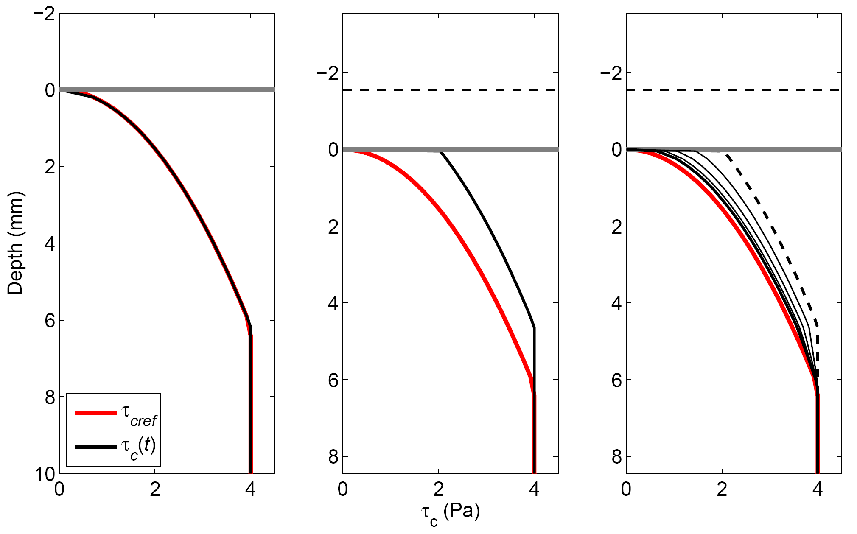
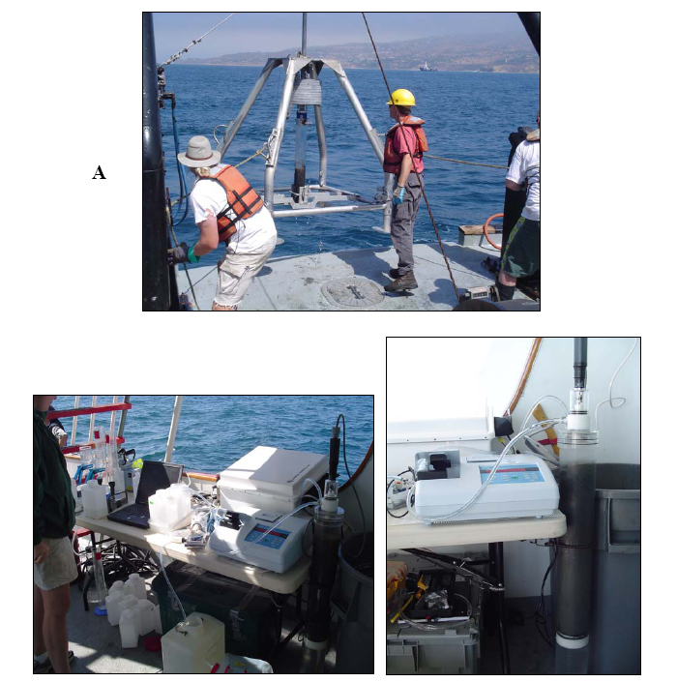
Cohesive Bed
Key bed property: critical shear stress
Initial equilibrium
τ_{cb} profile
Erosion of ~2 mm,
new τ_{cb} profile
τ_{cb} relaxes to
equilibrium
Notes:
We developed a cohesive sediment bed model for CSTSM that basically depends on a reference profile of critical shear stress that extends into the bed sediment. Typically, the critical shear stress (magnitude of bottom stress required to erode material) increases with depth into the bed…that is, as you erode material, the underlying material is harder to erode. Eventually, the critical shear stress is as big as the applied bottom stress (caused by waves and currents) and no more material can be eroded. Eventually, however, biological, physical, and geochemical processes soften up the surface material (some people call it “swelling”) and the truncated, higher critical stress profile gradually “relaxes” back to the initial reference condition. We don’t know how fast this happens…so we are conducting erosion-chamber experiments at Palos Verdes. Bottom picture is using Bothner’s hydraulically damped corer at PV to get cores with undisturbed tops. Upper picture is Pat Wiberg’s “Gust chamber” for applying stress to top of core and measuring amount of material eroded.

Slide 17
Cohesive Bed
Initial profile.
Deposition of 2 mm. τ_{c} profile (black) is extended to new surface; sediment at surface is easier to erode.
In absence of further deposition or erosion, τ_{c} profile slowly reverts toward reference profile (red)

Slide 18
Cohesive behavior
Equilibrium critical stress profile
Time-changing critical stress profile
Ambient Bottom Stress
Initial profile
Erosion
Bed swelling
Deposition

Slide 19
1-D case with 4 sediment classes

Slide 20
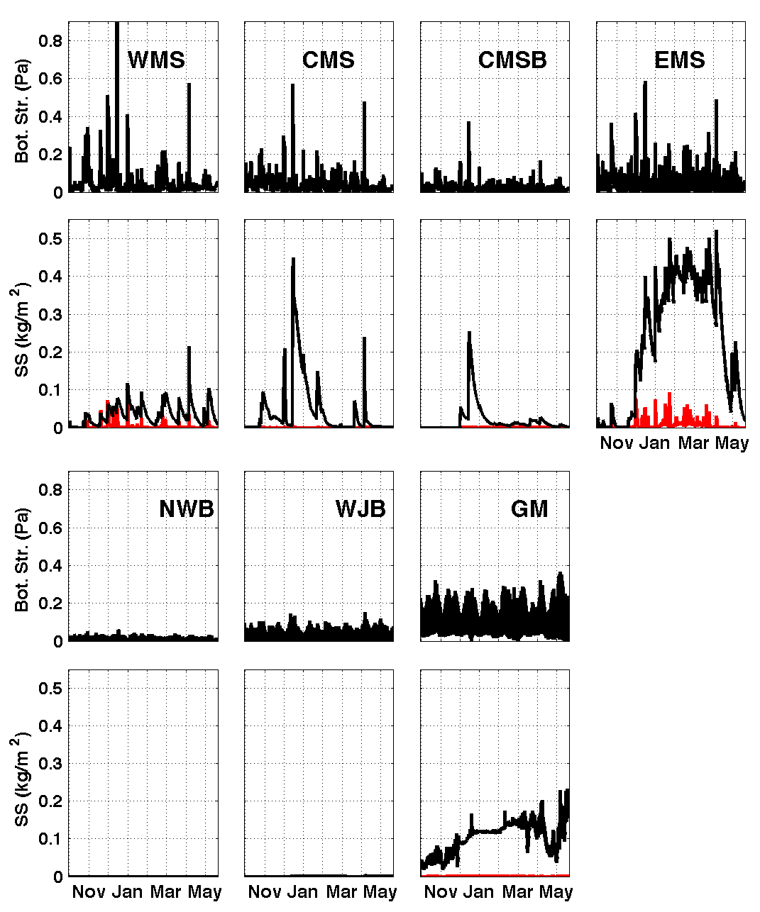
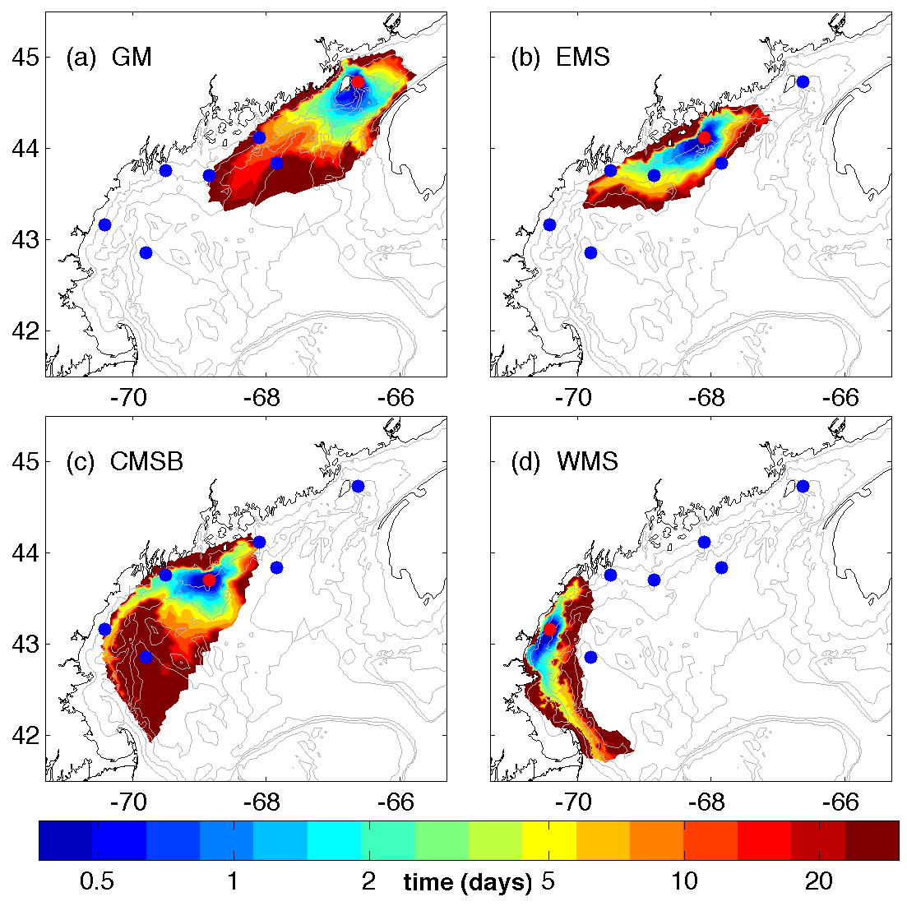
Example: cohesive bed
Study mud resuspension and redistribution (Gulf of Maine):
Butman et al.,
DSR II, 2014
Aretxabaleta et al., DSR II, 2014
Notes:
These 2 studies characterized the erosion of the predominantly cohesive sediment in the Gulf of Maine during several months and the subsequent redistribution of sediment. The goal was to study the potential for changing the distribution of HAB cyst-containing sediment.

Slide 21
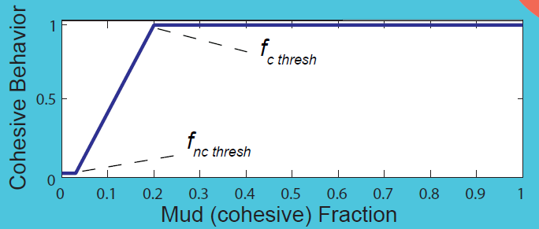

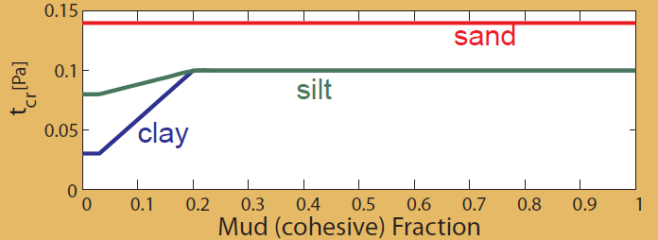
Mixed bed behavior
Thresholds from Mitchener and Torfs, Coast.Engin., 1996
Non-Cohesive Bed | Mixed Bed | Cohesive Bed
Erosion depends on each sed. class critical stress Mud fraction < 3-10% | Erosive behavior depends on mud/sand ratio 3-10% < Mud fraction < 20-30% | Erosion depends on entire bed critical stress Mud fraction > 20-30%

Slide 22
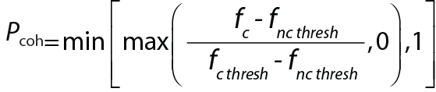
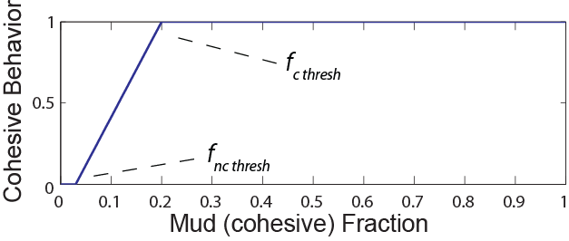
Mixed bed behavior
Determine how cohesive the bed is (P_{coh})
f_{c} is the cohesive fraction:
f_{c} < f_{nc thresh} (~0.03) -> fully non-cohesive behavior (Pcoh = 0)
f_{c} > f_{c thresh} (~0.20) -> fully cohesive behavior (P_{coh} = 1)
f_{nc thresh} < f_{c} < f_{c thresh} -> intermediate behavior:
“Cohesive behavior” P_{coh} is then applied to the critical shear stress and active - layer thickness.

Slide 23
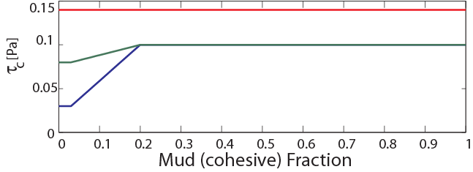
Bed critical shear stress τ_{cr}
Mixed bed behavior
If τ_{cbed} is the bed critical shear stress and τ_{cgrain} is the individual critical shear stress of the grains:
τ_{c} = max [ P_{coh} τ_{cbed} + (1- P_{coh}) τ_{cgrain} , τ_{cgrain}]
sand
silt
clay

Slide 24
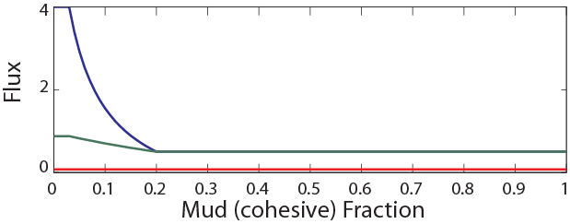
Resuspension flux near bottom
Mixed bed behavior
If dt is the time step, E₀ the surface erosion rate, fr_{i} the fraction for each class, τ_{w} the maximum bottom shear stress and ϕ the bed porosity:
flux_{i} = max (0, dt × E₀ × ( 1- ϕ ) × fr_{i} × (τ_{w} - τ_{cr}) )
clay
silt
sand

Slide 25
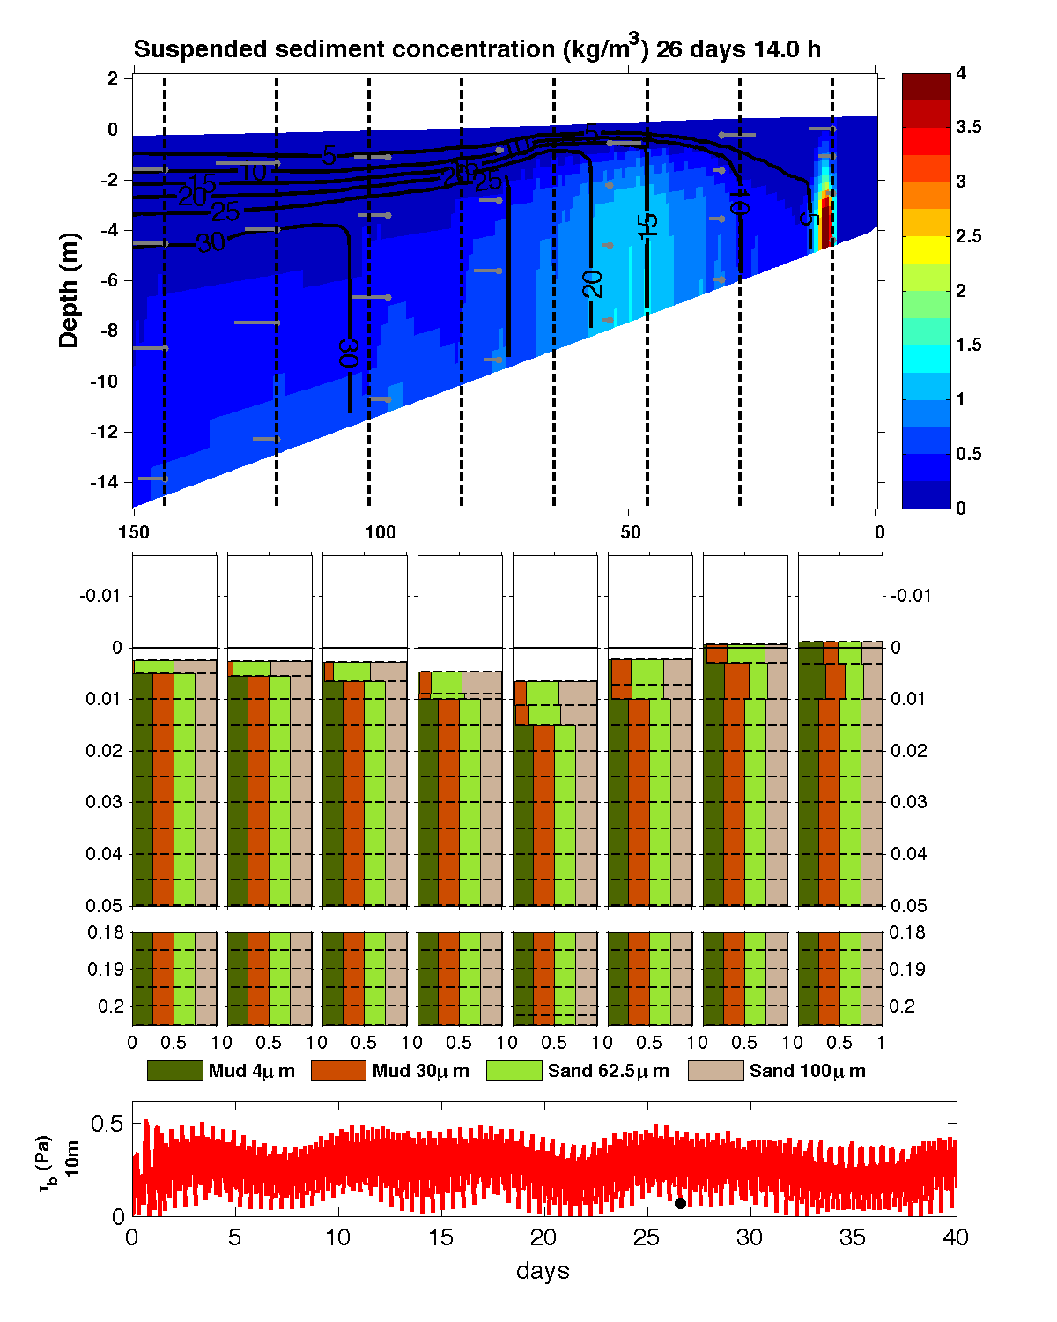
Estuarine Turbidity Maximum
Mixed bed (cohesive behavior >20% mud)
Spring-neap tidal cycle
Sediment has been eroded from bed (no initial SSC)
Suspended sediment concentration
Fraction of each class in bed
Bottom stress

Slide 26
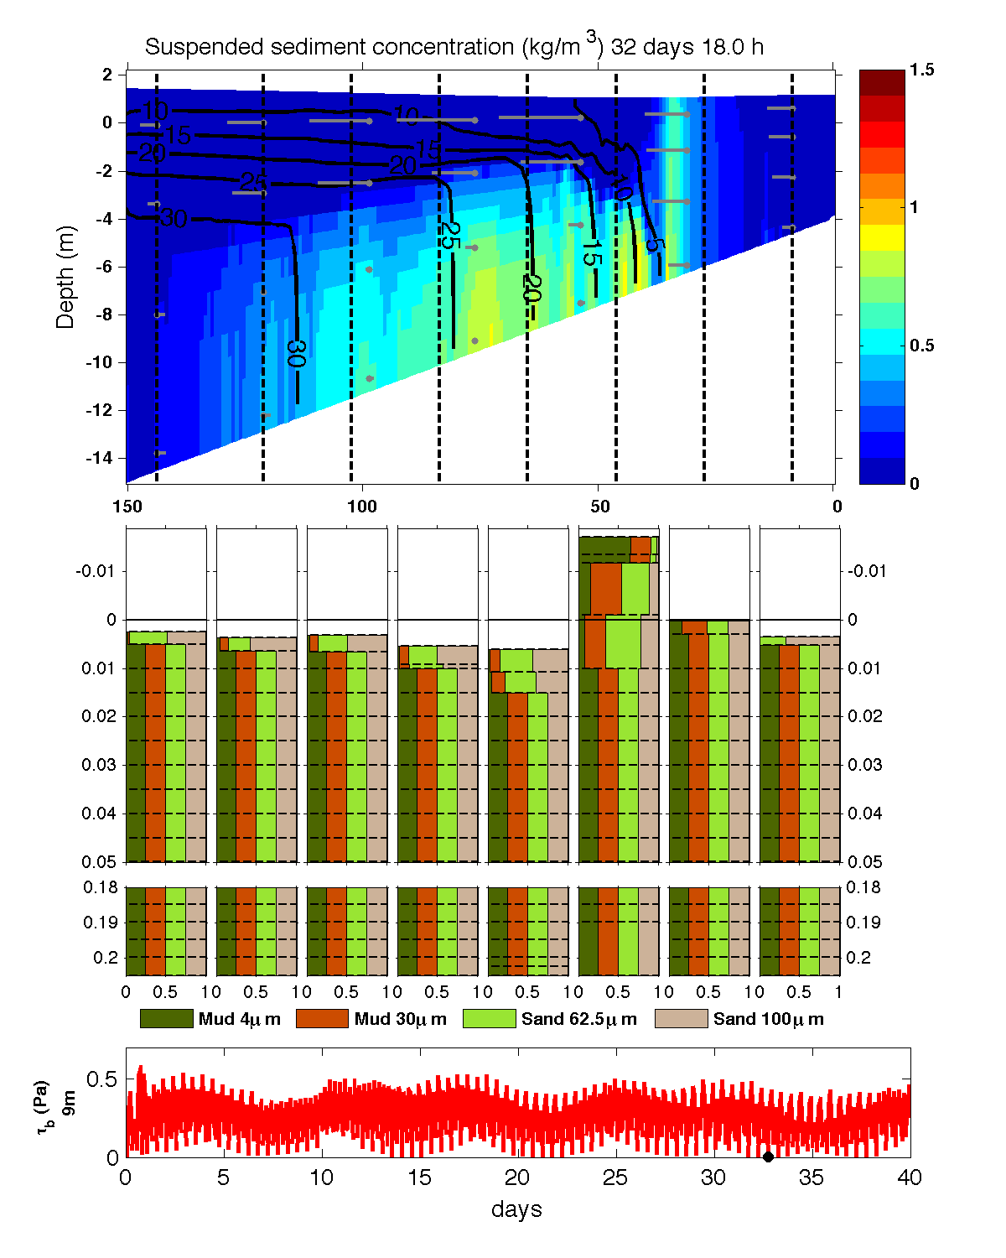
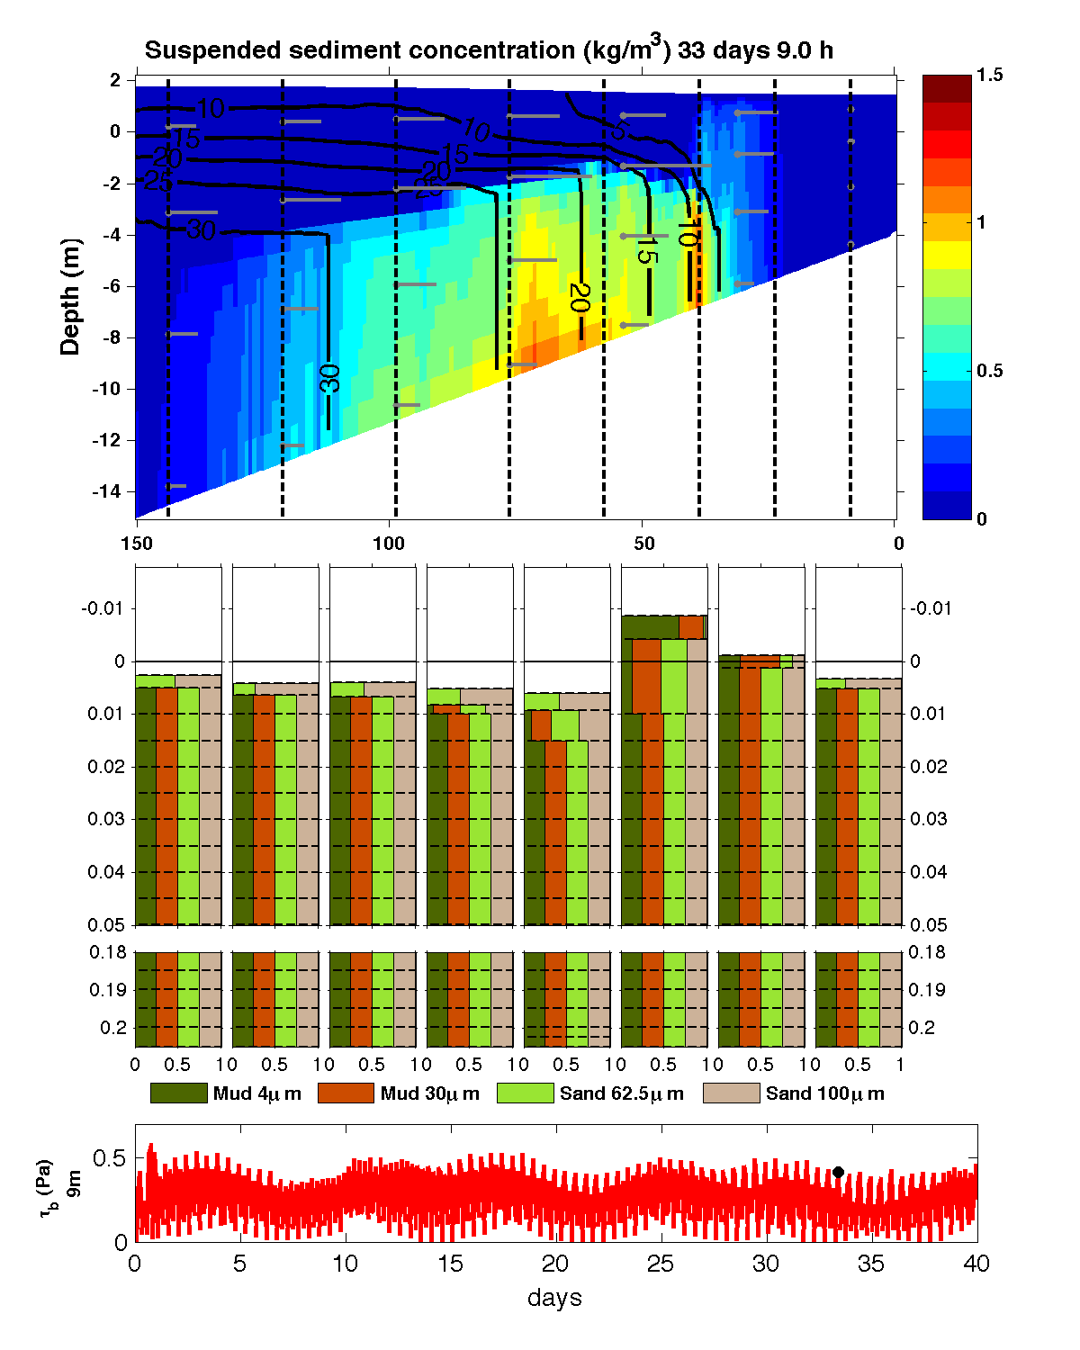
Estuarine Turbidity Maximum
Slack after ebb
Peak flood

Slide 27
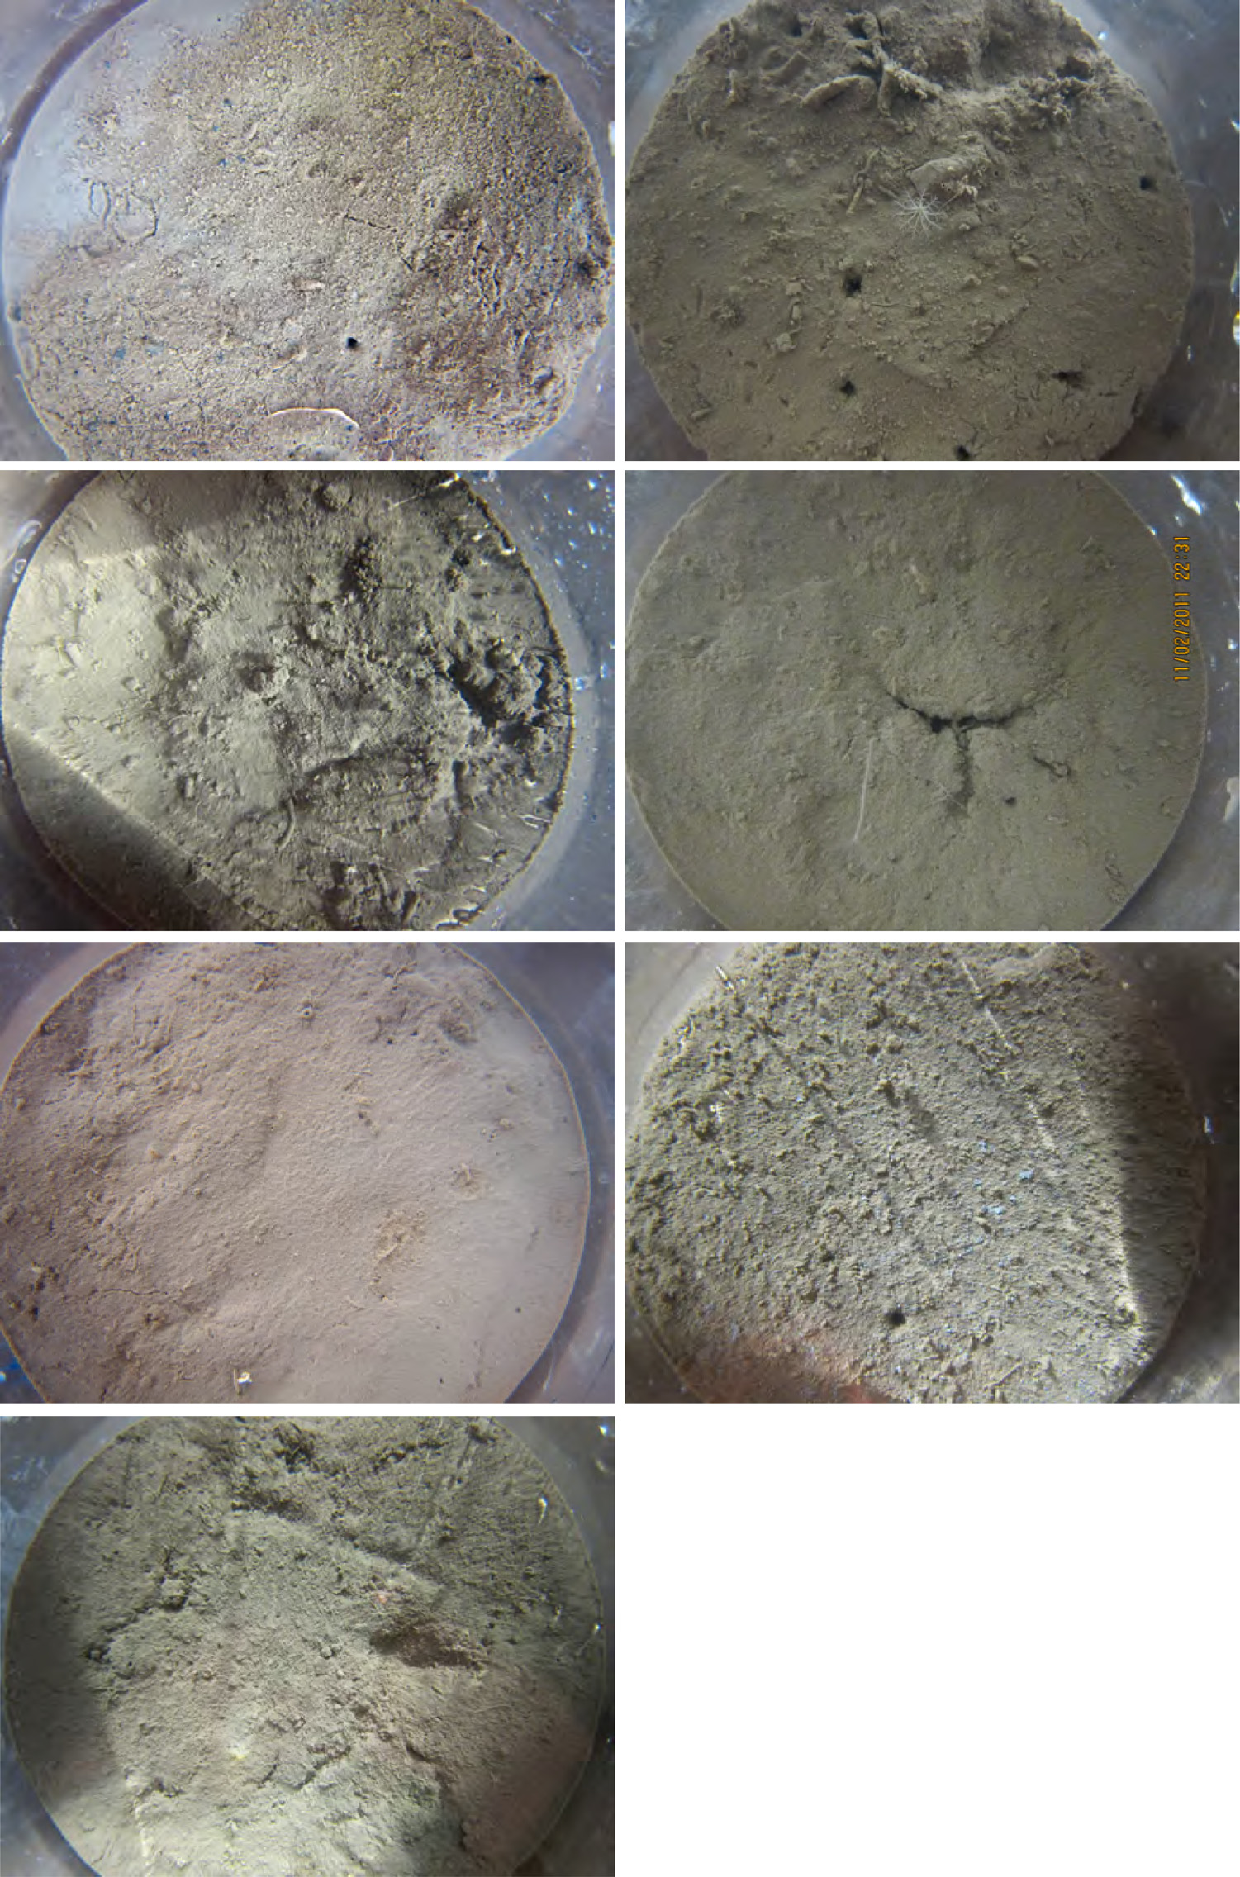

Slide 28
Biodiffusion
Bioturbation causes mixing in the bed
Resuspension & Desorption
Biodiffusion
Redeposition
Sherwood et al, CSR, 2002

Slide 29
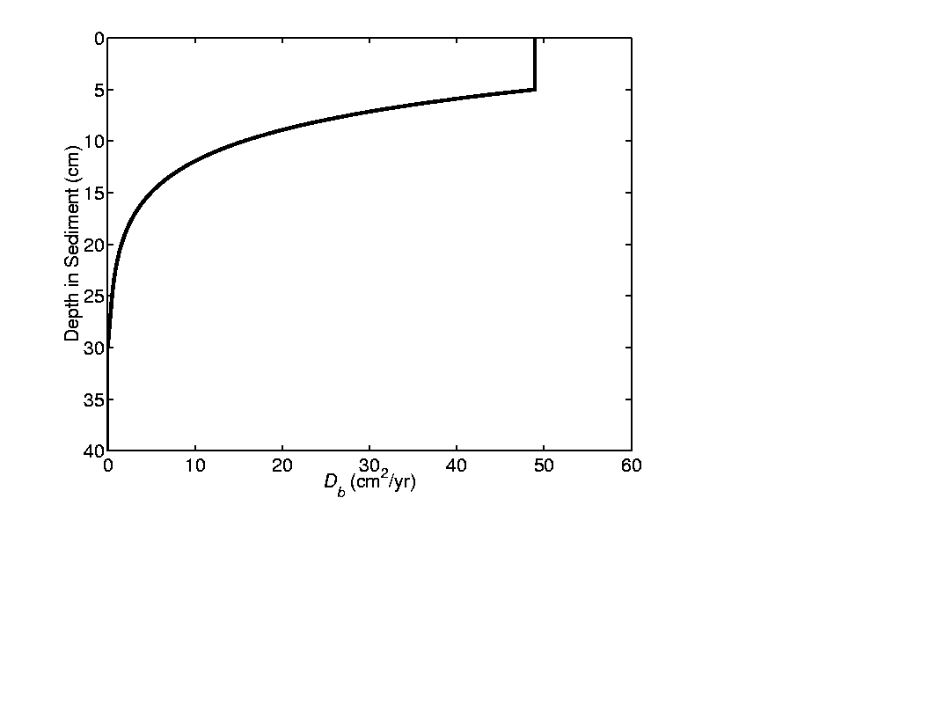
Biodiffusive Mixing
Implicit solution of diffusion equation
Mixing profile D_{b}(z) defined by five parameters
Typical values in top ~5-8 cm of the bed are 10 cm²/y
(O 10⁻⁷ m² s⁻¹)
Constant (in surface
layer (< 5 cm)
Exponential decrease
Zero below some
depth (~30 cm)

Slide 30
Biodiffusion + Mixed bed

Slide 31
Bedload
Meyer-Peter Müeller (1948)
Or Soulsby and Damgaard (2005)
Accounts for net transport over a wave cycle of components parallel and perpendicular to mean currents
Bed slope effect
where
In development: van der A et al. (2013) bedload caused by wave asymmetry (Consult with Taran Kalra)

Slide 32
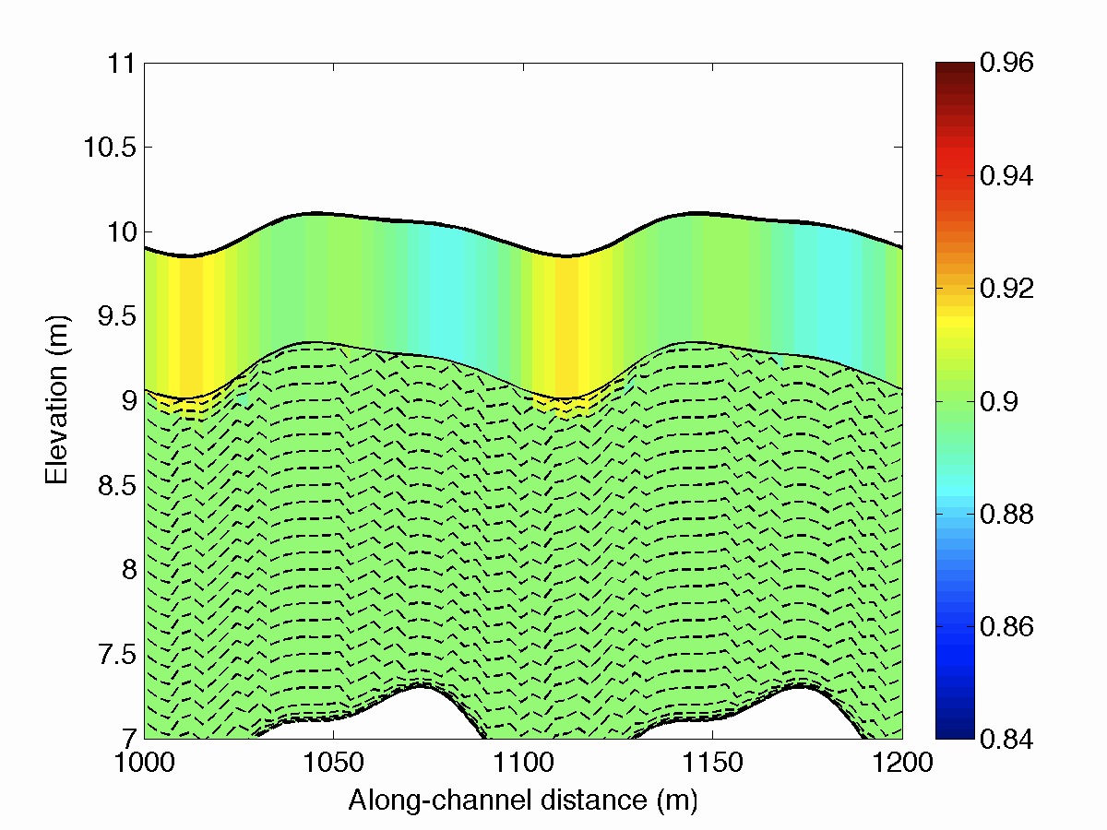
Bedload example: sorted bedform morphology
Fraction of finer sand class

Slide 33
Example: bedload transport
Study bedform evolution (Chincoteague Bay):
Ganju et al., Estuar. Coasts, 2016
Notes:
Ganju et al. (2016) quantified storm-induced bathymetric changes in Chincoteague Bay. The model indicates that fall-winter northeasterly wind results in southwestward sediment transport, while spring/summer southwesterly winds lead to the opposite trend.

Slide 34
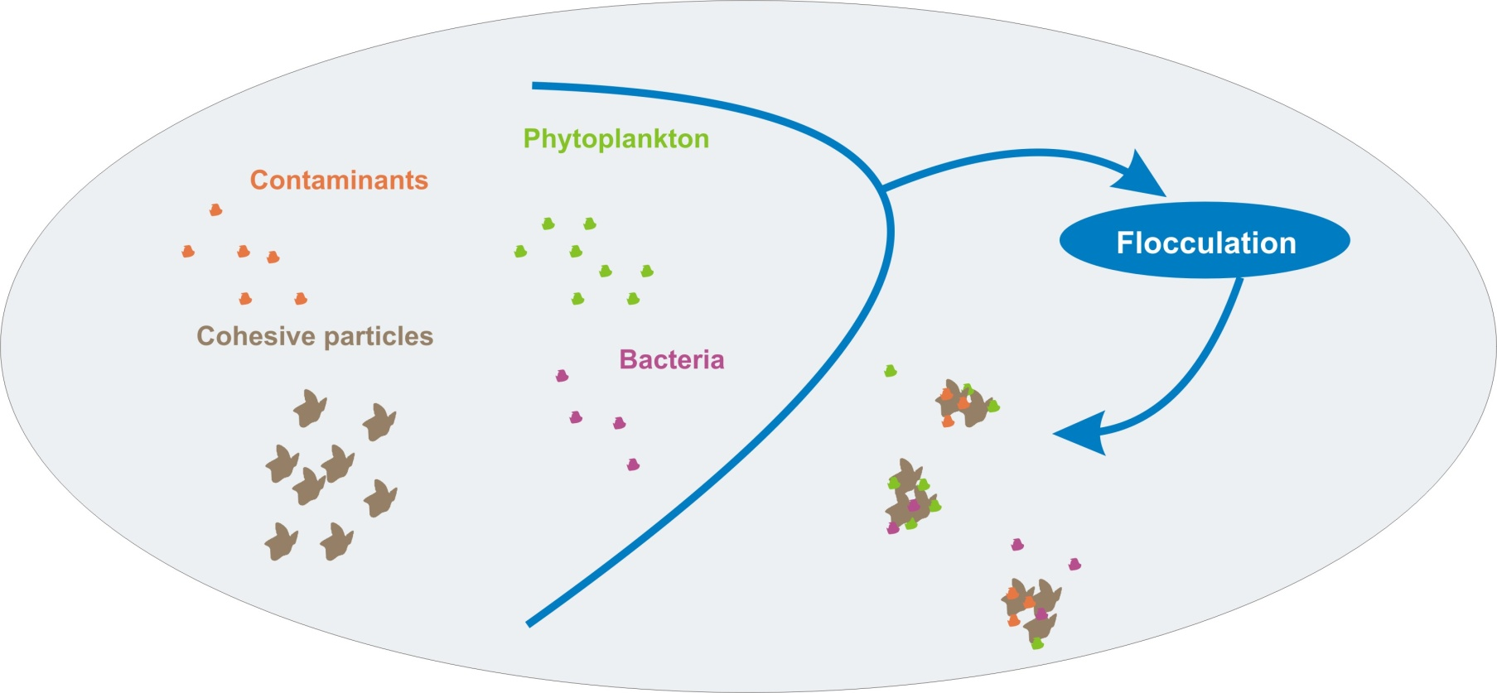
Flocculation
Romaric Verney

Slide 35
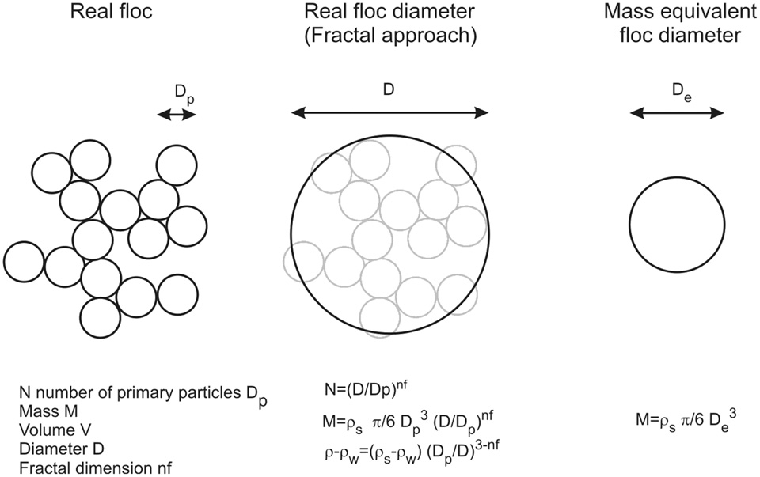
Flocculation
Verney et al., 2011

Slide 36
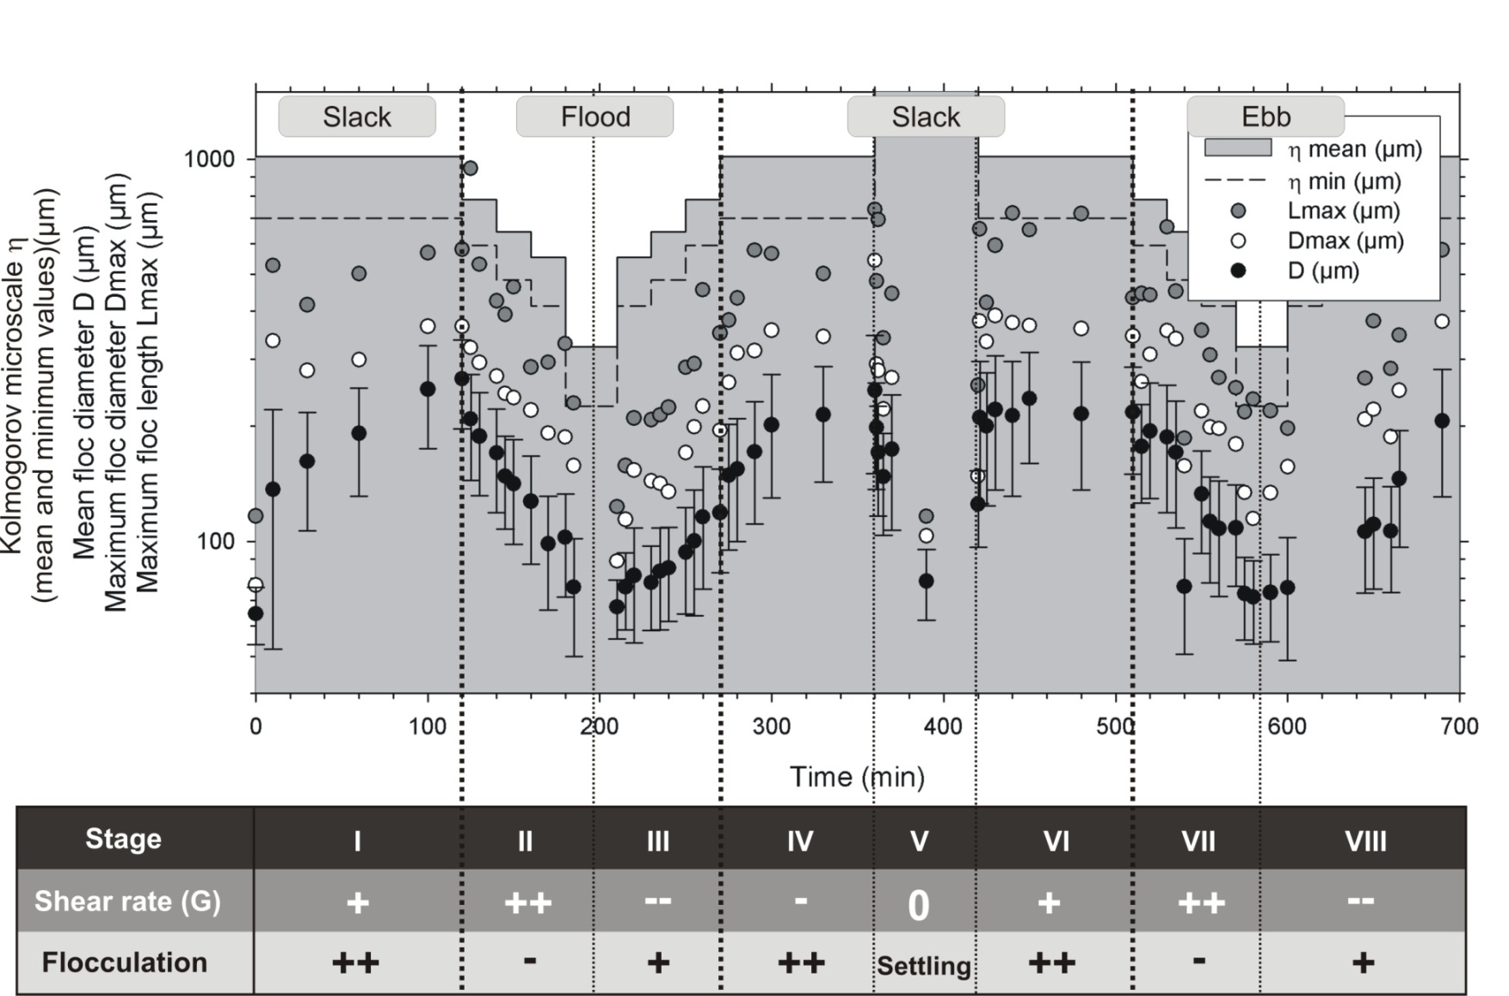
Flocculation
Laboratory experiments
Verney et al., 2011

Slide 37
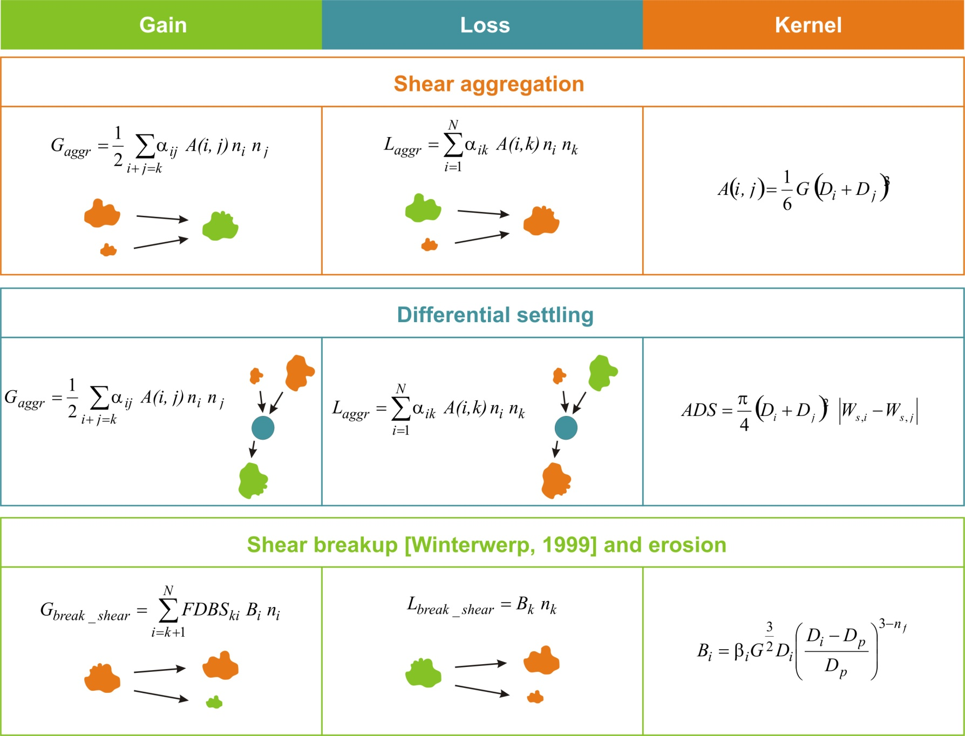
Flocculation

Slide 38
Flocculation
Description of the SCB model – FLOCMOD
Verney et al., 2011; Maerz et al., 2011; Mietta et al., 2011
Based on the population equation proposed by Smoluchowski (1917) :
The floc population is described by N size classes, logarithmically distributed:
D - 1: 50µm ; 2: 77µm ; 3: 118µm ; 4: 180µm ; 5: 275µm ; 6: 421µm ; 7: 643µm
Ws - 1: 0.13 ; 2: 0.19 ; 3: 0.28 ; 4: 0.41 ; 5: 0.61 ; 6: 0.89 ; 7: 1.30 mm/s
Assuming a floc fractal behaviour [nf=1.9]
Particles into these classes experience aggregation and fragmentation processes, mathematically represented by kernels formulations

Slide 39
Flocmod in COAWST (Sherwood et al., 2018)
Flocmod computed at each x,y,z,t
  Δt = 1/4 to 1 s
  7 to 15 floc classes (4 – 1500 μm)
  1 to 3 sand classes (125 – 250 μm)
  D_{p} = 4 μm, ρ_{s} = 2650 kg/m³, n_{f} = 2
  Binary fragmentation
  No floc deposition
  Other parameters according to Verney et al., 2011
Verney Tank Experiment
Constant concentration = 0.093 kg/m³
Notes:
Two tests of model implementation: Reproduces Verney plots w/ same forcing and no settling and, with no settling, size evolves to Winterwerp equilibrium.
Note that shear rates are high; concentration is constant at
Other tests suggest initial size distribution does not matter unless it all settles quickly.
! l_ADS : boolean set to .true. if differential settling aggregation
l_ADS == F
! l_ASH : boolean set to .true. if shear aggregation
l_ASH == T
! l_COLLFRAG : boolean set to .true. if collision-induced fragmentation enable
l_COLLFRAG == F
! f_dp0 : Primary particle size (m), typically 4e-6 m
f_dp0 == 0.000004d0
! f_nf : Floc fractal dimension, typically ranging from 1.6 to 2.6
f_nf == 2.0d0
! f_dmax : (unused) Maximum diameter (m)
f_dmax == 0.0015d0
! f_nb_frag : number of fragments by shear erosion. If binary/ternary : 2.
f_nb_frag == 2.0d0
! f_alpha : flocculation efficiency, ranging from 0 .to 1.
f_alpha == 0.35d0
! f_beta : shear fragmentation rate
f_beta == 0.15d0
! f_ater : for ternary breakup, use 0.5, for binary : 0. (a boolean could be better)
f_ater == 0.0d0
! f_ero_frac : fraction of the shear fragmentation term transfered to shear erosion.
! Ranging from 0. (no erosion) to 1. (all erosion)
f_ero_frac == 0.0d0
! f_ero_nbfrag : Number of fragments induced by shear erosion.
f_ero_nbfrag == 2.0d0
! f_ero_iv : fragment size class (could be changed to a particle
! size or a particle distribution (INTEGER)
f_ero_iv == 1
! f_collfragparam : Fragmentation rate for collision-induced breakup
f_collfragparam == 0.01d0
! f_clim : min concentration below which flocculation processes are not calculated
f_clim == 0.001d0
! l_testcase - if .TRUE. sets G(t) to values from Verney et al., 2011 lab experiment
l_testcase == F

Slide 40
Flocs in COAWST (Sherwood et al., 2018)
Steady flow, no settling, no deposition
Comparison with Keyvani & Strom (2014)
Study of different aggregation/disaggregation constants

Slide 41
Flocs in COAWST (Sherwood et al., 2018)
Steady flow, no settling, no deposition
Winterwerp (equilibrium profile)
Study of different aggregation/disaggregation constants

Slide 42
Flocs in COAWST (Sherwood et al., 2018)
Example: Steady flow

Slide 43
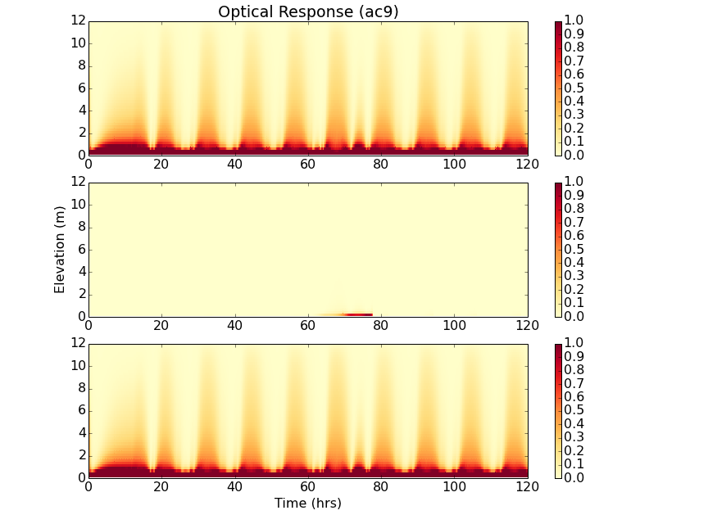
Example: Tidal flow + wave event
Flocs
Sand
Both

Slide 44
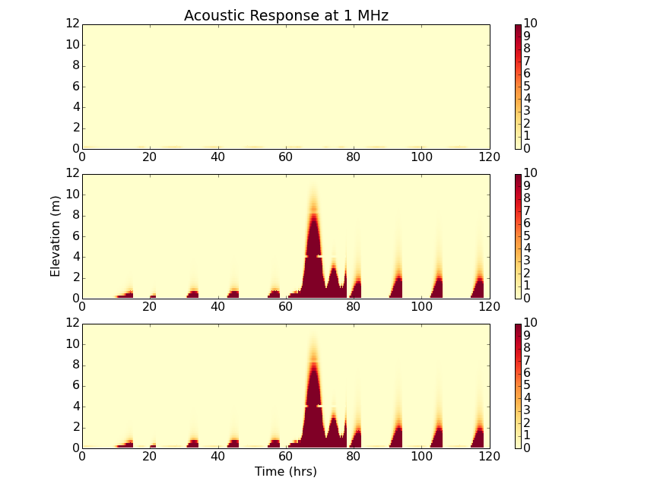
Example: Tidal flow + wave event
Flocs
Sand
Both

Slide 45
Estuarine Turbidity Maximum with FLOCS
No flocs
vs
Flocs
Suspended sediment concentration
Bed elevation
Diameter

Slide 46
What is different about sediment in COAWST? (external differences)
Minimal
  Switches in .h file
  Changes in .in file
  Need sediment.in file
  Need to modify (a copy of) ana_sediment.F
  …or provide more info in init.nc file
  New output in his.nc file
Many applications also need
  More info in init.nc file (initial bed)
  Wave input
  River sediment input
  Boundary conditions

Slide 47
Where in COAWST code?
User files
  Application .h file
  ana_ .F files
  varinfo.dat
  .in file
  Init and forcing .nc files
/ROMS/Nonlinear
bbl.F, ssw_bbl.h
/ROMS/Nonlinear/Sediment
sed_bed_cohesive.F, sed_bedload.F, sed_fluxes.F, sed_surface.F, sediment.F, sediment_inp.h, sediment_var.h, sed_bed.F sed_bed2.F, sed_biodiff.F, sed_settling.F, sedbed_mod.h, sediment_def.h, sediment_mod.h, sediment_wrt.h, sed_flocs.F, sedflocs_mod.h

Slide 48
Bottom Boundary Layer
Converts near-bottom velocities to stresses
Currents only, constant roughness [bustr, bvstr]
** UV_LOGDRAG use to turn ON or OFF logarithmic bottom friction **
** UV_LDRAG use to turn ON or OFF linear bottom friction **
** UV_QDRAG use to turn ON or OFF quadratic bottom friction **
Waves and currents, time-variable roughness [bustrc, bvstrc] and [bustrcwmax, bvstrcwmax]
** OPTIONS for the Sherwood/Signell/Warner bottom boundary layer closure: **
** **
** SSW_BBL use if Sherwood et al. BBL closure **
** SSW_CALC_ZNOT use if computing bottom roughness internally **
** SSW_LOGINT use if logarithmic interpolation of (Ur,Vr) **
** SSW_CALC_UB use if computing bottom orbital velocity internally **
** SSW_FORM_DRAG_COR use to activate form drag coefficient **
** SSW_ZOBIO use if biogenic bedform roughness from ripples **
** SSW_ZOBL use if bedload roughness for ripples **
** SSW_ZORIP use if bedform roughness from ripples **
** **

Slide 49
Sediment-Related Compiler Options
#define TS_MPDATA – need positive definite advection for suspload
#define SSW_BBL – wave-current interaction (Madsen 1994) – enhanced zoa
#ifdef SSW_BBL
# define SSW_CALC_UB – or read Uwave_rms from SWAN
# define SSW_CALC_ZNOT – otherwise, inner roughness is constant
# ifdef SSW_CALC_ZNOT – saltation from
# define SSW_ZOBL – ripples from Malarkey & Davies version of Harris & Wiberg
# define SSW_ZORIP - roughness proportional to h^2/l
# define SSW_ZOBIO – background value…in future might relax ripples to biogenic
# define SSW_FORM_DRAG_COR – separates form drag from total bottom stress
# undef SSW_LOGINT – may not work correctly
#endif
#define SEDIMENT – adds NSED tracers
#ifdef SEDIMENT
# define SUSPLOAD – water column tracer, interacts with bed
# define COHESIVE_BED or # define MIXED_BED – all or part cohesive
# define BEDLOAD_SOULSBY or #define BEDLOAD_MPM – bedload transport
# define SED_DENS – sus. sediment contributes to fluid density
# define SED_MORPH – bottom elevation evolves
# define SED_BIODIFF - mixing
#endif

Slide 50
Sediment in cpp_defs
(sed_floc_toy)
#define SSW_BBL
#ifdef SSW_BBL
# undef SSW_CALC_UB
# define SSW_CALC_ZNOT
# define SSW_LOGINT
#endif
#define GLS_MIXING
#ifdef GLS_MIXING
# define KANTHA_CLAYSON
# define N2S2_HORAVG
# undef CRAIG_BANNER
# undef CHARNOK
# undef ZOS_HSIG
# undef TKE_WAVEDISS
#endif
Usually want a bbl model for w-c combined stress
#define SEDIMENT
#ifdef SEDIMENT
# define SUSPLOAD
# undef BEDLOAD_SOULSBY
# undef BEDLOAD_MPM
# define SED_DENS
# undef COHESIVE_BED
# undef BF_TCR
# undef LINEAR_TCR
# undef POWERLAW_TCR
# define MIXED_BED
# undef SED_MORPH
# define SED_FLOCS
# undef FLOC_TURB_DISS
# define FLOC_BBL_DISS
# define SED_DEFLOC
# define SED_TAU_CD_CONST
# undef SED_TAU_CD_LIN
# undef SED_BIODIFF
#endif
Floc model usually wants a turbulence model

Slide 51
Sediment Variables
Sediment class variables dimension(#sed.classes)
  Median size, particle density, settling velocity, particle critical shear stress
Bottom variables dimension(#x,#y,#bot. props.)
  Average grain size, average particle critical shear stress, ripple geometry, hydraulic roughness, reference critical shear stress slope and offset, cohesive time scale, reference biodiffusion profile
Bed variables dimension(#x,#y,#layers, #bed props.)
  Thickness, volume solids fraction of each class, porosity, age, bed critical shear stress, mixed bed behavior, biodiffusivity
Bed mass dimension(#x,#y,#layers,#sed.classes)
Bed fraction dimension(#x,#y,#layers,#sed.classes)
Erosion-rate coefficient, mixed-layer specification

Slide 52
Sediment in ocean*.in
(Examples from sed_floc_toy)
Nbed, NCS, NNS
! Grid dimension parameters. See notes below in the Glossary for how to set
! these parameters correctly.
Lm == 6 ! Number of I-direction INTERIOR RHO-points
Mm == 5 ! Number of J-direction INTERIOR RHO-points
N == 50 ! Number of vertical levels
Nbed = 20 ! Number of sediment bed layers
NAT = 2 ! Number of active tracers (usually, 2)
NPT = 0 ! Number of inactive passive tracers
NCS = 15 ! Number of cohesive (mud) sediment tracers
NNS = 4 ! Number of non-cohesive (sand) sediment tracers

Slide 53
Sediment in sediment*.in
(examples from sed_floc_toy)
All applications need boundary conditions:
LBC(isTvar) == Gra Clo Gra Clo ! idsed(:), compact
Layer thickness affects stratigraphic fidelity:
! Depositional bed layer thickness criteria to create a new layer (m). If
! deposition exceeds this value, then a new layer is created, [1:Ngrids].
NEWLAYER_THICK == 0.001d0
For bedload, a tuning parameter:
! Bed load transport rate coefficient, [1:Ngrids].
BEDLOAD_COEFF == 0.15d0

Slide 54
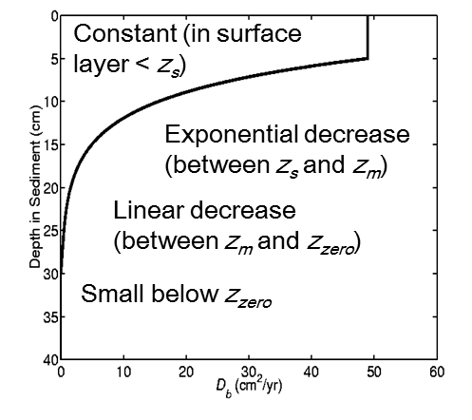
Sediment in sediment*.in (cont’d)
Controls on biodiffusive mixing profile (# define SED_BIODIFF):
! Maximum biodiffusivity, [1:Ngrids].
DBMAX == 1.0d-10
! Minimum biodiffusivity, [1:Ngrids].
DBMIN == 1.0d-12
! Depth of maximum biodiffusivity, [1:Ngrids].
DBZS == 0.002d0
! Depth of end of exponential biodiffusivity, [1:Ngrids].
DBZM == 0.08d0
! Depth of minimum biodiffusivity, [1:Ngrids].
DBZP == 0.01d0

Slide 55
Sediment in sediment*.in (cont’d)
! Logical switches (TRUE/FALSE) to activate writing of bed layer
! parameters, [1:Ngrids] values expected.
Hout(ithck) == T ! sediment layer thickness
Hout(iaged) == T ! sediment layer age
Hout(iporo) == T ! sediment layer porosity
Hout(idiff) == T ! biodiffusivity
! Logical switches (TRUE/FALSE) to activate writing of bed
! bottom sediment parameters, [1:Ngrids] values expected.
Hout(isd50) == T ! mean grain diameter
Hout(idens) == T ! mean grain density
Hout(iwsed) == T ! mean settling velocity
Hout(itauc) == T ! critical erosion stress
Hout(irlen) == T ! ripple length
Hout(irhgt) == T ! ripple height
Hout(ibwav) == T ! wave excursion amplitude
Hout(izdef) == T ! default bottom roughness
Hout(izapp) == T ! apparent bottom roughness
Hout(izNik) == T ! Nikuradse bottom roughness
Hout(izbio) == T ! biological bottom roughness
Hout(izbfm) == T ! bed form bottom roughness
Hout(izbld) == T ! bed load bottom roughness
Hout(izwbl) == T ! wave bottom roughness
Hout(iactv) == T ! active layer thickness
Hout(ishgt) == F ! saltation height
Hout(imaxD) == F ! maximum inundation depth
Hout(idnet) == F ! Erosion or deposition
Hout(idoff) == F ! dmix erodibility profile offset
Hout(idslp) == F ! dmix or erodibility slope
Hout(idtim) == F ! erodibility profile restore time
Hout(idbmx) == F ! Bed biodifusivity maximum
Hout(idbmm) == F ! Bed biodifusivity minimum
Hout(idbzs) == F ! Bed biodifusivity zs
Hout(idbzm) == F ! Bed biodifusivity zm
Hout(idbzp) == F ! Bed biodifusivity phi
Hout(idprp) == F ! cohesive behavior
Switches to control sediment bed output.
These used to be in ocean*.in

Slide 56
Sediment in sediment*.in (cont’d)
!------------------------------------------------------------------------------
! Non-cohesive Sediment Parameters, [1:NNS,1:Ngrids] values expected.
!------------------------------------------------------------------------------
! Median sediment grain diameter (mm).
SAND_SD50 == 0.0300d0 0.0625d0 0.1250d0 0.2500d0
! Sediment concentration (kg/m3).
SAND_CSED == 0.000000d0 0.000000d0 0.000000d0 0.000000d0
! Sediment grain density (kg/m3).
SAND_SRHO == 2650.0d0 2650.0d0 2650.0d0 2650.0d0
! Particle settling velocity (mm/s).
SAND_WSED == 0.4722d0 2.0421d0 7.9478d0 26.9607d0
! Surface erosion rate (kg/m2/s).
SAND_ERATE == 5.0d-4 5.0d-4 5.0d-4 5.0d-4
! Critical shear for erosion and deposition (N/m2).
SAND_TAU_CE == 0.0854d0 0.1244d0 0.1601d0 0.1980d0
SAND_TAU_CD == 60.0d0 60.0d0 60.0d0 60.0d0
! Porosity (nondimensional: 0.0-1.0): Vwater/(Vwater+Vsed).
SAND_POROS == 0.5d0 0.5d0 0.5d0 0.5d0
Important!
Sand properties.
One value per NNS class.
You have to provide the relationship between size, density, settling velocity, and critical shear stress.
Affects roughness and minimum mixed layer thickness
Global initial conditions
Affects bed mass / thickness and stratification #ifdef SED_DENS
Settling velocity is constant
Tunable parameter
Critical stress for erosion and deposition #idef SED_TAU_CD_xxx
Affects bed mass / thickness relationship

Slide 57
Sediment in sediment*.in (cont’d)
! Harmonic/biharmonic horizontal diffusion of tracer for nonlinear model
! and adjoint-based algorithms.
SAND_TNU2 == 0.0d0 ! m2/s
SAND_TNU4 == 0.0d0 ! m4/s
ad_SAND_TNU2 == 0.0d0 ! m2/s
ad_SAND_TNU4 == 0.0d0 ! m4/s
! Logical switches (TRUE/FALSE) to increase horizontal diffusivity
! of noncohesive sediment trace in specific areas of the application
! domain (like sponge areas) for the desired grid:
SAND_Sponge == F
! Vertical mixing coefficients for tracers in nonlinear model and
! basic state scale factor in adjoint-based algorithms.
SAND_AKT_BAK == 5.0d-6 ! m2/s
SAND_AKT_fac == 1.0d0 ! nondimensional
! Nudging/relaxation time scales, inverse scales will be computed
! internally.
SAND_TNUDG == 0.0d0 ! days
! Morphological time scale factor (greater than or equal to 1.0). A
! value of 1.0 has no scale effect.
SAND_MORPH_FAC == 1.0d0 ! nondimensional
! Logical switches (TRUE/FALSE) to activate tracers point Sources/Sinks
! (like river runoff) and to specify which tracer variables to consider.
! See glossary below for details.
SAND_Ltsrc == F
! Logical switches (TRUE/FALSE) to read and process noncohesive sediment
! tracers climatology. See glossary below for details.
SAND_Ltclm == F
Seldom-used switches.
These used to be in ocean*.in

Slide 58
Sediment in sediment*.in (cont’d)
! Logical switches (TRUE/FALSE) to activate writing of non-cohesive
! sediment into HISTORY output file.
Hout(idsand) == T ! suspended concentration
Hout(iSfrac) == T ! bed layer fraction
Hout(iSmass) == T ! bed layer mass
Hout(iSUbld) == T ! bed load at U-points
Hout(iSVbld) == T ! bed load at V-points
! Logical switches (TRUE/FALSE) to activate writing of time-averaged
! non-cohesive sediment fields into AVERAGE output file.
Aout(idsand) == F ! sand_01, ... suspended concentration
Aout(iSTTav) == F ! sand_01_2, ... quadratic <t*t> tracer terms
Aout(iSUTav) == F ! u_sand_01, ... quadratic <u*t> tracer terms
Aout(iSVTav) == F ! v_sand_01, ... quadratic <v*t> tracer terms
Aout(SHUTav) == F ! Huon_sand_01, ... tracer volume flux, <Huon*t>
Aout(SHVTav) == F ! Hvom_sand_01, ... tracer volume flux, <Hvom*t>
Aout(iSUbld) == F ! bedload_Usand_01, ... bed load at U-points
Aout(iSVbld) == F ! bedload_Vsand_01, ... bed load at V-points
! Logical switches (TRUE/FALSE) to activate writing of time-averaged,
! non-cohesive sediment diagnostic terms into DIAGNOSTIC output file.
Dout(STrate) == F ! sand_01_rate, ... time rate of change
Dout(SThadv) == F ! sand_01_hadv, ... horizontal total advection
Dout(STxadv) == F ! sand_01_xadv, ... horizontal XI-advection
Dout(STyadv) == F ! sand_01_yadv, ... horizontal ETA-advection
Dout(STvadv) == F ! sand_01_vadv, ... vertical advection
Dout(SThdif) == F ! sand_01_hdiff, ... horizontal total diffusion
Dout(STxdif) == F ! sand_01_xdiff, ... horizontal XI-diffusion
Dout(STydif) == F ! sand_01_ydiff, ... horizontal ETA-diffusion
Dout(STsdif) == F ! sand_01_sdiff, ... horizontal S-diffusion
Dout(STvdif) == F ! sand_01_vdiff, ... vertical diffusion
Switches to control non-cohesive sediment output.
These also used to be in ocean*.in

Slide 59
Sediment in sediment*.in (cont’d)
!------------------------------------------------------------------------------
! Suspended Cohesive Sediment Parameters, [1:NCS,1:Ngrids] values expected.
!------------------------------------------------------------------------------
! Median sediment grain diameter (mm).
MUD_SD50 == 0.020000d0 0.027225d0 0.037059d0 0.050446d0
! Sediment concentration (kg/m3).
MUD_CSED == 0.0d0 0.0d0 0.0d0 0.0d0 0.0d0 0.0d0 0.0d0
! Sediment grain density (kg/m3).
MUD_SRHO == 1350.000000d0 1263.753867d0 1200.395104d0
! Particle settling velocity (mm/s).
MUD_WSED == 0.070850d0 0.096443d0 0.131282d0 0.178706d0
! Surface erosion rate (kg/m2/s).
MUD_ERATE == 0.000500d0 0.000500d0 0.000500d0 0.000500d0
! Critical shear for erosion and deposition (N/m2).
MUD_TAU_CE == 0.03d0 0.03d0 0.03d0 0.03d0 0.03d0 0.03d0
MUD_TAU_CD == 60.00d0 60.00d0 60.00d0 60.00d0 60.00d0 60.00d
! Porosity (nondimensional: 0.0-1.0): Vwater/(Vwater+Vsed).
MUD_POROS == 0.500d0 0.500d0 0.500d0 0.500d0 0.500d0 0.50
0d0 0.500d0 0.500d0 0.500d0 0.500d0 0.500d0 0.500d0 0.500d0 0.500d0 0.500d0
Important!
Mud/floc properties.
One value per NCS class…similar to non-cohesive parameters except MUD_SRHO and MUD_WSED depend on MUD_SD50 and fractal dimension.
Affects roughness and minimum mixed layer thickness
Initial conditions only
Affects bed mass / thickness and stratification #ifdef SED_DENS
Settling velocity is constant
Tunable parameter
Critical stress for erosion and deposition #idef SED_TAU_CD_xxx
Affects bed mass / thickness relationship

Slide 60
Sediment in sediment*.in (cont’d)
! Harmonic/biharmonic horizontal diffusion of tracer for nonlinear model
! and adjoint-based algorithms.
MUD_TNU2 == 0.0d0 0.0d0 ! m2/s
MUD_TNU4 == 0.0d0 0.0d0 ! m4/s
ad_MUD_TNU2 == 0.0d0 0.0d0 ! m2/s
ad_MUD_TNU4 == 0.0d0 0.0d0 ! m4/s
! Logical switches (TRUE/FALSE) to increase horizontal diffusivity
! of cohesive sediment trace in specific areas of the application
! domain (like sponge areas) for the desired grid:
MUD_Sponge == F F
! Vertical mixing coefficients for tracers in nonlinear model and
! basic state scale factor in adjoint-based algorithms.
MUD_AKT_BAK == 5.0d-6 5.0d-6 ! m2/s
MUD_AKT_fac == 2*1.0d0 ! nondimensional
! Nudging/relaxation time scales, inverse scales will be computed
! internally.
MUD_TNUDG == 0.0d0 0.0d0 ! days
! Morphological time scale factor (greater than or equal to 1.0). A
! value of 1.0 has no scale effect.
MUD_MORPH_FAC == 1.0d0 1.0d0 ! nondimensional
! Logical switches (TRUE/FALSE) to activate tracers point Sources/Sinks
! (like river runoff) and to specify which tracer variables to consider.
! See glossary below for details.
MUD_Ltsrc == F F
! Logical switches (TRUE/FALSE) to read and process cohesive sediment
! tracers climatology. See glossary below for details.
MUD_Ltclm == F F
Seldom-used non-cohesive switches.
These have been added for consistency.
Notes:
These need one value per class.
Not sure it makes sense to have different values for different classes.

Slide 61
Sediment in sediment*.in (cont’d)
! Logical switches (TRUE/FALSE) to activate writing of cohesive sediment
! fields into HISTORY output file.
Hout(idmud) == T ! mud_01, ... suspended concentration
Hout(iMfrac) == T ! mudfrac_01, ... bed layer fraction
Hout(iMmass) == T ! mudmass_01, ... bed layer mass
Hout(iMUbld) == T ! bedload_Umud_01, ... bed load at U-points
Hout(iMVbld) == T ! bedload_Vmud_01, ... bed load at V-points
! Logical switches (TRUE/FALSE) to activate writing of time-averaged
! cohesive sediment fields into AVERAGE output file.
Aout(idmud) == F ! mud_01, ... suspended concentration
Aout(iMTTav) == F ! mud_01_2, ... quadratic <t*t> tracer terms
Aout(iMUTav) == F ! u_mud_01, ... quadratic <u*t> tracer terms
Aout(iMVTav) == F ! v_mud_01, ... quadratic <v*t> tracer terms
Aout(MHUTav) == F ! Huon_mud_01, ... tracer volume flux, <Huon*t>
Aout(MHVTav) == F ! Hvom_mud_01, ... tracer volume flux, <Hvom*t>
Aout(iMUbld) == F ! bedload_Umud_01, ... bed load at U-points
Aout(iMVbld) == F ! bedload_Vmud_01, ... bed load at V-points
! Logical switches (TRUE/FALSE) to activate writing of time-averaged,
! cohesive sediment diagnostic terms into DIAGNOSTIC output file.
Dout(MTrate) == F ! mud_01_rate, ... time rate of change
Dout(MThadv) == F ! mud_01_hadv, ... horizontal total advection
Dout(MTxadv) == F ! mud_01_xadv, ... horizontal XI-advection
Dout(MTyadv) == F ! mud_01_yadv, ... horizontal ETA-advection
Dout(MTvadv) == F ! mud_01_vadv, ... vertical advection
Dout(MThdif) == F ! mud_01_hdiff, ... horizontal total diffusion
Dout(MTxdif) == F ! mud_01_xdiff, ... horizontal XI-diffusion
Dout(MTydif) == F ! mud_01_ydiff, ... horizontal ETA-diffusion
Dout(MTsdif) == F ! mud_01_sdiff, ... horizontal S-diffusion
Dout(MTvdif) == F ! mud_01_vdiff, ... vertical diffusion
Switches to control cohesive sediment output.
These also used to be in ocean*.in

Slide 62
Sediment in sediment*.in (cont’d)
Defines transition from non-cohesive to cohesive
!------------------------------------------------------------------------------
! Mixed Bed parameters- Transition threshold for cohesive mix
! and non-cohesive behaviors [1:Ngrids] values expected.
!------------------------------------------------------------------------------
! Cohesive transition- Under that value of total mud fraction
! entire bed behaves as a non-cohesive bed
TRANSC == 0.03d0
! Noncohesive transition- Over that value of total mud fraction
! entire bed behaves as a cohesive bed
TRANSN == 0.2d0
!------------------------------------------------------------------------------
! Cohesive/Mixed bed critical shear
! Bed critical shear stress values if cohesive or mixed Bed is active
! These values are applied to the entire bed. [1:Ngrids] values expected.
!------------------------------------------------------------------------------
! Minimum shear for erosion
MUD_TAUCR_MIN == 0.030000d0
! Maximum shear for erosion
MUD_TAUCR_MAX == 5.20d0
! Tau_crit profile slope
MUD_TAUCR_SLOPE == 0.300000d0
! Tau_crit profile offset
MUD_TAUCR_OFF == 1.000000d0
! Tau_crit consolidation rate
MUD_TAUCR_TIME == 28800.0d0
Defines critical shear stress profile in bed

Slide 63
Sediment in sediment*.in (cont’d)
!------------------------------------------------------------------------------
! Flocculation Sediment Parameters.
!------------------------------------------------------------------------------
! Boolean set to .true. if differential settling aggregation
L_ADS == F
! Boolean set to .true. if shear aggregation
L_ASH == T
! Boolean set to .true. if collision-induced fragmentation enable
L_COLLFRAG == F
! Primary particle size (m), typically 4e-6 m
F_DP0 == 0.000004d0
! Floc fractal dimension, typically ranging from 1.6 to 2.6
F_NF == 2.0d0
! Maximum diameter (m)
F_DMAX == 0.0015d0
! Number of fragments by shear erosion, If binary/ternary : 2.0
F_NB_FRAG == 2.0d0
! Flocculation efficiency, ranging from 0 to 1.0
F_ALPHA == 0.35d0
! Shear fragmentation rate
F_BETA == 0.15d0
Floc model parameters.
See Verney et al. (2011)
These determine the particle-particle interactions in a Lagrangian time-dependent solution for each ROMS cell.

Slide 64
Sediment in sediment*.in (cont’d)
! For ternary breakup, use 0.5, for binary : 0. (a boolean could be better)
F_ATER == 0.0d0
! Fraction of the shear fragmentation term transfered to shear erosion.
! Ranging from [(0.0 - no erosion to 1.0 - all erosion)]
F_ERO_FRAC == 0.0d0
! Number of fragments induced by shear erosion.
F_ERO_NBFRAG == 2.0d0
! Fragment size class (could be changed to a particle
! size or a particle distribution) (INTEGER)
F_ERO_IV == 1
! Fragmentation rate for collision-induced breakup
F_COLLFRAGPARAM == 0.01d0
! Min concentration below which flocculation processes are not calculated
F_CLIM == 0.001d0
! If .TRUE. sets G(t) to values from Verney et al., 2011 lab experiment
L_TESTCASE == F
Floc model parameters cont’d.
See Verney et al. (2011)

Slide 65
Sediment in sediment*.in (cont’d)
!------------------------------------------------------------------------------
! Flocculation Decomposition in Bed Sediment Parameters
! Only #ifdef DEFLOC
!------------------------------------------------------------------------------
! Equilibrium fractional class distribution (they should add up to 1).
! There is no check for that
! [1:NCS,1:Ngrids] values expected.
MUD_FRAC_EQ == 0.10d0 0.20d0 0.40d0 0.20d0 0.10d0 0.0d0 0.0d0 0.00d0 0.0d0 0.0d0 0.0d0 0.0d0 0.0d0 0.0d0 0.0d0
! Time scale of flocculation decomposition in bed
! [1:Ngrids] values expected.
MUD_T_DFLOC == 200.0d0
!
Define equilibrium floc distribution in bed and time scale for nudging to this distribution
#ifdef DEFLOC

Slide 66
Creating input files
../COAWST/Tools/mfiles/mtools/create_roms_init.m
For the creation of the basic input file
distributed with COAWST release
SOULSBY_PARTICLE - Critcal shear stress and settling velocity (MKS units)
% p = soulsby_particle( d, rhos, rhow, nu, iverbose )
% Input (MKS units):
% d - diameter (m)
% rhos - sediment density (optional, default = 2650 kg/m3)
% rhow - water density (optional, default = 1027 kg/m3)
% nu - kinematic viscosity (optional, default = 1.36e-6 m2 s-1)
EXAMPLE:
p = soulsby_particle( 1e-4,2650,1027,1.36e-6,1)
Grain size (phi) d = 3.32255 [phi]
Grain size (microns) d = 100 [um]
Particle density rhos = 2650 [kg m-1]
Water density rhow = 1027 [kg m-1]
Kinematic viscosity nu = 1.36e-06 [m2 s-1]
Dimensionless grain size D* = 2.03133 [ ]
Threshold Shields param Shields_crit = 0.0894601 [ ]
Critical shear stress tau_crit = 0.142435 [N m-2]
Hallermeier settling velocity ws_h = 0.00633294 [m s-1]
van Rijn settling velocity ws_vr = 0.00633294 [m s-1]
Soulsby settling velocity ws = 0.00565758 [m s-1]
To create non-cohesive sediment properties, use soulsby_particle.m:
https://github.com/csherwood-usgs/fm_bbl/blob/master/soulsby_particle.m
% constants required for floc model calcs
rhos = 2650.0; g=9.81;
nf = 2.0; % Fractal dimension
rhoref = 1025;
Dp0 = 4.0e-6 % Primary particle diameter
Dpmin = 20.0e-6 % Smallest floc size
Dpmax = 1500e-6 % Max floc size
f_diam = 10.^linspace( log10(Dpmin),log10(Dpmax),NCS )
f_rho =rhoref+(rhos-rhoref)*(Dp0 ./f_diam).^(3.0-nf); % floc density
f_ws =g*(f_rho-rhoref).*f_diam.^2.0 ./(18.0*0.001); % settling velocity (Stokes)
To create floc sediment properties:
The floc parameters need to match values in sediment.in file

Slide 67
Sediment in sed_floc_toy output
http://geoport.whoi.edu/thredds/dodsC/clay/usgs/users/aretxabaleta/MVCO/ocean_his_117.nc
Float64 mud_01[ocean_time = 783][s_rho = 50][eta_rho = 7][xi_rho = 8];
Float64 mud_02[ocean_time = 783][s_rho = 50][eta_rho = 7][xi_rho = 8];
Float64 mud_03[ocean_time = 783][s_rho = 50][eta_rho = 7][xi_rho = 8];
Float64 mud_04[ocean_time = 783][s_rho = 50][eta_rho = 7][xi_rho = 8];
…
Float64 mud_14[ocean_time = 783][s_rho = 50][eta_rho = 7][xi_rho = 8];
Float64 mud_15[ocean_time = 783][s_rho = 50][eta_rho = 7][xi_rho = 8];
Float64 sand_01[ocean_time = 783][s_rho = 50][eta_rho = 7][xi_rho = 8];
Float64 sand_02[ocean_time = 783][s_rho = 50][eta_rho = 7][xi_rho = 8];
Float64 sand_03[ocean_time = 783][s_rho = 50][eta_rho = 7][xi_rho = 8];
Float64 sand_04[ocean_time = 783][s_rho = 50][eta_rho = 7][xi_rho = 8];
Float64 mudfrac_01[ocean_time = 783][Nbed = 20][eta_rho = 7][xi_rho = 8];
Float64 mudfrac_02[ocean_time = 783][Nbed = 20][eta_rho = 7][xi_rho = 8];
Float64 mudfrac_03[ocean_time = 783][Nbed = 20][eta_rho = 7][xi_rho = 8];
Float64 mudfrac_04[ocean_time = 783][Nbed = 20][eta_rho = 7][xi_rho = 8];
…
Float64 mudfrac_14[ocean_time = 783][Nbed = 20][eta_rho = 7][xi_rho = 8];
Float64 mudfrac_15[ocean_time = 783][Nbed = 20][eta_rho = 7][xi_rho = 8];
Float64 sandfrac_01[ocean_time = 783][Nbed = 20][eta_rho = 7][xi_rho = 8];
Float64 sandfrac_02[ocean_time = 783][Nbed = 20][eta_rho = 7][xi_rho = 8];
Float64 sandfrac_03[ocean_time = 783][Nbed = 20][eta_rho = 7][xi_rho = 8];
Float64 sandfrac_04[ocean_time = 783][Nbed = 20][eta_rho = 7][xi_rho = 8];
Float64 mudmass_01[ocean_time = 783][Nbed = 20][eta_rho = 7][xi_rho = 8];
Float64 mudmass_02[ocean_time = 783][Nbed = 20][eta_rho = 7][xi_rho = 8];
Float64 mudmass_03[ocean_time = 783][Nbed = 20][eta_rho = 7][xi_rho = 8];
…
Float64 mudmass_14[ocean_time = 783][Nbed = 20][eta_rho = 7][xi_rho = 8];
Float64 mudmass_15[ocean_time = 783][Nbed = 20][eta_rho = 7][xi_rho = 8];
Float64 sandmass_01[ocean_time = 783][Nbed = 20][eta_rho = 7][xi_rho = 8];
Float64 sandmass_02[ocean_time = 783][Nbed = 20][eta_rho = 7][xi_rho = 8];
Float64 sandmass_03[ocean_time = 783][Nbed = 20][eta_rho = 7][xi_rho = 8];
Float64 sandmass_04[ocean_time = 783][Nbed = 20][eta_rho = 7][xi_rho = 8];
Float64 bed_thickness[ocean_time = 783][Nbed = 20][eta_rho = 7][xi_rho = 8];
Float64 bed_age[ocean_time = 783][Nbed = 20][eta_rho = 7][xi_rho = 8];
Float64 bed_porosity[ocean_time = 783][Nbed = 20][eta_rho = 7][xi_rho = 8];
Float64 grain_diameter[ocean_time = 783][eta_rho = 7][xi_rho = 8];
The output includes variables for:
Sediment concentration in the water column,
Sediment fraction in the bed
Sediment mass in the bed
Bed variables

Slide 68
Post-processing input files
Output file assumed to be in Thredds repository
Extracting the basic variables from the output file:
https://github.com/csherwood-usgs/floc_proc/blob/master/floc_proc.m
Several more processing routines available at https://github.com/csherwood-usgs/floc_proc/
% floc_proc.m - Script to read and plot ROMS .his files
cas = 117
fprintf(fid2,'%d, ',cas)
url = sprintf('http://geoport.whoi.edu/thredds/dodsC/clay/usgs/users/aretxabaleta/MVCO/ocean_his_%02d.nc', cas)
…
%% Read in sediment sizes
fdiam = ncread(url,'Sd50');
ws = ncread(url,'Wsed');
rhos = ncread(url,'Srho');
tau_ce = ncread(url,'tau_ce');
tau_cd = ncread(url,'tau_cd');
…
%% read 15 mud classes, one cell only, for 1D results
nt = length(ocean_time);
nz = length(s_rho);
m = zeros( NCS, nz, nt);
for n=1:NCS
ncname = sprintf('mud_%02d',n)
m(n,:,:)=squeeze(ncread(url,ncname,[i j 1 1],[1 1 Inf Inf]));
end
muds = squeeze(sum(m));
summuds = sum( muds.*dzw);
% characterize mud load at 0.5 mab (skip first six hours...startup)
mean_mud_conc = mean(muds(iz50,6:end));
max_mud_conc = max(muds(iz50,6:end));
fprintf(fid2,'%9.6f, %9.6f, ',mean_mud_conc,max_mud_conc);
...
%% read 4 depositing sand classes, one cell only, for 1D results
snd = zeros( NND, nz, nt);
ic = 0;
for n=NNN+1:NNN+NND
ic = ic+1
ncname = sprintf('sand_%02d',n)
snd(ic,:,:)=squeeze(ncread(url,ncname,[i j 1 1],[1 1 Inf Inf]));
end

