Slide 1


Development of a wave-current-vegetation module in the COAWST modeling system
Tarandeep Kalra, Alexis Beudin, Neil Ganju, and John Warner
USGS, Woods Hole
Presented by : Tarandeep Kalra
February 28, 2019
COAWST Workshop, Raleigh, NC

Slide 2
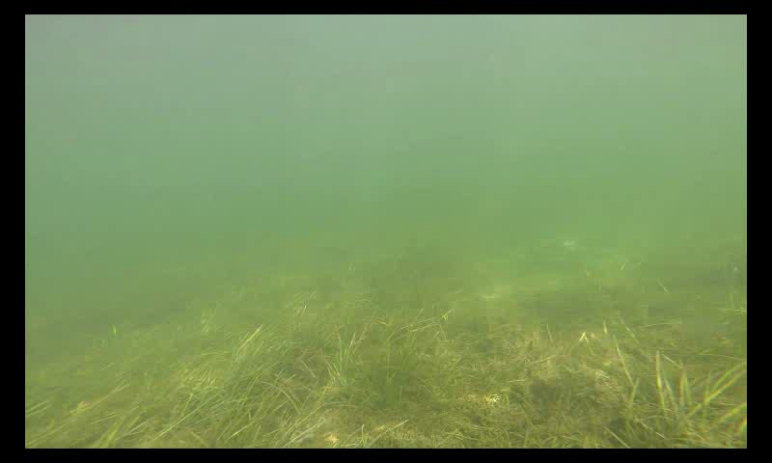

Motivation
Model changes in landscape from storms/coastal erosion in wetlands and salt marshes
Natural barriers to coastal erosion:
- Wetlands include the presence of submerged aquatic vegetation (SAV)
- Salt marshes involve emerged vegetation
SAV
- Reduce sediment suspension
- Increase light penetration
- Vulnerable to eutrophication
Salt marshes
- Carbon storage
- Habitat for flora and fauna
- Vulnerable to sea level rise and lateral wave attack
SAV at Chincoteague Bay, MD
Grand Bay, Alabama
2
Notes:
SAV loss is eutrophication that causes an increase in nutrients in the water column leading to phytoplankton growth and enhancing the growth of epiphytes growing on vegetation tissues. This results in a reduction of light availability (Burkholder et al., 2007), causing a loss of SAV habitat
SAV act as sediment bed stabilizers by reducing sediment suspension and increasing light penetrations. However , under high nutrient loading they
Are vulnerbal to eutrphicatioan

Slide 3
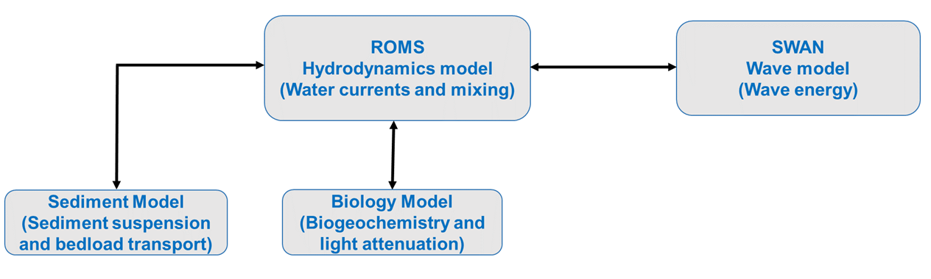
Open Source Model
COAWST: A Coupled-Ocean-Atmosphere-Wave-Sediment Transport Modeling System
3

Slide 4
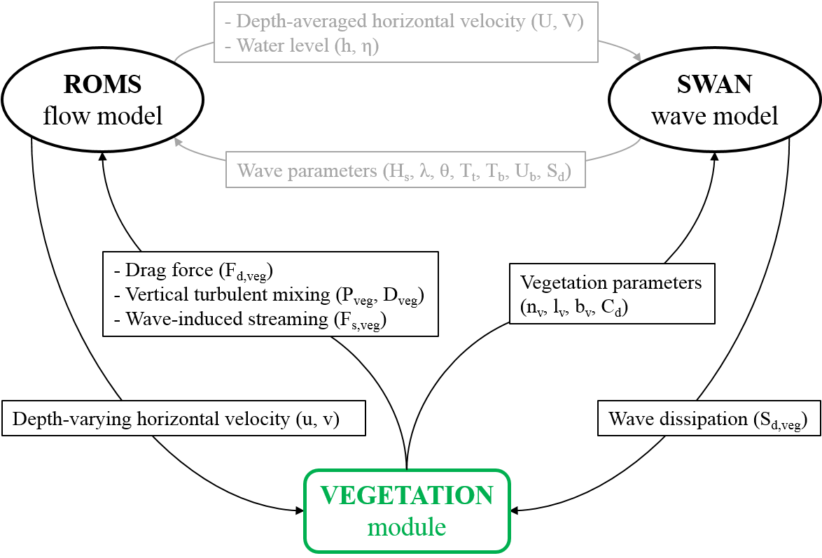
COAWST: Vegetation Module Implementation
- Depth-averaged horizontal velocity (u,v)
- Water level (h,η)
- Wave parameters (H_{s}, λ, T_{t}, T_{b}, U_{b}, S_{d})

Slide 5
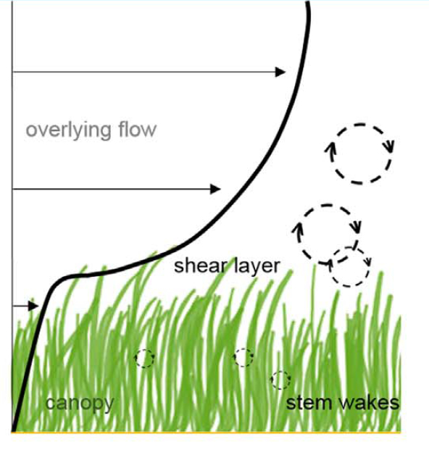
Effect of SAV on flow dynamics
3-D SAV represented by cylindrical structures
Modify mean and turbulent flow
Local adjustment of water level
Wave dissipation
Within the canopy, reduced TKE
Above the canopy, enhancing TKE
Schematic showing submerged vegetation canopy
Notes:
affected by the frontal area of canopy
Causes a decrease in momentum leading to a local adjustment of water level
Increase in wave period and wave length
reduction of space available for small scale eddies causes
in case of dense submerged canopies, the discontinuity at top of the canopy generates a shear layer that enhances vertical mixing,

Slide 6
Modifying momentum equations
u,v,w = velocity components
f = coriolis parameter
Φ = dynamic pressure normalized by sea
water density is molecular viscosity
D_{u}, D_{v} = horizontal diffusive terms
F_{u}, F_{v} = forcing terms including wave
averaged forces
Vegetation drag force
C_{D} = Plant drag coefficient
b_{v} = Width individual plant width
n_{v} = Number of plants per unit area
u,v = Horizontal velocity components at each vertical level in the canopy of height l_{v} (when upright)
Vertically varying forces with vegetation –
captures all 3 dimensions

Slide 7
Modifying turbulence modeling equations
k = Turbulent kinetic energy
σ_{k} = Turbulent Schmidt number for k
P_{s} = Production term from shear
B = Buoyancy flux
ε = Turbulent dissipation
K_{M} = Parameterized eddy viscosity
Ψ = Generic length scale
σ_{k} = Turbulent Schmidt number
c₁, c₂ = Coefficients based on Von Karman constant
c₃ = Stratification stability constant
σ_{ψ} = Turbulent Schmidt number for Ψ
F_{wall} = Wall proximity function
Vegetation turbulence terms (# VEG_DRAG)

Slide 8
Modifying turbulence modeling equations
Vegetation production and dissipation terms (# VEG_TURB)
k = Turbulent kinetic energy
σ_{k} = Turbulent Schmidt number for k
P_{s} = Production term from shear
B = Buoyancy flux
ε = Turbulent dissipation
K_{M} = Parameterized eddy viscosity
Ψ = Generic length scale
σ_{k} = Turbulent Schmidt number
c₁, c₂ = Coefficients based on Von Karman constant
c₃ = Stratification stability constant
σ_{ψ} = Turbulent Schmidt number for Ψ
F_{wall} = Wall proximity function
Uittenbogaard (2003)
τ_{free} = Dissipation scale of free turbulence
τ_{veg} = Dissipation time scale between plants
c_{k}= = 0.09
b_{v} = Width individual plant width
n_{v} = Number of plants per unit area
t_{v} = Blade thickness
L = Wall proximity function

Slide 9
Implementing vegetation flexibility (# VEG_FLEX)
Effective blade length (l_{veg})
Luhar and Nepf, 2011
C_{a} = Cauchy number
b_{v} = Width individual plant width
n_{v} = Number of plants per unit area
t_{v} = Blade thickness
ρ_{v} = Vegetation tissue density
l_{v} =
C_{D} = Drag coefficient
I = Second moment of area
E = Elastic Modulus
Account for drag reduction both due to the reduced frontal area (deflected height times width) and to the more streamlined shape of the bent blades
Notes:
An effective blade length (lve) is defined as the length of a rigid vertical blade that generates the same horizontal drag as the flexible blade of total length (lv), accounting for drag reduction both due to the reduced frontal area (deflected height times width) and to the more streamlined shape of the bent blades. Based on a theoretical plant posture model (described in details in Luhar and Nepf, 2011), the effective blade length expression can be reduced to (Eq. 16 in Luhar and Nepf, 2011):

Slide 10
SWAN - Vegetation effect on waves
(# VEG_SWAN_COUPLING)
SWAN (Simulating WAves Nearshore) – Spectral wave model
N = Wave energy density
= Source/sink for external forces
(Suzuki et al., 2012)
b_{v} = Width individual plant width
n_{v} = Plants per unit area
= Bulk drag coefficient
= Wave frequency
= Mean wave number
h = Water depth
E = Wave energy frequency
SWAN and ROMS coupling through
Wave-induced streaming (# VEG_STREAMING )
Wave-induced streaming (oscillatory contribution to steady wave stress) in direction of wave
Additional wave-averaged forcing in momentum balance
N = Wave energy density
= Source/sink for external forces
Notes:
N being the action density defined as the ratio of the wave energy density (or variance spectrum) distributed over (intrinsic) wave frequency (σ) and direction of propagation (θ) divided by frequency (=Eσ, θ/σ). The equation is a balance between local rate of change, advection in the horizontal (x and y) directions, shifting of relative frequency due to variation in water depth and current (exchanged between the flow and wave models), depth-induced refraction and additional source/sink terms (Stot), namely wave-growth due to wind input, energy transfer due to wave-wave interactions, and dissipation due to white-capping, depth-induced breaking, and bottom friction (plus vegetation drag described in next paragraph). SWAN can also account for diffraction, partial transmission, and reflection.

Slide 11
Method: Modeling SAV effect on flow dynamics
Process modeled | Additional terms in the model
1. Momentum extraction | Drag force in momentum equation (ROMS)
2. Turbulence production | Turbulent generation in the TKE equation (ROMS), Uittenbogaard (2003),
3. Turbulence dissipation | Generic length scale (ROMS)
4. Flexible SAV | Reduction of drag due to bending of flexible SAV (ROMS), Luhar and Nepf, 2011
5. Wave dissipation | Source term in wave action equation (SWAN), Dalrymple et al. (1984) and Mendez and Losada (2004)
6. Wave streaming | Wave averaged forcing in momentum (SWAN+ROMS), Luhar et al., 2010; Luhar and Nepf, 2013
Notes:
streaming Oscillatory contribution to steady wave stress generating a net current in wave direct

Slide 12
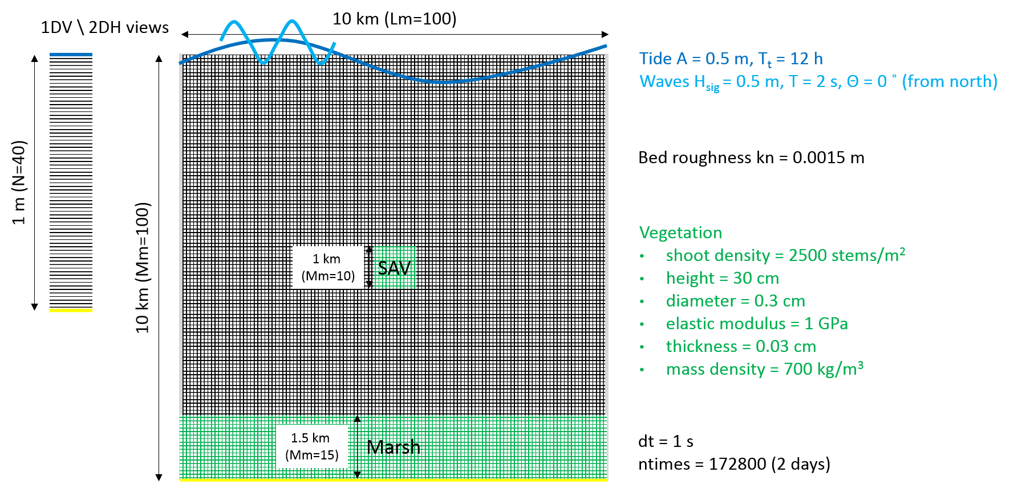
COAWST/Projects/Veg_test
Test case: Vegetation patch in a shallow basin
Tide A = 0.5 m, T_{t} = 12 h
Waves H_{sig} = 0.5 m, T = 2 s,
Θ = 0 ˚ (from North)
Bed roughness kn = 0.0015 m
Vegetation
shoot density = 2500 stems/m²
height = 30 cm
diameter = 0.3 cm
elastic modulus = 1 GPa
thickness = 0.3 mm
mass density = 700 kg/m³
Z
Y
X
dt = 1 s
ntimes = 172800 (2 days)

Slide 13
Test Case Inputs – Veg_test
Coupling_veg_test.in - Set coupling interval between ROMS and SWAN
Ocean_veg_test.in - ROMS general inputs
Sediment_veg_test.in - ROMS sediment inputs, not altered by vegetation module
Vegetation.in - ROMS vegetation inputs
Ana_fsobc.in - Set tidal boundary conditions in ROMS
Veg_test_grid.nc - ROMS grid
Veg_test_ini.nc - ROMS initial file specifying vegetation and marsh properties
Swan_veg_test.in - SWAN inputs with vegetation inputs
Veg_test_bathy.bot - SWAN bathymetry
Veg_test_coord.grd - SWAN grid coordinates
Compiling bash file (coawst.bash) and header file containing CPP flags (veg_test.h)
Coupling_veg_test.in - Set coupling interval between ROMS and SWAN
Ocean_veg_test.in - ROMS general inputs
Sediment_veg_test.in - ROMS sediment inputs, not altered by vegetation module
Vegetation.in - ROMS vegetation inputs
Ana_fsobc.in - Set tidal boundary conditions in ROMS
Veg_test_grid.nc - ROMS grid
Veg_test_ini.nc - ROMS initial file specifying vegetation and marsh properties
Swan_veg_test.in - SWAN inputs with vegetation inputs
Veg_test_bathy.bot - SWAN bathymetry
Veg_test_coord.grd - SWAN grid coordinates
Compiling bash file (coawst.bash) and header file containing CPP flags (veg_test.h)

Slide 14
Vegetation header file (veg_test.h)
#define VEGETATION
# ifdef VEGETATION
# define VEG_DRAG
# ifdef VEG_DRAG
# define VEG_FLEX
# define VEG_TURB
# endif
# define VEG_SWAN_COUPLING
# ifdef VEG_SWAN_COUPLING
# define VEG_STREAMING
# endif
# endif

Slide 15
Creating vegetation initial file (veg_test_ini.nc)
COAWST/Tools/mfiles/mtools -> create_roms_init.m
12) % set vegetation properties
NVEG=1 ;
plant_density=zeros(xi_rho,eta_rho,NVEG);
plant_height=zeros(xi_rho,eta_rho,NVEG);
plant_diameter=zeros(xi_rho,eta_rho,NVEG);
plant_thickness=zeros(xi_rho,eta_rho,NVEG);
plant_density(46:55,46:55,1)=2500;
plant_height(46:55,46:55,1)=0.3;
plant_diameter(46:55,46:55,1)=0.003;
plant_thickness(46:55,46:55,1)=0.3e-3;

Slide 16
Vegetation input and output (vegetation.in)
NVEG == 1 Number of vegetation types
Cd_VEG == 1.0d0 Drag coefficient of each vegetation type
E_VEG == 1.0d9 Young’s modulus for each vegetation type
VEG_MASSDENS == 700.0d0 Mass density for each vegetation type
! Logical switches (TRUE/FALSE) to activate writing of vegetation fields
Hout(ipdens) == T ! Plant_density Density of the plant for each vegetation
Hout(iphght) == T ! Plant_height Height of the plant for each vegetation
Hout(ipdiam) == T ! Plant_diameter Diameter of the plant for each vegetation
Hout(ipthck) == T ! Plant_thickness Thickness of the plant for each vegetation

Slide 17
Swan input file for vegetation
(swan_veg_test.in)
&& VEGETATION < [height] [diamtr] [nstems] [drag] >
&& Vegetation parameters set here are to be consistent
&& with the ones in ROMS input file
VEGETATION 0.3 0.003 2500 1.0
Recall for ROMS : COAWST/Tools/mfiles/mtools -> create_roms_init.m
plant_density(46:55,46:55,1)=2500;
plant_height(46:55,46:55,1)=0.3;
plant_diameter(46:55,46:55,1)=0.003;
plant_thickness(46:55,46:55,1)=0.3e-3;

Slide 18
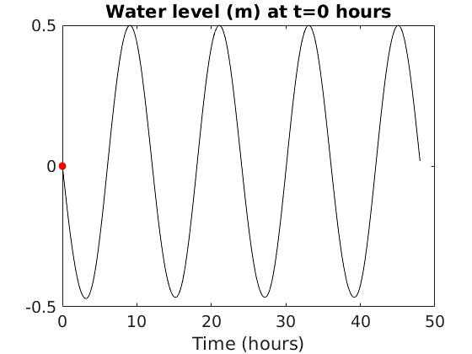
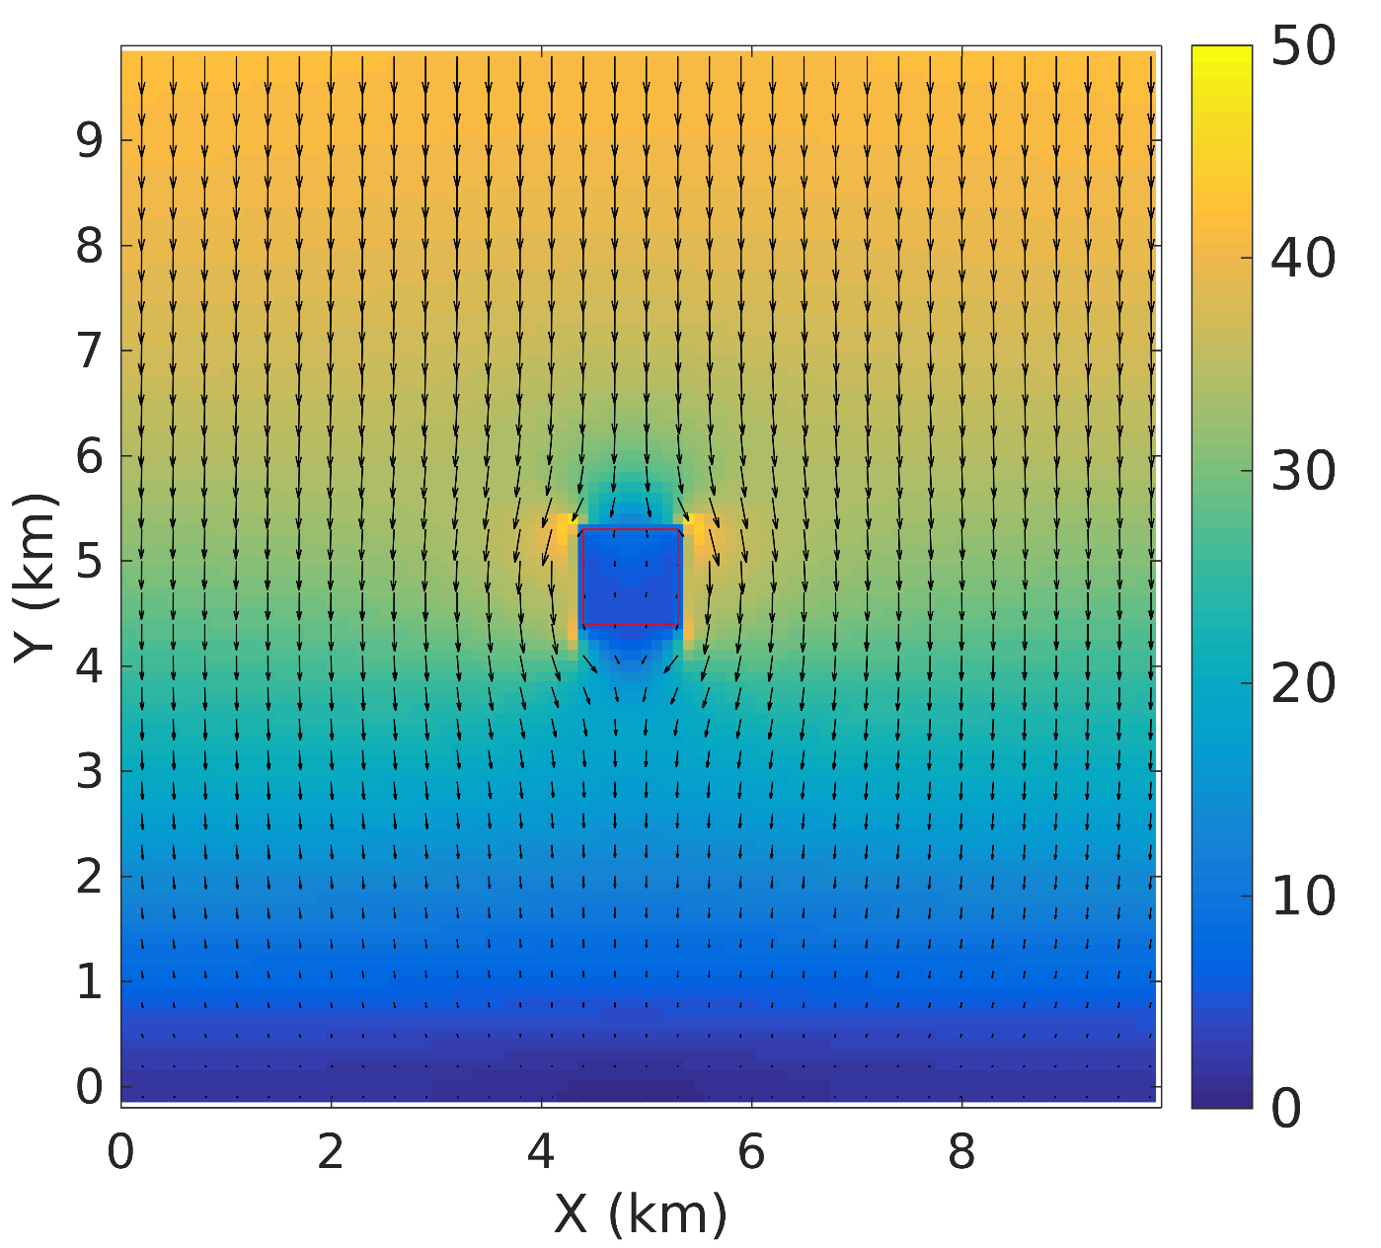
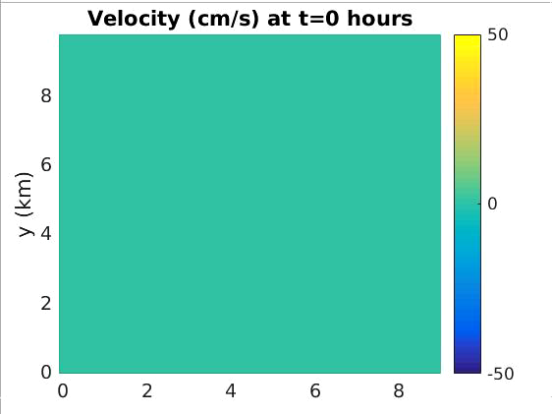
Model testing of SAV presence
Tidal forcing
at Northern boundary
Velocity at peak flood (cm/s)
Notes:
Change units bigger fonts

Slide 19
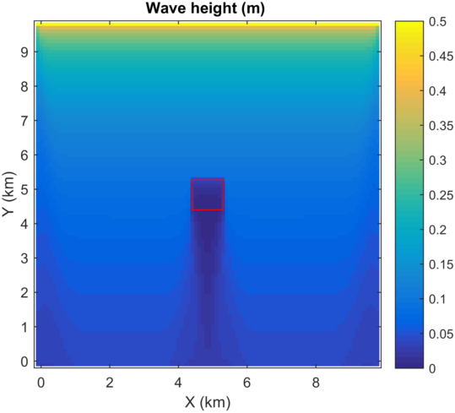
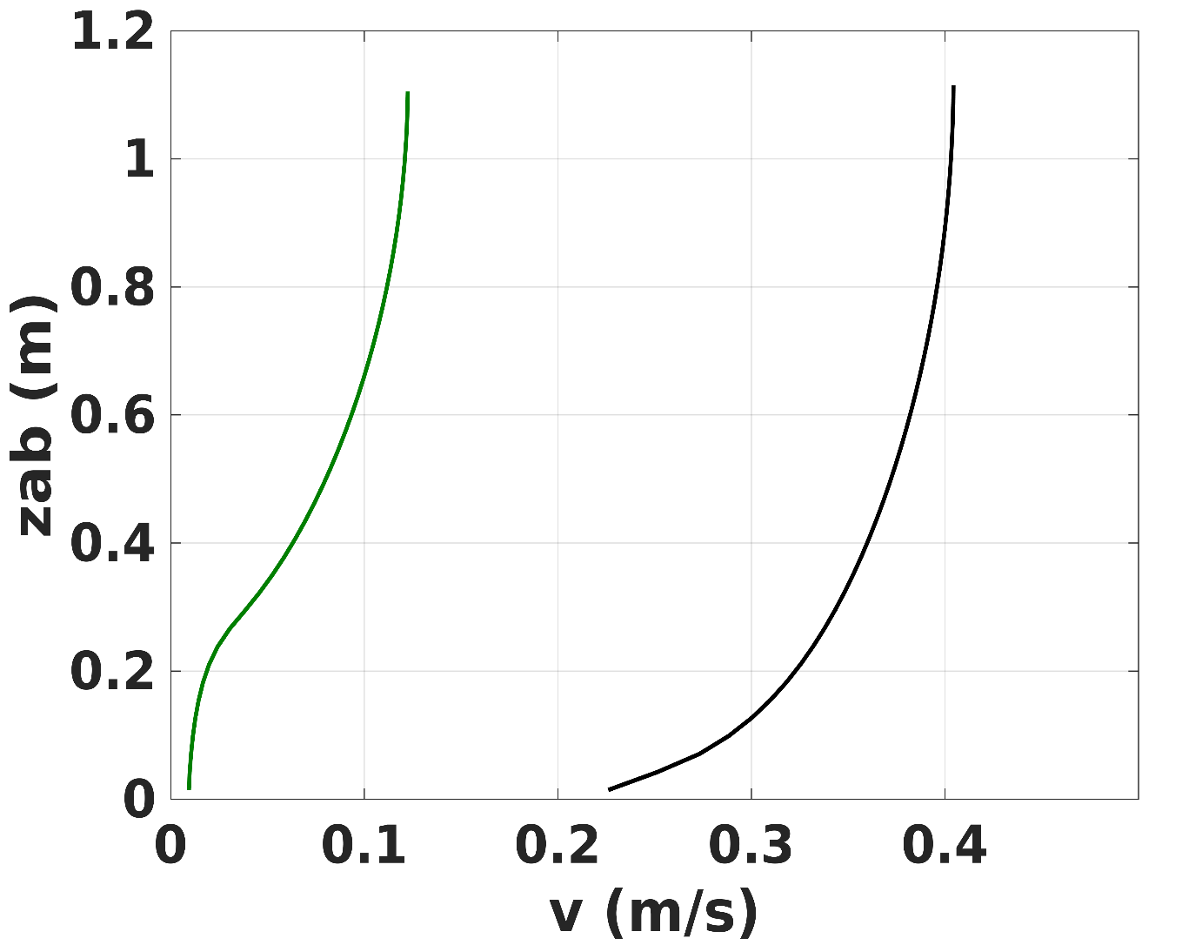
Model testing of SAV presence
Height above seabed
SAV
No SAV
Velocity (m/s)
Wave height close to 0 within and South of the SAV patch
Decrease in velocity (Kinetic energy in the canopy) compared to the bare region
19
Notes:
Mean wave period increased by ̴10 %
Divergent/convergent wave-driven flow

Slide 20
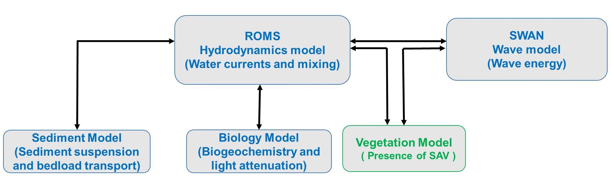
1. Model Integration: SAV effect on flow dynamics
Beudin, A., Kalra, T. S., Ganju, N., K., and Warner, J.C.,“Development of a Coupled Wave-Current-Vegetation Interaction”, Computers and Geosciences Journal – Elsevier, Dec 2016
20

Slide 21
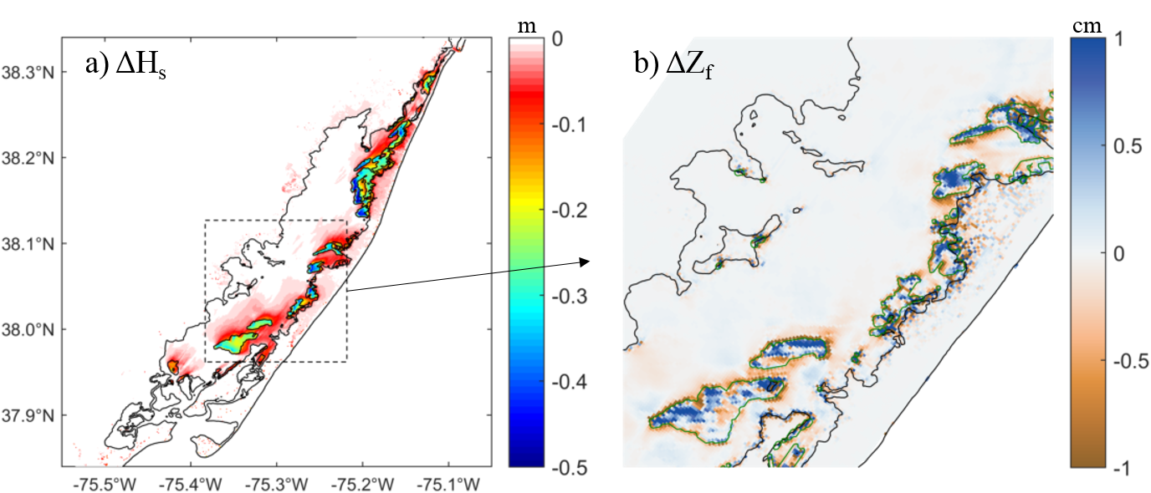
Current Applications of Vegetation Module
Assess the influence of seagrass on storm surge, residence time, and sediment transport in different back-barrier bays
  Chincoteague Bay, MD/VA
  Jamaica Bay, NY
  Barnegat Bay, NJ
Chincoteague Bay modeled post Hurricane Sandy impact using rigid sea-grass properties
Overall, water level not affected (less than 1 % difference on average)
Presence of submerged aquatic vegetation on the eastern shoals locally dampened waves and reduced the flushing of the bay by 10 %
Influence of seagrass meadows (difference between the Sandy and SAV scenarios) a) significant wave height at the instant of maximum wind stress, and b) sediment bed thickness at the end of Sandy (zoom). The seagrass meadows are outlined in green.
Notes:
The presence of extensive seagrass resulted in minimal overall water level differences. Locally, seagrass dampened wave height by 30 to 75 %, which decreased shoal erosion and reduced wave attack on the adjacent (within 1 km) marshes. Thus, seagrass contributed to an improved resilience of the back-barrier bay to storms.

Slide 22
Sensitivity of SAV inputs to model output
Using Sobol indices and running a combination of cases with varying:
Plant density
Plant height
Plant diameter
Plant thickness
Quantified model output sensitivity to these inputs
Kinetic energy,
Turbulent kinetic energy
Water level
Wave dissipation plant stem density
Changes are sensitive to
plant stem density, height
and,
to a lesser degree, diameter
T. Kalra, A Aretxabaleta, P Seshadri, N Ganju, A Beudin, “Sensitivity Analysis of a Coupled Hydrodynamic-Vegetation Model Using the Effectively Subsampled Quadratures Method,“ 2017,Geophysical Model Development Discussions.
Notes:
Helps in guidance for observations and modeling work by allowing future efforts to focus
on constraining the most influential inputs without having
to explore the entire parameter space. An

Slide 23
Additional modeling components related to vegetation module :
1. Emergent vegetation: Marsh edge erosion
- Model processes causing wave induced lateral marsh erosion
2. SAV biophysical interactions
- Coupling the biophysical interactions between SAV, hydrodynamics (currents and waves), sediment dynamics and nutrient loading
23

Slide 24
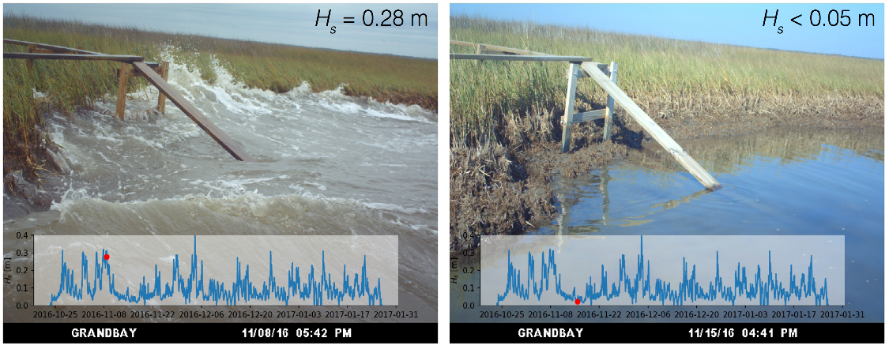
Wave induced lateral marsh erosion
Salt marsh erosion caused by two phenomenon:
Vertical drowning due to sea level rise
- Marshes inherently stable to mechanism of vertical drowning (Morris, 2002 and Fagherazzi et al. 2012)
Horizontal retreat due to wave thrust
- Caused by wave thrust in lateral direction
(Schwimmer, 2001; Marani et al., 2011; Fagherazzi, 2013; Leonardi et al., 2016)
Grand Bay, Alabama
Marsh platform represented by elevated bathymetry and SAV presence
Model marsh erosion by removing sediment upon the action of wave thrust
Sediment transport can occur from the marsh to the estuary and vice versa (Morphological evolution)
Notes:
1d model do not account for shoreline features and exchange of sediment

Slide 25
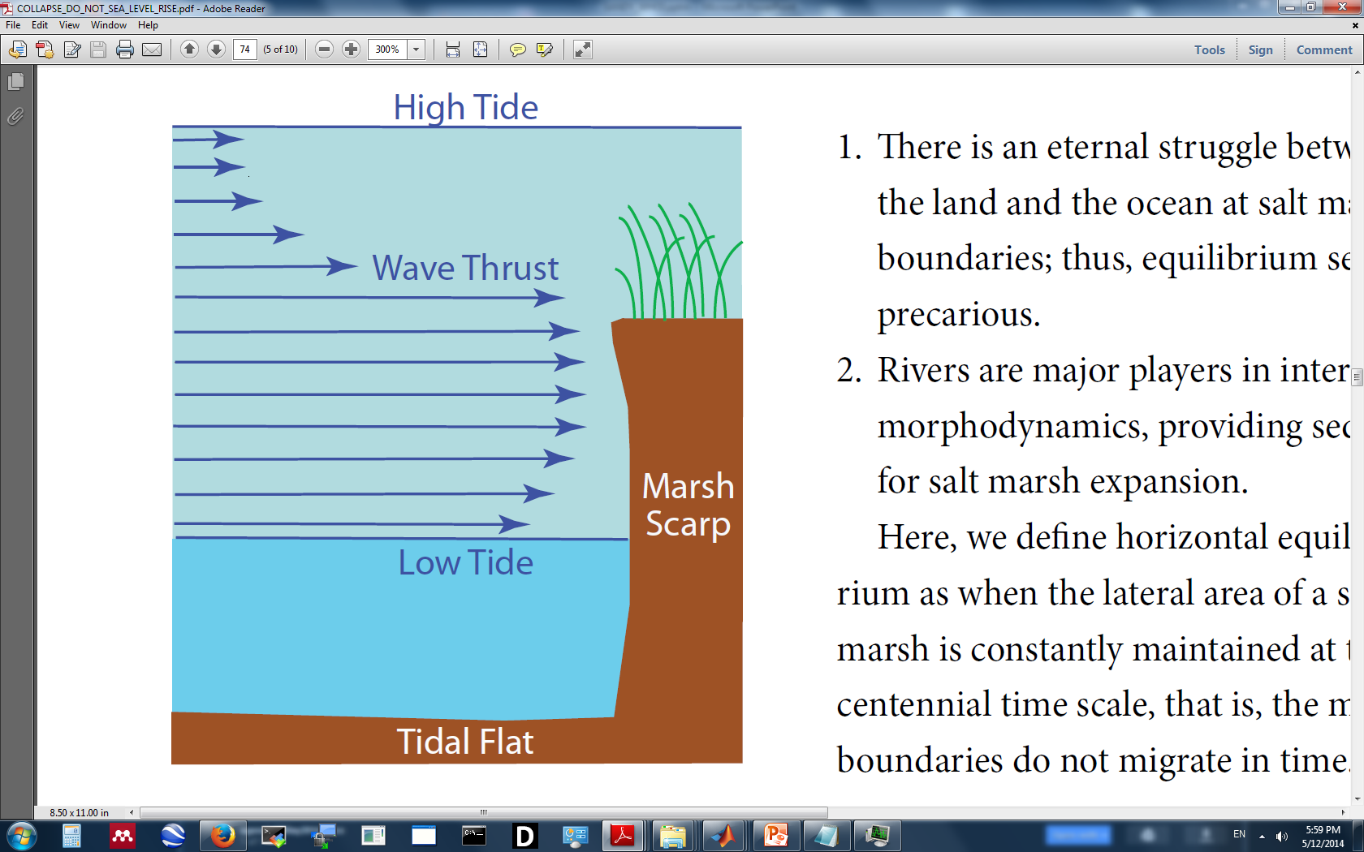
Method: Wave induced lateral marsh erosion
Process modeled | Modeling method
1. Wave thrust on marsh edge | Marsh cells identified by initial masking Marsh edge determined within the model Wave forcing from SWAN Effect of water level included
2. Marsh sediment flux | Bed mass exchange between cells supplying thrust and marsh cells Leads to a change in bathymetry
3. Conversion of marsh into open water | After a user defined amount of scarp height changes due to wave thrust, marsh mask can change
Schematics showing wave attack on marsh
Schematic of eroding marsh cells
Seaward cell
Wave thrust
from sea to
marsh cell
Sediment flux from
marsh to adjacent
sea cell
Kalra, T.S., Ganju, N. K., Moriarty, J. M., Warner, J. C. (In prep.), “Marsh Edge Erosion Under Wave Action Using A 3-D Coupled Wave-Flow-Sediment Model”
Marsh cell

Slide 26
Setup for marsh edge erosion model
COAWST/Tools/mfiles/mtools -> create_roms_init.m
% set marsh mask
marsh_mask=zeros(xi_rho,eta_rho);
marsh_mask(46:55,46:55,1)=1;
In header file
# define MARSH_WAVE_EROSION -> This can work without sediment
# define MARSH_SED_EROSION -> To get sediment transport
# define MARSH_RETREAT -> Calculating horizontal retreat through vertical
exchange of sediment (only to be used for high resolution grids)

Slide 27
Setup for marsh edge erosion model
In vegetation.in
Input parameters for the marsh erosion model
Kfac_marsh -> Marsh erodibility coefficient
Scarp_hght -> Critical scarp height after which marsh cell
converts into non-marsh cell
Output variables for the marsh erosion model
Hout(idTims) -> marsh mask
Hout(idTtot) -> thrust total
Hout(idTmfo) -> marsh flux out
Hout(idTmmr) -> marsh retreat

Slide 28
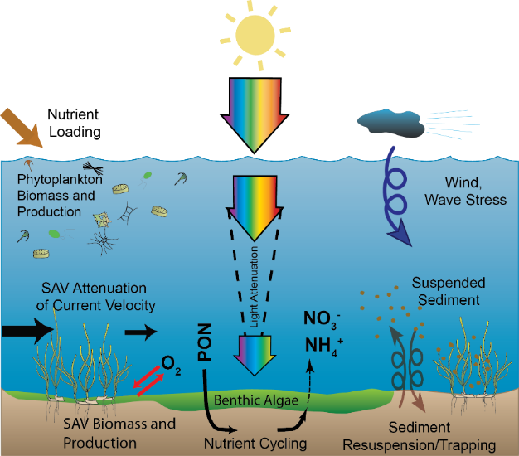
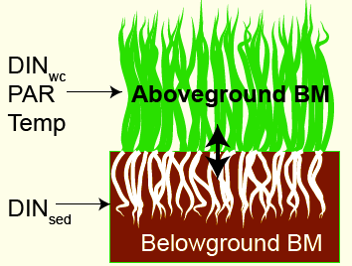
2. SAV biophysical interactions
Couple hydrodynamics-sediment-biological dynamics to estimate SAV growth
Kalra, T.S., Testa, J., and N. K. Ganju (Submitted to GMD), “Development of a Submerged Aquatic Vegetation Growth Model in a Coupled Wave-Current-Sediment Model”
Notes:
The modeling of SAV growth requires one to resolve spatial distributions of available nutrients in the water column, light attenuation, colored dissolved organic matter (CDOM), temperature forcing. Based on the available temperature, available nutrients in the water column and sediment colum, light availability that further depends on cdom, SSC and cholorphyll result in the
Depending on the above factors, model computes primary production, respiration, mortality of above and below ground biomass; with two way translocation of nitrogen of biomass
The growth of SAV is dependent upon light availability at the leaf surface, which is a function of light attenuation in the water-column and the biomass of epiphytic algae growing on SAV stems. One of the dominant factors of SAV loss is eutrophication that causes an increase in nutrients in the water column leading to phytoplankton growth and enhancing the growth of epiphytes growing on vegetation tissues. This results in a reduction of light availability (Burkholder et al., 2007), causing a loss of SAV habitat
. The model simulates the dynamics of above ground biomass (stems or shoots), below ground biomass (roots, rhizomes), and epiphyte biomass. The above ground biomass (AGB) is simulated as a total biomass per unit area, and empirical, measurement-based relationships are provided that relate above ground biomass to the density and height of stems. These empirical relationships are based upon a review of literature data, and alternative formulations are provided that can be parameterized for specific applications
The realized growth rate for SAV and epiphytes is then modeled as a function of temperature (i.e., ${ua}_{SAV}$), nutrient availability (nlim), and light availability (llim; Eq. 3)
Traditional photosynthesis-irradiance curves were used to represent SAV growth responses to light
where the SAV model includes a nutrient limitation formulation that represents the fact that rooted plants can obtain nutrients from both sediments and the water-column
COAWST also integrates a coupled (Fennel et al., 2006) and a light attenuation model depending on
concentrations of suspended sediment, organic material, and phytoplankton
(del Barrio et al., 2014).

Slide 29
Setup for SAV-biophysical model
Create ROMS initial file
% set plant above, below, epiphytes ground mass (AGB, BGB, EPB)
% set Dinsed – Dissolved inorganic Nitrogen in sediment column
In header file
# define ESTUARYBGC --> main biology file-> adapted from # define FENNEL
# define SAV_BIOMASS --> SAV growth model
# define BIO_SEDIMENT --> To get sediment transport
# define SPECTRAL_LIGHT --> Light model
+ Several other flags
Bio_veg_growth_test.in
- Boundary conditions for biological tracers
- Several biological inputs along with SAV biophysical model inputs
- Output from SAV-biophysical model

Slide 30
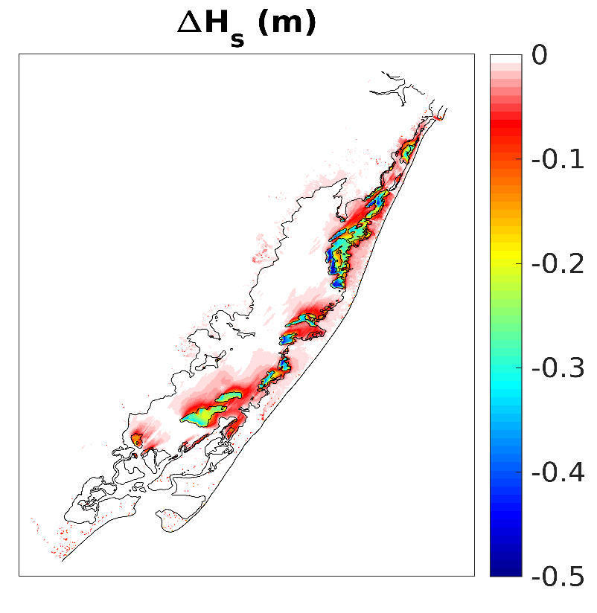
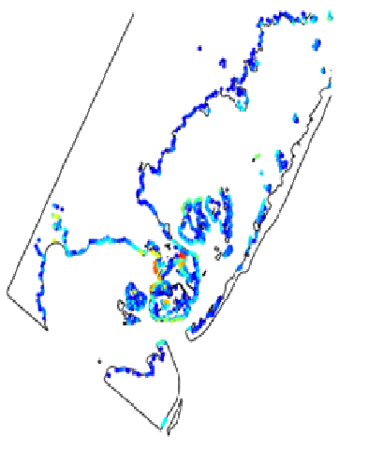
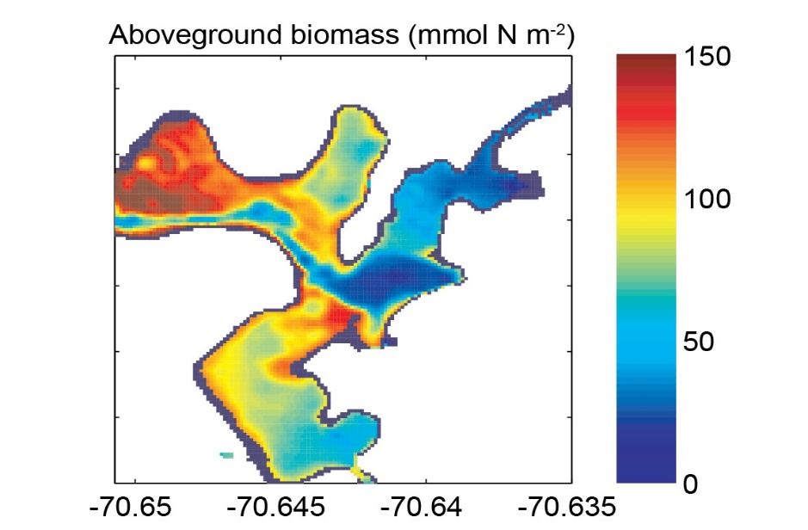
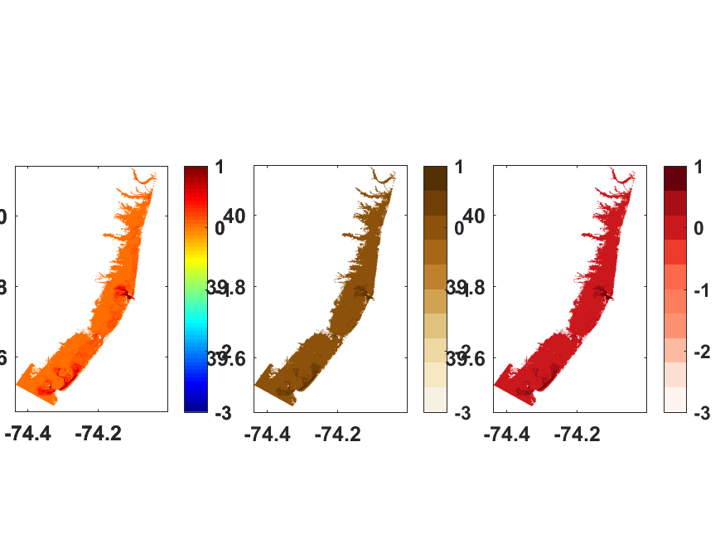
Model Application
Wave height with and without rigid SAV
SAV growth scenario
with nitrate loading
Marsh edge erosion rate
On eastern shoals locally
dampen waves
Best conditions in outer harbor with maximum biomass growth
Highest on exposed marshes near energetic waves
Chincoteague Bay, MD/VA
West Falmouth, MA
Barnegat Bay, NJ
Aboveground biomass
(mmol N sq.m)
Marsh
Erosion Rate
m y⁻¹
0
1
2
Beudin, A., Ganju, N. K., Defne, Z., and Aretxabaleta, A. L., (2017), Physical response of a back-barrier estuary to a post-tropical cyclone,
J. Geophys. Res. Oceans, 122, 5888–5904
Kalra, T.S., Testa, J., and Ganju, N. K., (GMD submitted), Development of a Submerged Aquatic Vegetation Growth Model in a Coupled Wave-Current-Sediment Model
Moriarty, M. J., Kalra, T.S., and Ganju, N. K., (In prep), Transport of sediment and carbon derived from marsh-edge erosion: A numerical modeling study of Banegat Bay, NJ.
30
Notes:
The presence of extensive seagrass resulted in minimal overall water level differences. Locally, seagrass dampened wave height by 30 to 75 %, which decreased shoal erosion and reduced wave attack on the adjacent (within 1 km) marshes. Thus, seagrass contributed to an improved resilience of the back-barrier bay to storms.
Assess the influence of seagrass on storm surge, residence time, and sediment transport in different back-barrier bays
SAV tissue density of 700 kg m3 , blade height 30 cm blade width 0.3 cm and blade thickness 0.3 mm
30

Slide 31
Thank you
Use vegetation module in COAWST and provide us valuable feedback !!

Slide 32
Back up slides

Slide 33
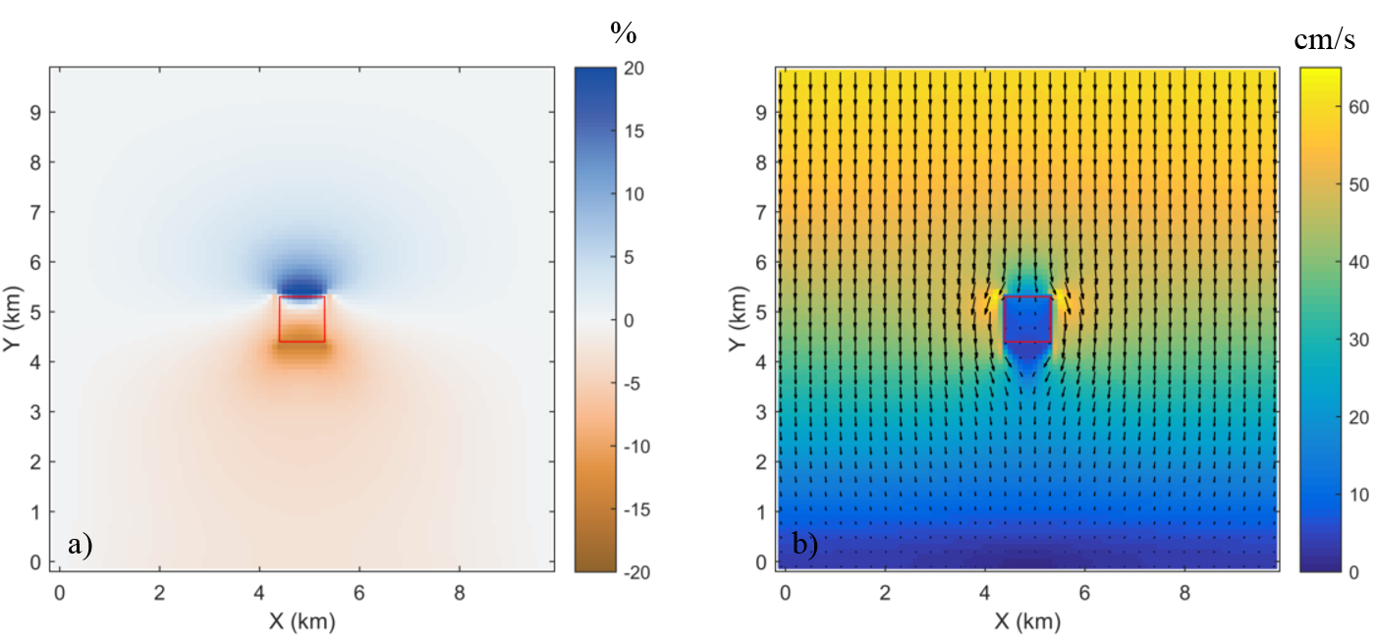
Effects on tidal flow
Water level anomaly (relative difference between the stiff vegetation and the non-vegetation cases)
Depth-averaged velocity at peak
flood
Deceleration of the flow upstream and in the wake of the patch, acceleration at the edges

Slide 34
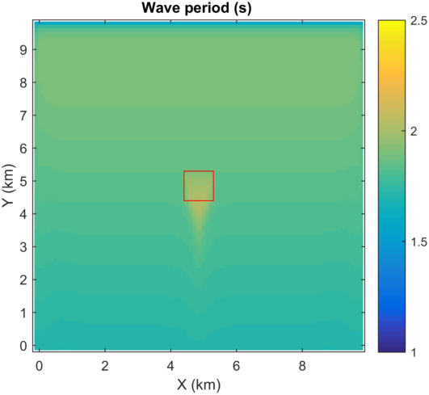
Effects on waves and wave-driven flow
Wave dissipation -
  Wave height 0 above and directly behind the patch
  Mean wave period increased by ̴10 %
Divergent/convergent wave-driven flow

Slide 35
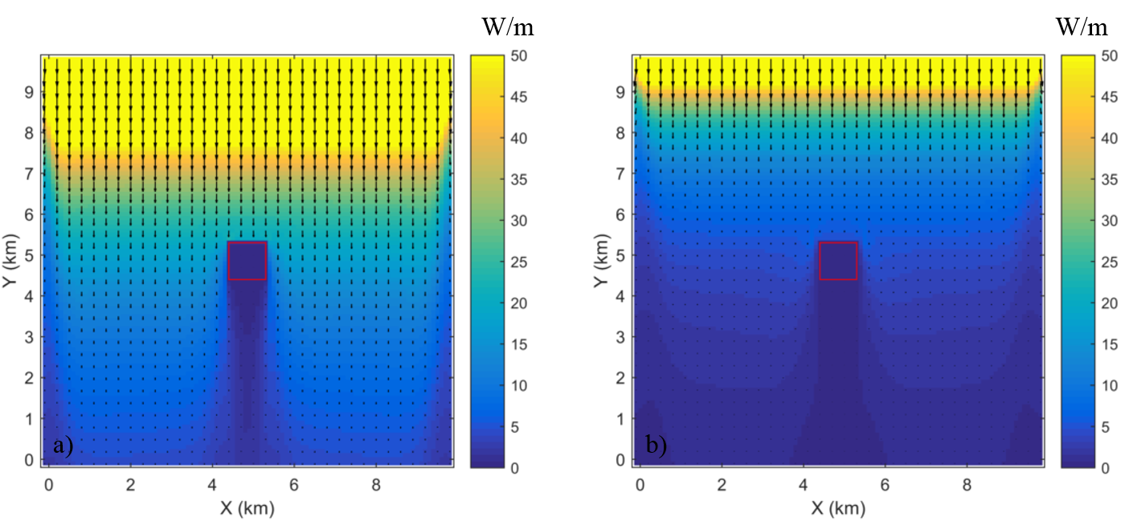
Transport of wave energy
Ebb
Flood
Ebb
Advection
Refraction
Doppler shift

Slide 36
Method: SAV biophysical interactions
Process modeled | Modeling method
1. Water column temperature | Hydrodynamics model ROMS (Shchepetkin and McWilliams, 2005, Haidvogel et al., 2008)
2. Available nutrients | Biogeochemical model (Fennel et al., 2006)
3. Light availability | Light attenuation model (Gallegos et al., 2009, del Barrio et al. 2014)
4. Change in biomass (above ground, below ground and epiphytes) | Biomass model (Madden and Kemp 1996, Cerco and Moore, 2011)
5. SAV growth coupled to biomass model | Kalra et al. 2018 (Publication in prep.)
Notes:
The light available the SAV leaves in the bottom cell was simulated using a bio-optical model that included biological and non-biological properties (Gallegos et al. 2009, del Barrio et al. 2014; Eq. 6). Shchepetkin and McWilliams 2005, Haidvogel et al., 2008
Biogeochemical model based on a nutrient, phytoplankton, zooplankton, and detritus model (Fennel et al., 2006)
Light attenuation model depending on concentrations of suspended sediment, organic material, and phytoplankton (Gallegos et al., 2009, del Barrio et al. 2014)
Biomass model depending on light, nutrients and temperature

