Slide 1




ROMS+WRF+Budgell
Jeff Willison¹, Ruoying He¹, Michael S. Dinniman², Xiaojun Yuan³
¹North Carolina State University
²Old Dominion University
³Lamont-Doherty Earth Observatory of Columbia University

Slide 2
Project Objectives
1) Couple sea ice, WRF, ROMS, and ice shelf models using COAWST framework
2) Use coupled model output along with obs from field campaign to study Prydz Bay in Antarctica
NSF AWARD #1443491

Slide 3
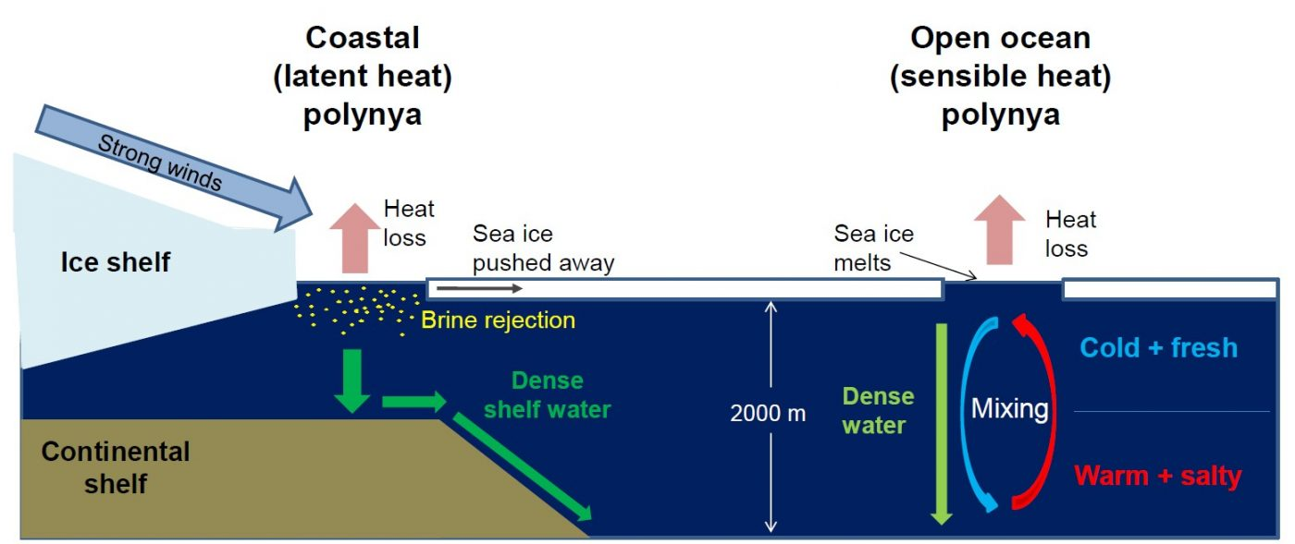
Polynyas
Credit: Céline Heuzé

Slide 4
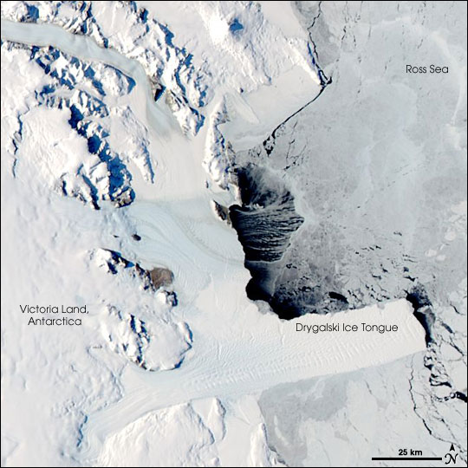
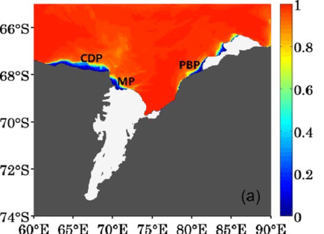
Polynyas
Liu et al. (2017)
NASA

Slide 5
Sea ice model options
Community Ice CodE
Budgell aka Los Alamos Sea Ice Model
aka CICE4
Easier to pronounce
“Melt ponds”
Not suitable for multi-year ice
Already fully coupled to ROMS
Less sophisticated
Good enough for Antarctica
Not easier to pronounce
Melt ponds
Pancake ice/Multi-year ice
Coupled version somewhat available?
More sophisticated and popular (CESM)
Good for either polar region
Notes:
https://slideplayer.com/slide/5010565/
https://github.com/CICE-Consortium/CICE/wiki
https://fimex.met.no/sparse/The%20coupled%20ROMS-CICE%20system.pdf
“Multiyear ice contains much less brine and more air pockets than first-year ice. Less brine means "stiffer" ice that is more difficult for icebreakers to navigate and clear.”

Slide 6
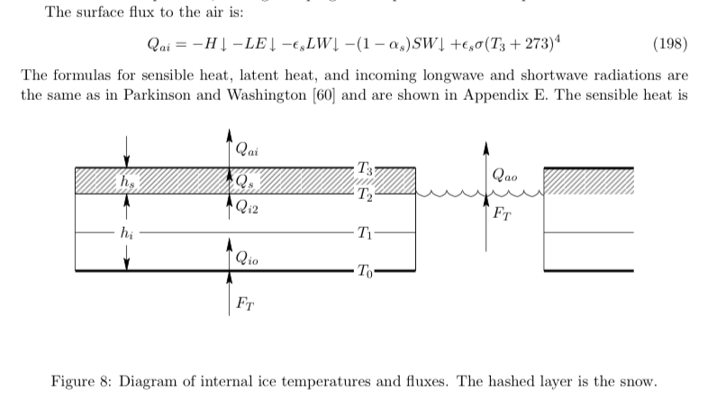
Budgell cont.
Dynamics:
Elastic-viscous-plastic (EVP) rheology [Hunke and Dukowicz (1997), Hunke (1991), Hunke and Dukowicz (1992)]
Thermodynamics:
Mellor and Kantha (1989) and Ha*kkinene and Mellor (1992).
  3-level, single layer ice; single snow layer
  Molecular sublayer under ice; Prandtl-type ice-ocean boundary layer
  Surface “melt ponds”
  Snow depth = precipitation*20
  Shortwave, longwave, sensible,
    latent heat fluxes into ice
Notes:
“The sea-ice component of ROMS is a combination of the elastic-viscous-plastic (EVP) rheology (Hunke and Dukowicz,
Hunke) and simple one-layer ice and snow thermodynamics with a molecular sublayer under the ice (Mellor and Kantha). “

Slide 7
Budgell cont.
Hedstrom ROMS manual
Notes:
“The sea-ice component of ROMS is a combination of the elastic-viscous-plastic (EVP) rheology (Hunke and Dukowicz,
Hunke) and simple one-layer ice and snow thermodynamics with a molecular sublayer under the ice (Mellor and Kantha). “

Slide 8
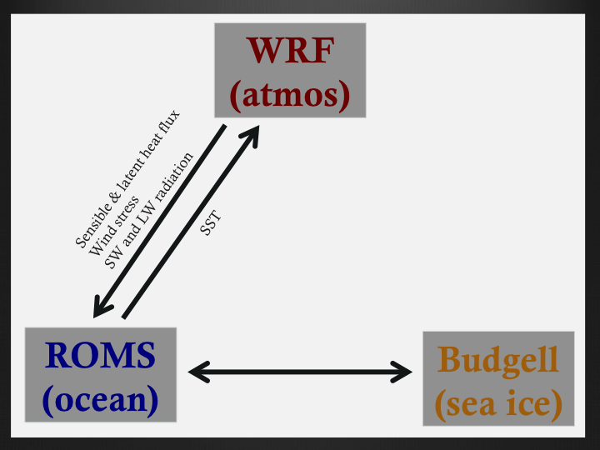
Coupled-Ocean-Atmosphere-Wave- Sediment Transport (COAWST) out of the box
No communication between atmosphere and sea ice models

Slide 9
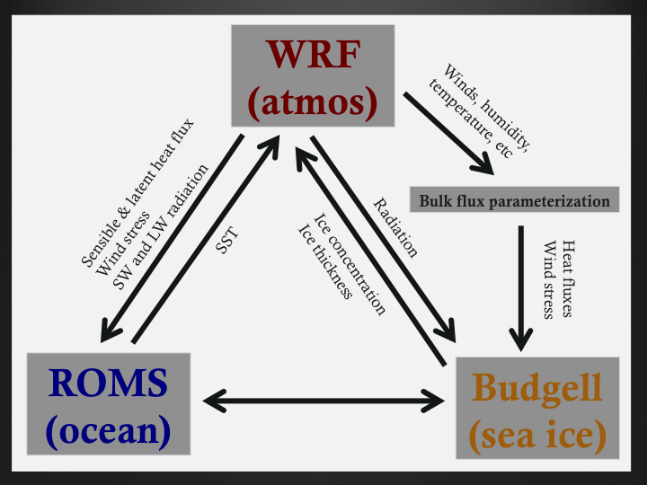
Previous attempt at coupling
Use temperature, humidity, wind from WRF to calculate fluxes over ice on ROMS side (similar to Warner et al. 2010)
Concerns about long-term stability

Slide 10
We separate the ocean and ice components inside WRF and pass to appropriate model

Slide 11
ROMS model configuration
10 km circumpolar domain (Dinniman et al. 2015)
Daily boundary conditions for 4 km Prydz Bay domain taken from 10 km simulation
Outer model domain
4 km domain and bathymetry

Slide 12
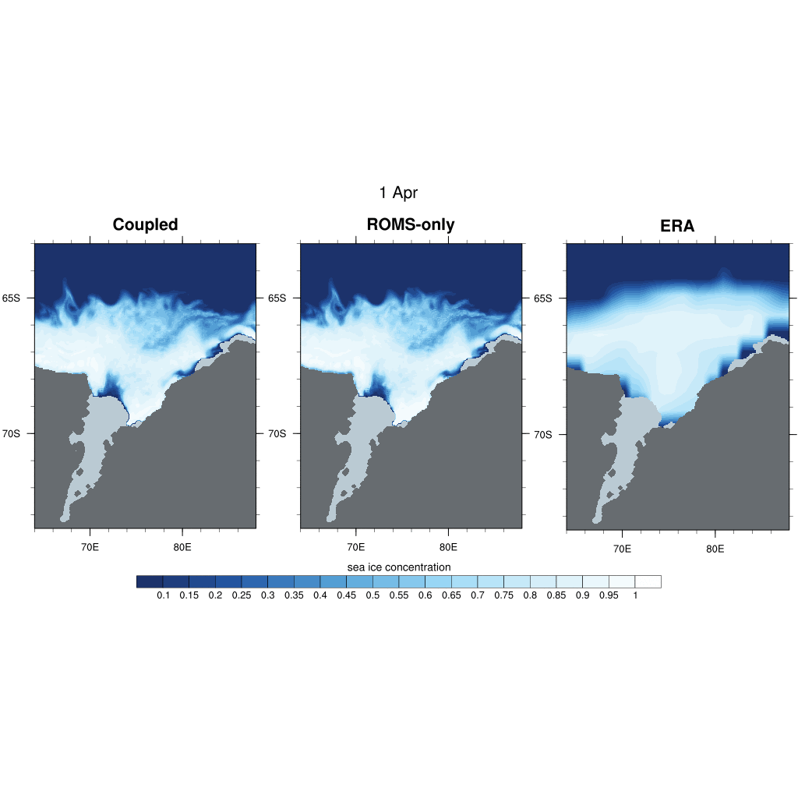

Slide 13
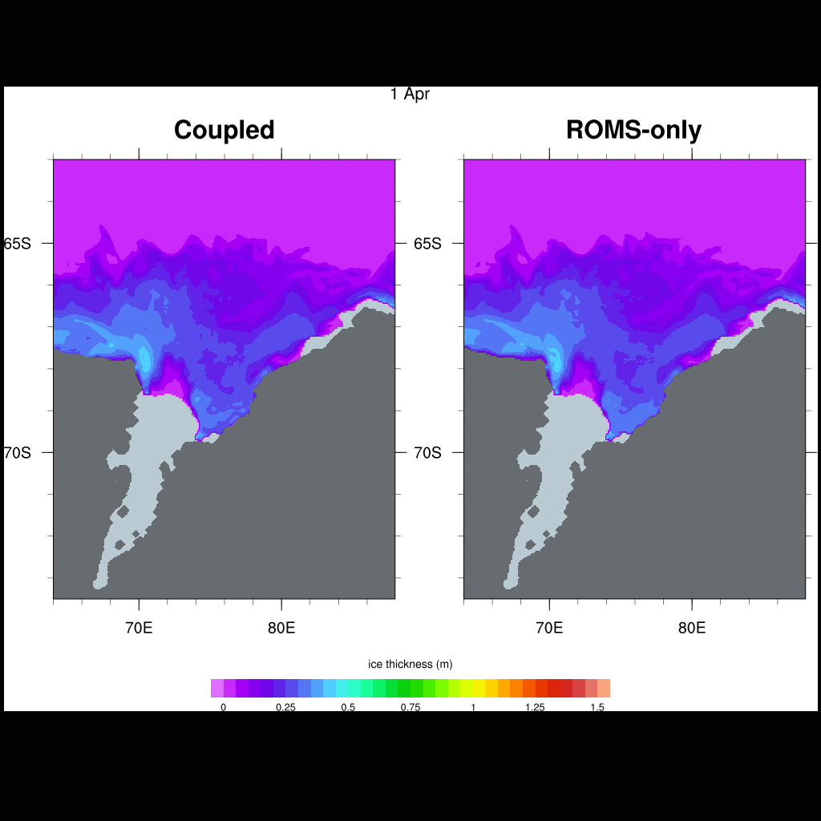
Ice thickness

Slide 14
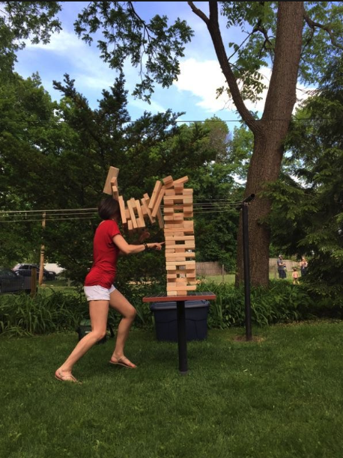
Summary
New capability on an old COAWST
WRF + ROMS + Budgell + ice shelves
Not the state of the art sea ice model
Can test some hypotheses with this tool
Potential to get right answers for right reasons
Very Sensitive system; easy to get rapidly diverging solutions
Notes:
Potential to get right answers for right reasons! If you have an extra 20 Wm-2 you can’t just dump it into the ocean/atmosphere anymore because it will come back to get you.

