Slide 1

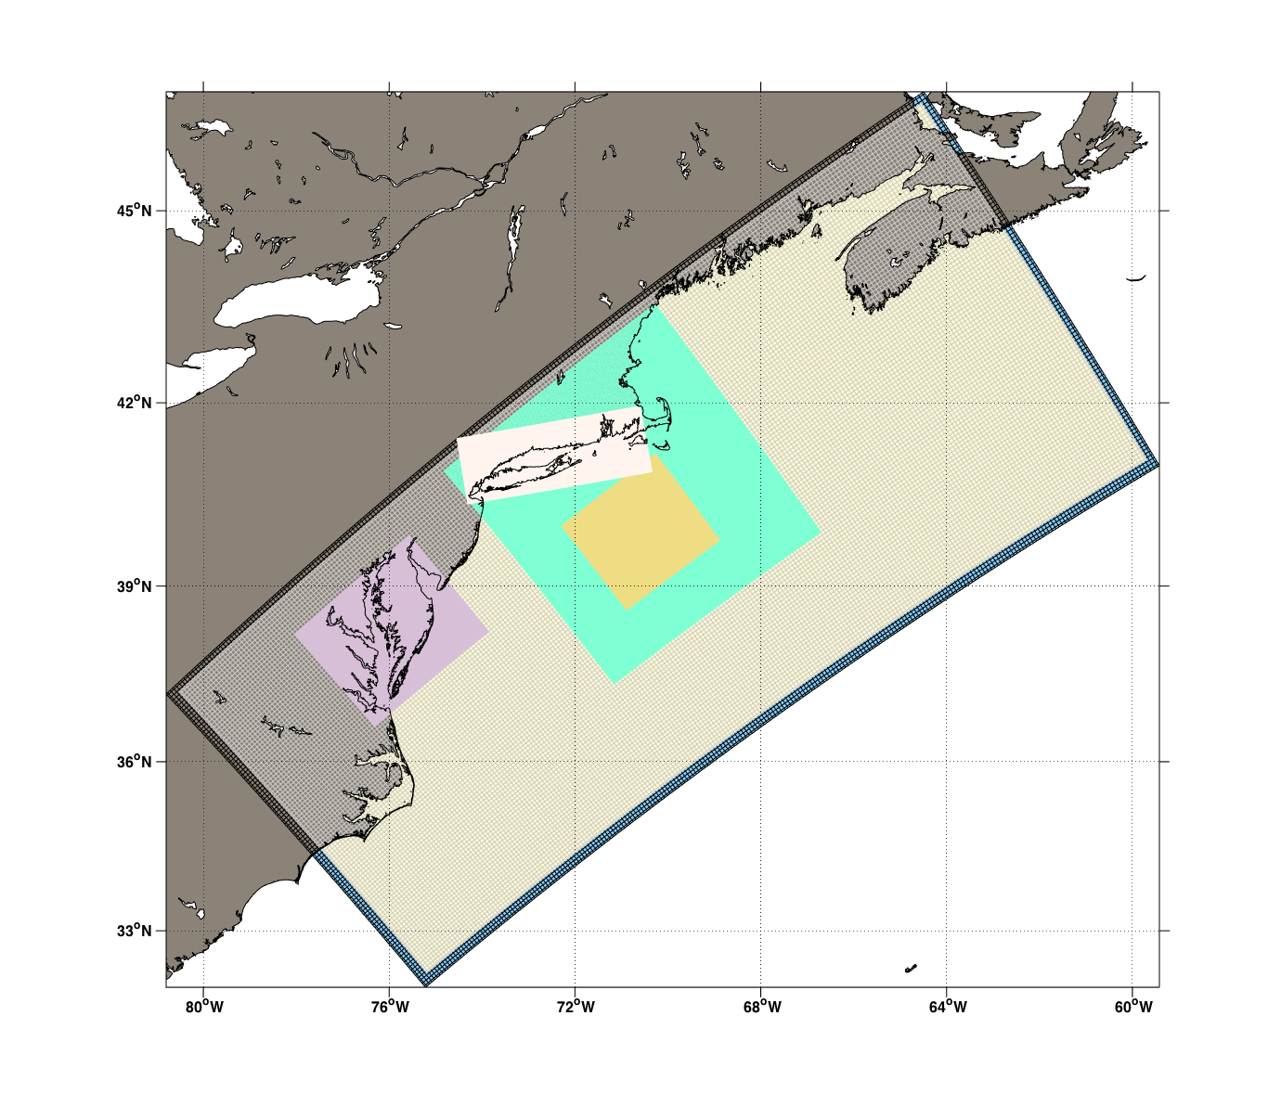
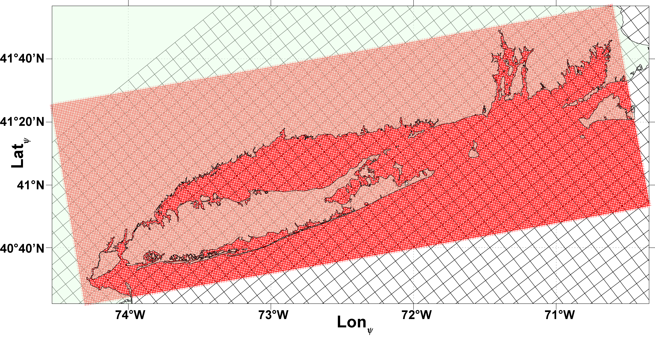
ROMS: Advances on Nesting Algorithms
Hernan G. Arango
DMCS, Rutgers University
2019 COAWST Workshop
NCSU, Raleigh, North Carolina, 26-Feb-2019

Slide 2

Collaborators
Andrew M. Moore, U. California Santa Cruz
John L. Wilkin, DMCS, Rutgers University
Julia Levin, DMCS, Rutgers University
John Warner, USGS, WHOI

Slide 3
Regional Ocean Prediction
To have successful and accurate regional ocean forecasting, the modeling system needs:
Atmospheric forcing for the forecast window or by coupling directly to an Atmosphere Model.
To resolve the dynamical spatial and temporal scales for reduction of forecast error. Spatial High-resolution can be achieved with nesting in particular areas while preserving the regional-scale circulation at an affordable computational cost in both atmosphere and ocean grids.
Appropriate lateral, open boundary conditions that minimize forecast error.
Surface and sub-surface observations (in ocean).
Advanced data assimilation schemes to combine models and observations optimally. In ROMS, we have
  Variational Data Assimilation based on either the primal (I4D-Var) or dual (4D-PSAS, R4D-Var) formulation
  Ensemble Adjustment Kalman Filter (EAKF) interface to the Data Assimilation Research Testbed (DART; Jeff Anderson and collaborators at NCAR)
Notes:
Primal Formulation: the search for the best estimate (posterior) is on the space spanned by the model state
Dual Formulation: the search for the posterior is in the subspace spanned only by the observations

Slide 4
ROMS Nesting Algorithms
The nesting algorithms in ROMS are unique an flexible to allow complex nested grid configurations in coastal applications. It supports various nested grid classes and capabilities:
Aligned and nonaligned composite grids
Aligned and nonaligned refinement grids
Refinement and composite grid combinations
Logically ordered nested grids layers: time-step size arrangement and order for the numerical kernel
Hybrid nesting to other models or external data: Heterogenous Nested Open Boundary Conditions (One-Way only)
One-Way or Two-Way (default) data exchanges
Nested 4D-Var (nested algorithms adjointed)
Nesting and Coupling

Slide 5
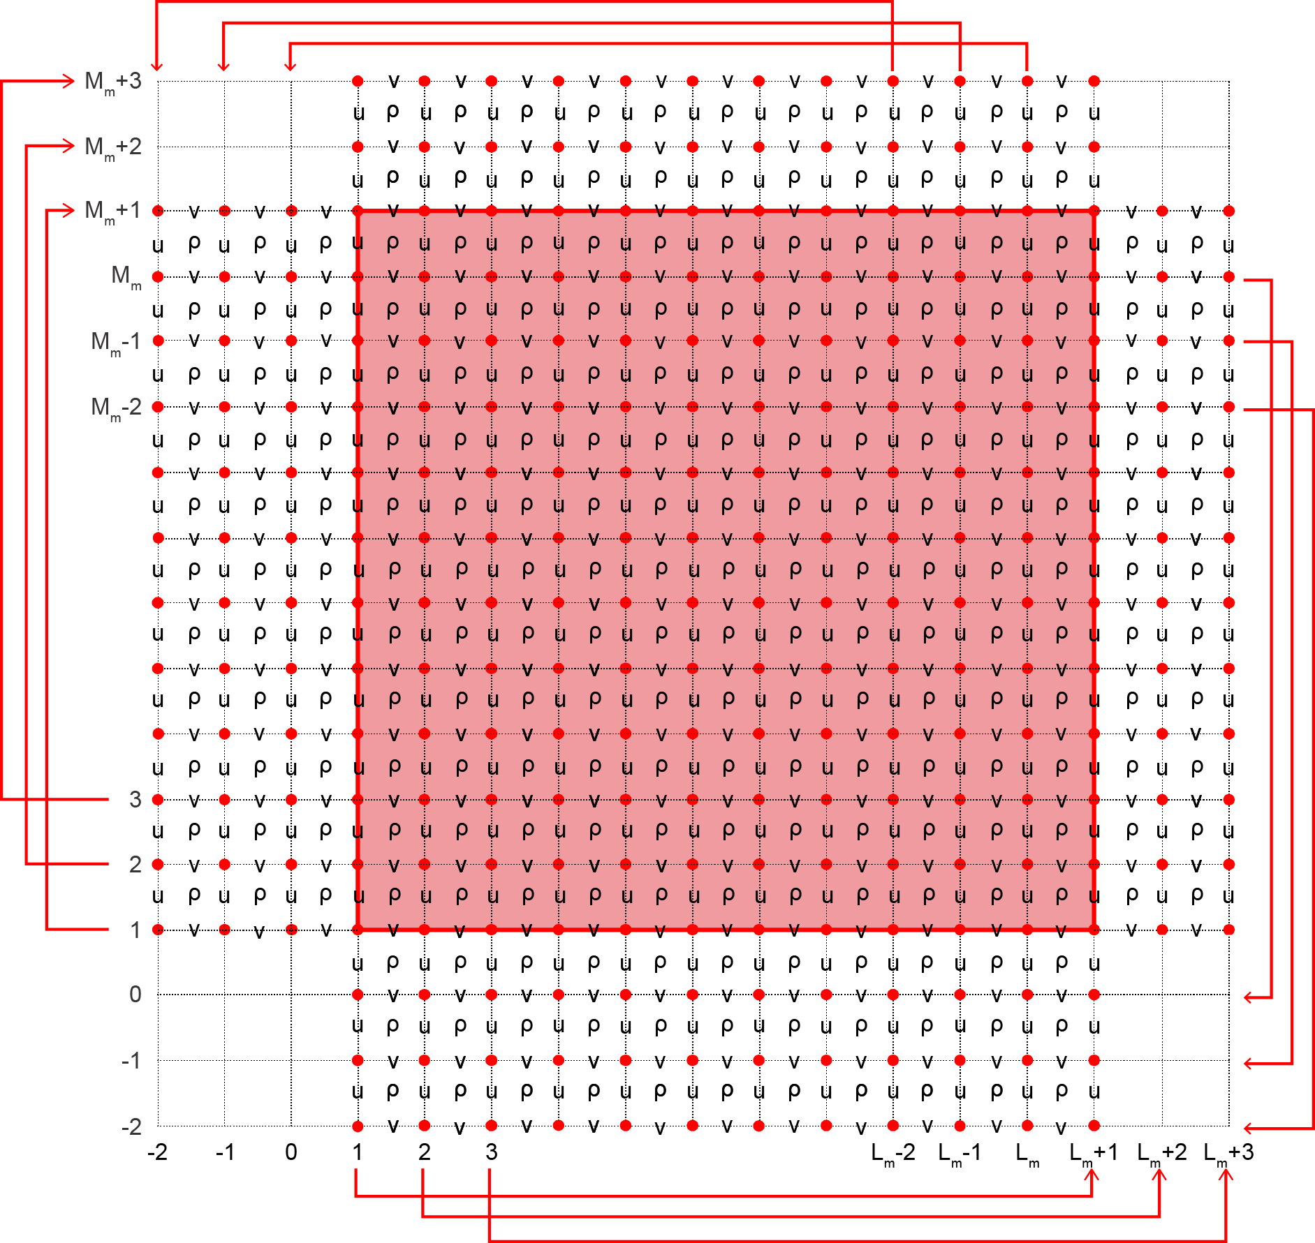
East-West Exchange
Double-Periodic Physical and Computational Mesh
East-West Exchange
Nesting Inspiration
South-North Exchange
North-South Exchange
West-East Exchange
Notes:
The MPI exchange of tile partitions uses similar logic but with halos of smaller size (2 to 3 points).

Slide 6
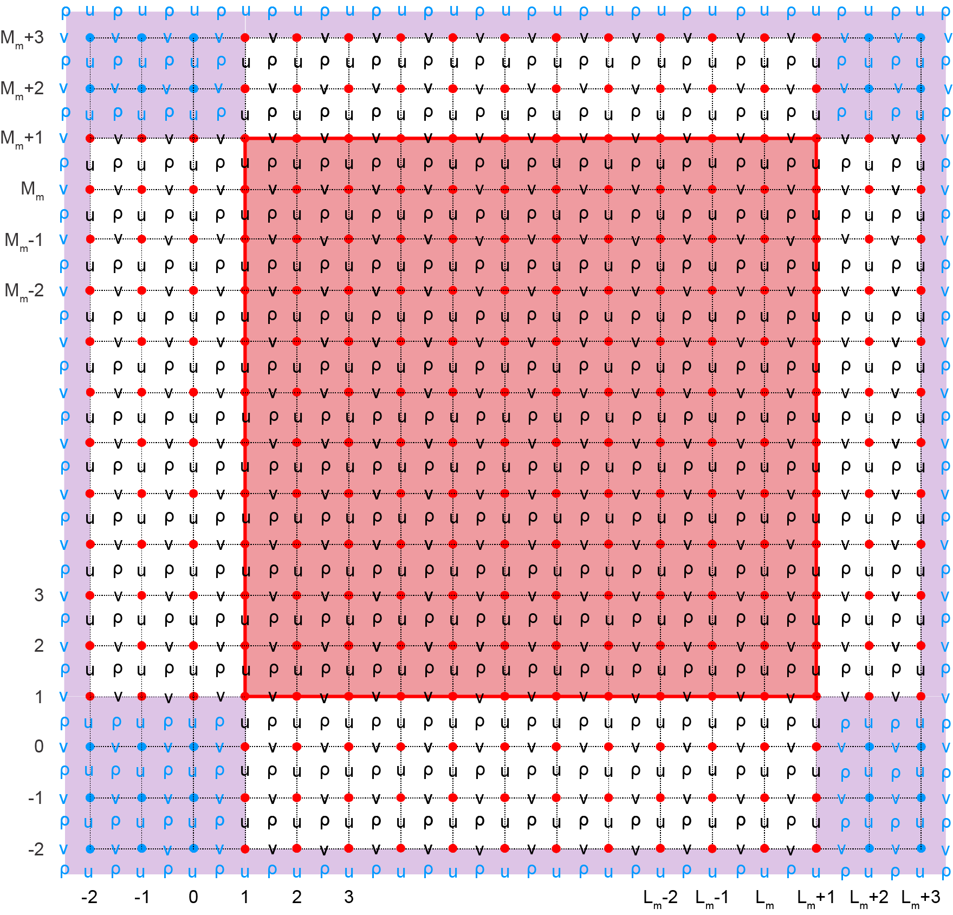
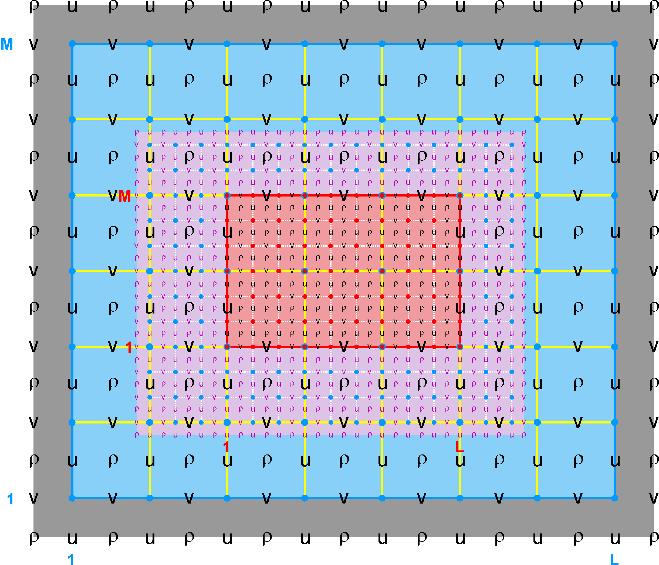
Nested Grids: Refinement
(Arakawa C-grid)
Double-Periodic to Refinement
Blue: Coarser Donor Grid
Red: Finer Receiver Grid
Purple: Contact Region and Contact Points
Each Contact Region has a Donor and Receiver grid. The Receiver grid data is interpolated from the Donor grid cell containing the Contact Point. The full governing equations horizontal operator is evaluated at the Contact Points giving the correct flux/gradient at the Receiver grid physical boundary, as in periodic boundary conditions.

Slide 7
Tile I- and J-Ranges
get_bounds.F
Istr = BOUNDS(ng) % Istr (tile)
IstrB = BOUNDS(ng) % IstrB (tile)
IstrM = BOUNDS(ng) % IstrM (tile)
IstrP = BOUNDS(ng) % IstrP (tile)
IstrR = BOUNDS(ng) % IstrR (tile)
IstrT = BOUNDS(ng) % IstrT (tile)
IstrU = BOUNDS(ng) % IstrU (tile)
Iend = BOUNDS(ng) % Iend (tile)
IendB = BOUNDS(ng) % IendB (tile)
IendP = BOUNDS(ng) % IendP (tile)
IendR = BOUNDS(ng) % IendR (tile)
IendT = BOUNDS(ng) % IendT (tile)
Jstr = BOUNDS(ng) % Jstr (tile)
JstrB = BOUNDS(ng) % JstrB (tile)
JstrM = BOUNDS(ng) % JstrM (tile)
JstrP = BOUNDS(ng) % JstrP (tile)
JstrR = BOUNDS(ng) % JstrR (tile)
JstrT = BOUNDS(ng) % JstrT (tile)
JstrV = BOUNDS(ng) % JstrV (tile)
Jend = BOUNDS(ng) % Jend (tile)
JendB = BOUNDS(ng) % JendB (tile)
JendP = BOUNDS(ng) % JendP (tile)
JendR = BOUNDS(ng) % JendR (tile)
JendT = BOUNDS(ng) % JendT (tile)
Istrm3 = BOUNDS(ng) % Istrm3 (tile) Istr-3
Istrm2 = BOUNDS(ng) % Istrm2 (tile) Istr-2
Istrm1 = BOUNDS(ng) % Istrm1 (tile) Istr-1
IstrUm2 = BOUNDS(ng) % IstrUm2 (tile) IstrU-2
IstrUm1 = BOUNDS(ng) % IstrUm1 (tile) IstrU-1
Iendp1 = BOUNDS(ng) % Iendp1 (tile) Iend+1
Iendp2 = BOUNDS(ng) % Iendp2 (tile) Iend+2
Iendp2i = BOUNDS(ng) % Iendp2i (tile) Iend+2 interior
Iendp3 = BOUNDS(ng) % Iendp3 (tile) Iend+3
Jstrm3 = BOUNDS(ng) % Jstrm3 (tile) Jstr-3
Jstrm2 = BOUNDS(ng) % Jstrm2 (tile) Jstr-2
Jstrm1 = BOUNDS(ng) % Jstrm1 (tile) Jstr-1
JstrVm2 = BOUNDS(ng) % JstrVm2 (tile) JstrV-2
JstrVm1 = BOUNDS(ng) % JstrVm1 (tile) JstrV-1
Jendp1 = BOUNDS(ng) % Jendp1 (tile) Jend+1
Jendp2 = BOUNDS(ng) % Jendp2 (tile) Jend+2
Jendp2i = BOUNDS(ng) % Jendp2i (tile) Jend+2 interior
Jendp3 = BOUNDS(ng) % Jendp3 (tile) Jend+3
Suffix:
R : tile RHO-points B : Boundary tile RHO- and V-points
U : tile U-points M : Boundary tile PSI- and U-points
V : tile V-points P : Nesting PSI-, U-, and V-points
T : Nesting RHO-points

Slide 8
Boundary Tile Indices
If not nesting grids, the additional boundary tile indices associated with nesting are set to:
IstrT = IstrR full range, starting I- direction (RHO-point)
IendT = IendR full range, ending I- direction (RHO-point)
JstrT = JstrR full range, starting J- direction (RHO-point)
JendT = JendR full range, ending J- direction (RHO-point)
IstrP = Istr full range, starting I- direction (PSI-, U-point)
IendP = Iend full range, ending I- direction (PSI-point)
JstrP = Jstr full range, starting J- direction (PSI-, V-point)
JendP = Jend full range, ending J- direction (PSI-point)
IstrB = Istr interior range, starting I- direction (RHO-, V-point)
IendB = Iend interior range, ending I- direction (RHO-, V-point)
JstrB = Jstr interior range, starting J- direction (RHO-, U-point)
JendB = Jend interior range, ending J- direction (RHO-, U-point)
IstrM = IstrU interior range, starting I- direction (PSI-, U-point)
JstrM = JstrV interior range, starting J- direction (PSI-, V-point)

Slide 9
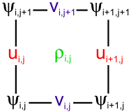
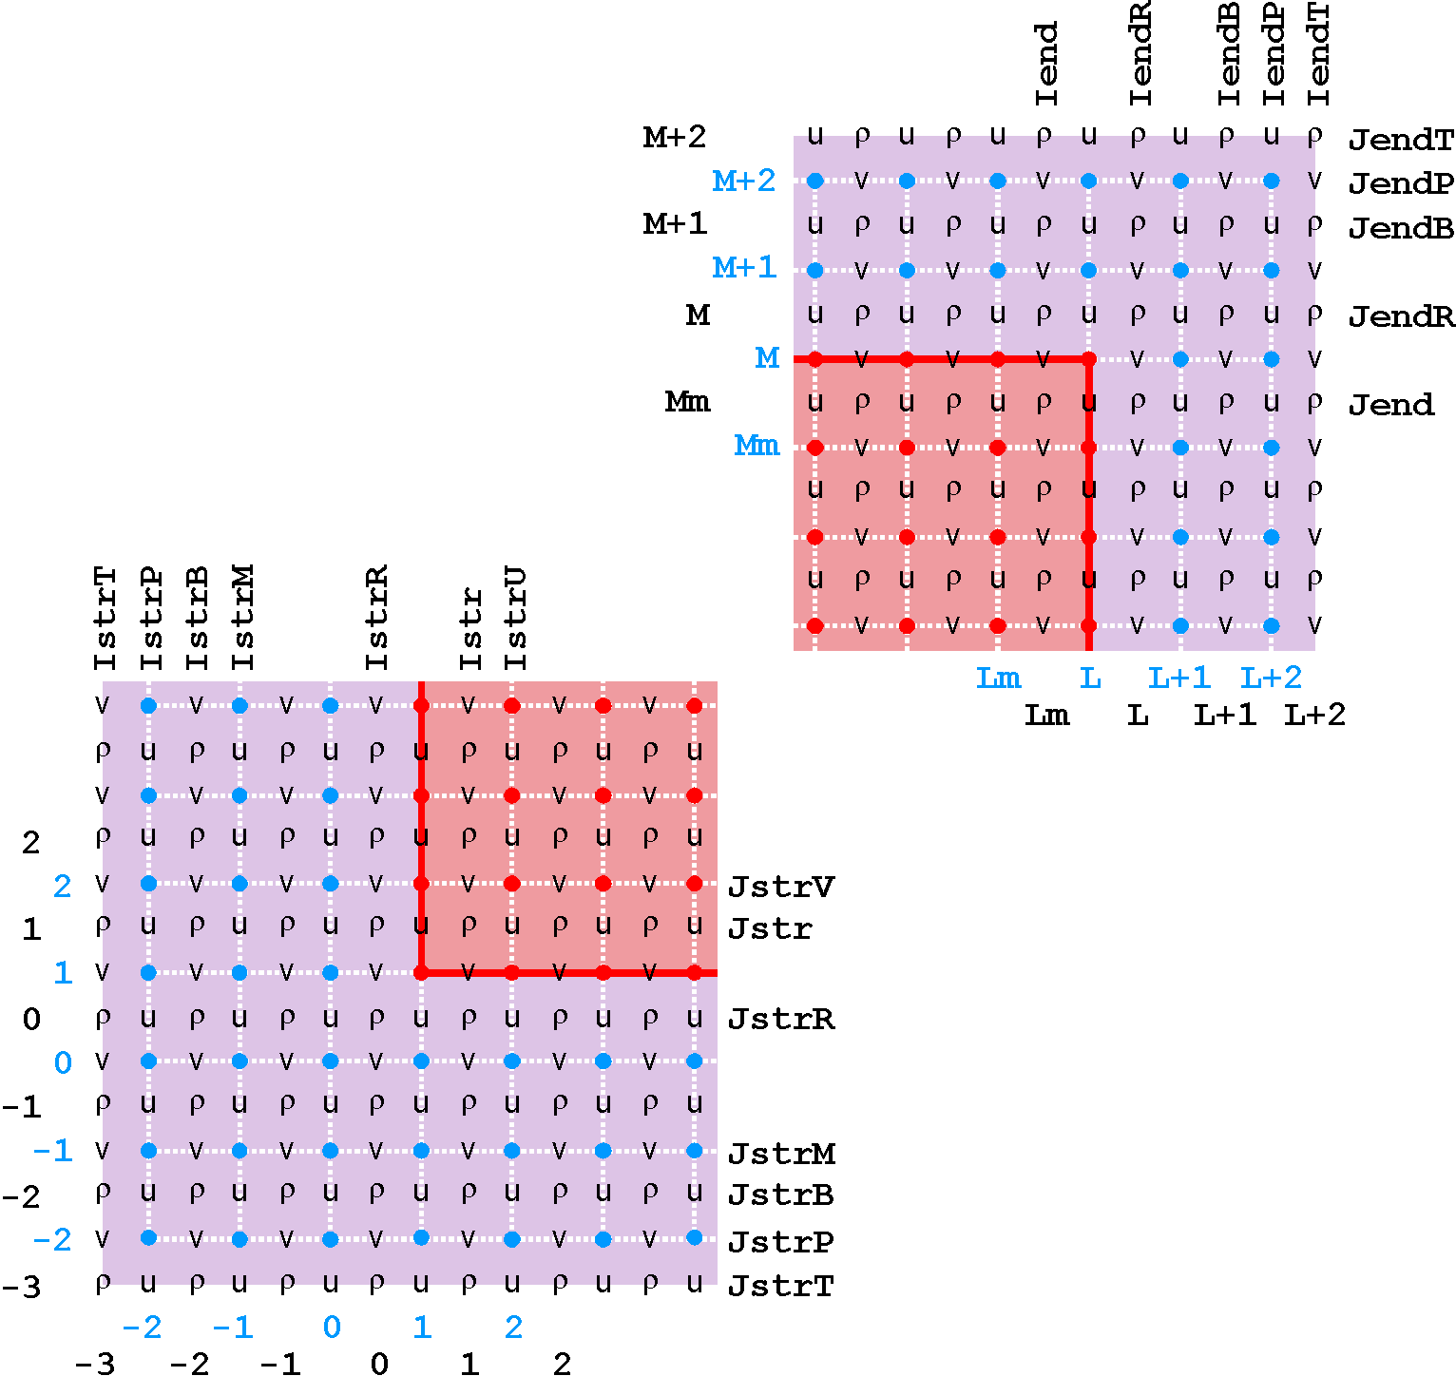
Tile Indices Locations
Right-Handed Indexing
The Contact Points in the Contact
Region (purple) are interpolated from
the Donor Grid.
The discreate horizontal operators
are evaluated at the Contact Points
yielding a full exchange of information
between Donor and Receiver grids.
The approach is generic to any discrete
horizontal operator (like gradient,
advection, diffusion , etc.)

Slide 10
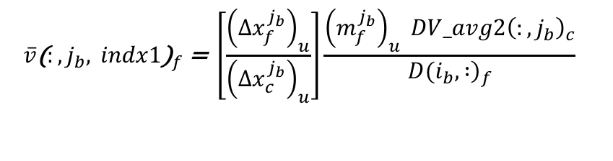
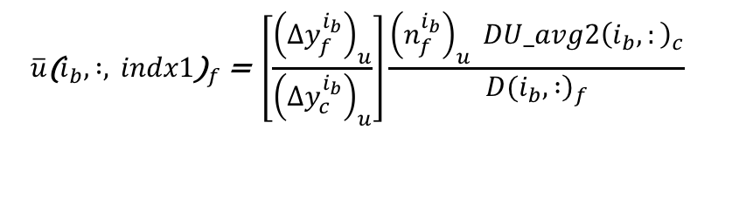
Transport Mass Flux
The donor (coarser) grid vertically-integrated mass flux is imposed at the receiver (finer) grid physical boundary:
$${\overline{u}\text{(}i_{b}, :, indx1\text{)}}_{f}\text{ = }\left[\frac{{\left({∆y}_{f}^{i_{b}}\right)}_{u}}{{\left({Δy}_{c}^{i_{b}}\right)}_{u}}\right]\frac{{\left(n_{f}^{i_{b}}\right)}_{u} {DU_avg2\left(i_{b},:\right)}_{c}}{{\left.D(i_{b}, :\right)}_{f}}$$
East and West
boundaries
$${\overline{v}\text{(}:, j_{b}, indx1\text{)}}_{f}\text{ = }\left[\frac{{\left({∆x}_{f}^{j_{b}}\right)}_{u}}{{\left({Δx}_{c}^{j_{b}}\right)}_{u}}\right]\frac{{\left(m_{f}^{j_{b}}\right)}_{u} {DV_avg2\left(:,j_{b}\right)}_{c}}{{\left.D(i_{b}, :\right)}_{f}}$$
North and South
boundaries
where DU_avg2 and DV_avg2 are the time-averaged (over all barotropic steps) mass fluxes (m³/s) used in the 3D momentum equations

Slide 11
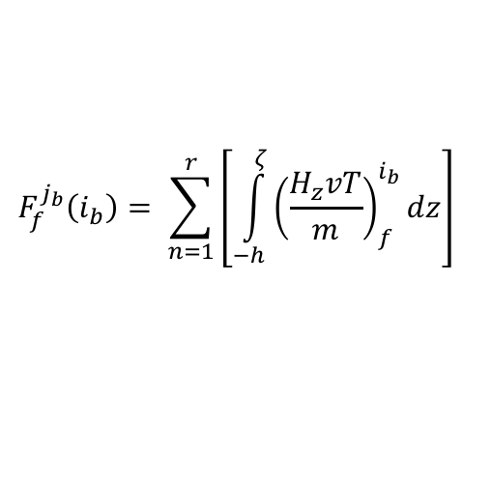
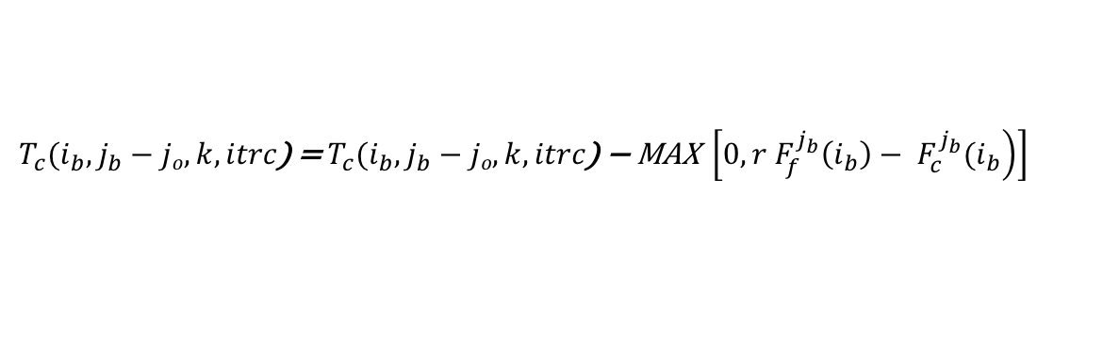
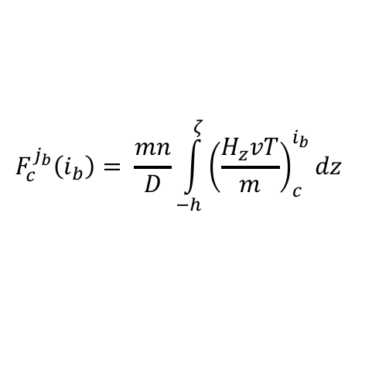
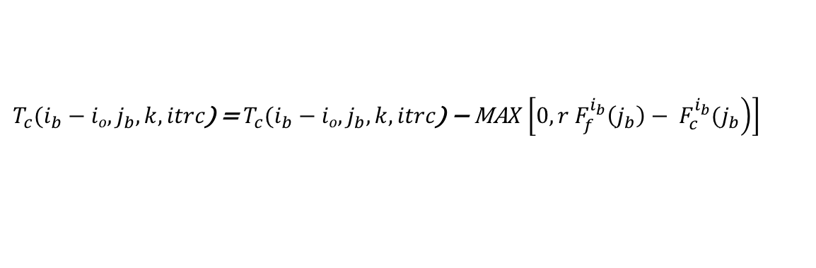
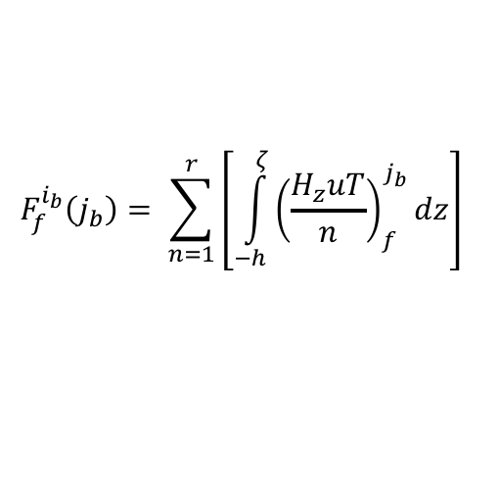
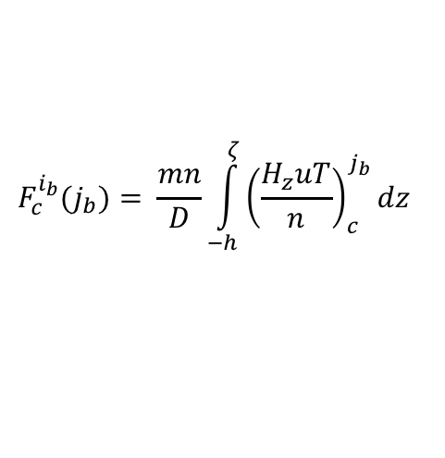
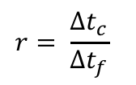
Tracer Transport Correction
If two-way refinement, the coarser grid tracer value is adjusted at the finer grid physical boundary:
$$T_{c}(i_{b}−io,j_{b}, k, itrc\text{) = }T_{c}(i_{b}−io,j_{b}, k, itrc\text{) − }\text{MA}X\left[0, \left.r F_{f}^{i_{b}}\left(j_{b}\right)− F_{c}^{i_{b}}(j_{b}\right)\right]$$
East (i_{o}=0),
West (i_{o}=1)
$$T_{c}(i_{b},j_{b}−jo, k, itrc\text{) = }T_{c}(i_{b},j_{b}−jo, k, itrc\text{) −} \text{MAX} \left[0, \left.r F_{f}^{j_{b}}\left(i_{b}\right)− F_{c}^{j_{b}}(i_{b}\right)\right]$$
North (j_{o}=0),
South (j_{o}=1)
where
$$r= \frac{{Δt}_{c}}{{Δt}_{f}}$$
time-refinement ratio
and vertically-integrated, horizontal advective fluxes:
$$F_{f}^{i_{b}}\left(j_{b}\right)= \sum_{n=1}^{r}{\left[\int_{−h}^{ζ}{{\left(\frac{H_{z}uT}{n}\right)}_{f}^{j_{b}}}dz\right]}$$
$$F_{c}^{i_{b}}(j_{b})= \frac{mn}{D}\int_{−h}^{ζ}{{\left(\frac{H_{z}uT}{n}\right)}_{c}^{j_{b}}}dz$$
East, West finer
and coarser flux
$$F_{f}^{j_{b}}\left(i_{b}\right)= \sum_{n=1}^{r}{\left[\int_{−h}^{ζ}{{\left(\frac{H_{z}vT}{m}\right)}_{f}^{i_{b}}}dz\right]}$$
$$F_{c}^{j_{b}}\left(i_{b}\right)= \frac{mn}{D}\int_{−h}^{ζ}{{\left(\frac{H_{z}vT}{m}\right)}_{c}^{i_{b}}}dz$$
North, South finer
and coarser flux

Slide 12
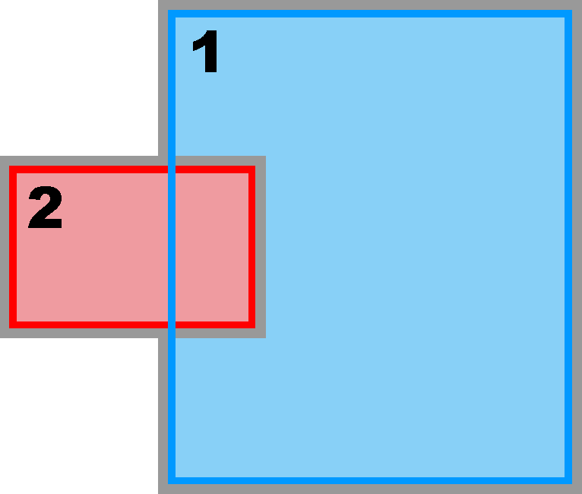
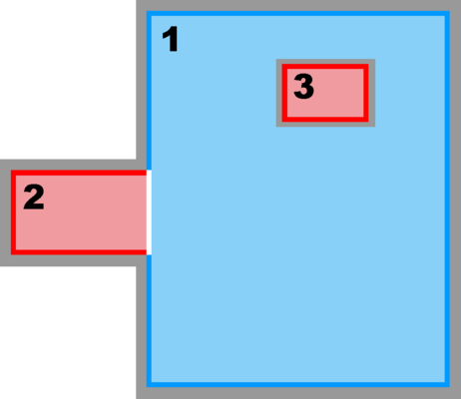
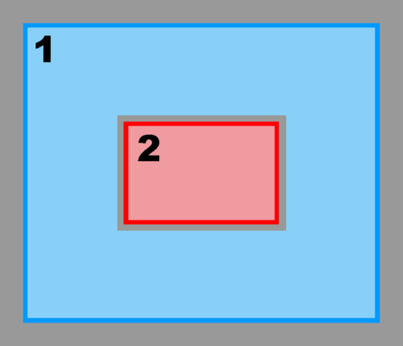
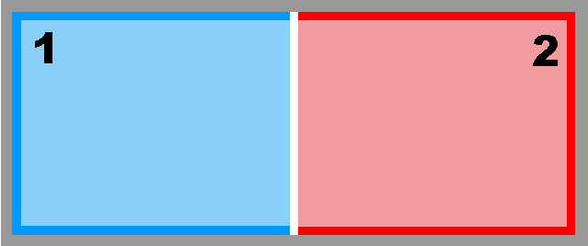
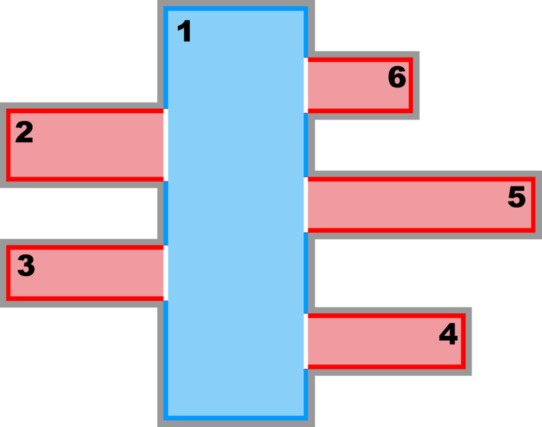
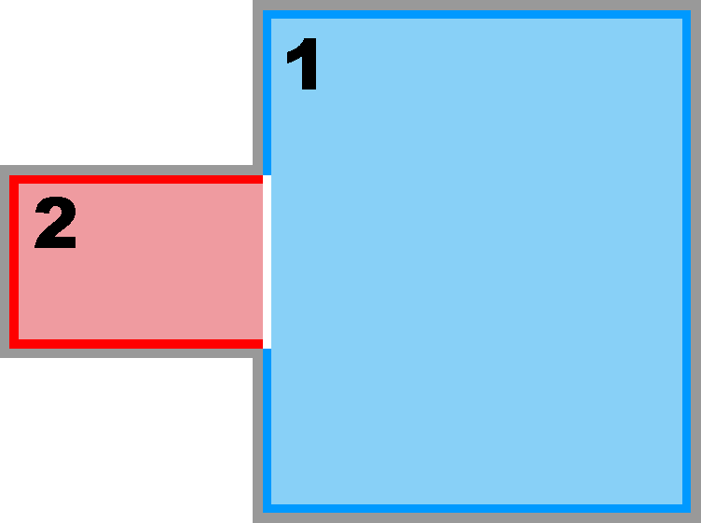
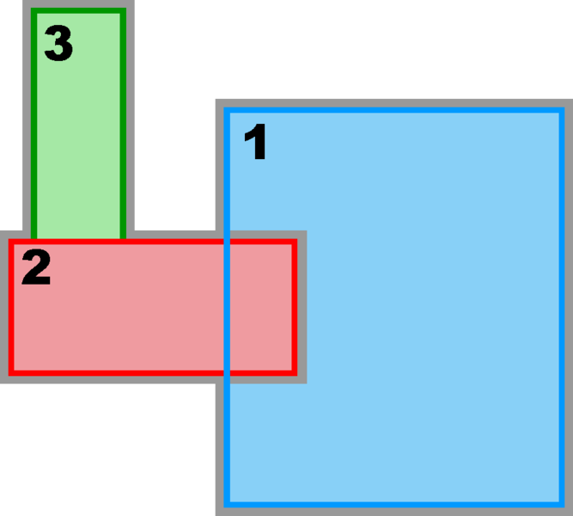
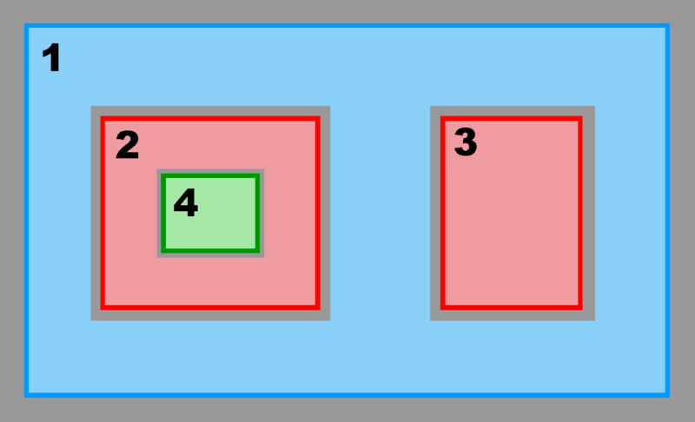
Nesting Configuration Types
Mosaic
Composite
Refinement
Composite/Refinement
Partial Boundary
Complex Estuary
Multiple Refinement
Composite/Refinement
Estuary

Slide 13
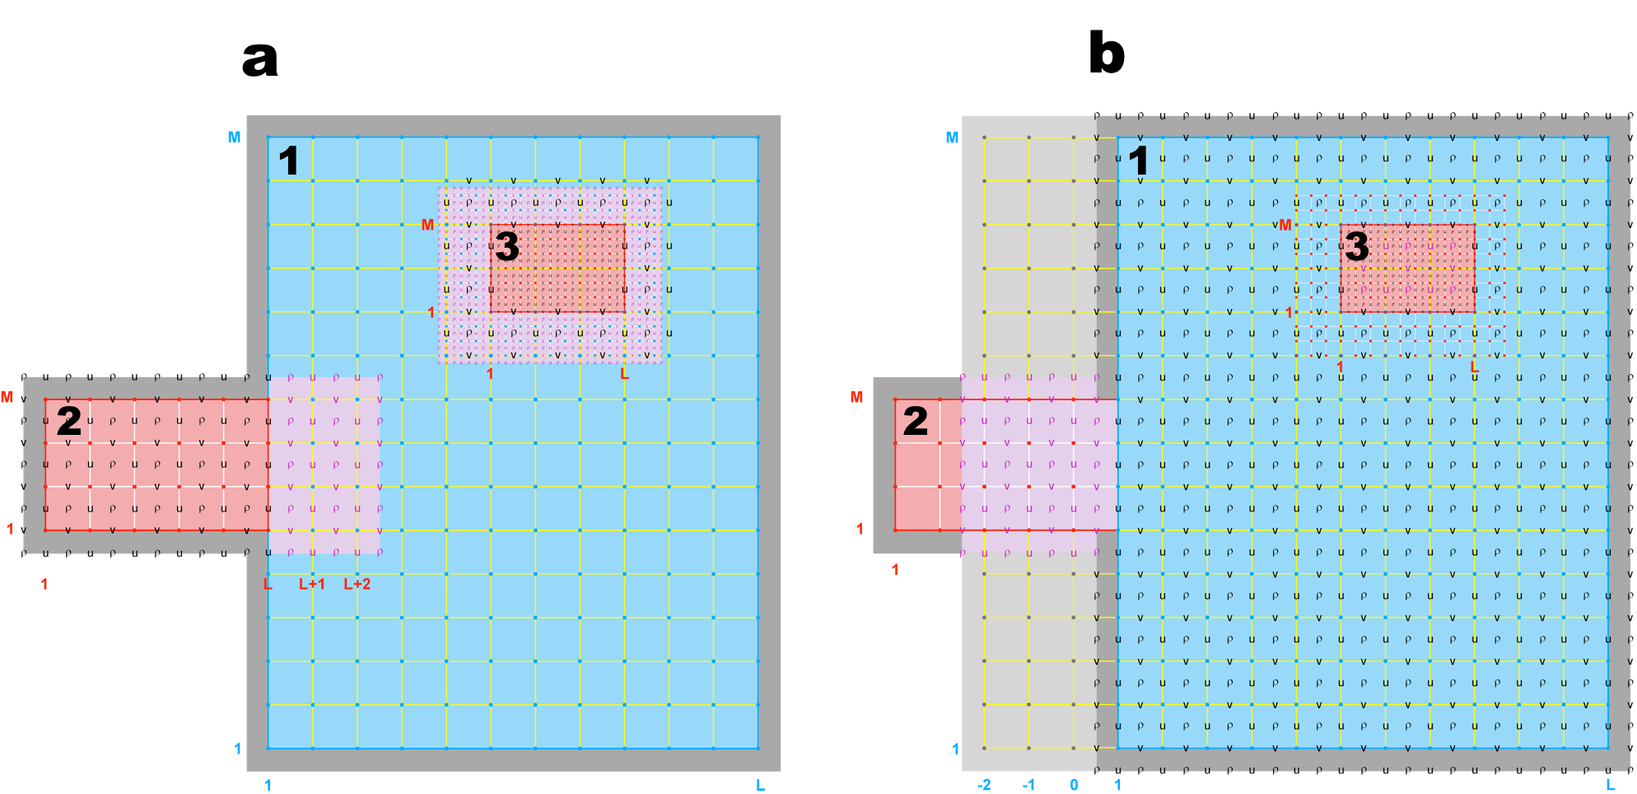
Contact Regions and Contact Points
(Donor and Receiver Grids Duality)
Blue Donor, Red Receiver
Coarse-to-Fine
Blue Receiver, Red Donor
Fine-to-Coarse
There are four contact regions in this application, Ncontact = (Ngrids-1) * 2

Slide 14
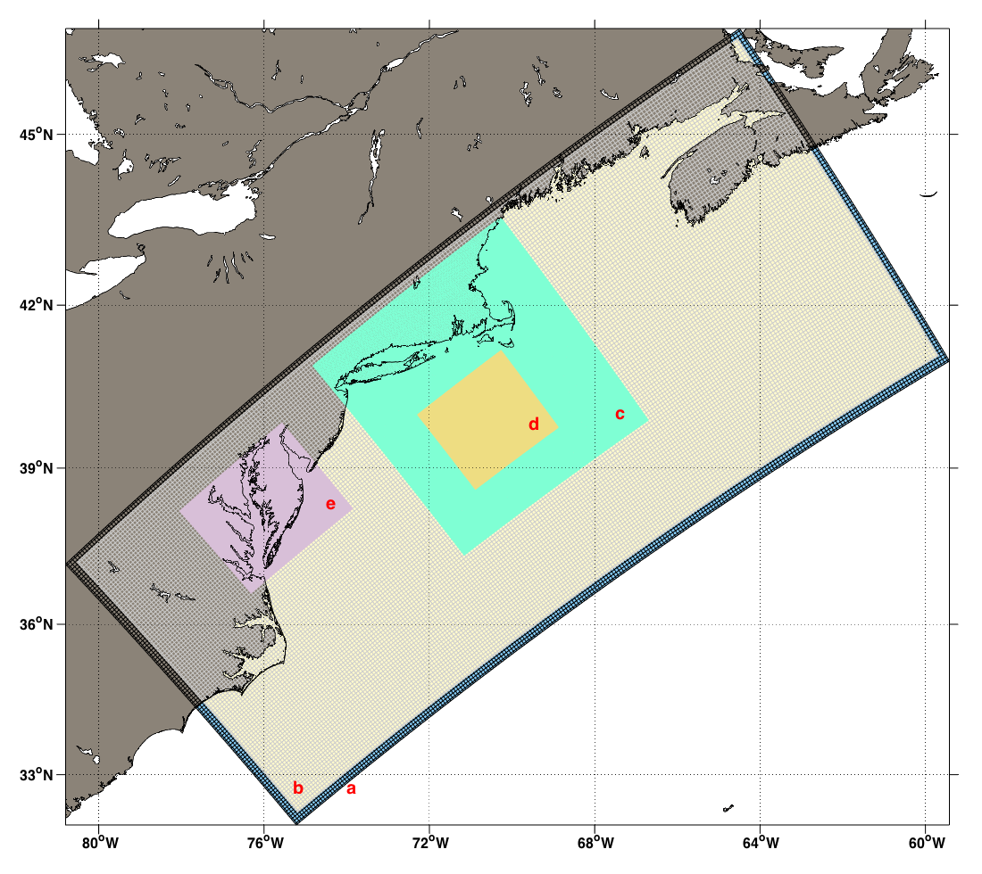
Nesting and Data Assimilation:
US East Coast Application
a: Hybrid DOPPIO nest
b: DOPPIO
c: PIONEER
d: ARRAY
e: USECOS

Slide 15
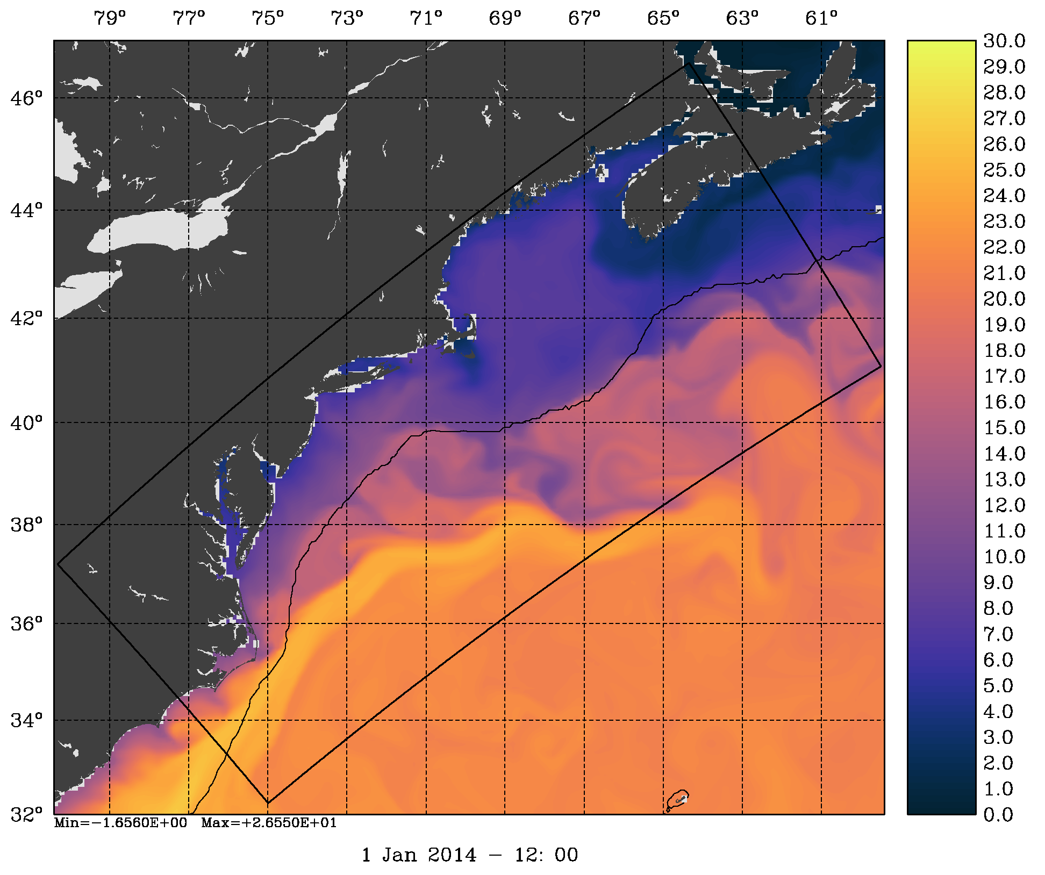
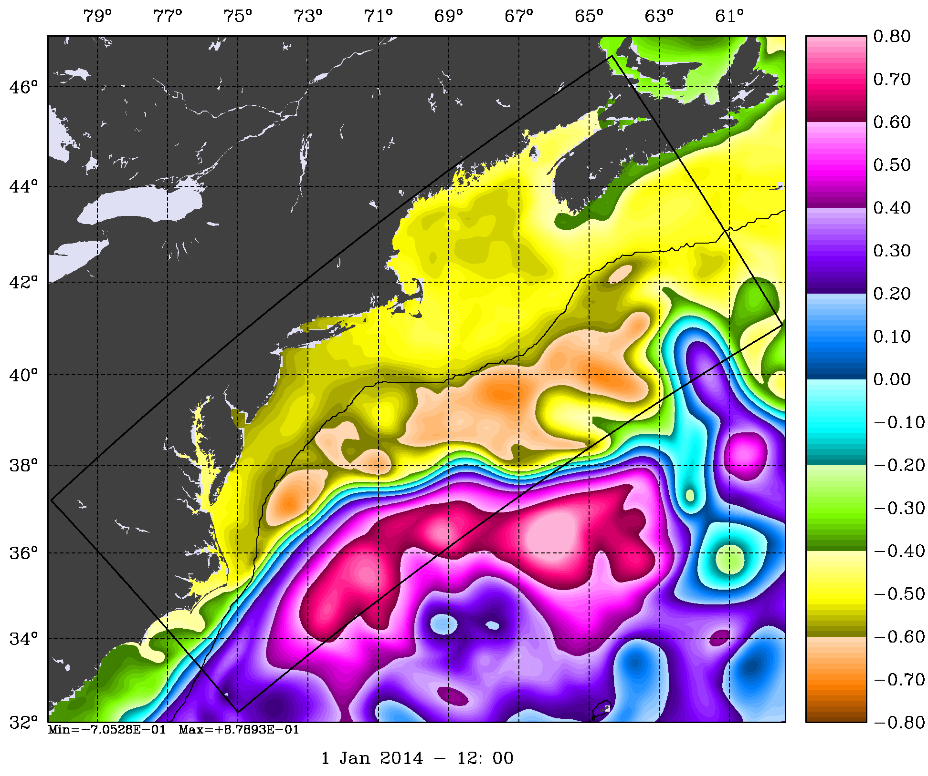
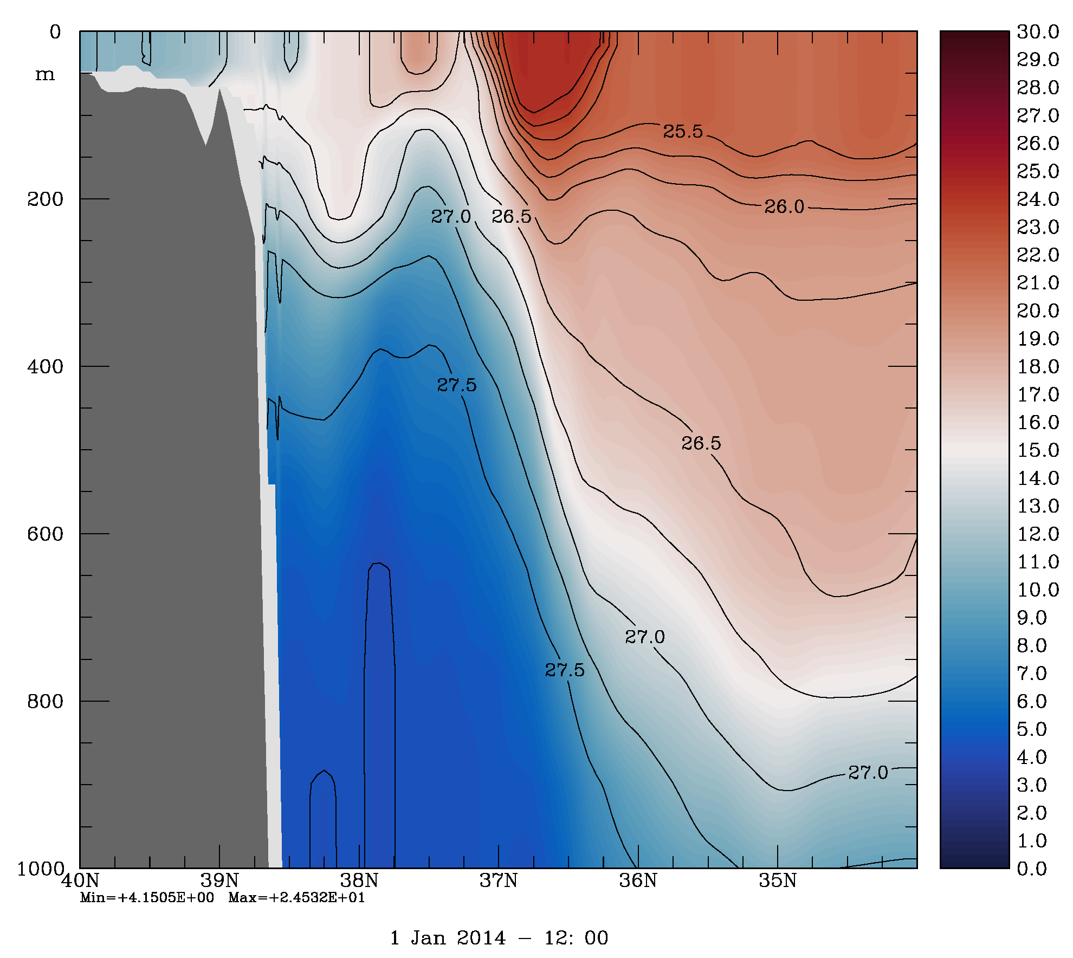
Mercator Daily Lateral Boundary
Conditions (PSY4QV3R1)
SST (C)
Open boundary conditions mean (T and S) are adjusted by matching mean to regional climatology (MOCHA)
Removing bias from open boundary conditions is necessary for 4D-Var convergence
SSH (m)
Temperature (C)

Slide 16
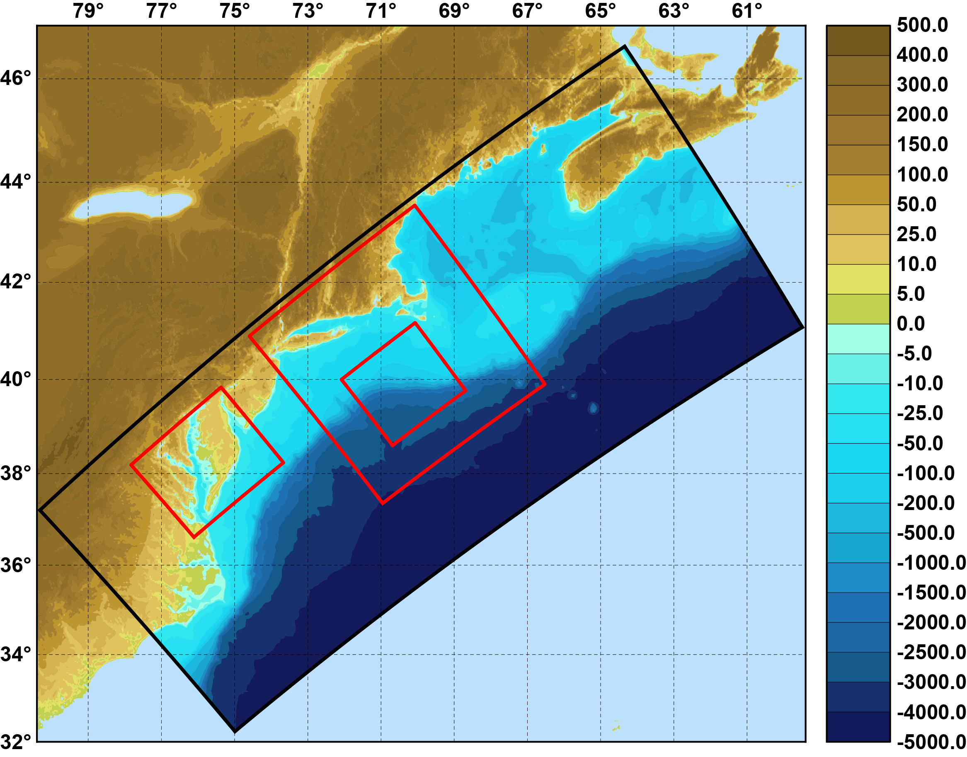
The Mid-Atlantic Bight and Gulf of Maine
ROMS Application
Data Assimilation System:
ROMS ~7km/~2.3/~1km, 40 levels
3 nested grids solutions (2014 & 2015)
4D-Var data assimilation (4D-PSAS)
Dual formulation (augmented RPCG)
2 outer-loops, 7 inner-loops
3 day assimilation windows (2014 & 2015)
1:3
Assimilation Data Sets: [Real-Time Source]
Regional CODAR hourly [RU TDS]
IOOS glider T,S (1-hr delay) [RU ERDDAP]
AVHRR IR passes 6/day [MARACOOS TDS]
AMRS2+OceanSat mu-wave SST [NASA PODAAC]
Jason-2, CryoSat, AltiKa [RADS.tudelft.nl]
GTS XBT/CTD, Argo floats [OSMC NOAA ERDDAP]
1:3
1:5
Bathymetry (m)
Model surface and boundary forcing:
Surface forcing derived from NAM [NCEP NOMADS]
USGS daily average flow [waterdata.USGS.gov]
Mercator open boundary conditions
Observations per 3 day cycle:
SST ~10⁵
HF radar ~10⁴
in situ ~5X10³
Altimetry ~10³

Slide 17
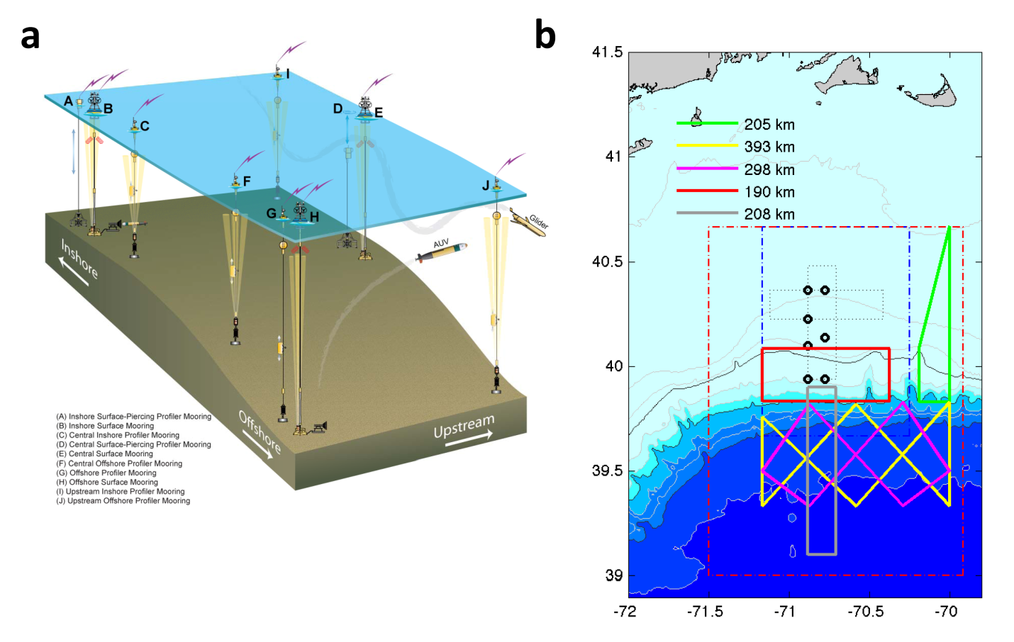
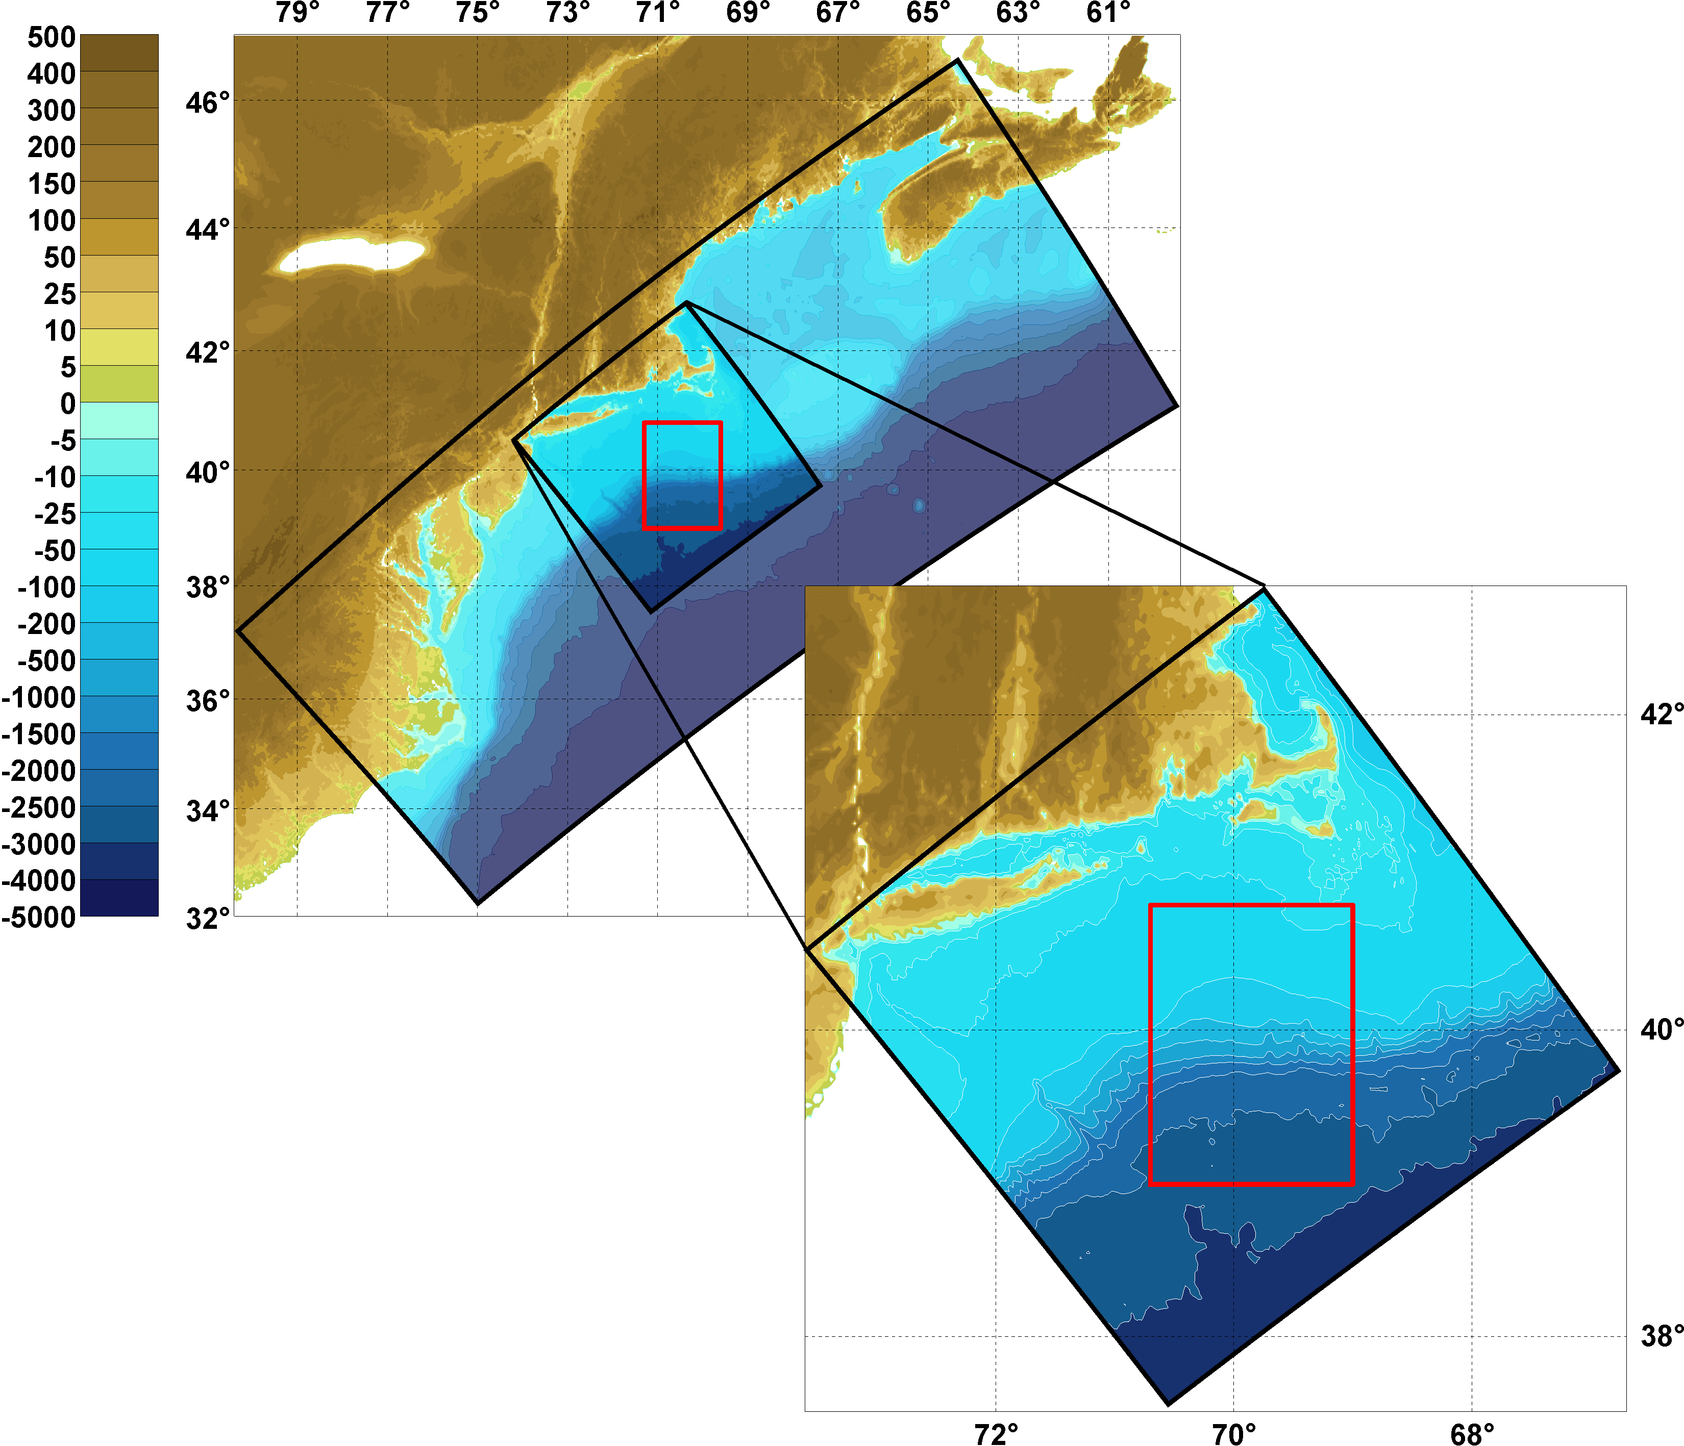
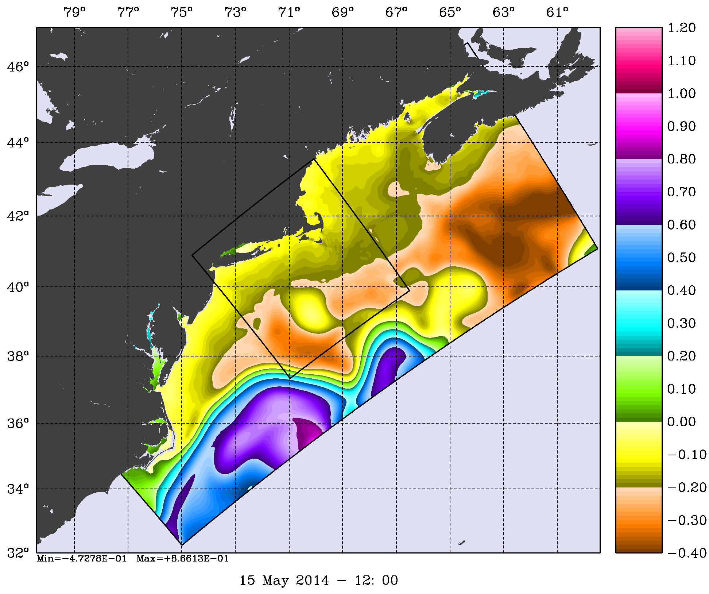
Downscaling with Nested Grids:
DOPPIO and PIONEER
SSH
7 km
~2.3 km
Nested grids for the MAB model. The red box indicates the location of the NSF OOI Pioneer Coastal Array

Slide 18
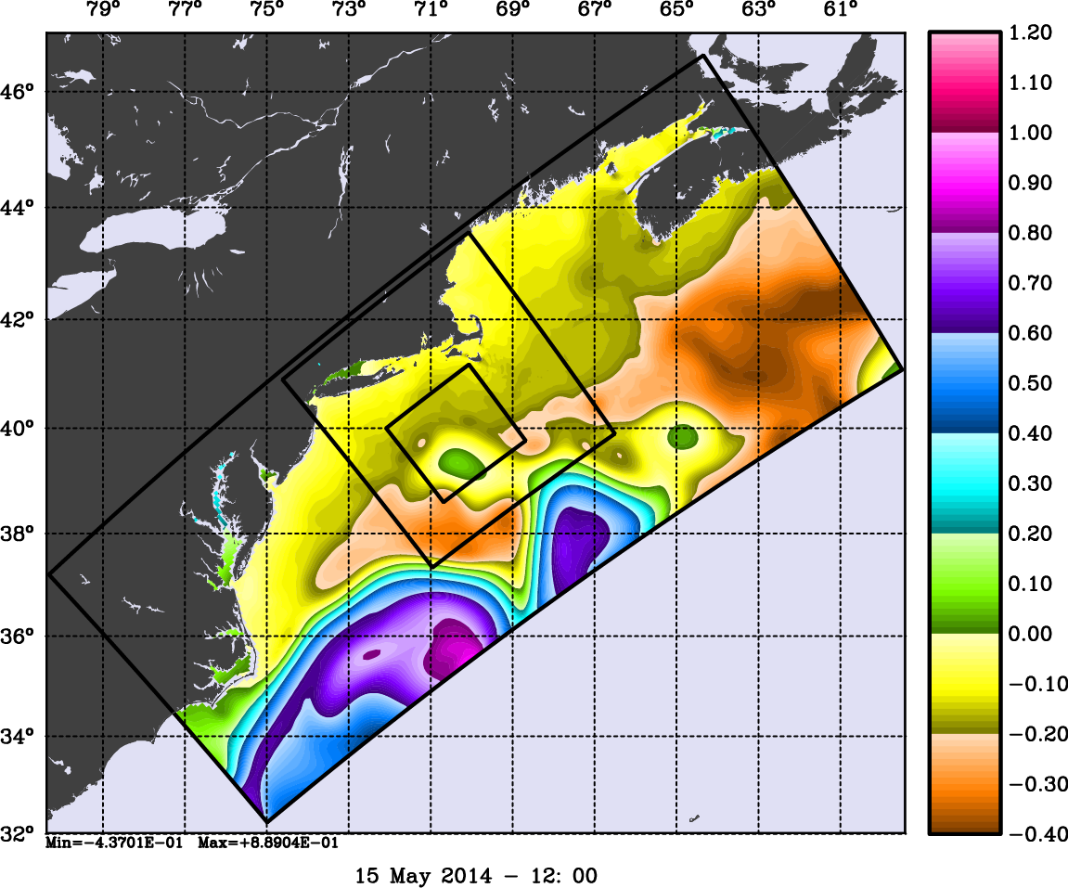
The Mid-Atlantic Bight and Gulf of Maine
Two-Way Nesting
Two Nested Grids
Three Nested Grids
Day 134
Day 134
Free-Surface (m)
Notes:
Nested solutions initialized on 1 Jan 2014. The nested solutions are overlaid in top of the coarser grid. The refinement is 1:3.

Slide 19
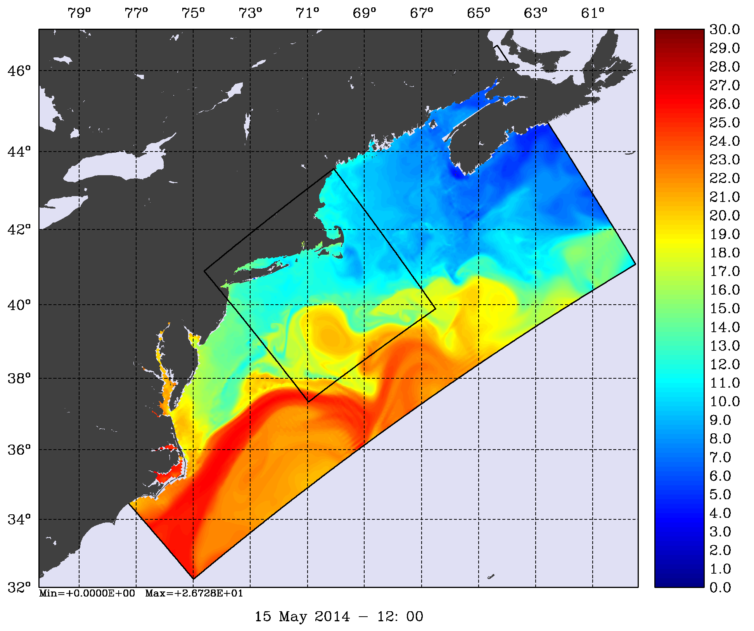
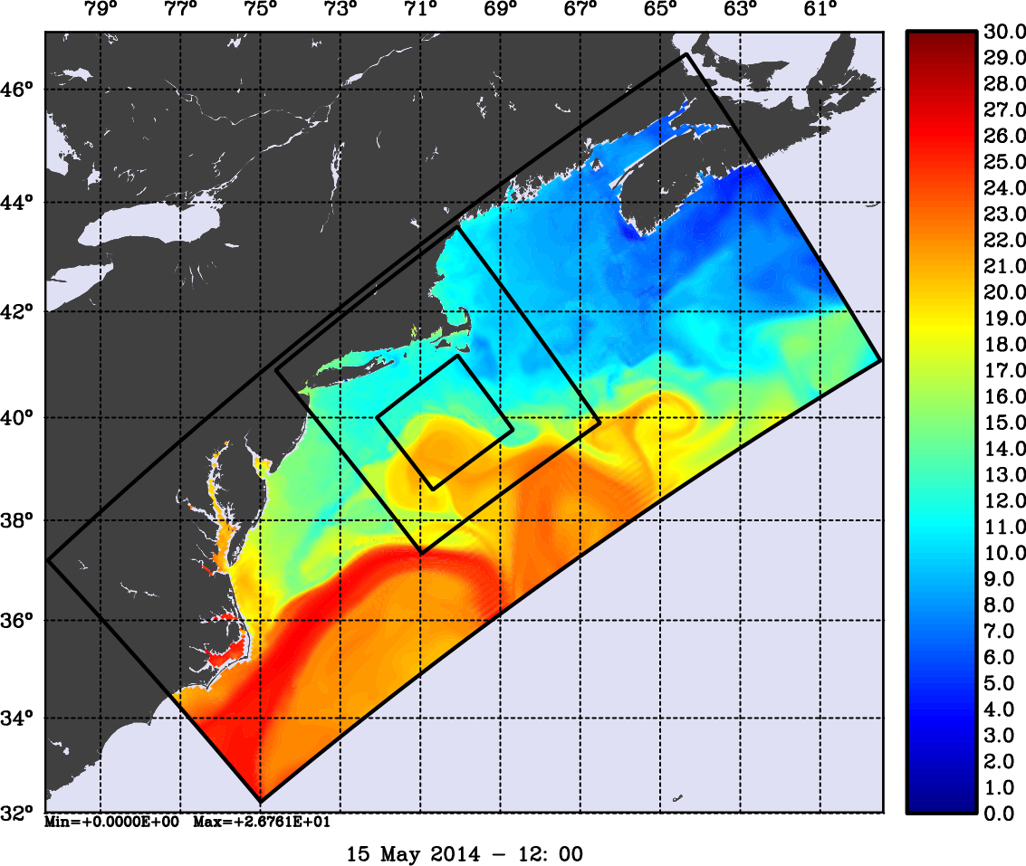
The Mid-Atlantic Bight and Gulf of Maine
Two-Way Nesting
Two Nested Grids
Three Nested Grids
Day 134
Day 134
Surface Temperature (Celsius)

Slide 20
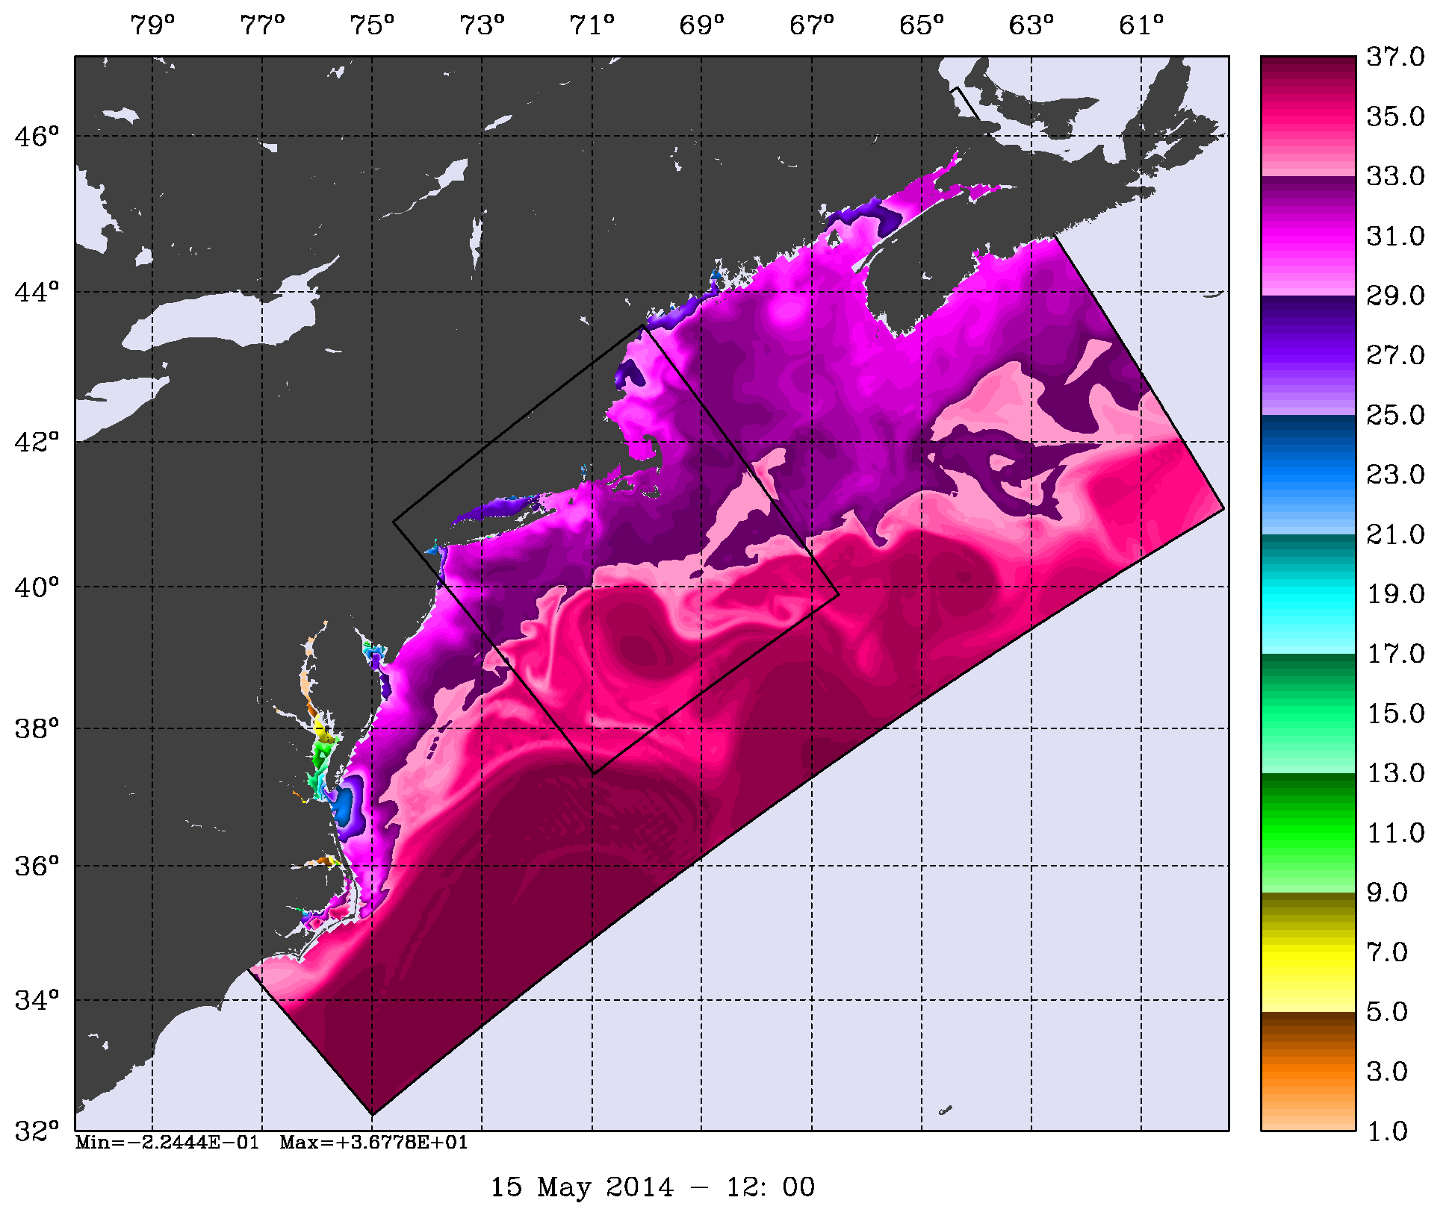
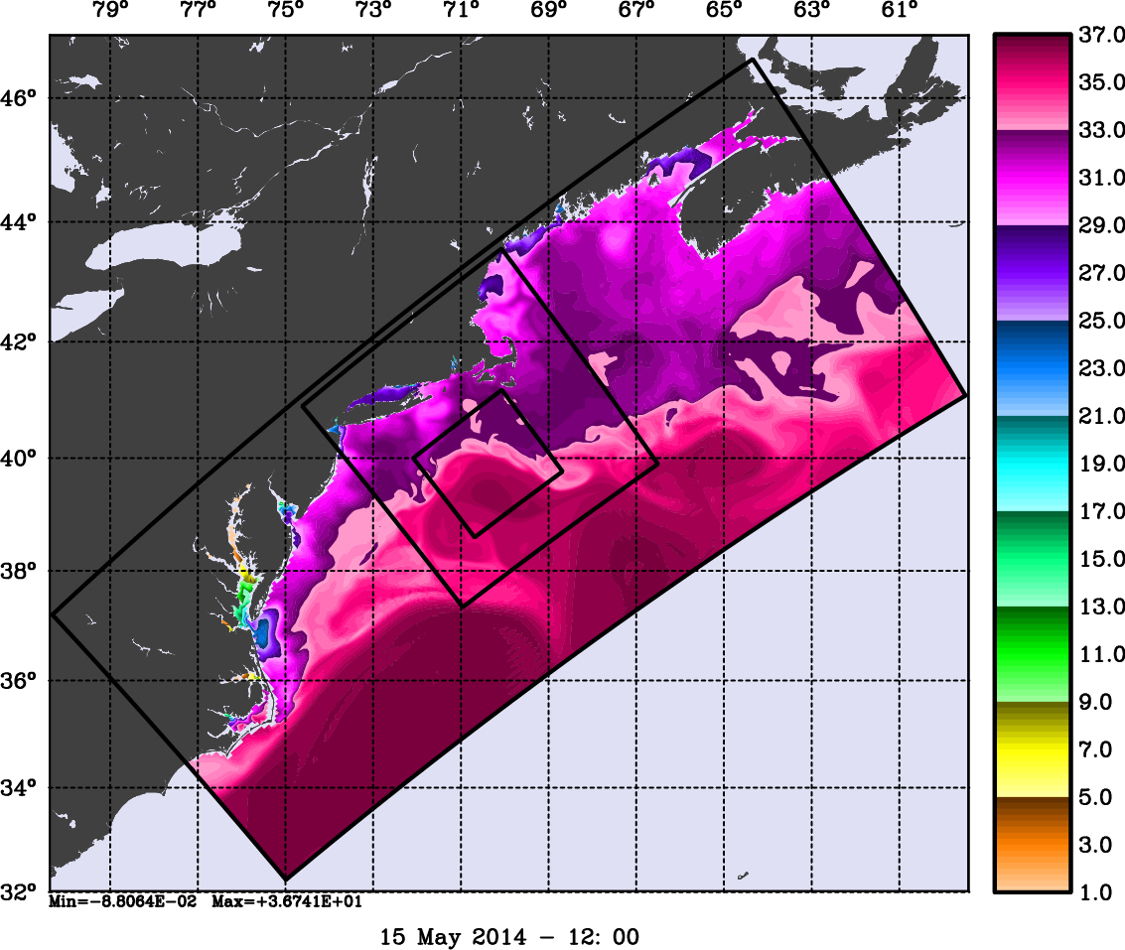
The Mid-Atlantic Bight and Gulf of Maine
Two-Way Nesting
Two Nested Grids
Three Nested Grids
Day 134
Day 134
Surface Salinity

Slide 21
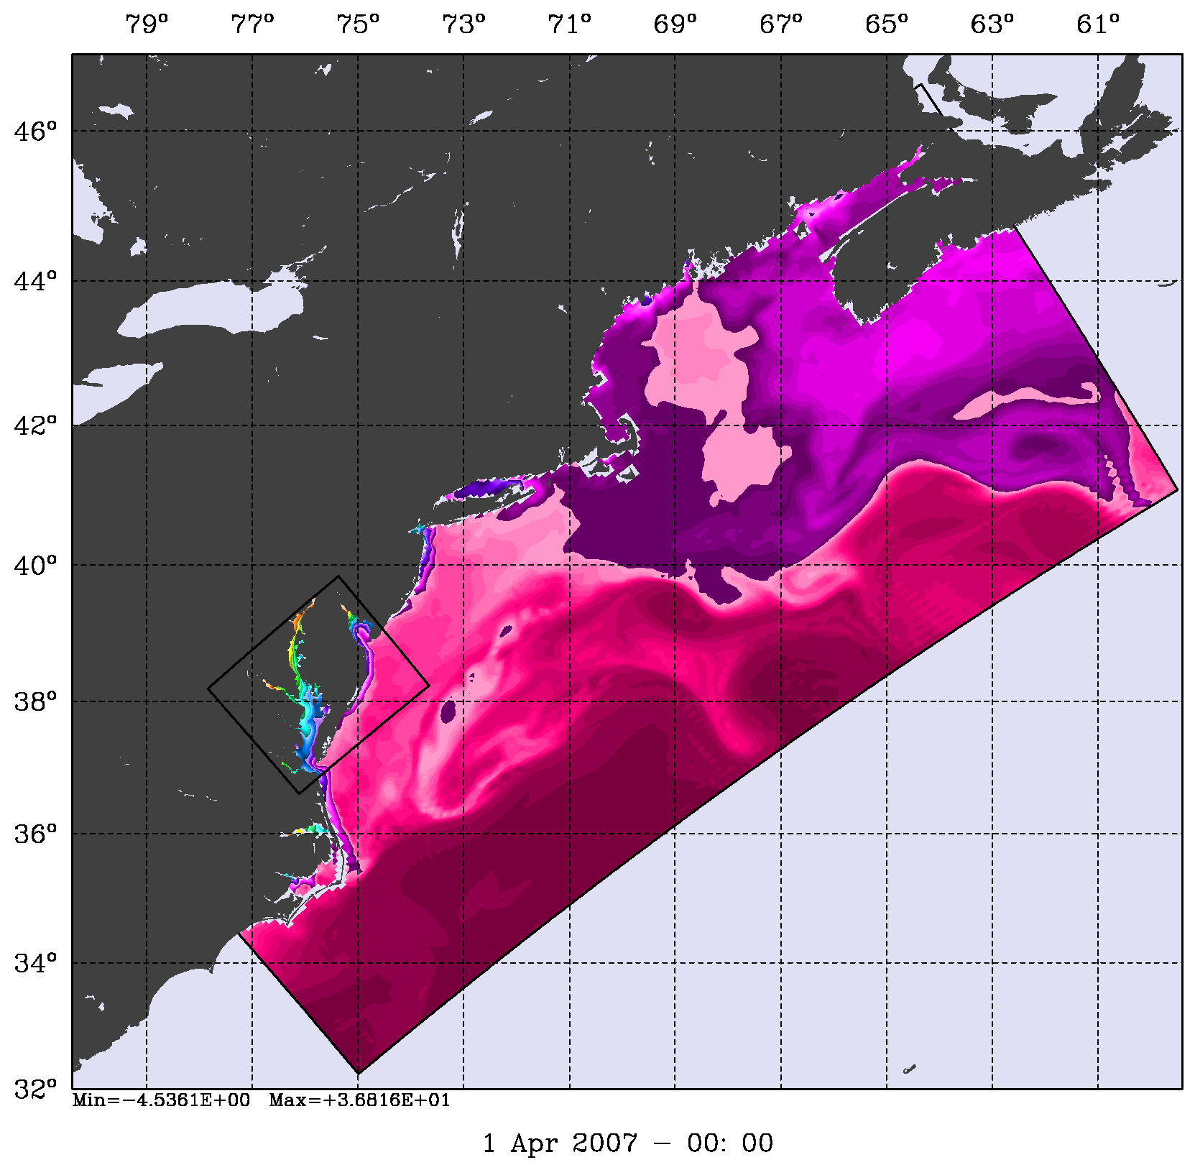
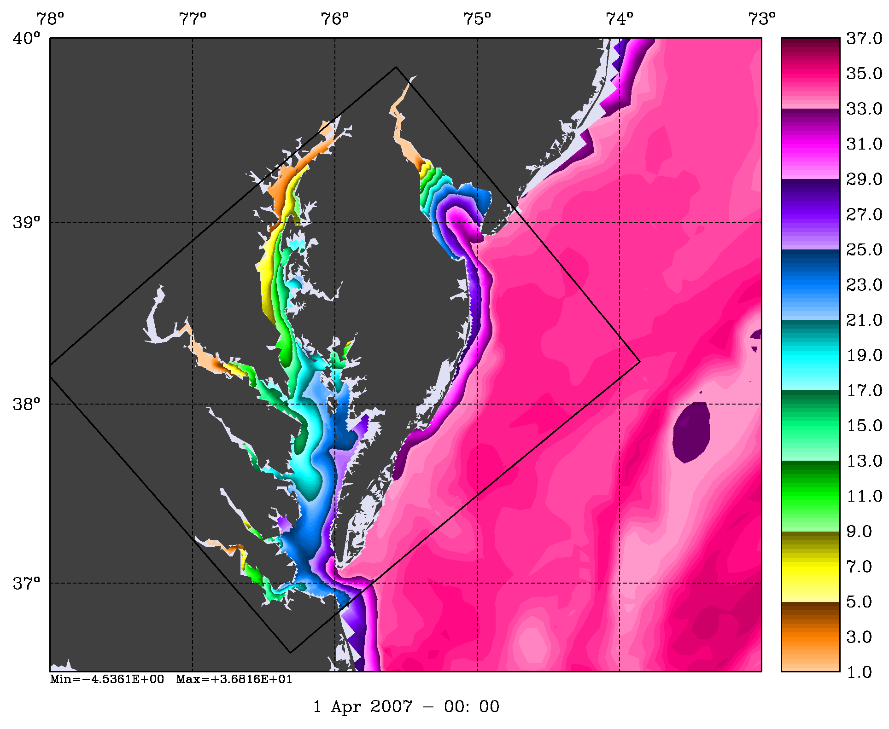
Chesapeake and Delaware Estuaries Grid
Two-Way Nesting
1:5 Refinement
Surface Salinity

Slide 22
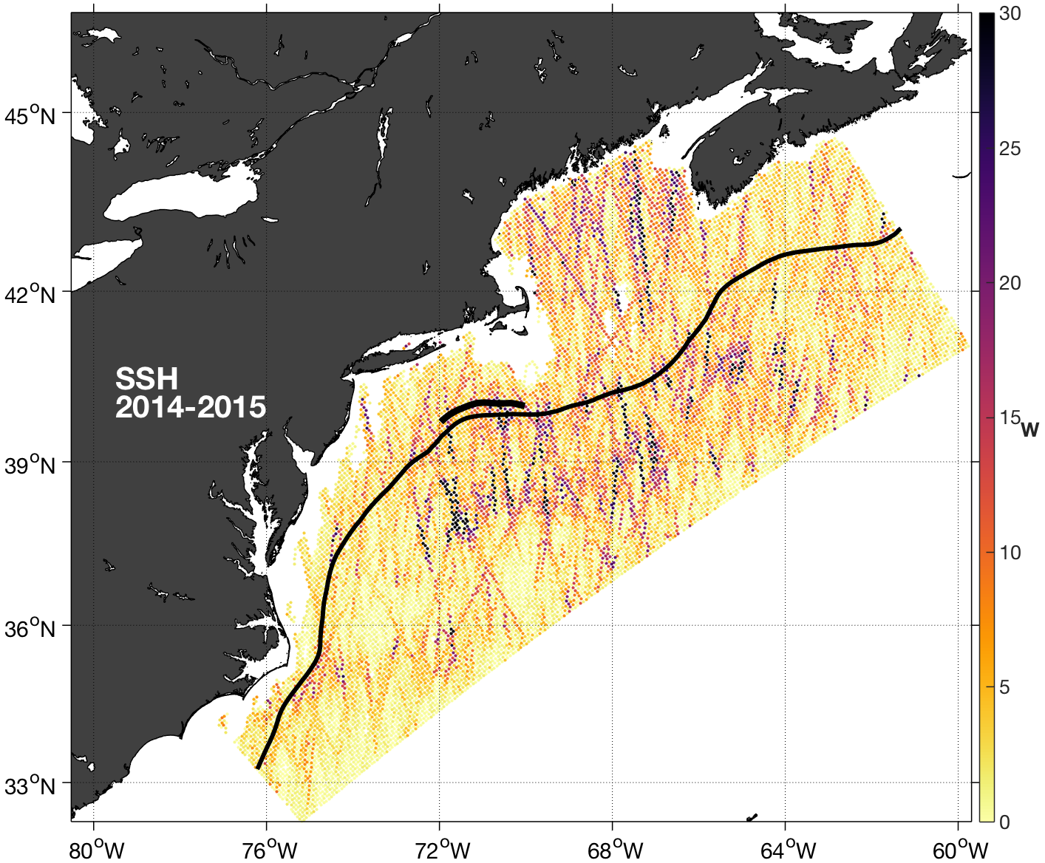
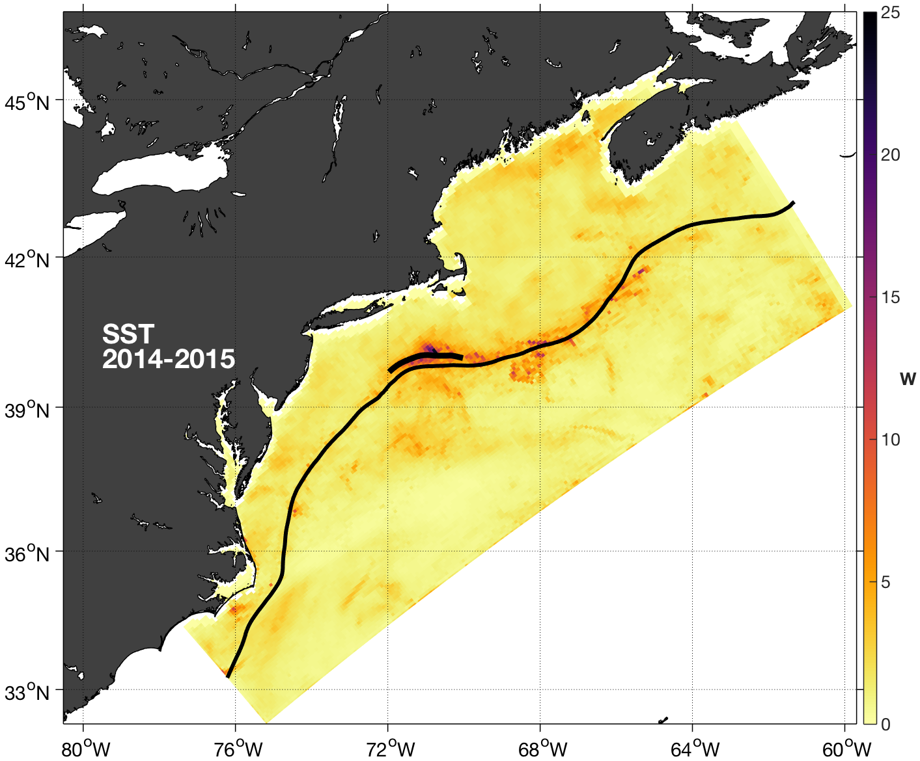
RMS impact per datum on Target cross-shelf
Heat Transport (W) for the Period 2014-2015
The target area is an alongshelf-vertical section following the 200 m isobath and passing through OOI Pioneer Array
Satellite Altimetry
Satellite SST
Jason-2, Altika, CryoSat
AVHRR, GOES, AMSR2
SSH observations on and off the continental shelf are important including Gulf of Maine
SST observations along the shelf-break down stream of the target site are important

Slide 23
Nonaligned Refinement
f
d
c
e
a: Hybrid DOPPIO nest
b: DOPPIO
c: PIONEER
d: ARRAY
e: USECOS
f: LONGISLAND
b
a

Slide 24
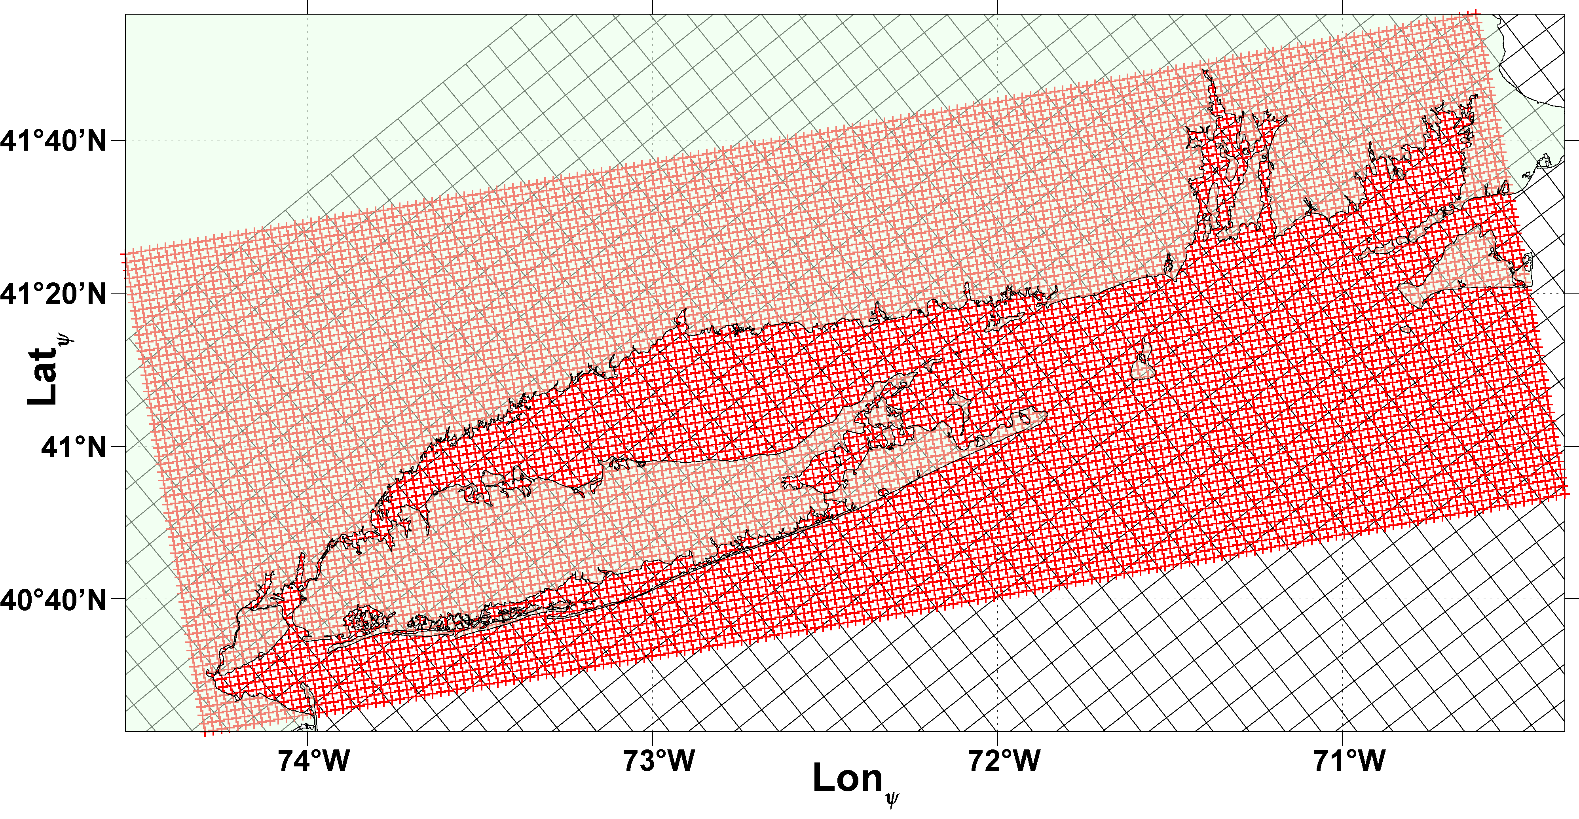
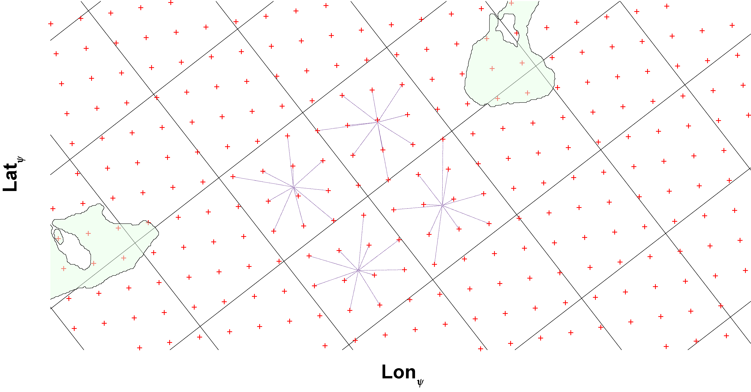
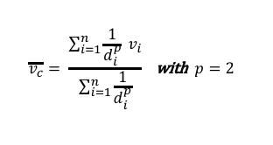
Nonaligned Refinement
Long Island Sound
2x2 km Grid
Two-way fine-to-coarse
exchange: Inverse
Distance Weighting (IDW)
average at center of coarse
grid cell
$$\overline{v_{c}}= \frac{\sum_{i=1}^{n}{\frac{1}{d_{i}^{p}} v_{i}}}{\sum_{i=1}^{n}{\frac{1}{d_{i}^{p}}}} \text{with} p=2$$

Slide 25
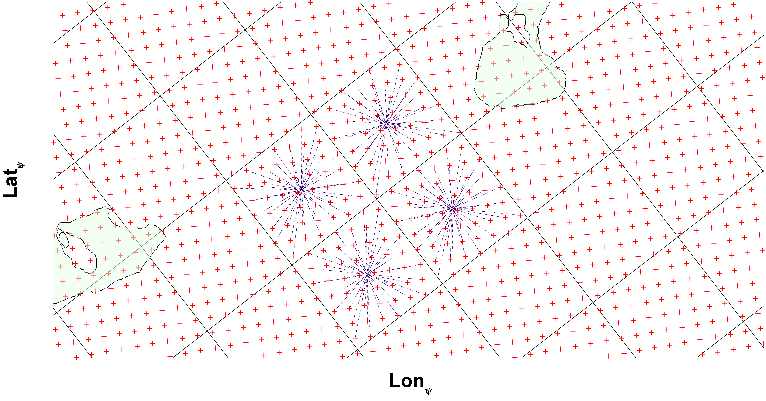
Nonaligned Refinement
Long Island Sound
1x1 km Grid
Two-way fine-to-coarse
exchange: Inverse
Distance Weighting (IDW)
average at center of coarse
grid cell
$$\overline{v_{c}}= \frac{\sum_{i=1}^{n}{\frac{1}{d_{i}^{p}} v_{i}}}{\sum_{i=1}^{n}{\frac{1}{d_{i}^{p}}}} \text{with} p=2$$

Slide 26
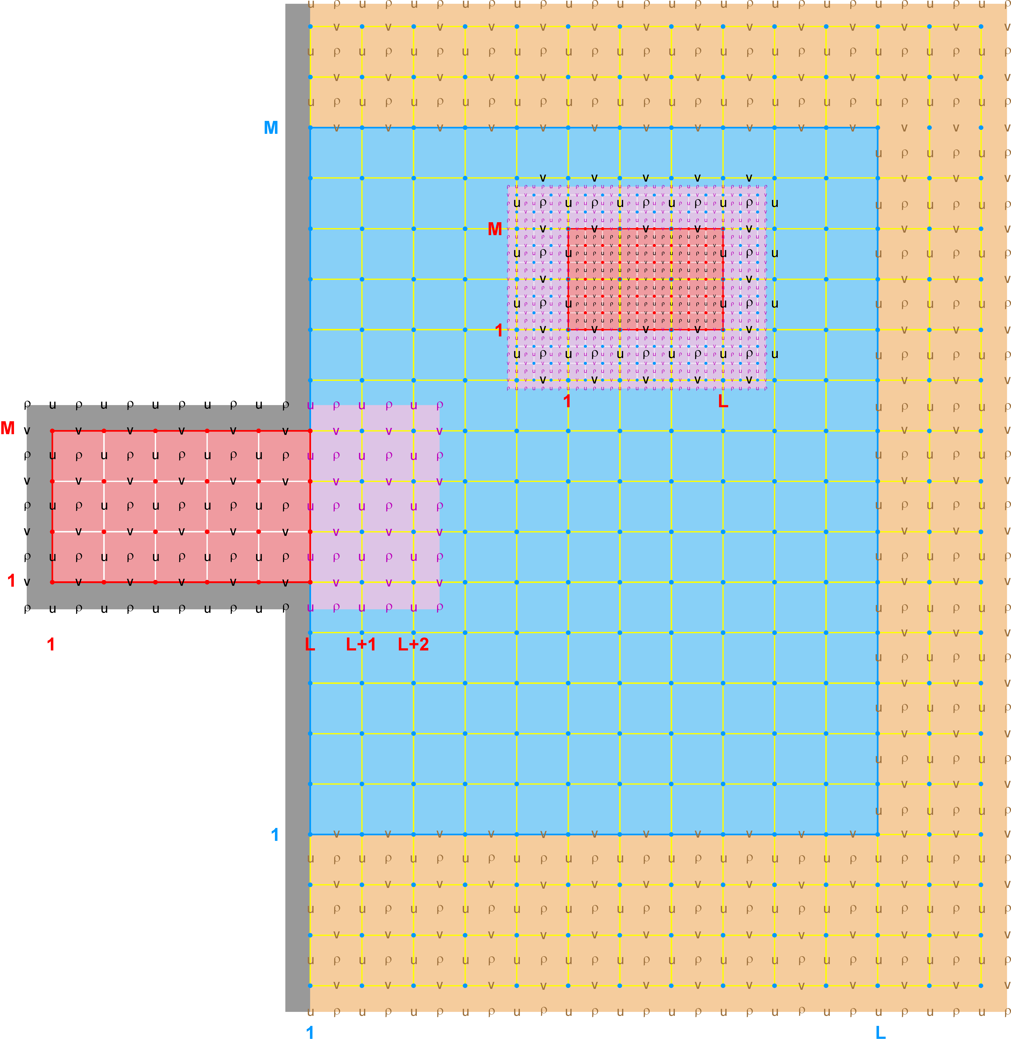
Hybrid, Heterogeneous Model Nesting
(One-Way Open Boundary Conditions)
The nesting strategy in ROMS is to evaluate the spatial horizontal operators (gradients, advection, diffusion) in the contact regions (purple area) yielding the full exchange of information between donor and receiver grids
A new hybrid nesting approach is to exchange information between any basin-scale and ROMS over the hybrid contact region (orange area)
The exchange of information can occur concurrently via ESMF/NUOPC library or independently offline with NetCDF files

Slide 27
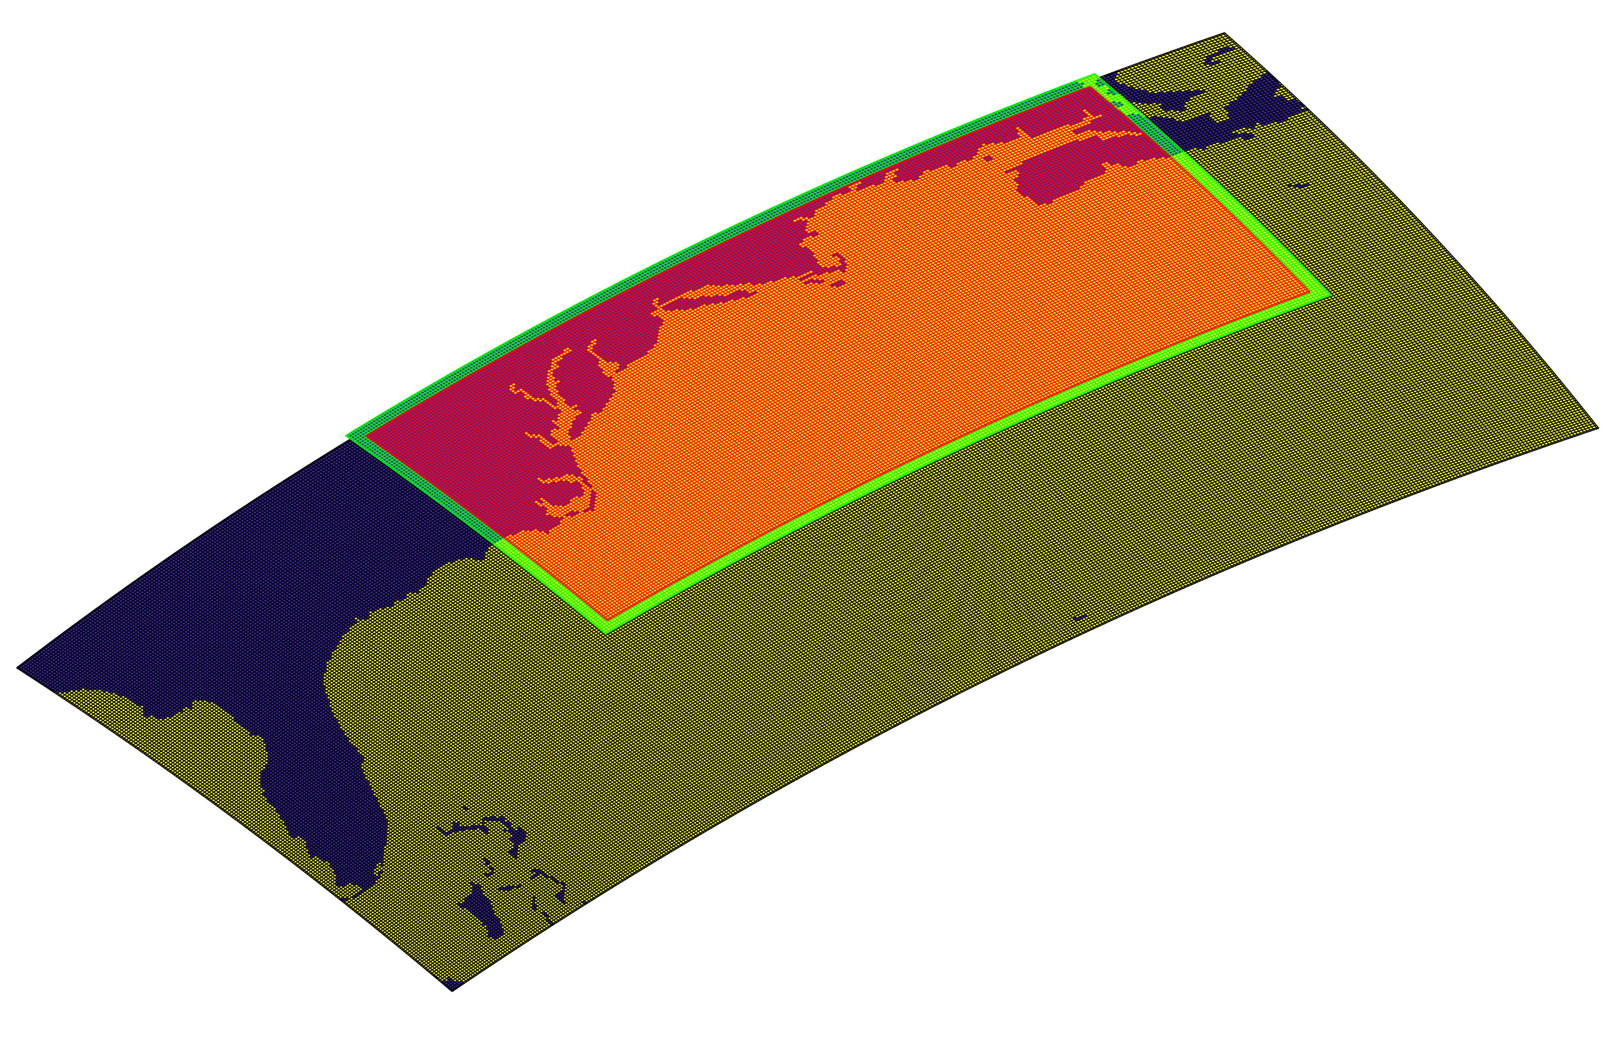
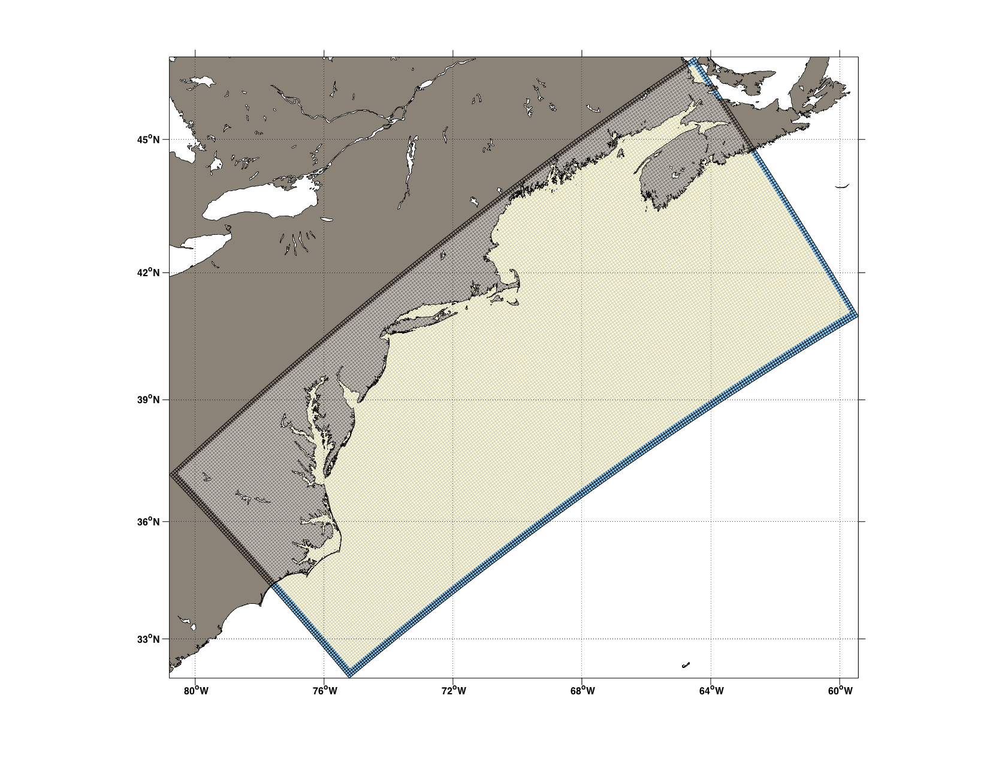
U.S. East Coast: Hybrid Nesting

Slide 28
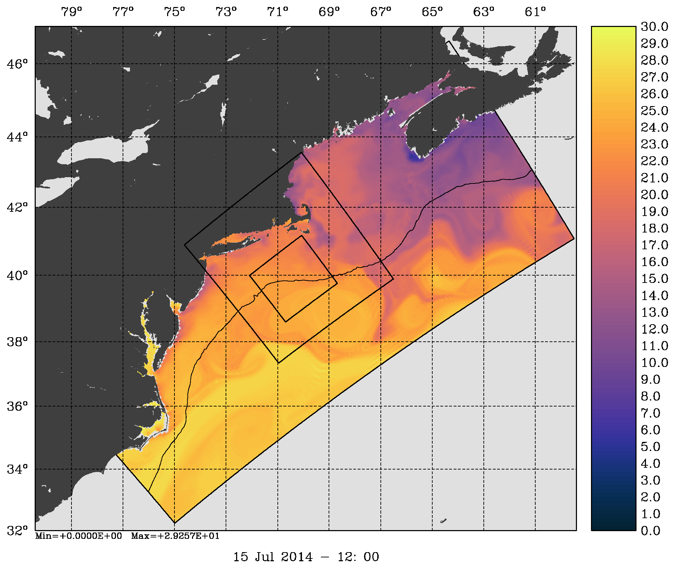



Working on Hybrid Nesting and Nested 4D-Var
Surface Temperature (C)
Surface Salinity
Sea Surface Height (m)
Surface Relative Vorticity (1/s)
Notes:
Nested solutions initialized on 1 Jan 2014. The nested solutions are overlaid in top of the coarser grid. The refinement is 1:3.

Slide 29




Hybrid Nesting Source: Mercator PSY4QV3R1
Surface Temperature (C)
Surface Salinity
Sea Surface Height (m)
Surface Relative Vorticity (1/s)

Slide 30
Nesting Summary
ROMS nesting capabilities are unique and allow complex estuary and coastal configurations with unlimited number of composite and refined grids
Coincident composite and mosaic grids produce identical solutions when compared to one large continuous grid
Both one-way and two-way nesting are possible
Placement of nested grids is application dependent and subject to geometrical and dynamical constrains
Hybrid nesting as open boundary conditions is the way of the future to reduce forecast error
Nonaligned refinement adds flexibility in complex coastal applications. We should no exceed 1:7 ratios in shallowed applications. Recommend to use 1:3 or 1:5 ratios. I finer resolution is needed, use telescoping grids

Slide 31

Future Work: Coupling and Nesting
a: WRF
b: DOPPIO
c: PIONEER
d: ARRAY
e: USECOS

Slide 32

Future Work: Coupling, Nesting, and 4D-Var
Split 4D-PSAS

Slide 33
Thank you!

