Slide 1
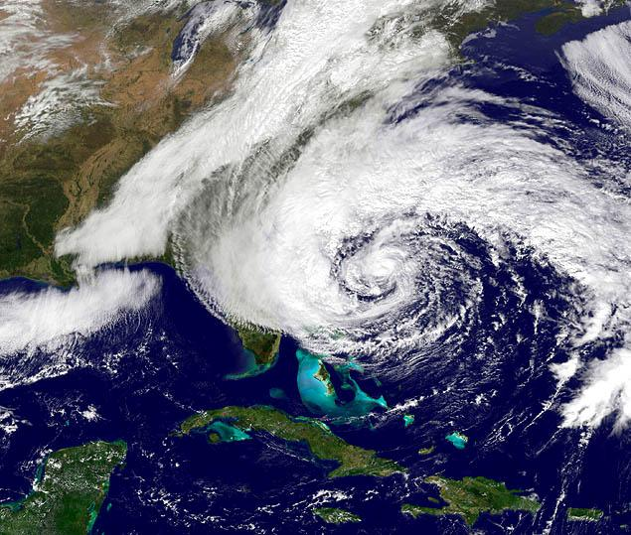
ROMS Application Tutorial
Projects/Sandy- Hurricane Sandy example

Slide 2
Regional Ocean Modeling System
Free surface, hydrostatic ocean model
Finite-difference 3D Reynolds-averaged Navier-Stokes equations
Horizontal orthogonal curvilinear Arakawa C grid
Vertical stretched terrain-following Sigma coordinates
Wide range of advection schemes: (e.g. 3rd-order upstream-biased, 4th-order)
Wide range of open boundary conditions: (e.g. Radiation, clamped, nudged)
CF-compliant NetCDF I/O
Wide range of vertical mixing schemes (k-epsilon, k-omega, MY2.5, KPP, GLS)
Ice model
Biological modules
Model adjoint for data assimilation
Fortran 90; Runs on Unix, Mac, and Windows
Parallel code in MPI and OpenMP

Slide 3
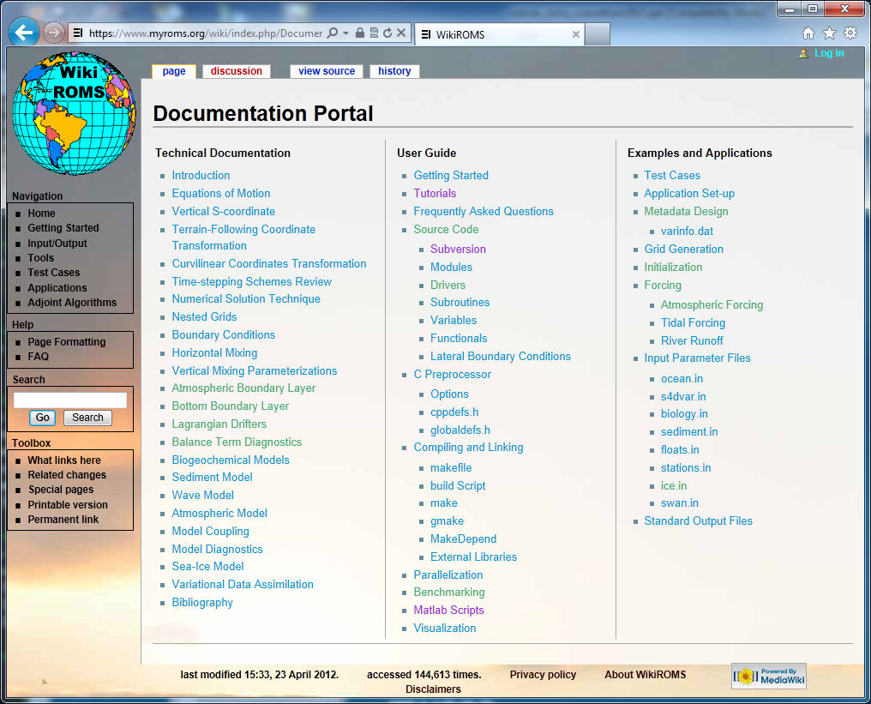
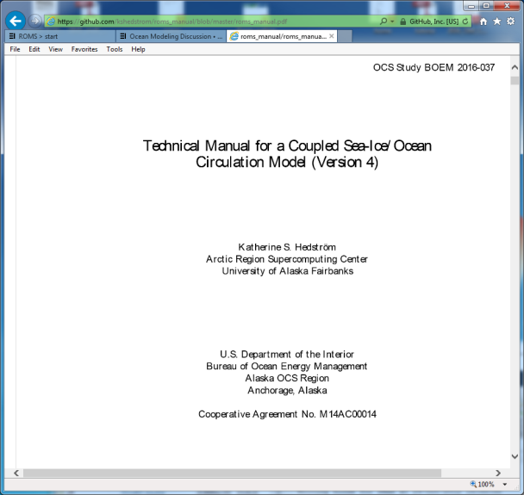
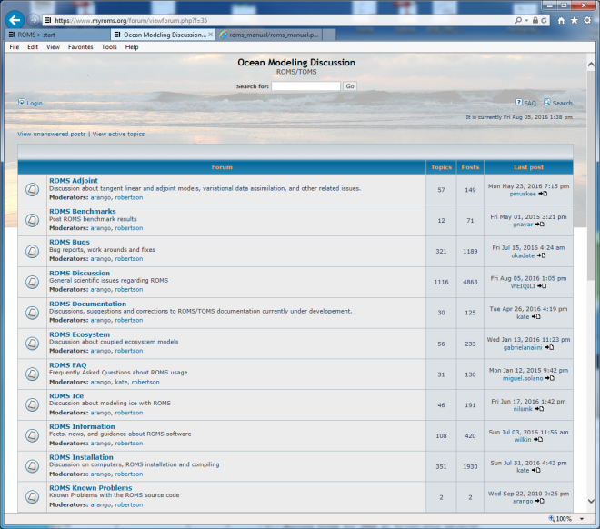
ROMS information
https://github.com/kshedstrom/roms_manual/blob/
master/roms_manual.pdf
https://www.myroms.org/wiki
https://www.myroms.org/forum/index.php

Slide 4
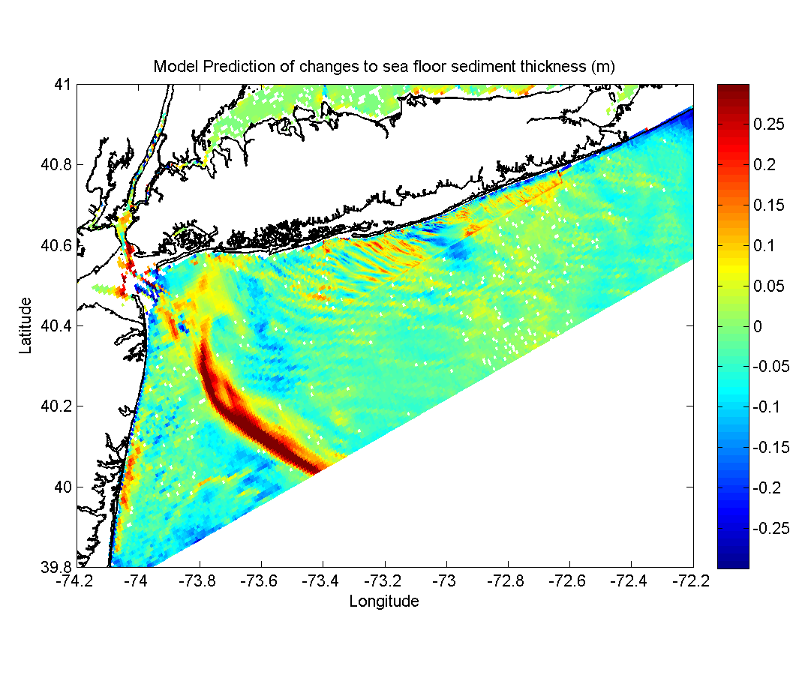
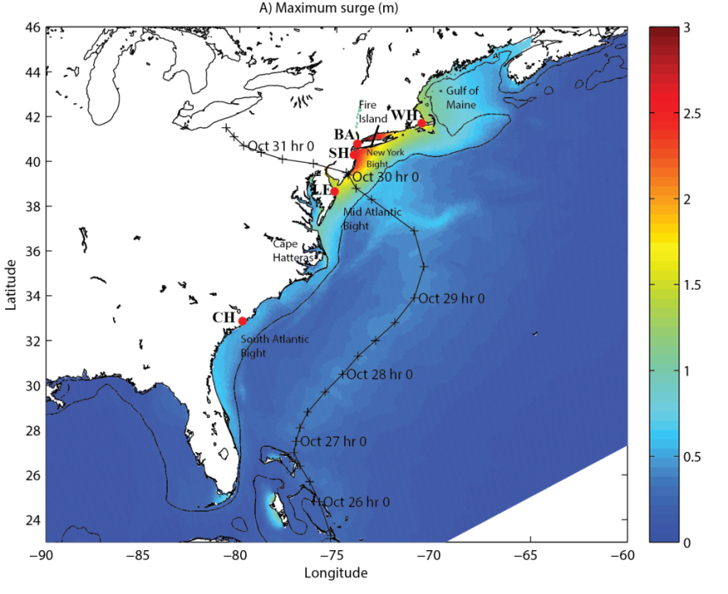
Wide Range of realistic Applications
seafloor bed thickness change (H. Sandy)
Storm surge (H. Sandy)
SST (H. Ivan)

Slide 5
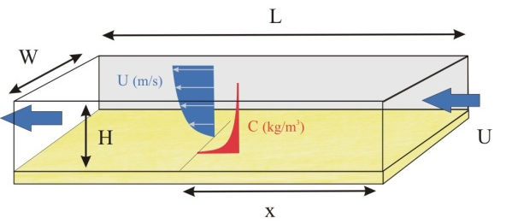
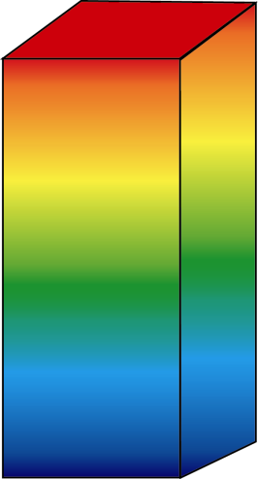
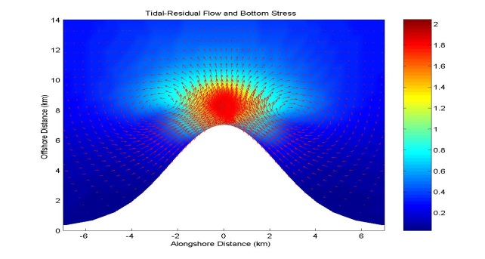
Test Cases
Open channel flow
W
ρ
Wind
3) Mixed layer deepening
L
D_{m}
2) Closed basin,
wind-driven circulation
H
4) Tidal flow around
a headland
5) Estuarine circulation
http://woodshole.er.usgs.gov/project-pages/sediment-transport/

Slide 6
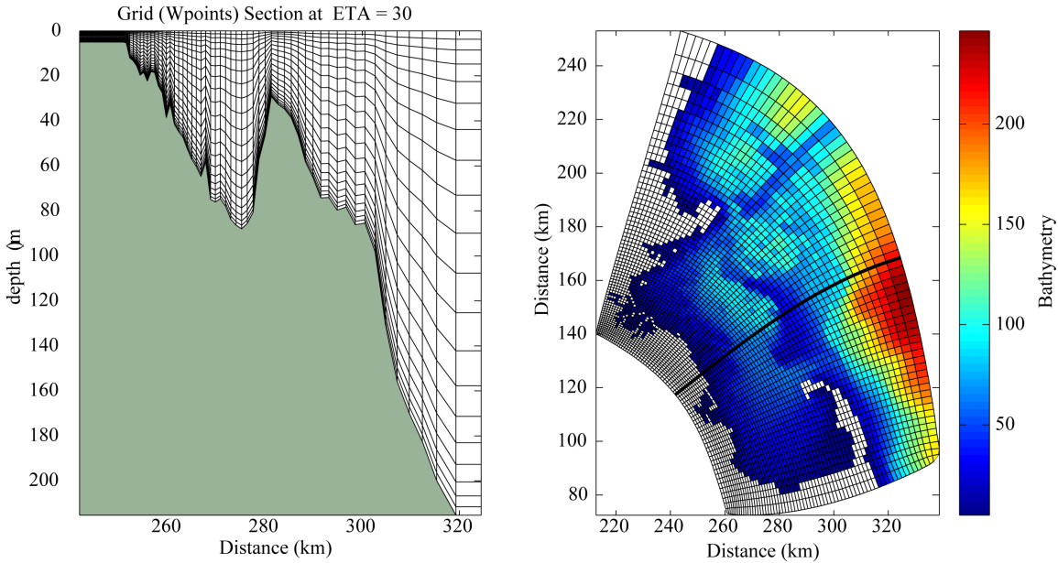
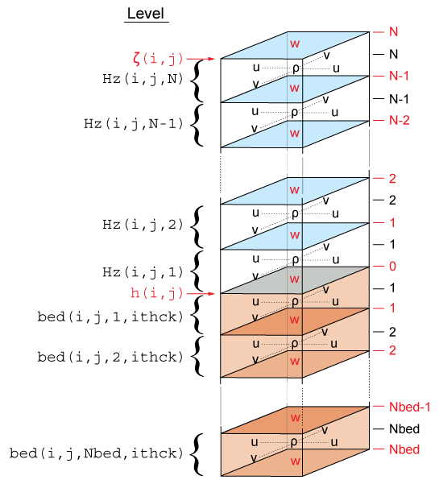
ROMS Grid
- masking
- curvature
- stretching
terrain following coordinates
Horizontal
Arakawa "C" grid
Vertical
eta
xi

Slide 7
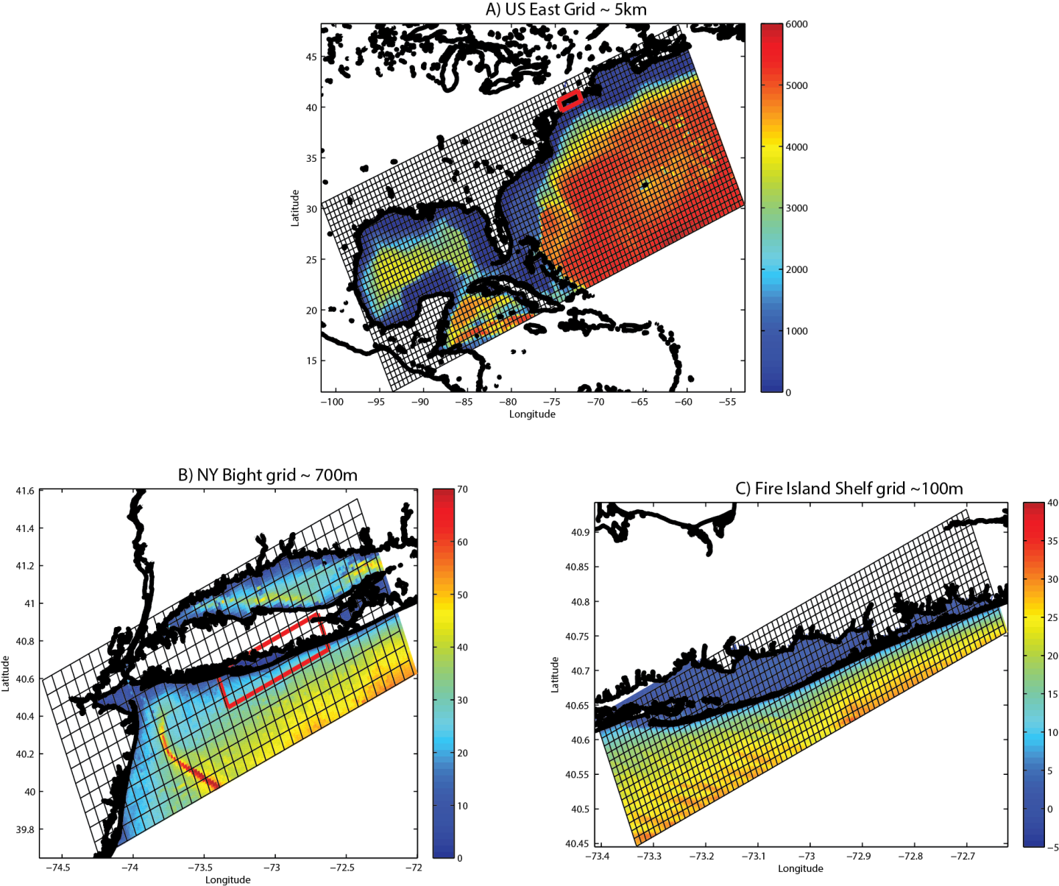
Grid resolution – horizontal static nests
5000 m
For structured grids, use grid refinement to increase resolution.
700 m
100 m
Want to increase resolution in areas of strong gradients
and in areas of changing processes.

Slide 8
Terrain following transformations
(Vtransform + Vstrectching)
Vtransform
1
2
https://www.myroms.org/wiki/index.php/Vertical_S-coordinate

Slide 9
Vstretch (1 of 4)

Slide 10
Vstretch (2 of 4)

Slide 11
Vstretch (3 of 4)

Slide 12
Vstretch (4 of 4)

Slide 13
Equations in Mass Flux form
u, v, $ωs$ = Eulerian Velocity
u^{l}, v^{l}, $ωsl$ = Lagrangian Velocity
u^{st}, v^{st}, $ωsSt$ = Stokes Velocity
f = Coriolis parameter
φ = Dynamic pressure
H_{z} = Grid cell thickness
$ℱ^{η};ℱ^{ξ}$ = Non wave body force
$D^{η};D^{ξ}$ = Momentum mixing terms
$ℱ^{wη};ℱ^{wξ}$ = Non-conservative wave force
Continuity
xi-direction Momentum Balance

Slide 14
eta-Direction Momentum Balance
Description of Terms
ACC = Local Acceleration
HA = Horizontal Advection
VA = Vertical Advection
COR = Coriolis Force
StCOR = Stokes-Coriolis Force
PG = Pressure Gradient
HVF = Horizontal Vortex Force
BF = Body Force
BA+RA+BuSt+SuSt = Breaking Acceleration+ Roller Acceleration+
Bottom Streaming+ Surface Streaming
HM = Horizontal Mixing
VM = Vertical Mixing
Fcurv = Curvilinear terms
Kumar, N., Voulgaris, G., Warner, J.C., and M., Olabarrieta (2012). Implementation of a vortex force formalism in a coupled modeling system for inner-shelf and surf-zone applications. Ocean Modelling, 47, 65-95.

Slide 15
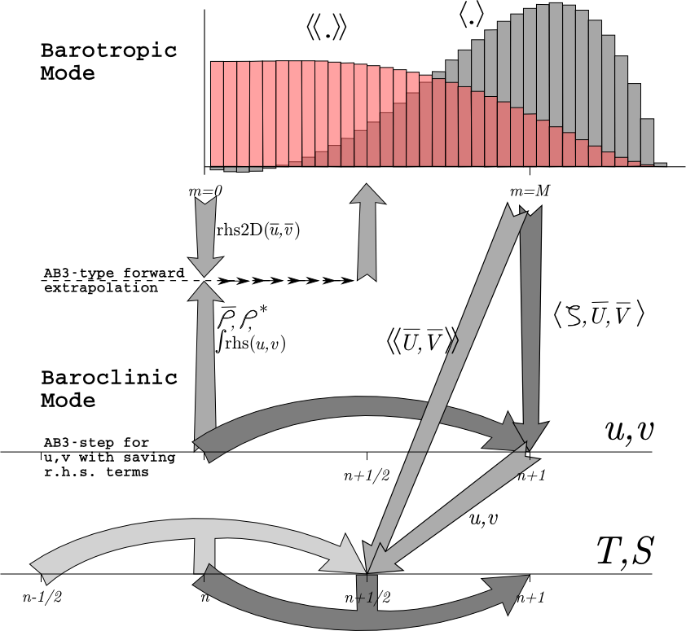
Solution techniques- mode splitting
Shchepetkin, A. F., and J. C. McWilliams, 2008: Computational kernel algorithms for fine-scale, multi-process, long-time oceanic simulations. In: Handbook of Numerical Analysis: Computational Methods for the Ocean and the Atmosphere, eds. R. Temam & J. Tribbia, Elsevier Science, ISBN-10: 0444518932, ISBN-13: 978-0444518934.

Slide 16
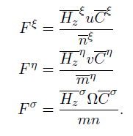
Numerical algorithms
Advection schemes
- 2nd order centered
- 4th order centered
- 4th order Akima
- TSU3 3rd order
- MPDATA
- HSIMT
many choices, see manual for details. ……

Slide 17
How do we select different schemes
c pre-processor definitions (list them in your project *.h “header” file)
during compilation, .F → .f90s
compiles f90's into objects
compiles objects to libs
ar the libs to make 1 exe
for coupling, it makes wrf, roms, and swan as libs, then pull them together for coupling and only produces one exe → coawstM [.exe]

Slide 18
Build errors
During the build, the error “can not make wrf.exe” or ‘undefined reference to MAIN” is ok.
libdev/frtl/src/libfor/for_main.c:(.text+0x2a): undefined reference to `MAIN__'
make[2]: [em_wrf] Error 1 (ignored)
This “Error” is ok.
If you get other errors, do this:
scrip build.txt
./coawst.bash
exit
and that will create a file build.txt
Edit that file and search for the word “error”

Slide 19
COAWST specific cpp options
You need to use at least 1 model of the 3:
#define ROMS_MODEL if you want to use the ROMS model
#define SWAN_MODEL if you want to use the SWAN model
#define WRF_MODEL if you want to use the WRF model
#define MCT_LIB if you have more than one model selected
Use these 3 INTERP calls if the models are on different grids.
#define MCT_INTERP_WV2AT allows grid interpolation between the wave and
atmosphere models
#define MCT_INTERP_OC2AT allows grid interpolation between the ocean and
atmosphere models
#define MCT_INTERP_OC2WV allows grid interpolation between the ocean and
wave models
#define NESTING allows grid refinement in roms or in swan
For now, I suggest if you couple ROMS+SWAN and
use NESTING, then use the same grids for R+S.

Slide 20
COAWST specific cpp options
If you activate ROMS + WRF, then pick one of these:
#define ATM2OCN_FLUXES provide consistent fluxes between atm and ocn.
WRF send USTRESS,VSTRESS, LH, HFX, GSW, GLW
--- OR --- If you don’t use this, then
#define BULK_FLUXES this will send Uwind, Vwind, Patm, RH, Tair,
cloud, GSW, GLW
Related:
#define EMINUSP send EVAP and RAIN from WRF to ROMS
#define CLOUDS send cloud fraction from WRF to ROMS
#define ATM_PRESS send MSLP (Patm) from WRF to ROMS
These 3 options use SWAN wave data for computation of ocean surface stress in ROMS bulk_fluxes and in WRF myjsfc and mynn surface layer schemes :
#define COARE_TAYLOR_YELLAND wave enhanced roughness (swan to roms or wrf)
#define COARE_OOST wave enhanced roughness (swan to roms or wrf)
#define DRENNAN wave enhanced roughness (swan to roms or wrf)
#define DRAGLIM_DAVIS feature added to WRF and SWAN to limit the ocean
roughness drag to be a maximum of 2.85E-3

Slide 21
COAWST specific cpp options
If you couple ROMS + WRF then you can select this for testing:
#define SST_CONST do not allow SST from ROMS to affect WRF
Wave Options
#define UV_CONST send vel = 0 from the ocn to wave model
#define ZETA_CONST send zeta = 0 from the ocn to wave model
#define UV_KIRBY compute "depth-avg" current based on Hwave to
be sent from the ocn to the wav model for coupling
#define WEC_MELLOR radiation stress terms from Mellor 08
#define WEC_VF wave-current stresses from Uchiyama et al.
#define WDISS_THORGUZA wave dissipation from Thorton/Guza
#define WDISS_CHURTHOR wave dissipation from Church/Thorton
#define WDISS_WAVEMOD wave dissipation from a wave model
#define WDISS_INWAVE wave dissipation from a InWave model
#define ROLLER_SVENDSEN wave roller based on Svendsen
#define ROLLER_MONO wave roller for monochromatic waves
#define ROLLER_RENIERS wave roller based on Reniers
#define BOTTOM_STREAMING wave enhanced bottom streaming
#define SURFACE_STREAMING wave enhanced surface streaming

Slide 22
COAWST specific cpp options
Wave Options
#define CHARNOK Charnok surface roughness from wind stress
#define CRAIG_BANNER Craig and Banner wave breaking surface flux
--- or ---
#define ZOS_HSIG surface roughness from wave amplitude
#define TKE_WAVEDISS wave breaking surface flux from wave amplitude
Vegetation Options
# define VEGETATION Activate vegetation module
# define VEG_DRAG Drag terms Luhar M. et.al (2011)
# define VEG_FLEX Flexible vegetation terms
# define VEG_TURB Turbulence terms, Uittenbogaard R. (2003)
# define VEG_SWAN_COUPLING Exchange of VEG data btwn. ROMS and SWAN
# define VEG_STREAMING Wave streaming effects
# define MARSH_WAVE_THRUST Wave thrust on marshes, Tonelli, M. et al. (2010)
Tracer Advection Option
# define TS_HSIMT Positive definite tracer advection (Wu and Zhu, OM 2010)
+ ROMS Specific CPP options …..

Slide 23
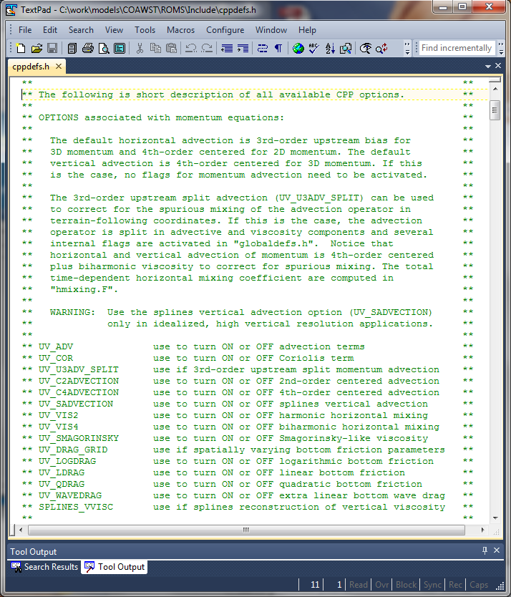
ROMS/Include/cppdefs.h
See cppdefs for a complete list of ROMS options
This list goes on for many many more pages …..

Slide 25
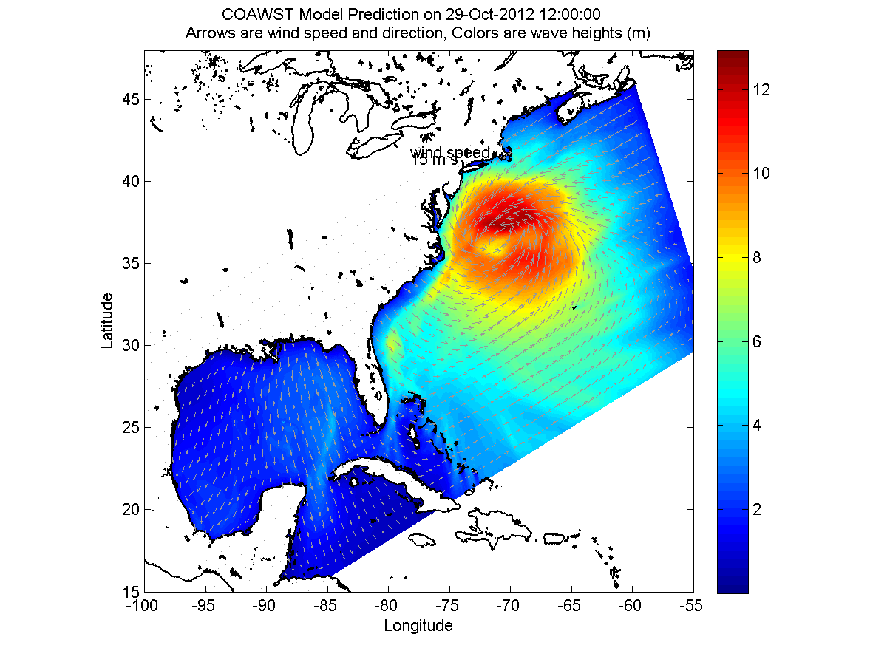
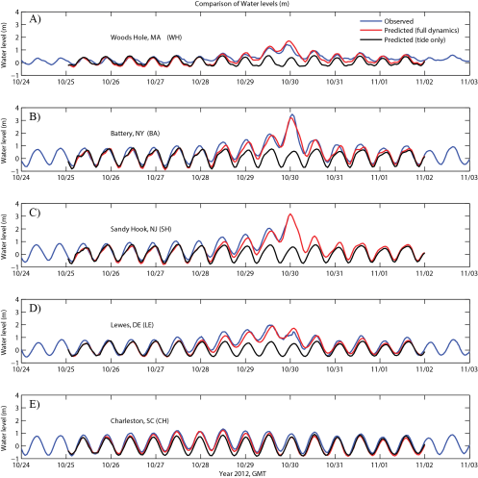
Projects/Sandy Application

Slide 26
Steps to create ROMS application
1) parent grid
2) masking
3) bathymetry
4) child grid
5) 3D: BC's (u,v,temp,salt), init, and climatology
6) 2D: BC's (ubar, vbar, zeta) = tides
7) Surface forcing (heat and momentum fluxes)
8) ROMS input files: sandy.h and ocean_sandy.in
9) Build and run: coawst.bash
10) Output
These steps will follow the User Manual Section 9

Slide 27
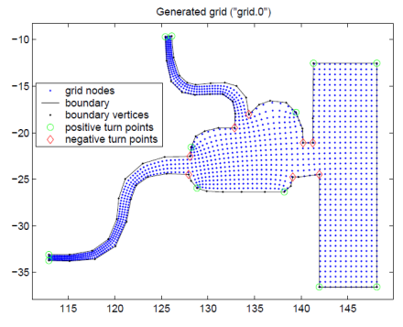
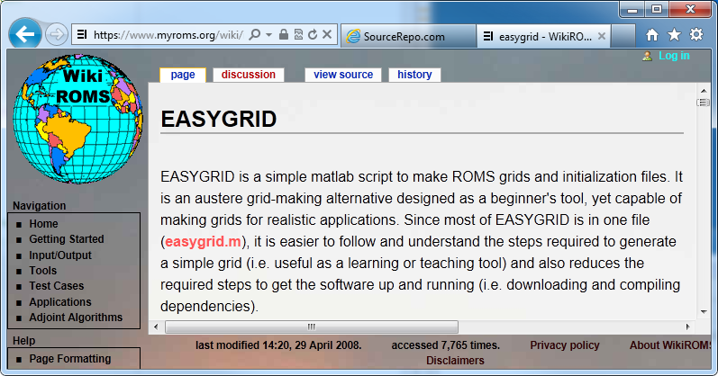
1) Grid generation tools
Seagrid - matlab
http://woodshole.er.usgs.gov/operations/
modeling/seagrid/
(needs unsupported
netcdf interface)
gridgen - command line
http://code.google.com/p/gridgen-c/
EASYGRID

Slide 28
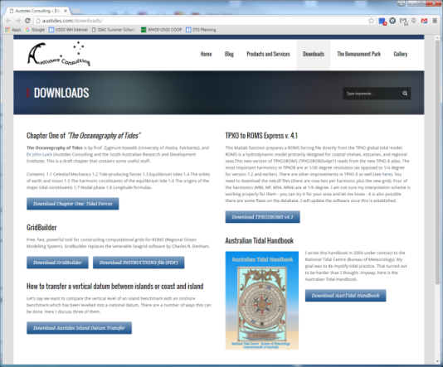
1) Grid generation tools
Austides - Gridbuilder
http://austides.com/downloads/
COAWST/Tools/mfiles/mtools/wrf2roms _mw.m
function wrf2roms_mw(theWRFFile, theROMSFile)
Generates a ROMS grid from a WRF grid.
COAWST/Tools/mfiles/mtools/create_roms_xygrid.m
intended for simple rectilinear grids
or any other method that you know

Slide 29
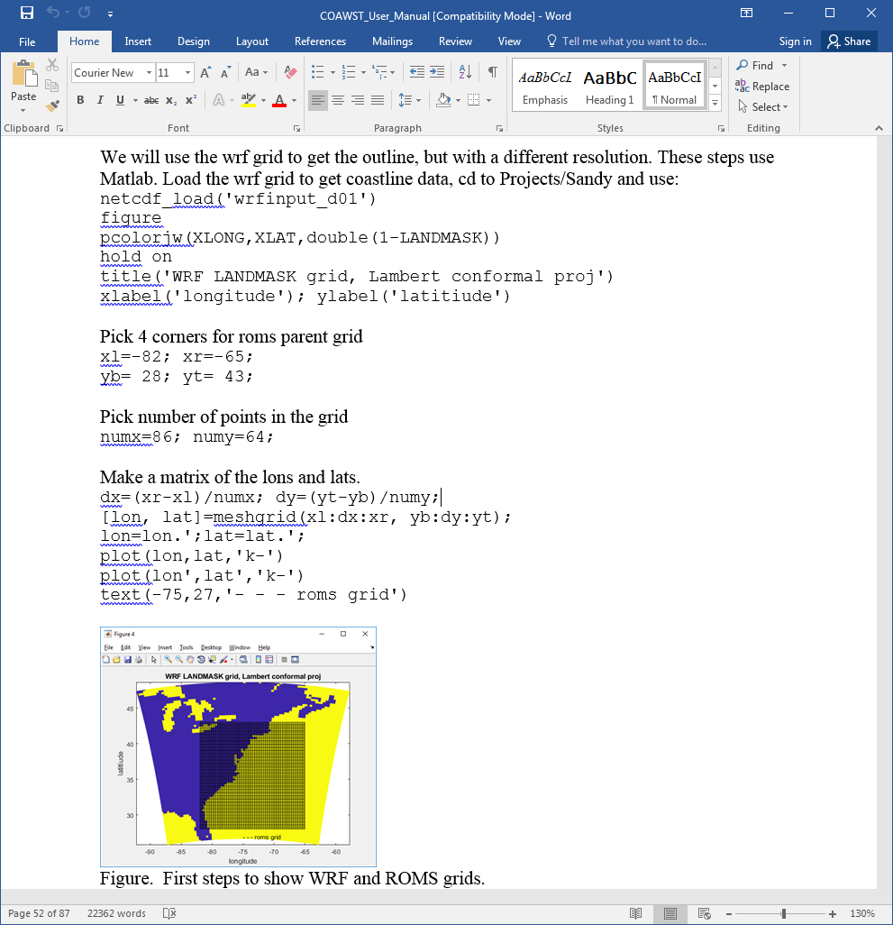
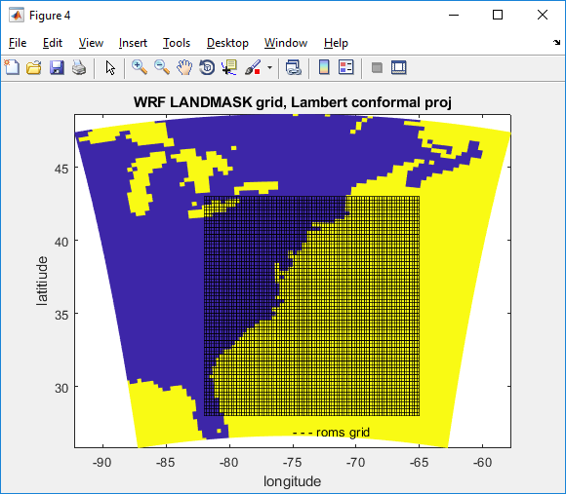
1) Grid generation tools – matlab
select 4 corners

Slide 30
1) Grid generation tools
This step creates a roms grid file called ‘Sandy_roms_grid.nc’

Slide 31
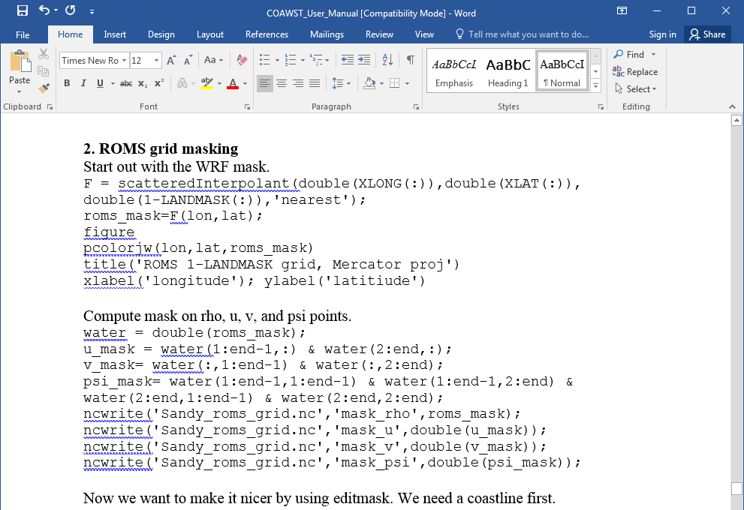
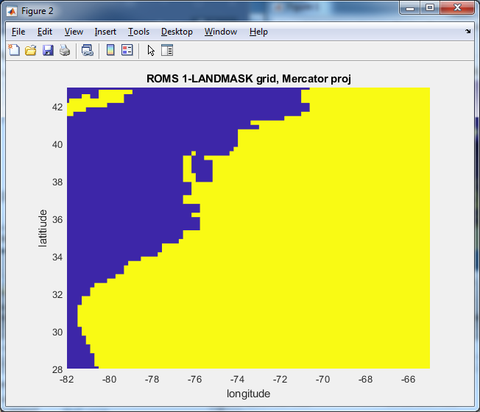
2) masking – first base it on WRF

Slide 32
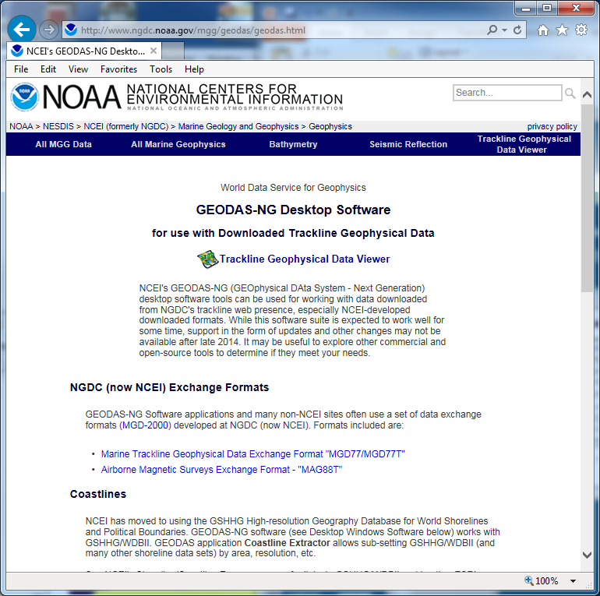
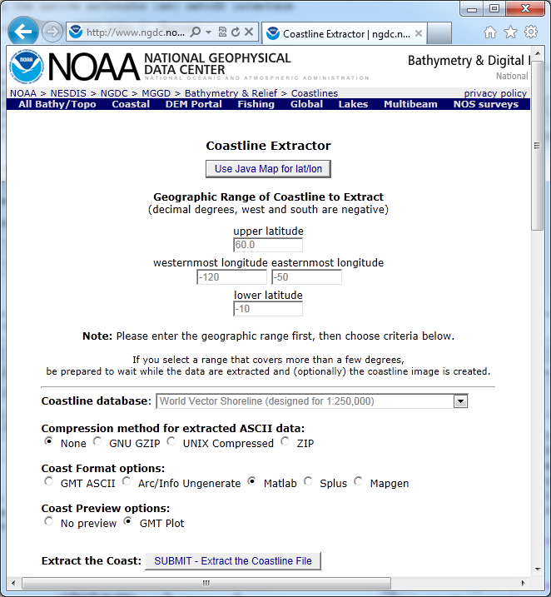
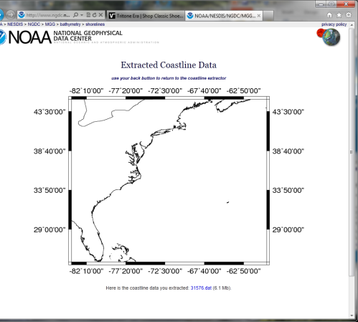
2) Masking – get coastline
May also need a coastline, can obtain this here:
http://www.ngdc.noaa.gov/mgg/coast/
45
-84
-60
25
No longer active.
http://www.ngdc.noaa.gov/mgg/geodas/geodas.html
lon=coastline(:,1);
lat=coastline(:,2);
save coastline.mat lon lat

Slide 33
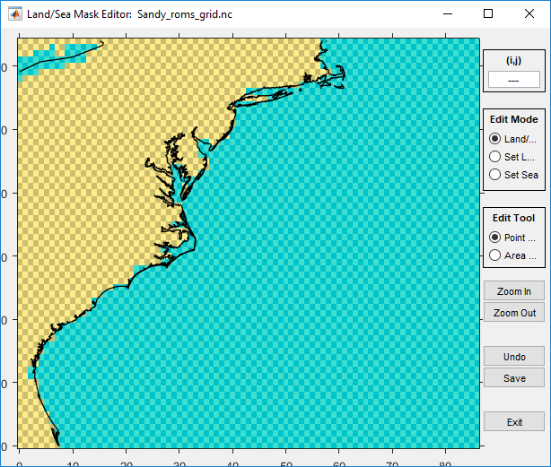
2) Masking
use COAWST/Tools/mfiles/rutgers/landmask/editmask m file
editmask(‘Sandy_roms_grid.nc','coastline.mat')

Slide 34
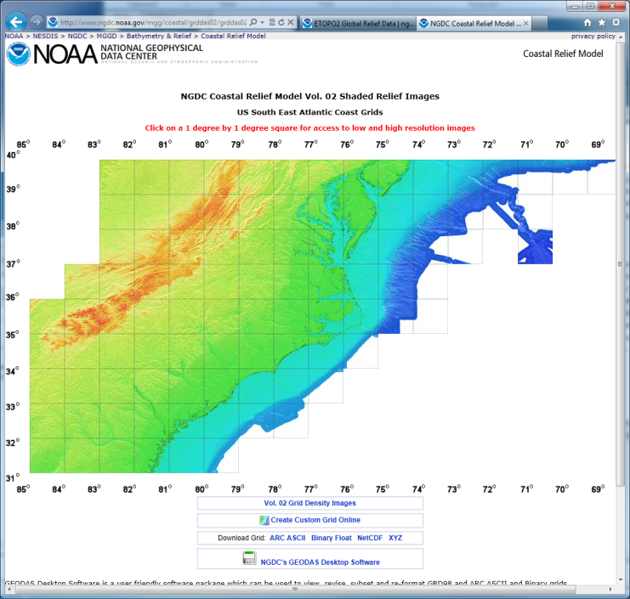
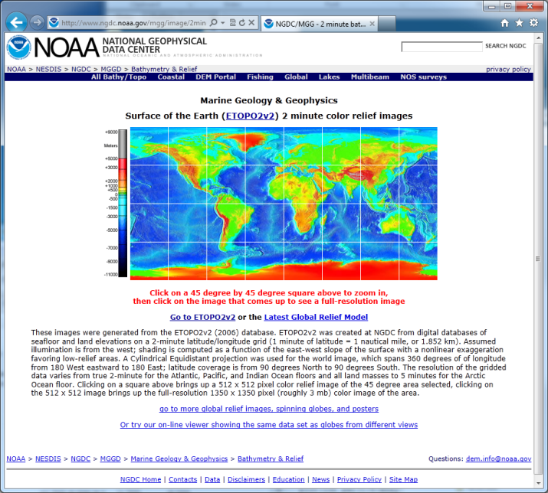
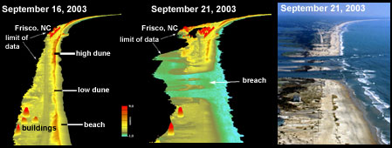
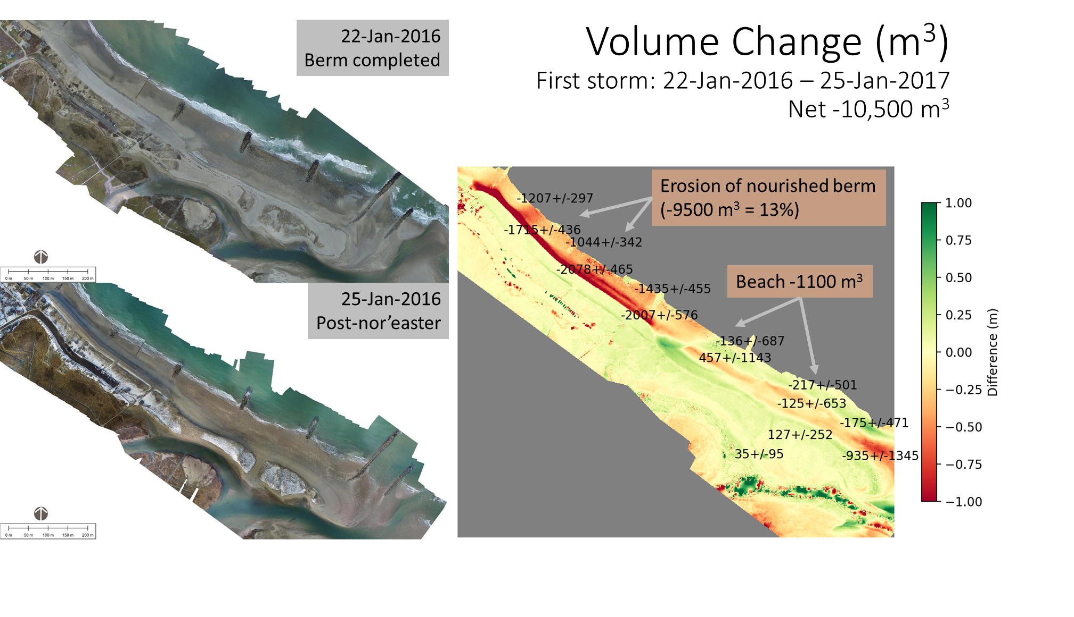
3) bathymetry
many sources
ETOPO2
Coastal Relief Model
LIDAR
SFM structure from motion

Slide 35
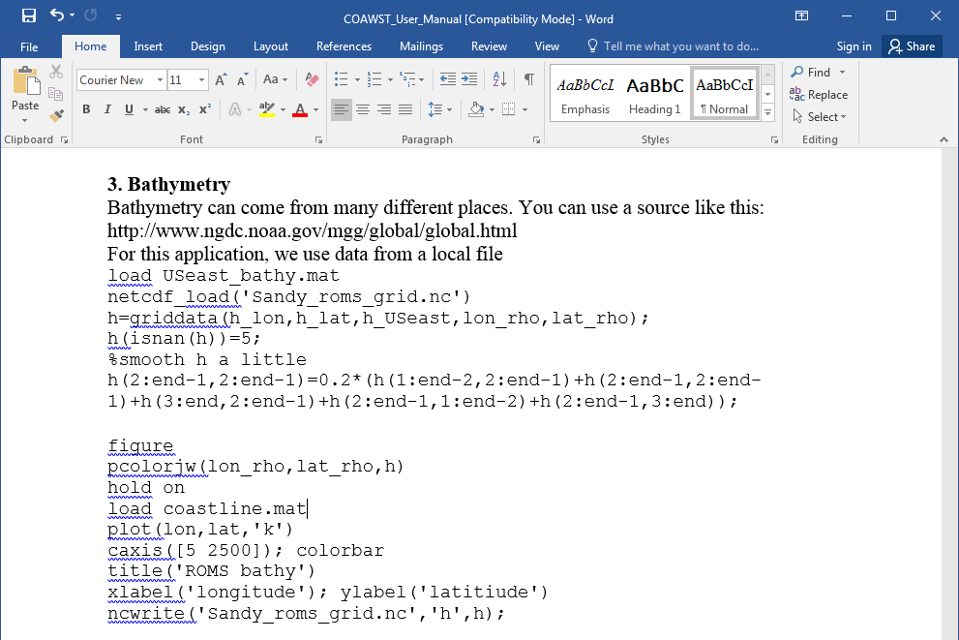
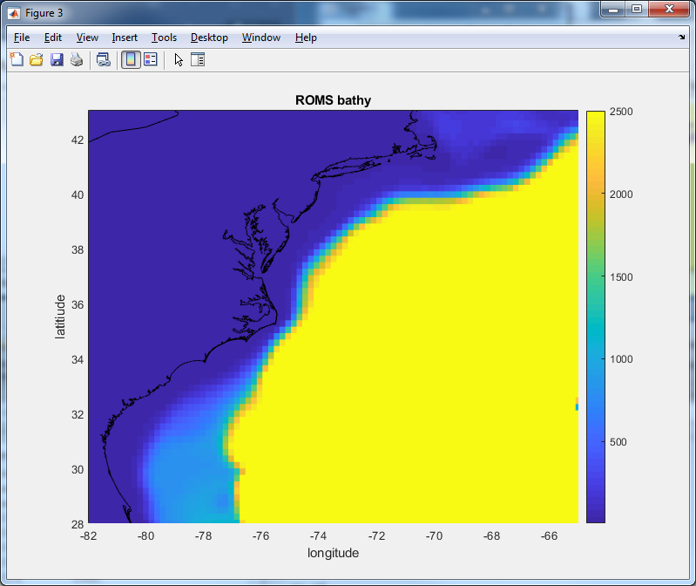
3) bathymetry

Slide 36
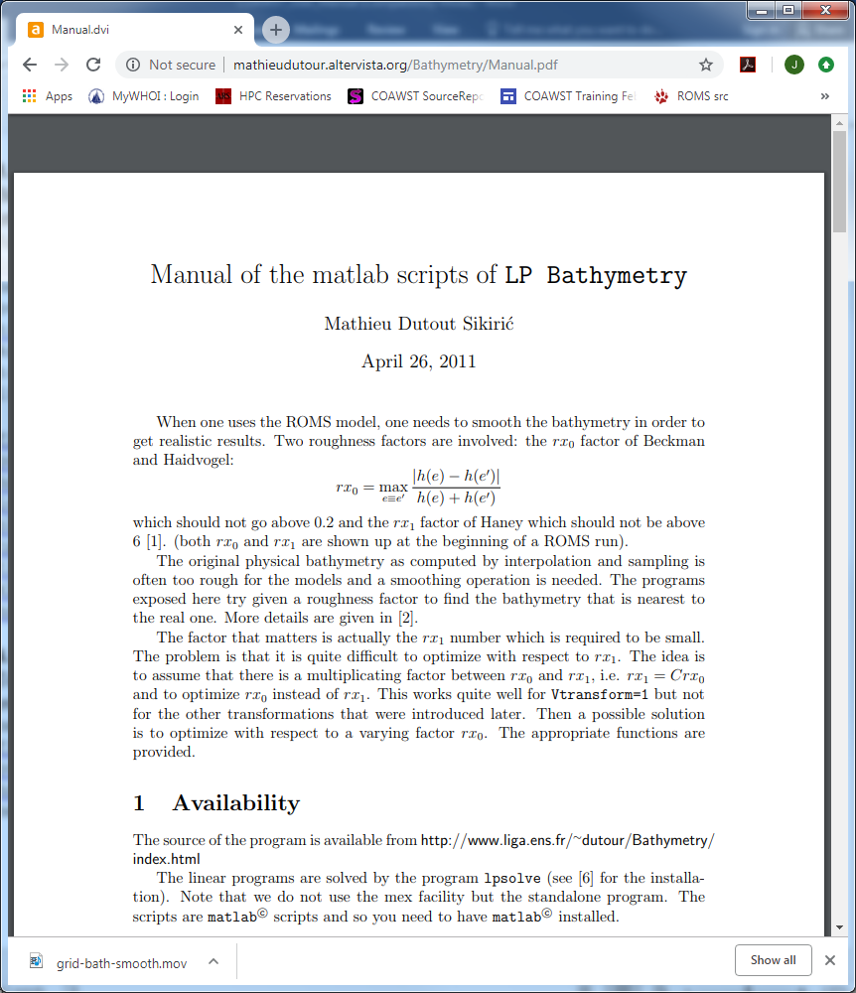
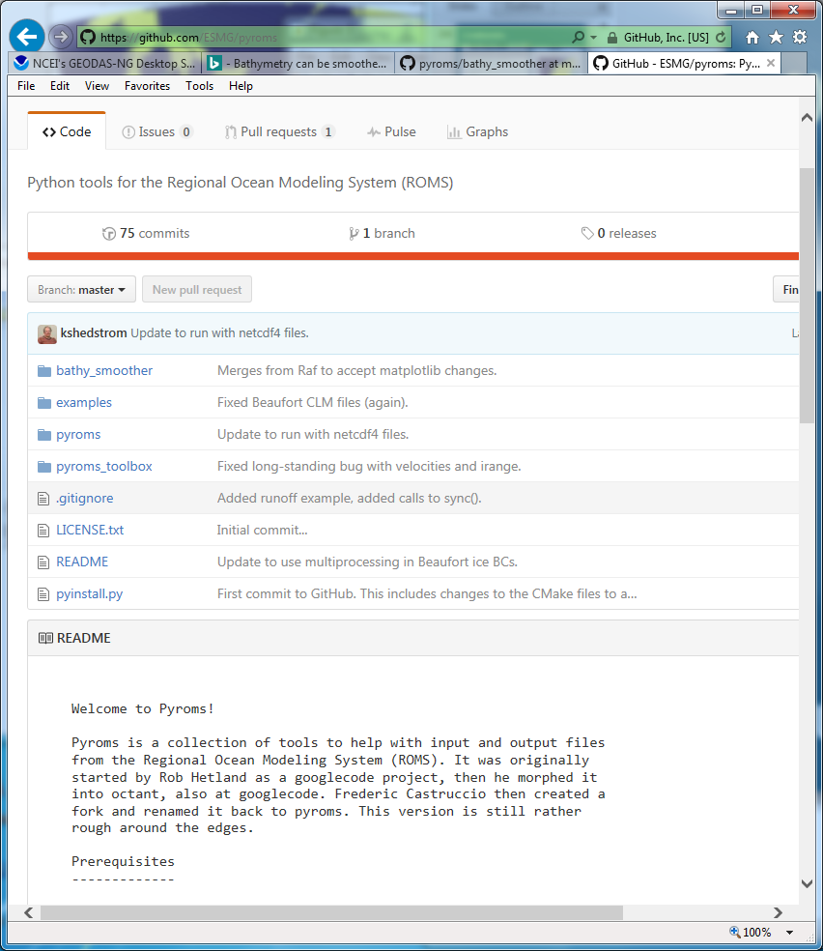
3) bathymetry
Bathy smoothing:
https://github.com/ESMG/pyroms
LP Bathy

Slide 37
Grid Parameters
Beckman & Haidvogel number (1993)
Haney number (1991)
should be < 0.2 but can be fine up to ~ 0.4
determined only by smoothing
should be < 9 but can be fine up to ~ 16 in some cases
determined by smoothing AND vertical coordinate functions
If these numbers are too large, you will get large pressure gradient errors and Courant number violations and the model will typically blow up right away

Slide 38
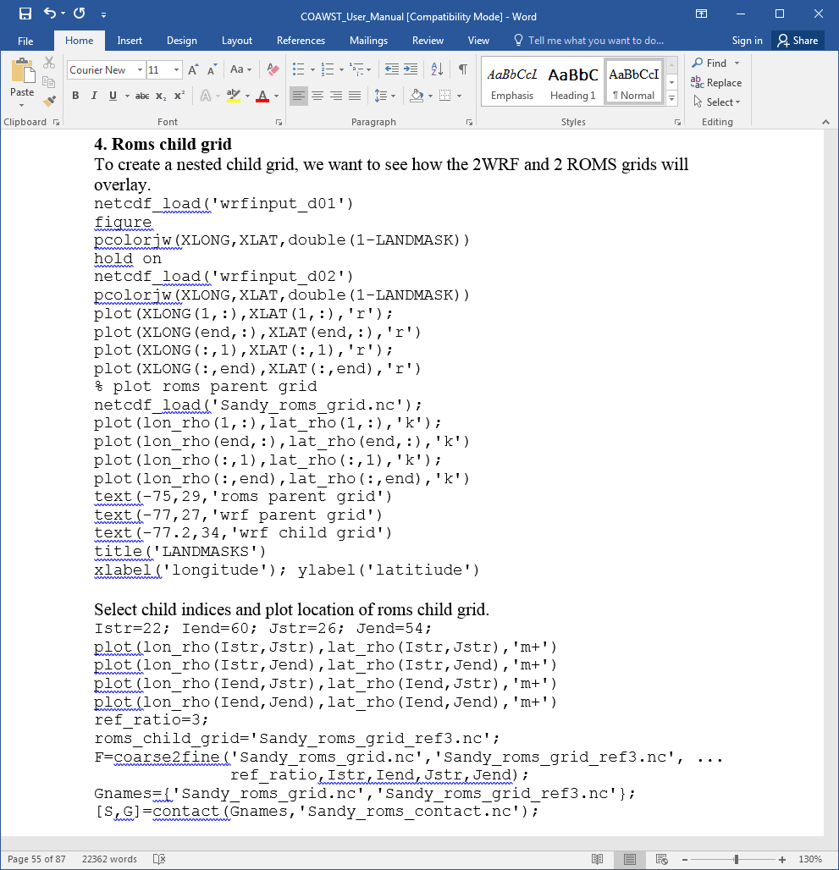
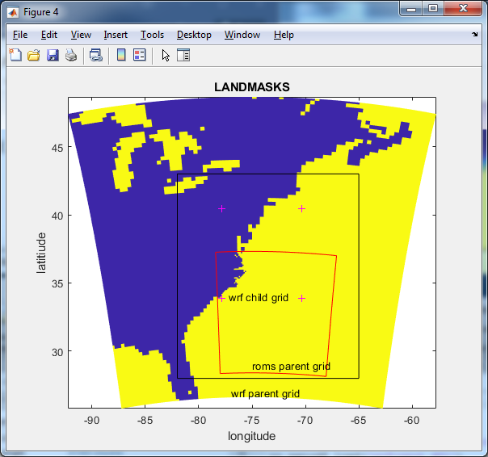
4) Child grid

Slide 39
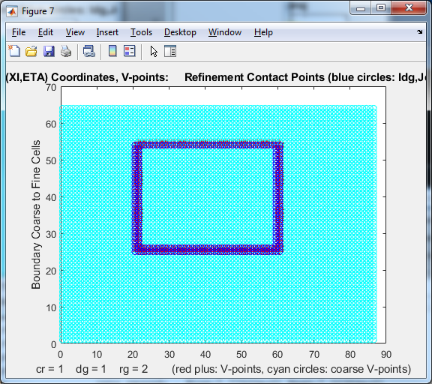
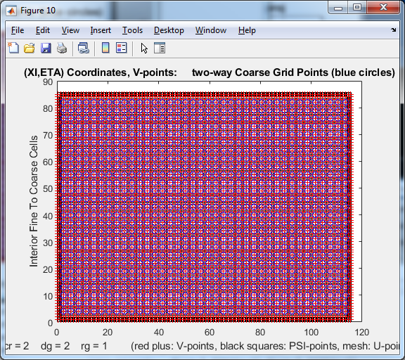
4) Child grid

Slide 40
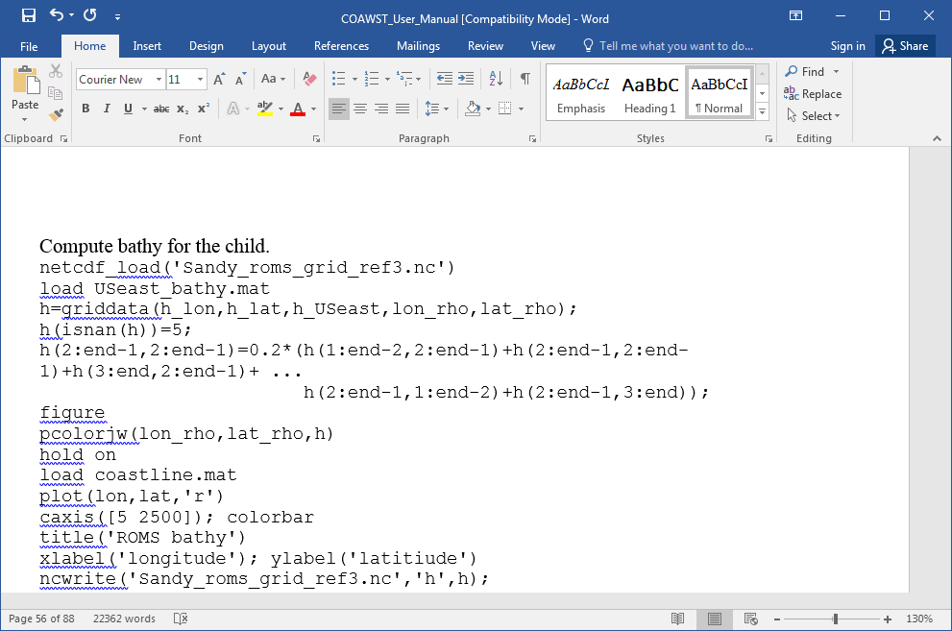
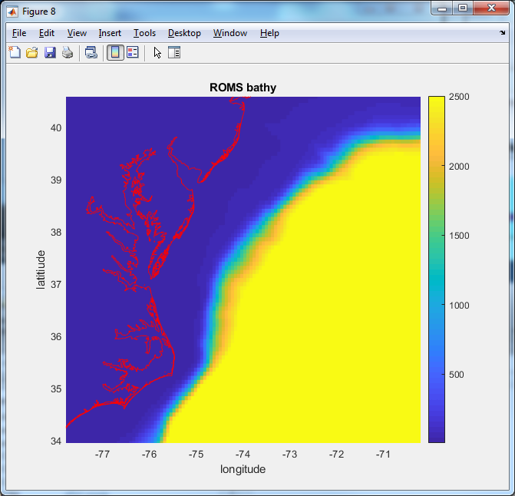
4) Child grid- bathy

Slide 41
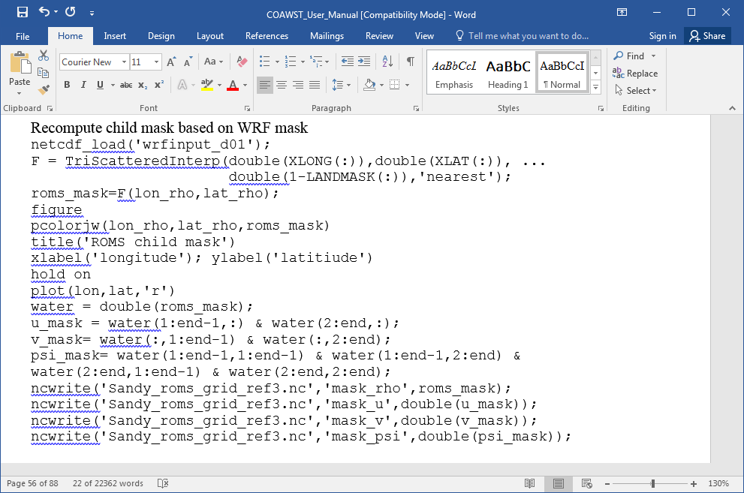
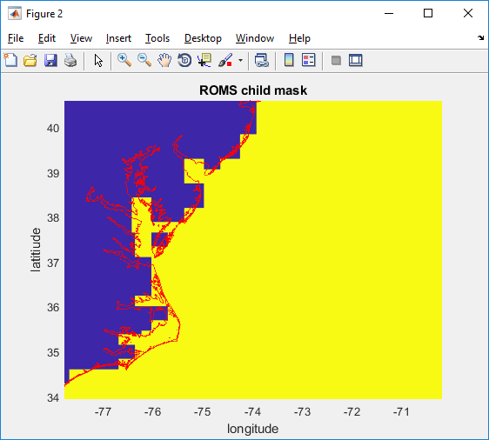
4) Child grid- masking
You can use editmask again to make this nicer!

Slide 42
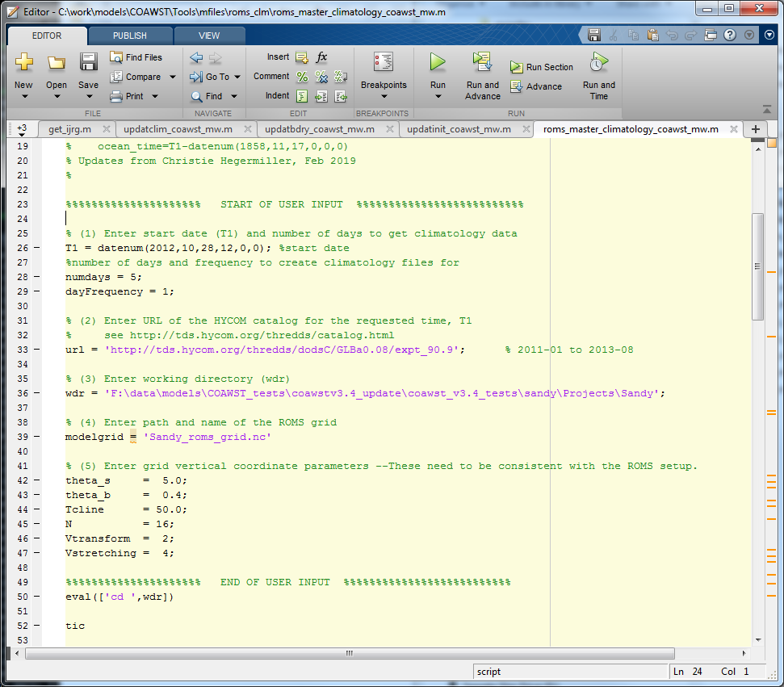
5) 3D BC's (u,v,temp,salt), init, clim
This step creates roms init conditions, bc's, and nudging files. There are several tools out there. Here we will use
Tools/mfiles/mtools/roms_master_climatology_coawst_mw
This m file will create BC, IC, and Climatology for the parent grid.
Inactive

Slide 43
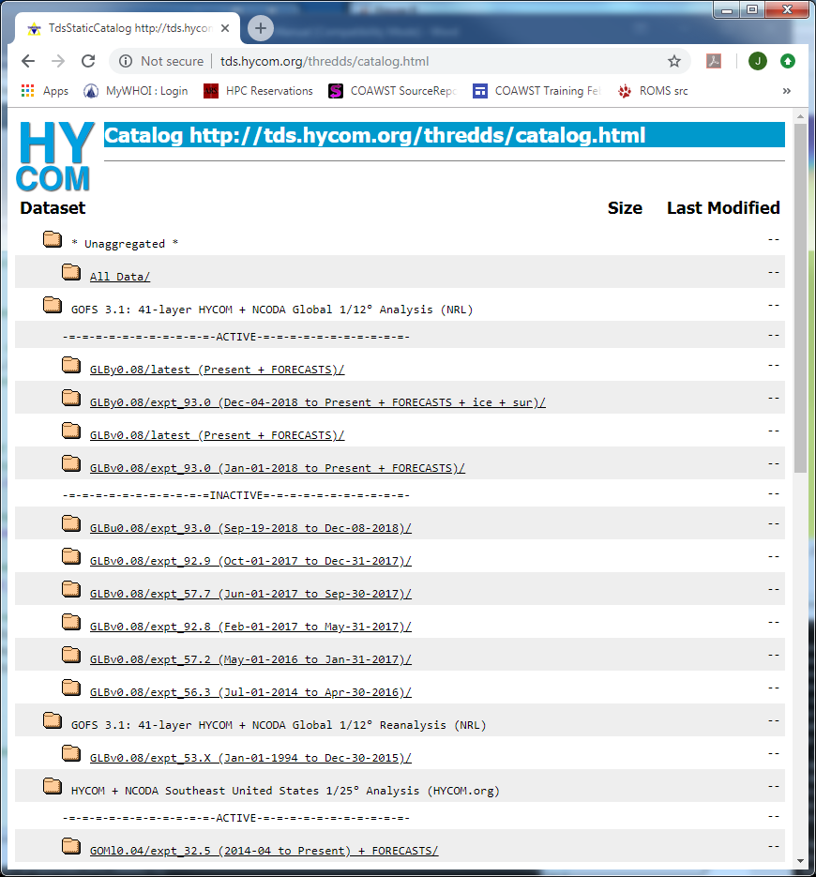
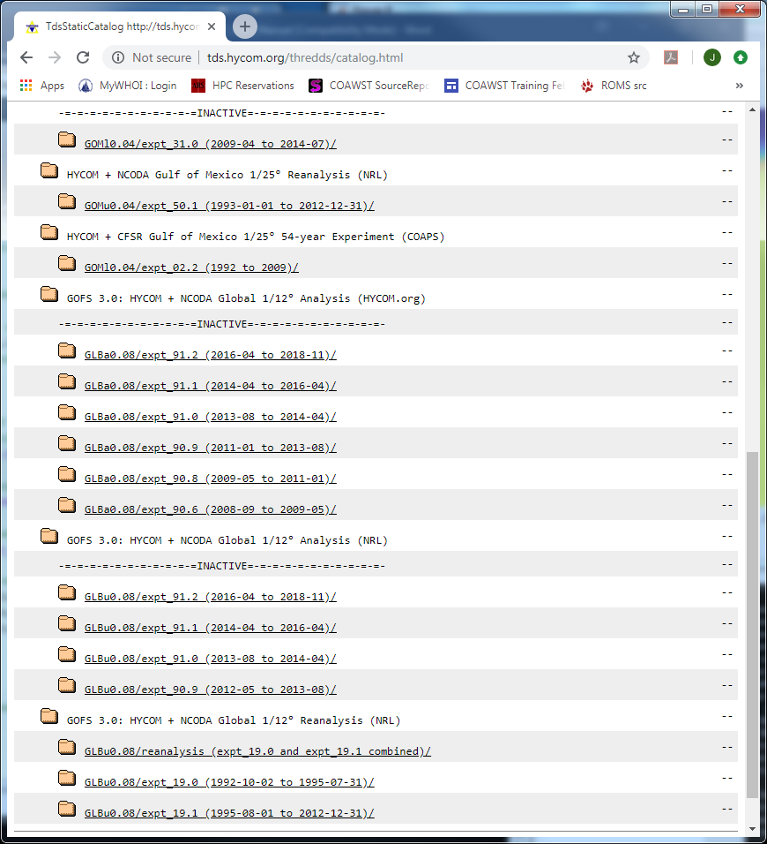
5) 3D BC's (u,v,temp,salt), init, clim
Active
Inactive

Slide 44
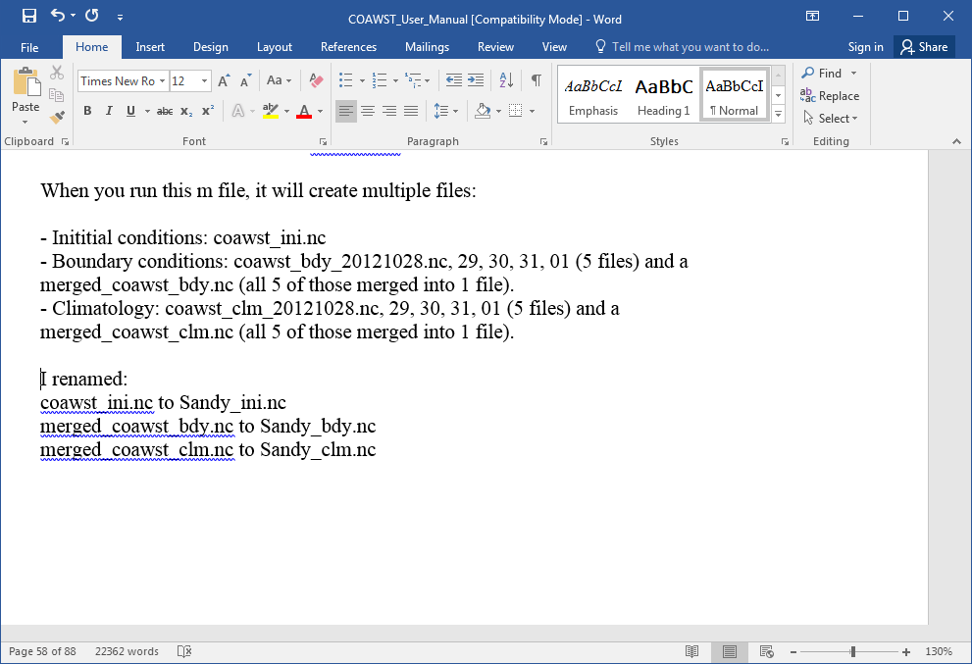
5) 3D BC's (u,v,temp,salt), init, clim

Slide 45
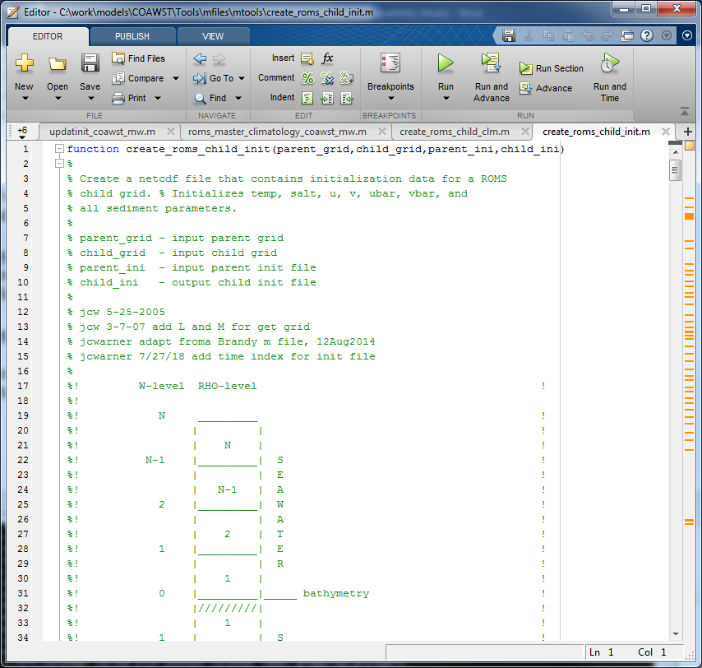
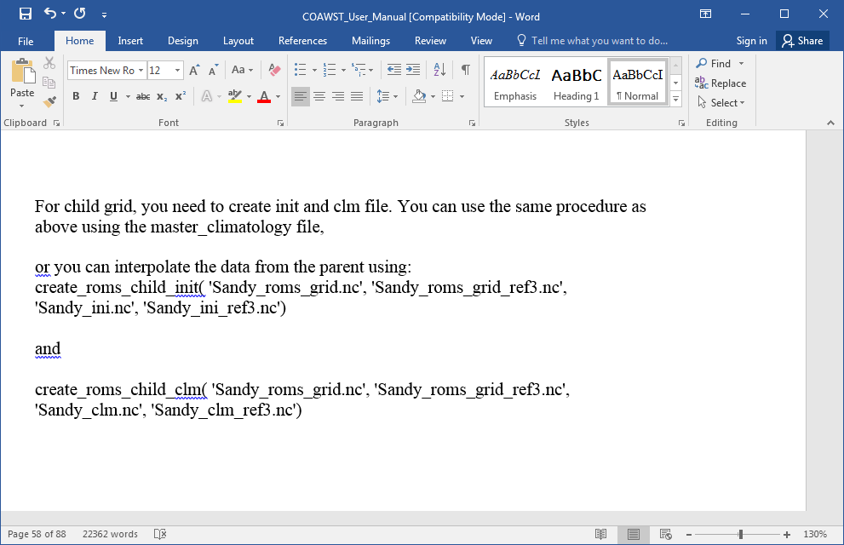
5) For child grid need init and clim.

Slide 46
6) 2D: BC's (ubar, vbar, zeta) = tides

Slide 47
6) 2D: BC's (ubar, vbar, zeta) = tides
1) Get the tidal data at
svn checkout https://coawstmodel.sourcerepo.com/coawstmodel/data .
2) edit Tools/mfiles/tides/create_roms_tides

Slide 48
6) 2D: BC's (ubar, vbar, zeta) = tides
netcdf_load('Sandy_roms_grid.nc')
pcolorjw(lon_rho,lat_rho,squeeze(tide_Eamp(:,:,1)))
M2 tidal amplitude

Slide 49
7) Surface forcings
Many options. We will use ncei_2roms.m

Slide 50
7) Surface forcings – ncei_2roms.m
COAWST/Tools/mfiles/mtools/
ncei_2roms
creates netcdf forcing files for ROMS.

Slide 51
7) Surface forcings – ncei_2roms.m
1) Select variables to be downloaded.
2) Forcing file name
3) Times
4) Data sets

Slide 52
7) Surface forcings – ncei_2roms.m
5) User or model grid
6) Native tools or outside toolbox

Slide 53
8) ROMS input files: sandy.h

Slide 54
8) ROMS input files: sandy_ocean.in
Nesting params
Grid sizes
NtileI NtileJ

Slide 55
8) ROMS input files: sandy_ocean.in
BC’s

Slide 56
8) ROMS input files: sandy_ocean.in
Time stepping
nhis, navg, etc

Slide 57
8) ROMS input files: sandy_ocean.in
Limiters for mixing terms

Slide 58
8) ROMS input files: sandy_ocean.in
GLS params
Wave breaking params
Bottom roughness
Bulk flux heights
Grid stretching params

Slide 59
8) ROMS input files: sandy_ocean.in
Time starts, tide start
BC tnudge

Slide 60
8) ROMS input files: sandy_ocean.in
History
Averages
Diagnostics

Slide 61
8) ROMS input files: sandy_ocean.in
Different in COAWST

Slide 62
8) ROMS input files: sandy_ocean.in
Only list tide forc for parent
You can use same forcing file for both grids
his and avg names, etc

Slide 63
9) Build and run: coawst.bash

Slide 64
9) Build and run: coawst.bash
Makefile determines the
Compilers file from:
uname –s
the FORT value
For example, here it will be
Compilers/Linux-ifort.mk

Slide 65
9) Build and run: coawst.bash
Set the header and ana paths
Customize the build here
build options
To build the code use
./coawst.bash –j N
this should make the
coawstM

Slide 66
9) Build and run: run_coawst
Make sure the –np X number of procs is equal to the NtileI * NtileJ in the ocean.in file.
To run just ROMS,
the mpirun should point to the ocean.in

Slide 67
10) Output
sustr
temp (surface)
It’s that easy. I don’t understand why people have problems.

