Slide 1
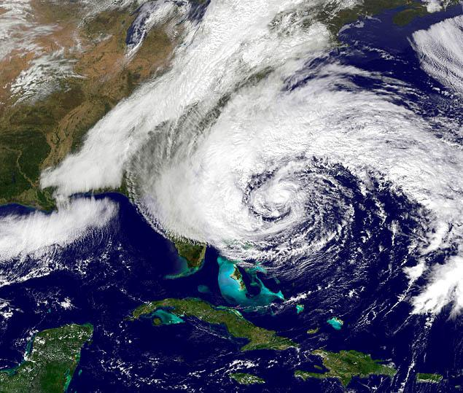
Coupled model applications Tutorial
Projects/Sandy- Hurricane Sandy example

Slide 2
- How does the coupled modeling system work (MCT)
- SCRIP interpolation
- Setting up a coupled application

Slide 3
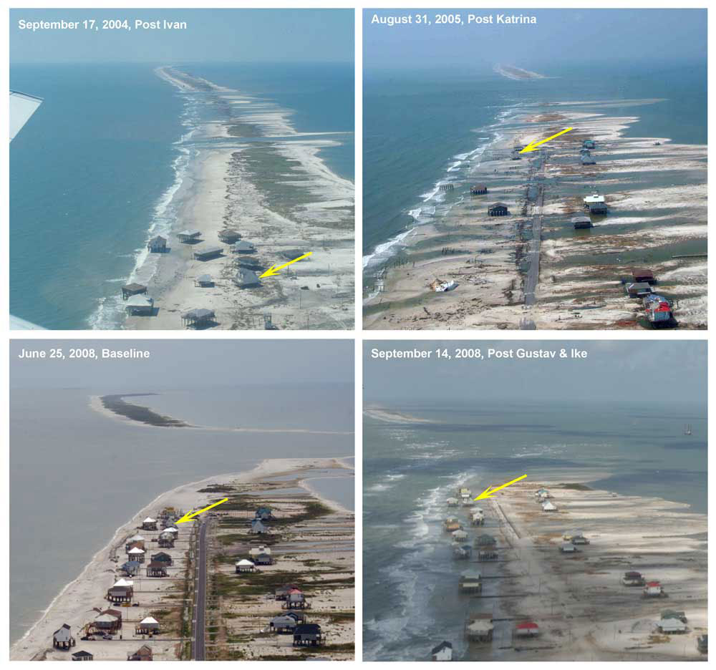
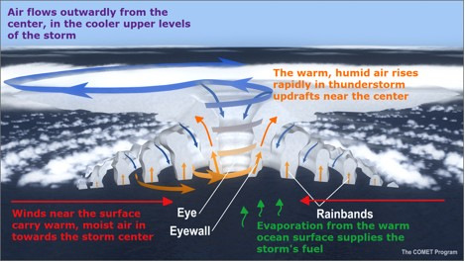
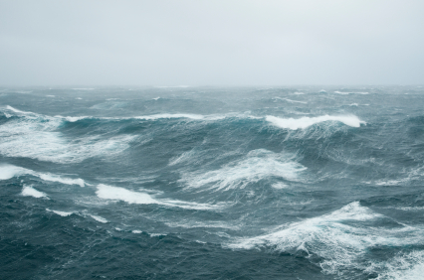
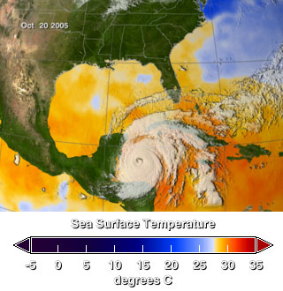
Why do we couple models?
Usually treated independently but actually occur together
Atmosphere
Coastal
geomorphology
Wave
Ocean

Slide 4

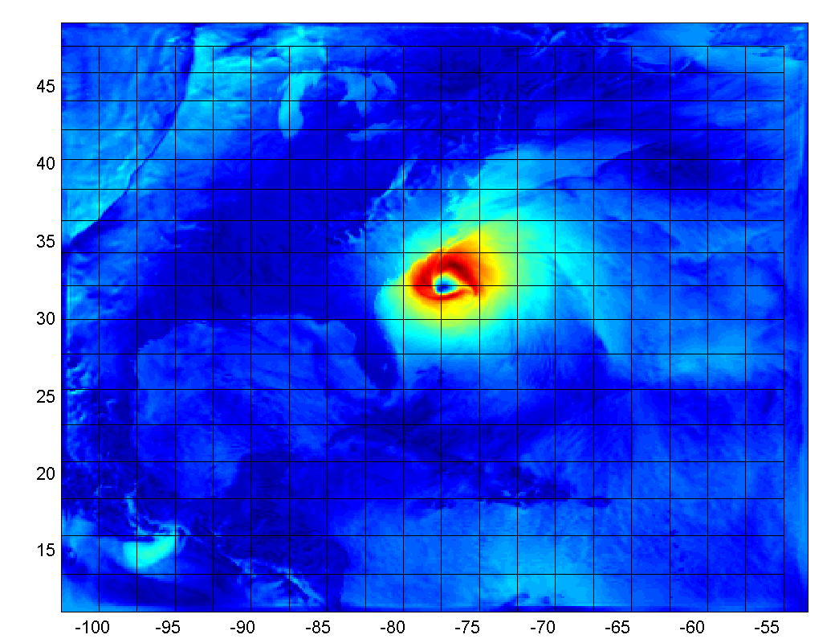
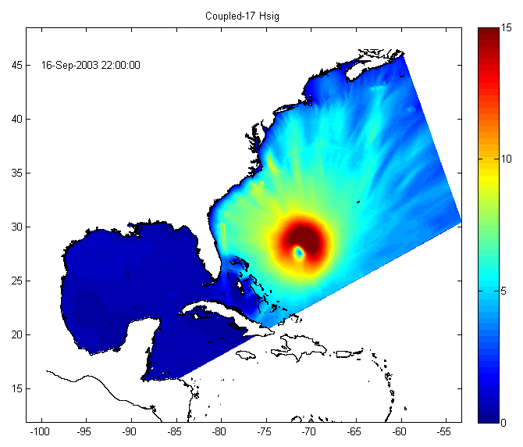
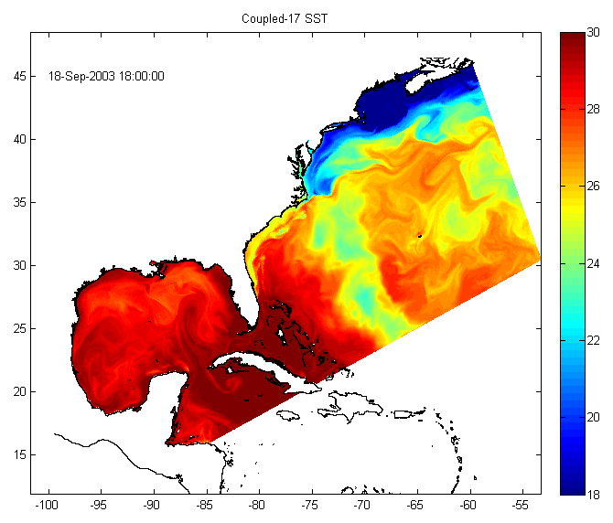
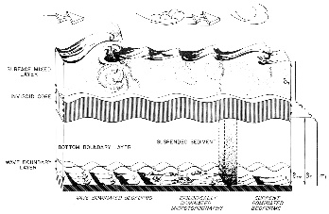



Model setup
ATMOSPHERE
H_{wave}, L_{pwave}, T_{psurf},
Latitude
Uwind, Vwind, Patm, RH, Tair,
cloud, rain, evap, SWrad, Lwrad
LH, HFX, Ustress, Vstress
MCT
SST
MCT
WRF wind speed
Longitude
U_{wind}, V_{wind}
H_{wave}, L_{mwave}, L_{pwave}, D_{wave},
Dwavep, T_{psurf}, T_{mbott}, Q_{b},
Diss_{bot}, Diss_{surf}, Diss_{wcap},
U_{bot}
ROMS SST
MCT
SWAN Hsig
u_{s}, v_{s}, η, bath, Z₀
WAVE
OCEAN
SEDIMENT
Ice
Biology
Vegetation

Slide 5




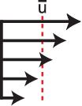
OCN interactions
ATM
Uwind, Vwind, Patm, RH, Tair,
cloud, rain, evap, SWrad, Lwrad
LH, HFX, Ustress, Vstress
Use consistent stress roms+wrf
#define ATM2OCN_FLUXES
Use wrf vars in COARE
#define
BULK_FLUXES
H_{wave}, L_{mwave}, L_{pwave}, D_{wave},
T_{psurf}, T_{mbott}, Q_{b},
Diss_{bot}, Diss_{surf}, Diss_{wcap},
U_{bot}
or
OCN
Salt flux
Atm press
WAVE
Patm
Ustress, Vstress,
Swrad, Lwrad
LH, HFX
Uwind-ucur, Vwind-vcur,
Swrad, Lwrad,
RH, Tair,
cloud
rain, evap
Water column
τ
Surface
Bottom
Stokes + VF
s= f ( Z_{os} )
Zoa
τ
b = f ( Z_{ob} )
H_{wave}, L_{mwave}, D_{wave},
T_{psurf}, Q_{b},
Diss_{bot}, Diss_{surf},
Diss_{wcap},
H_{wave}, L_{pwave}, D_{wave}, T_{psurf},
H_{wave}, L_{mwave}, D_{wave},
T_{mbott}, U_{bot}
Integration and Application Network (ian.umces.edu/symbols),
University of Maryland Center for Environmental Science.

Slide 6
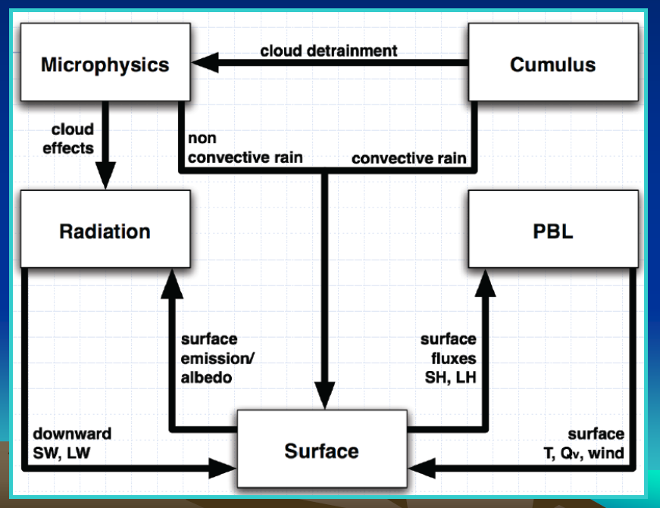
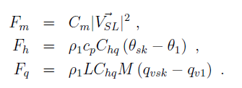
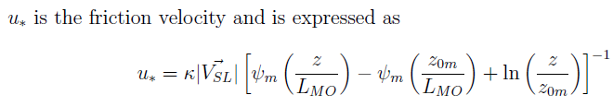
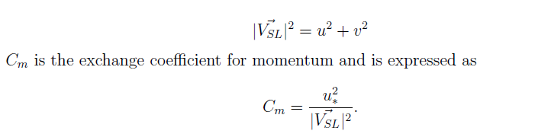
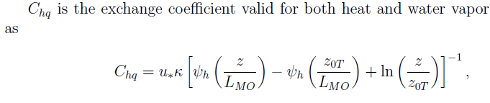
ATM interactions
ATM
H_{wave}, L_{pwave}, T_{psurf},
SST
OCN
WAV
SST
OCN
Momentum
Surface fluxes
Heat
Moisture
= f ( H_{wave}, L_{pwave}, T_{psurf} )
WAV

Slide 7
OCEAN SURFACE ROUGHNESS CLOSURE MODELS
CHARNOCK 1955
TAYLOR & YELLAND 2001: TY2001
- Wave steepness based parameterization.
- Based on three datasets representing sea-state conditions ranging from strongly forced to shoaling.
DRENNAN 2003: DGQH
Wave age based formula to characterize the ocean roughness.
They combined data from many field experiments representing a variety of condition and grouped the data as a function of the wind friction velocity.
OOST 2002: OOST
- Wave age dependent formula but it also considers the effect of the wave steepness.

Slide 8
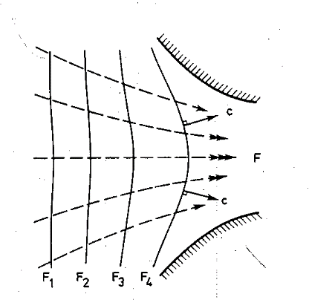
WAV interactions
ATM
U_{wind}, V_{wind}
WAV
1) Generation – wind speed forcing
is modified by ocean currents:
S(w) = f( U_{wind} – u_{s} ; V_{wind} – v_{s} )
u_{s}, v_{s}, η, bath, Z₀
OCN
2) Propagation
– wave celerity in geographic space is modified by ocean currents
c_{x} = c_{gx} + u_{s ;} c_{y} = c_{gy} + v_{s}
– change of wave direction (refraction) due to η, bathy, and currents:

Slide 9
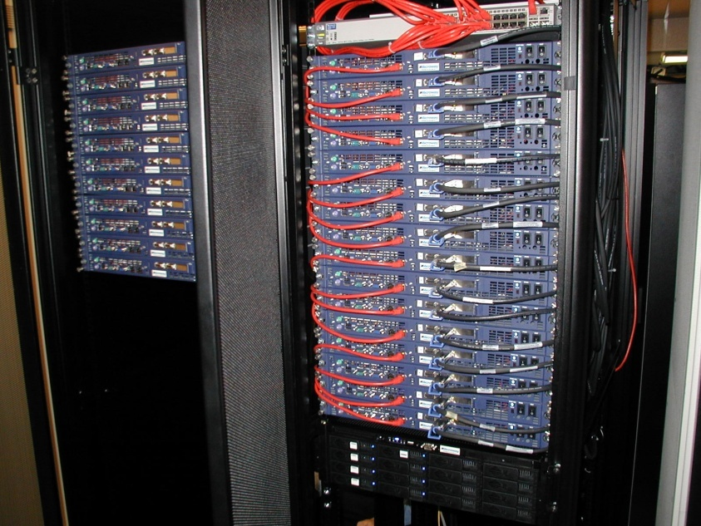


Coupled Modeling System
Model Coupling Toolkit
Mathematics and Computer Science Division Argonne National Laboratory
http://www-unix.mcs.anl.gov/mct/
MCT is an open-source package that provides MPI based communications between all nodes of a distributed memory modeling component system. Download and compile as libraries that are linked to.
Model A running on M nodes.
Model B running on N nodes.
Model C ………
MCT provides
communications
between all models.
………
(it also works here)
Warner, J.C., Perlin, N., and Skyllingstad, E. (2008). Using the Model Coupling Toolkit to couple earth system models. Environmental Modeling and Software

Slide 10
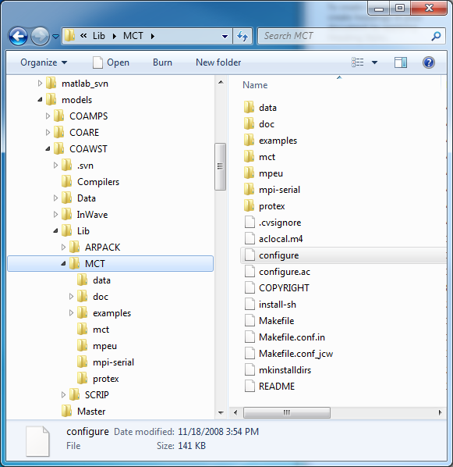
Libraries
MCT - v2.60 or higher (distributed)
1) cd to the MCT dir
2) ./configure
This makes Makefile.conf. you can edit this file.
3) make
4) make install
5) set environment vars
setenv MCT_INCDIR COAWST/Lib/MCT/include
setenv MCT_LIBDIR COAWST/Lib/MCT/lib
(or where ever you installed them, see last slide)

Slide 11
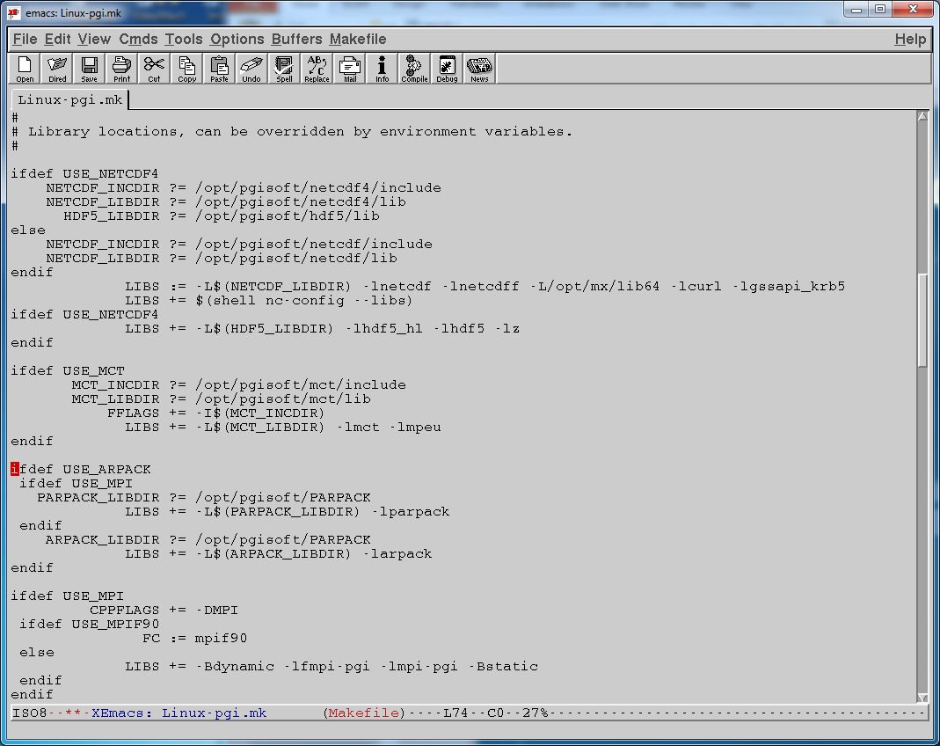
Compilers dir (side note)
?= means that it checks your environment first

Slide 12
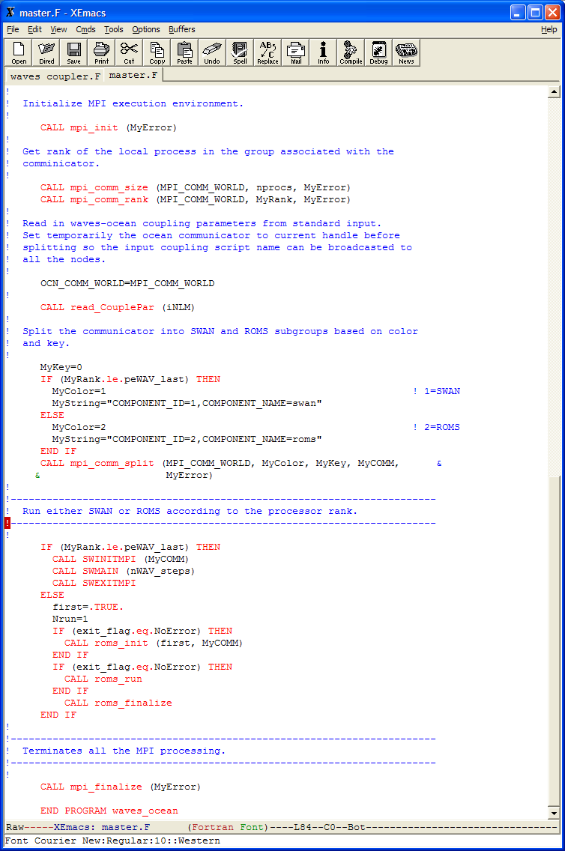
Model organization
master.F
mpi_init
init_file (# procs/model)
{
init
run
finalize
SWAN
{
init
run
finalize
ROMS

Slide 13
init, run, and finalize
ROMS
SWAN
init_param
init_parallel
init_scaclars
init_coupling
MPI_INIT
init
(grid decomp)
roms_init
SWINIT
SWREAD (grid)
init_coupling
SWINITMPI
main3d
.....
waves_coupling
...
run
(sync. point)
swanmain
.....
ocean_coupling
...
roms_run
SWMAIN
roms_finalize
mpi_finalize
close_io
finalize
mpi_finalize
close_io
SWEXITMPI

Slide 14
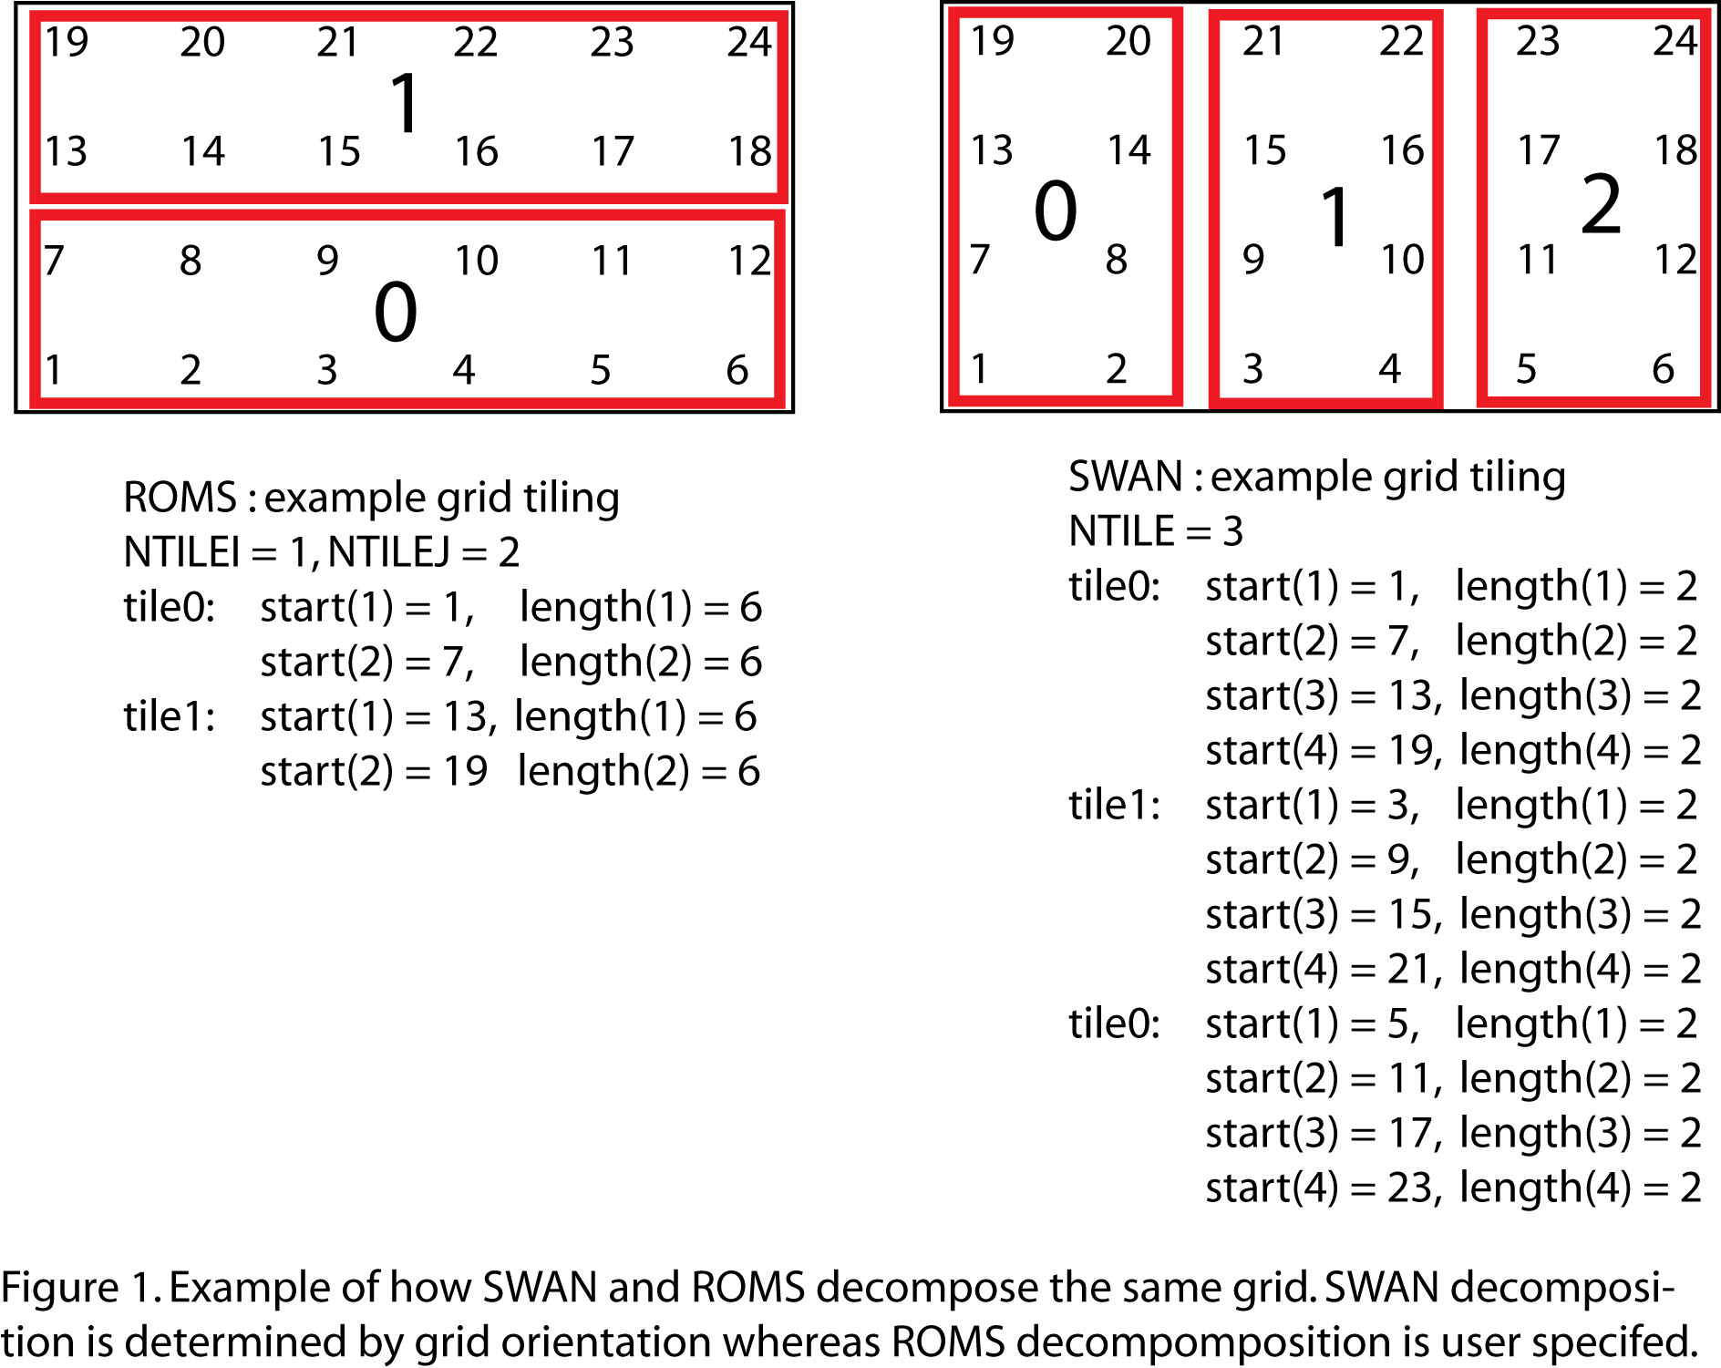
Grid decomposition (during initialization)
ROMS
SWAN
Each tile is on a
separate processor.
Each tile registers
with MCT.

Slide 15
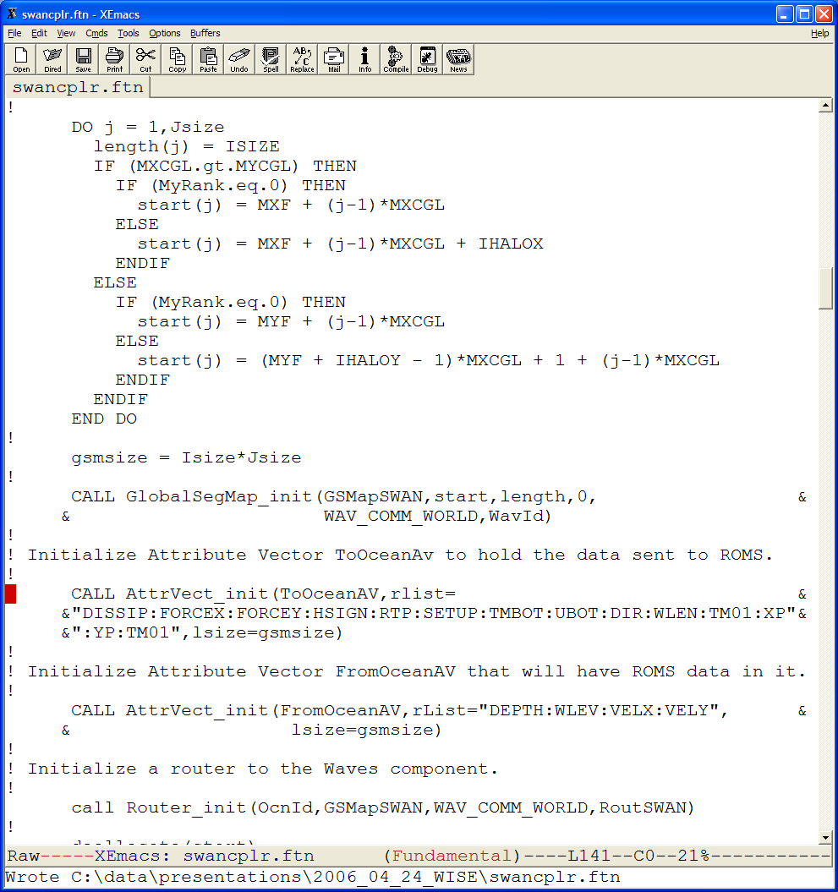
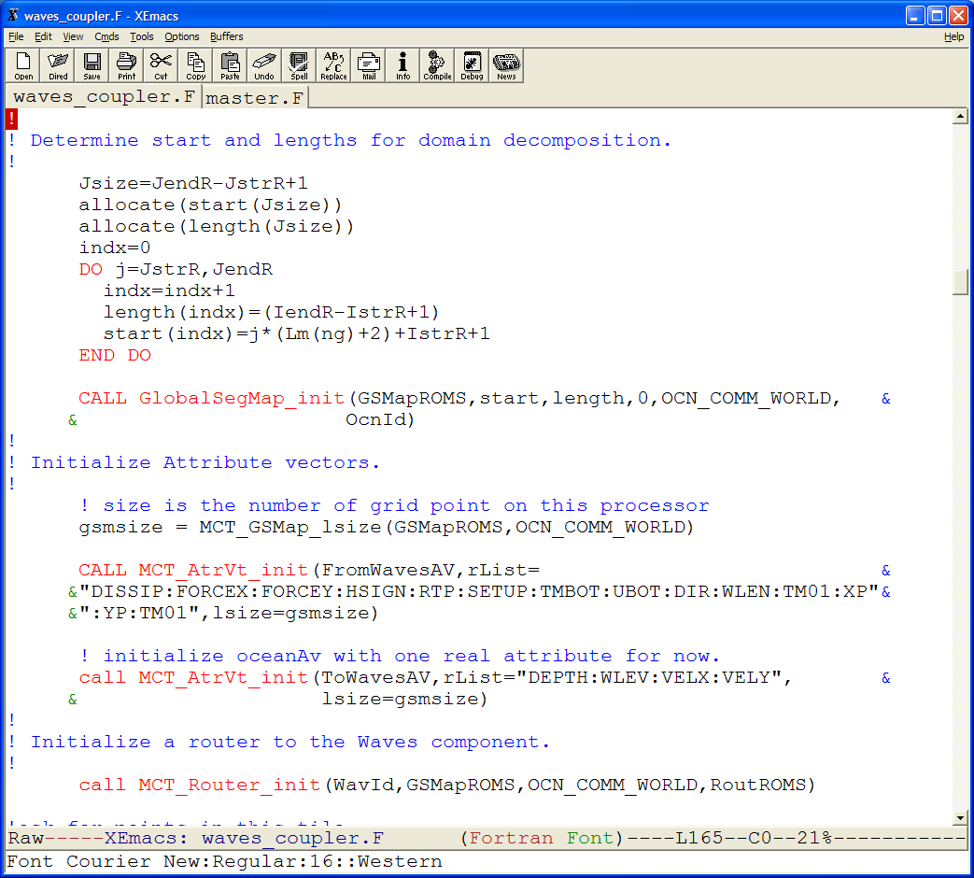
Determine what information to exchange
ROMS- init_coupling
SWAN- init_coupling
processed by each ROMS tile
processed by each SWAN tile
1
1
2
2
3
3

Slide 16
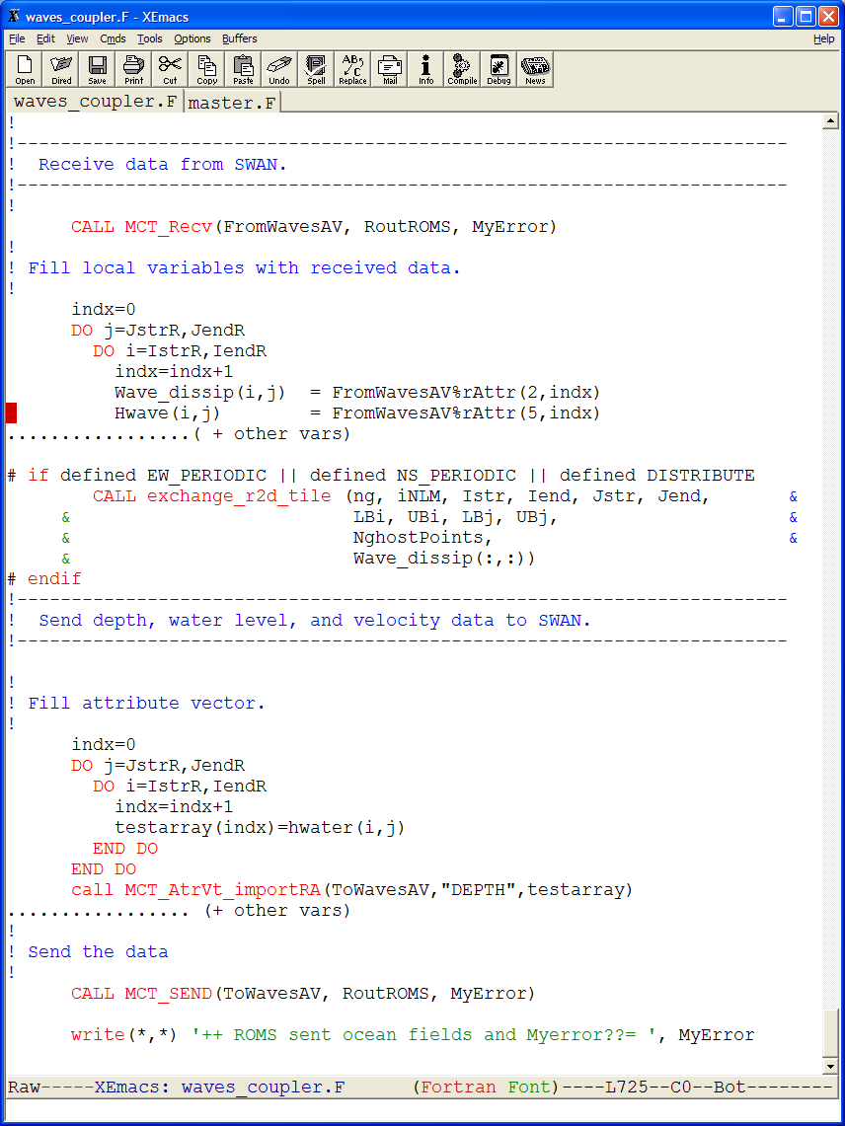
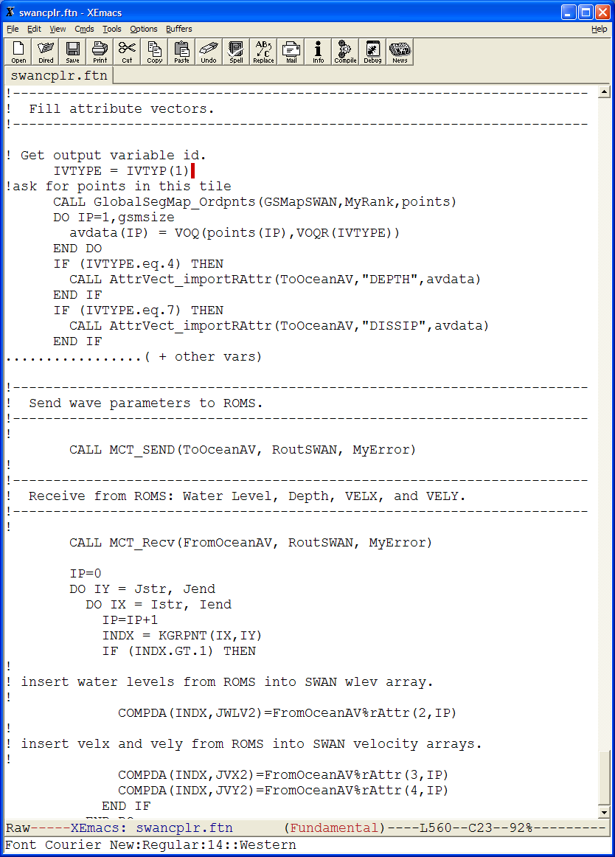
Synchronization (run phase)
ROMS- ocean_coupling
SWAN- waves_coupling
MCT
MCT
processed by each ROMS tile
processed by each SWAN tile

Slide 17
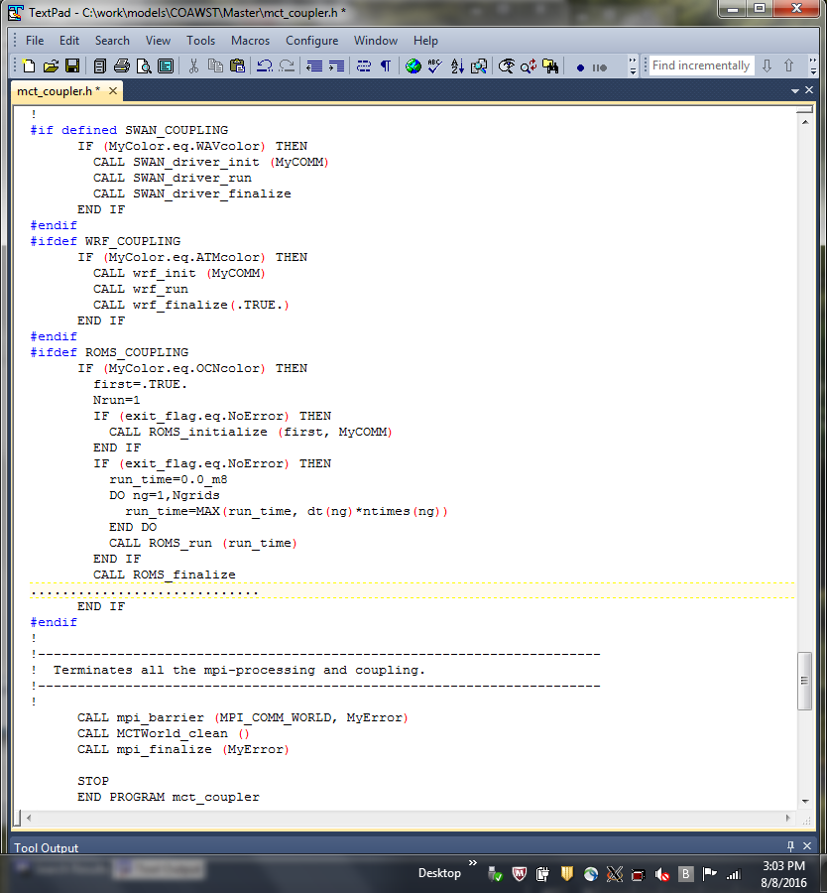
End phase
“master.F”
MPI barrier prevents program complete exit until all models arrive at this point.
Sometimes one model may die and other model is waiting.

Slide 18
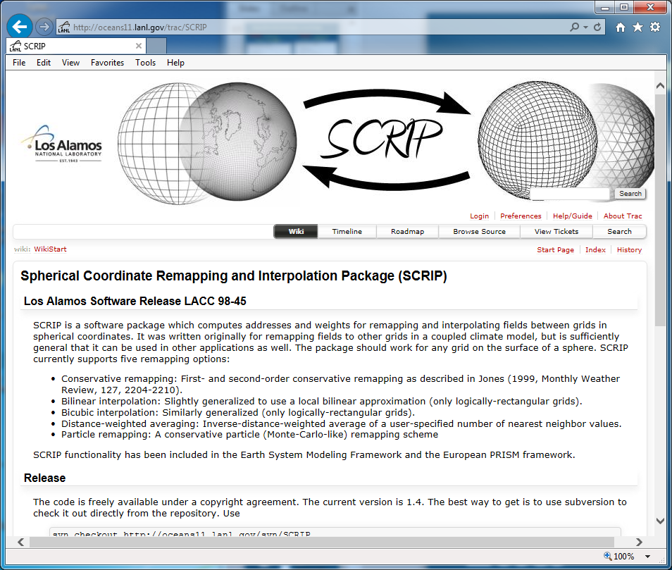
SCRIP grid interpolation
Needed when you run more than 1 model and the models are on different grids.
We started with SCRIP from LANL.
We adapted the code to read model grids, and write out one NetCDF file with all the interpolation weights.
We use the ‘group’ capability in NetCDF4.
http://oceans11.lanl.gov/trac/SCRIP

Slide 19
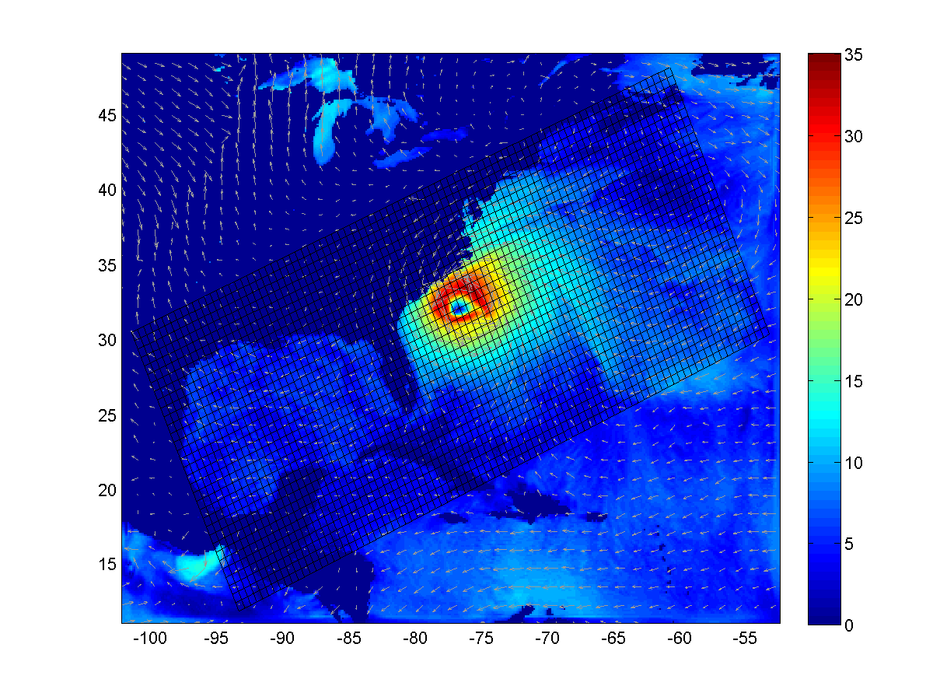
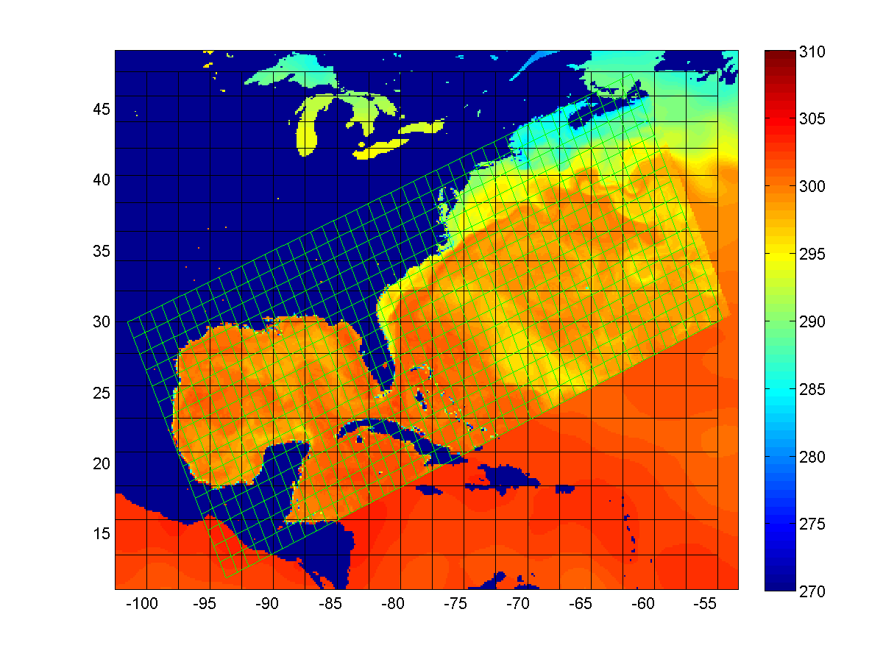
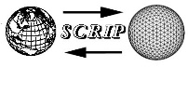
3) SCRIP - grid interpolation
Ocean grid
Atm Grid
1⁰ GFS data
HFLX
SST
Ocean model provides higher resolution and coupled response of SST to atmosphere. But the ocean grid(s) are limited in spatial coverage so atmosphere model must combine data from different sources.
Atmosphere model provides heat flux to cover entire ocean grid. SCRIP interpolations weights needed to remap data fields.
Flux conservative
remapping scheme
Two main issues:
Interpolate data between different grids.
Combine data from different sources.

Slide 20
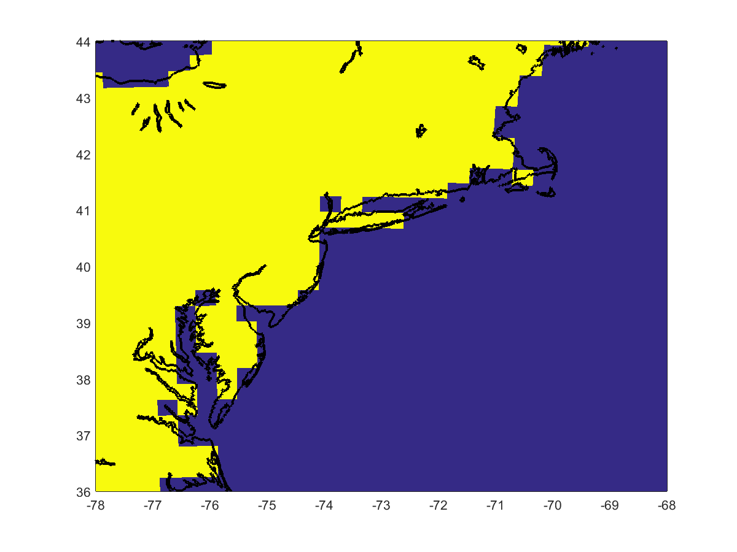
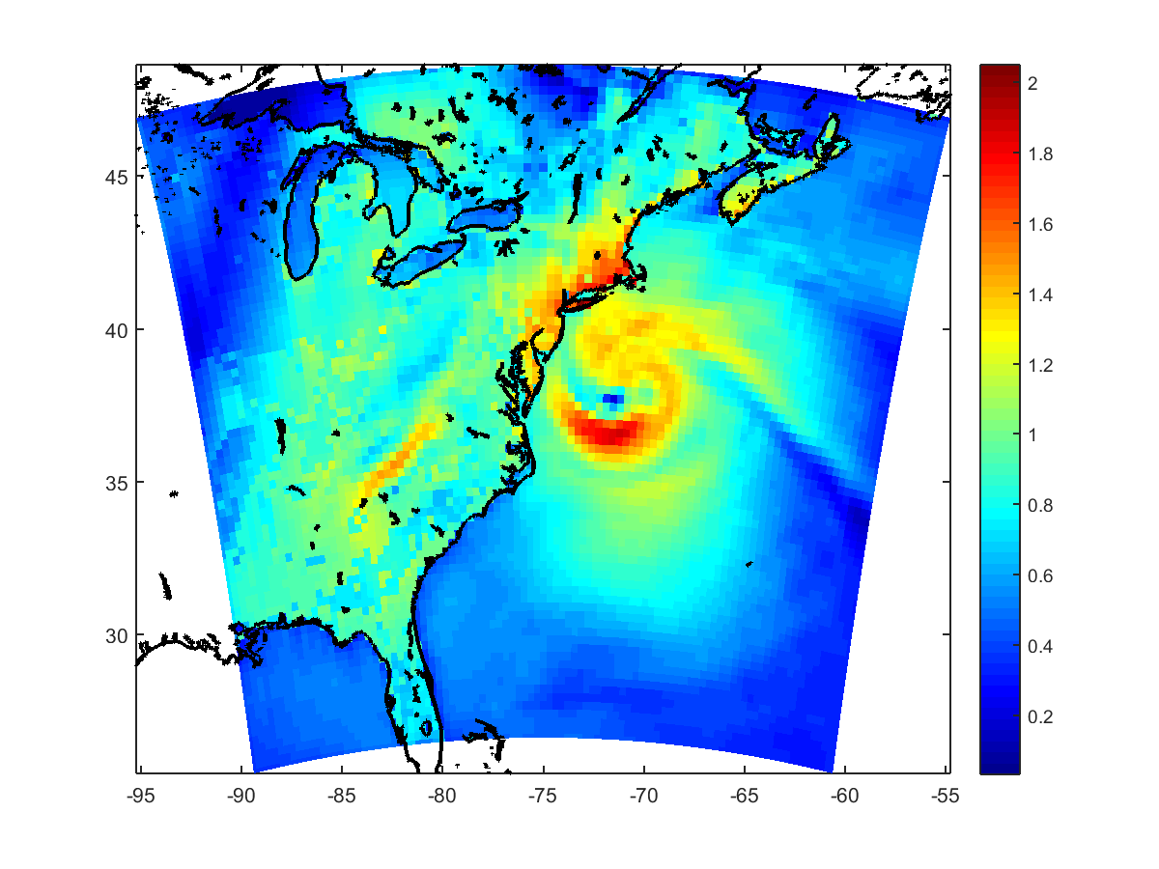
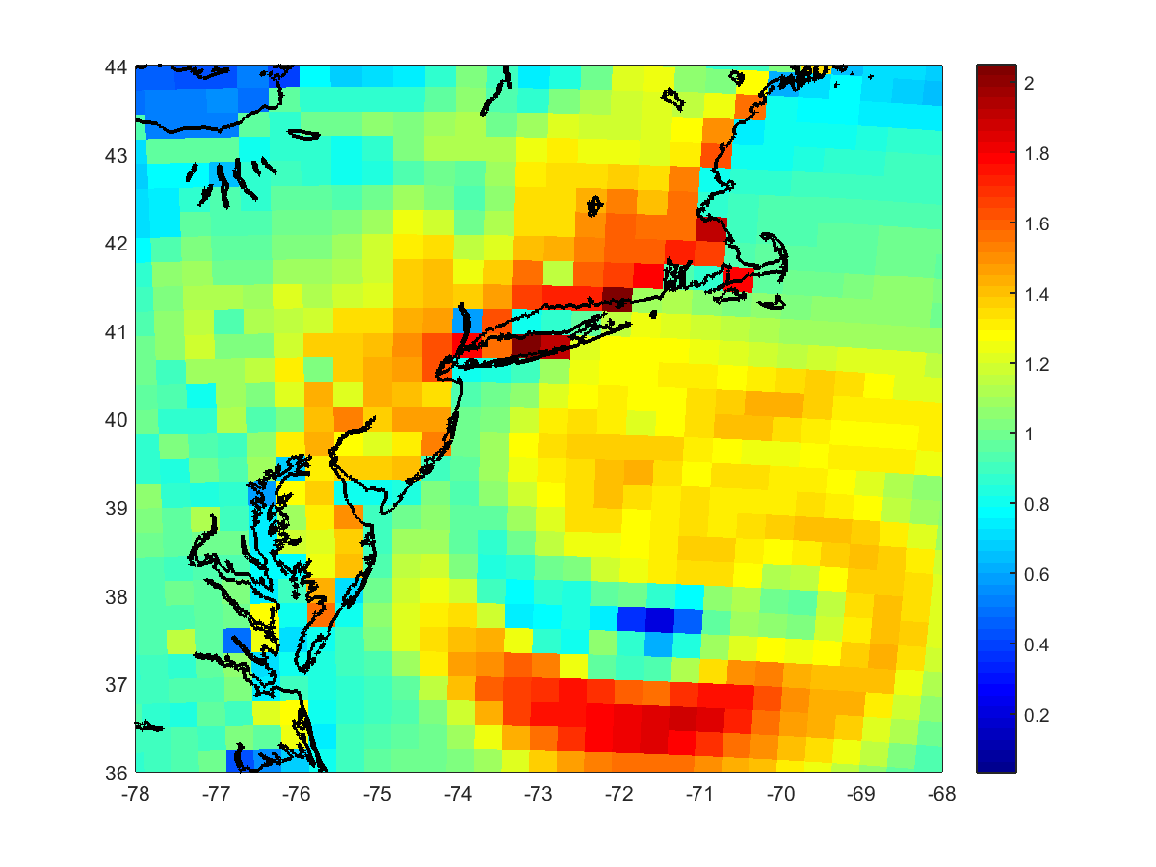
Land masking effects – example of grid interpolation
LANDMASK
This is a coarse example to demonstrate the effects of land/sea masking on atmospheric processes.
Large bottom stress over land will cause problems on an ocean grid with different masking.
Bottom stress (UST)

Slide 21
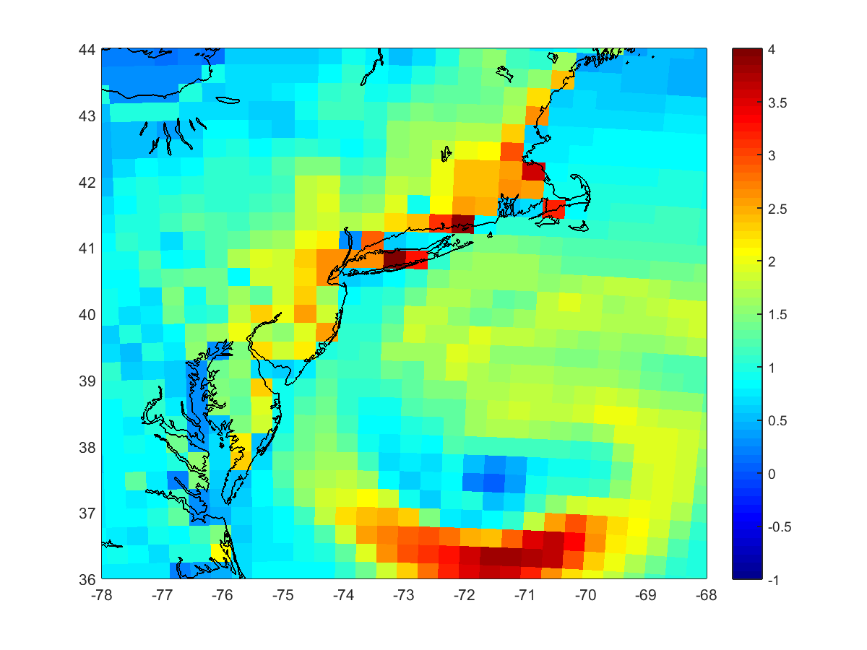
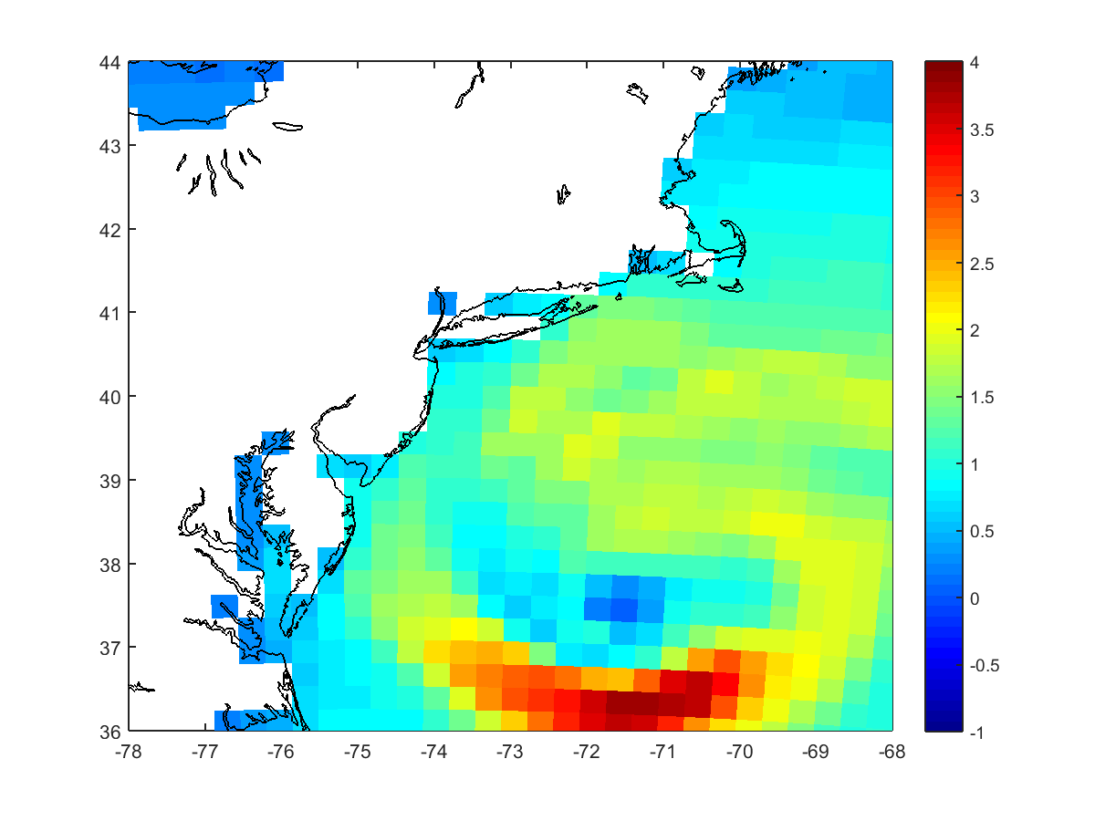
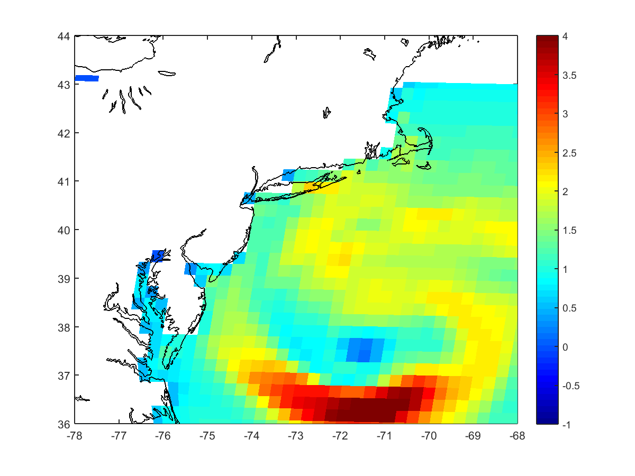
Grid interpolation
ATM land mask areas do not effect ocean.
WRF UST^2 over land + ocean
ROMS su/vstr over ocean only
WRF UST^2 over ocean only

Slide 22
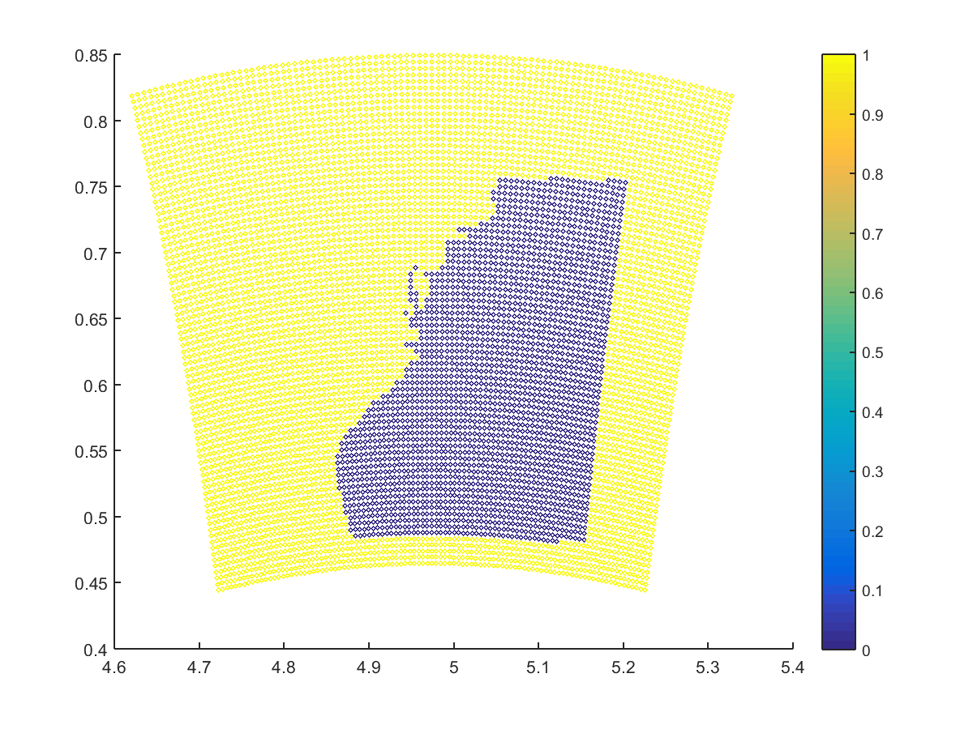
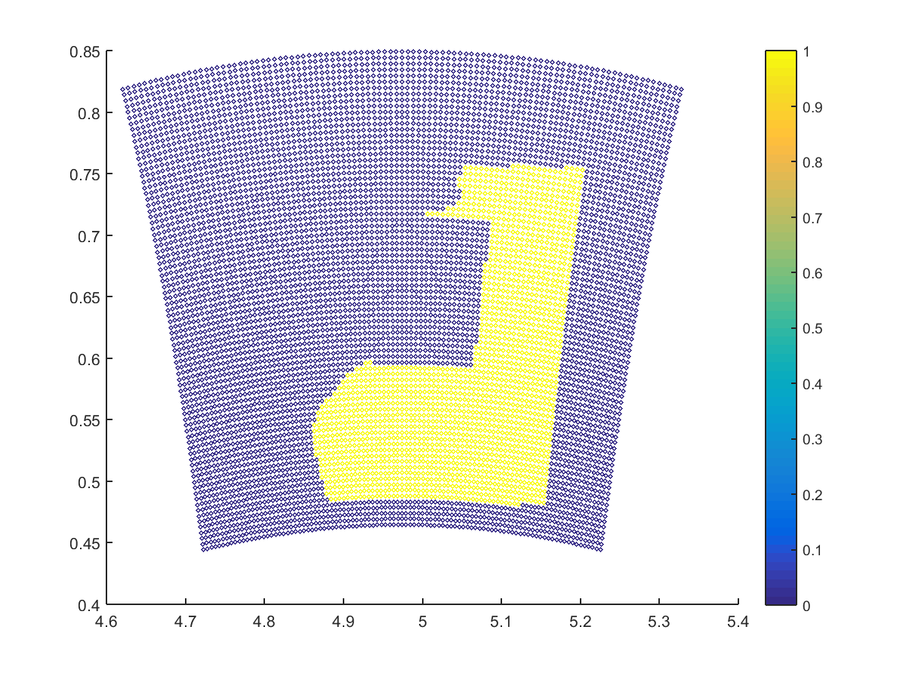
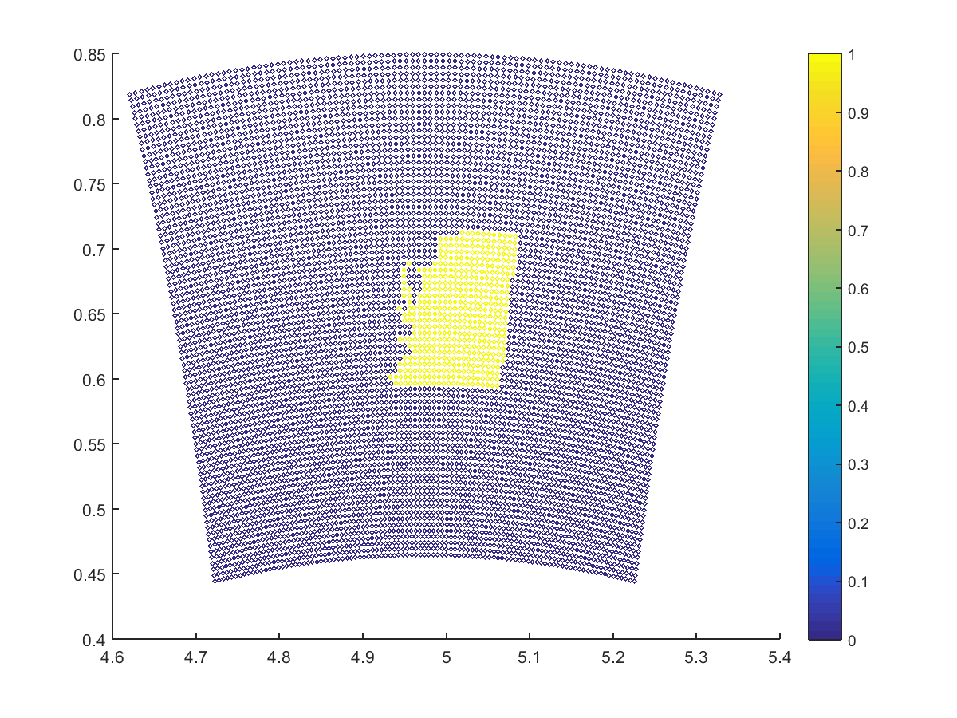
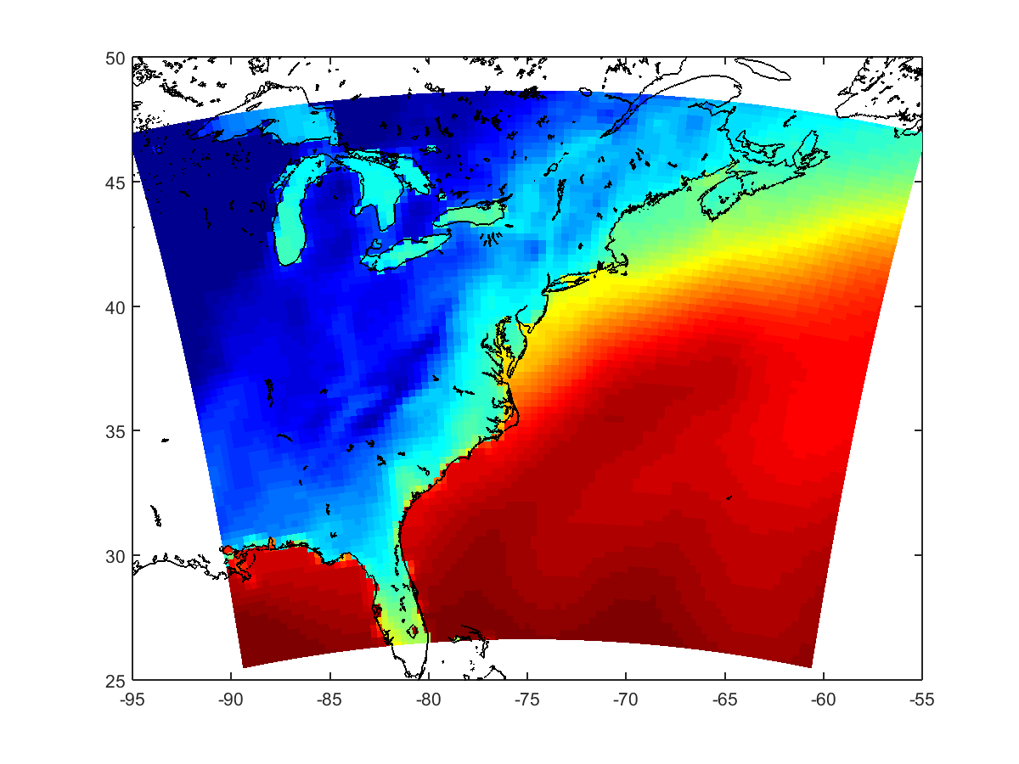
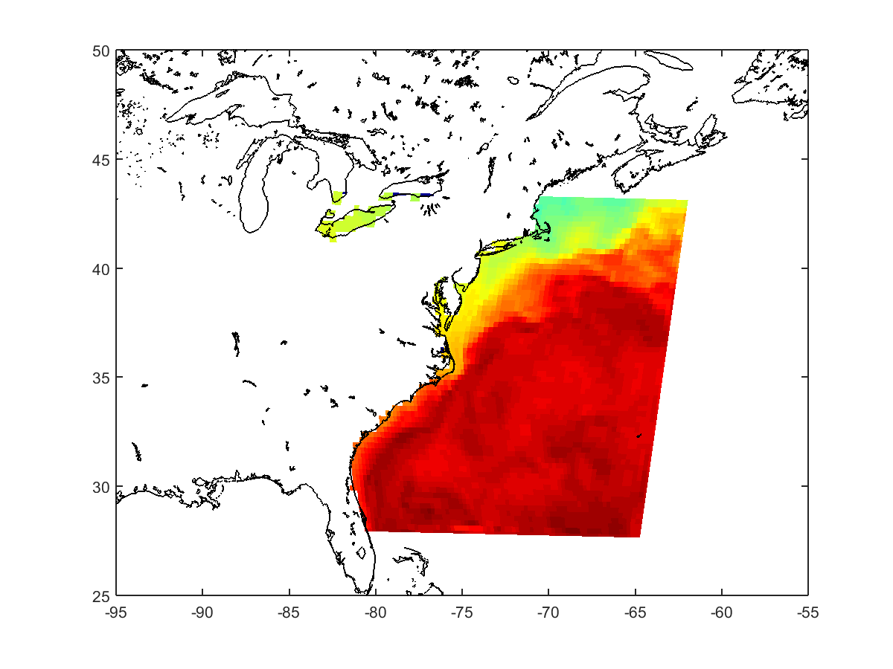
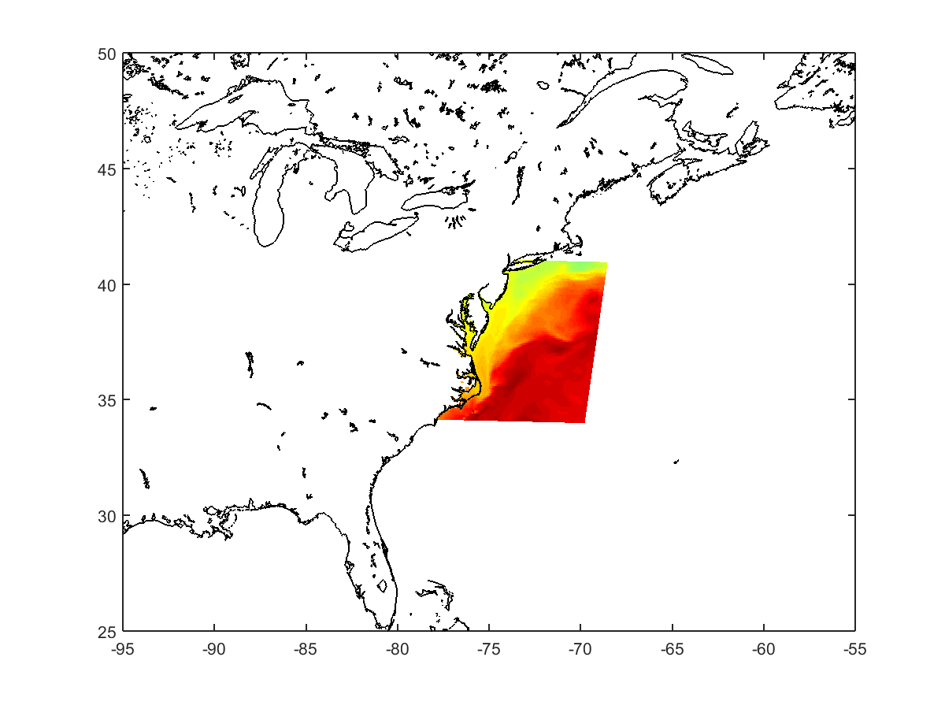
Combining multiple sources
Sum of all 3 masks = 1
Background GFS SST mask
ocn 1 to atm 1 mask
ocn 2 to atm 1 mask
Background GFS SST
ocn 1 SST
ocn 2 SST

Slide 23
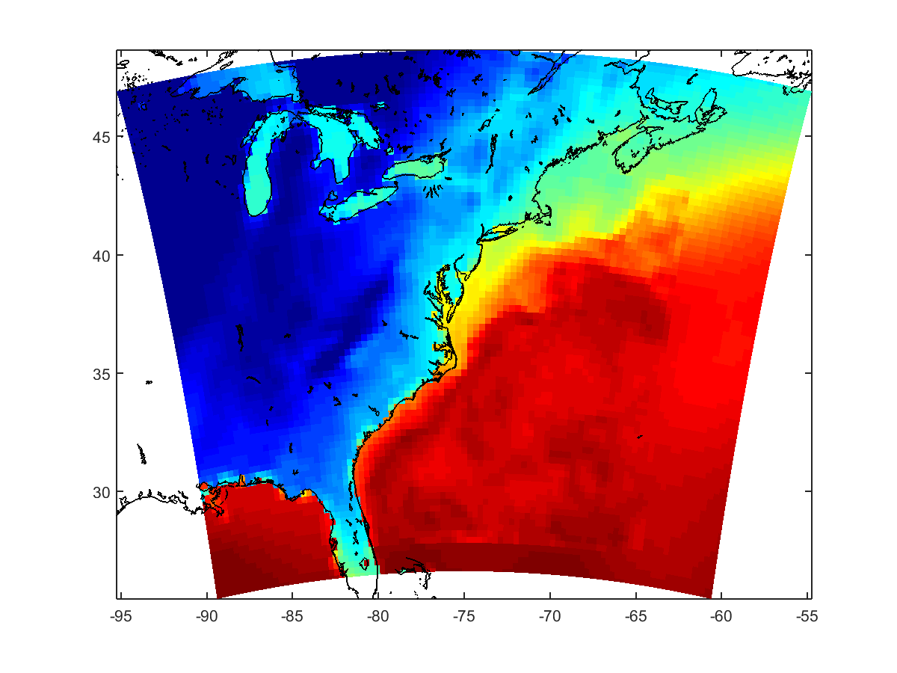
Combining multiple sources
Sum of all 3 masks = 1
Background GFS SST mask
ocn 1 to atm 1 mask
ocn 2 to atm 1 mask
SST Total
Background GFS SST
ocn 1 SST
ocn 2 SST

Slide 24
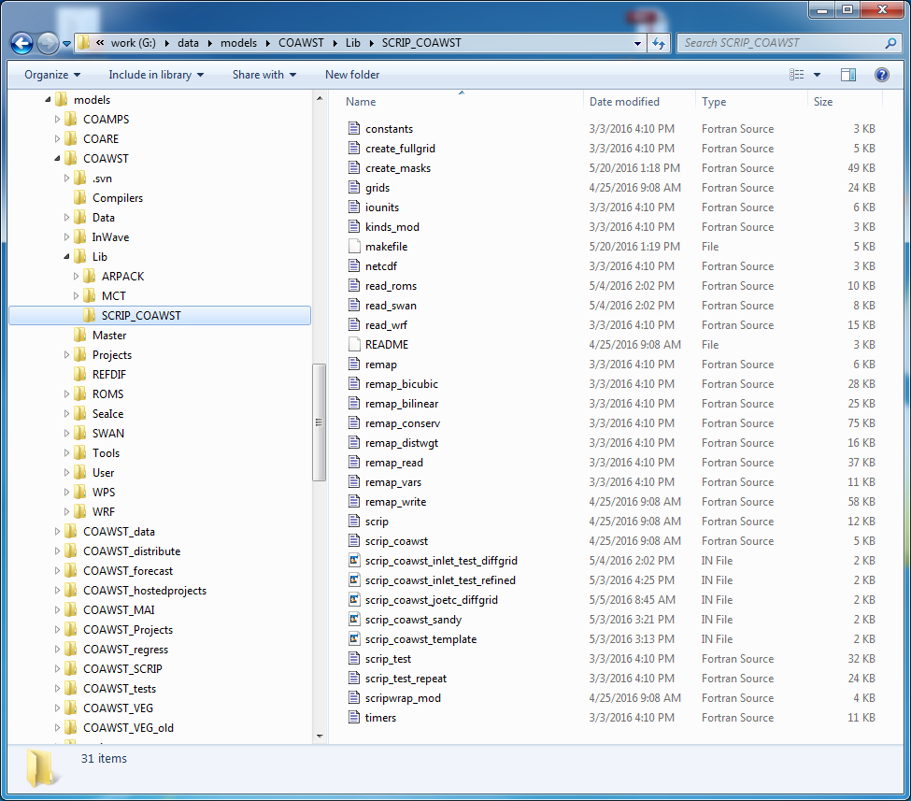
SCRIP_COAWST
– based on SCRIP v 1.6 and modified to read scrip_coawst.in

Slide 25
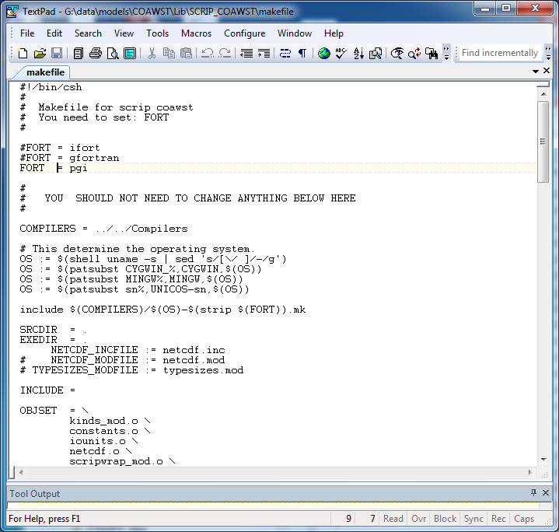
SCRIP_COAWST
1) cd to COAWST/Lib/SCRIP_COAWST
2) edit makefile
3) make
Set your compiler here
This will build the program “scrip_coawst”

Slide 26
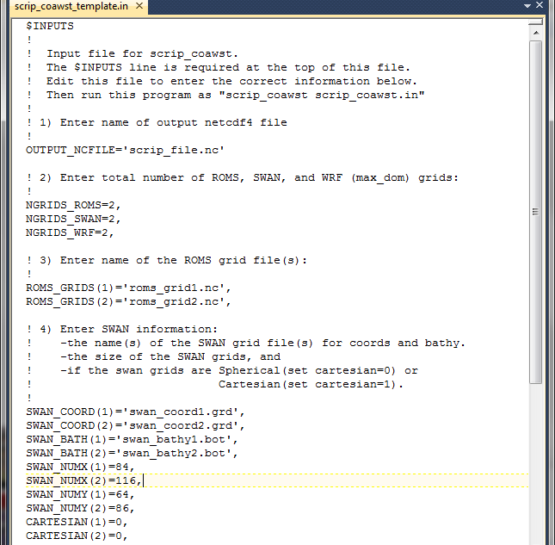
SCRIP_COAWST – input file
Output file name
Number of grids
for each model
ROMS grid names
SWAN grid names

Slide 27
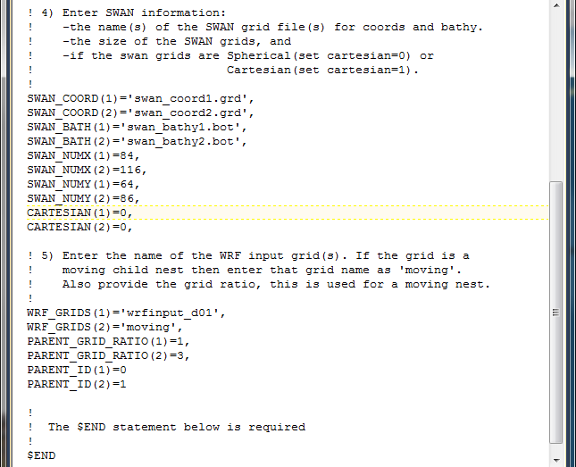
SCRIP_COAWST – input file
SWAN grid names
WRF grid names
Enter ‘moving’ for a moving nest.
Only the last WRF grid can be moving.

Slide 28
SCRIP file(s)
Run the scrip coawst program using
./scrip_coawst scrip_coawst.in
We use NetCDF 4 functionality to create only 1 netcdf file using the ‘group’ functionality.
To read the data in matlab you can use (for example)
dst_grid2=ncread('scrip_sandy_static.nc','/ocn2_to_atm1_weights.nc/dst_grid_imask');
The old way: created a weight file between each grid.
So if you have 1 WRF grid, and 2 ROMS grids, it will produce
atm1_to_ocn1_weights.nc
atm1_to_ocn2_weights.nc
ocn1_to_atm1_weights.nc
ocn2_to_atm1_weights.nc

Slide 29
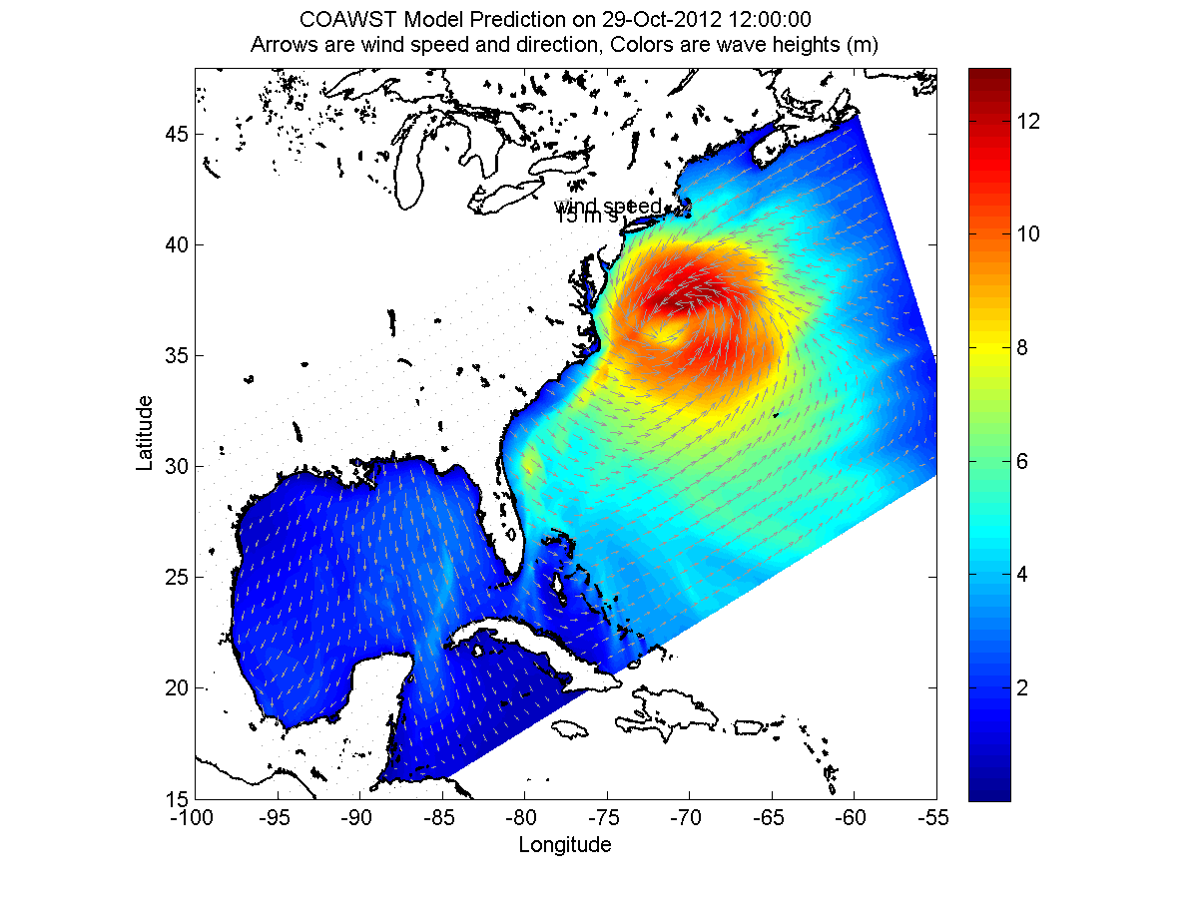
Setting up a coupled application:
Projects/Sandy

Slide 30
How to create coupled application
1) Create all input, BC, init, forcing, etc files for each model as if running separately. I recommend that you run each model separately first.
2) SCRIP (if different grids or grid refinement)
3) modify cppdefs in your header file.
4) ocean.in, namelist.in, and coupling.in
5) coawst.bash
6) run it as coawstM

Slide 31
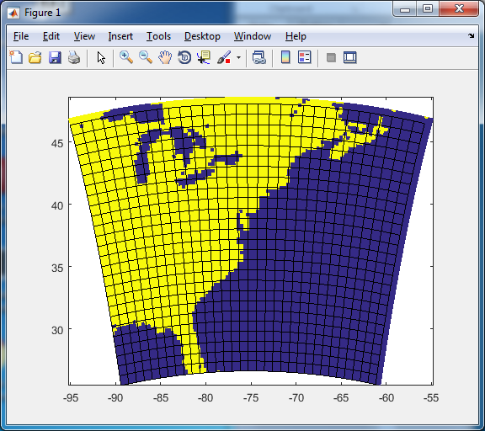
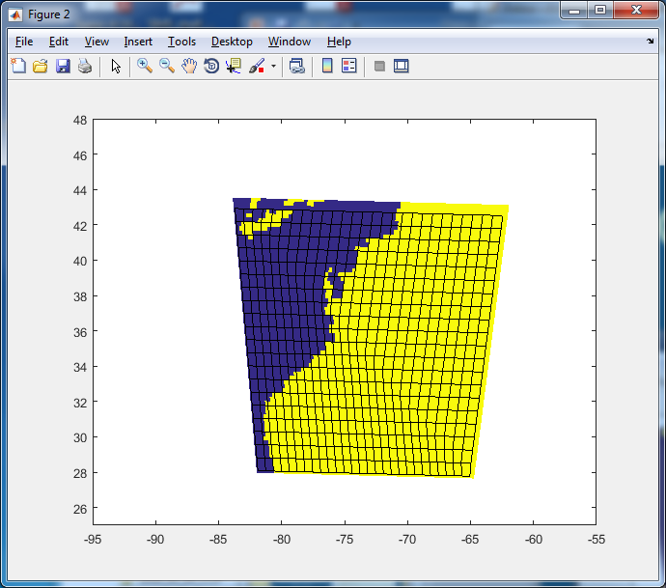
1) Use each model separately
WRF
  27 vertical levels
  dt 36 s
  Physics
    Lin microphysics
    RRTM longwave, Dudhia shortwave
    Mellor-Yamada-Janjic (MYJ) PBL
    …..
ROMS
  16 vertical levels
  dt 240, 48
  Physics
    GLS turbulence closure
    COARE bulk fluxes
    BC's from HYCOM
    …..

Slide 32

2) SCRIP
Edit the SCRIP input file:
COAWST/Lib/SCRIP_COAWST/scrip_coawst_sandy.in

Slide 33

2) SCRIP
Edit the SCRIP input file:
COAWST/Lib/SCRIP_COAWST/scrip_coawst_sandy.in

Slide 34
2) SCRIP
Run this in COAWST/Lib/SCRIP_COAWST
./scrip_coawst scrip_coawst_sandy.in
This will create one file called
OUTPUT_NCFILE='scrip_sandy_static.nc'

Slide 35

3) sandy.h
ROMS + WRF
application

Slide 36

4) coupling.in (this is a ROMS+WRF app)
Projects/Sandy/coupling_sandy.in
set # procs for each model
set coupling interval.
Can be different for each direction.
input file names. only 1 for WRF, 1 for ROMS, multiple for SWAN

Slide 37

4) coupling.in (this is a ROMS+WRF app)
SCRIP weights OPTION 1 or 2
SCRIP weights files name listed here for Option 1
(single file)
NetCDF file uses “groups” feature so we need netcdf 4.
SCRIP weights files names are listed here for Option 2
(multiple files, this option to be phased out.)

Slide 38


4) ocean.in
set # procs NtileI NtileJ
Model dt needs to divide evenly into the
coupling interval.

Slide 39

5) namelist.input
need dt of 180 to divide
evenly into coupling interval
of 1800 sec.
set # procs for atm model

Slide 40

6) run it as coawstM
use total number of procs from coupling.in
only 1 executable

Slide 41

Processor allocation
stdout reports processor allocation
and
Number of steps between synchronization.
This looks like from a different run,
but you get the idea

Slide 42

Processor allocation
"Timing for …." = WRF
"1 179 52974 02:59:00 " = ROMS
Here is where the model coupling synchronization occurs.
so probably could re-allocate more nodes to WRF

Slide 43

Data field exchange min/max values
WRF 1 to ROMS 1
WRF 2 to ROMS 1
WRF 1 to ROMS 2
WRF 2 to ROMS 2

