Slide 1
Gulf of Mexico Blowout:
Initialization and Predictability
by
David Dietrich,
Computational Science Research Center, San Diego State U.
Yu-heng Tseng,
National Center for Atmospheric Research
Konstantin Korotenko,
P.P. Shirshov Institute of Oceanology
Malcolm Bowman,
School of Marine Sciences, State U. of New York/Stony Brook
http://efdl.as.ntu.edu.tw/research/diecast http://efdl.as.ntu.edu.tw/research/timcom/FRAME/PDTIMCOM.html
Acknowledgement :
We acknowledge Bob Haney, Avichal Mehra, George Carnevale
and Keith Thompson for valuable comments and suggestions.

Slide 2
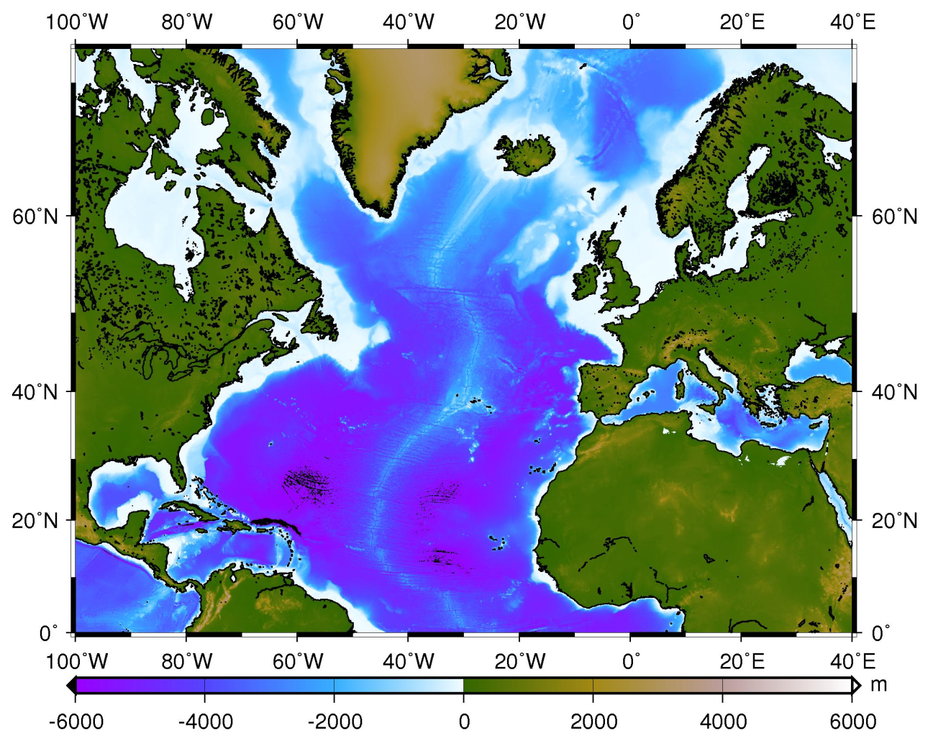
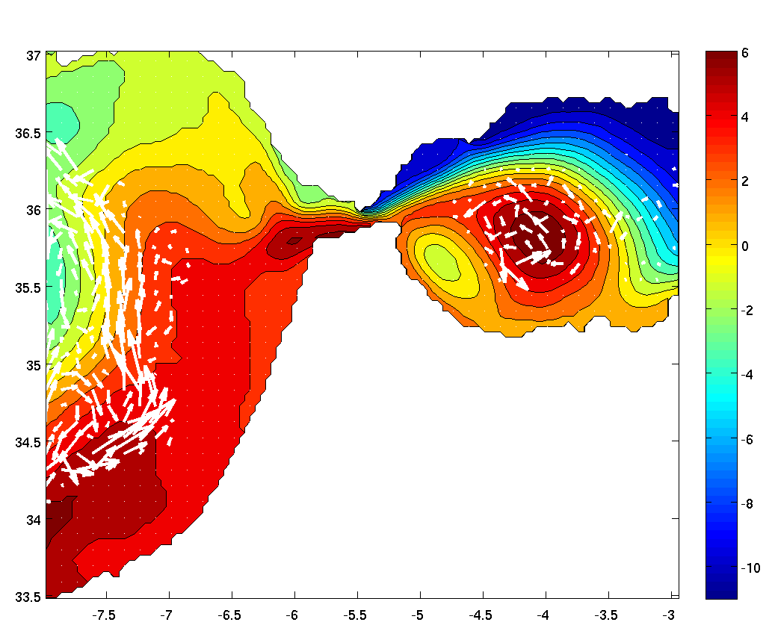
MEDiNA model: Bathymetry (km) and sub-domains
Six domain:
GOM (1/8º) 304x336
NAB (1/4º) 162x398
IBE (1/8º) 100x794
VIS (1/16º) 60x158
GIB (1/24º) 125x107
MED (1/8º) 316x157
Greenland
1/8ºx1/8º
1/16ºx1/16º
30 vertical layers;
top layer 11 m thick;
bottom layer 750 m thick
1/4ºx1/4º
1/8ºx1/8º
1/8ºx1/8º
1/24ºx1/24º
Strait of Gibraltar is resolved (Dietrich et al., 2008)
Notes:
We applied the multiple-grids approach to simulate circulations in the Mediterranean Sea and North Atlantic Ocean. Resolution varies from ¼ to 1/24. This allows the model toe resolve small features efficiently in a multi-basin model.
Such small features affect all scales because of nonlinearity and low dissipation. No instant convective adjustment or other highly diffusive process is used.
We can accurately simulate the downslope migration of MOW water which is well-known to be important for the global climate system. The MOW is dense due to its high salinity. Although the transport is small, the MOW has significant effect on the deep North Atlantic heat and salt budget. This is a challenging problem for ocean model. A focus of this study is to simulate the dense MOW that spills over the Strait of Gibraltar sill.

Slide 3
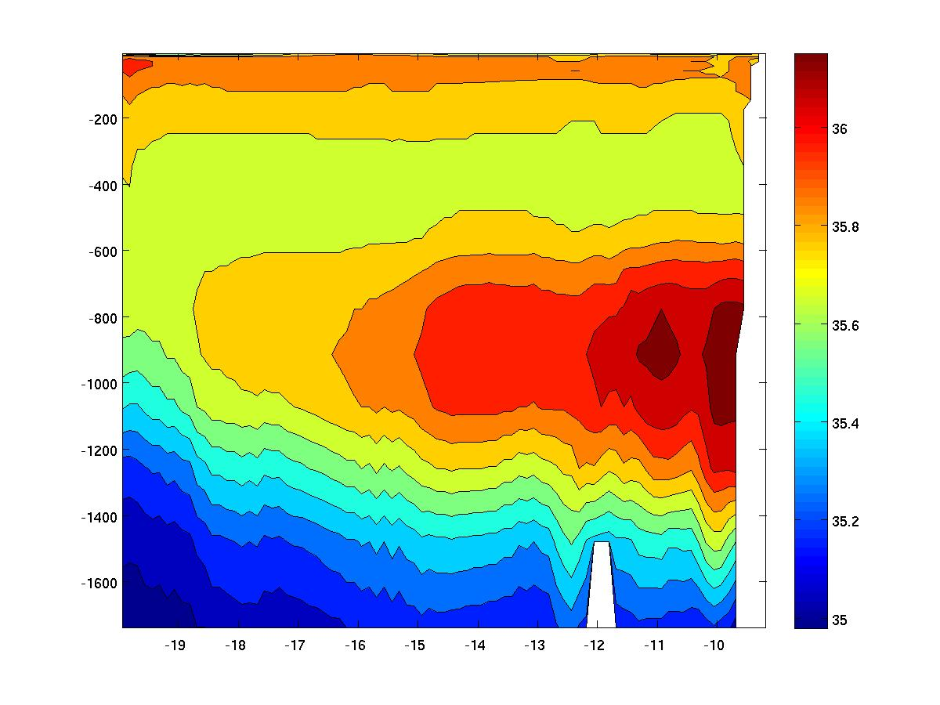
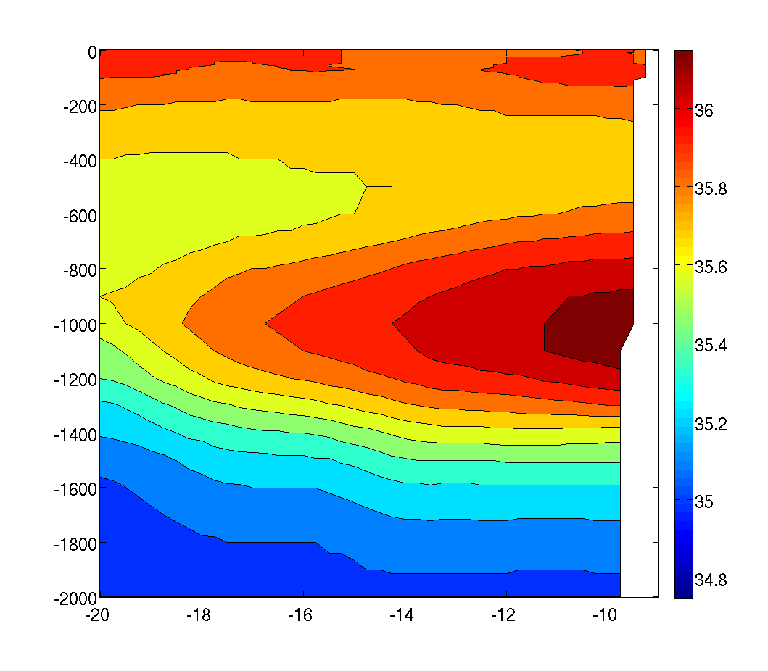

Vertical/longitudinal salinity section at 43°N
Annual averaged model results
U. S. Navy’s GDEM climatology
Notes:
The modeled MOW material, concentrated near 1000m depth, is clearly seen in the vertical salinity cross-section at 43N.The consistency implies the realistic MOW penetration, dilution and propagation can be resolved in the 1/8 eastern NA grid.
We also observe meddies and other advection-diffusion effects gradually spread the MOW offshore near its equilibrium level.

Slide 4
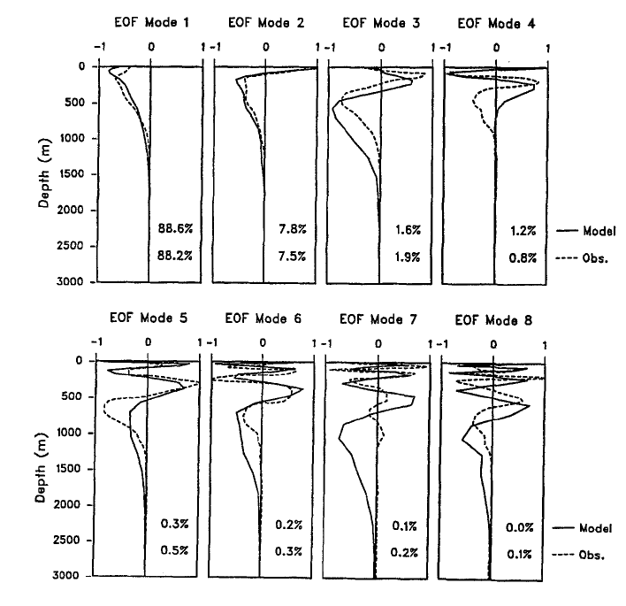
Comparison of the vertical EOF modes of the model with those derived from observations
The total variance represented by each EOF mode is similar between Model and Obs.

Slide 5
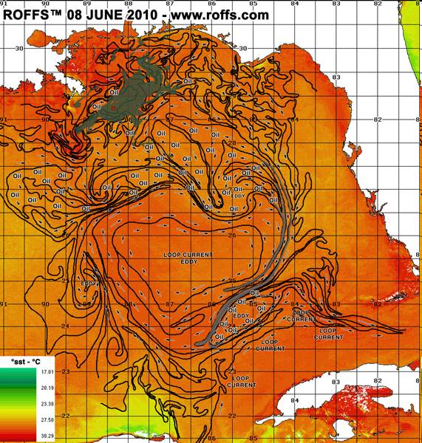
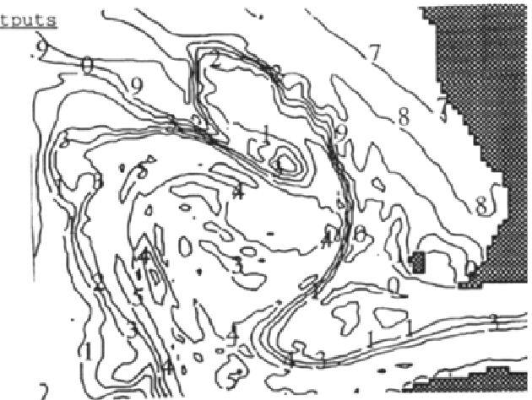
Left: ROFFS analysis of Loop Current and Loop Current eddy 8 June 2010. Colors represent sea surface temperature. See
<http://www.roffs.com/deepwaterhorizon.html >.
Right: DieCAST simulation of Loop Current and Loop Current Eddy. The contour markers are °C above 20 °C ., e.g., 7 = 27 °C. From Dietrich et al., (1997).

Slide 6
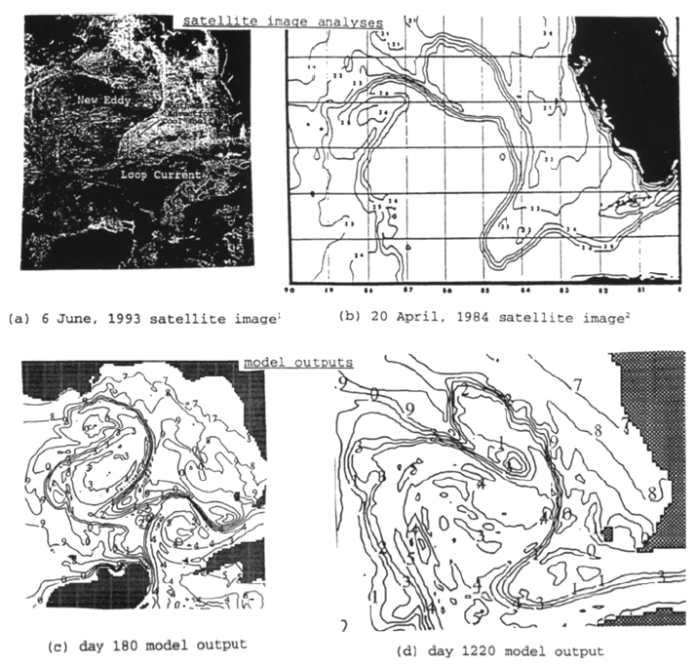
A comparison of analyzed satellite surface temperatures (top panels) and snapshots of the top layer (10 m depth) model temperature (bottom panels).

Slide 7
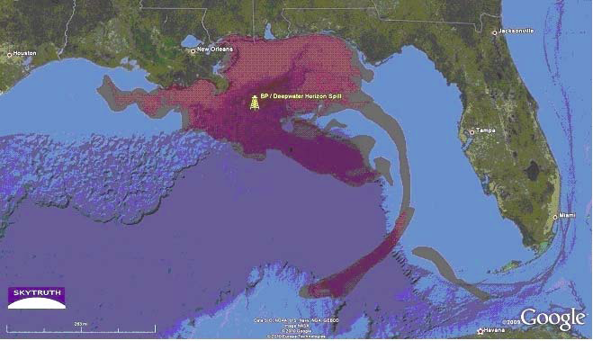
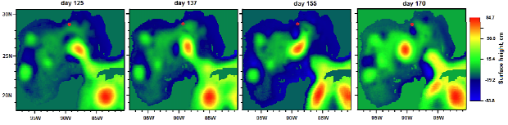
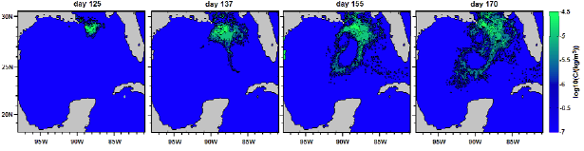
Animation

Slide 8
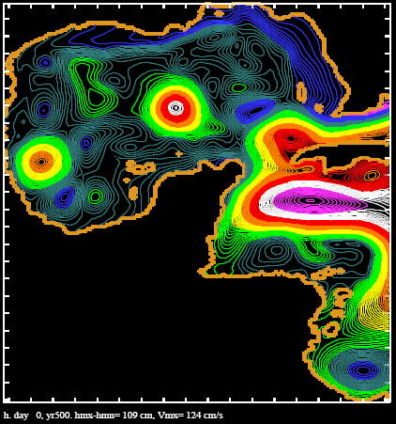
Snapshot at
day 0 of
year 500

Slide 9
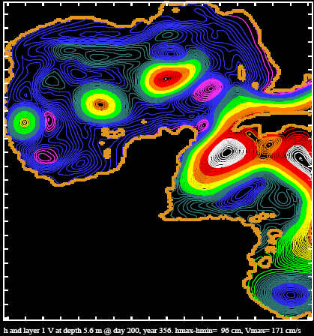

Snapshot at day 200 of year 356

Slide 10
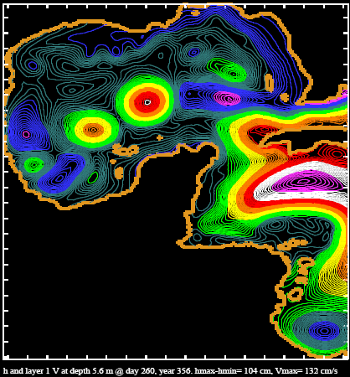
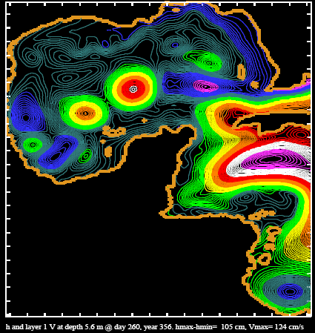
Snapshot at day 260 of year 356

Slide 11
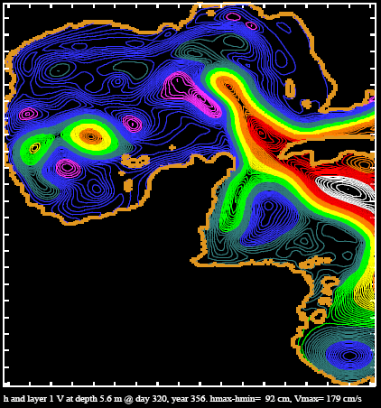
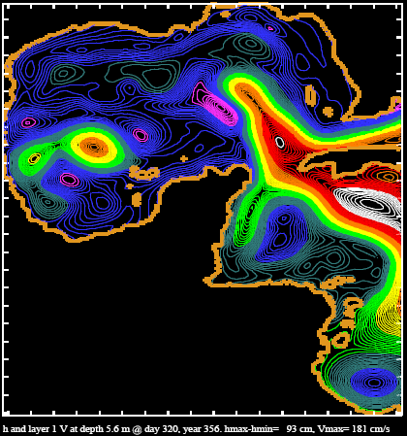
Snapshot at day 320 of year 356

Slide 12
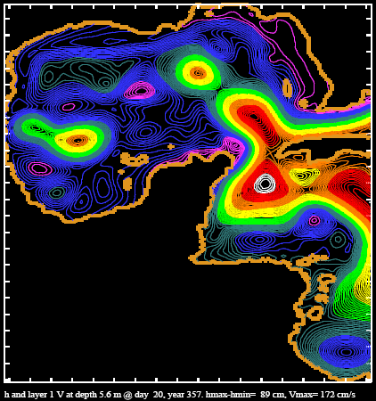
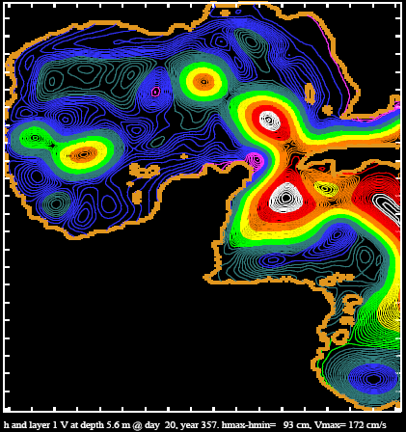
Snapshot at day 020 of year 357

Slide 13
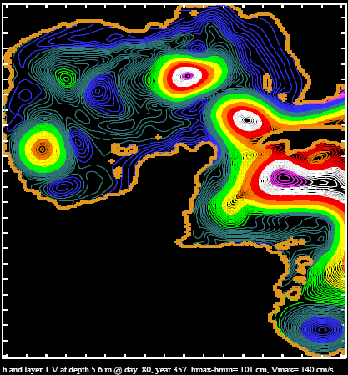
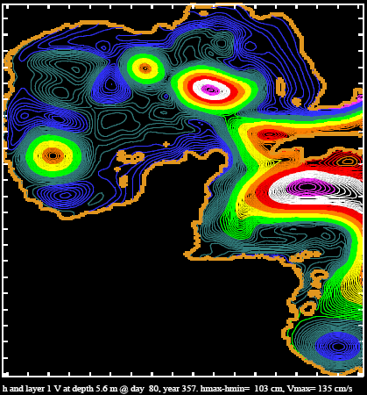
Snapshot at day 080 of year 357

Slide 14
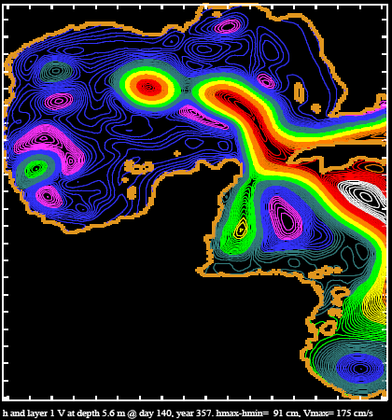
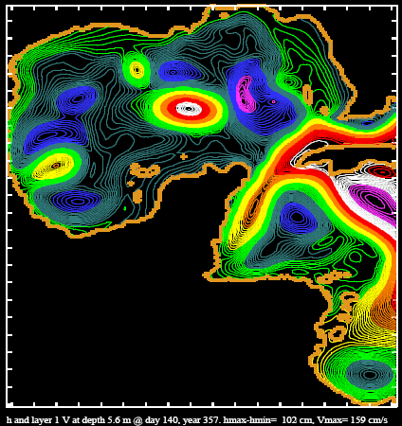
Snapshot at day 140 of year 357

Slide 15
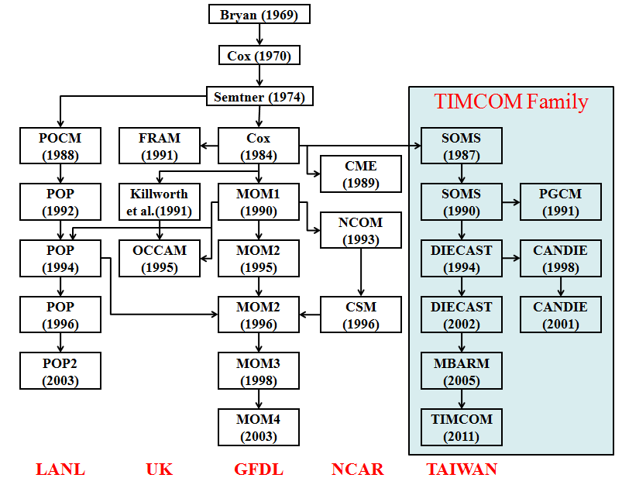
Parallel Domain-Decomposed Taiwan
Multi-Scale Community Model (PD-TIMCOM)
1/4 and 1/16 degree global models are in the production mode.
1/32 and 1/64 degree global model settings can be done as we obtain enough computational resource (need > 3200 cores for better performance)
Scalable with cpu cores (no bottleneck in I/O and parallelization).
Tseng and Chien (2011), Comp. Fluids
Shen et al. (2011), J. Mar. Sys.
Tseng et al. (2012), Prog. Ocean
Young et al. (2012), Env. Modell. Soft.
Shen et al. (2012), Prog. Ocean (revised)
http://efdl.as.ntu.edu.tw/research/timcom
Notes:
15

Slide 16
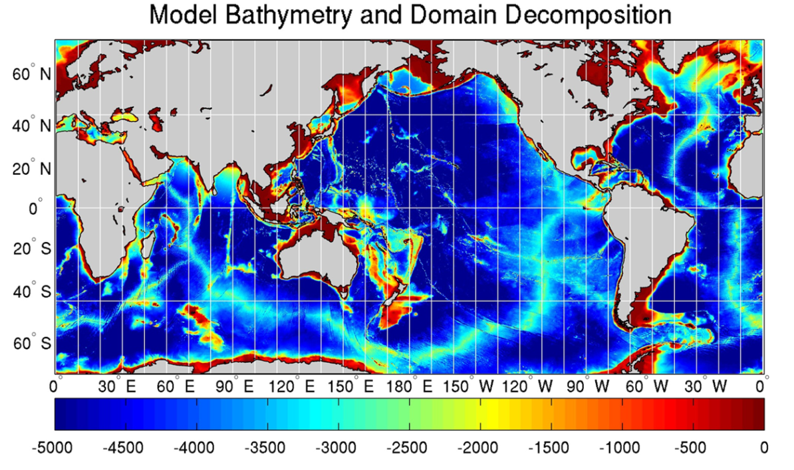
Parallel Domain-Decomposed Taiwan
Multi-Scale Community Model (PD-TIMCOM)
Tseng and Chien (2011)
Bathymetry from 1-min Etopo1
Pacanowski and Philander Vertical mixing (1982) and Smagorinsky horizontal mixing (1993).
Initial Temperature and Salinity from NOAA WOA 09.
Surface wind forcing from Hellerman and Rosenstein (1983)
1/16°and 1/4° horizontal resolution, latitudes covers from 72°S to 72°N.
with 51 linear exponential levels vertically
Primitive, hydrostatic equation
Fourth-order numerics combined Arakawa A and C-grid
Rid-lid approx. and Free surface are used (Yang et al., 2012).
Notes:
16
Here, we will focus more on the results based on the pure OGCM simulation.
16

Slide 17
 | Comp. | Comm.
384 | 2673.4 | 95.9
768 (24) (12) | 1624.0 1045.6 897.4 | 87.7 38.7 26.0
1024 (24) | 1183.5 843.8 | 62.7 28.2
1536 (24) | 1109.5 558.3 | 28.3 13.0
2048 | 941.9 | 34.8
3072 | 829.6 | 26.1
 | 1 | 2 | 6 | 12 | 24 | 48 | 96 | 192 | 384
Comp. | 295.83 | 139.03 | 55.11 | 31.34 | 20.05 | 14.41 | 6.88 | 3.91 | 2.27
Comm. | 0 | 0.49 | 0.29 | 0.26 | 0.35 | 0.65 | 0.42 | 0.55 | 0.36
Notes:
17

Slide 19
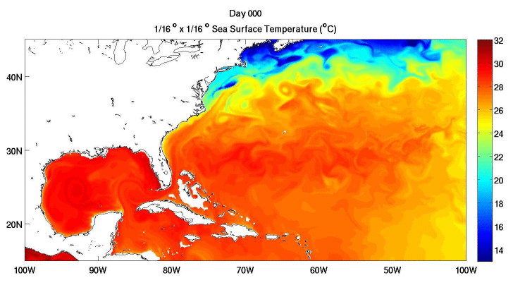

Slide 20
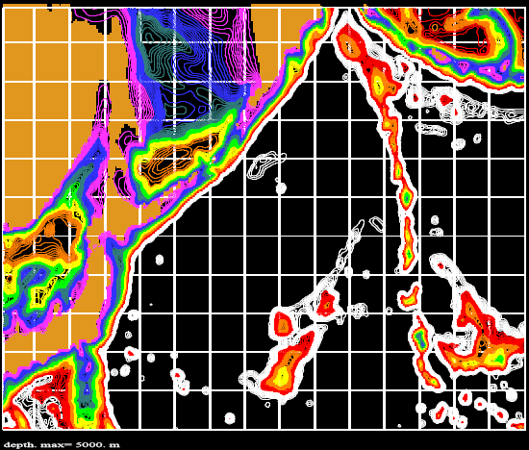
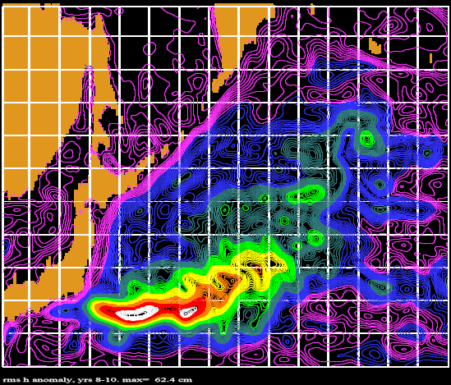
Kuroshio extension east of Japan
rms SSh anomaly

Slide 21
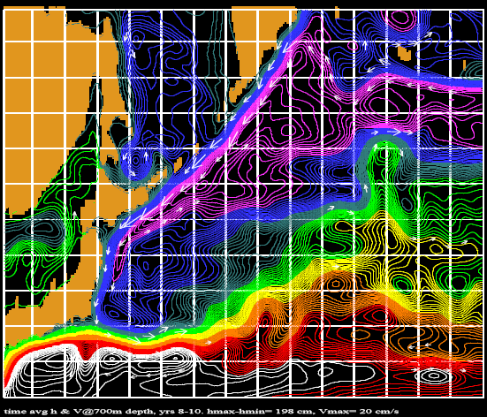
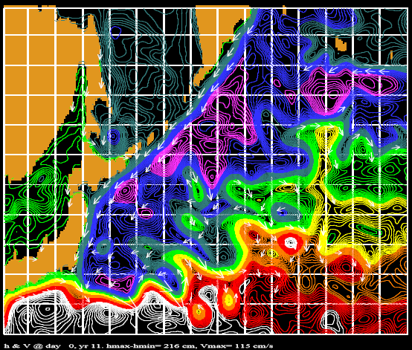
Time avg. h and velocity vector at 700m
Surface h and velocity vector

Slide 22
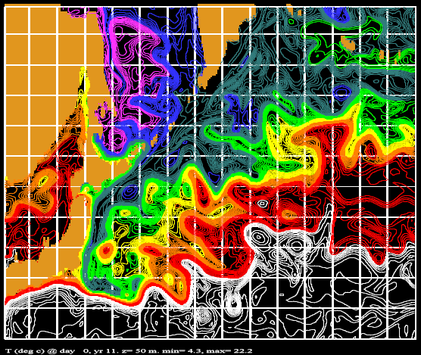
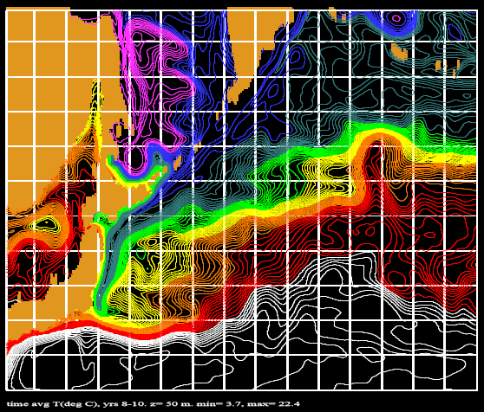
Instantaneous and avg. temperature at 50m
Instantaneous Time avg.

Slide 23
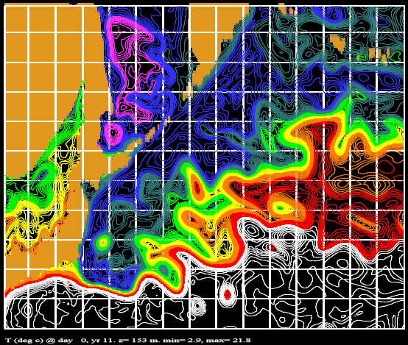
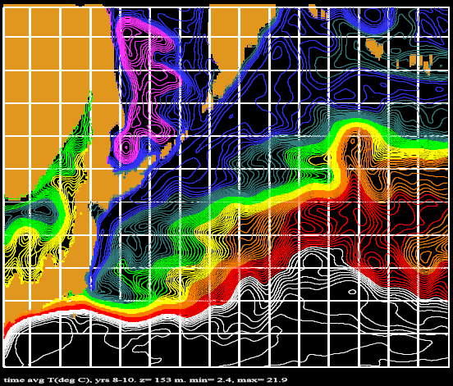
Instantaneous and avg. temperature at 150m
Instantaneous Time avg.

Slide 24
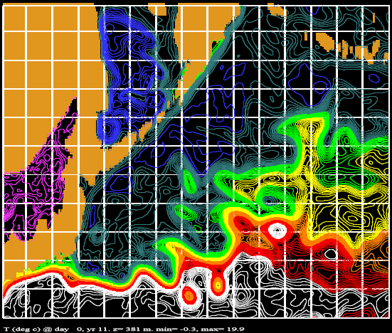
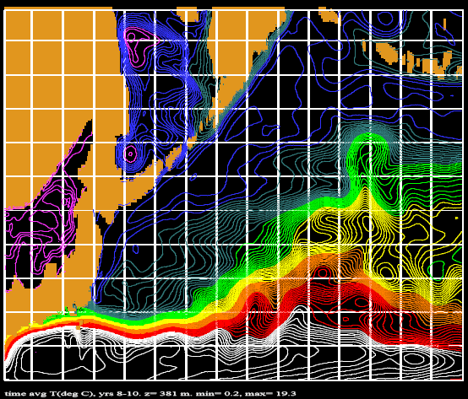
Instantaneous and avg. temperature at 380m
Instantaneous Time avg.

Slide 25
CONCLUDING REMARKS
Successful simulation of the oil blowout surface plume requires accurate synoptic winds. It is thus limited by wind field prediction. However, our results suggest that our model can simulate the deep flow beyond the time scale of surface layer predictability. Thus, it may be useful for estimating long term effects of the large amount of blowout material that is deeply suspended, or resuspended from the bottom sediments, by storms.
Subthermocline material is below the Florida Strait sill level, trapped in the Gulf of Mexico by rotation and buoyancy constraints, except during storm events such as 2012 category one hurricane Isaac that upwelled tarballs and blew them ashore. The average residence time of deep subthermocline material is 250 years.
High resolution (1/16˚and 1/32˚) global simulation will be useful to assess the regional phenomena and provide appropriate initial and boundary conditions.

Slide 26
Future Work
Assess the performance our simple model-data-based initialization/nowcast approach in the Gulf of Mexico, and use it to find predictability limits.
Assess long term effects of deeply suspended oil caused by dispersants
National Taiwan University websites for the model used throughout this talk
http://efdl.as.ntu.edu.tw/research/diecast
http://efdl.as.ntu.edu.tw/research/timcom/FRAME/PDTIMCOM.html
1. from original GoM model that created snapshots and EOFs to be shown (model ran on vintage 1993 SGI workstation)
http://albertomestas.com/research/gulf-of-mexico-circulation-with-diecast-model/
2. years 350-360 animation using special color band contour graphics (from 500-year Gulf of Mexico simulation ran on a desktop processor USING NO DATA ASSIMILATION)
http://stormy.msrc.sunysb.edu/diecast/GoM/126040-129600.avi
3. year 43 animation (uses high quality commercial graphics)
http://stormy.msrc.sunysb.edu/diecast/GoM_surface_height_year43_day180-360.avi

Slide 27

Thank you!

Slide 28
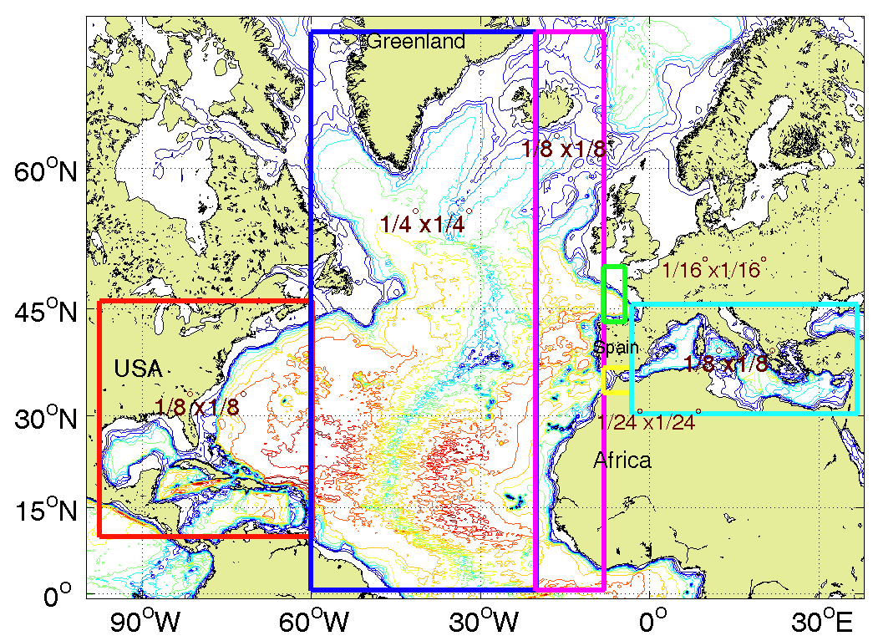
Six-grids MEDiNA model
-Strait of Gibraltar is resolved (Dietrich et al., 2008)

