Slide 1
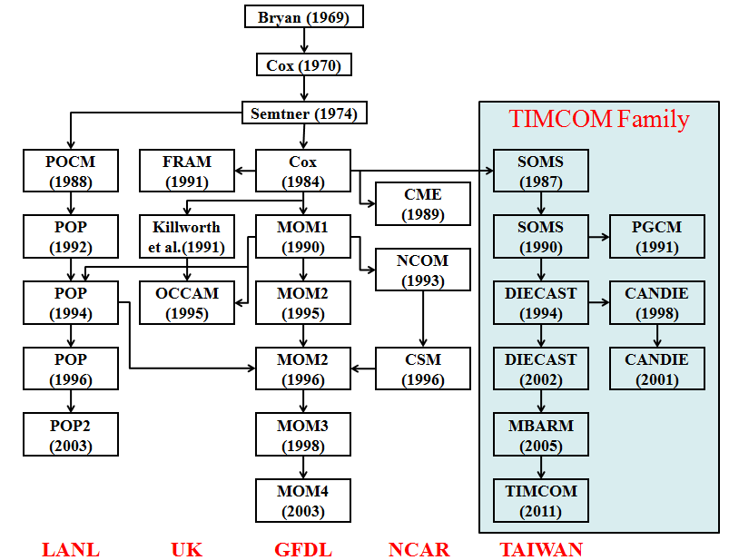
Parallel Domain-Decomposed Taiwan
Multi-Scale Community Model (PD-TIMCOM)
1/4 and 1/16 degree global models are in the production mode.
1/32 and 1/64 degree global model settings can be done as we obtain enough computational resource (need > 3200 cores for better performance)
Scalable with cpu cores (no bottleneck in I/O and parallelization).
Tseng and Chien (2011), Comp. Fluids
Shen et al. (2011), J. Mar. Sys.
Tseng et al. (2012), Prog. Ocean
Young et al. (2012), Env. Modell. Soft.
Shen et al. (2012), Prog. Ocean (revised)
http://efdl.as.ntu.edu.tw/research/timcom
Notes:
1

Slide 2
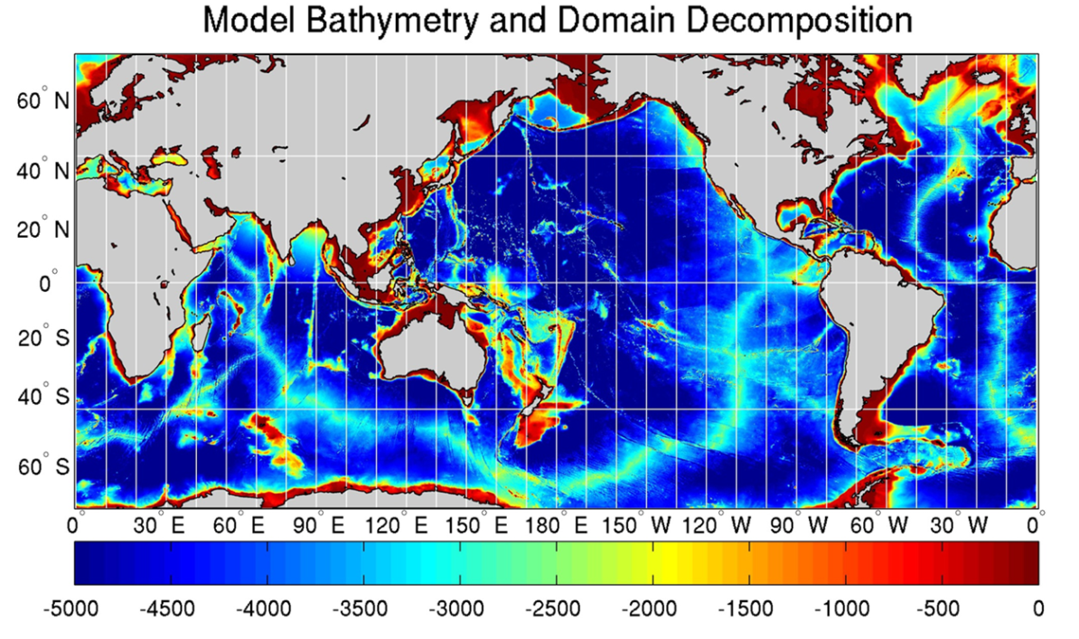
Parallel Domain-Decomposed Taiwan
Multi-Scale Community Model (PD-TIMCOM)
Tseng and Chien (2011)
Bathymetry from 1-min Etopo1
Pacanowski and Philander Vertical mixing (1982) and Smagorinsky horizontal mixing (1993).
Initial Temperature and Salinity from NOAA WOA 09.
Surface wind forcing from Hellerman and Rosenstein (1983)
1/16°and 1/4° horizontal resolution, latitudes covers from 72°S to 72°N.
with 51 linear exponential levels vertically
Primitive, hydrostatic equation
Fourth-order numerics combined Arakawa A and C-grid
Rid-lid approx. and Free surface are used (Yang et al., 2012).
Notes:
2
Here, we will focus more on the results based on the pure OGCM simulation.
2

Slide 3

 | Comp. | Comm.
384 | 2673.4 | 95.9
768 (24) (12) | 1624.0 1045.6 897.4 | 87.7 38.7 26.0
1024 (24) | 1183.5 843.8 | 62.7 28.2
1536 (24) | 1109.5 558.3 | 28.3 13.0
2048 | 941.9 | 34.8
3072 | 829.6 | 26.1
 | 1 | 2 | 6 | 12 | 24 | 48 | 96 | 192 | 384
Comp. | 295.83 | 139.03 | 55.11 | 31.34 | 20.05 | 14.41 | 6.88 | 3.91 | 2.27
Comm. | 0 | 0.49 | 0.29 | 0.26 | 0.35 | 0.65 | 0.42 | 0.55 | 0.36
Notes:
3

Slide 4
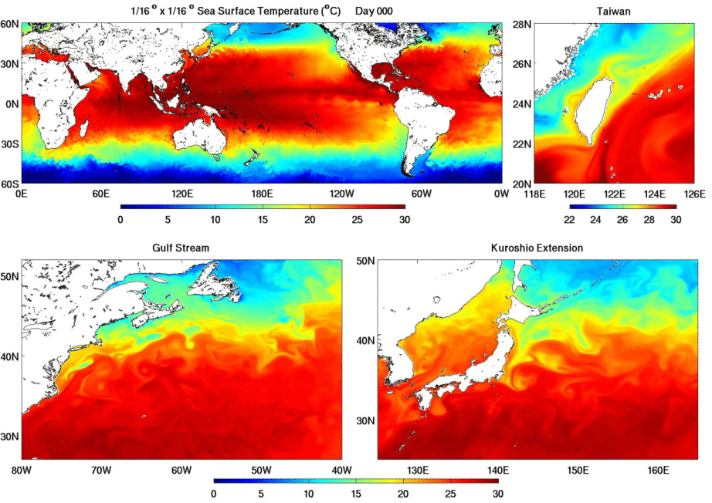

Slide 5
