Slide 1
North and equatorial Pacific Ocean circulation in the CORE-II hindcast simulations
Yu-heng Tseng
Institute of Oceanography,
National Taiwan University
Hongyang Lin², Han-ching Chen³, Keith Thompson⁴, Mats Bentsen⁵, Claus W. Böning⁶, Alexandra Bozec⁷, Christophe Cassou⁸, Eric Chassignet⁷, Chun Hoe Chow⁹, Gokhan Danabasoglu¹, Sergey Danilov¹⁰, Riccardo Farneti¹¹, Pier Giuseppe Fogli¹², Yosuke Fujii¹³, Stephen M. Griffies¹⁴, Mehmet Ilicak⁵, Thomas Jung¹⁰, Simona Masina^{12,15}, Antonio Navarra^{12,15}, Lavinia Patara⁶, Bonita L. Samuels¹⁴, Markus Scheinert⁶, Dmitry Sidorenko¹⁰, Chung-Hsiung Sui³, Hiroyuki Tsujino¹³, Sophie Valcke⁸, Aurore Voldoire¹⁶, Qiang Wang¹⁰
²Xiamen University; ³National Taiwan University; ⁴Dalhousie University; ⁵Uni Research Ltd.; ⁶GEOMAR Helmholtz Center for Ocean Research Kiel; ⁷Florida State University;⁸Centre Européen de Recherche et de Formation Avancée en Calcul Scientifique; ⁹Research Academia Sinica;¹⁰Alfred Wegener Institute for Polar and Marine Research; ¹¹International Centre for Theoretical Physics; ¹²Centro Euro Mediterraneo sui Cambiamenti Climatici; ¹³Meterological Research Institute; ¹⁴Geophysical Fluid Dynamics Laboratory; ¹⁵Istituto Nazionale di Geofisica e Vulcanologia; ¹⁶Centre National de Recherches Météorologiques (CNRM-GAME)
EASM-3: Collaborative Research: Quantifying Predictability Limits, Uncertainties, Mechanisms, and Regional Impacts of Pacific Decadal Climate Variability
Notes:
What I am going to present is

Slide 2
Introduction
General surface pattern in the Pacific
Kuroshio/Oyashio in the Asian Marginal Seas and Kuroshio extension
Mixed layer depth and water mass in the North Pacific
Tropical Pacific dynamics and Subtropical cells (STCs)
Conclusion

Slide 3
http://www.clivar.org/clivar-panels/omdp/core-2
CLIVAR Coordinated Ocean-ice Reference Experiments-Phase 2
Multi-model analysis
North Atlantic Simulations in Coordinated Ocean-ice Reference Experiments phase II (CORE-II). Part I: Mean States Danabasoglu, G., S. G. Yeager, D. Bailey, E. Behrens, M. Bentsen, D. Bi, A. Biastoch, C. Boning, A. Bozec, V. Canuto, C. Cassou, E. Chassignet, A. C. Coward, S. Danilov, N. Diansky, H. Drange, R. Farneti, E. Fernandez, P. G. Fogli, G. Forget, Y. Fujii, S. M. Griffies, A. Gusev, P. Heimbach, A. Howard, T. Jung, M. Kelley, W. G. Large, A. Leboissetier, J. Lu, G. Madec, S. J. Marsland, S. Masina, A. Navarra, A. J. G. Nurser, A. Pirani, D. Salas y Melia, B. L. Samuels, M. Scheinert, D. Sidorenko, A.-M. Treguier, H. Tsujino, P. Uotila, S. Valcke, A. Voldoire, and Q. Wang, 2014. Ocean Modelling, 73, 76-107, doi:10.1016/j.ocemod.2013.10.005.
North Atlantic Simulations in Coordinated Ocean-ice Reference Experiments phase II (CORE-II). Part II: Inter-Annual to Decadal Variability Danabasoglu, G., S. G. Yeager, W. M. Kim, E. Behrens, M. Bentsen, D. Bi, A. Biastoch, R. Bleck, C. Boning, A. Bozec, V. M. Canuto, C. Cassou, E. Chassignet, A. C. Coward, S. Danilov, N. Diansky, H. Drange, R. Farneti, E. Fernandez, P. G. Fogli, G. Forget, Y. Fujii, S. M. Griffies, A. Gusev, P. Heimbach, A. Howard, T. Jung, M. Kelley, W. G. Large, A. Leboissetier, J. Lu, G. Madec, S. J. Marsland, S. Masina, A. Navarra, A. J. G. Nurser, A. Pirani, A. Romanou, D. Salas y Melia, B. L. Samuels, M. Scheinert, D. Sidorenko, S. Sun, A.-M. Treguier, H. Tsujino, P. Uotila, S. Valcke, A. Voldoire, Q. Wang, 2015: North Atlantic Simulations in Coordinated Ocean-ice Reference Experiments phase II (CORE-II). Part II: Inter-Annual to Decadal Variability. Ocean Modelling, in press.
An assessment of global and regional sea level for years 1993–2007 in a suite of interannual CORE-II simulations Griffies, S. M., J. Yin, P. J. Durack, P. Goddard, S. C. Bates, E. Behrens, M. Bentsen, D. Bi, A. Biastoch, C. W. Böning, A. Bozec, E. Chassignet, G. Danabasoglu, S. Danilov, C. M. Domingues, H. Drange, R. Farneti, E. Fernandez, R. J. Greatbatch, D. M. Holland, M. Ilicak, W. G. Large, K. Lorbacher, J. Lu, S. J. Marsland, A. Mishra, A. J. G. Nurser, D. Salas y Mélia, J. B. Palter, B. L. Samuels, J. Schröter, F. U. Schwarzkopf, D. Sidorenko, A. M. Treguier, Y.-H. Tseng, H. Tsujino, P. Uotila, S. Valcke, A. Voldoire, Q. Wang, M. Winton, Z. Zhang, 2014. Ocean Modelling, 78, 35-89,doi:10.1016/j.ocemod.2014.03.004
An assessment of Antarctic Circumpolar Current and Southern Ocean Meridional Overturning Circulation during 1958-2007 in a suite of interannual CORE-II simulations Farneti, R., S. M. Downes, S. M. Griffies, S. J. Marsland, D. Bailey, E. Behrens, M. Bentsen, D. Bi, A. Biastoch, C. Boning, A. Bozec, E. Chassignet, G. Danabasoglu, S. Danilov, N. Diansky, H. Drange, P. G. Fogli, A. Gusev, R. W. Hallberg, A. Howard, M. Kelley, M. Illicak, W. G. Large, A. Leboissetier, M. Long, J. Lu, S. Masina, A. Mishra, A. Navarra, A. J. G. Nurser, L. Patara, B. L. Samuels, D. Sidorenko, H. Tsujino, P. Uotila, S. G. Yeager, Q. Wang, 2015. Ocean Modelling, doi: 10.1016/j.ocemod.2015.07.009
An assesment of Southern Ocean water masses and sea ice during 1988-2007 in a suite of interannual CORE-II simulations Downes, S. M., R. Farneti, P. Uotila, S. M. Griffies, S. J. Marsland, D. Bailey, E. Behrens, M. Bentsen, D. Bi, A. Biastoch, C. Boning, A. Bozec, V. M. Canuto, E. Chassignet, G. Danabasoglu, S. Danilov, N. Diansky, H. Drange, P. G. Fogli, A. Gusev, A. Howard, M. Kelley, M. Ilicak, T. Jung, M. Kelley, W. G. Large, A. Leboissetier, M. Long, J. Lu, S. Masina, A. Mishra, A. Navarra, A. J. G. Nurser, L. Patara, B. L. Samuels, D. Sidorenko, P. Spence, H. Tsujino, Q. Wang, S. G. Yeager. Ocean Modelling ,under review
North and Equatorial Pacific Ocean Circulation in the CORE-II Hindcast Simulations Tseng, Y.-H., H. Lin; H.-C. Chen, K. Thompson, M. Bentsen, C. Boning, A. Bozec, C. Cassou, E. Chassignet, C. H. Chow, G. Danabasoglu, S. Danilov, R. Farneti, Y. Fujii, S. Griffies, M. Ilicak, T. Jung, S. Masina, A. Navarra, L. Patara, B. Samuels, M. Scheinert, D. Sidorenko, C.-H Sui, H. Tsujino, S. Valcke, A. Voldoire, Q. Wang. North and Equatorial Pacific Ocean Circulation in the CORE-II Hindcast Simulations. Ocean Modelling, under review

Slide 4
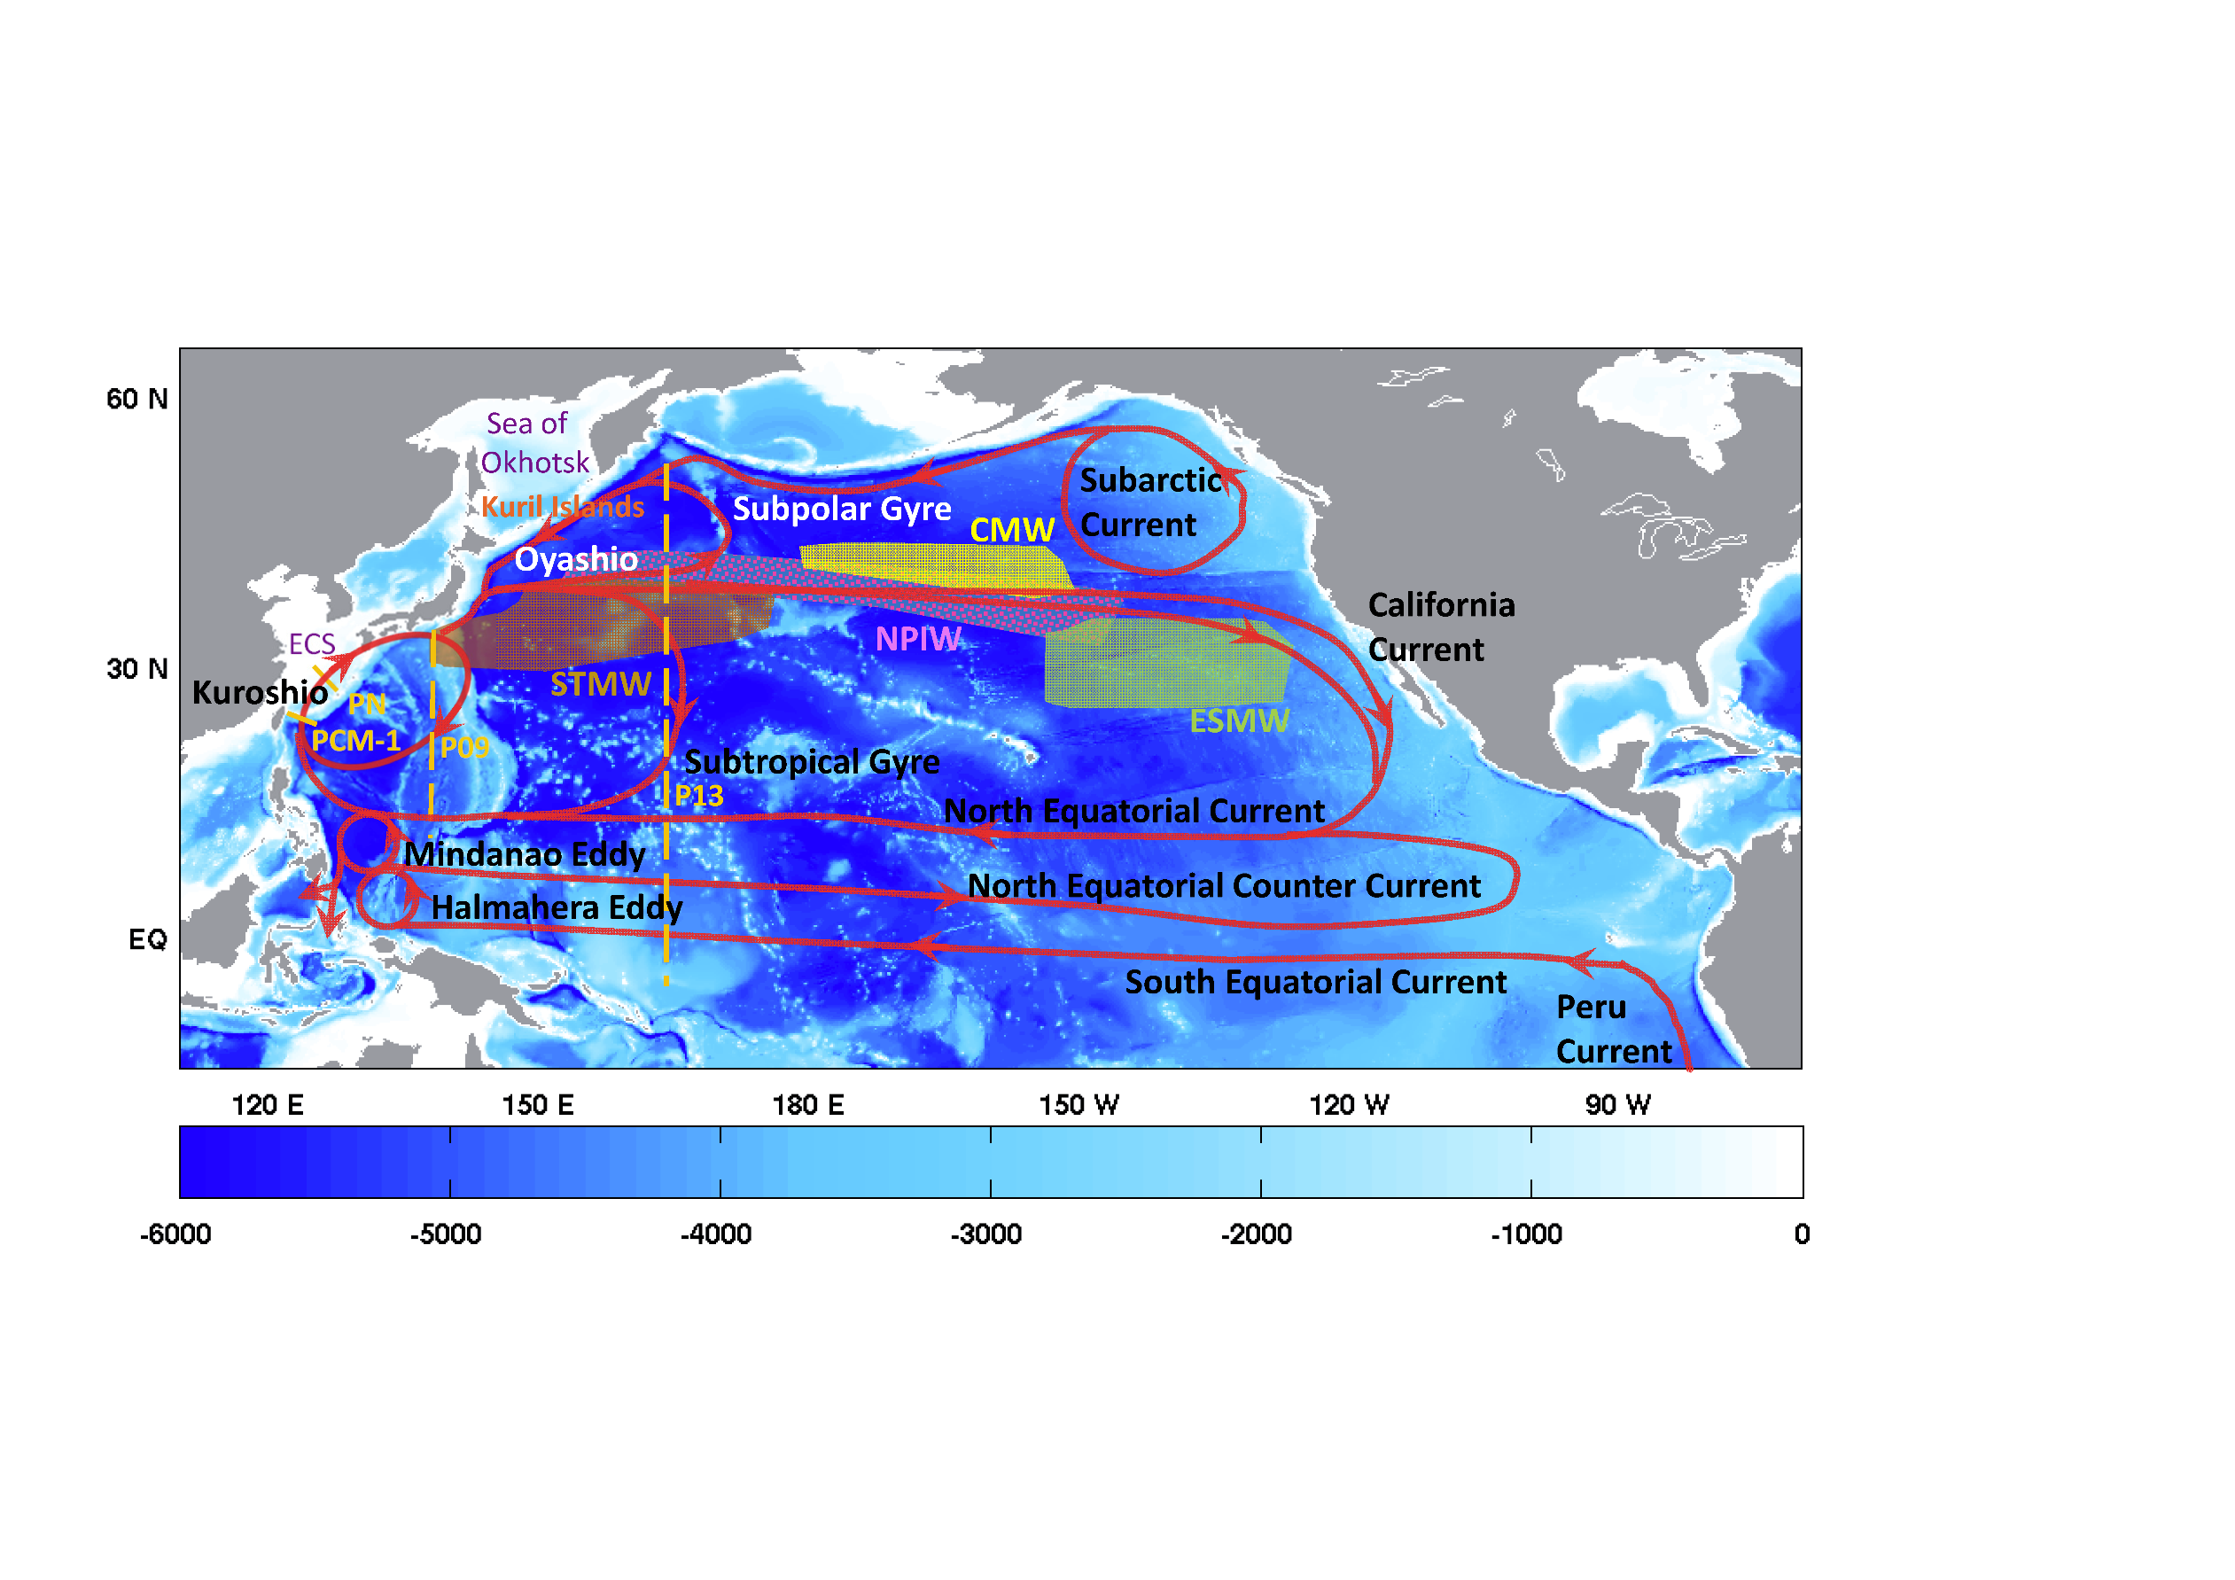
Pacific circulation and water mass distribution

Slide 5
Summary of the model configurations
Group | Ocean model | Sea-ice model | Vertical | Horiz. res.
AWI | FESOM 1.4 |  | z (46) | Nominal 1°
BERGEN | MICOM | CICE 4 | sigma (53) | Nominal 1°
CCLICS | TIMCOM | CICE 4 | z (40) | Nominal 1.25°
CERFACS | NEMO 3.2 | LIM 2 | z (42) | Nominal 1°
CMCC | NEMO 3.3 | CICE 4 | z (46) | Nominal 1°
CNRM | NEMO 3.2 | Gelato 5 | z (42) | Nominal 1°
FSU | HYCOM 2.2 | CICE 5 | hybrid (32) | Nominal 1°
GFDL-MOM | MOM 4p1 | SIS | z* (50) | Nominal 1°
GFDL-GOLD | GOLD | SIS | Sigma (63) | Nominal 1°
ICTP | MOM 4p1 | SIS | z* (30) | Nominal 2°
KIEL-R025 | NEMO 3.4.1 | LIM 2 | z (46) | Nominal 0.25°
KIEL-R050 | NEMO 3.1.1 | LIM 2 | z (46) | Nominal 0.5°
MRI-ASSIM | MOVE/MRI.COM 3 | MK89; CICE | z (50) | 1° × 0.5°
MRI-FREE | MRI.COM 3 | MK89; CICE | z (50) | 1° × 0.5°
NCAR | POP 2 | CICE 4 | z (60) | Nominal 1°

Slide 6
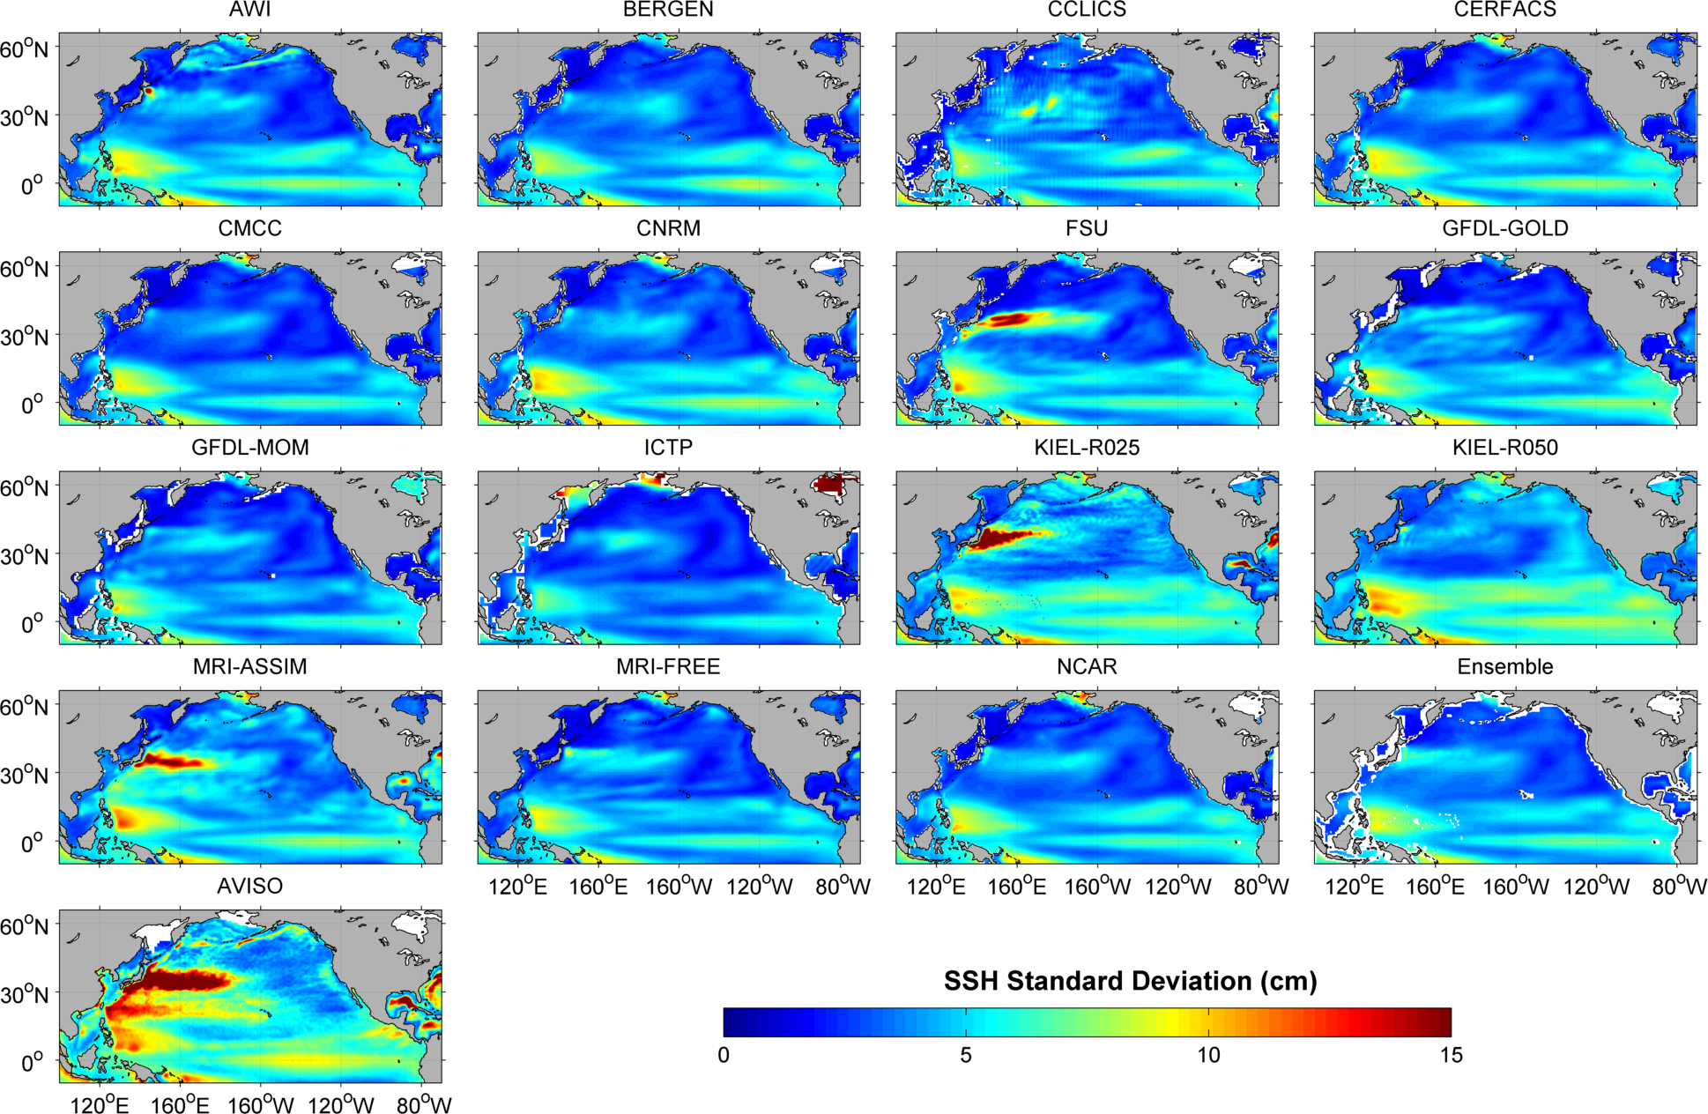
Standard deviation of Sea Surface Height (SSH)
1993-2007

Slide 7
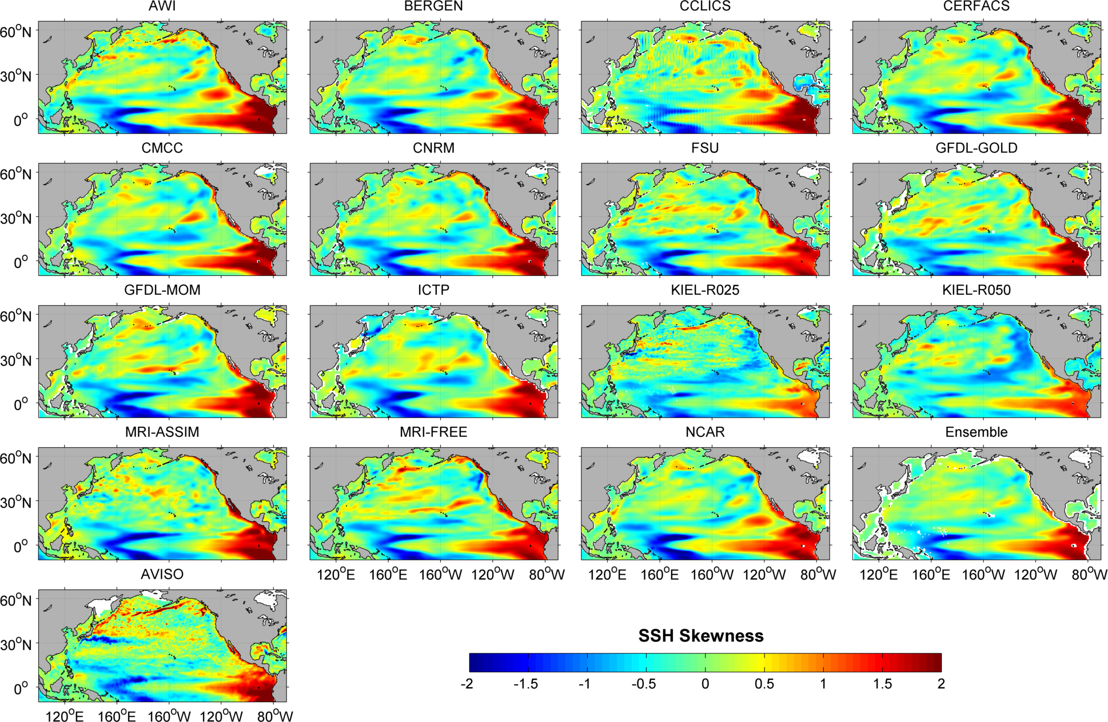
Skewness of SSH
1993-2007

Slide 8
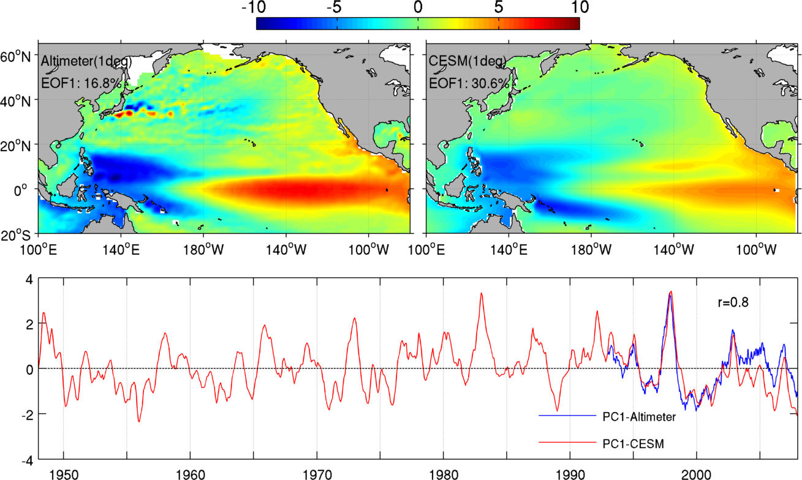
1st EOF mode of SSH in North and tropical Pacific based on altimetry (1993-2007) and POP model (1948-2007)

Slide 9
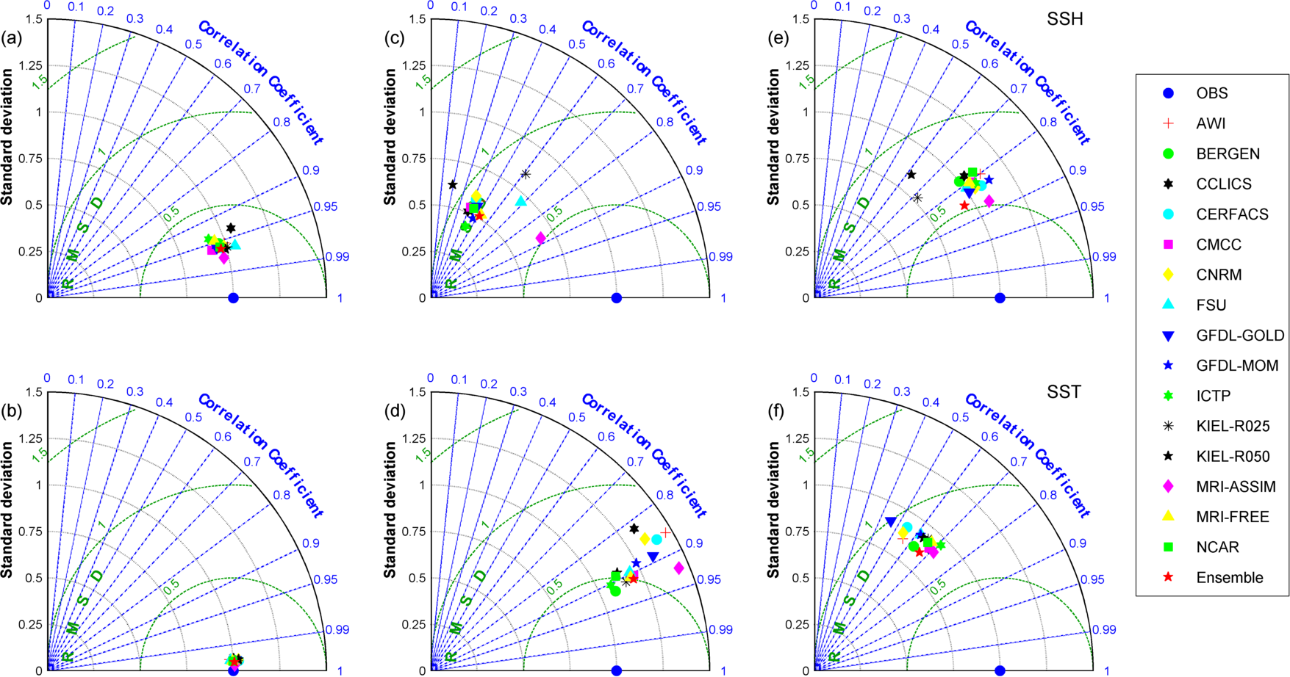
Comparison of spatial maps of the statistics model output and observation using Taylor Diagrams
Mean Variance Skewness
SSH is the model diagnostic of the integrated circulation
Large discrepancies are found in variance and skewness

Slide 10
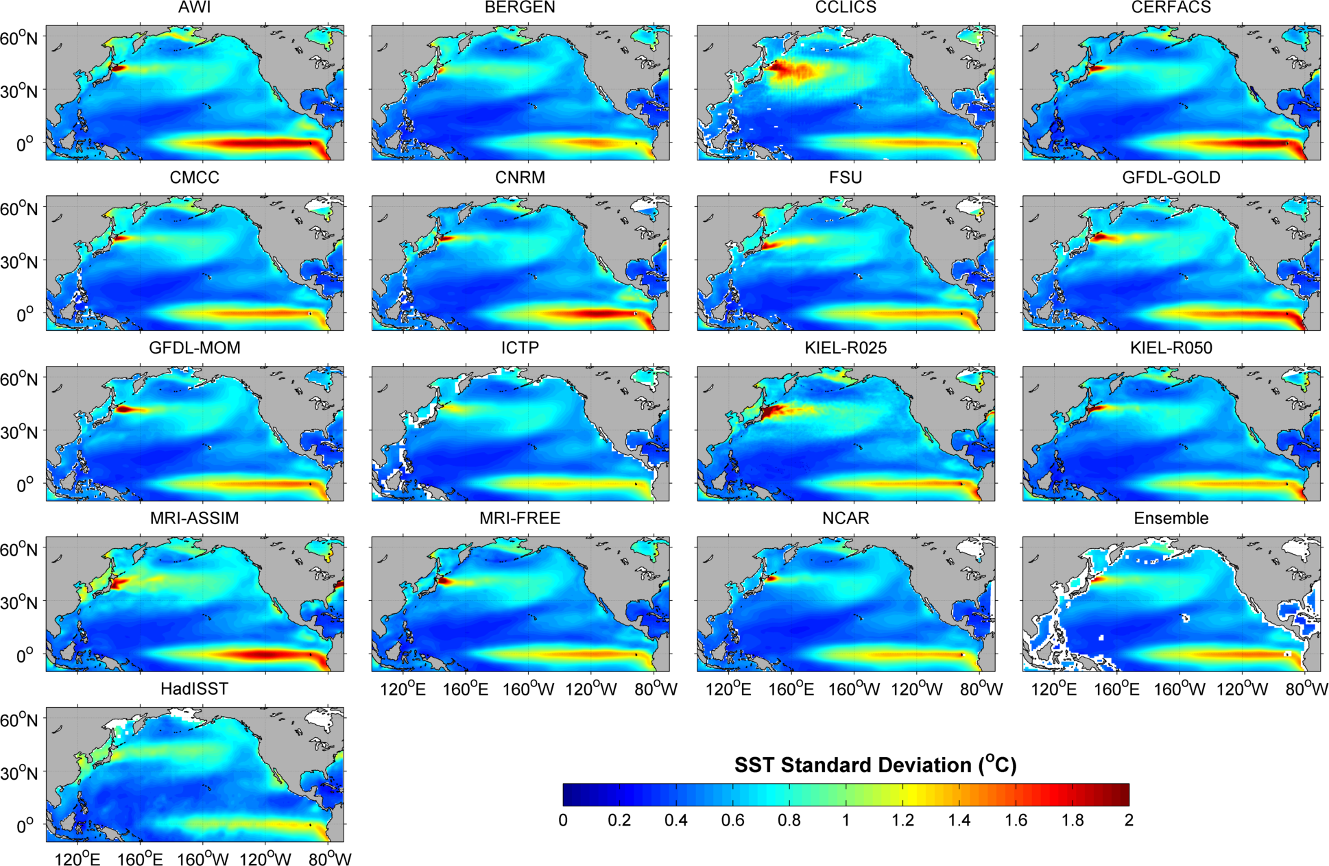
Standard deviation of Sea Surface Temperature (SST)
1963-2007

Slide 11
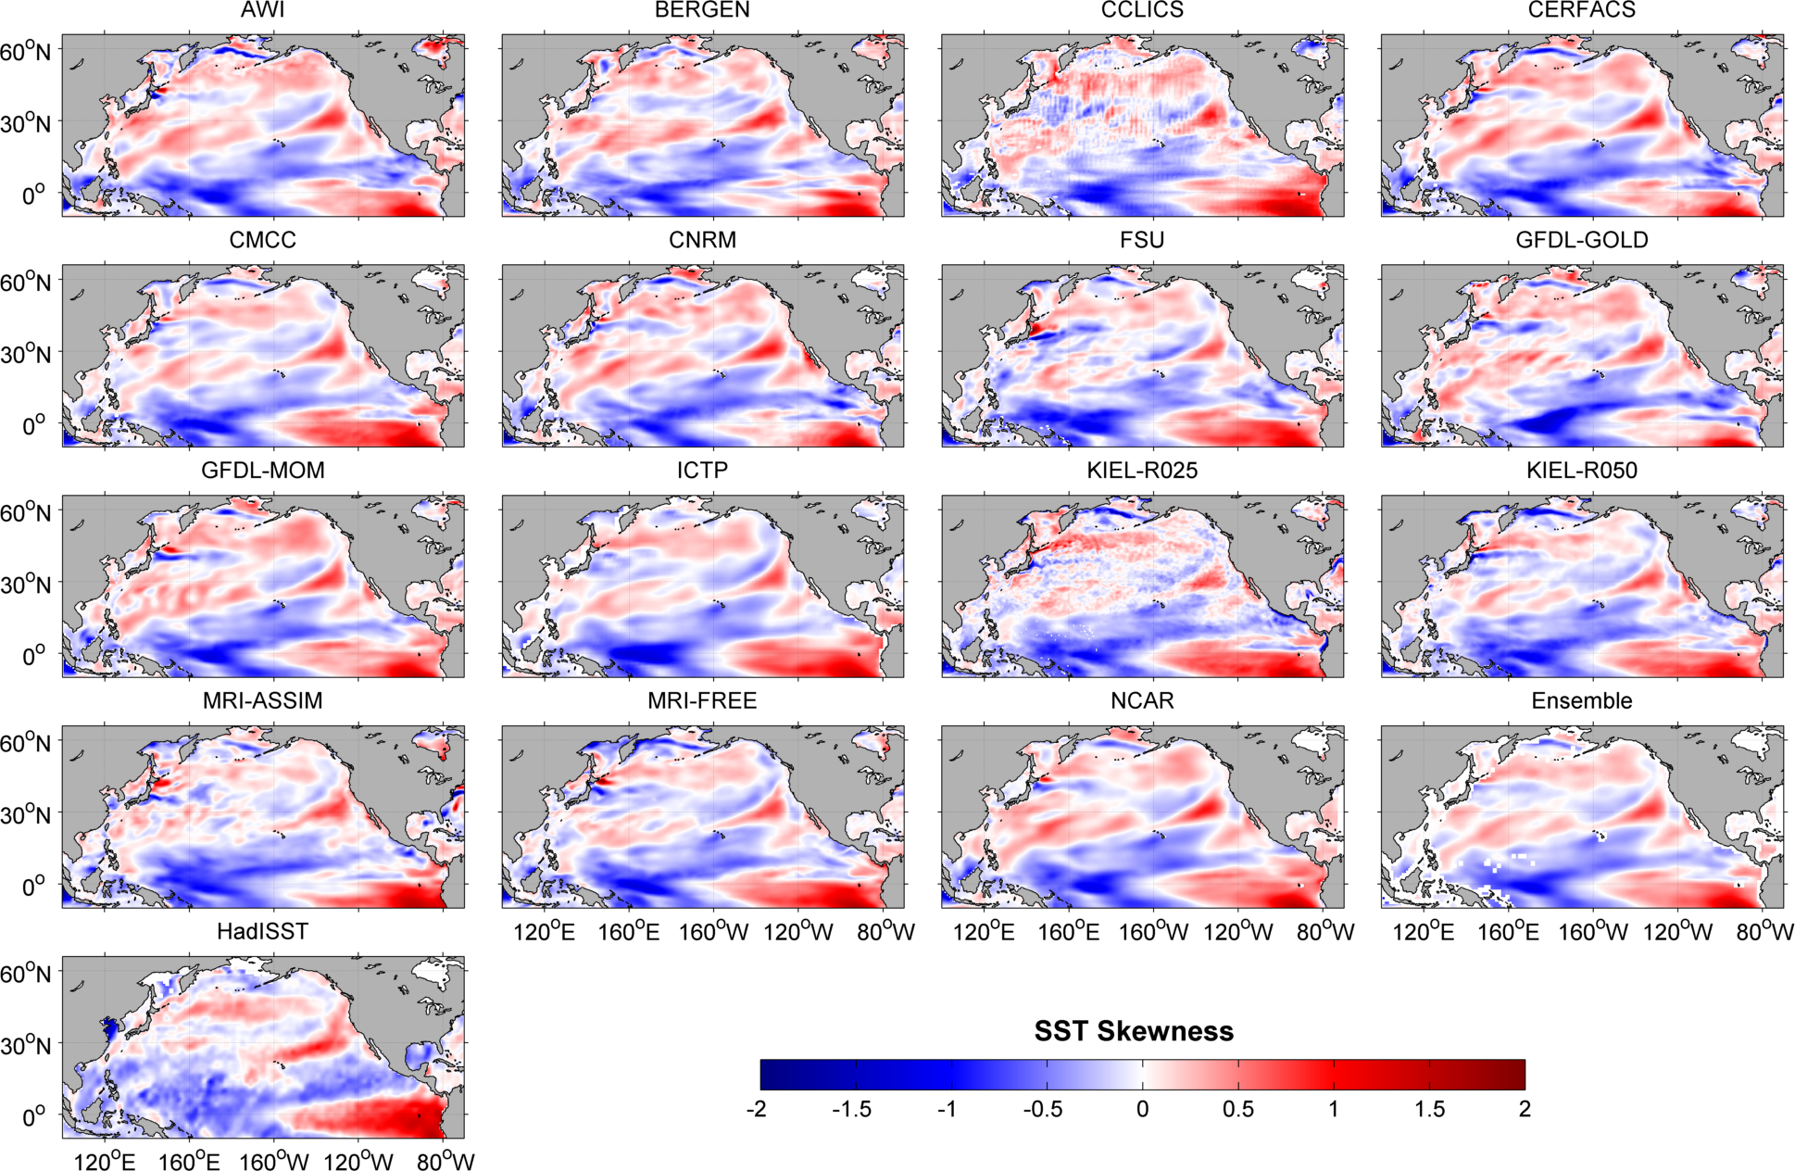
Skewness of SST
1963-2007

Slide 12
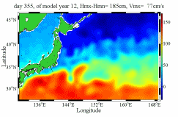
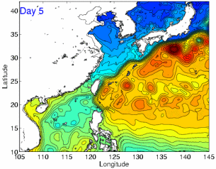
Kuroshio current and its transport in the Pacific Asian Margiona Sea (PAMS)

Slide 13
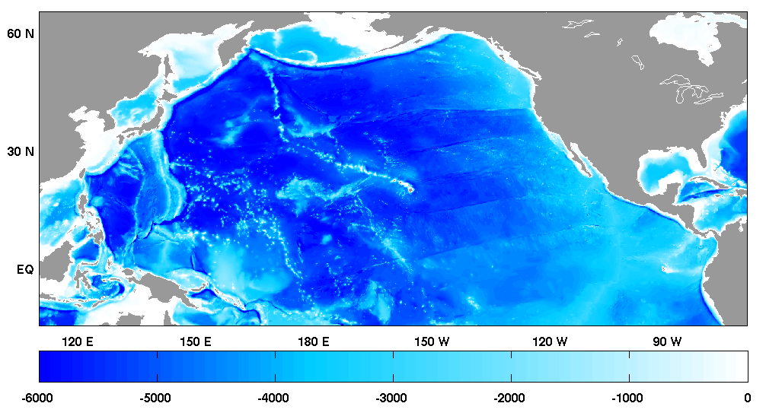
Kuroshio transport
Sea of
Okhotsk
Subarctic
Current
P13
California Current
ECS
 | PCM-1 | PN | 137°E
AWI | 26.1(34.6) | 7.5(10.5) | 24.3(34.0)
BERGEN | 10.4(16.3) | 6.0(11.9) | 25.5(28.8)
CCLICS | 10.2(19.1) | 2.2(19.1) | 27.8(41.4)
CERFACS | 12.5(30.7) | 5.8(12.7) | 22.5(26.1)
CMCC | 17.7(30.3) | 11.8(10.1) | 21.0(24.7)
CNRM | 12.6(30.3) | 7.2(13.6) | 22.5(25.9)
FSU | 20.9(29.1) | 12.3(15.6) | 29.4(58.1)
GFDL-GOLD | 15.1(29.7) | 2.9(15.6) | 18.0(31.7)
GFDL-MOM | 8.3(23.7) | 4.8(8.2) | 20.8(28.7)
ICTP | 6.7(21.6) | 2.7(0.9) | 23.4(27.2)
KIEL-R025 | 30.9(33.6) | 13.9(19.0) | 26.7(45.6)
KIEL-R050 | 25.7(31.8) | 7.2(9.4) | 29.2(34.3)
MRI-ASSIM | 24.1(30.8) | 12.0(18.3) | 26.6(42.2)
MRI-FREE | 21.7(28.7) | 11.0(16.2) | 25.2(30.8)
NCAR | 10.6(24.1) | 6.2(11.7) | 25.9(30.5)
Ensemble Mean | 16.4±7.5(27.4±5.5) | 7.2±3.7(12.1±4.7) | 24.6±3.3(33.7±9.4)
OBS | 21.2±2.4 | 24.1±3.4 | 33.0(49.4)
Kuroshio
PN
PCM-1
P09
NEC
Unit: Sv

Slide 14
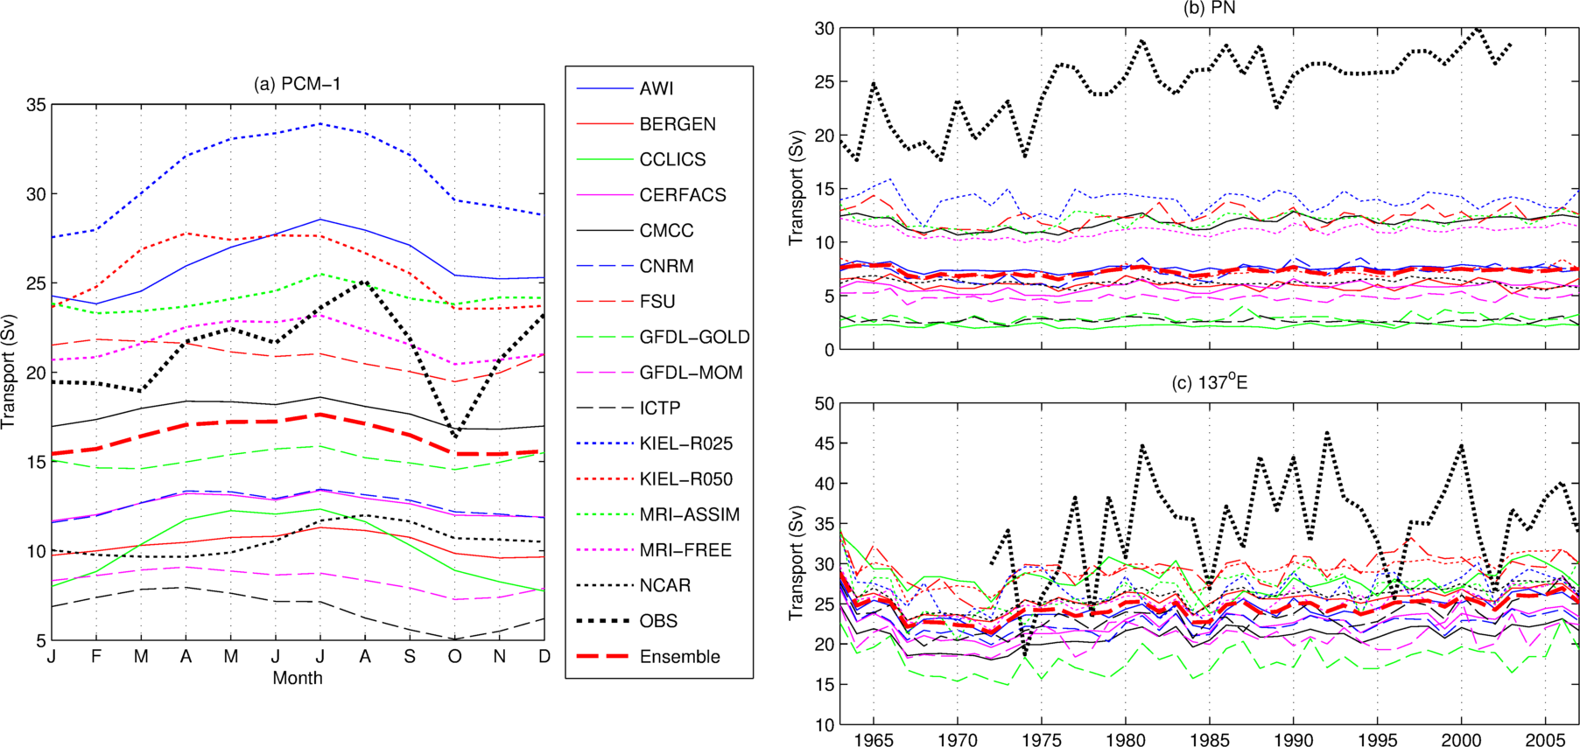
Seasonal variability along PCM-1 and interannual variability along PN and P09

Slide 15
Mixed Layer Depth (MLD) and Water Mass Distribution
CMW
STMW
NPIW
ESMW

Slide 16
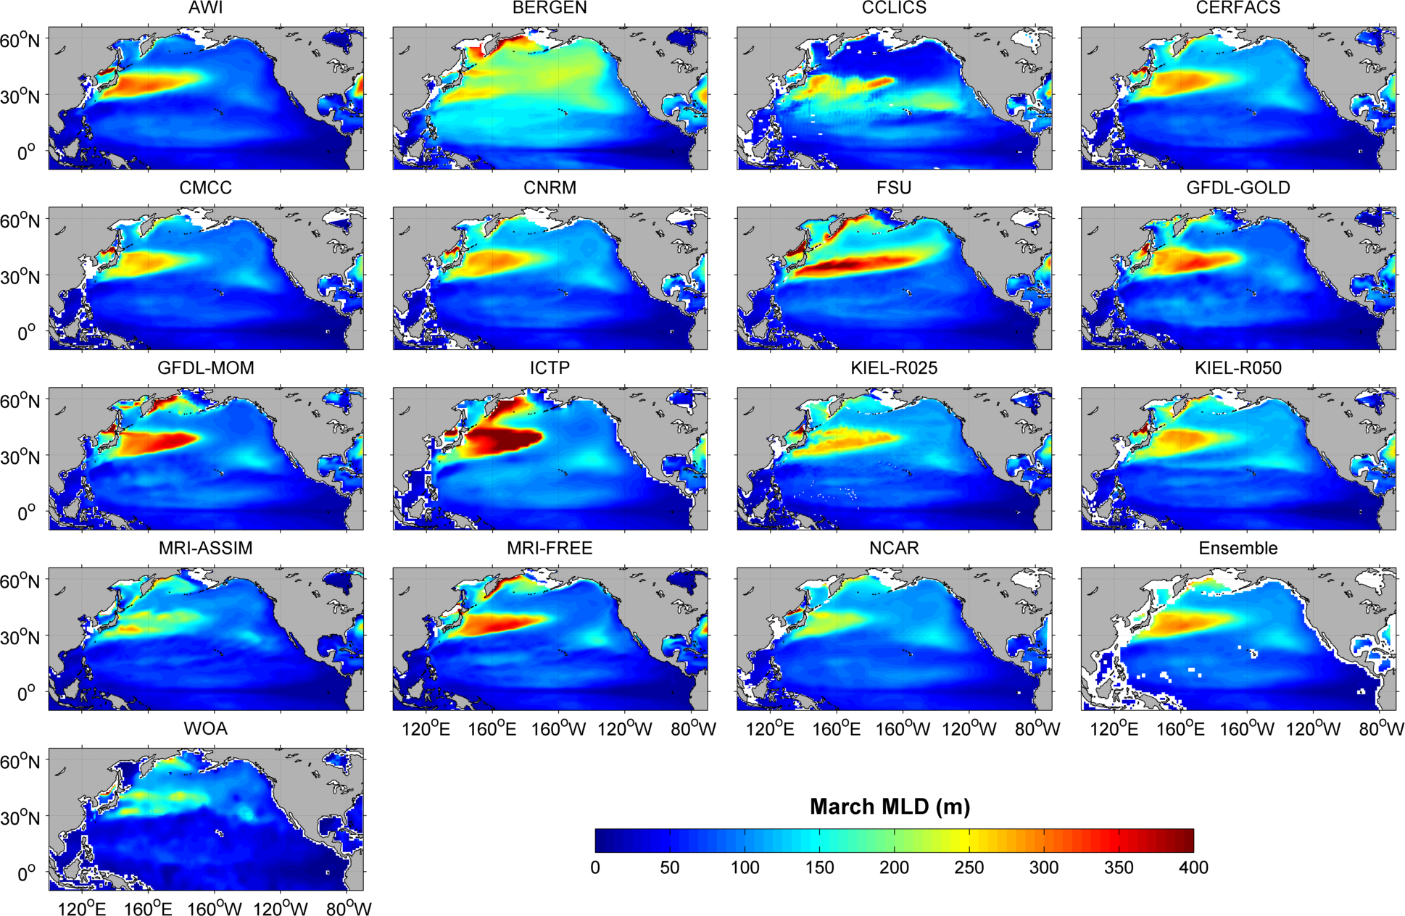
Mixed layer depth (MLD) in March

Slide 17
Mean PV (10⁻¹⁰ m⁻¹ s⁻¹) along 26.2σ_{θ}
 | Region A | Region B | Region C
AWI | 1.96 | 3.42 | 2.92
BERGEN | 4.60 | 3.57 | 3.25
CCLICS | 3.46 | 3.57 | 2.71
CERFACS | 2.03 | 3.28 | 2.50
CMCC | 2.44 | 3.11 | 2.29
CNRM | 1.98 | 3.29 | 2.56
FSU | 3.83 | 4.38 | 4.47
GFDL-GOLD | 1.70 | 2.73 | 2.02
GFDL-MOM | 2.25 | 2.93 | 2.71
ICTP | 2.72 | 3.50 | 3.54
KIEL-R025 | 2.08 | 2.81 | 2.58
KIEL-R050 | 1.80 | 2.78 | 2.19
MRI-ASSIM | 2.11 | 2.22 | 1.74
MRI-FREE | 1.61 | 2.75 | 2.38
NCAR | 1.91 | 2.23 | 1.74
WOA | 1.97 | 2.08 | 2.23
STMD and CMW formation coalesce into a large pool in all models
CMW
A
B
C
STMW
NPIW
ESMW

Slide 18
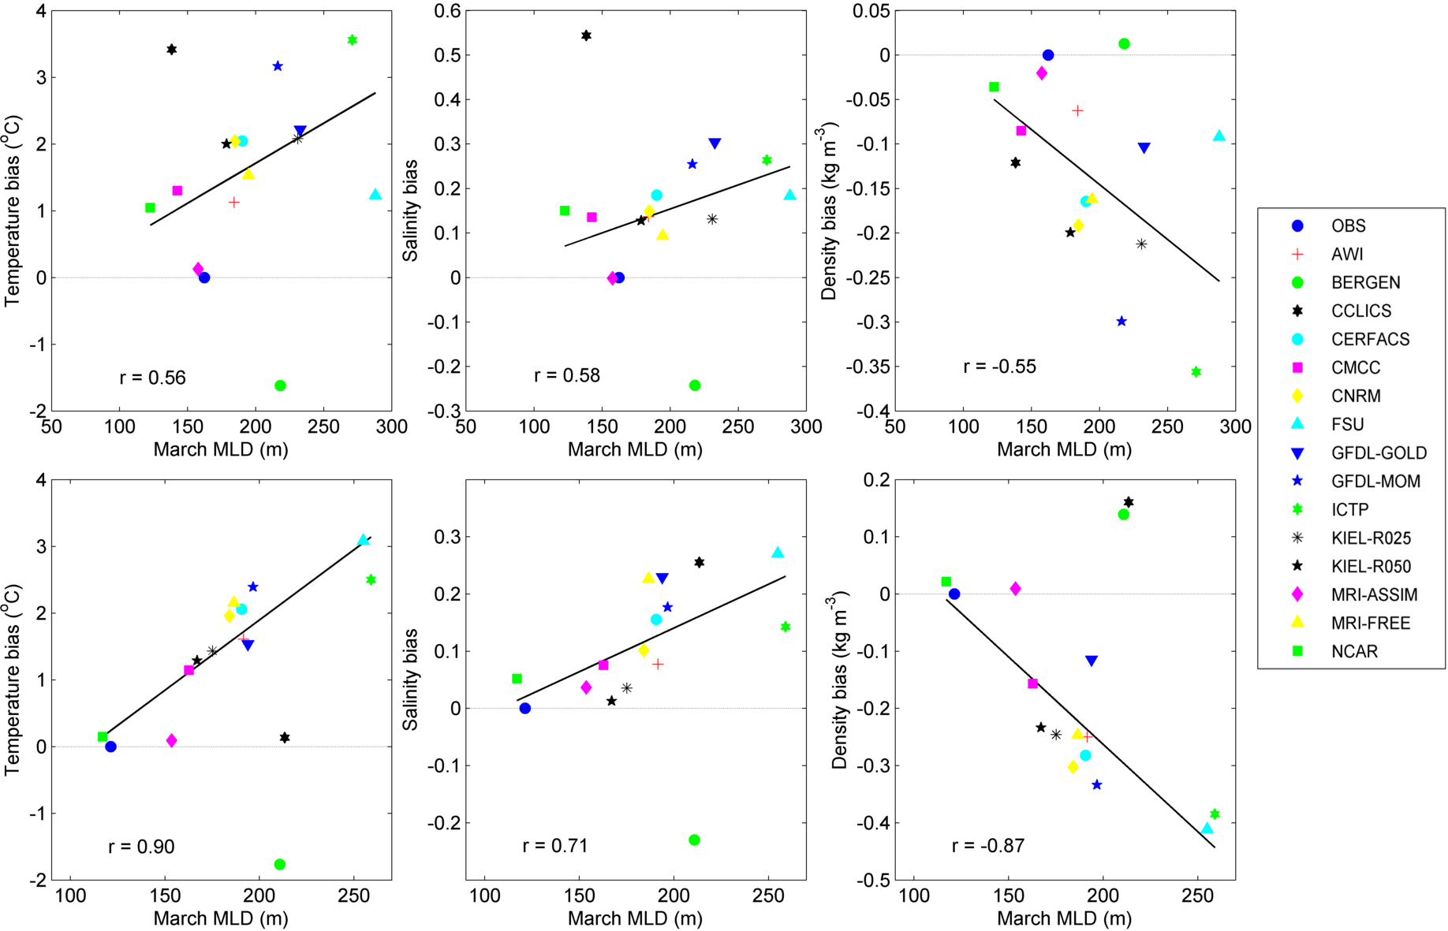
Scatter plots of the March MLD against the corresponding potential temperature, salinity and density biases over the upper 400m
Region A
Region B

Slide 19
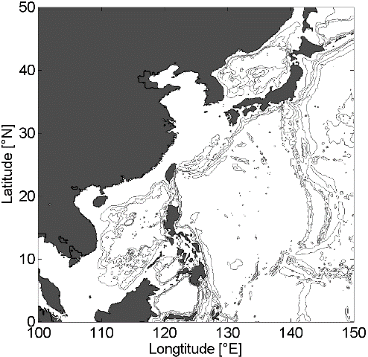
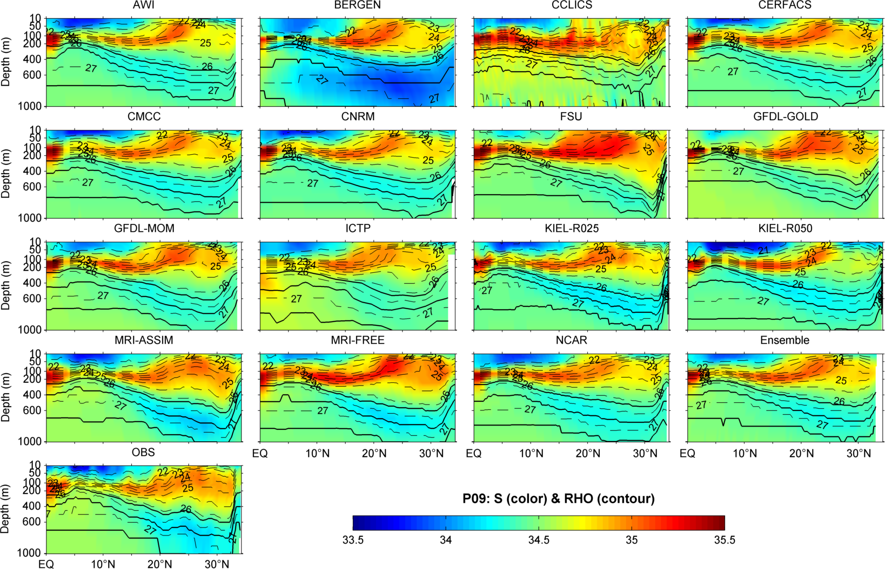
Vertical cross section of salinity and potential density along P09 (137°E)

Slide 20
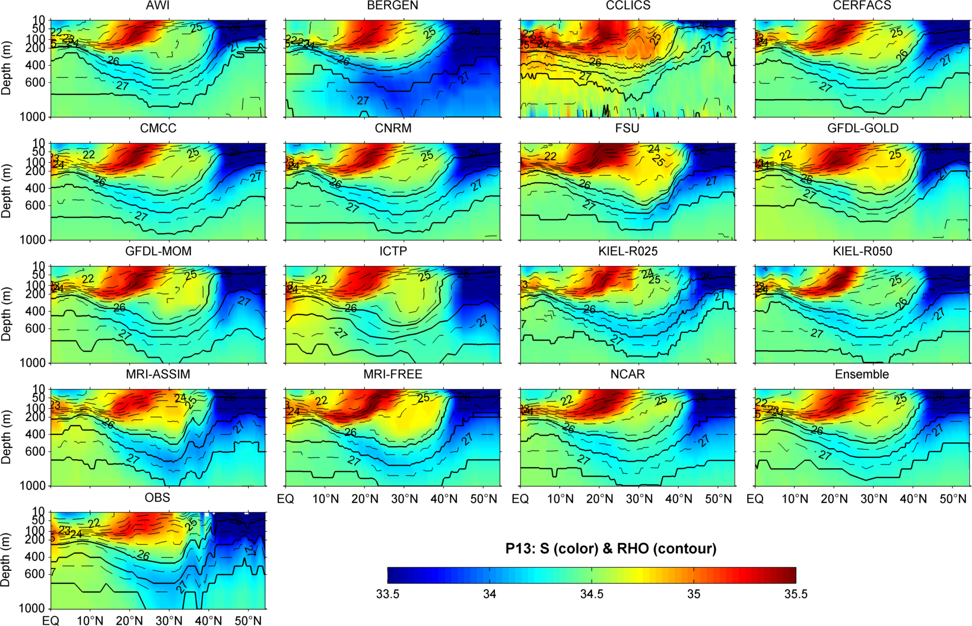
Vertical cross section of salinity and potential density along P13 (165°E)

Slide 21
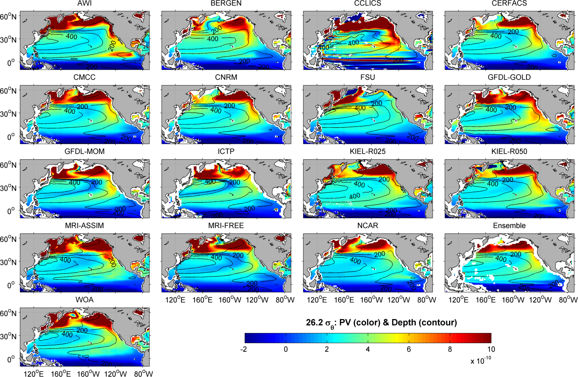
Distributions of Potential Vorticity (PV) and depth (26.2 σ_{θ})

Slide 22
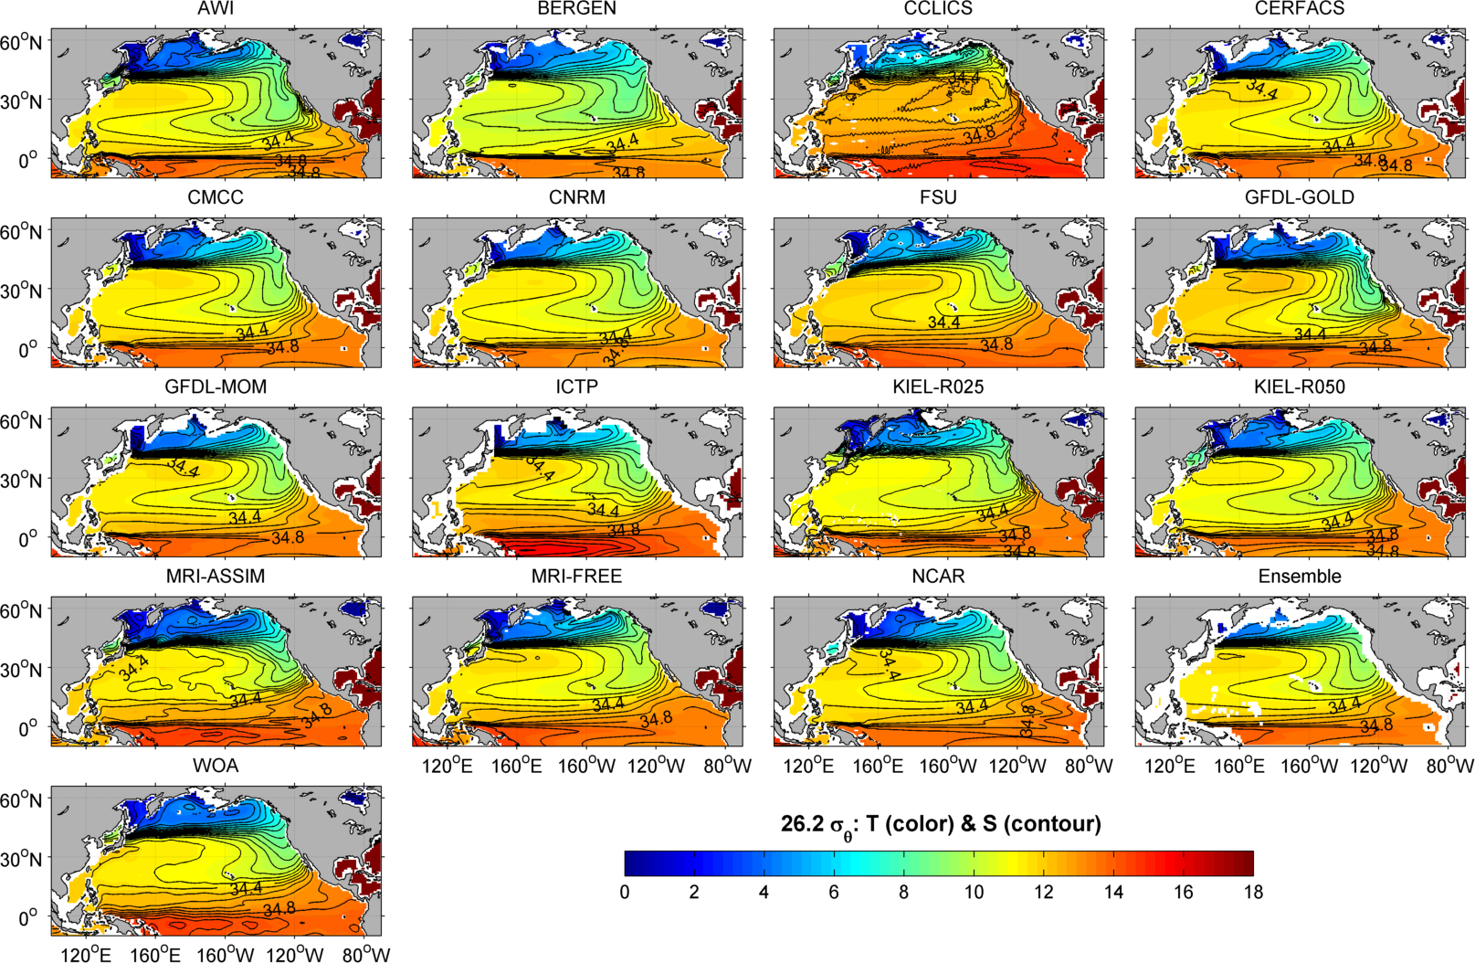
Distributions of T and S (26.2 σ_{θ})

Slide 23
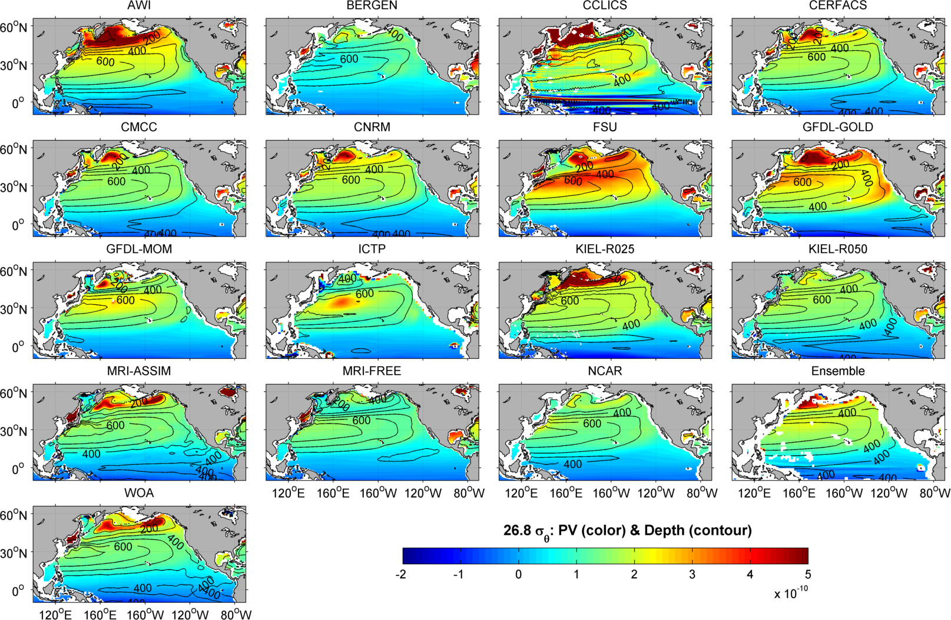
Distributions of PV and depth (26.8 σ_{θ})

Slide 24
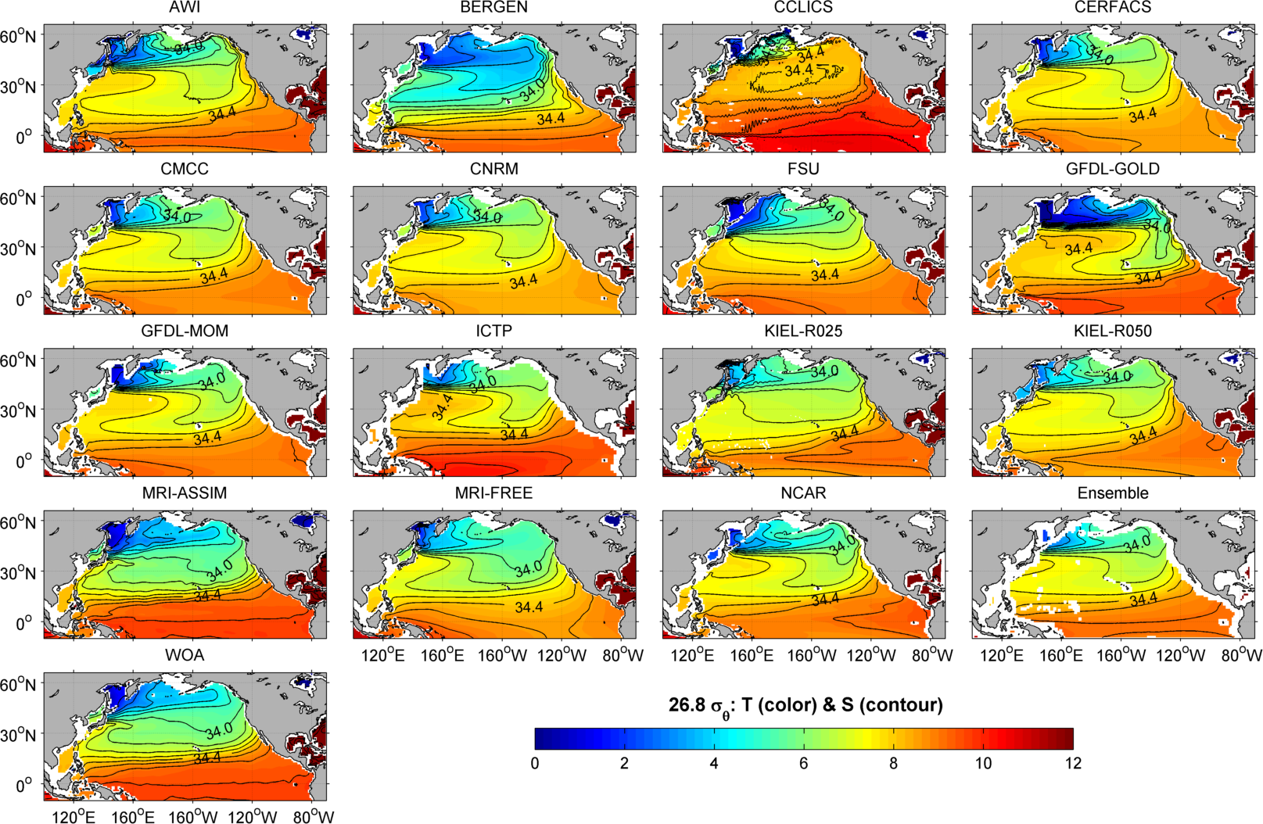
Distributions of T and S (26.8 σ_{θ})

Slide 25
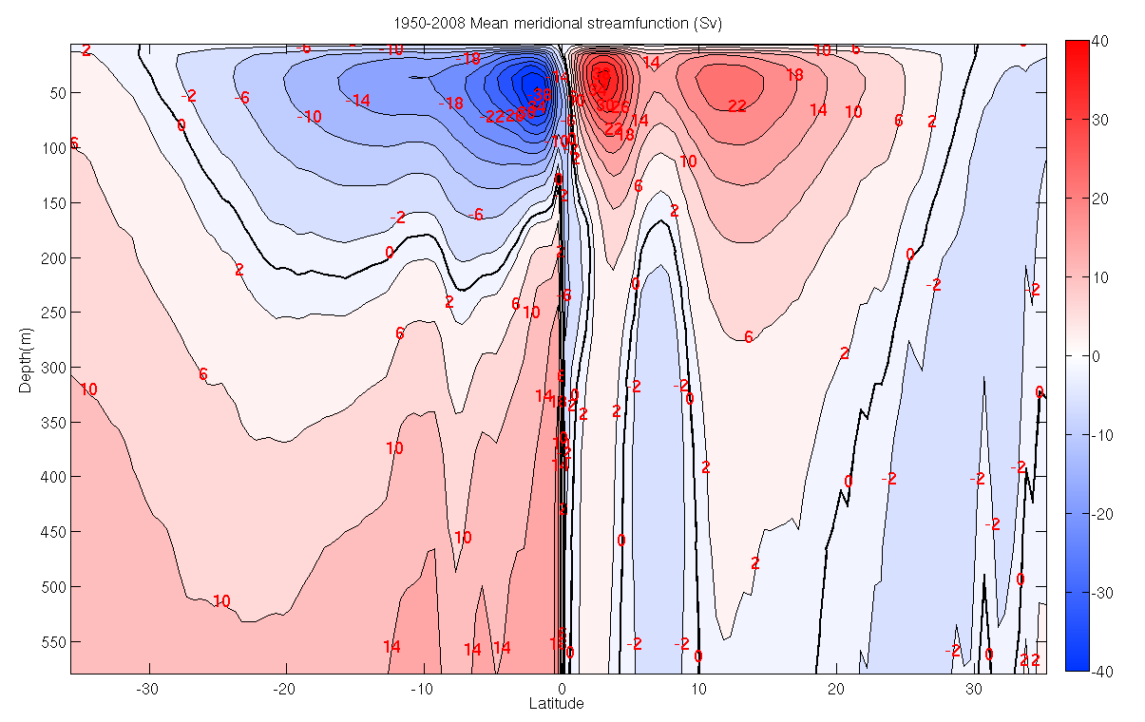
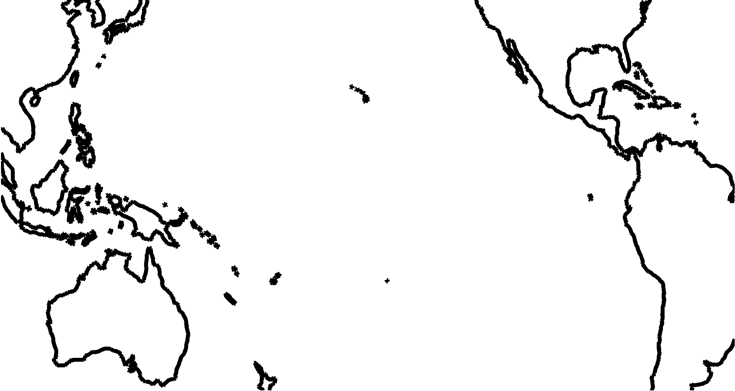
Tropical Dynamics and Subtropical Cells (STCs)
Mean meridional streamfunction
shallow meridional overturning circulations
Ekman transport
Equatorial
Undercurrent
Interior pycnocline transport

Slide 26
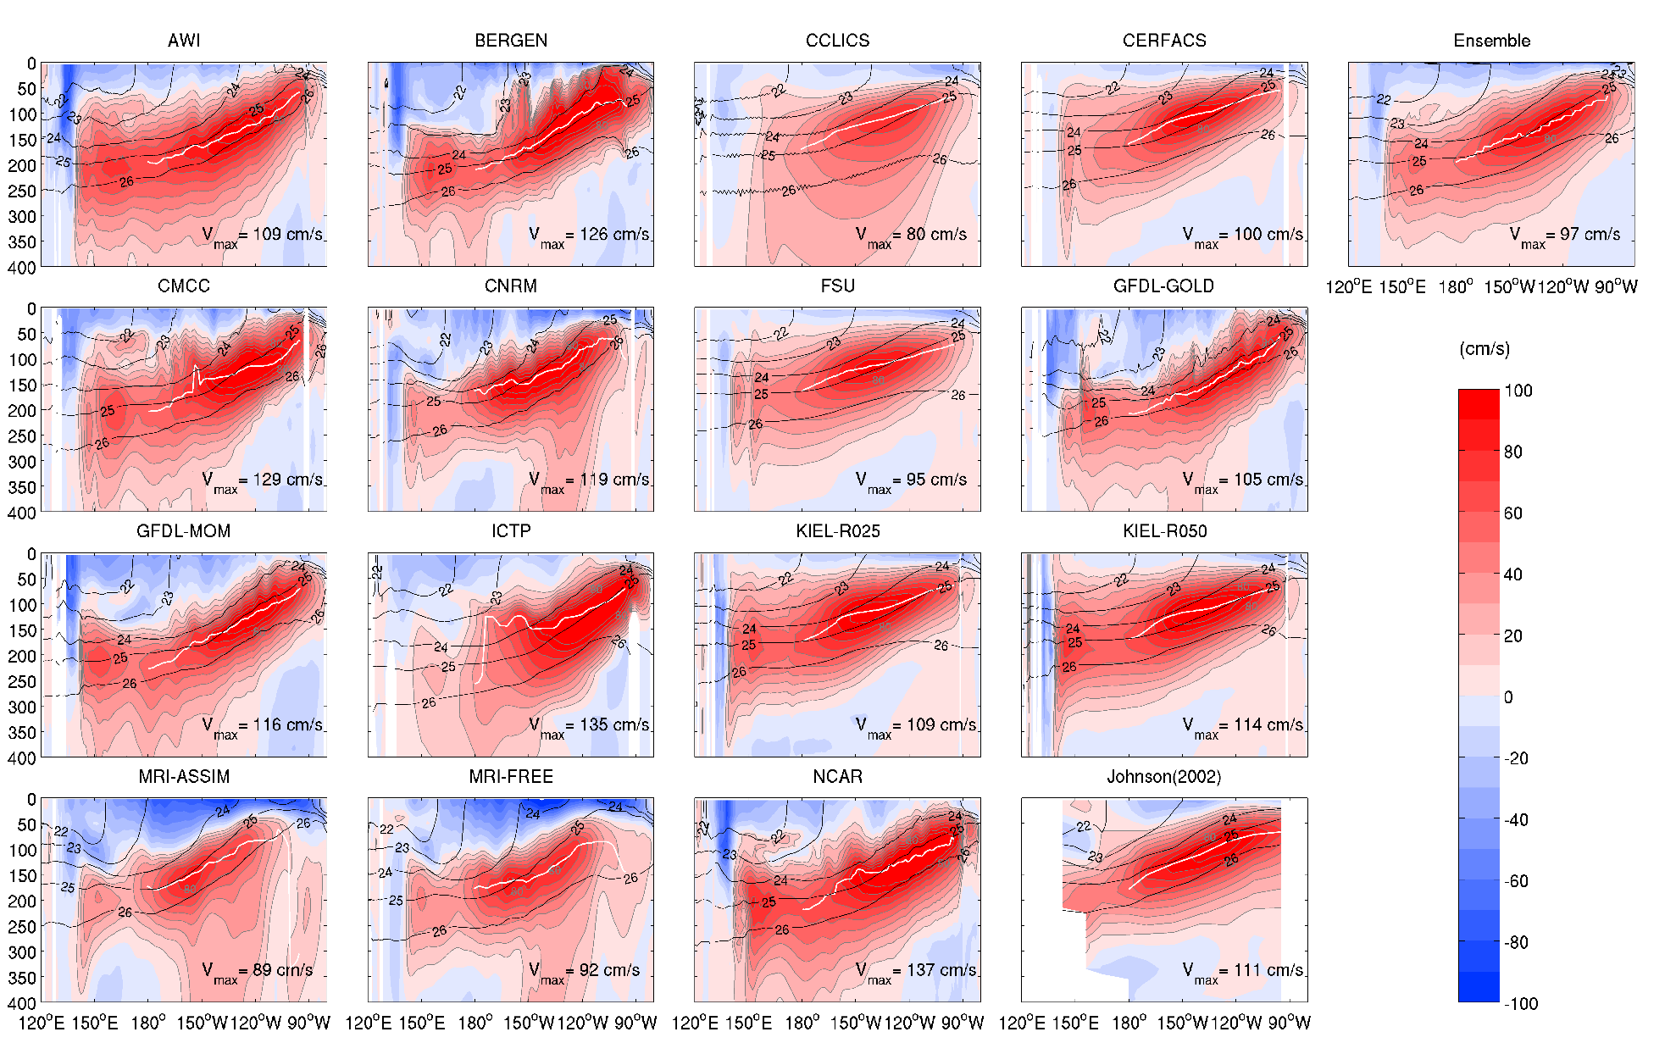
Mean zonal velocity and potential density along equator
(1986-2007)

Slide 27
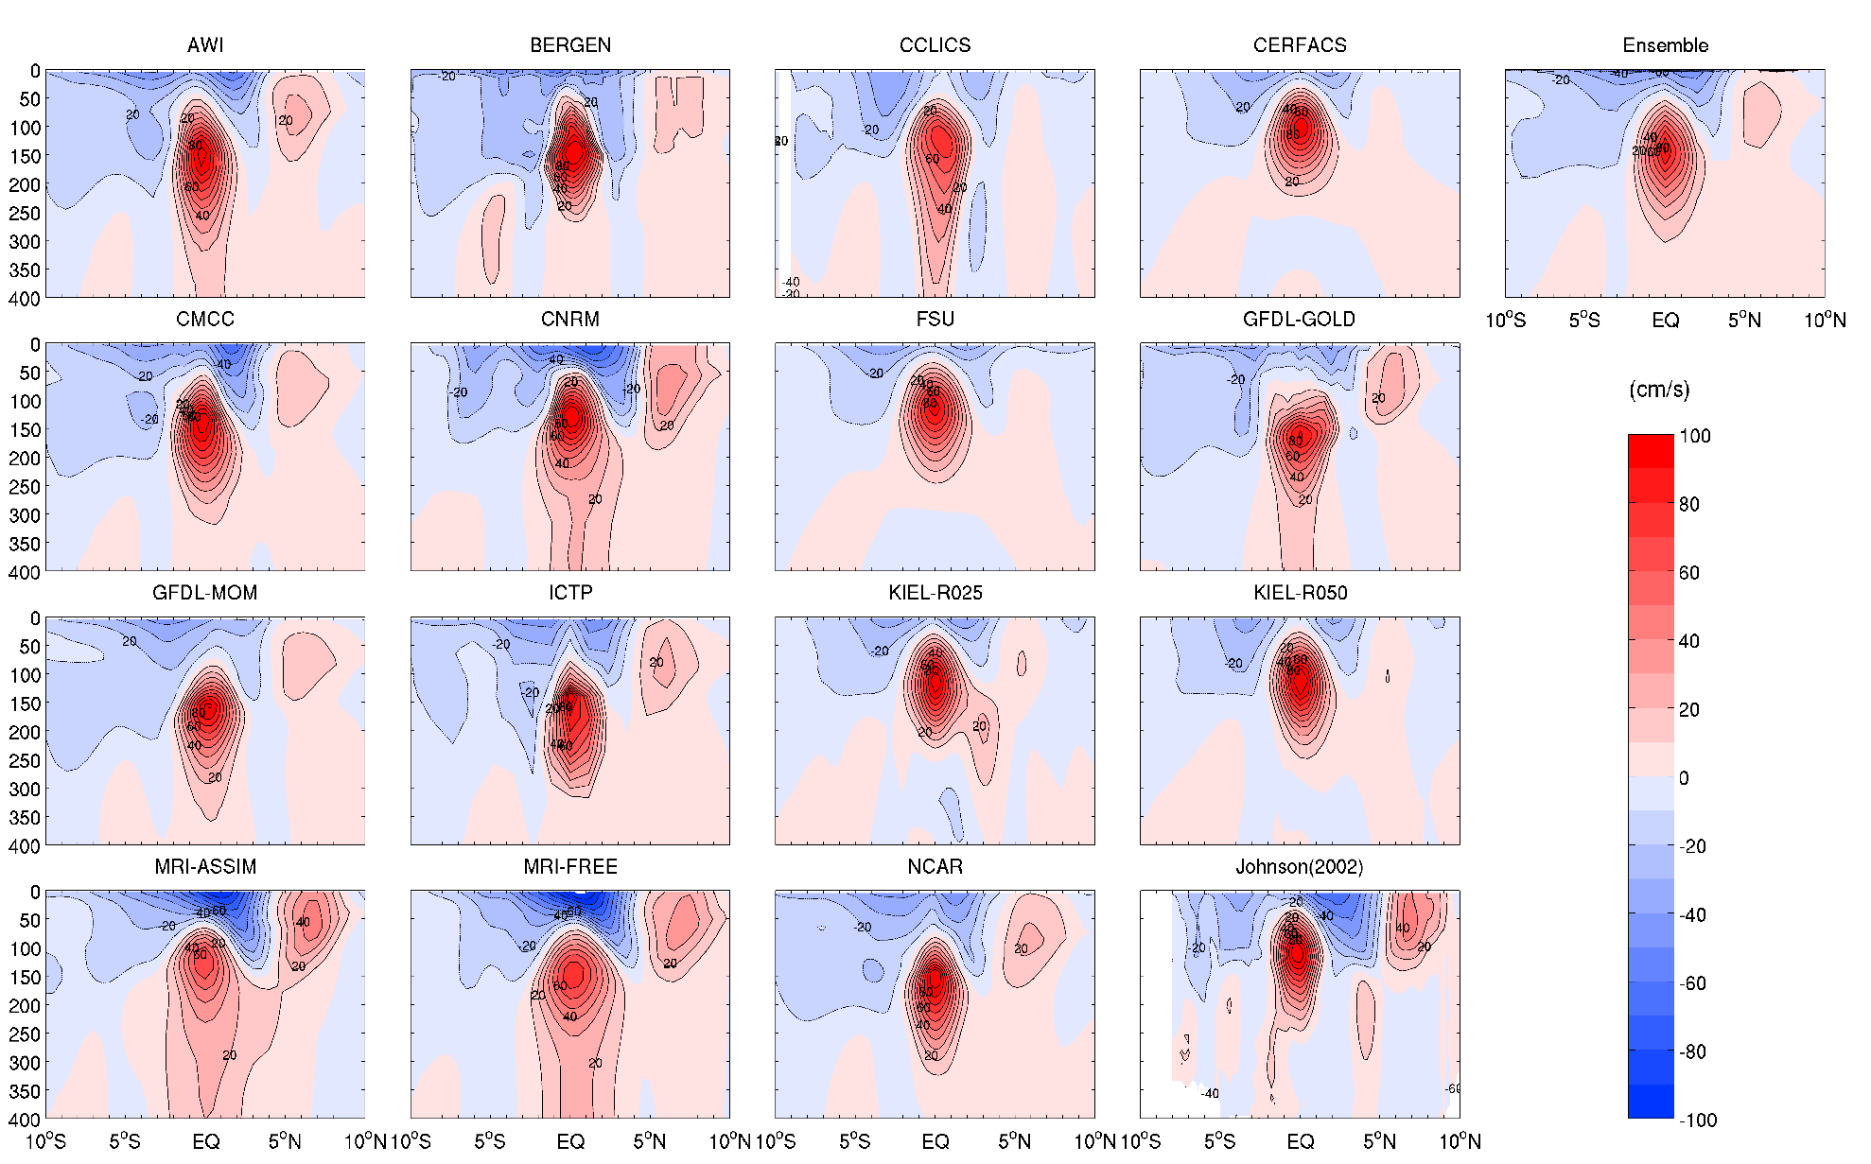
Mean zonal velocity along 140°W
SEC
NECC
EUC

Slide 28
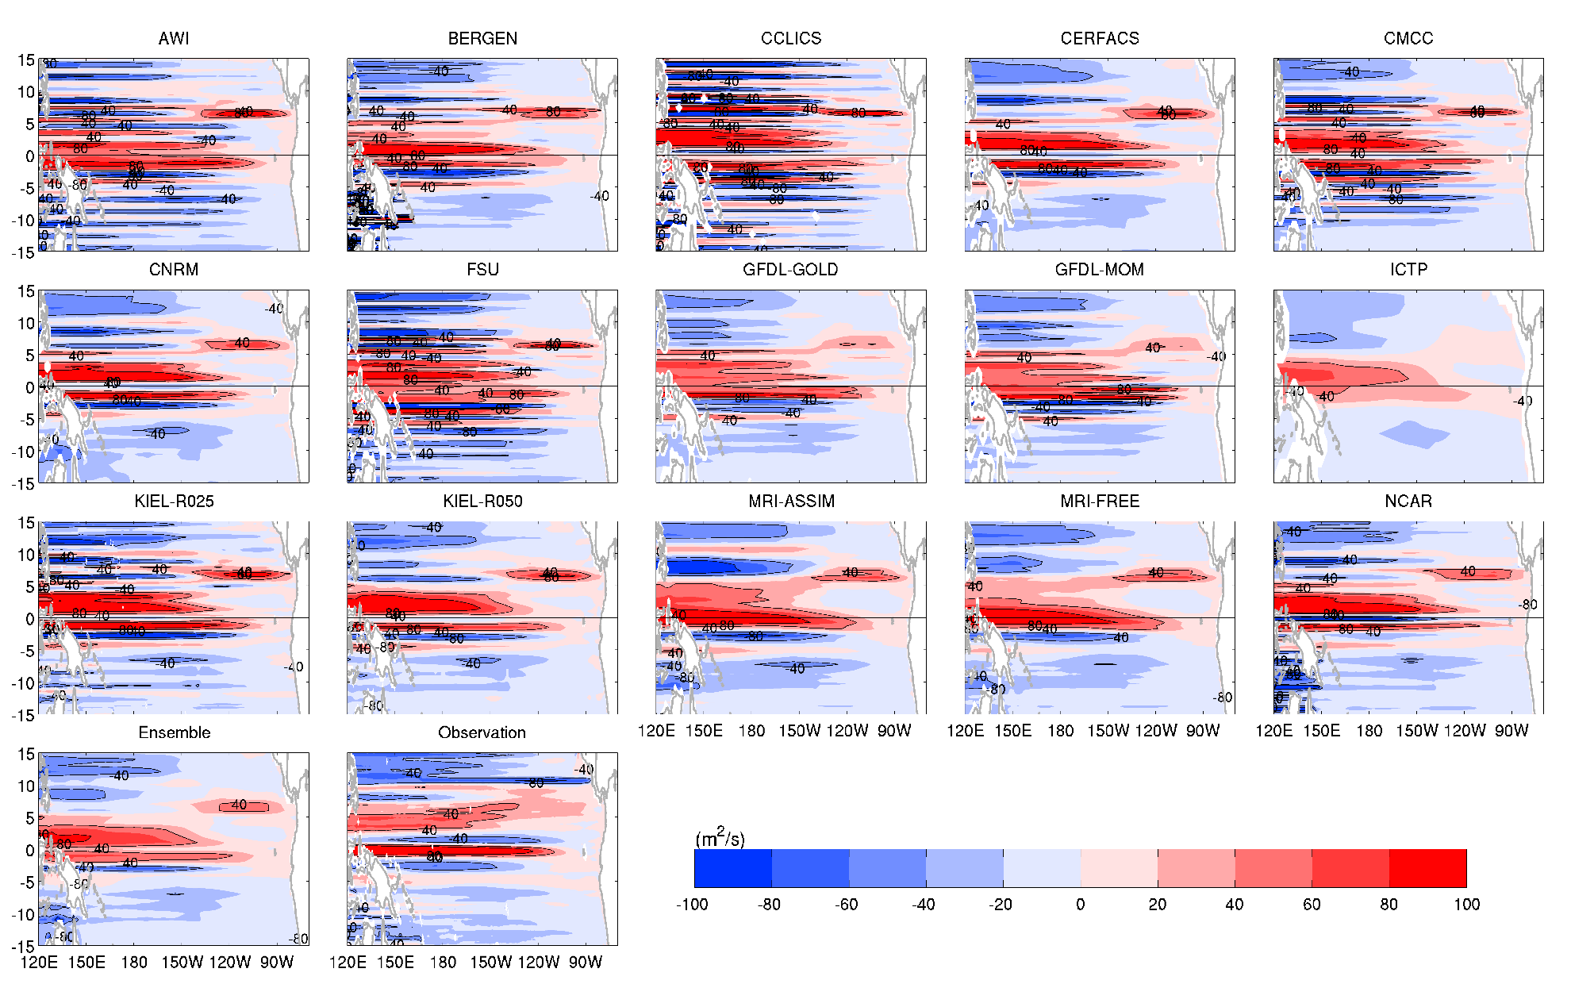
Vertical integrated zonal transport
NECC is sensitive to (curl τ)_{y}

Slide 29
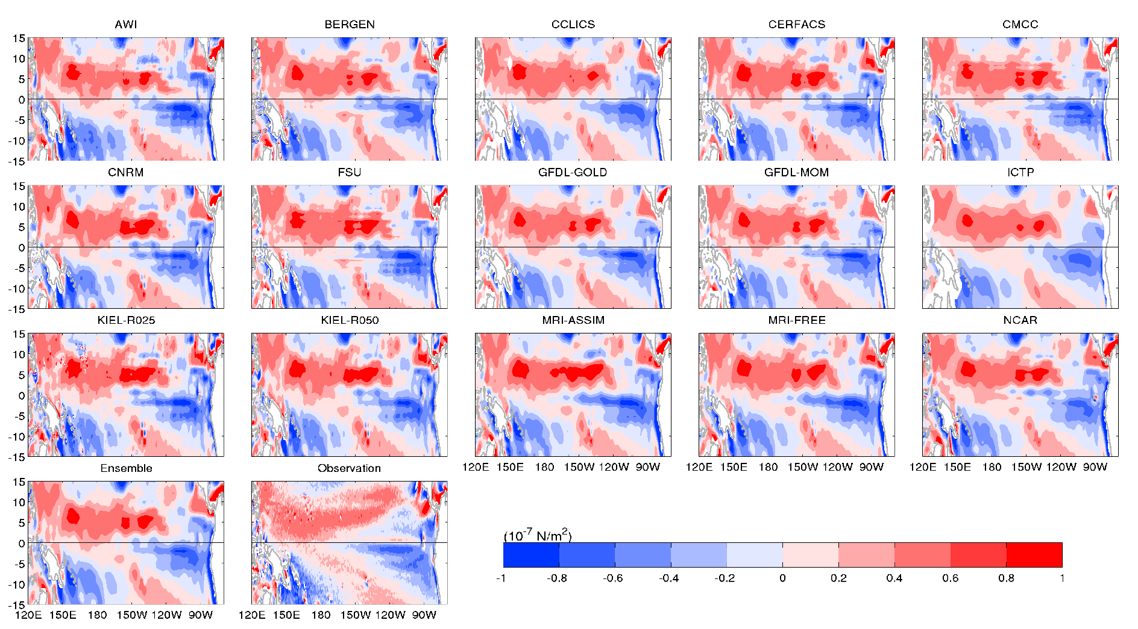
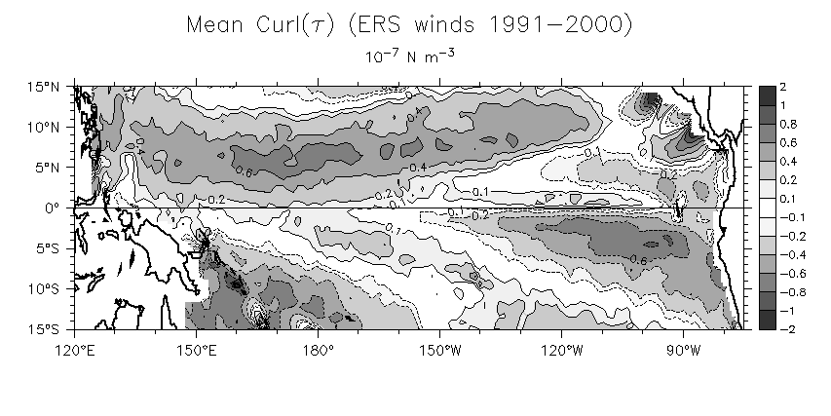
along 140°W
Sverdrup Transport of NECC (2-10N)
AWI | 4.3
BERGEN | 8.7
CCLICS | 11.2
CERFACS | 9.7
CMCC | 8.7
CNRM | 9.0
FSU | 7.6
GFDL-GOLD | 5.9
GFDL-MOM | 4.8
ICTP | 4.1
KIEL-R025 | 11.6
KIEL-R050 | 12.2
MRI-ASSIM | 7.1
MRI-FREE | 7.7
NCAR | 11.5
OBS | 17.2
Ensemble Mean | 8.4±2.5
Wind stress curl (WSC)
Kessler et al. (2003)

Slide 30

Mean meridional volume transport
Ekman transport
Equatorial
Undercurrent
Obs (McPhaden and Zhang, 2004) :
13.4 ± 1.6 Sv (07/1992-06/1998)
24.1 ± 1.8 Sv (07/1998-06/2003)
Interior pycnocline transport
 | 10°N |  |  |  | 10°S |  |  |  | Convergence (10°S-10°N)
 | WB | EK | Interior STC | Total STC | WB | EK | Interior STC | Total STC | Interior STC | Total STC
AWI | -4.5 | 19.5 | -11.1 | 3.9 | 7.2 | -17.1 | 12.0 | 2.1 | 23.1 | -1.8
BERGEN | -14.0 | 11.6 | -2.8 | -5.2 | 5.5 | -10.0 | 6.4 | 1.9 | 9.2 | 7.1
CCLICS | -3.3 | 18.3 | -7.7 | 7.3 | -0.8 | -13.4 | 7.8 | -6.3 | 15.5 | -13.7
CERFACS | -6.1 | 19.5 | -14.6 | -1.2 | 8.9 | -17.3 | 12.6 | 4.2 | 27.2 | 5.4
CMCC | -4.6 | 19.8 | -15.2 | 0.0 | 9.1 | -17.7 | 12.9 | 4.3 | 28.1 | 4.3
CNRM | -5.9 | 19.2 | -15.2 | -1.9 | 8.0 | -17.9 | 14.1 | 4.3 | 29.3 | 6.2
FSU | -11.4 | 22.7 | -4.5 | 6.8 | 7.4 | -21.2 | 9.2 | -4.6 | 13.7 | -11.4
GFDL-GOLD | -9.8 | 16.9 | -7.6 | -0.5 | 6.9 | -13.6 | 8.9 | 2.2 | 16.5 | 2.7
GFDL-MOM | -10.9 | 20.9 | -10.5 | -0.5 | 5.3 | -17.4 | 12.9 | 0.8 | 23.4 | 1.3
ICTP | -12.1 | 20.1 | -11.2 | -3.2 | 4.8 | -16.2 | 12.5 | 1.1 | 23.7 | 4.3
KIEL-R025 | -4.2 | 20.7 | -17.7 | -1.2 | 7.4 | -17.2 | 13.5 | 3.7 | 31.2 | 4.9
KIEL-R050 | -9.1 | 19.5 | -12.2 | -1.8 | 3.6 | -15.4 | 12.8 | 1.0 | 25.0 | 2.8
MRI-ASSIM | -20.9 | 28.6 | -5.4 | 2.3 | 13.0 | -19.7 | 10.7 | 4.0 | 16.1 | 1.7
MRI-FREE | -12.8 | 23.2 | -11.2 | -0.8 | 5.1 | -18.8 | 11.8 | -1.9 | 23.0 | -1.1
NCAR | -8.1 | 19.8 | -11.8 | -0.1 | 6.1 | -17.0 | 12.3 | 1.4 | 24.0 | 1.5
Ensemble Mean | -8.3±4.5 | 19.4±2.7 | -10.9±4.0 | 0.1±3.4 | 6.0±2.4 | -16.4±2.6 | 11.4±2.3 | 1.0±3.1 | 22.4±6.1 | 0.9±6.0

Slide 31
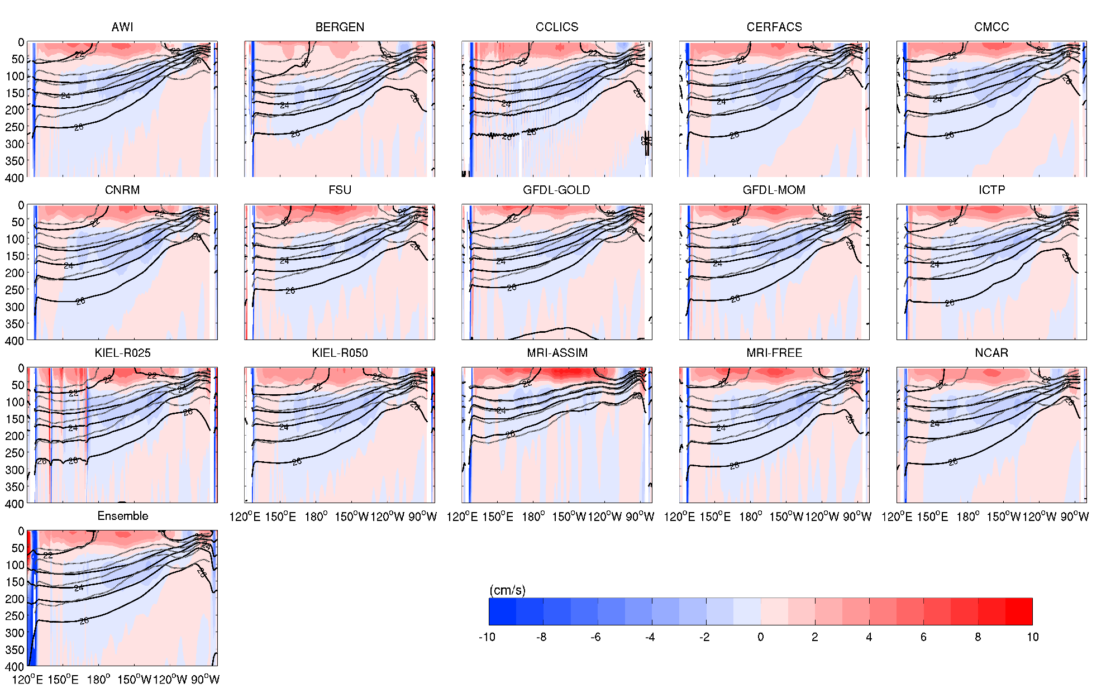
Time-mean meridional velocity (m s⁻¹) along 10°N
Deeper pycnocline than obs.

Slide 32
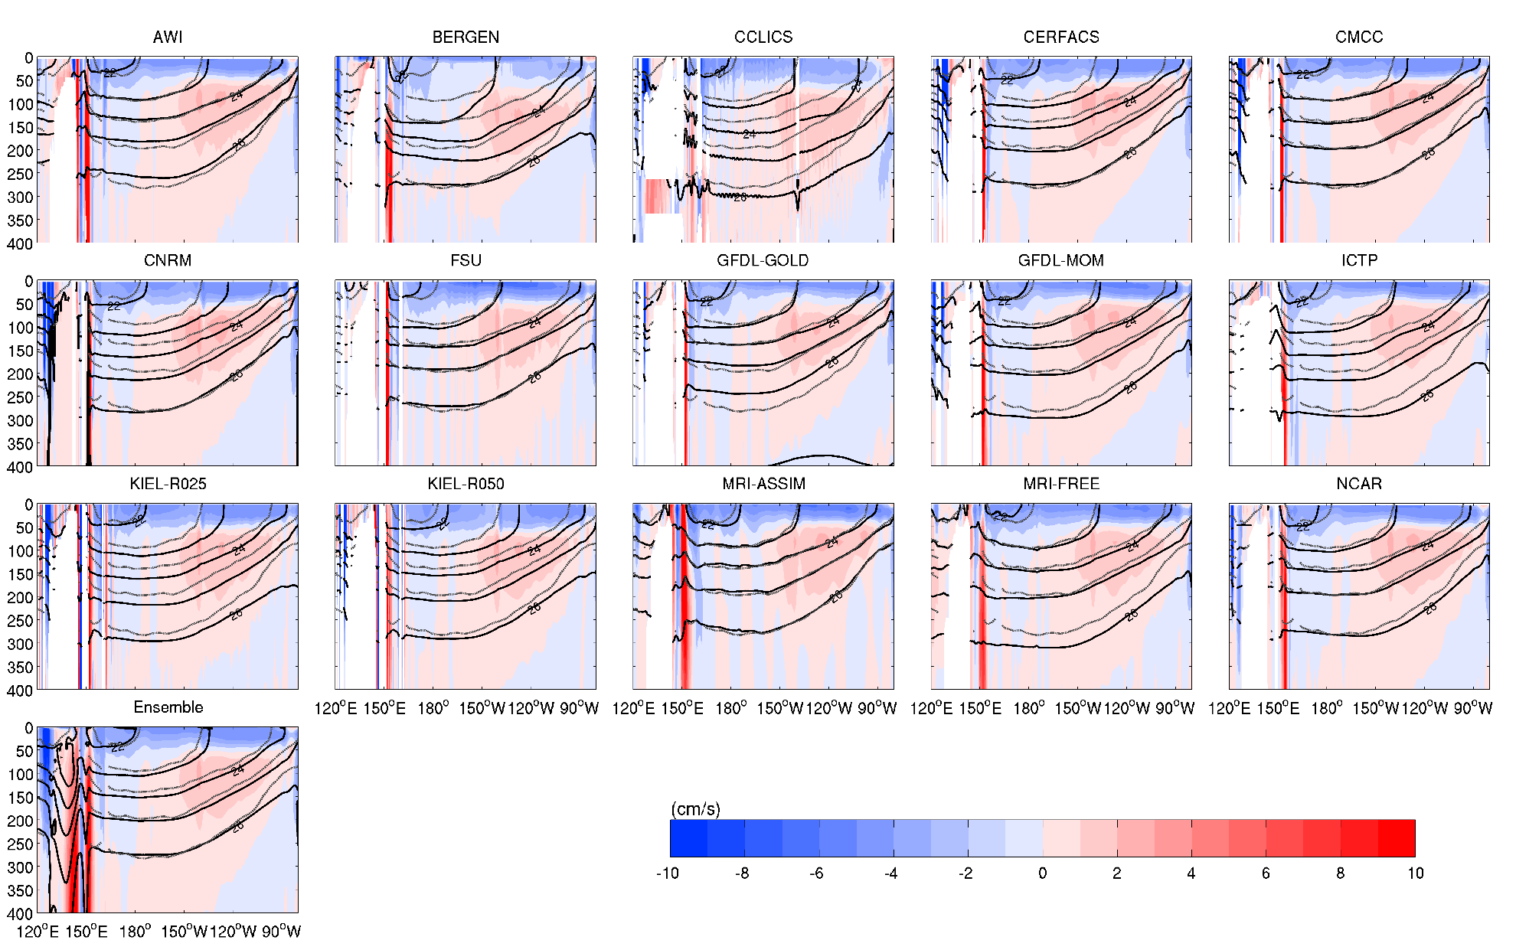
Time-mean meridional velocity (m s⁻¹) along 10°S

Slide 33
Conclusion
Mean circulation patterns, water mass dist. and tropical dynamics of the North and tropical Pacific Ocean are examined using 15 CORE-II models
Large discrepancies are found in the variance and skewness of SSH/SST
Most models underestimate the Kuroshio transport in the PAMS (unresolved western boundary current and meso-scale eddies)
MLDs:
the two maxima associated with STMW and CMW formation coalesce into a large pool of deep MLDs in all free running models.
local maximum associated with the formation of ESMW can be found in all models with different magnitudes.
The main model biases of deep MLDs result from the excess formation of STMW due to the inaccurate Kuroshio separation and the associated excess warm and salty Kuroshio water. In particular, temp. biases dominate the changes in density.
NPIW can penetrate southward in most models, however, the distribution greatly varies among models

Slide 34
Conclusion
Similar large scale tropical structures, but with different structures of EUC. We confirm the key role of the meridional derivative of the WSC in driving the equatorial transport, leading to a generally weak NECC in all models due to the inaccurate CORE-II equatorial wind fields.
Most models show a larger interior transport of Pacific STCs due to the overestimated transport in the Northern Hemisphere likely resulting from the deep pycnocline.
Future Work
North Pacific Variability and Indonesia Throughflow (ITF) in CORE-II forcing models
Improvement and consideration of high-resolution models (required?)

