Slide 1
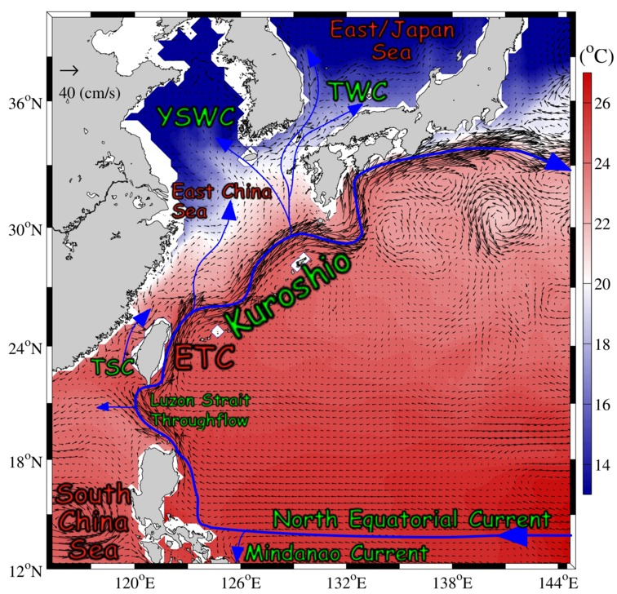
Operational eddy-resolving ocean model for the western Pacific and the coupled model simulation for the South China Sea
Yu-Heng Tsengª, Chih-Chieh Young^{b}, Yi-chun Kuoª, Yun-Chuan Shaoª ª Institute of Oceanography, National Taiwan University ^{b} Department of Marine Environmental Informatics, National Taiwan Ocean

Slide 2
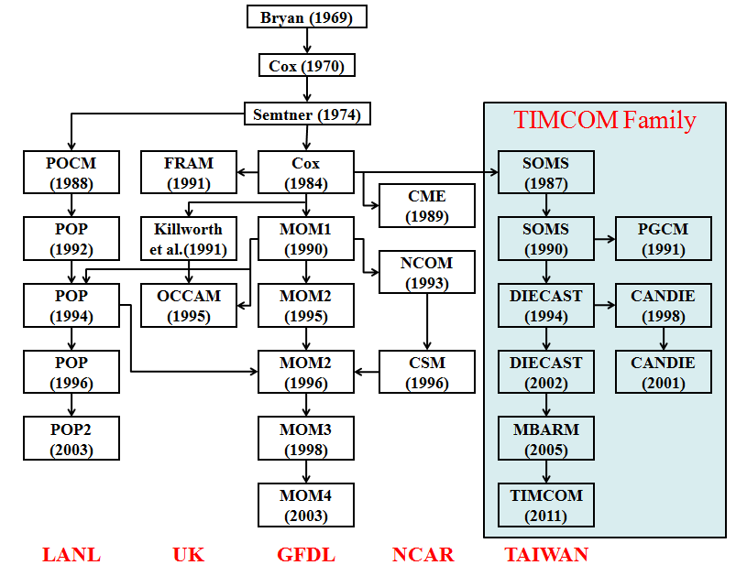
Multi-Scale Ocean Circulation System (TIMCOM)
Tseng et al. (2012), Prog. Ocean
Tseng and Chien (2011), Comp. Fluids
Shen et al. (2011), J. Mar. Sys.
Shen et al. (2013), Prog. Ocean
Young et al. (2012), Env. Modell. Soft.
Young et al. (2013) MWR
http://140.112.69.65/coda/research/timcom
Notes:
The parallel version of the OGCM is called PD-TIMCOM. It is actually a cousin of POP2. These models originate from the Bryan-Cox-Semtner type of model.
2

Slide 3
4th order accurate, Z-level, free surface (or rigid-lid)
Mixed Arakawa “a” and “c” grids
The control volume equations include fluxes of the conservation of momentum, heat and salt across control volume faces.
Bathymetry:
Interpolated from unfiltered ETOPO2 depth data
The vertical resolution ~ linear-exponential stretched grid, 26 layers
Varying latitude and uniform longitude grid (Mercator grid).
Surface forcing:
NCEP GFS atmospheric state
Use 1/12° HYCOM global model for the initialization.
The northern boundary is closed. Insulated bottom, with non-slip conditions parameterized by a nonlinear bottom drag.
Sub-grid scale vertical mixing is parameterized by eddy diffusivity/viscosity using a modified Richardson number based approach

Slide 4
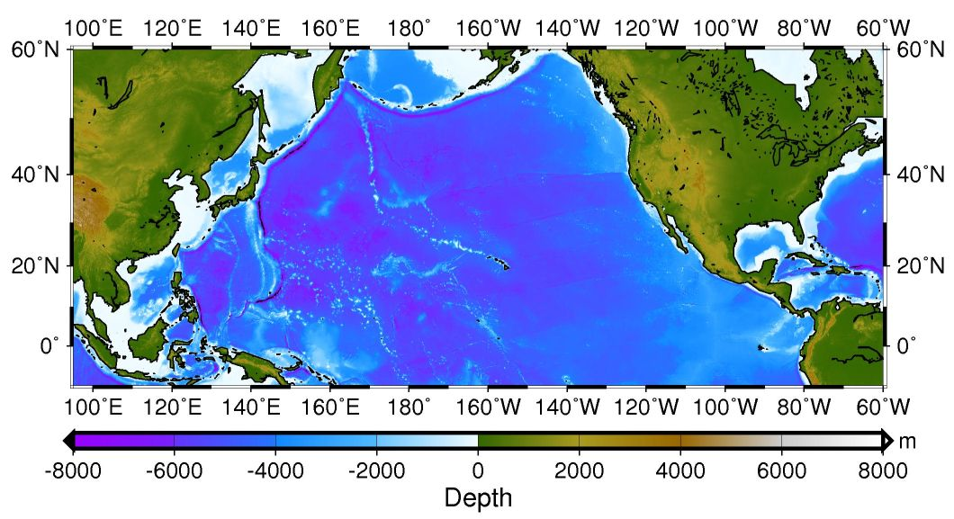
NPB (North Pacific Basin) Domain:
30°S to 60°N and 150°E to 80°W
grid resolution 1/4°
TAI Domain:
0° to 50°N and 100°E to 150°E
grid resolution 1/8°
North Pacific Config.
Japan Sea
East China Sea
1/8^{O}x1/8^{O}
1/4^{O}x1/4^{O}
South China Sea
Extended to 30^{O}S

Slide 5
Computing starts.
Create non-divergent u, v, w by pressure correction
Start a new time step
Is incompressibility satisfied?
Calculate internal fluxes
A-C grids interpolation
No.
Yes.
4th-order pressure gradient
Update each variable with FLTW method
bottom stress included
Apply fluxes to conservation equations, including momentum, salinity and temperature
Climatological surface restoring
Do all time steps finished ?
No.
surface and Coriolis forcing included
Open boundary condition treatment
Yes.
Pass all data to postprocessors.

Slide 6
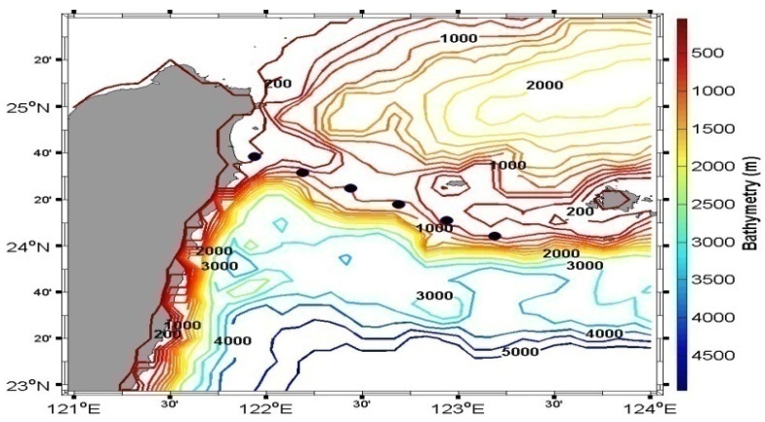
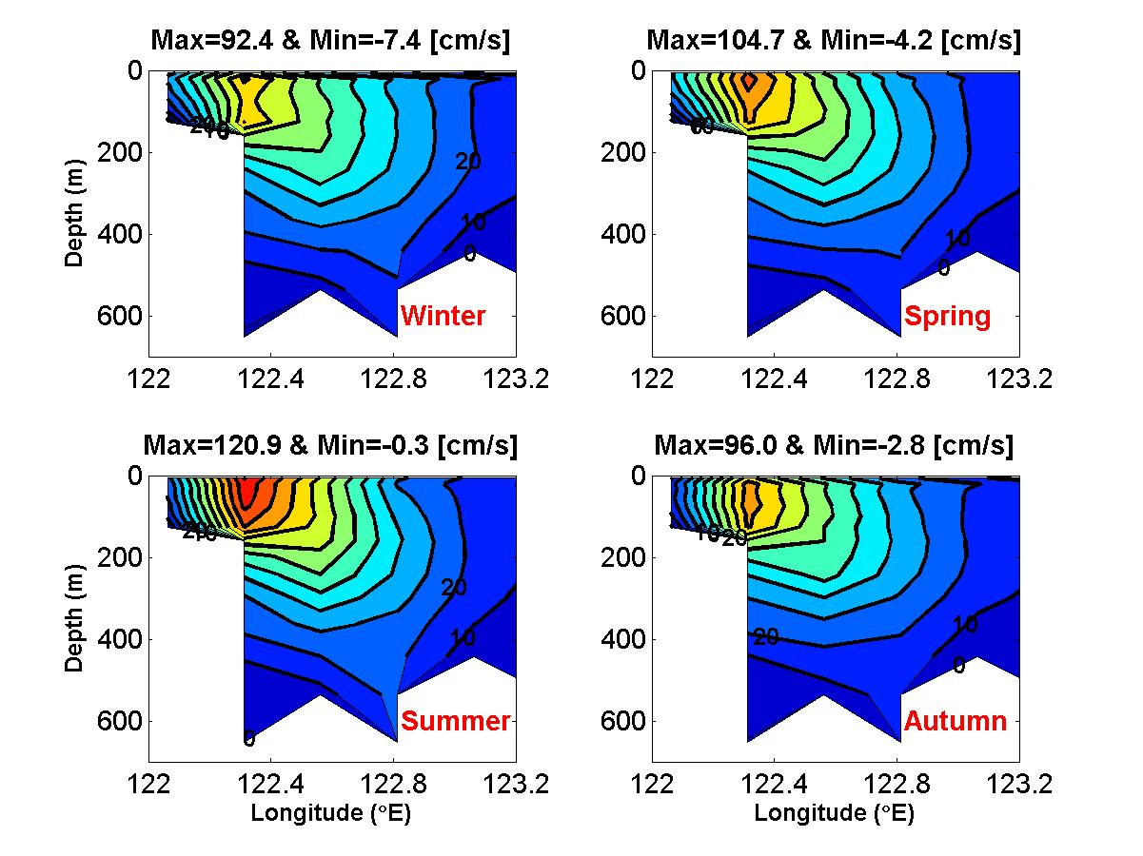
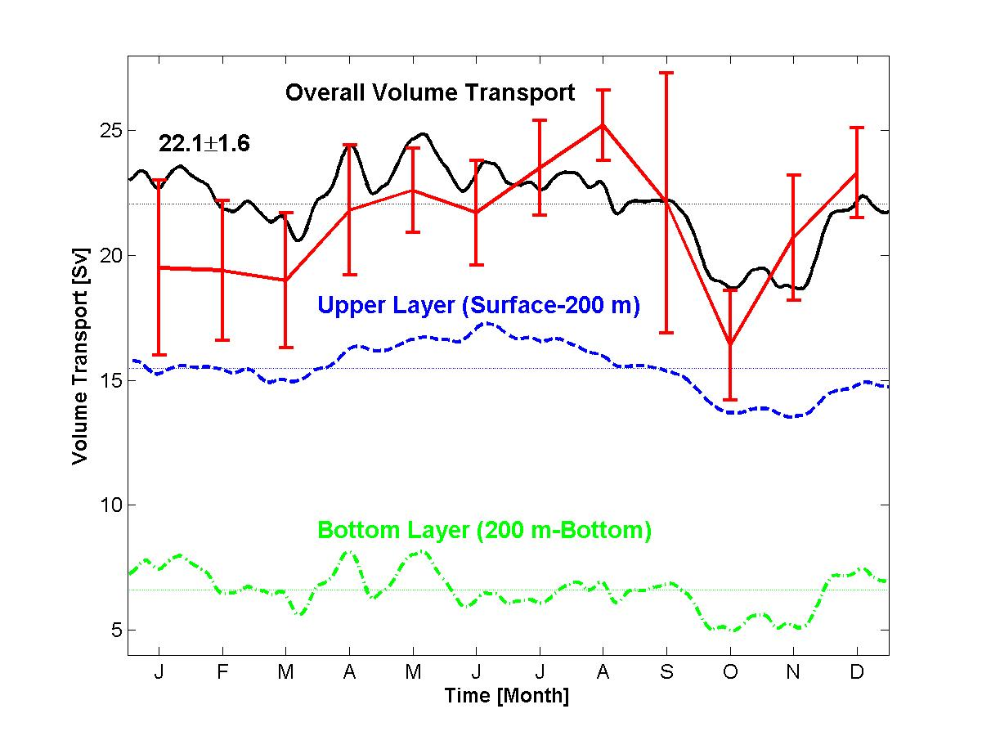
PCM1 Section
5-day running mean, averaged volume (year 37-39) transport across the PCM-1 section.
Seasonal mean (year 37-39) of the vertical current structure normal to the PCM-1 section.

Slide 7
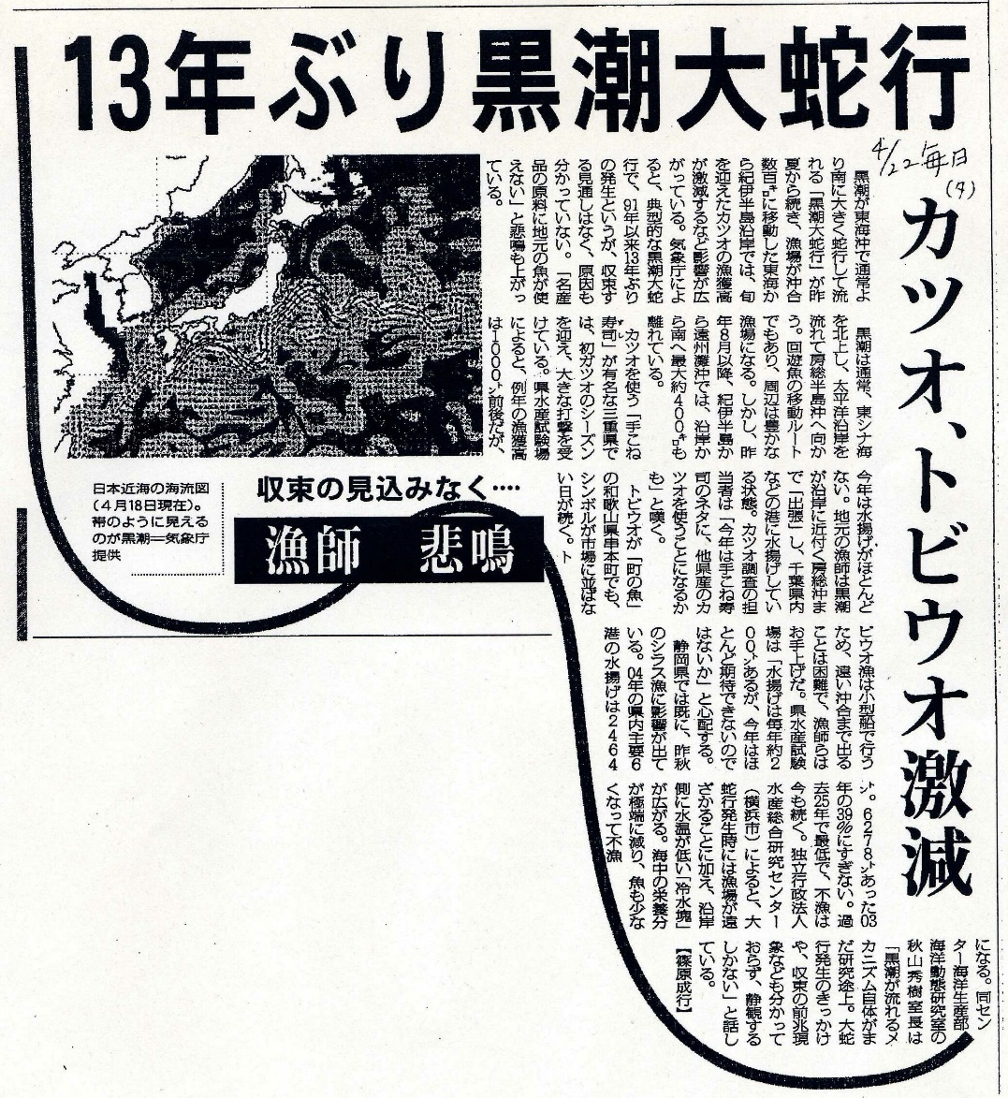
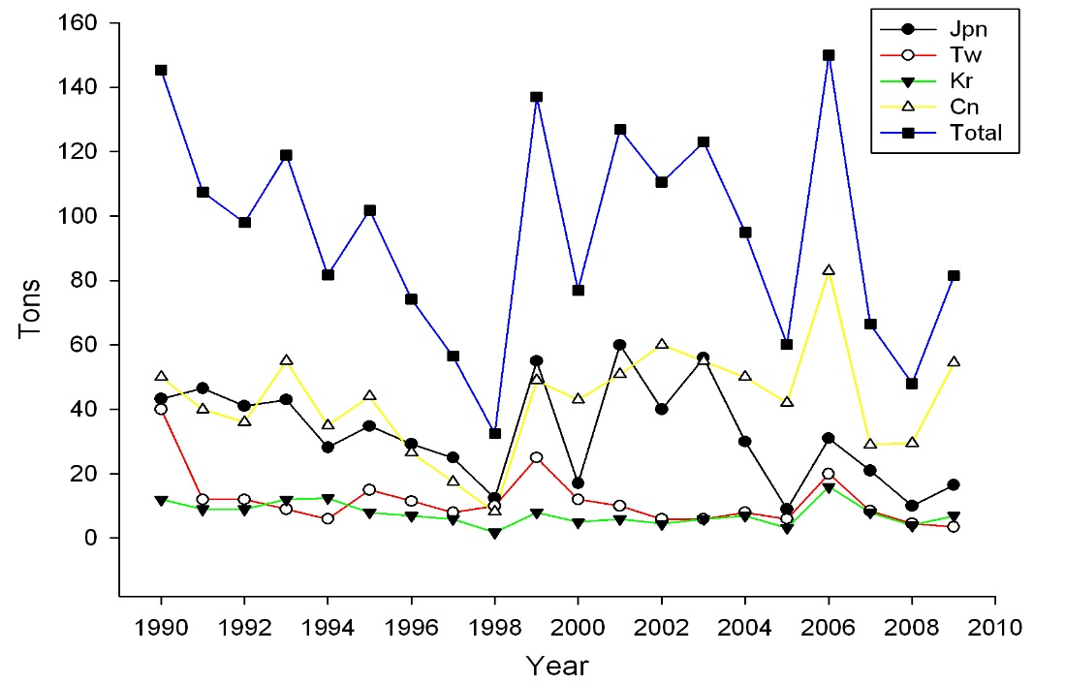
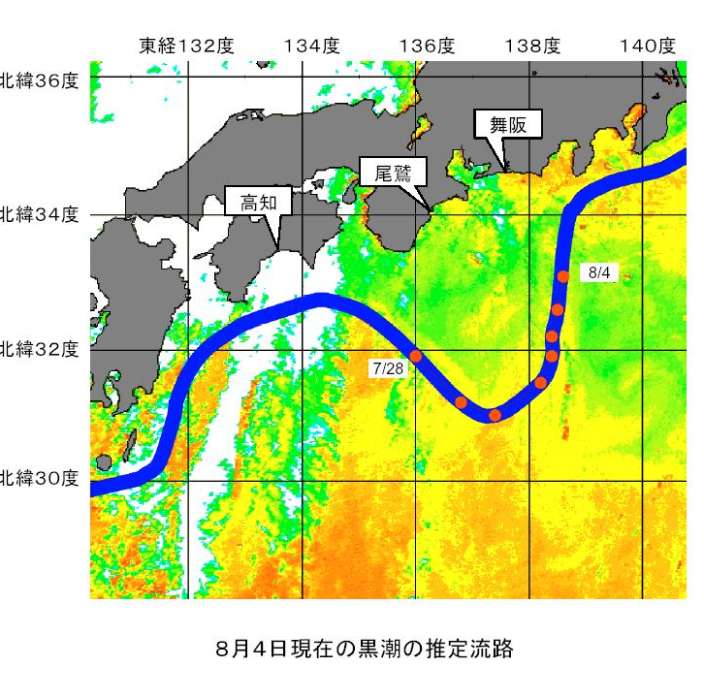
Press Release (Kuroshio Large Meander)
JMA called societies attention to the Kuroshio large meander’s influence to fisheries and shipping industries etc. in May 2004.
2004/05 -> 2004/08
Mainichi Newspaper 2005/04/22
Bonito, flying fish decreased markedly Fisherman cries …!
柳葉鰻產量

Slide 8
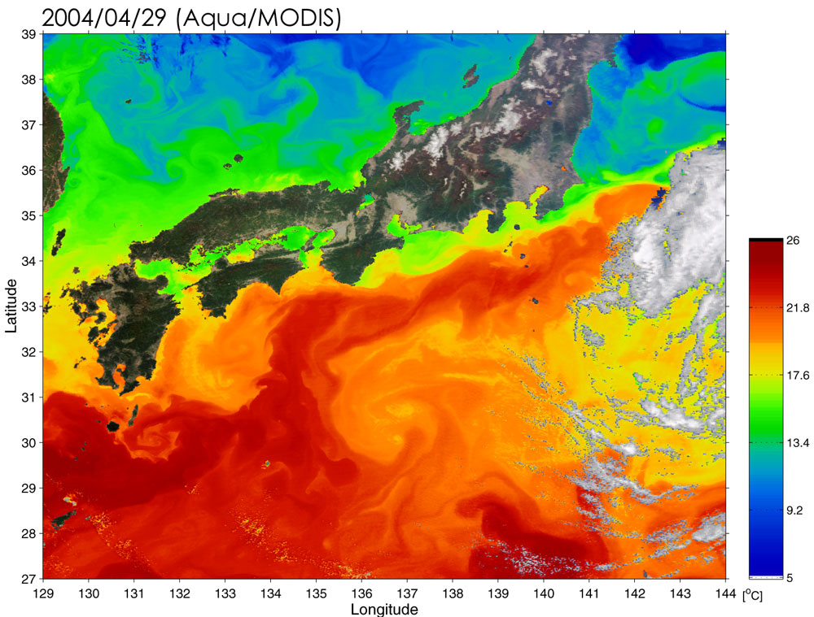
SST/C
After an interval of 13 years in the non-large meander path, the Kuroshio switched to the large meander in summer of 2004.
Japanese Aerospace Exploration Agency, Earth Observation Research Center

Slide 9
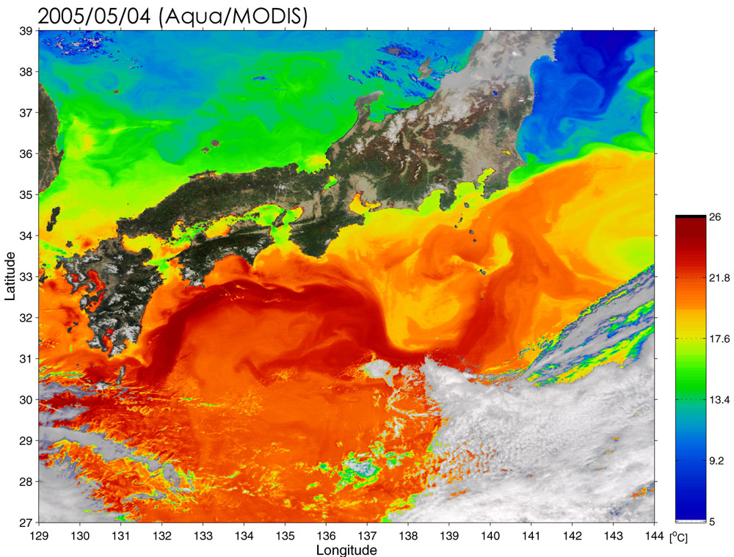
SST/C
Japanese Aerospace Exploration Agency, Earth Observation Research Center

Slide 10
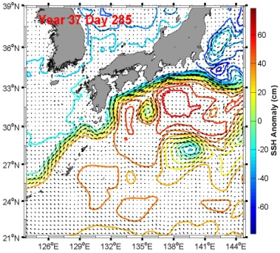
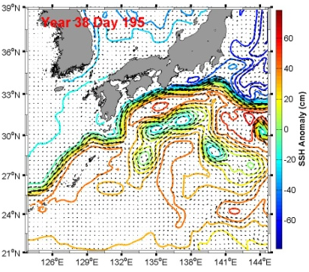
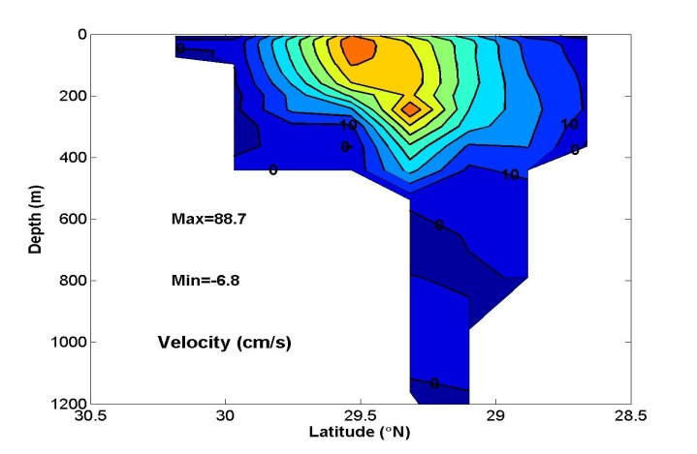
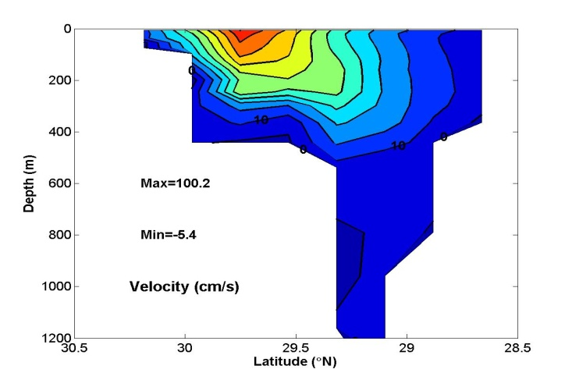
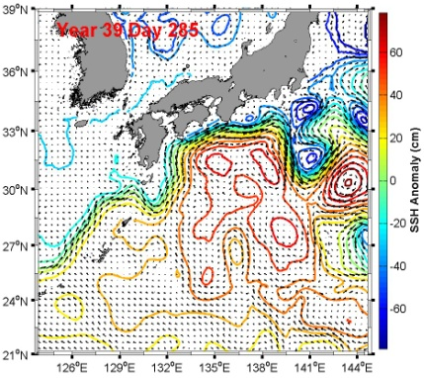
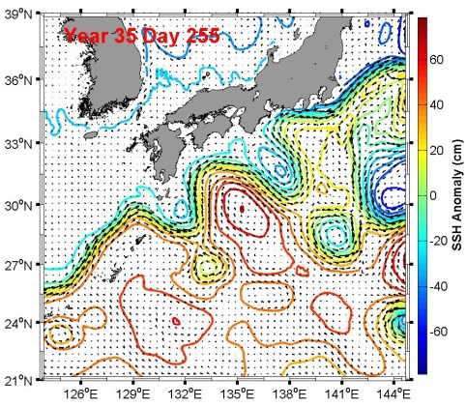
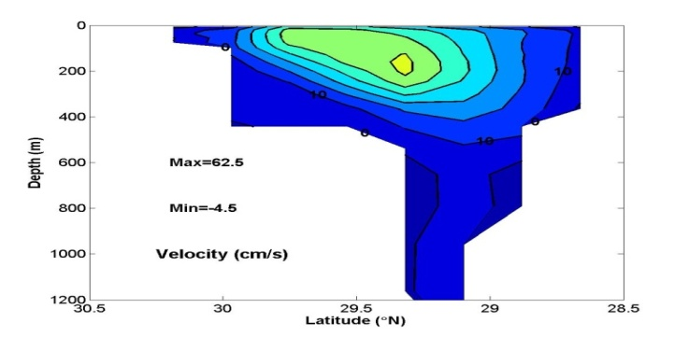
Snapshot of the distribution of sea surface temperature and horizontal velocity at sea surface.
Snapshot of the vertical current structure normal to the TK section
Year 37
Day 285
nNLM path
nNLM path
Year 38
Day 195
oNLM path
LM path
Year 39
Day 285
oNLM path

Slide 11
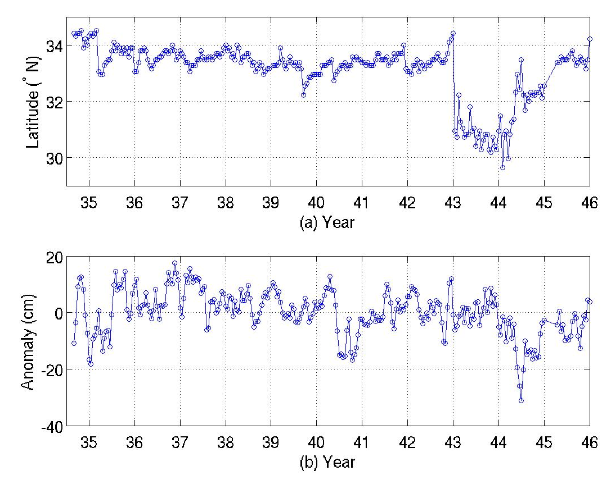
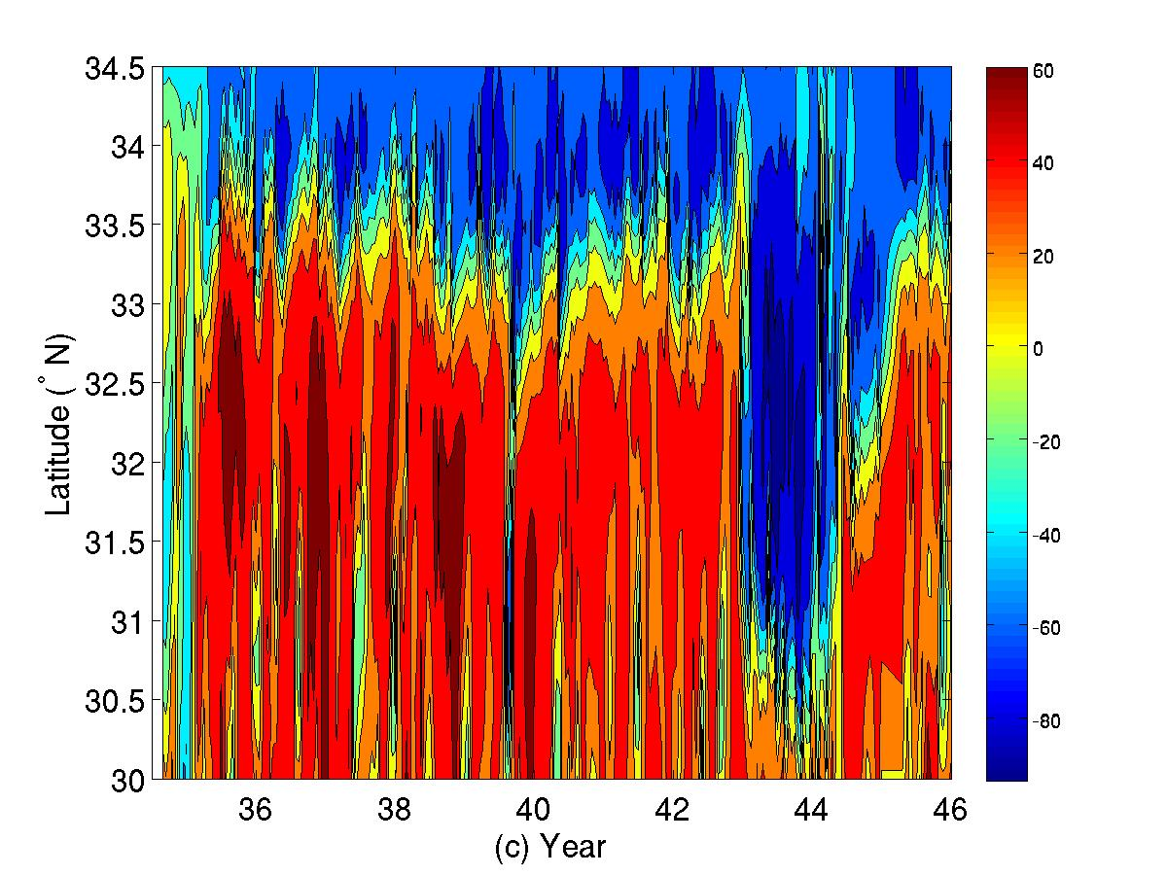
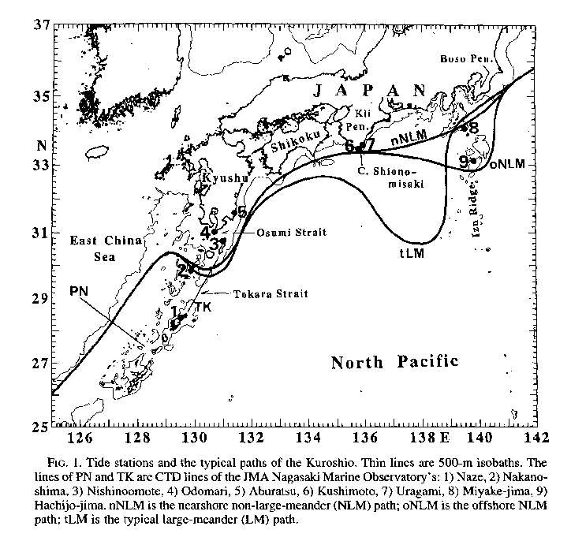
Kuroshio Path position along 138°E
SSH anomaly (131-134°E,30-33°N)
SSH anomaly along 138°E

Slide 12
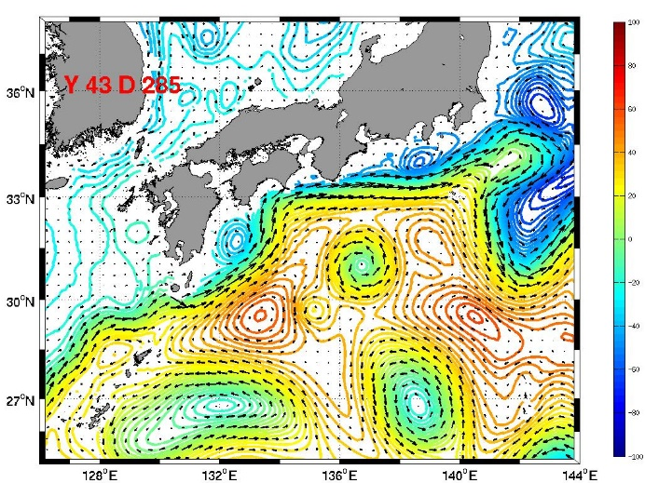
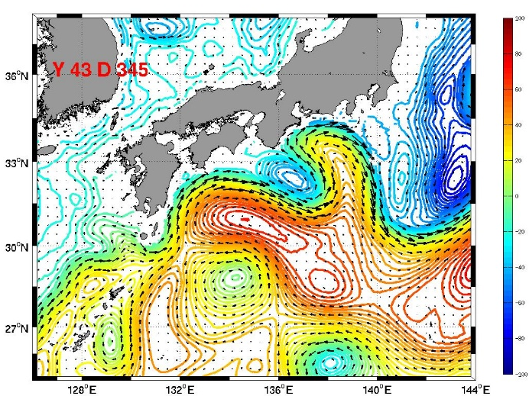
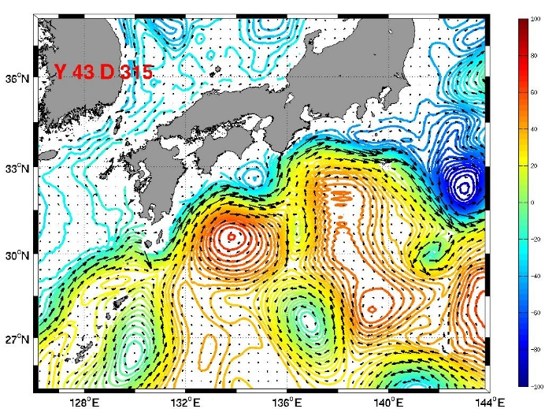
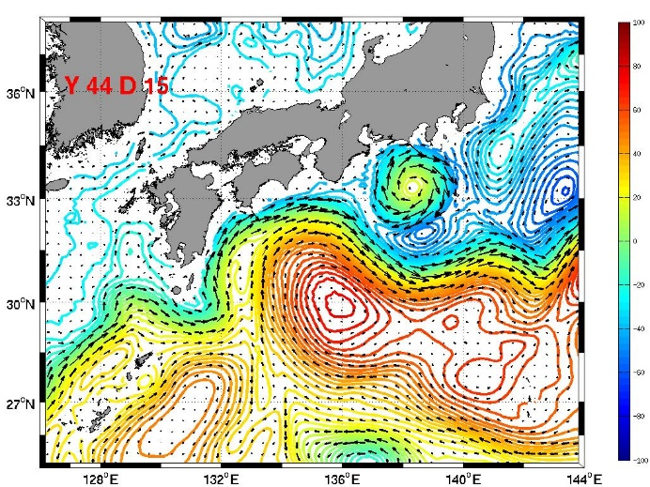
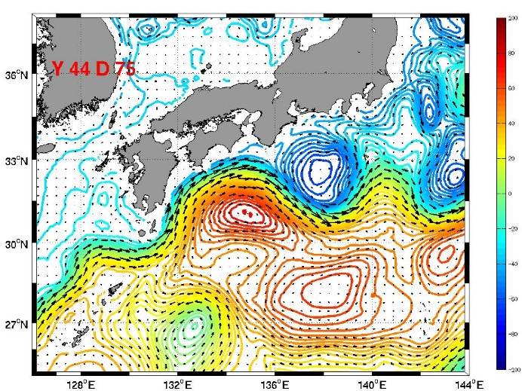
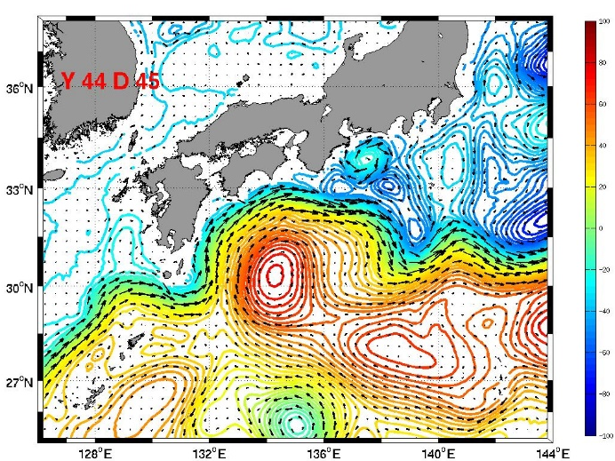
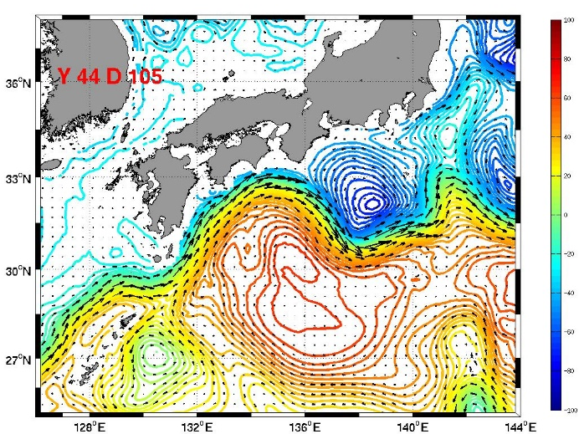
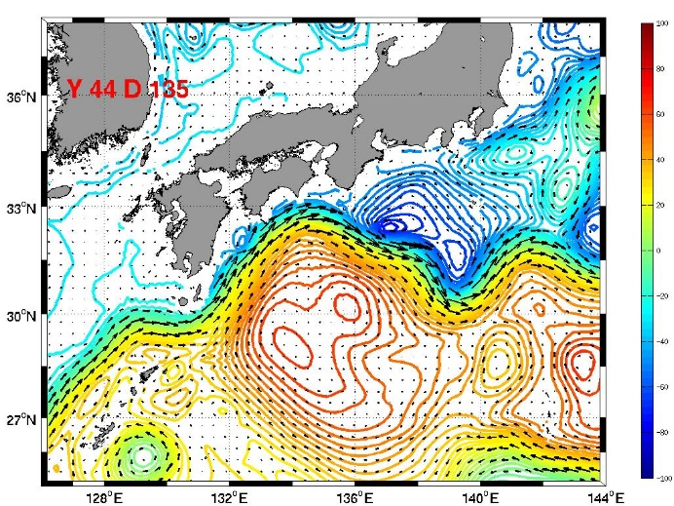
Formation of Large Meander in the Model

Slide 13
Different KT Phases
mean
std
mean
std
Huge NEC transport
mean
std
KT vs. -WP
KT vs. ENSO
Limit NEC transport
Notes:
13

Slide 14
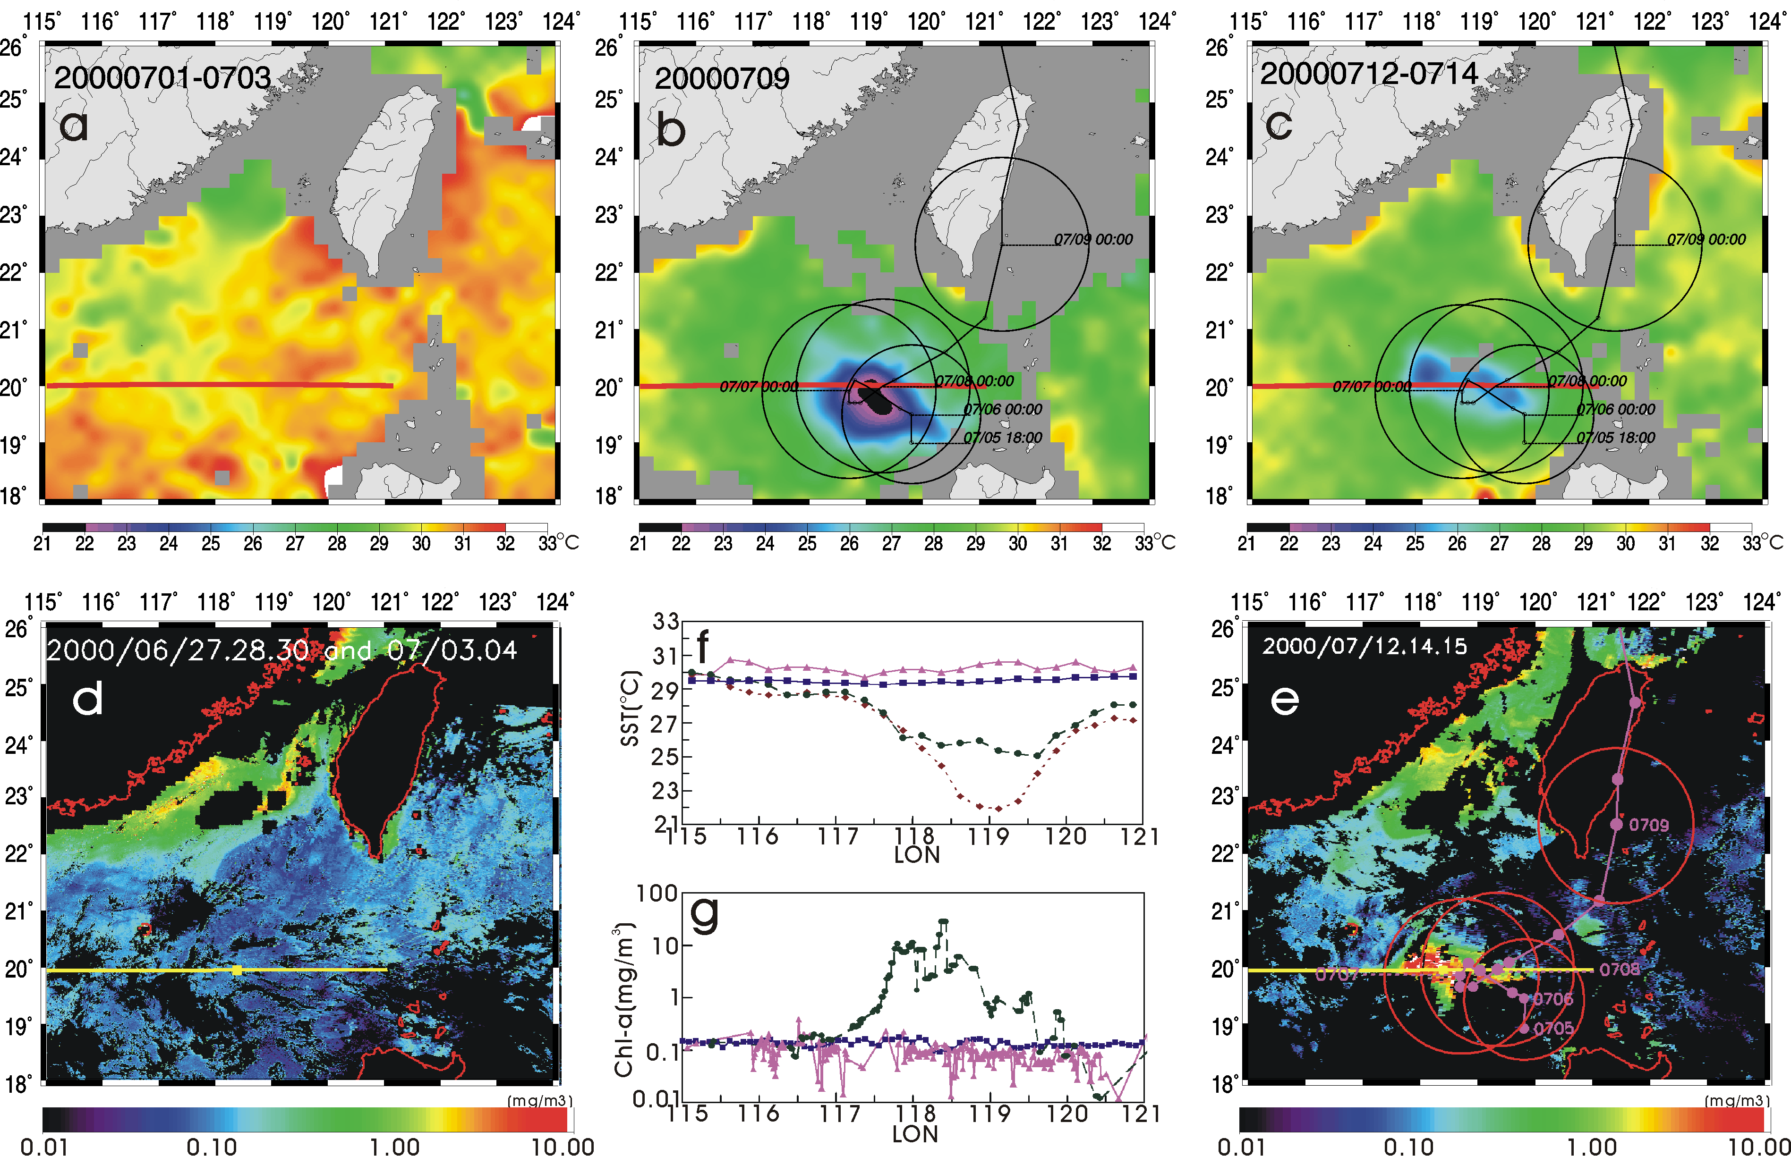
New Evidence for Enhanced Ocean Primary Production Triggered by Tropical Cyclone (Lin et al., 2003c; GRL)
Typhoon Kai-Tak
Notes:
QuikSCAT observed typhoon Kai-Tak lingering for several days in the northern part of South China Sea (SCS) between 5th to 8th July 2000. There is a sharp increase of Ekman pumping velocity, (the vertical velocity resulted from wind induced surface convergence and uplifting of the thermocline) computed from QuikSCAT winds, during the passage of Kai-Tak (Fig. 1a). The sea surface surface temperature dropped from 30degree C before the typhoon to 22 degree C the day after the typhoon departure, a drastic 8 degree drop as revealed by TMI in Fig. 1b. SeaWiFS showed 300 time increase (from 01 to 30 mg/m^2) in chlorophyll-a (indicating biological activities) within a few days (Fig. 1c). Integrated over the period and the area of the biological bloom, the Kai-Tak passage was found to generate 2-4% of the annual new production on SCS.

Slide 15
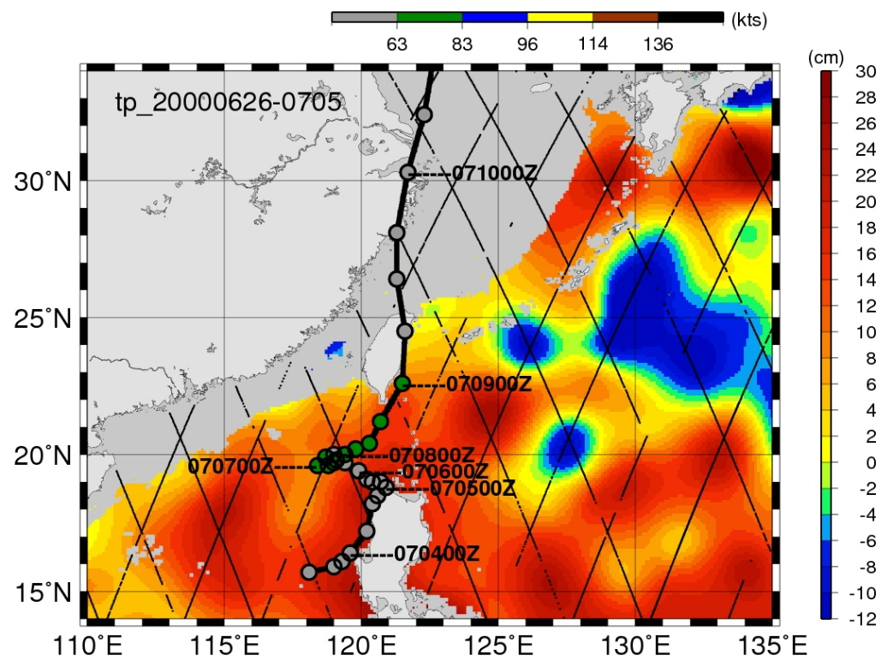
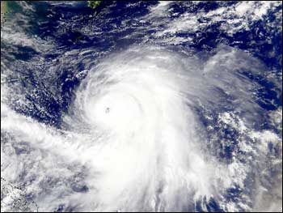
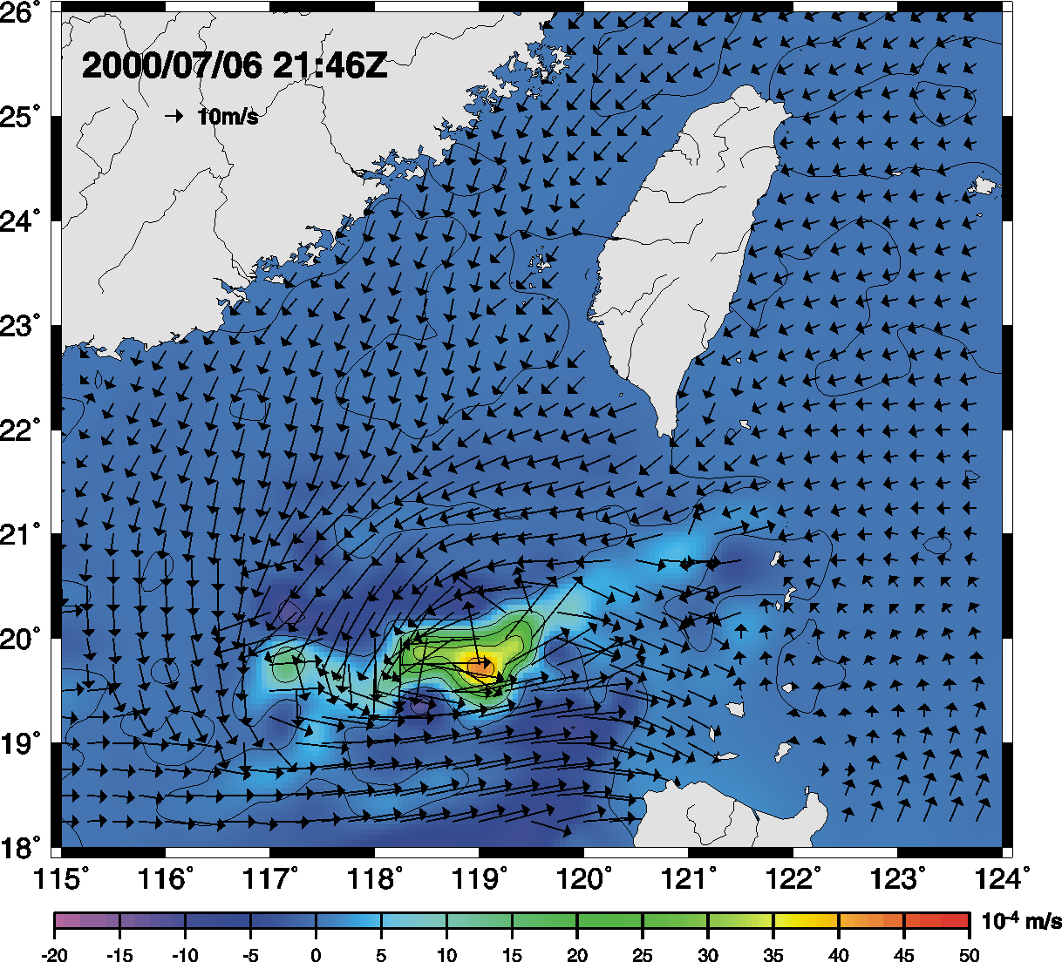
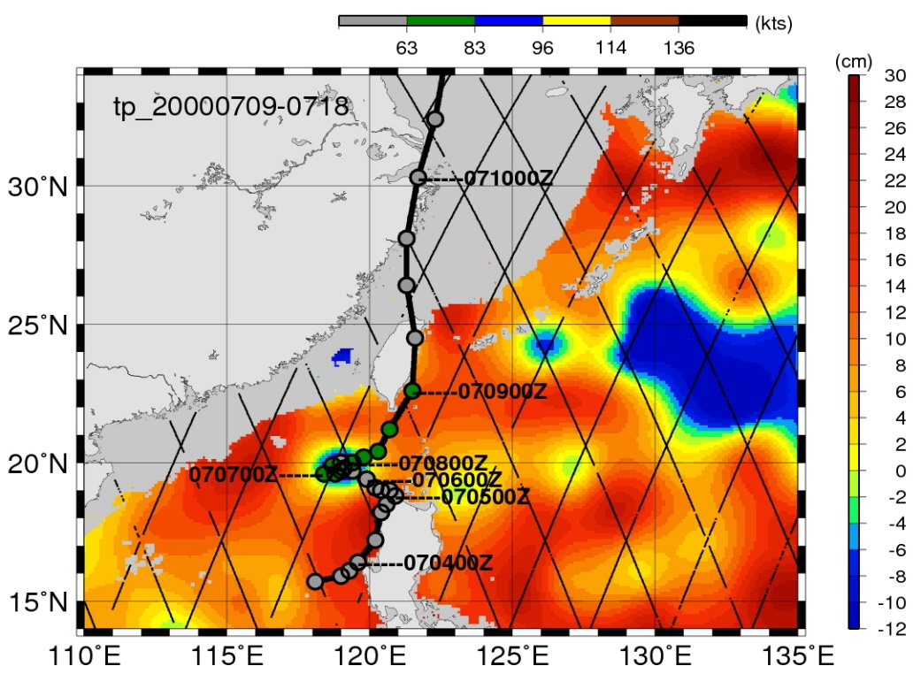
Entrianment Depth (PWP model, Price et al., 86) : 90m
2. Uh<4m/s, Upwelling: 20*10⁻⁴ m/s
(100m for half inertial period)
Before
After
Notes:
Ten-day averaged SSHA images from the TOPEX/Poseidon satellite altimeter before and after typhoon Kai-Tak’s passing.

Slide 16
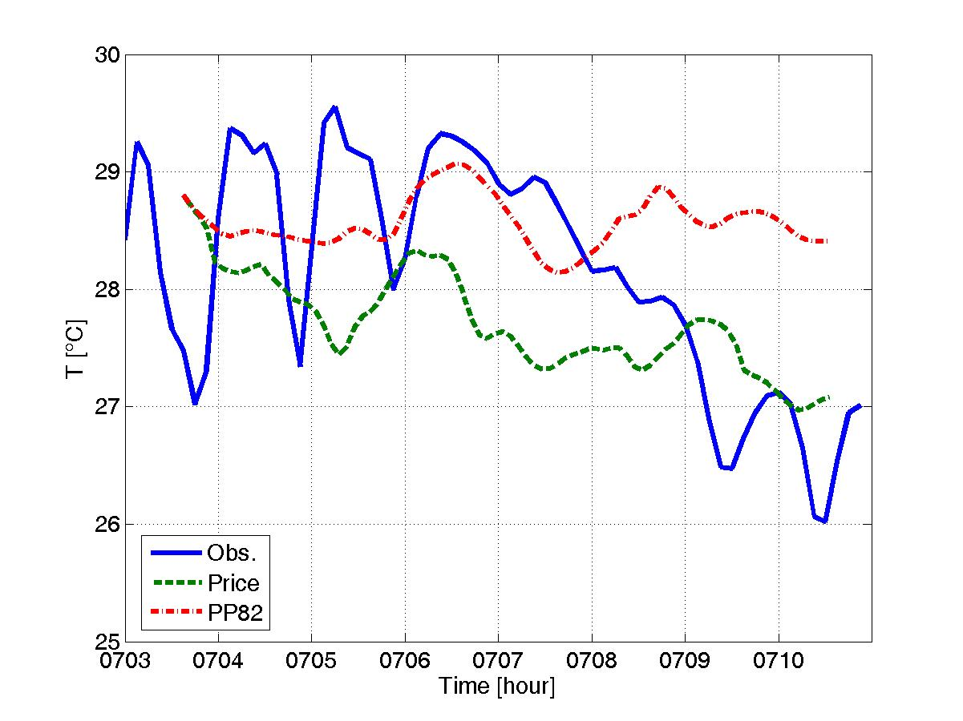
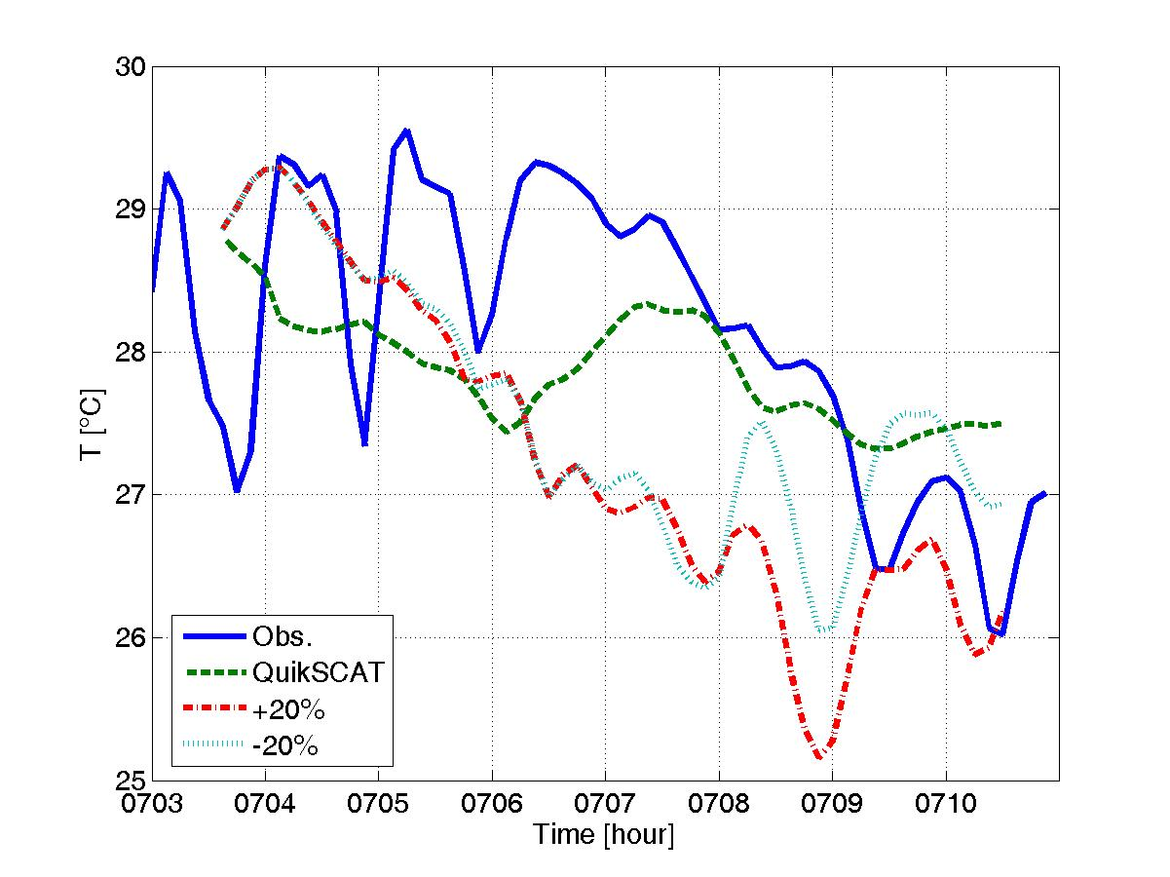
Modeled oceanic response to typhoon Kai-tak
Comparisons with observation (station: ST)
Sensitivity of turbulent parameterization
Temperature drops due to (1) vertical mixing and (2) topographical upwelling
(Tseng et al., 2010)
Sensitivity of wind stress strength

Slide 17
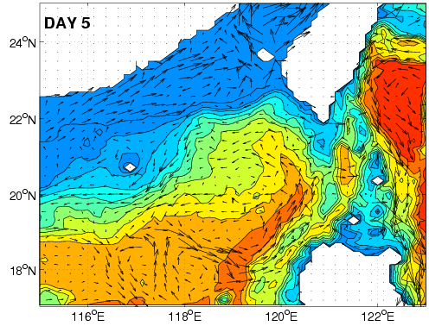

Bottom current vectors
Strong currents along topography

Slide 18
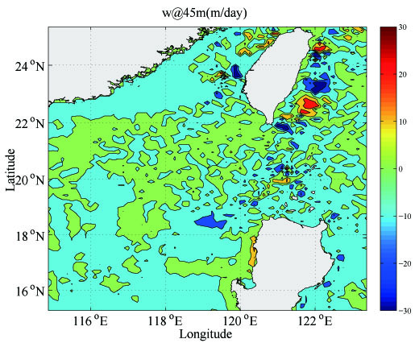
Daily-averaged vertical velocity
Day 1
(7/4)

Slide 19
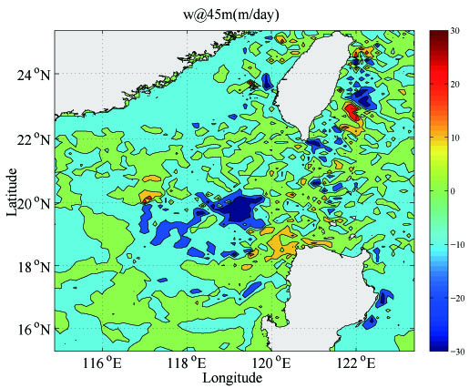
Daily-averaged vertical velocity
Day 2
(7/5)

Slide 20
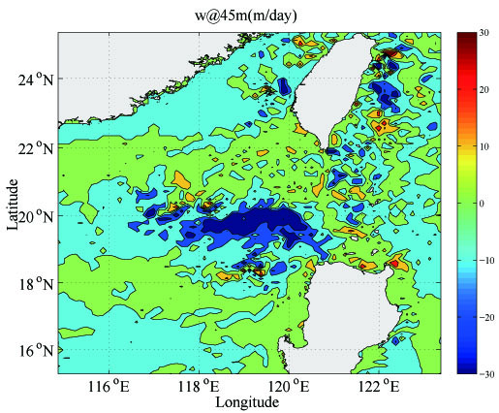
Daily-averaged vertical velocity
Day 3
(7/6)
Strong upwelling

Slide 21
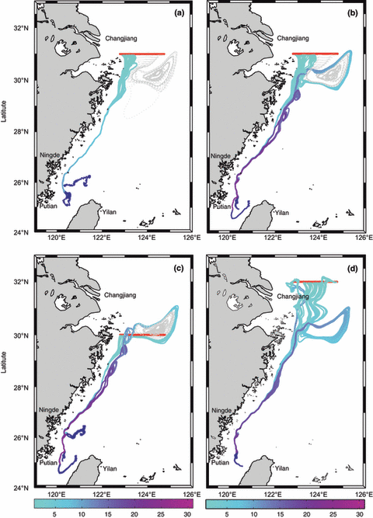
Passive tracers (drifters) releases in the model to study the fishery
Larval Japanese eel (Anguilla japonica)
Japanese anchovy (Engraulis japonicas)
Notes:
Anchovy and Japanese Eel Larval Japanese eel (Anguilla japonica)

Slide 22
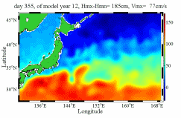
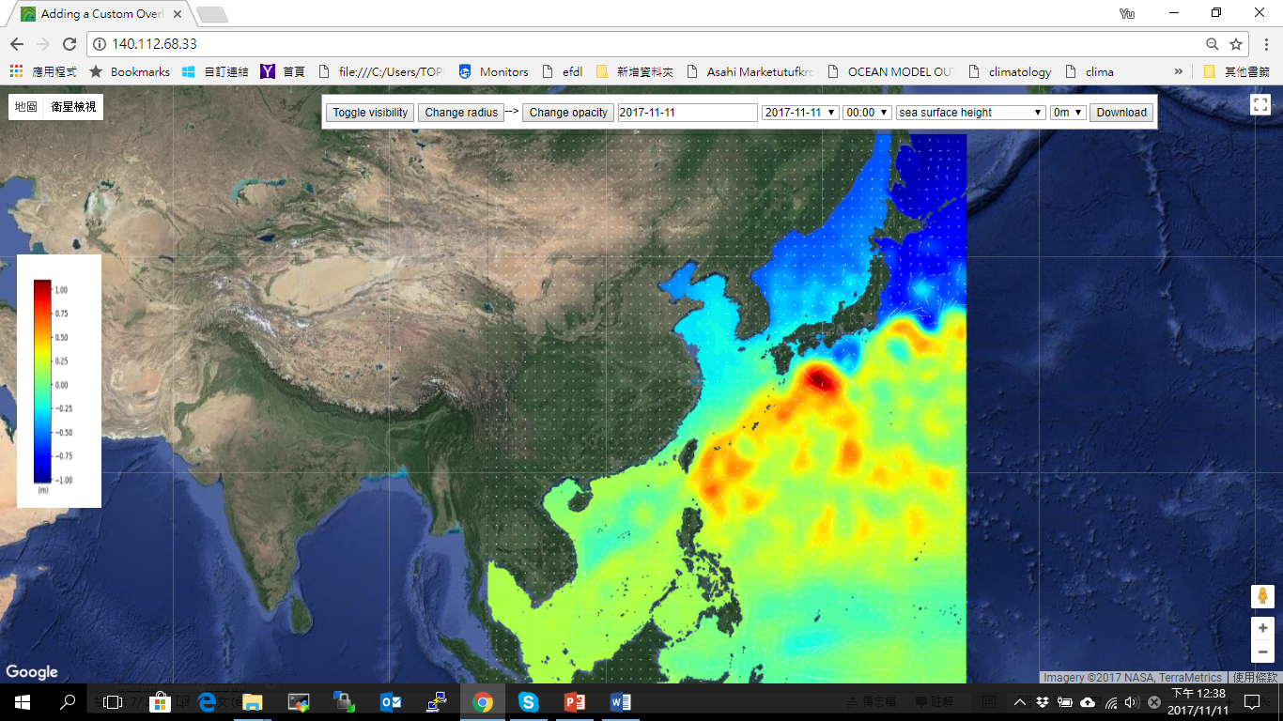
Real time ocean nowcast system http://140.112.68.33/
TIMCOM-TAI domain
Japan Sea
East China Sea
1/8^{O}x1/8^{O}
1/4^{O}x1/4^{O}
South China Sea
Extended to 30^{O}S

Slide 23
Crucial Role of the Coupled Land-Ocean-Atmosphere Interaction

Slide 24
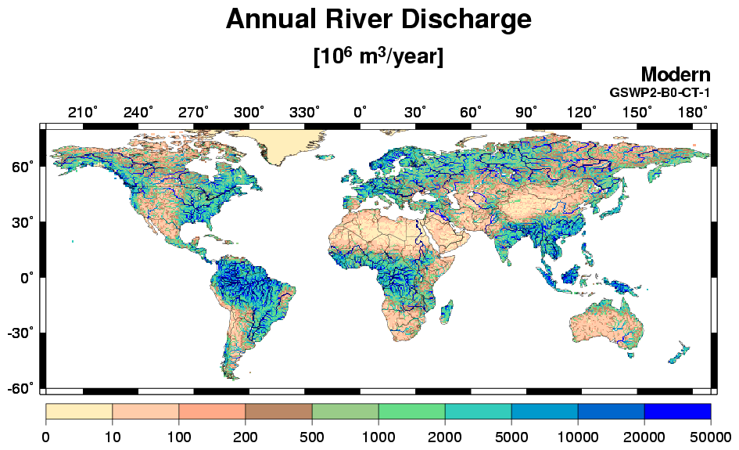
Freshwater budgets in the land-ocean-atmos. interaction
http://hydro.iis.u-tokyo.ac.jp/GW/result/global/annual/runoff/GSWP2-B0-CT-1/index.html

Slide 25



















River discharge-convection interactions
Madden and Julian (1970) Matthews et al. (2013) Cronin and McPhaden (2002)
Woolnough et al. (2000) DeMott et al. (2016)
convection
surface fluxes
Rainfall
River discharge
Salinity advection
fresh water lens
warm SST
buoyancy flux, stabilization
Anderson et al. (1996) McPhaden (2002)
heating
Hendon and Glick (1997) Shinoda et al. (1998)
shallow ML

Slide 26
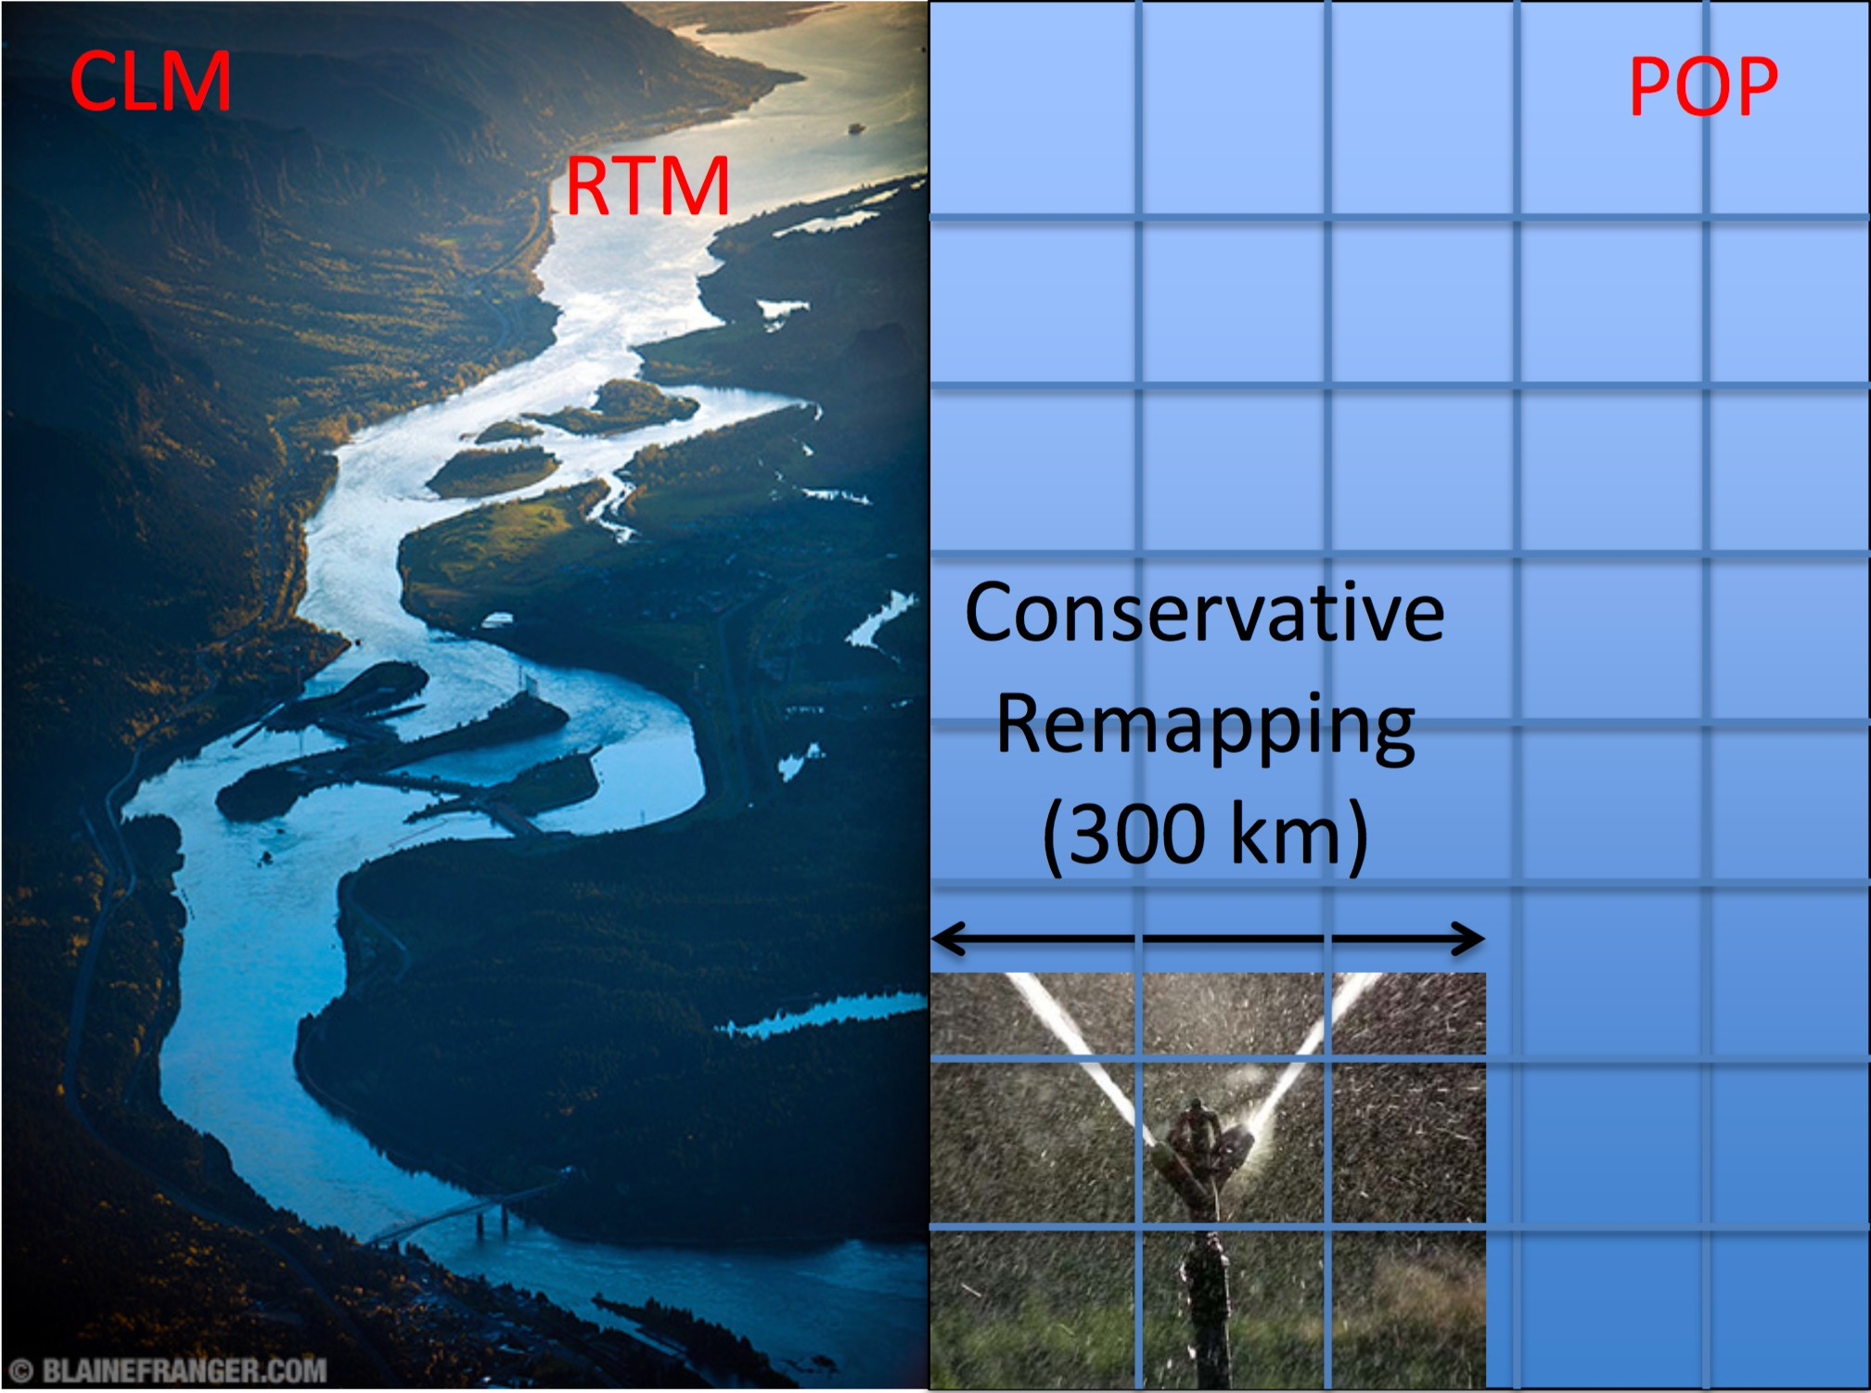
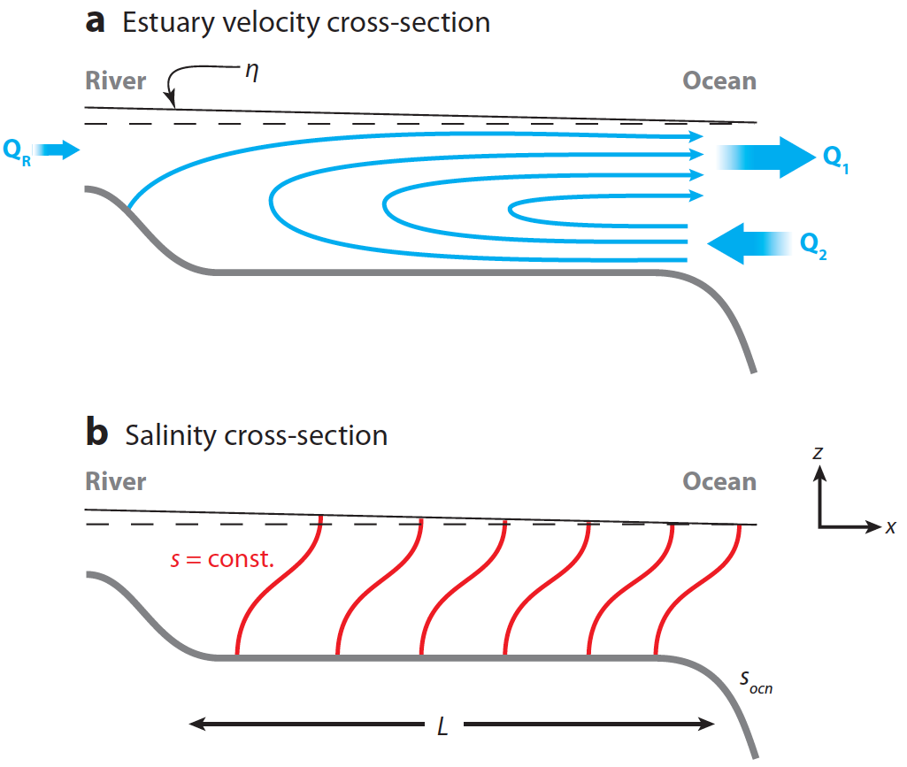


River discharge in ocean models
virtual salt flux
estuary box model
adapted from: MacCready and Guyer (2010)
river discharge is spread uniformly over ocean surface (300 km x 300 km area adjacent to river delta).
no vertical mixing.
river discharge is mixed with adjacent ocean water at river delta grid point.
delta-specific geometry for 20 largest deltas (~65% global drainage); generic geometry for other deltas.

Slide 27
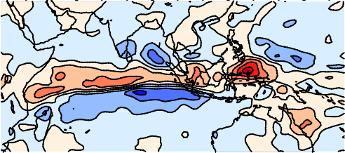


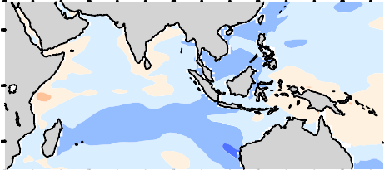
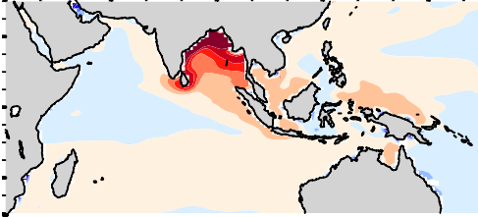


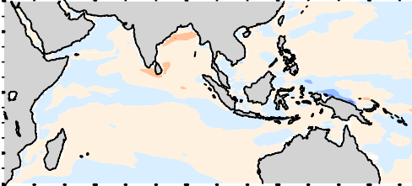
mean fields: EBM - VSF
rain
surface fluxes
rainfall river discharge
salinity advection
SST
EBM > VSF
SSS
EBM < VSF
heating
buoyancy flux, stabilization
MLD

Slide 28



anomalous runoff in VSF vs EBM
VSF EBM
₁₀-5 _{kg m}-2 _{s}-1

Slide 29


anomalous runoff in VSF vs EBM
VSF EBM
₁₀-5 _{kg m}-2 _{s}-1
runoff in EBM is hard to see! easier to infer from salinity anomalies…

Slide 30

Regional ocean-atmospheric interaction in the SCS
d01_wrf
_wrf
d01_ROMS
d01_ROMS
Model ran for 1 year (2016)
Weather Research and Forecasting Model (WRF)
Horizontal Resolution: Domain 1 =36km, Domain 2 =12km
Vertical : 36 levels
Data:
Geography: http://www2.mmm.ucar.edu/wrf/src/wps_files/geog_complete.tar.bz2
Initial and boundary : NCEP FNL Operational Model Global Tropospheric Analyses, continuing from July 1999 (ds083.2)
Regional Ocean Modeling System (ROMS)
Horizontal Resolution:
Domain 1 : 26~27 km
Domain 2 : 8~9 km
Vertical : 36 levels
Data:
geography : ETOPO2
Initial and boundary : HYCOM

Slide 31

2016 monthly SLP and sea level wind anomaly
NCEP reanalysis (contours & black vectors )
WRF output (shading & blue vectors )
(mb)
(mb)
(mb)
(mb)
(mb)
(mb)

Slide 32


2016 SST anomaly (°C, 2-month average)
MODIS
ROMS

Slide 33

2-month average MLD/surface velocity
Deeper MLD
Shallower MLD

Slide 34



$∂SST/∂t$= heat flux + other source(adv)
$∂SST/∂t$= heat flux + other source(adv)
time lag
SST
heat flux =f(SST)
Spring: Atm. dominates SST variability
Summer: SST dominates heat flux change

Slide 35
Summary
Operational eddy-resolving nowcast/forecast system
Physical/typhoons/fishery/rescue
Coupled ocean-atmosphere modeling
Distinct ocean-atmospheric interaction in the SCS
Link to the global climate system

Slide 36


Thank you!

