Slide 2
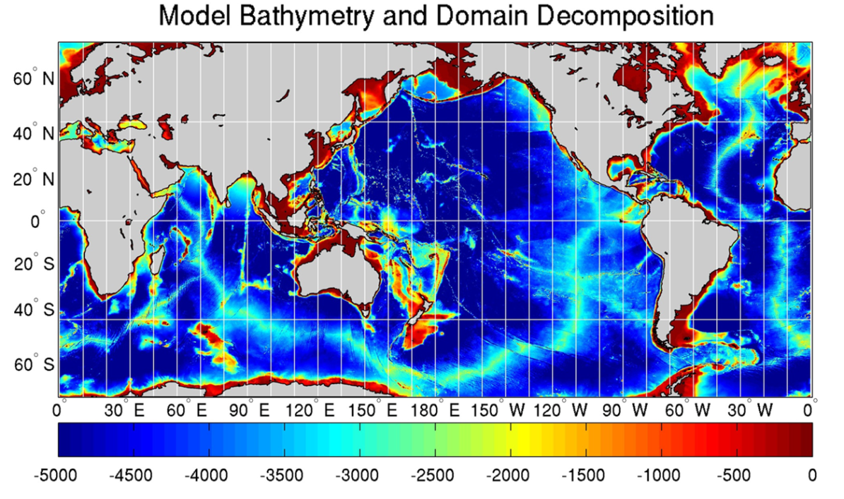
Parallel Domain-Decomposed Taiwan Muti-Scale Community Model (PD-TIMCOM)
Bathymetry form 1-min etopo1
Pacanowski and Philander Vertical mixing (1982) and Smagorinsky horizontal mixing (1993).
Initial Temperature and Salinity from NOAA WOA 09.
Surface wind forcing from Hellerman and Rosenstein (1983)
1/16°and 1/4° horizontal resolution, latitudes covers from 72°S to 72°N. with 51 linear exponential levels vertically. (1440x792x51)
Primitive, hydrostatic equation
Fourth-order combined Arakawa A and C-grid (1977)
Rid-lid approx. and Free surface are used (Yang et al., 2012).
Tseng and Chien (2011)
Notes:
1:20
2

Slide 3

 | Comp. | Comm.
384 | 2673.4 | 95.9
768 (24) (12) | 1624.0 1045.6 897.4 | 87.7 38.7 26.0
1024 (24) | 1183.5 843.8 | 62.7 28.2
1536 (24) | 1109.5 558.3 | 28.3 13.0
2048 | 941.9 | 34.8
3072 | 829.6 | 26.1
 | 1 | 2 | 6 | 12 | 24 | 48 | 96 | 192 | 384
Comp. | 295.83 | 139.03 | 55.11 | 31.34 | 20.05 | 14.41 | 6.88 | 3.91 | 2.27
Comm. | 0 | 0.49 | 0.29 | 0.26 | 0.35 | 0.65 | 0.42 | 0.55 | 0.36
Notes:
3

Slide 4
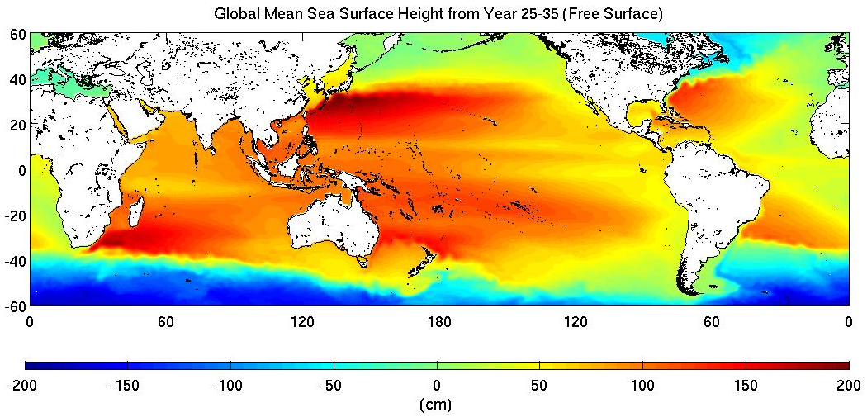
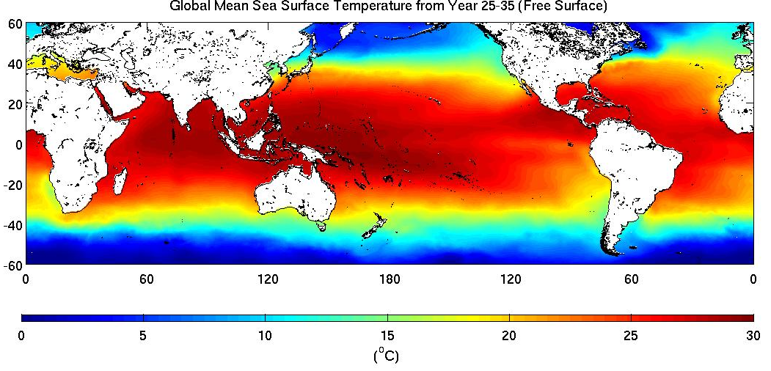
Mean Sea Surface Height (SSH) and Sea Surface Temperature (SST)

Slide 5
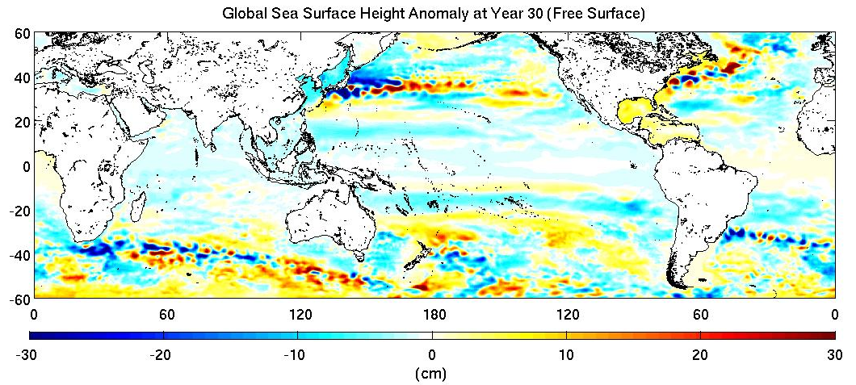
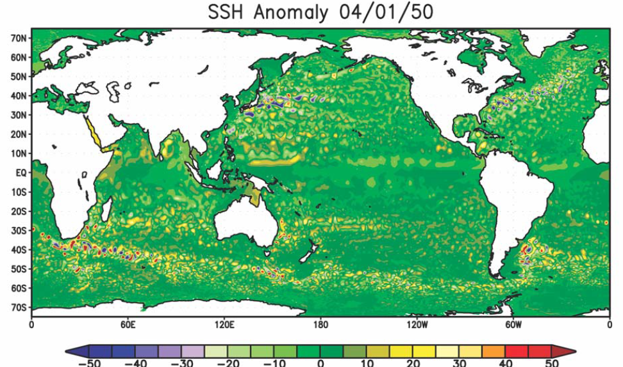
Global Sea Surface Height Anomaly
Masumoto et al. (2004)

Slide 6
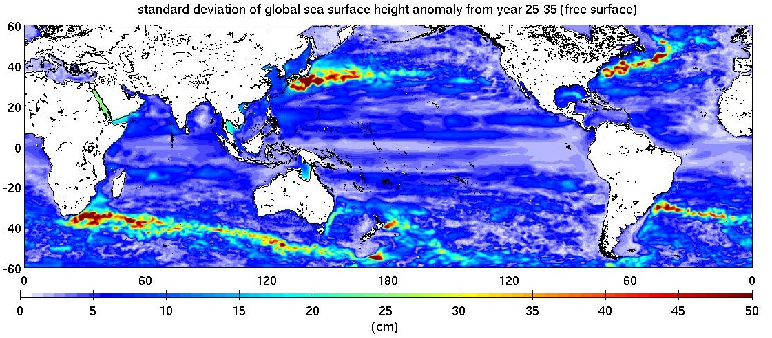
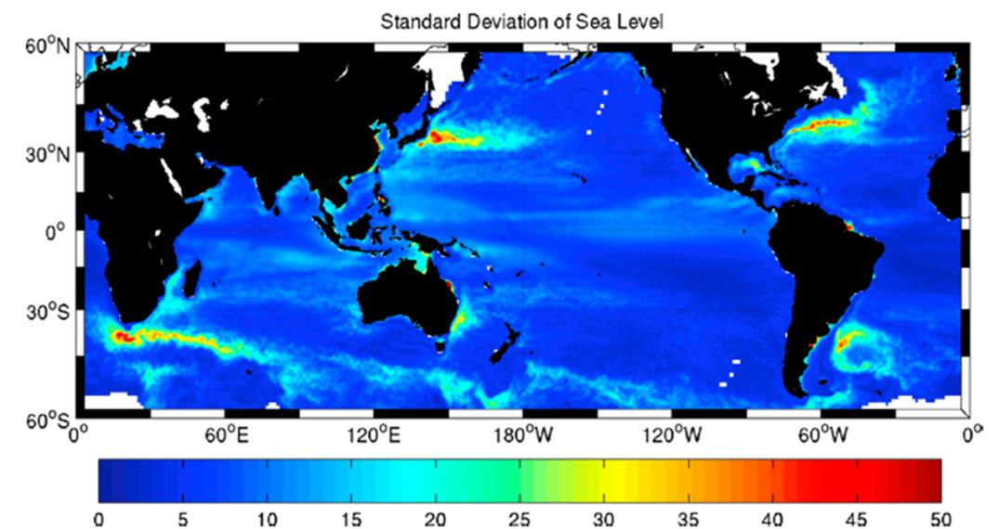
Comparison with Observation
Thompson and Demirov (2006)

